Slide 1


IGNITE, ELEVATE,THRIVE
Business Coaching & Consulting​​
06/06/2024

Slide 2

INDEX
Executive Summary: About Us
Company Description: Our Approach
Market Research and Analysis: Challenges
Value Proposition: Community of Threefold
Marketing and Sales Strategy: Entrepreneurial Success Amplified
Organizational Structure and Team: Team Responsibilities
Financial Projections:
Funding Requirements (if applicable):
Implementation Timeline:
Monitoring and Adjustments

Slide 3

ABOUT US
At TresVelo, we believe in the power of three, a synergy that propels entrepreneurs toward success. Our mission is to accelerate your entrepreneurial journey by providing triple-focused coaching that combines expertise, community, and growth
OUR APPROACH
Our coaching programs are designed to move your entrepreneurial journey forward at triple the speed.

Slide 4

Community of Threefold Support
At TresVelo, you’re not alone. Our vibrant community forms the backbone of our coaching programs:
Peer Network: Connect with fellow entrepreneurs who share your passion. Exchange ideas, collaborate, and learn from each other’s experiences.
Expert Advisors: Our network includes seasoned entrepreneurs, industry experts, and thought leaders. Tap into their wisdom and gain insights that can transform your business.
Accountability Partners: We believe in the power of accountability. Your TresVelo coach and fellow entrepreneurs will keep you on track, celebrating wins and overcoming challenges together.

Slide 5



Overcoming nervousness
Results-Driven Coaching
Tangible outcomes matter. We focus on measurable progress, whether it’s revenue growth, market expansion, or personal development.
Innovation Catalyst
TresVelo encourages bold thinking and innovation. We’ll help you explore new avenues, experiment fearlessly, and disrupt the status quo.
Legacy Building
Beyond immediate success, we’re passionate about leaving a lasting impact. Together, we’ll build a legacy that extends beyond your entrepreneurial journey.
Entrepreneurial Success Amplified
We measure our success by your success. When you choose TresVelo, you’re not just getting coaching; you’re gaining a partner committed to your growth.

Slide 6
Growth
Maturity
Decline
Start-Up
Financial Management
Capital Risk & Venture Funding
Business Innovation
Cost and Debt Management
Risk Management
Business Rescue/ Exit Strategy
Business Development
Working capital & Cash flow management
LEAN Thinking
Leading Product/ Service Innovation
Wealth Management
Business Networking
Financial Management
Human Resource Management
Business Optimization (systems, processes, management)
Customer Relationship Management
Project Management
Entrepreneurship Baseline Assessment & Gap Analyses
Business & Financial Planning (Plan for business)
Compliance & Business Set up (Legal entity, staff agreements, Compliance docs)
Website Development & Email Hosting
Sales Planning and Marketing plan
Social Media Marketing Calendar
Principles of customer service for entrepreneurs
Coaching Solutions
Entrepreneurial Journey
Mastery at every phase of the business lifecycle

Slide 7

Costing of Business Start Up Package
Service Provided | Detail of Service | Cost of Service
Baseline Assessment | 4 x Coaching Session Baseline gap analyses | R2,500-00
Business Plan creation | Full Business Plan including Financial Forecast & Marketing Plan | R5,000-00
Six Month Coaching Plan | 6 x Coaching Session 1 hr each | R500-00 per month
Website Development & Logo Design | Full Website Development 5 Page Website (Additional pages at R1,500-00 each) | R7,500-00
Website & Email Hosting Service | Up to 20 emails accounts, website updates within 12 months. | R450-00 per month
Social Media Marketing | Marketing Callender, Social media platforms management incl Facebook, Instagram & TikTok | R500-00 per month

Slide 8
Market Research- Macro Dynamics

Slide 9
Market Research and Analysis
Type of Challenge | Why is it a problem | At what stage of the business is it a challenge | Possible Remedies to consider
Access to Capital | Limited access to funding inhibits growth opportunities such as expanding operations, hiring more staff, or investing in technology. | Growth stage, when businesses need additional capital to scale up operations. | Seek alternative funding sources like venture capital, angel investors, or government grants. Develop strong business plans and financial projections to attract investors.
Market Competition | Fierce competition from established companies and other entrepreneurs makes it challenging to stand out and capture market share. | Early stage to growth stage, as businesses try to establish their presence in the market. | Differentiate products/services through innovation or unique selling propositions. Conduct thorough market research to identify niche markets or underserved segments. Focus on building a strong brand and customer loyalty.
Regulatory Hurdles | Complex and ever-changing regulations in various industries create barriers to entry and hinder growth. Compliance with legal requirements can be time-consuming and costly. | Start-up to growth stage, as businesses navigate regulatory frameworks and compliance issues. | Hire legal experts or consultants to navigate regulatory requirements effectively. Stay updated on changes in laws and regulations impacting the industry. Advocate for policy changes that support small business growth.
Skills Shortages | Difficulty in finding qualified and skilled employees, especially in specialized fields, limits productivity and innovation. | Early stage to growth stage, as businesses require talented individuals to drive expansion and innovation. | Invest in training and development programs to upskill existing employees. Partner with educational institutions to provide internships or apprenticeships. Offer competitive salaries and benefits to attract top talent.

Slide 10
Market Research and Analysis
Access to Markets | Limited access to domestic and international markets restricts sales opportunities and revenue growth. Lack of distribution networks or export channels can hinder market expansion efforts. | Growth stage, when businesses aim to expand beyond their local markets and reach broader audiences. | Develop strategic partnerships with distributors, retailers, or e-commerce platforms to access new markets. Participate in trade fairs, exhibitions, or export promotion programs to showcase products/services internationally. Leverage digital marketing and e-commerce platforms to reach a wider audience.
Lack of Mentorship/Networking | Absence of mentorship and networking opportunities deprives entrepreneurs of valuable guidance, support, and business connections. Learning from experienced mentors and peers can accelerate growth and mitigate challenges. | All stages of the business, as mentorship and networking are crucial for learning, growth, and overcoming obstacles. | Join industry associations, business chambers, or entrepreneurial networks to access mentorship and networking opportunities. Seek out experienced mentors or advisors who can provide valuable insights and guidance. Attend workshops, seminars, or networking events to build relationships and exchange knowledge with other entrepreneurs.
Infrastructure Deficiencies | Inadequate infrastructure such as unreliable power supply, transportation limitations, and poor internet connectivity, hampers operational efficiency and growth prospects. | All stages of the business, as infrastructure challenges affect day-to-day operations and expansion plans. | Explore alternative solutions such as off-grid power sources or investing in backup systems. Advocate for infrastructure improvements at the local or national level. Utilize technology to overcome connectivity issues, such as cloud-based software solutions.

Slide 11
Market Research and Analysis
Access to Markets | Limited access to domestic and international markets restricts sales opportunities and revenue growth. Lack of distribution networks or export channels can hinder market expansion efforts. | Growth stage, when businesses aim to expand beyond their local markets and reach broader audiences. | Develop strategic partnerships with distributors, retailers, or e-commerce platforms to access new markets. Participate in trade fairs, exhibitions, or export promotion programs to showcase products/services internationally. Leverage digital marketing and e-commerce platforms to reach a wider audience.
Lack of Mentorship/Networking | Absence of mentorship and networking opportunities deprives entrepreneurs of valuable guidance, support, and business connections. Learning from experienced mentors and peers can accelerate growth and mitigate challenges. | All stages of the business, as mentorship and networking are crucial for learning, growth, and overcoming obstacles. | Join industry associations, business chambers, or entrepreneurial networks to access mentorship and networking opportunities. Seek out experienced mentors or advisors who can provide valuable insights and guidance. Attend workshops, seminars, or networking events to build relationships and exchange knowledge with other entrepreneurs.
Infrastructure Deficiencies | Inadequate infrastructure such as unreliable power supply, transportation limitations, and poor internet connectivity, hampers operational efficiency and growth prospects. | All stages of the business, as infrastructure challenges affect day-to-day operations and expansion plans. | Explore alternative solutions such as off-grid power sources or investing in backup systems. Advocate for infrastructure improvements at the local or national level. Utilize technology to overcome connectivity issues, such as cloud-based software solutions.

Slide 12

Organisational Structure

Slide 13
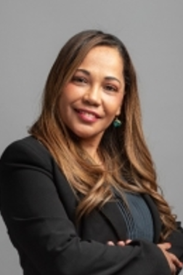
Chantelle McKenzie (Designer & Coach)
Chantelle obtained a Certification in Coaching from Newfield Network (USA) acquired in 2014, complemented by a prestigious three-year Scholarship at the Institute for Generative Leadership, Boulder, Colorado, USA, also attained in 2014. These credentials have significantly enhanced her proficiency in organizational and business leadership development. Her expertise in coaching has been instrumental in guiding business leaders to foster greater loyalty among customers and employees, drive superior results, and foster a sustainable business ecosystem. Throughout her career, Chantelle has successfully overseen and executed numerous coaching projects, including:
Leadership Development Group Coaching for Results at Standard Bank (SA & Africa), focusing on Business and Private Banking sectors.
Enterprise Development Coaching program for Toyota.
Implementation of a new Performance Management Framework at Liberty Group, with a focus on Divisional Manager Coaching.
SMME Skills & Enterprise Development Coaching, Monitoring, and Evaluation at Afrika Tikkun. Coaching and Mentoring for Entrepreneurs at Tshwane East Business Chambers.
Positioning teams for action and strategic relevance at Seda Automotive Technology Centre (SATEC), serving as an industry incubator.
Performance Coaching for Branch Managers at ADvTECH Group. Creating a High-Performance Organization through Executive Coaching at Proserve (EOH). Mentorship engagement with Vital Voices Global Partnership. These endeavors underscore Chantelle's commitment to driving organizational excellence and fostering leadership acumen across diverse business landscapes.

Slide 14
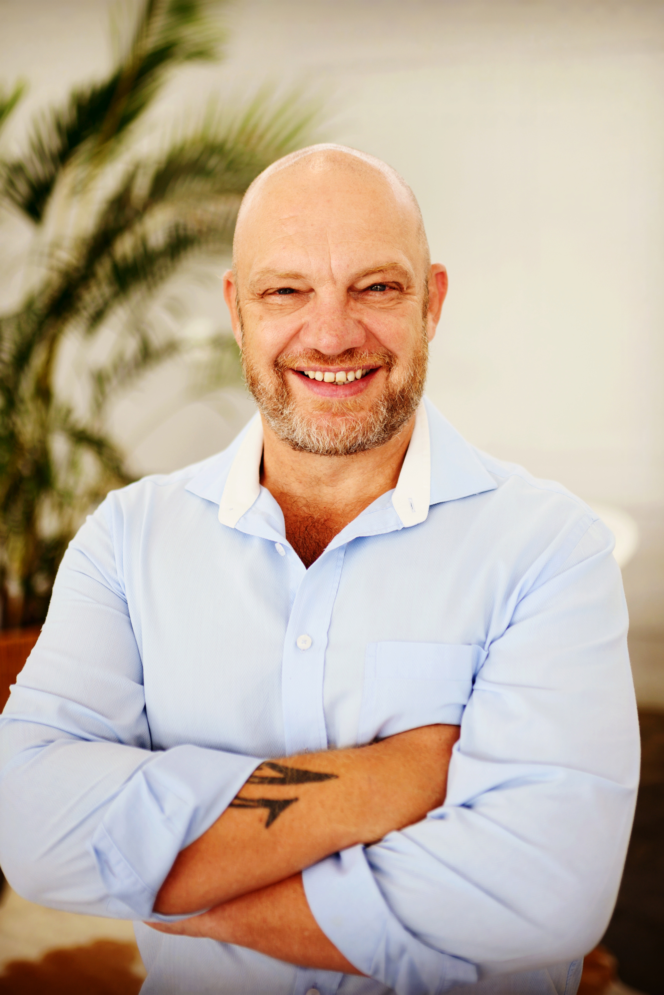
Martin Wessels
(Business Operations)
An ex-Commercial Relationship Bank Manager, Martin has some 18 years’ workplace experience in banking, predominantly in Business & Commercial Banking environments growing in various roles including an Account Analyst, Business Manager, Account Executive and as a Credit Manager in the Corporate Investment Banking environments.
Martin furthered his business knowledge as an entrepreneur and spent 5 years as an independent operator where he spent it as part of an independent Restaurant Chain, namely Amici Pizzeria and through this helped build a business which involved 7 branches , with a Turn-Key Supply Line and Events Divisions and equally setting up various new business opportunities and business ventures.
After gaining experience in the retail sector, Martin transitioned back to the business environment and assumed the role of Business Owner in the Non-Academic Portfolio at Cornerstone Performance Solutions (Pty) Ltd., where he currently, he oversees the portfolio, focusing on enhancing the capability skills of Business Bankers, particularly in Retail and Business Banking sectors. Martin brings to the table extensive expertise in Project and Key Account Management, coupled with his additional role as the Lead Facilitator for the Business Banking Academy.
Throughout his tenure, Martin pursued further education, earning a degree in Business Management with a specialization in Entrepreneur Development.

Slide 15
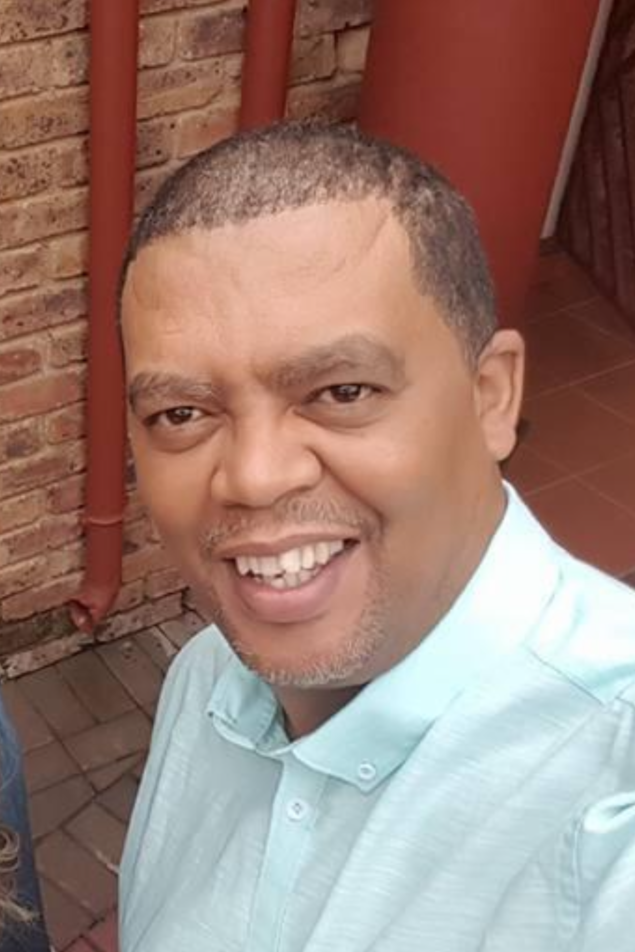
Mervyn Jacobs
(Content Development)
Mervyn is a sole director of Pensive Learning (PTY) Ltd, a company specializing in the design and development of learning programs tailored to companies seeking SAQA-accredited initiatives for their workforce.
Mervyn has actively contributed to the enhancement and revamping of Learnership Programs accredited by BANKSETA, a testament to their expertise in the field. Furthermore, played a pivotal role within the banking industry team responsible for pioneering the inaugural occupational certificates in collaboration with the QCTO and BANKSETA.
Mervyn has been instrumental in the creation of two CHE qualifications, namely the Higher Certificate in Banking and the Advanced Certificate in Banking, demonstrating a commitment to elevating educational standards in the banking sector.
To ensure the quality and accuracy of its programs, Mervyn, through his company Pensive Learning (PTY) Ltd collaborates with industry experts for authentication and verification, as well as employing independent language editors. The company utilizes various project management tools such as Trello, Asana, and Jira to streamline operations. Additionally, the director's proficiency extends to e-learning authoring tools like Articulate Storyline, and they have overseen the implementation of various Learning Management Systems.
In the role of curriculum designer, instructional designer, and learning and development specialist, the director's primary objective is to empower organizations to unlock the full potential of their workforce. With only 6% of the South African population holding university degrees, 6% possessing diplomas, and 3% with TVET certificates, the importance of accessible and effective learning programs cannot be overstated. Pensive Learning (PTY) Ltd stands as a valuable partner in bridging this educational gap and driving organizational success through tailored learning solutions.

Slide 16
Proposed Roles and Responsibilities
Company Requirements | Chantelle McKenzie | Martin Wessels | Mervyn Jacobs
Business Structure & Strategy
Business Development | XXX | XXX | XXX
Customer Relationship Management |  | XXX
Marketing and Branding | XXX | XXX | XXX
Operations
Design of Coaching Platform | XXX | XXX | XXX
Website Updates | XXX | XXX | XXX
IT Infrastructure | XXX | XXX | XXX
Banking & Accounting |  | XXX
Coaching Clients
Contracting & Scheduling | XXX | XXX | XXX
Design of Coaching Modules | XXX |  | XXX

Slide 17

Financial Projections

Slide 18
Financial Projections
Income | March 2025 | April 2025 | May 2025 | June 2025 | July 2025 | August 2025
Sales (Coaching Sessions) | R0,00 | R750,00 | R1 000,00 | R1 500,00 | R2 000,00 | R2 500,00
Sales (Online Products) | R0,00 | R500,00 | R1 000,00 | R1 500,00 | R2 000,00 | R2 500,00
Less Cost of Sales | R0,00 | R120,00 | R200,00 | R250,00 | R300,00 | R350,00
Net Sales Income | R0,00 | R1 130,00 | R1 800,00 | R2 750,00 | R3 700,00 | R4 650,00
Expenditure
Bank Fees | R50,00 | R50,00 | R50,00 | R50,00 | R50,00 | R50,00
Email Hosting | R500,00 | R500,00 | R500,00 | R500,00 | R500,00 | R500,00
Accounting Package | R200,00 | R200,00 | R200,00 | R200,00 | R200,00 | R200,00
Certifications | R250,00 | R250,00 | R250,00 | R250,00 | R250,00 | R250,00
Miscellaneous | R500,00 | R500,00 | R500,00 | R500,00 | R500,00 | R500,00
Total Expenditure | R1 500,00 | R1 500,00 | R1 500,00 | R1 500,00 | R1 500,00 | R1 500,00
Net Income | -R550,00 | -R370,00 | R300,00 | R1 250,00 | R2 200,00 | R3 150,00

Slide 19

Implementation Plan

Slide 20
Implementation Plan
Action Required | Due Date | Responsible
Confirmation of Business Plan by Partners | 13 May 2024 | MW,CM,MJ
Go to market strategy to be formulated | 20 May 2024 | MW,CM,MJ
Bank Account to be opened | 20 May 2024 | MW
Company registration to be completed | 21 May 20245 | MW
Website Design to be completed | 24 May 2024 | MW,CM,MJ
Design Scoping of Coaching Modules for Coaching Programme | 27 May 2024 | CM,MJ
Design of First Module | 02 June 2024 | CM,MJ
Design of Second Module | 09 June 2024 | CM,MJ
Review of First Phase of Coaching Approach | 10 June 2024 | MW,CM,MJ

Slide 21

Thank you

