Slide 1
Sports Related Dementia (and other Brain Diseases)
Litigation Overview
Where it has been , where it is now and where it is heading?

Slide 2
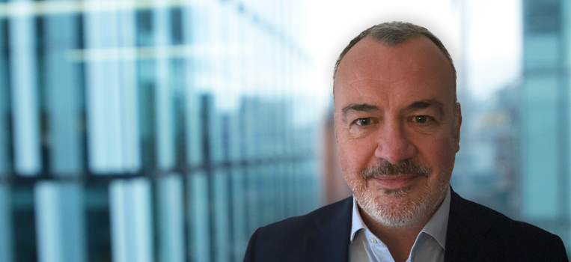
Welcome
David Wynn
Partner, Global Head of Legacy
M +44(0)7557 311 669
E David.Wynn@dwf.law

Slide 3
Where it has been
NFL concussion lawsuits.

Slide 4
Where it is now
UK Dementia Litigation Update

Slide 5
Where is it heading?
Other Jurisdictions, Australia , Canada ?

Slide 6
Medical and Legal Causation and impact on Insurance and Reinsurance.

Slide 7
Conclusions

