Slide 1
Key Insurance & Reinsurance Issues From the Los Angeles Area Wildfires
Steven D. Allison
Michael T. Carolan
IntAP Technical Meeting
June 2025
These materials and commentary are intended for educational purposes only. No portion may be construed as rendering legal advice for specific cases, or as creating an attorney-client relationship between the audience and the author. The opinions expressed herein are solely those of the author.

Slide 2
The 2025 Los Angeles Wildfires
In January 2025, more than a dozen wildfires impacted the greater Los Angeles metropolitan area and San Diego County in California.
Extensive damage was caused by the two largest fires, the Palisades Fire in the Pacific Palisades region of Los Angeles, California, and the Eaton Fire in Altadena, California.
Between the two fires, the California Department of Forestry and Fire Protection (CAL FIRE) reports 37,469 acres were burned, more than 18,000 residential, commercial, and other structures were destroyed or damaged, and there were 30 fatalities.

Slide 3
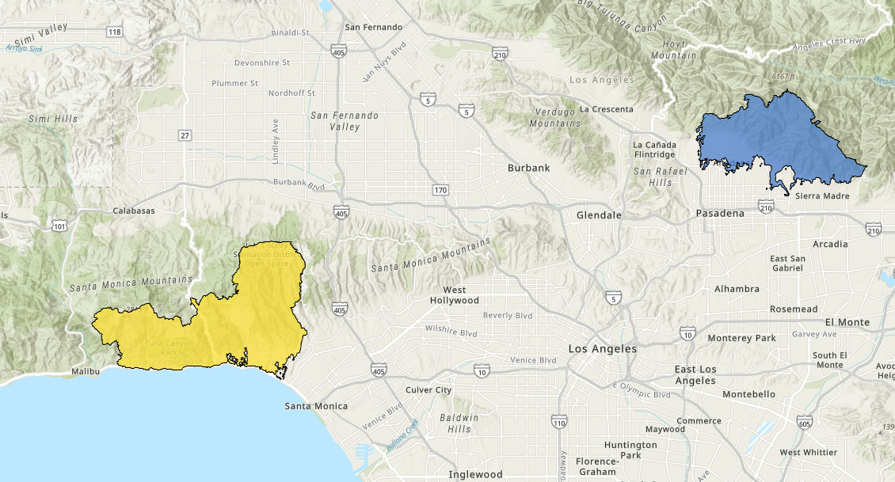
Yellow Area: Represents the Palisades Fire
Blue Area: Represents the Eaton Fire
Source: City of Los Angeles Geohub

Slide 4
Insurance Impact of the Wildfires
As of March 5, 2025, when last updated, the California Department of Insurance estimated:
Claims filed – 37,749
Claims partially paid – 27,821
Claims paid - $12.1 billion
As of February 11, 2025, the California FAIR Plan had received 3,469 claims for the Palisades Fire and 1,325 claims for the Eaton Fire.
Claims paid by FAIR - $914,000,000
45% total losses, 45% partial losses, and 10% fair rental value only
Prior to these fires, many insurers had stopped writing homeowners’ insurance in California citing wildfire risks as well as the increased cost of construction.

Slide 5
The New Reality: California FAIR Plan
The FAIR Plan is an “insurer of last resort” through a syndicated fire insurance pool comprised of all insurers licensed to conduct property/casualty business in California. Established by the California legislature in 1968.
All licensed property/casualty insurers which write basic property insurance are members of the FAIR Plan. The FAIR Plan issues policies on behalf of its member companies. Each member company participates in the profits, losses and expenses of the Plan in direct proportion to its market share of business written in the state.
FAIR Plan is run by a governing committee composed of elected insurers, nonvoting representatives of insurance agents and brokers, surplus lines brokers, and the public, appointed by the Governor.
FAIR Plan maximum limit of $3,000,000, raised in 2020 from $1,500,000.

Slide 6
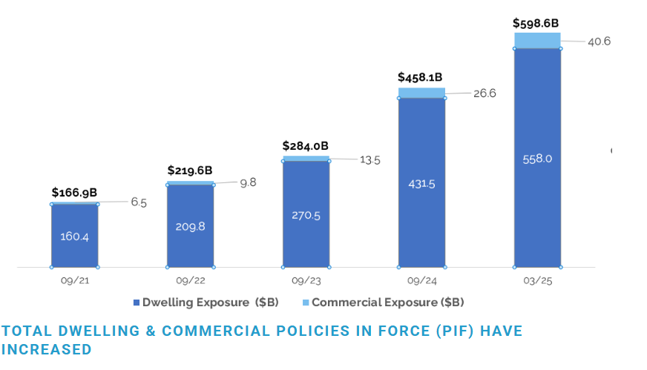
California FAIR Plan Policies in Force
Source: California Fair Plan Property Insurance

Slide 7
Key Issue No. 1: Is Smoke Damage Covered?
Buildings that aren’t burned can be damaged by smoke, soot and ash.
Raises question of whether covered under policies defining “property damage” as “direct physical loss or damage property” (DPLOD)
Key recent California Supreme Court ruing (Another Planet v Vigilant Ins.,15 Cal. 4th 1106)
“Under California law, direct physical loss of or damage to property requires a distinct, demonstrable, physical alteration to property. The physical alteration need not be visible to the naked eye, nor must it be structural, but it must result in some injury to or impairment of the property as property.”
Was in the context of denying COVID-19 claims but states broader principles on interpreting the term “property damage”.

Slide 8
Key Issue No. 1: Is Smoke Damage Covered?
Competing cases interpreting Another Planet in context of smoke damage.
Bottega LLC v. National Surety Corp. (N.D. Cal. 2025): Federal district court found smoke damage from North Bay Fires “caused by direct physical loss of or damage to property” even though the damage was not visible or structural because of clear causal connection between the DPLOD and the suspension of operations for BI losses
Gharibian v. Wawanesa Gen. Ins. Co., (Cal App. 2d Dist. 2025): State appellate court found soot and ash damage to house not covered where wildfire burned “half a mile away” with debris entering home and swimming pool, but no burn damage as “no evidence” of any DPLOD.
Department of Insurance Bulletin 2025-7, March 7, 2025,
DOI takes position “recent cases do not support position that smoke damage is never covered as a matter of law.”
Gharibian is “limited to the facts presented in that case” and therefore does not conflict because the plaintiffs’ smoke damage evidence was not sufficient to establish coverage, thus each case .
Does not have force of law but might be persuasive to a court.
Early attempt to avoid Another Planet: Jungwirth v. Cal. FAIR Plan Ass’n, et al., homeowner claiming smoke damage unlawfully removed from FAIR Plan coverage in violation of DOI regulations.

Slide 9
Key Issue No. 2: Subsequent Flood/Mud Damage
Very often in the rainy season after fire damage, there are significant risks of increased flooding and mud flow.
In past fires, insureds have attempted to claim that these are related losses from the fire, with limited success.
Current example is Shephard v. California FAIR Plan pending in Los Angeles Superior Court
Homeowner’s house was damaged by mud flow from heavy rains resulting from burn scar from the Portola Fire.
Plaintiff tendered to flood insurer Lloyds, who covered part of the loss and paid out its policy limits, which was insufficient.
FAIR Plan covered the property otherwise; FAIR Plan declined coverage because not fire damage.
Case in current litigation.

Slide 10
Key Issue No. 3: Claims Handling Issues
Heightened attention and sensitivity to claims handling in the wake of the scope and devastation from the fires.
Case example: Wood v. State Farm et al., Los Angeles Superior Court
Senior citizen Plaintiffs claim difficulty contacting adjuster who failed to return calls for several weeks after fire.
Plaintiffs relied on State Farm to advise on proper limits through own internal replacement cost estimates, which amounted to $408/ft coverage when $750/ft was needed.
Seven weeks after loss, State Farm confirmed no estimate had been created because estimator had been fired. When estimate was provided it was significantly under the market estimates to rebuild the house.
In addition to seeking coverage, plaintiffs claiming bad faith, financial elder abuse, and professional negligence.

Slide 11
Key Issue No. 4: Is FAIR Plan Adequate Insurance?
FAIR Plan has significant limits especially as applied in certain real estate markets in coastal California communities.
Often results in underinsured properties.
Current case example: Crane v. Integon, Los Angeles Superior Court
Crane bought home for $6.2m with secured mortgage of $4.2m which required insurance
In October 2024 State Farm non-renewed policy; Crane then purchased California Fair Plan policy for $2.73m dwelling and $272k Ordinance/Law, and an excess insurance clause.
Because Crane had not secured acceptable insurance, U.S. Bank purchased an Integon Policy to cover the home, with $5.3m dwelling coverage with premiums paid out of escrow account.
Integon denied claim for fire loss immediately without investigation because of the existence of other insurance. FAIR Plan had excess provision; Integon policy had provision stating “This policy prohibits other insurance” but then further referenced “acceptable” insurance.
Crane argue they never had other acceptable insurance.

Slide 12
Key Issue No. 5: Is There Exposure for Failure to Provide Insurance?
Two cases brought by prominent bad faith lawyer and a former federal judge.
Ferrier et al., v. State Farm Fire and Cas. Co., et al., Los Angeles Superior Court.
Class of plaintiffs insured by FAIR Plan following cancellations and then lost homes in fires.
Alleges carriers “agreed to jointly establish a group boycott to withhold insurance coverage” by refusal to renew policies in fire-prone areas to force policyholders on to FAIR Plan.
Claims FAIR plan premiums “above competitive levels for policies that provided severely limited fire coverage.”
Carriers then able to offset the risk of major losses by receiving permission from DOI to assess a surcharge on other homeowners’ policies in state.
Canzoneri v. State Farm Fire and Cas. Co., Los Angeles Superior Court
Same basic allegations (brought by the same counsel) as Ferrier
Different class of plaintiffs who did not lose their homes in fires but similarly allege anticompetitively forced into FAIR Plan.
Although no substantive activity yet, early motions seeking to dismiss the cases are expected.

Slide 13
Wildfires are Here to Stay, and Not Just in California
With today’s climate, about 1.3° relative to preindustrial, conditions that drove the LA Fires are expected to occur once every 17 years. The trend is not linear and expected to increase.
“A model developed for California’s Fourth Climate Change Assessment projected up to a 77 percent increase in average area burned and a 50 percent increase in the frequency of fires exceeding 25,000 acres by 2100.” Summary of Projected Climate Change Impacts on California, California Climate Adaptation Strategy.

Slide 14
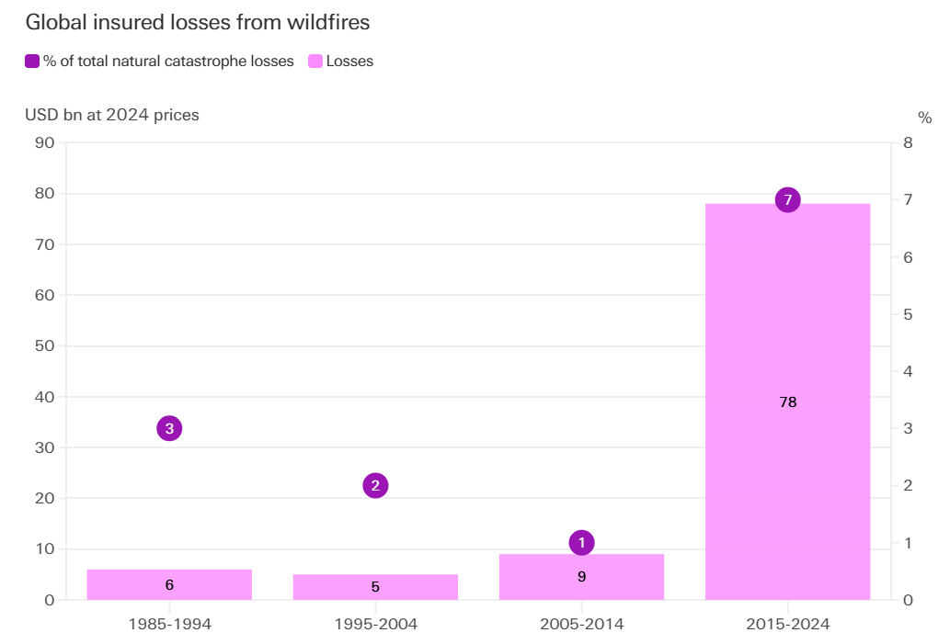
Global Insured Losses from Wildfires
Source: Swiss Re Institute

Slide 15
What Does the Future Hold?
Insurers exiting the market and increased reliance on FAIR Plan.
Continued tension over cancellations, rate increases, and scope of coverage
For example, DOI adopted ruling granting State Farm emergency rate increase, contingent on $400m cash infusion from parent company and precluding State Farm from non-renewing through the end of 2025.
Attempts to make fires less deadly and damaging
For example, California Safe Homes Act introduced in State Assembly (lower house) in April 2025, which funds mitigation efforts: (1) fire-safe roofing, (2) defensible space around homes; and (3) community-level wildfire protection strategies.

Slide 16
Key Reinsurance Issues from Los Angeles Wildfires

Slide 17
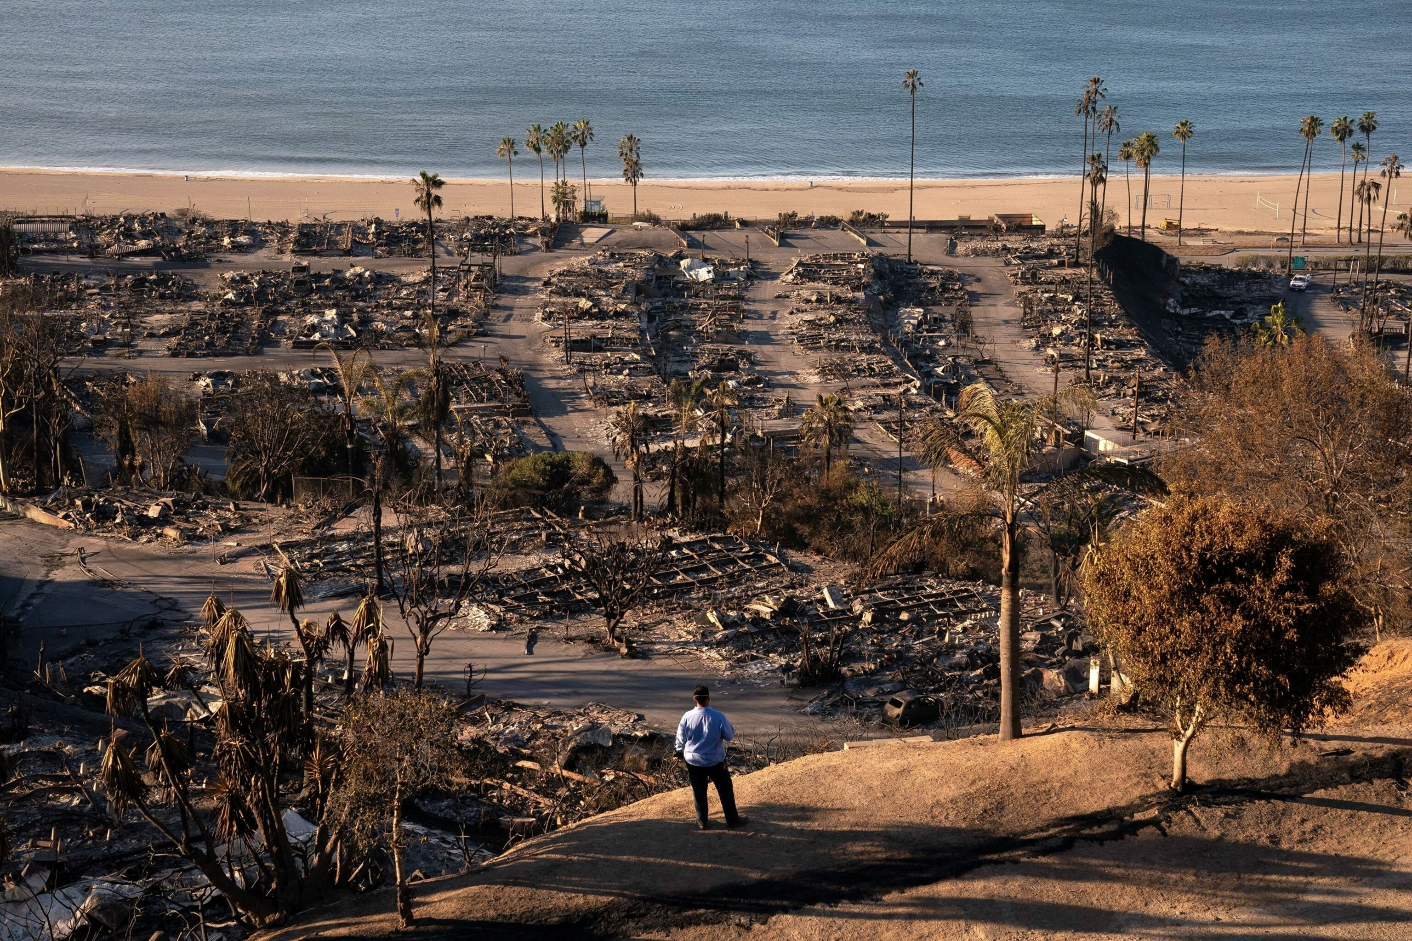
Reinsurers Have A Significant Share of LA Wildfires
According to Aon, between $11B and $17B of LA wildfire losses are being ceded to reinsurers, representing between 25% and 33% of total insured losses.
According to Moody’s, as of April 2025 the LA wildfire losses already cost around 39% of annual reinsurance catastrophe budgets.
The ultimate losses due to the LA wildfires remains uncertain but looks to be much closer to $40B - $50B than earlier estimates of $20B - $30B.
Photo: ABC News

Slide 18
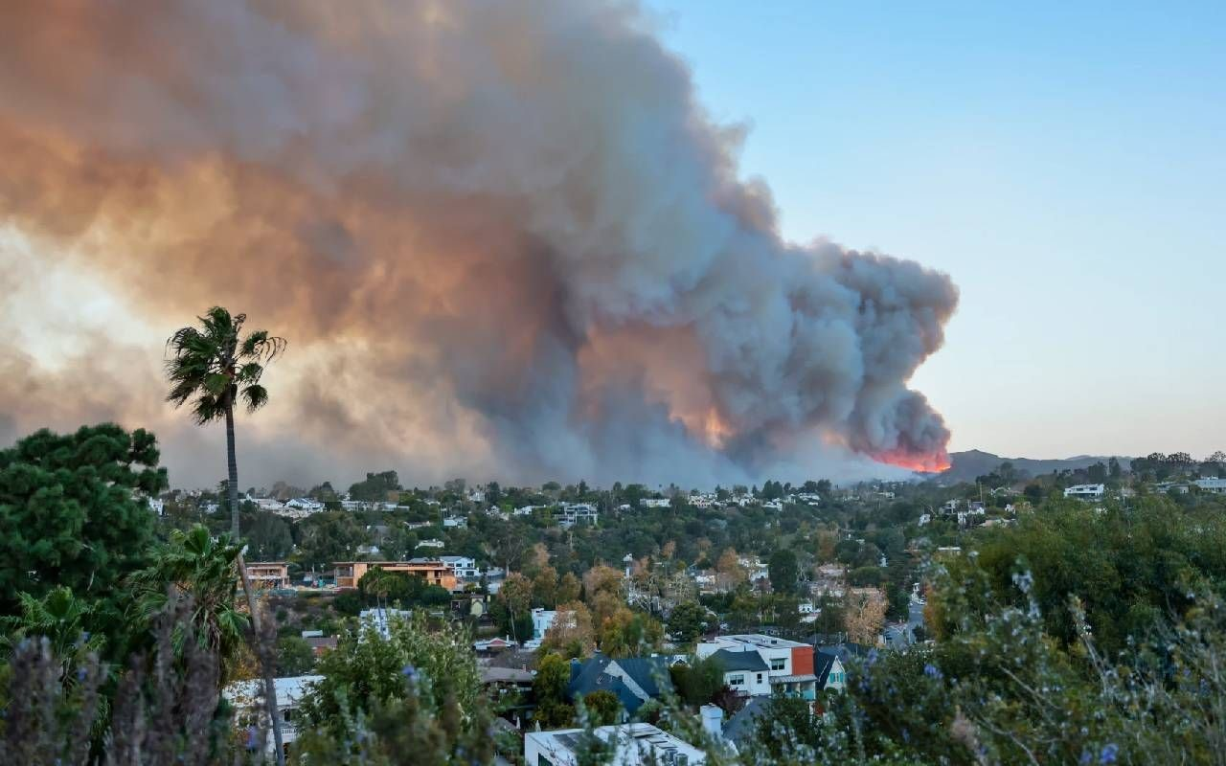
Prominent Reinsurance Issues for LA Wildfires
Aggregation: One event or two
Reinsurance coverage questions:
Smoke
Follow-on losses – e.g., mudslides, flooding, or ash
FAIR Plan
Bad faith
Reinstatement
Subrogation rights
Retrocession issues
Photo: Next Avenue

Slide 19
Aggregation: One Event or Two?
Typical catastrophe reinsurance loss occurrence definition:
“the sum of all individual losses directly occasioned by any one disaster,accident or loss or series of disasters, accidents or losses arising out of one event…”
Also often including:
Geographic limitation – e.g., one state or contiguous states.
Hours clause – e.g., 168 hours.

Slide 20
Aggregation: One Event or Two?
Wildfire is often separately defined:
Irrespective of origin or how the fire spread.
Different geographic limitation – e.g., within a 100-mile radius.
Longer hours clause – e.g., 240 hours.
Sometimes defined by PCS designation.
Individual losses cannot be included in more than one loss occurrence

Slide 21
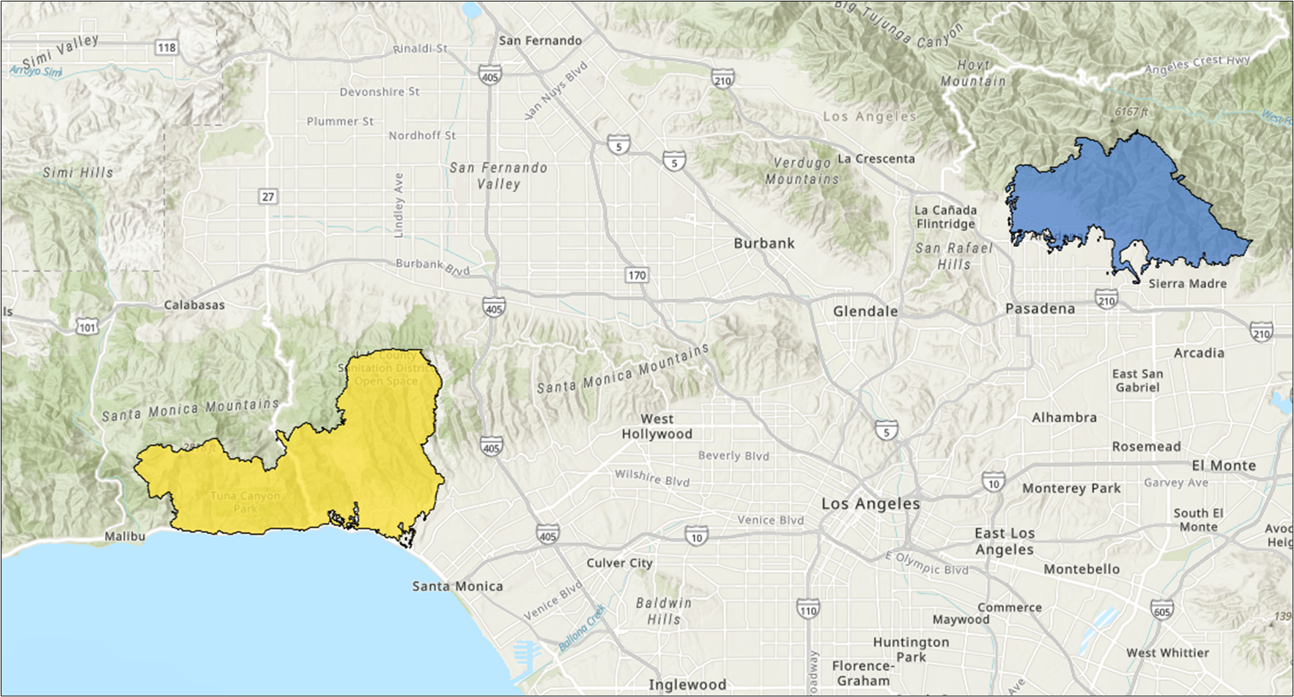
Aggregation: One Event or Two?
January 2025
Mercury publicly states that its catastrophe reinsurance treaty allows it to aggregate losses from wildfire events that occur within a 150-mile radius, which is an option in relation to the Palisades and Eaton fires.
Mercury states that its treaty also allows for a two occurrence scenario, due to the separate PCS designations.
Mercury thus had “not yet determined” if it will consider the wildfires as two separate events.
Yellow Area: Represents the Palisades Fire
Blue Area: Represents the Eaton Fire
One event? Or two?
Who decides?

Slide 22
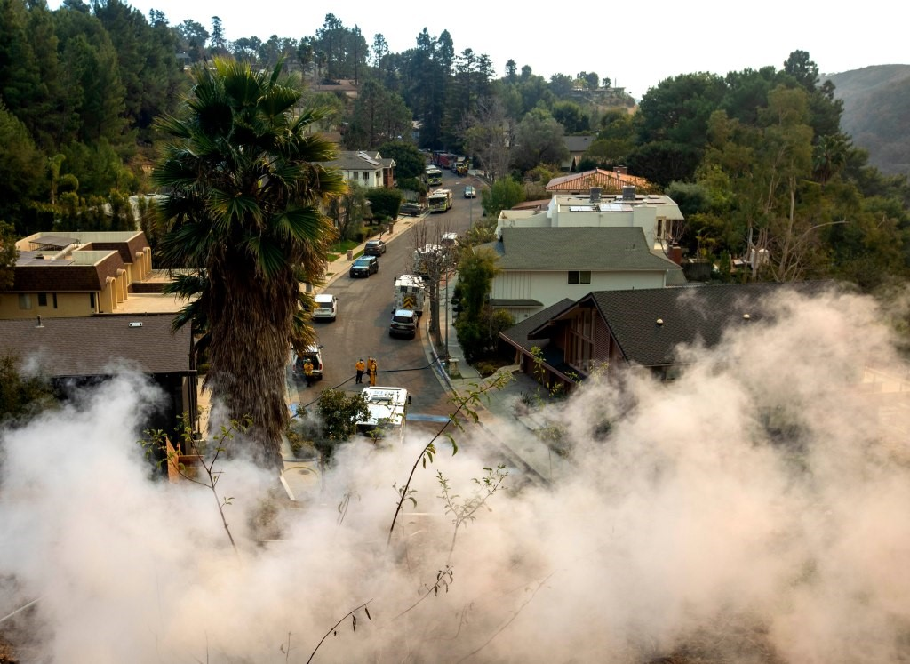
Reinsurance Coverage Issues: Smoke
The wildfire loss occurrence definition in a treaty may or may not specify that “smoke” losses may be included in the loss occurrence.
If the wildfire loss occurrence definition does not so specify, are smoke-only losses reinsured?
Consider follow-the-fortunes / follow-the-settlements / sole judge clauses, or specific intent.
Photo: New York Post

Slide 23
Reinsurance Coverage Issues: Follow-on Losses Such as Mudslides, Flood, Ash, Etc.
The loss of vegetation due to wildfires can cause mudslides or “debris flows” often days, weeks, or months after the wildfire.
The highly-urban LA wildfires also allegedly left approximately 9 billion pounds of “toxic ash” in the Palisades and Eaton neighborhoods.
https://www.cbsnews.com/video/california-wildfire-clean-up-challenges-60-minutes-video-2025-05-25/
It is uncertain whether California courts will apply insurance policy earth movement, flood, or other exclusions if the cause is wildfire.
Photo: Los Angeles Times

Slide 24
Reinsurance Coverage Issues: FAIR Plan
Some treaties exclude loss or liability of a cedent due to its membership in a pool or association such as FAIR; other treaties may carve FAIR out of the exclusion.
If the exclusion does not apply, are FAIR losses or assessments stemming from the LA wildfires reinsured?
It is not clear how FAIR losses would be due to “liability under the company’s policies”; on the other hand, what is the intent?

Slide 25
Reinsurance Coverage Issues: Bad Faith
Many catastrophe reinsurance treaties reinsure losses in excess of policy limits and extra-contractual obligations, at least to some extent.
There have been numerous bad faith claims arising from the LA Wildfires, and likely will be more in the future.
Some of these claims also include “elder abuse” or “professional negligence” causes of action.
Is there a point at which bad faith would not be reinsured?

Slide 26
Reinstatement Issues
Most catastrophe reinsurance treaties permit reinstatement:
In the event that all or any portion of the reinsurance under this contract is exhausted by ultimate net loss, the amount so exhausted will be reinstated immediately from the time the loss occurrences commenced hereon.
Given the growing number of significant wildfires, there is a question as to the future pricing and application of reinstatement.

Slide 27
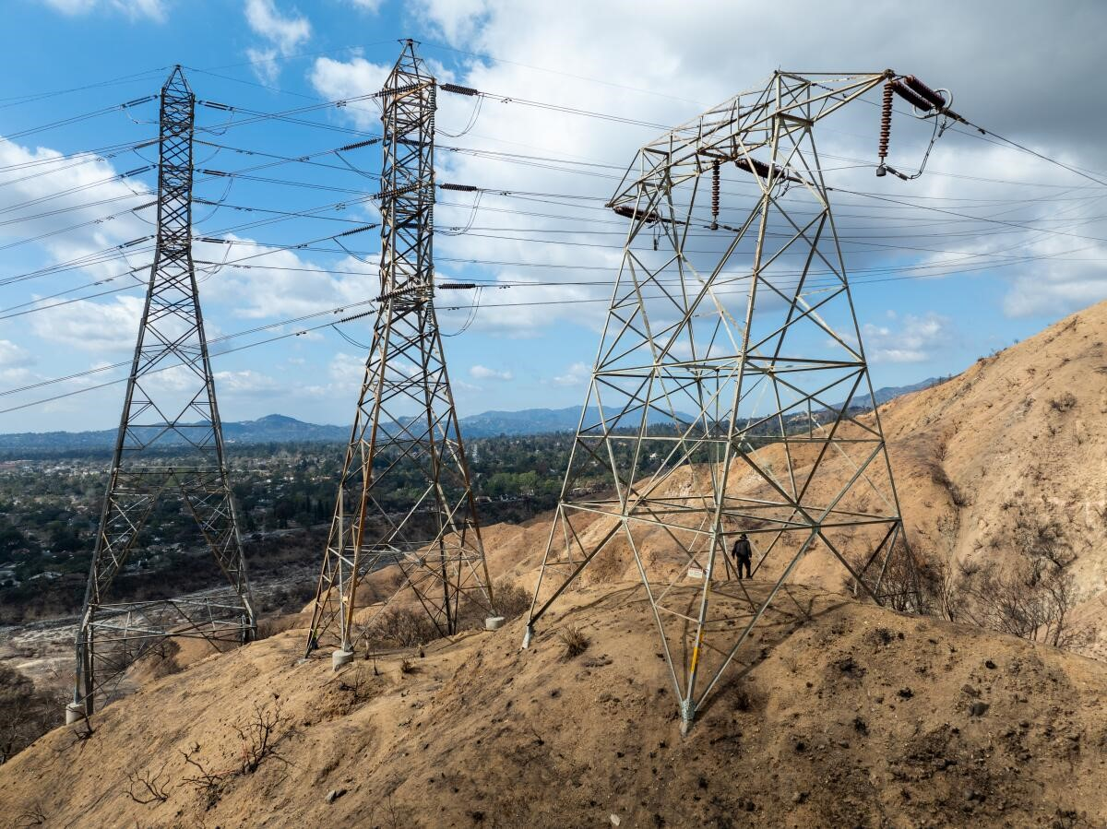
Subrogation Rights
The potential for subrogation recoveries is significant.
The Eaton Fire is alleged to have been caused by sparking from Southern California Edison electric transmission lines.
The Palisades Fire is alleged to have been exacerbated due to the failures of the Los Angeles Department of Water and Power.
Photo: Los Angeles Times

Slide 28
Subrogation Rights
Reinsurers are credited with their share of subrogation in respect of claims and settlements involving the reinsurance contract, typically in the “reverse order” of their participation in the loss.
When paying or settling a disputed billing, reinsurers may want to refrain from waiving their right to collect on subrogation claims.
Photo: Los Angeles Times

Slide 29
Subrogation Rights
Wall Street Brokers Start Trading Insurer Claims From LA Fires
By Blake Brittain | March 20, 2025
Some cedents may attempt to sell their subrogation claims to third-party investors.
This type of sale may breach the subrogation provision in a reinsurance contract, which often will say that the company “shall enforce” its rights to salvage or subrogation relating to any reinsured loss or require the reinsurer’s consent to give up prosecuting subrogation claims.
Source: Insurance Journal

Slide 30
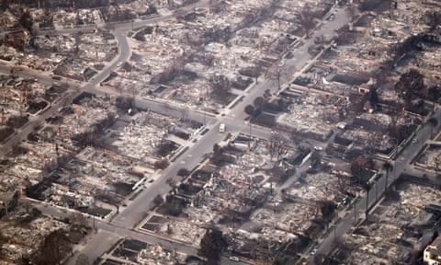
Retrocession Issues
Reinsurers will want to avoid a disconnect between their XOL reinsurance and retro reinsurance.
Some retrocessional contracts may not include wildfire-specific “loss occurrence” definitions.
This could lead to a situation where the loss occurrence definition for retro reinsurance is narrower than in the XOL reinsurance contracts.
Photo: The Guardian

Slide 31
LA Wildfires: Future Questions & Issues
According to Gallagher Re, catastrophe reinsurance capacity remains strong, with traditional reinsurance capital rising to $655B as of December 31, 2024, with an additional $114B in alternative capital available as well.
In this market, it is difficult to assess the long-term impact of the LA wildfires on reinsurance terms and claims, but consider:
How much discretion is granted on aggregation?
Should contracts likely to involve wildfire address accumulation and timing issues?
What comes out of California market changes?

Slide 32
LA Wildfires: Future Questions & Issues
Mercury General 1st Quarter Financial Report: May 6, 2025
Although the Company recorded the Palisades and Eaton fires as one event for reinsurance purposes, it retains the ability to consider them as two separate events
…
As more information becomes available to the Company, including any updated subrogation recovery estimates and the impact on future reinsurance premiums under the two-event scenario, the Company may re-evaluate whether it will consider the Palisades and Eaton fires as two separate events.

Slide 33
Contacts
Steven D. Allison
Partner | Orange County
949.622.2703 steven.allison@troutman.com
Michael T. Carolan
Partner | Detroit & Washington, D.C.
248.359.7321 michael.carolan@troutman.com

