Slide 1
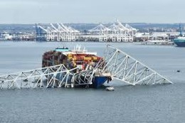
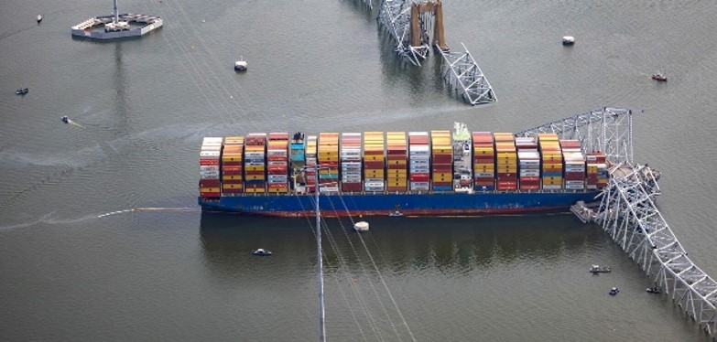
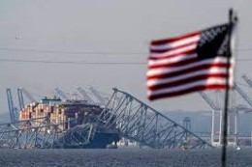
IntAP
DALI Drama: Baltimore Bridge To Nowhere
IntAP
James E. Mercante
IntAP Spring Meeting
Munich, Germany
June 4, 2025

Slide 2
Today’s Journey
Litigation Status- Phases (“Bifurcated”)
Phase 1- Limitation of Liability issues only – Bench Trial June 1, 2026
Phase 2- Discovery to “reopen” on claims, damages, dispositive motions, experts, evidence
rulings, hearings, trial on allocations of fault and recoverable damages.
NTSB strikes at Key Bridge
Legislation to amend Limitation Act status
Likelihood of Success ?

Slide 3
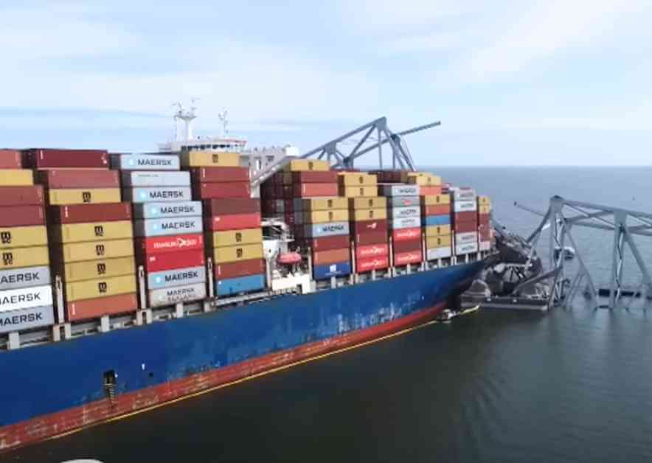
THE LITIGATION
(Full Speed Ahead)
Highlights:
Casualty Date – March 26, 2024
First shot fired in 6 days – April 1, 2024
Over 85 claims filed to date. Attempt to break limitation and recover full damages
Court docket: 170 pages; 520 entries.
Judge’s many Case Management orders.
Multiple Depositions taken – crew, pilots, ship interests.
Tens of Thousands of documents exchanged.
First settlement: $100 million (U.S. Gov’t).

Slide 4
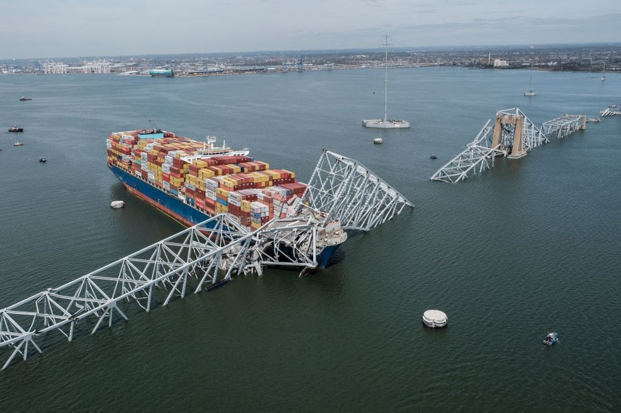
Multiple Claims and Exposure/One Venue
Complete collapse of bridge > 1 Billion
Fatalities & Injuries
Cargo & Container Claims
Business Interruption (Bridge owner)
Wreck Removal/Response costs (settled)
Hull & Machinery
General Average (New York jurisdiction agreed)
Charter Party Disputes
Class Action-local businesses
FBI Investigation
Seaman’s Manslaughter Statute?
Punitive Damages
Legal Fees

Slide 5
LIMITATION of LIABILITY Proceeding
Judge James Bredar: “The goal is to ensure PHASE 1 (Limitation) is “resolved efficiently and expeditiously”
MULTIPLE BENEFITS OF LOLA in the United States:
Limitation Fund = Post-casualty value of vessel plus freight
Venue for all claims against owner in one Federal forum
Restraining Order issued by Federal Judge halts all other legal actions
Limitation Fund posted by Letter of Undertaking only (No Bond or Cash)
Non-Jury Limitation of Liability trial. BIFURCATED
Avoids inconsistent results in multiple jurisdictions
Federal Judge familiarity with Admiralty Law
Encourages settlements due to risk of Limited Liability
Pro Rata distribution of the Limitation Fund.

Slide 6
THE LITIGATION:
The DALI LIMITATION ACTION
Challenge the right to limit Liability.
Challenge who can seek Limitation? (Maybe moot after Phase 1 trial)
Challenge the calculation of the Limitation Fund? (Maybe moot after Phase 1 trial)
Challenge the Bridge owner? (Allocations of Fault)
Compare US Law to UK Law (1976 Convention).
Predictions? What we can tell from prior LOLA precedent?
Goal- one way or another is to limit ‘damages’

Slide 7
Loose Lips Sink Ships - 'Loose Wire' Sinks Who?
BURDENS OF PROOF: 2 Prong Test in Non-Jury Federal Court Hearing:
#1. Claimants burden to prove Negligence or Unseaworthiness. If not, owner is Exonerated.
#2. If Negligence or Unseaworthiness of vessel is proven by claiments: burden of proof shifts to vessel owner to establish vessel owner’s (‘Petitioners’) lack of privity or knowledge of such ‘acts’ or ‘omissions’.
NTSB concluded primary electrical breaker triggered.
To succeed in limiting liability, Petitioner/owner must not have personally participated in (or have knowledge of) the act or omissions that caused or contributed to the casualty.
Query: Is it an owner issue (ashore) or crew negligence? (onboard)
For example: Knowledge of (and reason for) two 'Blackouts' prior to departure and maintenance issues with electrical? (Who knew what/when)?
Presumption of Fault against ship? (Striking stationary object).
Evidentiary issues (admissibility in evidence of NTSB and USCG reports)?

Slide 8
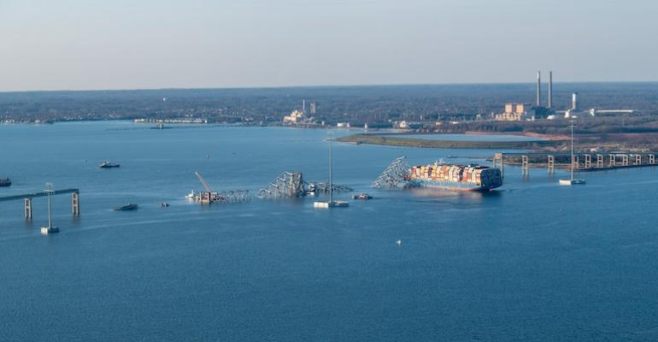
Phase 2
DALI Defenses?
DISCOVERY REOPENS!
DAMAGES AND DISPOSITIVE MOTIONS
Business interruption recovery requires physical damage. (U.S. Supreme Court – Robins Dry Dock Vs. Flint – 1927).
Owner of bridge has viable claim.
Owners of other businesses with no physical damage do not, without some applicable exception, such as intentional or reckless act, public nuisance, criminal conviction.
Third-Party claims?

Slide 9
DALI Damages Defenses?
Building/Replacing the Bridge
Defense of Betterment & Depreciation to reduce extent of recoverable damages.
No upgrade to bridge protection (piers/dolphins) in decades (despite prior warnings).
"Betterment" reductions subject to evidence and judges' discretion (i.e. Building more reinforced bridge and pilings: adding more lanes; greater capacity; higher elevation)
1983 Bridge Study mentions F.S. Key Bridge.
NTSB strikes at bridge! March 18, 2025 Report:
Had MDTA conducted the 1991 and 2009 vulnerability assessment of the bridge, it would have been aware the Key Bridge was well above the threshold of risk for catastrophic collapse from a vessel collision.

Slide 10
THE LEGISLATION – UNDERWAY or Aground?
Proposed amendment to LOLA: August 13, 2024, submitted to U.S. Congress (“Justice for Victims of Foreign Vessel Accidents Act”) H.R. 9348
Increase Limitation Fund to 10x the ship value
Retroactive effect.
Hard Aground

Slide 11
New York Law Journal and Lloyd’s List
DALI Drama: Baltimore Bridge to Nowhere: New York Law Journal, March 25, 2025 by James E. Mercante, Esq.
Lloyd’s List DALI LITIGATION Podcast

Slide 12
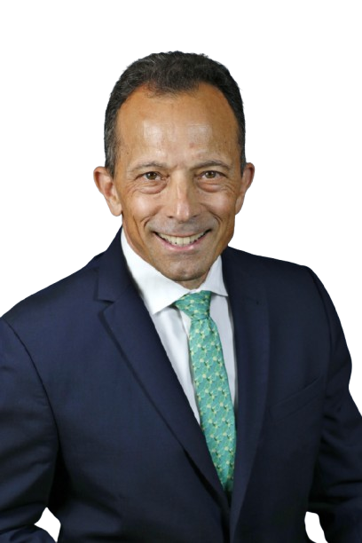
IntAP
James E. Mercante, Esq.
jmercante@gvlaw.com
Office: (212) 683-7100

