Slide 1
IntAP Spring Technical Meeting
4th and 5th June 2025

Slide 2
Caledonian Riots
Dr. Karl Ömer Rösch & Dr. Nikolaos Tsolakidis
ARKTIK Legal

Slide 3
Agenda
Introductory Facts
Direct Insurance Implications
Re-Insurance Implications
Implications for further French Territories
Subrogation
Conclusion

Slide 4
A. Introductory Facts

Slide 5
New Caledonia
New Caledonia is a French overseas territory, located about 1,500 km east of Australia.
The population mainly consists of Kanaks (the indigenous population) and the Caldoche (people of European descent).
Unbalanced economical situation between Kanaks and Caldoche.
Nickel industry: 13,000 jobs, 25% of global reserves and 5th largest exporter.
Nickel is crucial for production of accumulators, batteries, cell phones and generally for low-carbon technologies.
High dependency on French trade (50–66%).

Slide 6
Special legal status
Sui generis status under the Nouméa Accord (1998) and Organic Law No. 99-209
Extensive legislative autonomy: labour law, property, taxation, electoral law
Shared sovereignty: France retains defence, currency, foreign affairs
Frozen electoral roll since 1998 – unique globally
Referendums regarding the independence in 2018, 2020, 2021
In the last referendum 96.5% voted to remain part of France, with a turnout of 43.9%
The pro-independence party declared that they will not recognize the vote

Slide 7
May 2024 Riots
Phase 1: 13 – 15 May 2024: Unrest erupted in response to proposed voting reforms by the French government.
Phase 2: France declared a state of emergency on 15 May 2024, ordered curfews and deployed over 3500 troops. Violence targeted then shops, businesses, and government buildings. State of emergency lifted on 28 May 2024 – but curfews remained.
Violence started deescalating in June 2024, when Macron suspended the electoral reform. Curfew was lifted on 3 December 2024.
In total: At least 14 fatalities, hundreds injured, and €2.2 billion in economic losses.

Slide 8
Key Targets and Infrastructure Impacted
Public infrastructure and mining facilities specifically targeted.
Only 1 out of 5 mines of 'Le Nickel' operational as of 16 May.
La Tontouta Airport closed until at least 2 June 2024.
Food shortages and disrupted supply chains reported.

Slide 9
Various Types of Damages
Vast damage due to riots, looting, and arson since 13 May 2024, estimated at over €2 billion.
Approx. 400 businesses destroyed, incl. Ducos industrial zone.
80–90% of consumer goods distribution network obliterated.
At least 300 cars and 20 schools damaged or destroyed.
80–90% supply chain disruption.
30–40% of losses from business interruption.
Tourism collapse (5% of GDP).

Slide 10
B. Direct Insurance Implications

Slide 11
Typical Coverage Issues in Primary Insurance
Types of damages covered: property damage, business interruption, arson, looting.
Challenges in assessing and quantifying losses.
Legal basis for coverage: policy terms and conditions, exclusions.
Ex gratia and settlement payments.

Slide 12
French Insurers’ Commitments
On 22 May 2024, French insurers met with the French Minister for the Economy and discussed the following measures:
Notification deadline extended from 5 to 30 days.
Pay out advances on insurance indemnities as soon as practicably possible.
Construe and apply insurance in the “most benevolent fashion” with respect to small and medium-sized businesses.
Remote loss assessments allowed (video/photo) to speed up claims settlement.
Send loss adjusters on-site as soon as public order has been restored.

Slide 13
C. Re-Insurance Implications

Slide 14
Key Reinsurance Challenges
Defining the precise territorial scope of relevant reinsurance treaties (France / French overseas territories).
Defining covered classes of business and losses.
Interpreting key aggregation mechanisms based on “events”, “loss occurrence” and “hours clauses”.
Ex gratia payments .
Follow-the-settlements clauses.

Slide 15
Territorial Scope and Classes of Business
Territorial Scope:
Worldwide (incl. French overseas territories).
Worldwide (excl. Europe, incl. French overseas territories).
Wheresoever arising.
Classes of Business:
Property Damage.
Business Interruption (BI).
Non-physical damage BI losses.

Slide 16
Event Definition Clause (EDC)
Defines an “event” (or a “loss occurrence”) which is reinsured.
Determines how losses are aggregated and whether they constitute a single event or multiple events.
For example: “accumulation of individual losses […]resulting from the same generating cause”.
Or more specific: “Events: […] c) Riots, civil commotions and malicious damage within the limits of any one city, town or village”.

Slide 17
Exclusion Clause
Excludes certain occurrences from the event definition.
Some Treaties exclude certain perils like: Civil war, mutiny, military rising, insurrection, rebellion, revolution etc.
Issue: Whether the unrest qualifies as insurrection/rebellion and is excluded or if it rather constitutes a covered riot or civil commotion.

Slide 18
Exclusion Clause - Possible Interpretations
Differentiating between “riots” and “rebellion”: intensity and purpose.
Approach: assessing the overall picture and context.
Arguments for coverage: focus on political protest, not overthrowing government.
Arguments against coverage: high level of violence, presence of armed forces.

Slide 19
Hours Clause
Limits the duration of damage coverage for certain listed perils.
Affects the aggregation of losses and the application of event limits.
Typical: 72, 96 or 168 consecutive hours for riots.
Certain types of losses (e.g. physical damage or business interruption Losses) can at times be exempt from the hours limitations.

Slide 20
Ex Gratia Payments and Follow-the-Settlements Clause
Ex Gratia Payments:
Payments made without legal obligation.
Reinsurers not liable for ex gratia payments.
Issue: When is a payment ex gratia – when within a benevolent interpretation of the insurance contract?
Follow-the-Settlements Clause:
Claims settlements binding on reinsurers.
Must be within terms of original policies and reinsurance contract.

Slide 21
D. Implications for further French Territories

Slide 22
General Overview on French territories
Type of territory | Examples | Political Status | Separatism | Economy
DOM | Guadeloupe, Martinique, Réunion, Mayotte | Fully integrated French regions | No significant independence movement | Agriculture, tourism, limited industry
COM | French Polynesia, Wallis and Futuna | Partial autonomy, but no frozen voting rights | Partial independence movements, but stable | Tourism, pearl farming, fishing
New Caledonia | – | Sui generis, extensive autonomy, frozen right to vote | Strong, historically grown independence movement (FLNKS) | Nickel mining (20–30% of global reserves), industry

Slide 23
Economic Overview on French territories
Territory (important examples) | Main Economic Sectors | Key Features/Notes
New Caledonia | Mining (nickel), services, public sector | Highly concentrated in nickel mining; mining = major GDP/employment share; limited diversification
French Polynesia | Services (esp. tourism), pearl farming, fisheries, small-scale industry | Economy dominated by tourism and services; small-scale agro-processing and crafts
Guadeloupe | Services (tourism, public), agriculture, light industry | Services dominate; some agro-food industry (rum, sugar); fragmented industrial base
Martinique | Services (public, tourism), agriculture, light industry | Similar to Guadeloupe; services and public sector are largest; minor agro-food and light industry
Réunion | Services (public, tourism), agriculture, light industry | Services and public sector dominant; sugar, rum, light manufacturing
French Guiana | Public sector, mining (gold), services, agriculture | Large public sector; gold mining significant; some agriculture (rice, bananas), space industry (Kourou)
Mayotte | Services (public), agriculture, fisheries | Public sector and services dominate; agriculture and fishing important locally
No comparable industrial concentration such as in New Caledonia

Slide 24
Comparative Risk Assessment of Civil Unrest
Factor I: Likelihood of a similar event
Comparison of the political status and separatism movements in the French territories, e.g.
Historical precedent of political or ethnic tensions.
Presence of unresolved constitutional or autonomy disputes.
Degree of mobilisation and organisation of protest movements.
Trigger events.
Factor II: Damage Potential
Comparison of the economy in the French territories, e.g.
Concentration of insured assets (e.g. industrial zones, infrastructure).
Economic reliance on vulnerable sectors (e.g. mining, tourism).

Slide 25
I. Likelihood of a Similar Event
Political Status & Separatism Movements
New Caledonia: Sui generis collectivity with a 1998 autonomy agreement (Nouméa Accord) and unresolved independence referendums (2020–2021). Active Kanak separatist movements (FLNKS) and recent violent protests.
French Polynesia: Overseas country with limited autonomy. Pro-independence Tavini Huiraatira party holds 44% of assembly seats, but tensions are largely institutional.
Martinique/Guadeloupe: Overseas departments (Article 73) with limited autonomy. Pro-independence movements (e.g., Martinican Liberation Party) lack broad support but have growing influence amid social inequality debates.

Slide 26
I. Likelihood of a Similar Event
Historical Precedent
New Caledonia: Decades of ethnic tensions (1980s civil war, 2024 riots).
French Polynesia: Annexation conflicts (1840s–1897) and nuclear-testing grievances.
Caribbean territories: 2009 Guadeloupe general strikes over living costs.

Slide 27
I. Likelihood of a Similar Event
Constitutional disputes
New Caledonia: Electoral roll reforms (2024) bypassing local consultations sparked unrest.
French Polynesia: Autonomy statute revisions (2004, 2007) remain contested.
Article 73 territories: Repeated calls for greater fiscal/political autonomy ignored by Paris.

Slide 28
I. Likelihood of a Similar Event
Mobilisation Capacity
New Caledonia: Highly organised Kanak groups (CCAT) with cross-territory solidarity (e.g., Guadeloupe, Réunion).
French Polynesia: Protests are sporadic and fragmented.
Caribbean: Smaller, less coordinated movements but rising youth activism.

Slide 29
I. Likelihood of a Similar Event
Trigger Events
2024 Riots in New Caledonia:
Proposed constitutional reform to expand voting rights.
Perceived as a threat to Kanak political representation.
Situation in other French territories:
No similar reforms.
No similar ethnical situation.

Slide 30
II. Damage Potential
Typical insurance coverage
Industrial assets typically insured against standard risks.
Political risk coverage limited or expensive.
Unrest in other territories unlikely to cause systemic insured losses.

Slide 31
II. Damage Potential
Insured Assets at Risk
New Caledonia: Nickel mining infrastructure (e.g., Koniambo plant, 20% GDP at risk) and critical port facilities.
French Polynesia: Tourism hubs (e.g., Bora Bora resorts) and pearl farming infrastructure.
Martinique/Guadeloupe: Industrial zones (petrochemical plants) and tourism infrastructure.

Slide 32
II. Damage Potential
Economic Vulnerabilities
New Caledonia: Nickel sector employs 20–25% of workforce; global price volatility and Indonesian competition threaten stability.
French Polynesia: Tourism (13% GDP pre-pandemic) and fisheries exposed to climate/geopolitical shocks.
Caribbean Territories: Agriculture (banana exports) and tourism reliant on EU subsidies and air/sea connectivity.

Slide 33
Key Takeaways for (Re-)Insurers
High Risk: New Caledonia (ongoing unrest, strategic nickel dependence).
Moderate to low Risk: French Polynesia (autonomy disputes, tourism concentration).
Emerging Risk: Caribbean territories (social inequality, activist networks).
Mitigation strategies: Diversify portfolios, monitor electoral reforms, and engage local partners for real-time risk assessments.

Slide 34
E. Subrogation

Slide 35
Subrogation Against the French State
Article L.121-12 of the French Insurance Code:
insurers may subrogate into the rights of the insured against liable third parties.
The French State may only be liable for riot-related damages in cases of gross negligence (faute lourde):
very high evidentiary threshold successful claims are extremely rare
Jurisdiction lies with administrative courts (e.g. Nouméa or Paris); proceedings typically last 2–5 years.
French state liability law may not apply in all overseas territories alike.

Slide 36
Legal Precedents
No successful subrogation after riots known.
Exceptionally rare success (e.g. Commune de Grande-Synthe, 2015).
In practice, state immunity and the lack of judicial precedent make recovery highly unlikely.

Slide 37
Precedence of Subrogation before Reinsurance?
No general legal obligation exists for the cedant to pursue subrogation before claiming under reinsurance.
However, reinsurance contracts may include clauses requiring:
Diligent pursuit of subrogation rights,
Notification of potential recoveries,
Or even waiver of subrogation if deemed uneconomical or legally futile.

Slide 38
Key Considerations
Whether subrogation is a precondition to reinsurance recovery depends on the individual treaty wording.
Reinsurers may request evidence that subrogation was considered and reasonably dismissed.
In complex political unrest scenarios, contractual clarity is essential to avoid disputes.

Slide 39
F. Conclusion

Slide 40
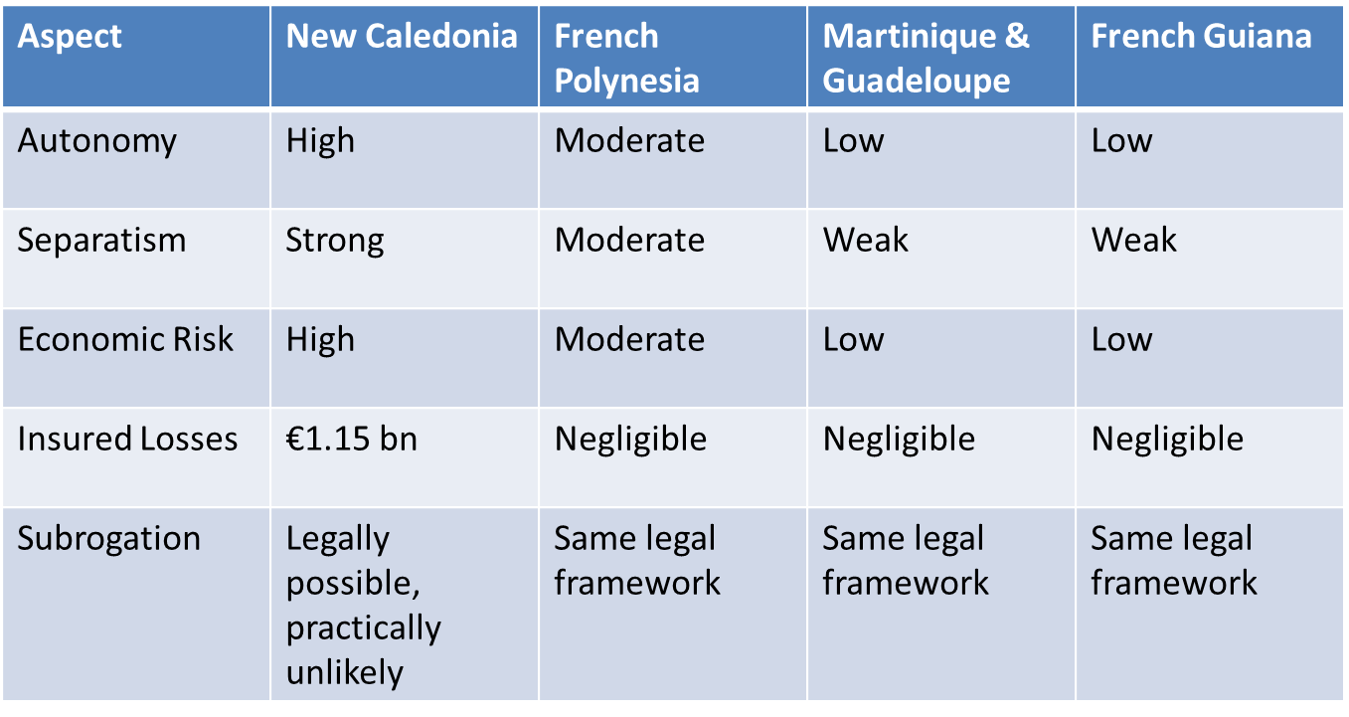
Summary Table

Slide 41
Final remarks
New Caledonia is a legal, political, and economic outlier.
Transferability of unrest risk is low.
Reinsurance strategies should reflect this asymmetry.

Slide 42
Thank you!

