Slide 1

SENTIX
Survival of patients with early stages cervical cancer after SLN biopsy without systematic pelvic lymphadenectomy
SENTIX prospective single-arm international trial (CEEGOG CX-01; ENGOT-CX2)
PI: prof. MUDr. David Cibula, CSc., FCMA
Department of Obstetrics and Gynecology, First Faculty of Medicine, Charles University and General University Hospital in Prague, Czech Republic

Slide 2
01
ENDPOINTS

Slide 3
PRIMARY ENDPOINT
STUDY ENDPOINTS
Reference RR was based on historical cohorts of patients
(IB1, no LN+ or low proportion of LN+)
27 manuscripts
Data on more than 8700 patients (approx. 100-1400 per study)
RR in the range of 3-29%, with the median RR between 7%-13%
Recurrence rate (RR) at 24th month of follow-up
(not counting cervix recurrences after fertility-sparing procedures)
Reference recurrence rate: 7% (at the 24th month follow-up) in patients after systematic pelvic lymphadenectomy.
Margin of non-inferiority: 4%.
Author (year) | Short title | Design / Population (N) | Stage | Recurrence Rate (RR)
Park 2011 | LSC NSRH | Retrospective N=125 | IB1–IB2 IB1 84% | 10 % IB1=9%
Hoogendam 2014 | Outcome after RRH | Retrospective N=104 | IA1–IIB IA–IB1 91% | 13%
Kim 2014 | RRH vs. LRH | Retrospective N=184 | I–IIA IA–IB1 84% | RRH=9% LRH=10%
Laterza 2016 | LRH vs. ARH | Retrospective N=150 | IA1–IIA1 | LRH=11% ARH=19%
Zanagnolo 2016 | RRH vs. ARH | Retrospective N=405 | IA1–IIB | RRH= 9% ARH= 11%
*Only few relevant examples shown.

Slide 4
PRIMARY ENDPOINT
STUDY ENDPOINTS
OTHER ENDPOINTS
SECONDARY ENPOINT
Prevalence of symptomatic pelvic lymphocele and lower extremity lymphedema.
Recurrence rate (RR) at 24th month of follow-up
(not counting cervix recurrences after fertility-sparing procedures)
Reference recurrence rate: 7% (at the 24th month follow-up) in patients after systematic pelvic lymphadenectomy.
Margin of non-inferiority: 3%.
Quality of Life
Disease-Free Survival
Pelvic Disease-Free Survival
Overall Survival

Slide 5
02
DESIGN

Slide 6
STUDY DESIGN
STUDY DESIGN
PATIENTS PRE-REGISTERED TO SENTIX STUDY
Cervical cancer: IA1 + LVSI - IB1 (<4 cm), OR less than 2 cm if FST
No suspicious LN or distant metastases
Squamous cell OR adenocarcinoma usual type
Scheduled for primary surgical treatment with SLN biopsy without PLND
SLN cohort
No further LN dissection
Bilateral SLN
detection
Negative on frozen section
Radical hysterectomy or
fertility-sparing procedure
SLN
Ultrastaging
Final histology
Follow up
SLN not detected or detected only unilaterally
At least unilateral systematic PLND
Control cohort
Positive SLN/ parametria
/resection margins
Adjuvant ChemoRT
PATIENTS NOT PRE-REGISTERED TO SENTIX STUDY
Cervical cancer: IA1 + LVSI - IB1 (<4 cm), OR less than 2 cm if FST
No suspicious LN or distant metastases
Squamous cell OR adenocarcinoma usual type
Scheduled for primary surgical treatment with PLND
Systematic PLND
SURGERY

Slide 7
POWER ANALYSIS
POWER ANALYSIS
SAMPLE SIZE
Necessary sample size: 600
Non-inferiority margin at 24. months: 4%
Power: 90%
Significance: 0.05
Recurrence rate (RR) was estimated at the 24th month of follow-up to prove a non-inferiority of SLN biopsy to the reference value (RR 24th month: 7 %).
The selected number of patients (increased by the protocol amendment from 2018) also enabled a subgroup analysis of patients based on risk factors: tumour size and the presence of lymphovascular invasion.
Non-inferiority (P₀) was determined using a one-sided Z-test.

Slide 8
03
TIMELINE & ENROLLMENT

Slide 9
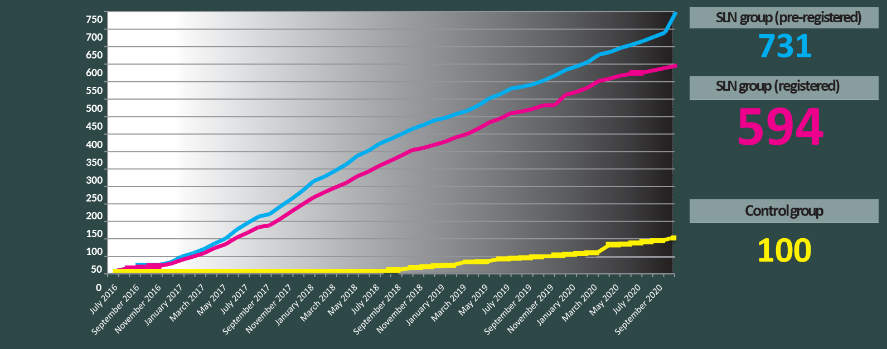
TIMELINE AND ENROLLMENT
Safety analysis performed after
30 60 150 300
Patients finished 12 months follow-up
Primary endpoint follow-up end
First patient enrolled
Last patient enrolled
VI.
2016
IV. 2018
VIII. 2018
XII. 2018
XII. 2019
X.
2020
Q4 2022
Follow-up
ENGOT model A
No. of patients: 600 SLN group
Timeline: FPI: VI.2016, LPI: X.2020

Slide 10
INTERNATIONAL COLLABORATION
SENTIX consortium
47 centres from 18 countries

Slide 11




INTERNATIONAL COLLABORATION
International collaboration
Study Chair: David Cibula
Main Investigator: Roman Kocian
Central pathology review: Pavel Dundr
Kristyna Nemejcova
Study coordinators: Ivana Nohova, Irena Jasova
 |  |  | Principal investigator
 | General University Hospital Prague | Czech Republic | David Cibula, MD, PhD, FCMA, Prof
 | Bulovka Hospital Prague | Czech Republic | Borek Sehnal, MD, PhD
 | University Hospital Ostrava | Czech Republic | Jaroslav Klát, MD, PhD, Ass. Prof
 | University Hospital Plzeň | Czech Republic | Zdeněk Novotný, MD, PhD, CSc.
 | University Hospital Olomouc | Czech Republic | Radovan Pilka, MD, PhD, Prof
 | Hospital České Budějovice | Czech Republic | Martin Michal, MD
 | Tomas Bata Regional Hospital Zlin | Czech Republic | Pavel Havelka, MD, PhD
 | University Hospital Brno | Czech Republic | Luboš Minář, MD, PhD
 | University Clinical Centre Gdańsk | Poland | Dariusz Wydra, MD, PhD, Ass. Prof
 | Jagiellonian University Medical College | Poland | Kazimierz Pitynski, MD, PhD, Ass. Prof
 | Swietokrzyskie Cancer Center Kielce | Poland | Kamil Zalewski, MD; Marcin Misiek, MD
 | Institute of Mother and Child Warsaw | Poland | Grzegorz Szewczyk, MD, PhD
 | Israeli Oncological Hospital Plyuty | Ukraine | Alla Vinnytska, MD, PhD
 | University Hospital Trenčín | Slovakia | Peter Kaščák, MD, PhD
 | University Hospital Bratislava | Slovakia | Mikuláš Redecha, MD, PhD
 | Oncology Institute of East Slovakia | Slovakia | Róbert Tóth, MD, PhD
 | University Medical Centre Maribor | Slovenia | Maja Pakiž, MD, PhD, Ass. Prof
 | University Medical Centre Ljubljana | Slovenia | Špela Smrkolj, MD, PhD, Ass. Prof
 | University of Debrecen | Hungary | Róbert Póka, MD, PhD, Prof
 | Non-ENGOT sites |  | Principal investigator
 | Asklepios Klinik Hamburg Altona | Germany | Christhardt Köhler, MD, PhD, Prof
 | La Paz University Hospital | Spain | Ignacio Zapardiel MD, PhD
 | Hospital Clinico San Carlos Madrid | Spain | Pluvio J. Coronado Martín, MD, PhD
 | MD Anderson Cancer Center | Spain | Francisco de Santiago García, MD
 | Hospital Clinic de Barcelona | Spain | A. Torné, MD, PhD
 | Hospital Universitari de Bellvitge | Spain | Jordi Ponce i Sebastià, MD
 | Fundacion Instituto Valenciano de Oncologia | Spain | Cristina Zorrero, MD
 | University Hospital of Canary Islands | Spain | Octavio Arencibia Sánchez, MD
 | San Gerardo Hospital Monza | Italy | Fabio Landoni, MD, PhD, Prof
 | Fondazione IRCCS Istituto Nazionale Tumori | Italy | Francesco Raspagliesi, MD, PhD, Prof
 | Academic Medical Center Amsterdam | Netherlands | Luc van Lonkhuijzen, MD
 | Hospital Español de Buenos Aires | Argentina | Juan Carlos Staringer, MD
 | Institute of Oncology Angel H. Roffo | Argentina | Marcela Ostojich, MD
 | Hospital de Alta Complejidad de Formosa | Argentina | Juan Carlos Staringer, MD
 | Trondheim University Hospital | Norway | Solveig Tingulstad, MD
 | Podilskyy Regional Oncological Centre Vinnytsia | Ukraine | Andriy Hryhorenki, MD, PhD
 | Instituto Portugues de Oncologia do Porto | Portugal | Almerinda Petiz, MD
 | University of Pretoria | South Africa | Leon C. Snyman, MD, PhD, Prof
 | Medizinische Universität Graz | Austria | Karl Tamussino, M.D, PhD, Prof
 | Luzerner Kantonsspital | Switzerland | Barbara Kipp, MD
 | Alexandra Hospital Athens | Greece | Dimitrios Haidopoulos, MD
 |  |  | Principal investigator
 | Cliniques Universitaires Saint-Luc | Belgium | Mathieu Luyckx, MD
 | CHU Saint Pierre | Belgium | Dario Bucella, MD
 | University Hospitals Leuven | Belgium | Toon Van Gorp, MD, PhD, Prof
 | Notre Dame des Bruyeres | Belgium | Kridelka Frederic, MD, PhD, Prof
 | AZ Turnhout | Belgium | Isabelle Cadron, MD, PhD
 | UZ Gent - Vrouwenkliniek | Belgium | Philippe Tummers, MD, PhD, Prof
 | CHU Ambroise Paré | Belgium | Nathalie Cornez, MD
Sites activated:

Slide 12
04
PRIMARY ENDPOINT
SURVIVAL OUTCOMES

Slide 13
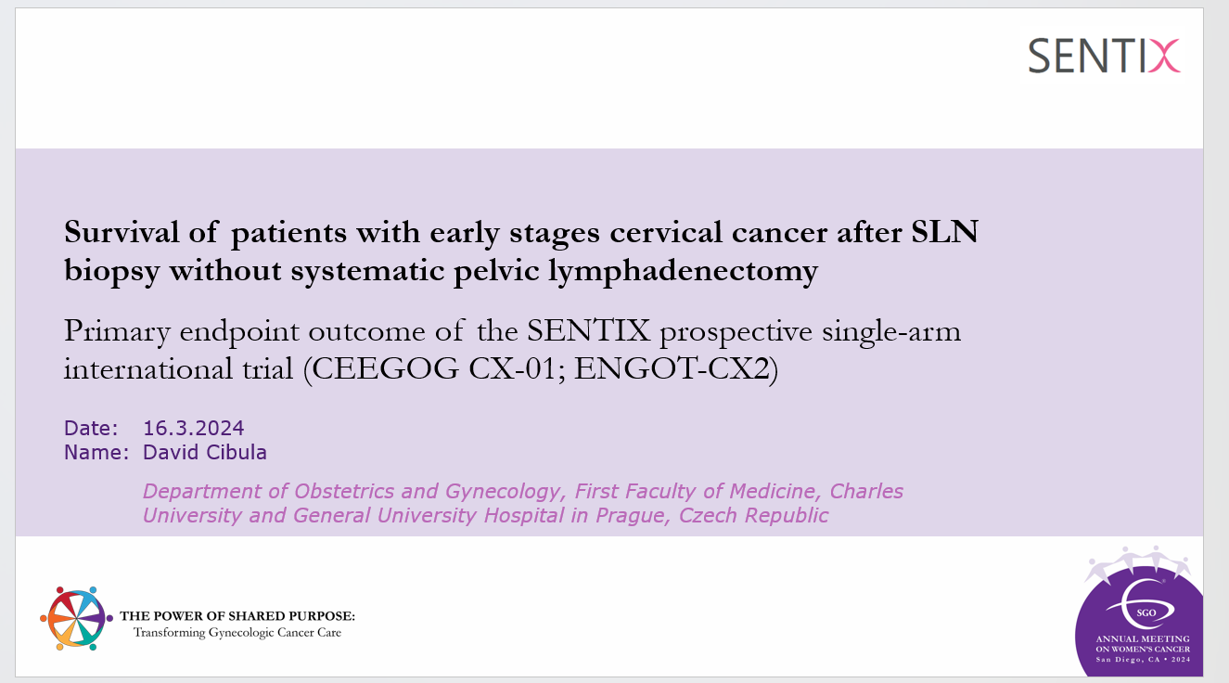
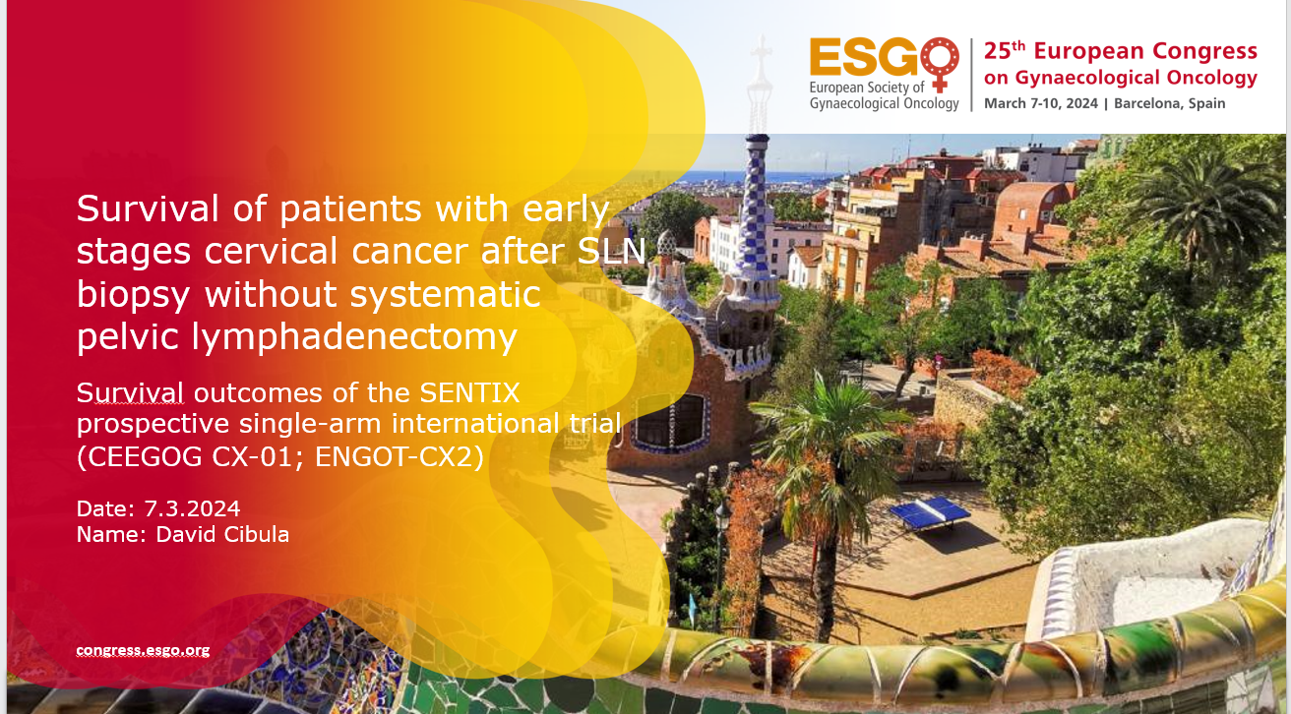
PRIMARY ENDPOINT PRESENTATION
SGO 2024, San Diego, USA https://www.sgo.org/events/annual-meeting/
Oral: Late breaking abstract presentation
Presented by: David Cibula
ESGO 2024, Barcelona, Spain https://congress.esgo.org/
Best Oral presentation
Presented by: David Cibula
Currently under review in Nature Cancer

Slide 14

PATIENT FLOW
SLN biopsy only
731 patients pre-registered
SLN not detected on both sides (N=57)
Metastatic SLN on FS (N=48)
Unexpected intraoperative tumor spread (N=13)
Second primary cancer (N=5)
Informed consent withdrawal (N=4)
Surgery cancelled (N=4)
Downstaging (N=3)
Critical deviations (N=3)
PRIMARY ENDPOINT - RESULTS
Intention to treat N=594

Slide 15
PATIENT CHARACTERISTICS
Characteristics |  | Total (N=594)
Tumour stage preoperative | IA1 + LVSI | 35 (5.9%)
 | IA2 | 62 (10.4%)
 | IB1 | 497 (83.7%)
Surgical approach | Open | 213 (35.9%)
 | Minimally invasive | 381 (64.1%)
Fertility sparing treatment | No | 488
 | Yes | 106
Radical parametrectomy type | B | 149
 | C1 | 242
 | C2 | 87
 | Not done | 116
Number of removed SLN | Median (95% CI) | 3 (2-7)
Histology type | Squamous cell c. | 392 (66.0%)
 | Adenocarcinoma* | 183 (30.8%)
 | Other | 19 (3.2%)
Characteristics |  | Total (N=594)
LVSI | Yes | 174 (29.3%)
Tumour size (based on final pathology) | ≤2 cm | 390 (65.7%)
 | 2-4 cm | 185 (31.1%)
 | >4 cm | 19 (3.2%)
Tumour grade | G1 | 156 (26.9%)
 | G2 | 292 (50.4%)
 | G3 | 131 (22.6%)
Biggest size of SLN metastasis (based on ultrastaging pathological examination) | LN negative | 538 (90.6%)
 | ITC | 20 (3.4%)
 | MIC | 30 (5.1%)
 | MAC | 6 (1.0%)
PRIMARY ENDPOINT - RESULTS
Adjuvant treatment: 79/594 patients (13.3%)
    LN metastasis 45
    Intermediate risk factors 13
    Parametrial involvement 8
    Positive vaginal margins 9
    Other 1
*HPV-related

Slide 16
RESULTS - Primary end point
Recurrence rate at the 24th month of follow-up
(cervical recurrences after FST are excluded)
Reference recurrence rate of 7% (at the 24th month of follow-up) in patients after systematic pelvic lymphadenectomy
Total: 6.06% (36/594)
Pelvic: 44.4% (16/36)
Distal: 30.6% (11/36)
Combined: 25.0% ( 9/36)
FST-related: 0.5% (3/594)
PRIMARY ENDPOINT - RESULTS

Slide 17
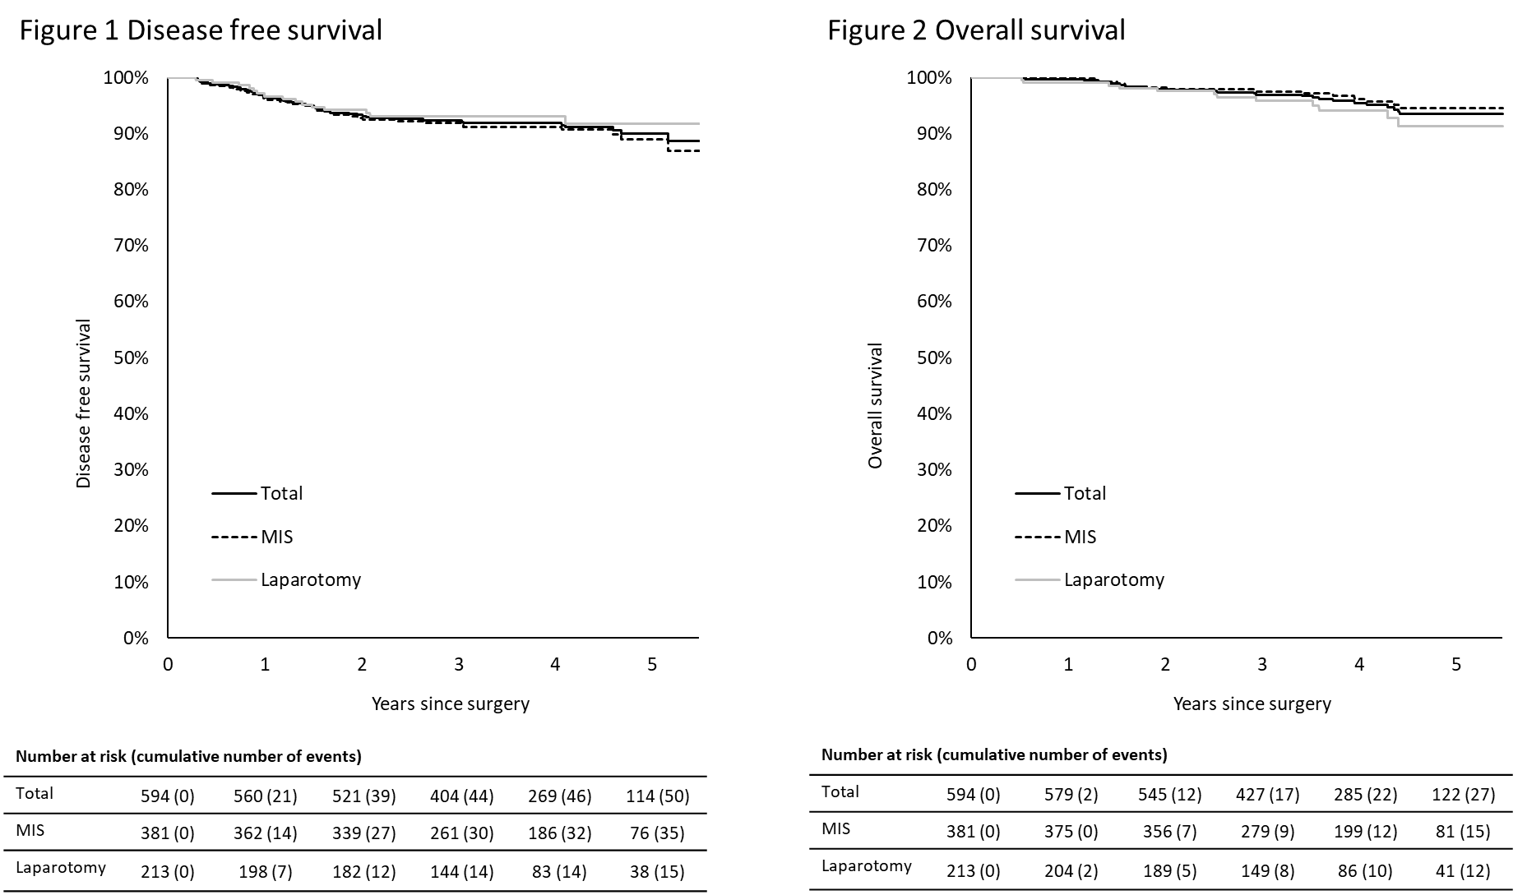
RESULTS – Survival outcomes
Year | DFS All (95% CI)
1 | 96.4% (97.6%; 95.2%)
2 | 93.3% (94.9%; 91.6%)
3 | 92.3% (94.1%; 90.6%)
4 | 91.9% (93.7%; 90.0%)
5 | 89.9% (92.3%; 87.5%)
Year | OS All (95% CI)
1 | 99.7% (100%; 99.3%)
2 | 97.9% (98.9%; 97.0%)
3 | 96.9% (98.1%; 95.7%)
4 | 95.5% (97.0%; 93.9%)
5 | 93.4% (95.5%; 91.3%)
PRIMARY ENDPOINT - RESULTS
Median follow-up: 47 months (range 1-76)

Slide 18
RESULTS – DFS related factors
 |  | HR (95% CI) | p
Final histology | Squamous cell carcinoma | reference
 | Adenocarcinoma usual type (HPV related) | 0.487 (0.236; 1.006) | 0.052
 | Other | 1.704 (0.526; 5.515) | 0.374
Tumour stage postoperative | IA1 + LVSI | reference
 | IA2 | 1.849 (0.168; 20.393) | 0.616
 | IBI ≤2 cm | 1.681 (0.224; 12.635) | 0.614
 | IB2 2-4 cm | 3.722 (0.497; 27.885) | 0.201
 | IB3 >4 cm | 11.075 (1.237; 99.124) | 0.032
 | IIA | 5.825 (0.527; 64.325) | 0.150
 | IIB | 8.552 (0.889; 82.246) | 0.063
 | IIIC | 3.541 (0.396; 31.691) | 0.258
Tumour size postoperative | ≤2 cm | reference
 | 2-4 cm | 2.562 (1.434; 4.577) | 0.001
 | >4 cm | 5.226 (1.970; 13.868) | 0.001
Tumour grade | G1 | reference
 | G2 | 2.136 (0.873; 5.226) | 0.097
 | G3 | 4.241 (1.703; 10.562) | 0.002
LVSI |  | 2.653 (1.531; 4.596) | 0.001
SLN positive (the biggest size of metastasis based on the ultrastaging examination) | LN negative | reference
 | ITC | -
 | MIC | 1.113 (0.346; 3.578) | 0.857
 | MAC | 2.205 (0.304; 16.007) | 0.434
Surgical approach | Minimally-invasive surgery | reference
 | Laparotomy | 0.768 (0.420; 1.403) | 0.390
PRIMARY ENDPOINT - RESULTS

Slide 19
RESULTS – DFS related factors
 |  | HR (95% CI) | p
Final histology | Squamous cell carcinoma | reference
 | Adenocarcinoma usual type (HPV related) | 0.487 (0.236; 1.006) | 0.052
 | Other | 1.704 (0.526; 5.515) | 0.374
Tumour stage postoperative | IA1 + LVSI | reference
 | IA2 | 1.849 (0.168; 20.393) | 0.616
 | IBI ≤2 cm | 1.681 (0.224; 12.635) | 0.614
 | IB2 2-4 cm | 3.722 (0.497; 27.885) | 0.201
 | IB3 >4 cm | 11.075 (1.237; 99.124) | 0.032
 | IIA | 5.825 (0.527; 64.325) | 0.150
 | IIB | 8.552 (0.889; 82.246) | 0.063
 | IIIC | 3.541 (0.396; 31.691) | 0.258
Tumour size postoperative | ≤2 cm | reference
 | 2-4 cm | 2.562 (1.434; 4.577) | 0.001
 | >4 cm | 5.226 (1.970; 13.868) | 0.001
Tumour grade | G1 | reference
 | G2 | 2.136 (0.873; 5.226) | 0.097
 | G3 | 4.241 (1.703; 10.562) | 0.002
LVSI |  | 2.653 (1.531; 4.596) | 0.001
SLN positive (the biggest size of metastasis based on the ultrastaging examination) | LN negative | reference
 | ITC | -
 | MIC | 1.113 (0.346; 3.578) | 0.857
 | MAC | 2.205 (0.304; 16.007) | 0.434
Surgical approach | Minimally-invasive surgery | reference
 | Laparotomy | 0.768 (0.420; 1.403) | 0.390
PRIMARY ENDPOINT - RESULTS

Slide 20
RESULTS – DFS related factors
 |  | HR (95% CI) | p
Final histology | Squamous cell carcinoma | reference
 | Adenocarcinoma usual type (HPV related) | 0.487 (0.236; 1.006) | 0.052
 | Other | 1.704 (0.526; 5.515) | 0.374
Tumour stage postoperative | IA1 + LVSI | reference
 | IA2 | 1.849 (0.168; 20.393) | 0.616
 | IBI ≤2 cm | 1.681 (0.224; 12.635) | 0.614
 | IB2 2-4 cm | 3.722 (0.497; 27.885) | 0.201
 | IB3 >4 cm | 11.075 (1.237; 99.124) | 0.032
 | IIA | 5.825 (0.527; 64.325) | 0.150
 | IIB | 8.552 (0.889; 82.246) | 0.063
 | IIIC | 3.541 (0.396; 31.691) | 0.258
Tumour size postoperative | ≤2 cm | reference
 | 2-4 cm | 2.562 (1.434; 4.577) | 0.001
 | >4 cm | 5.226 (1.970; 13.868) | 0.001
Tumour grade | G1 | reference
 | G2 | 2.136 (0.873; 5.226) | 0.097
 | G3 | 4.241 (1.703; 10.562) | 0.002
LVSI |  | 2.653 (1.531; 4.596) | 0.001
SLN positive (the biggest size of metastasis based on the ultrastaging examination) | LN negative | reference
 | ITC | -
 | MIC | 1.113 (0.346; 3.578) | 0.857
 | MAC | 2.205 (0.304; 16.007) | 0.434
Surgical approach | Minimally-invasive surgery | reference
 | Laparotomy | 0.768 (0.420; 1.403) | 0.390
PRIMARY ENDPOINT - RESULTS

Slide 21
RESULTS
 | SENTIX | LACC |  | ConCerv | SENTICOL II |  | SHAPE
Subgroup | All | Open | MIS | All | SLN | PLND | All
 | N=594 | N=312 | N=319 | N=100 | N=105 | N=101 | N=700
2Y DFS | 93.3% | 97.1% | 91.2% | ~95.0% | 92% | 94.4%
3Y DFS | 92.3% | 97.1% | 91.2% |  | 92% | 94.4% | 97.5%
3Y OS | 96.9% | 99.0% | 93.8%
3Y DSS | 97.6% | 0.6% | 4.4% |  |  |  | 99.3%
Main inclusion criteria | IA1 LVSI, IA2 – IB1 Max dimension ≤40 mm Squamous cell, Adenocarcinoma | IA1 LVSI, IA2 – IB1 Max dimension ≤4 cm Squamous cell, Adenocarcinoma, Adenosquamous |  | IA2–IB1 squamous cell (any grade) adenocarcinoma (grade 1-2) histology tumor size ≤2 cm | IA1 LVSI, IA2 – IIA1 Max dimension ≤40 mm All histologic types except neuroendocrine carcinoma |  | IA2 – IB1 <10mm/ <50% strom. Inv. Max dimension ≤20 mm Sq., adeno., adenosq.
Reference | This work. | Ramirez 2018. Doi: 10.1056/NEJMoa1806395 |  | Schmeler 2021. doi:10.1136/ijgc-2021-002921 | Mathevet 2021. doi: 10.1016/j.ejca.2021.02.009 |  | Plante 2024. https://www.cancer.net/CX5-SHAPE
PRIMARY ENDPOINT - RESULTS

Slide 22
CONCLUSIONS
The study fulfilled the primary endpoint.
RR at 24th months of follow-up in SENTIX ITT was 6.06%.
Study confirmed the null hypothesis that the RR after SLN biopsy is non-inferior to the reference RR of 7% in patients after PLND.
In early-stage cervical cancer patients, SLN biopsy with pathological ultrastaging is safe and accurate method to detect lymph node metastases.
PRIMARY ENDPOINT - CONSLUTSIONS

Slide 23
05
OTHER OUTCOMES

Slide 24
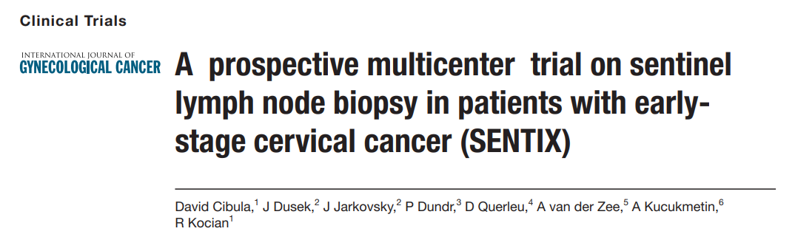
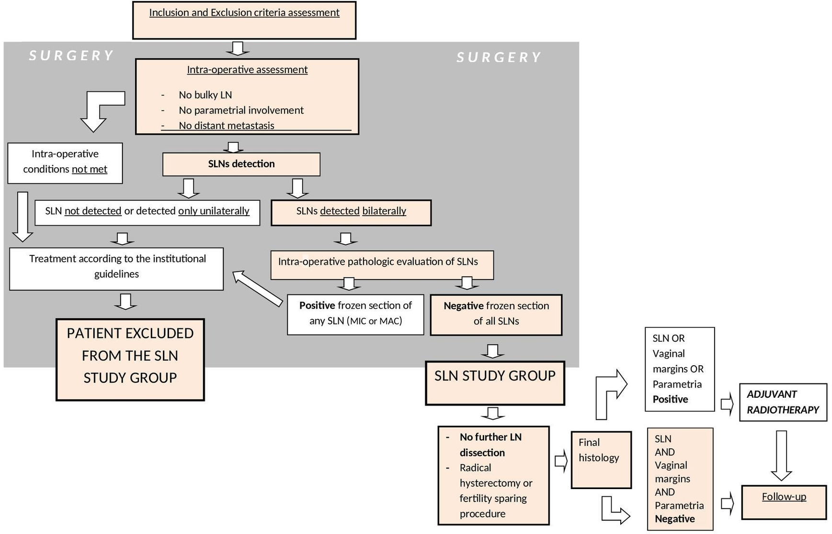
PUBLICATIONS
IF 4,6
Q1
Trial protocol publication.
Cibula D, et al. Int J Gynecol Cancer 2019;29:212–215.

Slide 25

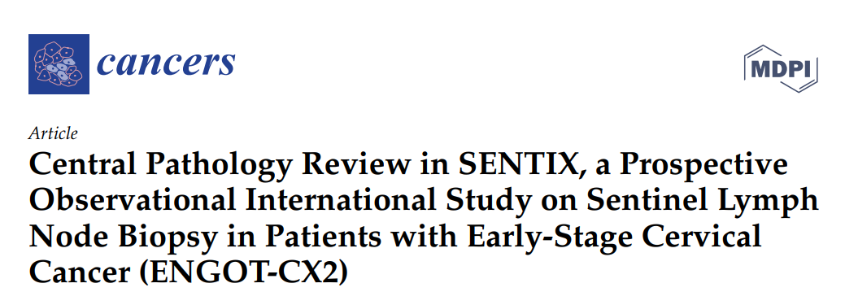
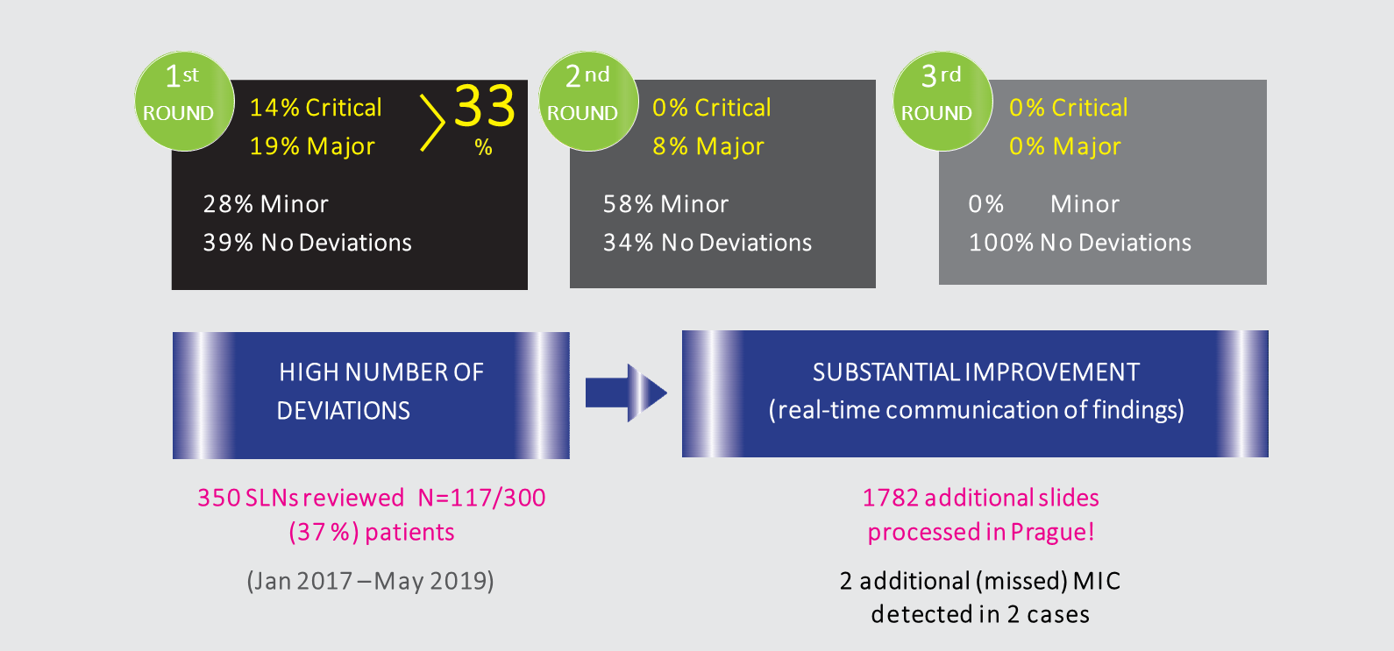
PUBLICATIONS
IF 5,2
Q1
Central quality control of SLN pathological processing using ultrastaging
Poor quality of SLN pathological processing in some centers.
Quality improvement during the course of the study.
Nemejcova K, et al. Cancers (Basel). 2020 Apr 29;12(5):1115.

Slide 26
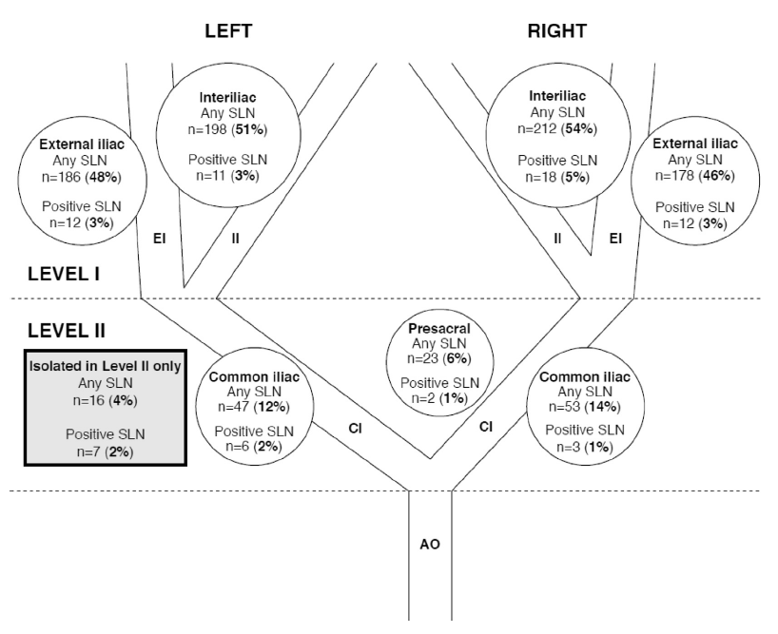
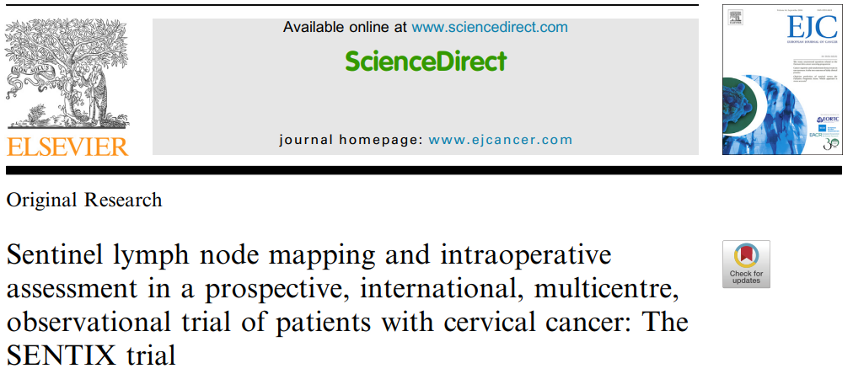
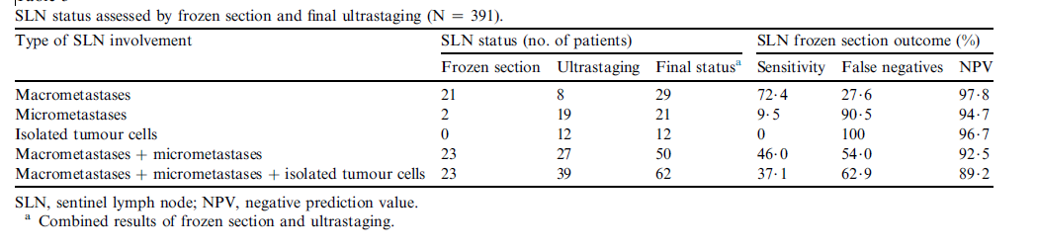
PUBLICATIONS
IF 8,4
Q1
Bilateral SLN detection success rate = 93%
97% of SLNs located distal to the interiliac bifurcation – only 1.3% of positive SLNs found outside this area
Half of pN1 cases not identified intraoperatively
Cibula D, et al. European Journal of Cancer. 2020;137:69-80.

Slide 27

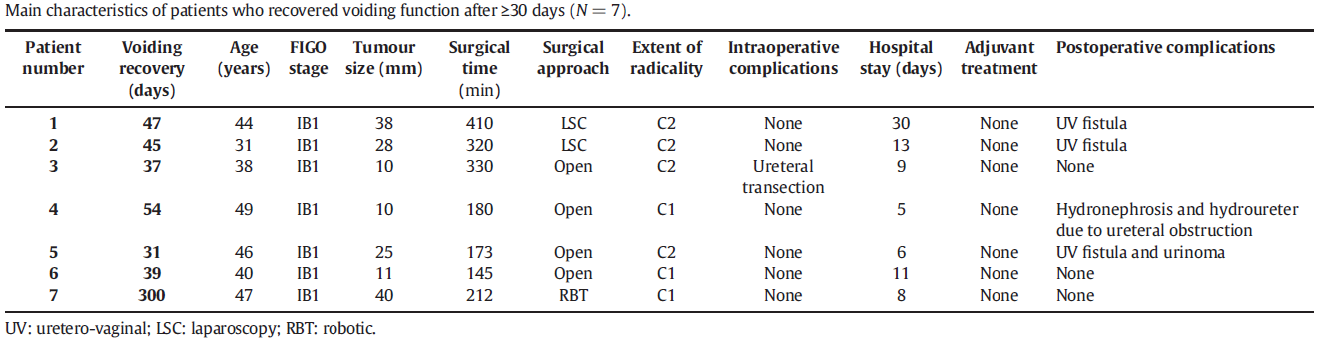
PUBLICATIONS
IF 4,7
Q1
Kaplan-Meier survival curve for time to voiding recovery: radical hysterectomy type.
* Log-rank test; SD: standard deviation; SH: simple hysterectomy; ST: simple trachelectomy.
Postoperative bladder emptying dysfunction is influenced by the radicality of parametrectomy.
Only 1% of patients experience severe long-term dysfunction.
Zapardiel I. et al. Gynecol Oncol. 2021 Mar;160(3):729-734.

Slide 28
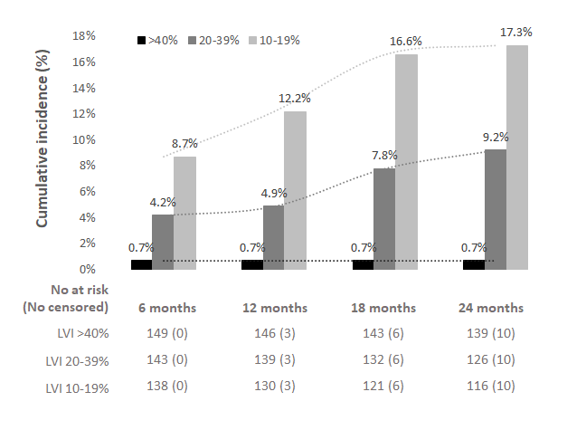
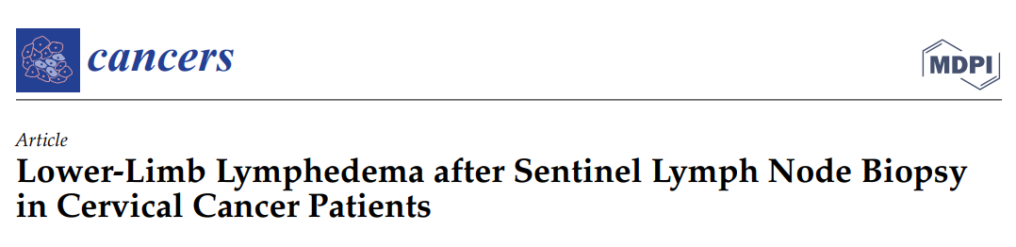
PUBLICATIONS
IF 5,2
Q1
SLNB does not eliminate the risk of mild to moderate lymphedema (26%).
Cibula D, et al. Cancers (Basel). 2021 May 13;13(10):2360.

Slide 29
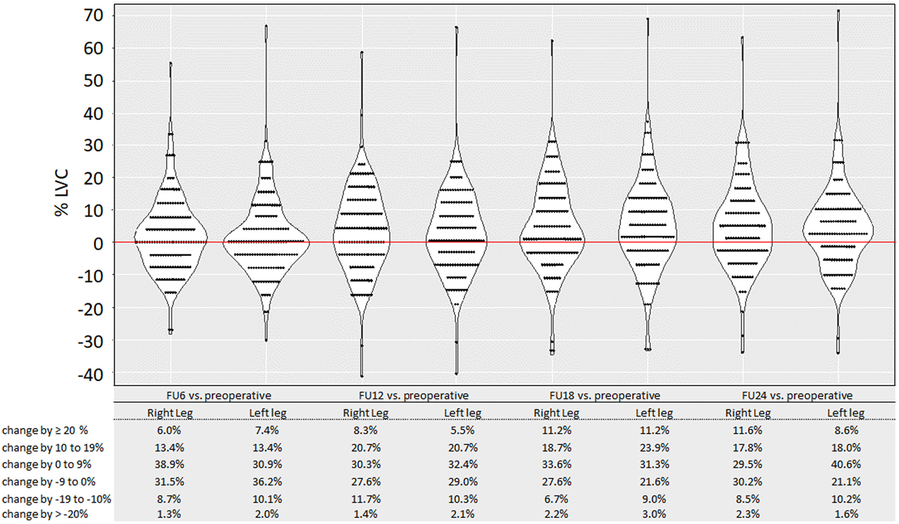

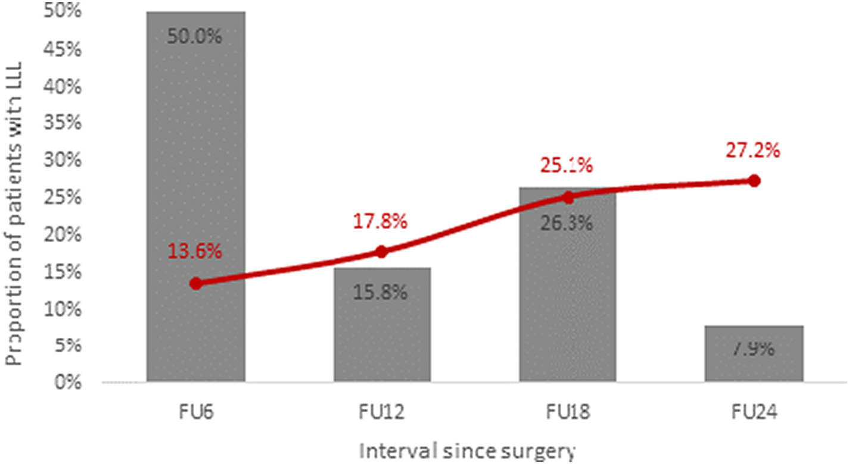
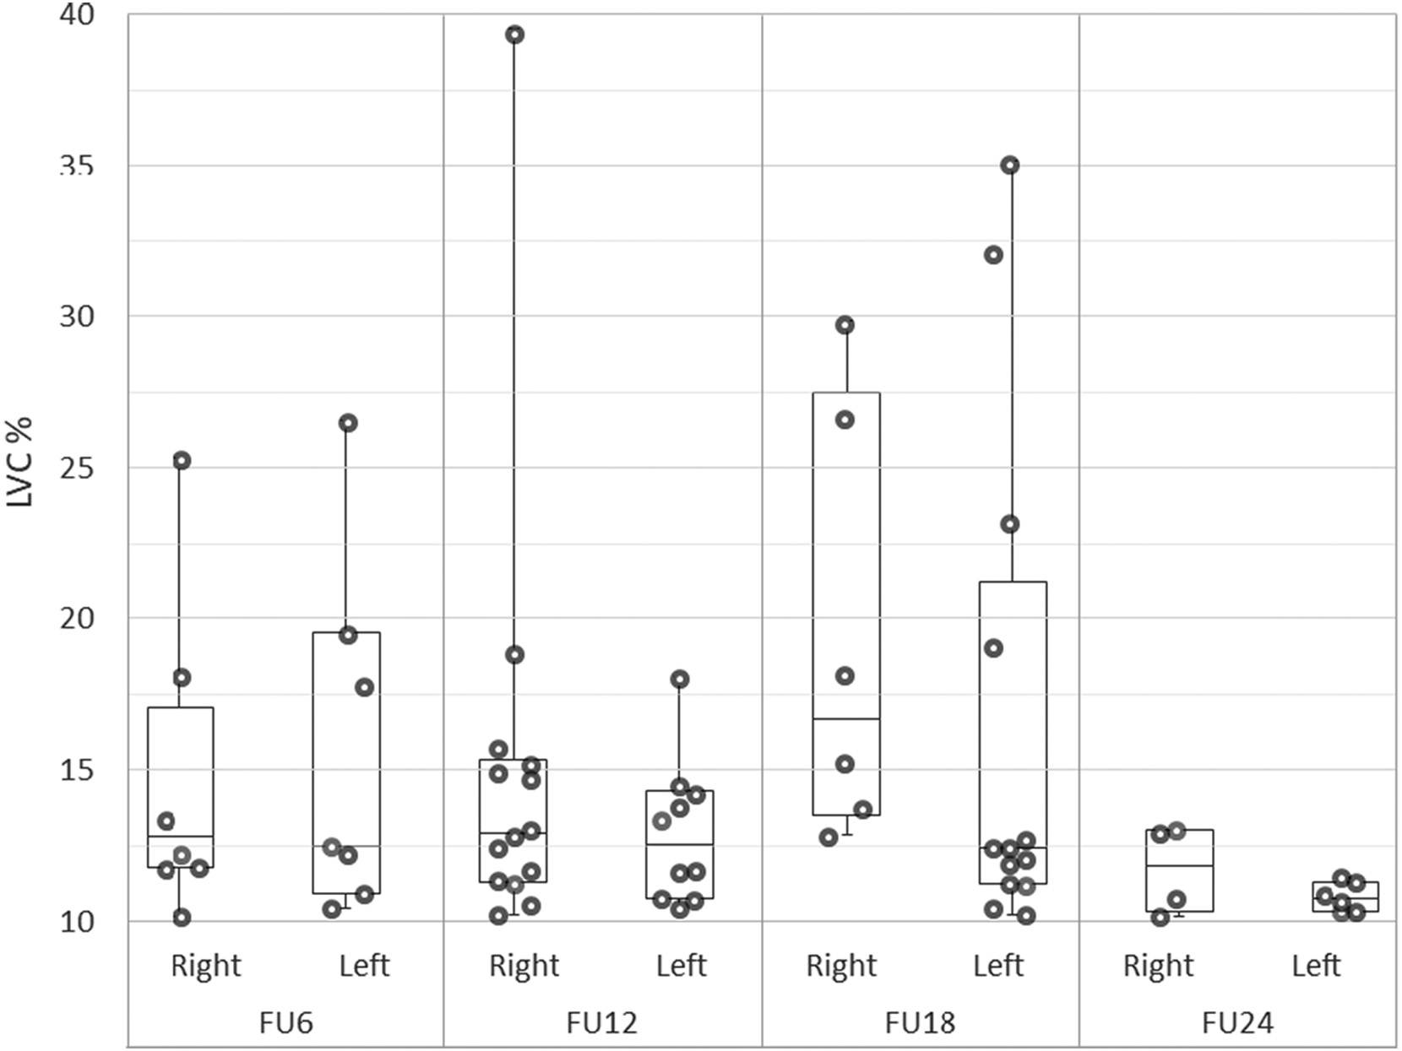
PUBLICATIONS
IF 4,7
Q1
Distribution of the limb volume change (LVC) of right and left lower limb during the follow-up period
LLL incidence and onset.
Grey columns depict what proportion of patients was diagnosed at individual intervals since surgery. The line shows the cumulative incidence of LLL in the cohort
Evaluation of the methodology for assessing lymphedema in patients:
Levels of significance
Duration of follow-up
Measurement frequency
Differentiation between transient swelling and lymphedema.
Incidence of transient oedema
Borčinová M, et al. Gynecol Oncol. 2022. Jan;164(1):76-84.

Slide 30
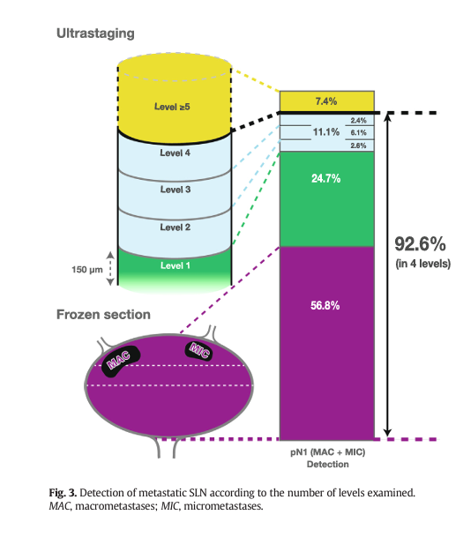
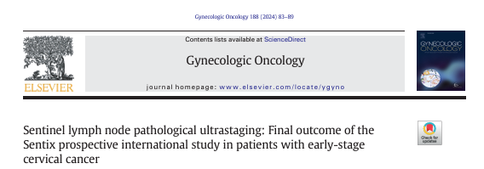
PUBLICATIONS
IF 4,7
Q1
43% of cases with N1 (macrometastasis, micrometastasis) are detected by pathological ultrastaging of SLN.
The detection rate of SLN metastatic involvement correlates with the number of levels assessed by ultrastaging.
Four levels should become the international standard, detecting over 90% of N1 cases.
Kocian R, et al. Gynecol Oncol. 2024. Sep:188:83-89.

Slide 31
OTHER PRESENTATIONS
SENTIX – Accuracy of preoperative local staging in the SENTIX trial: ESGO 2021, Mini-oral
Sensitivity and false negativity of SLN frozen section histological evaluation in the SENTIX trial: ESGO 2021, Mini-oral
SENTIX – accuracy of preoperative local staging in the SENTIX trial: ESGO 2021, Mini-oral
Lower-limb lymphedema after sentinel lymph node biopsy in cervical cancer patients: ESGO 2021, Mini-oral
Pathological assessment of sentinel lymph node in early-stage cervical cancer. Results from the prospective SENTIX trial. ESMO 2022, Mini-oral
Pelvic sentinel lymph node distribution. The final outcome of the SENTIX study. ESGO 2022, Best oral
Lower-limb lymphedema after sentinel lymph node biopsy in cervical cancer patients. The final outcome of the SENTIX study. ESGO 2023, Best oral
Magnetic Resonance Imaging Or Expert Ultrasound In Preoperative Local Staging Of Patients With Early-Stage Cervical Cancer. The final outcome of the SENTIX study. ESGO 2023, Best oral
Tumour Size Assessment In Patients With Early-Stage Cervical Cancer And Its Impact On A Tailored Management: Final Results Of A Prospective, International Multicenter Study SENTIX (CEEGOG CX-01; ENGOT-CX2). ESGO 2024, Mini-Oral

Slide 32
PUBLICATIONS SOUHRN
PUBLICATIONS UNDER REVIEW/ IN PRESS
2 main publications
Oncological safety and survival outcomes
Morbidity and quality of life
Other publications
Accuracy of pelvic ultrasound and MRI in preoperative staging
Accuracy of preoperative staging concerning FIGO stage and tumor size

Slide 33
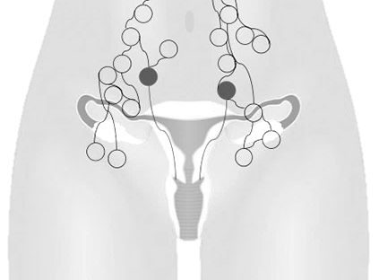


PUBLICATIONS IN PRESS
Magnetic Resonance Imaging Or Expert Ultrasound In Preoperative Local Staging Of Patients With Early-Stage Cervical Cancer. The final outcome of the SENTIX study.
ESGO 2023, Best oral
Tumor size undermeasured by >1 cm
Parametrial invasion
Macrometastatic LN involvement
11.8%
14.9%
3.1%
4.7%
6.0%
5.9%

Slide 34
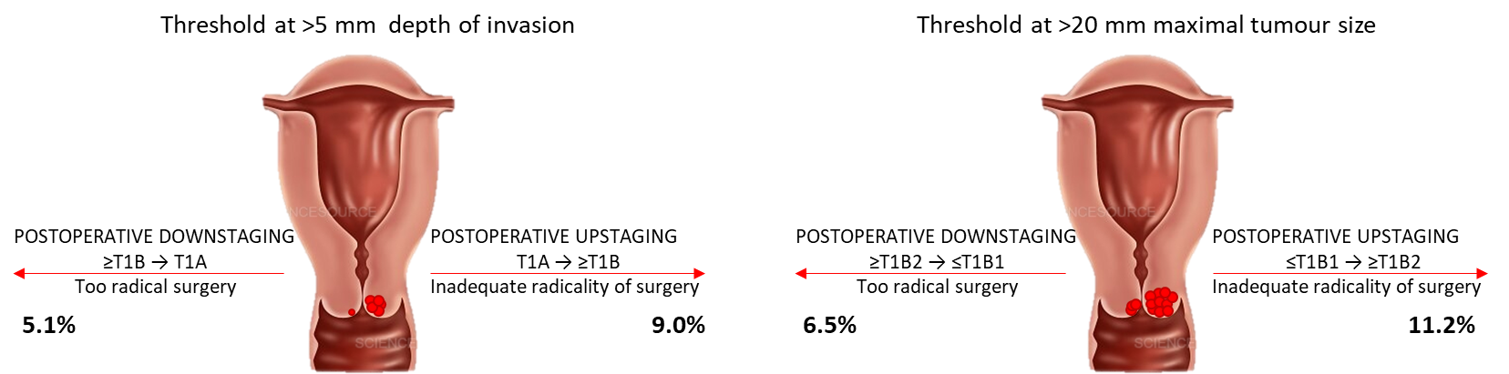
PUBLICATIONS IN PRESS
Tumour Size Assessment In Patients With Early-Stage Cervical Cancer And Its Impact On A Tailored Management. The final outcome of the SENTIX study.
ESGO 2024, Mini-oral

Slide 35
PUBLICATIONS IN PRESS
Lower-limb lymphedema after sentinel lymph node biopsy in cervical cancer patients: final results of the SENTIX prospective international study
ESGO 2023, Best oral
Analysis based on leg volume increase (%)
Persistent limb volume increase ≥40% 1.8% VS 1.1%
Transient oedema (resolved < 6 months) 15.2% VS 13.0%

Slide 36
PUBLICATIONS IN PRESS
Lower-limb lymphedema after sentinel lymph node biopsy in cervical cancer patients: final results of the SENTIX prospective international study
ESGO 2023, Best oral
    Subjectively reported persistent swelling was significantly less frequently reported in the SLN cohort
    Severe LLL (LVI >40%) assessed by objective measurement was rare in both cohorts
    Occurrence of mild and moderate LLL was similar in both cohorts, however objective and subjective assessments correlated weakly
    Replacement of standard PLND by bilateral SLN biopsy is associated with lower rate of subjectively reported lower limb swelling but it does not eliminate persistent limb volume increase
P < 0.001

Slide 37
THANK YOU
Trial PI: David Cibula (david.cibula@vfn.cz)
Trial sub-PI: Roman Kocian (roman.kocian@vfn.cz)
Sponsor: CEEGOG reg.ass. (ceegog@ceegog.eu)

