Slide 1
Oral Presentation : EPREUVE E4
Higher National Diploma in Information Technology
Kylian laurent
2024-2025

Slide 2
Plan
1
Course
Organization
Missions carried out in organization
Framed Custom Projects
Technology watch
Conclusion
2
3
4
5
6

Slide 3
Parcours
1
Profile – kylianlaurent.fr
Higher National Diploma in Information Technology : ESICAD (Labège)
Option : Infrastructure, systems and network solutions
2023 - 2025
Technological baccalaureate
Baccalaureate of Science in Industry and Sustainable Development (STI2D)
: Lycée St Exupéry (Blagnac)
2020 - 2023

Slide 4
Organization : ADES
2
ADES is a Toulouse-based consultancy and computer services company dedicated to artisans, traders, professionals and SMEs/ SMEs in the Midi-Pyrénées region.
IT solutions
Mainly focused on the use of open source software
reduced license cost
easy personalization
for all materials
adapted to your needs
In addition to having a complete range of tailored services in the field of IT, we can offer you a solution for monitoring and support when using your tools.
Notes:
Operateur multi services :
150 0000 salariées dont 90 000 en france
Client 4G 65million
FAI
Particulier et entreprise
Technologies
xDSL
Fibre
4G
Opérateur mobile
5G déployer en décembre 2020
Couverture de 99% de la population
Couverture de 88% du territoire
1er réseau mobile en France depuis 9ans selon l’ARCEP
Bank
Leader
Habitation éligible a la fibre
65 million de client dans le monde
En moyenne 7000 brevet posséder chaque année selon statia.com
https://fr.statista.com/statistiques/597320/orange-nombre-de-brevets/

Slide 5
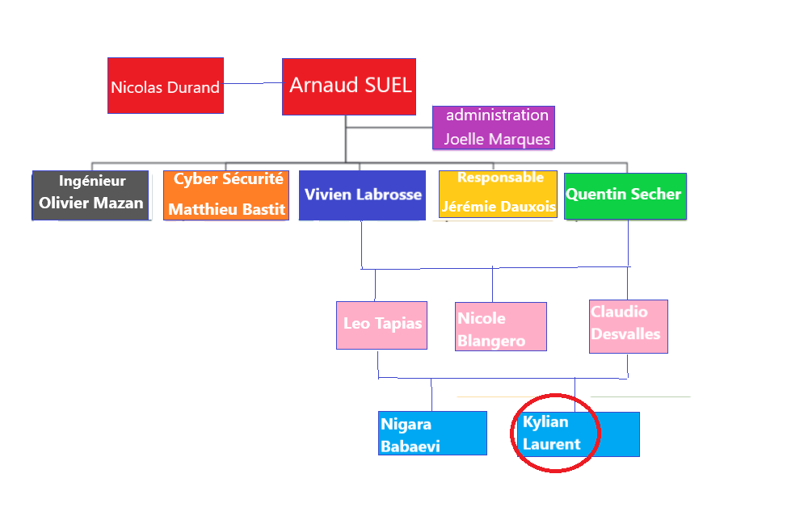
Organigramme du service
Service : DISU/TSP

Slide 6
Missions carried out in organization
3
Mission 1 : Job preparation
Job preparation consists of preparing the entire PC for the future user, that is to install the operating system (OS), software and make updates so that the future user can work directly.
We tend to prepare only DELL computers
Préparation
User support
Installation
data transfer

Slide 7
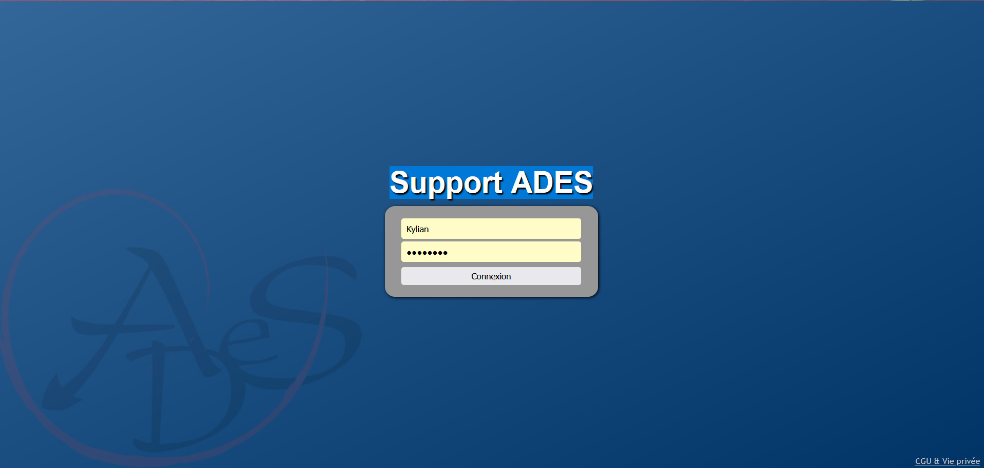
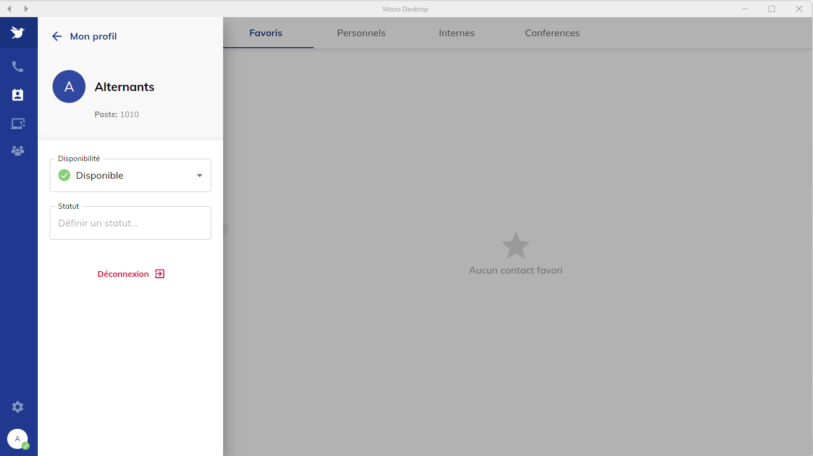
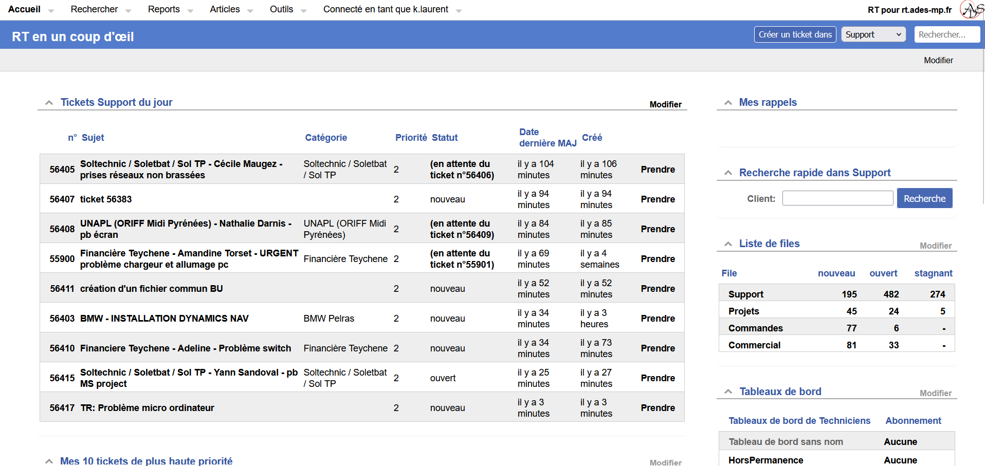
Missions carried out in organization
Mission 2 : Support
Software ADES :
Wazo
Identifying a problem
Creating a ticket on RT
Customer Help/Listening
Taking charge of his post with Mesh or TeamViewer
Calling customers with Wazo
Issue tracking
MESH
RT

Slide 8
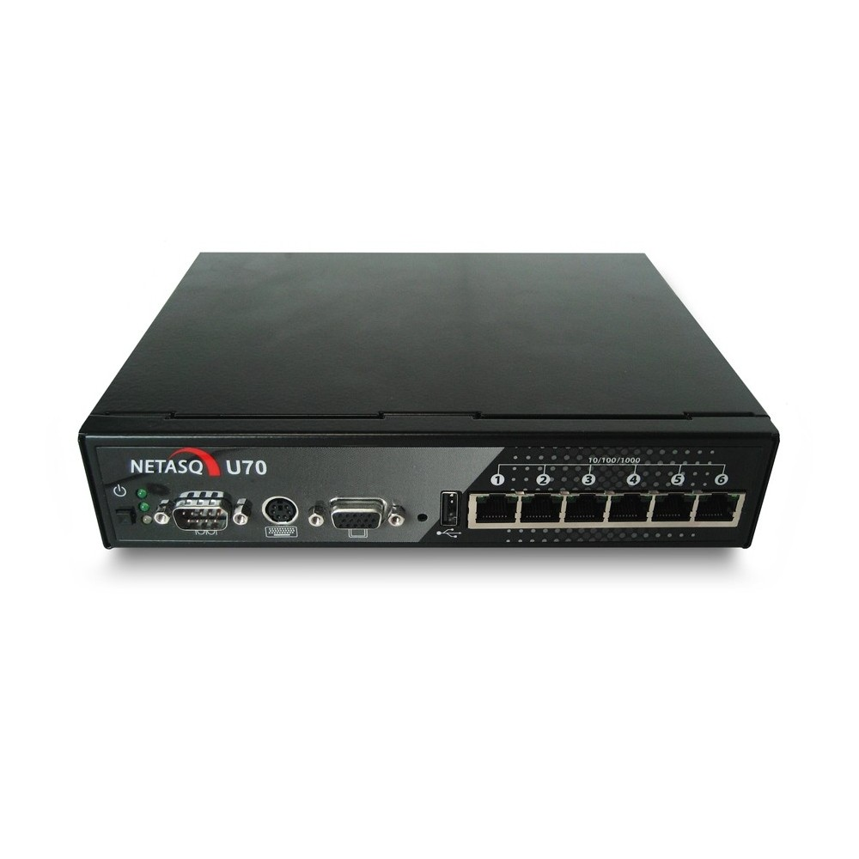
Missions carried out in organization
Mission 3 : creation of a FW Netasq de redondance for the Town Hall of Labège
Provides redundancy if the Stormshield of the Town Hall breaks down
Netasq is very old (1998-2016)

Slide 9
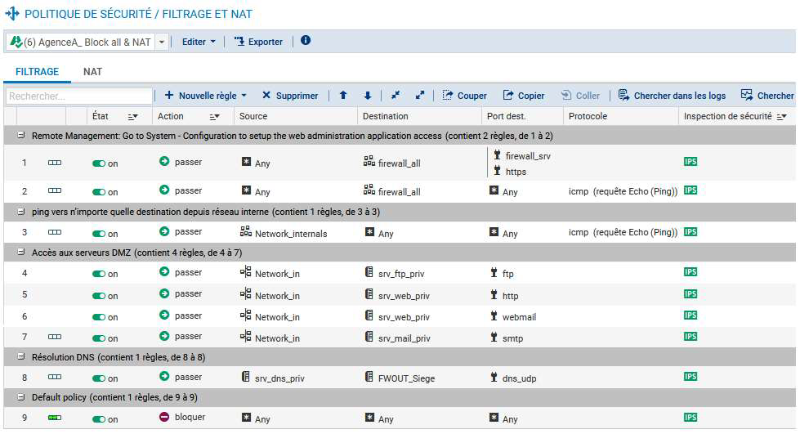

Slide 10
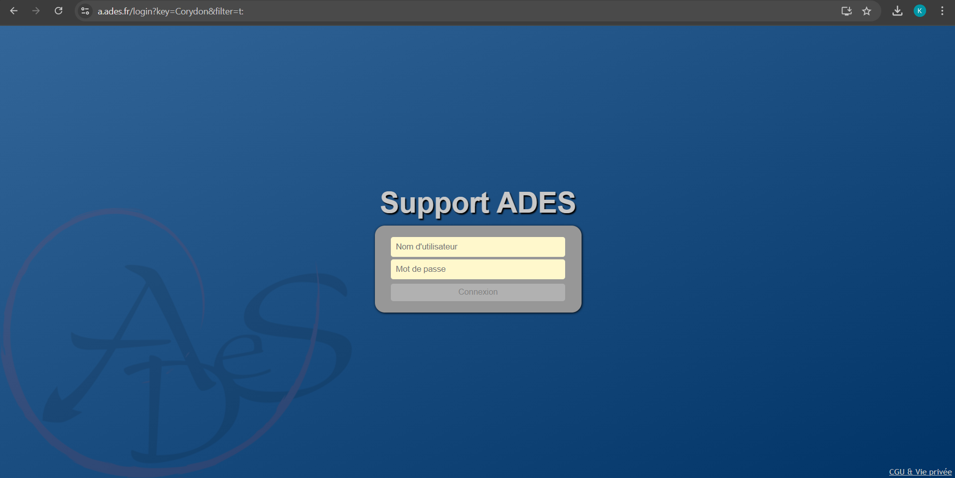
Missions carried out in organization
Mission 4 : Installation and configuration of a local mesh
User support
Remote control
Server monitoring

Slide 11
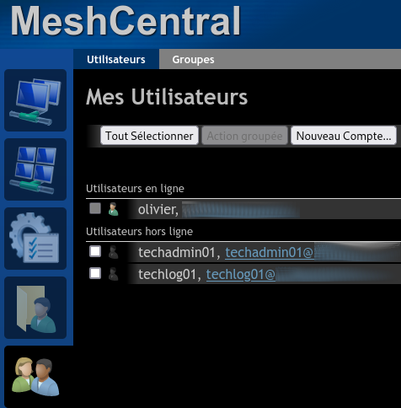
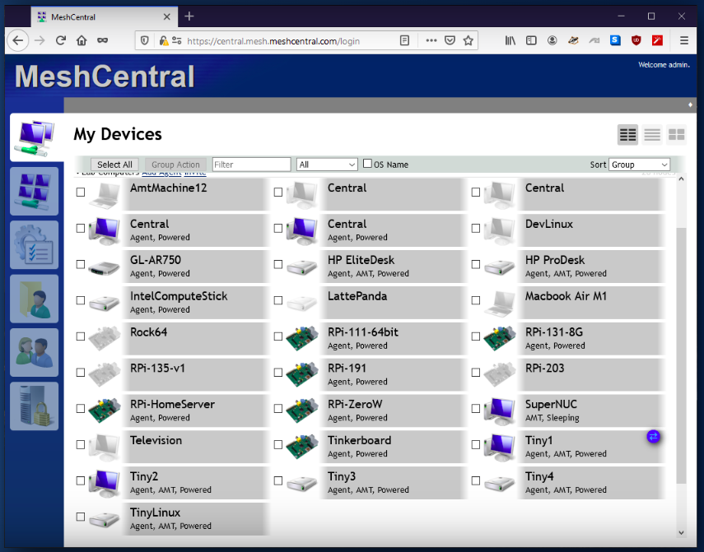

Slide 12
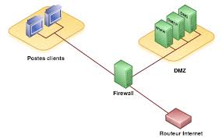
Custom projects framed (CPF)
4
PPE 1 : Securing a file server on Windows
PPE 2 : Setting up a gateway and DMZ under Debian
PPE 3 : Setting up a DMZ with PFsense
PPE 4 : Monitoring servers and services with Zabbix
EPREUVE E4 – BTS SIO SISR kylianlaurent.fr
Notes:
PPE 1 : Migration des postes en Windows 10
Windows 7 plus supporté par Microsoft depuis 14 Janvier 2020
Nouvelles fonctionnalités
Plus de sécurité
PPE 2 : Mise en place d’un contrôleur de domaine (Windows server 2016)
Gestion centraliser des comptes et sessions des utilisateurs
Mise en place de politique de restriction des utilisateurs
Mise en place de ressource communes
PPE 3 : Mise en place d’une solution de supervision (Centreon)
Surveillance des serveurs et services
Alertes en cas d’interruption de services ou panne serveur
PPE 4 : Mise en place d’un solution de gestion de parc informatique
Inventaire des équipements du parc
Solution de création et gestion des ticket d’incident ou demande
Suivit des incidents ou problèmes et leur résolutions

Slide 13
Technology watch: How will cybersecurity develop over time?
5
How will cybersecurity develop over time?
Cybersecurity will grow with the rapid evolution of technology, requiring more and more professionals to counter increasingly complex cyber attacks.
The methods used for setting up the watch :
Regular consultation of article on the internet or questions asked to my company
Technology watch is available on my website :
Kylianlaurent.fr

Slide 14
Conclusion
6
Skills developed:
PC mastering process
Data transfer process
Use of supervision software
Request and Incident Manager
Intervention process
Customer report in the Services area
Knowledge of Computer Equipment and Hardware
Exchange of information, teamwork, communication, autonomy, patience, listening.

Slide 15
Conclusion
Projet futur :
Bachelor Cybersécurité
The bachelor cybersecurity is a higher education training that allows you to obtain a diploma of level bac+3. It is delivered in private institutions such as an engineering school, a computer and digital school or a cybersecurity school. In some cases, this course is recognized by the state through a RNCP (National Directory of Professional Certifications) title and grants a level 6.
Durée: 1an

