Slide 1
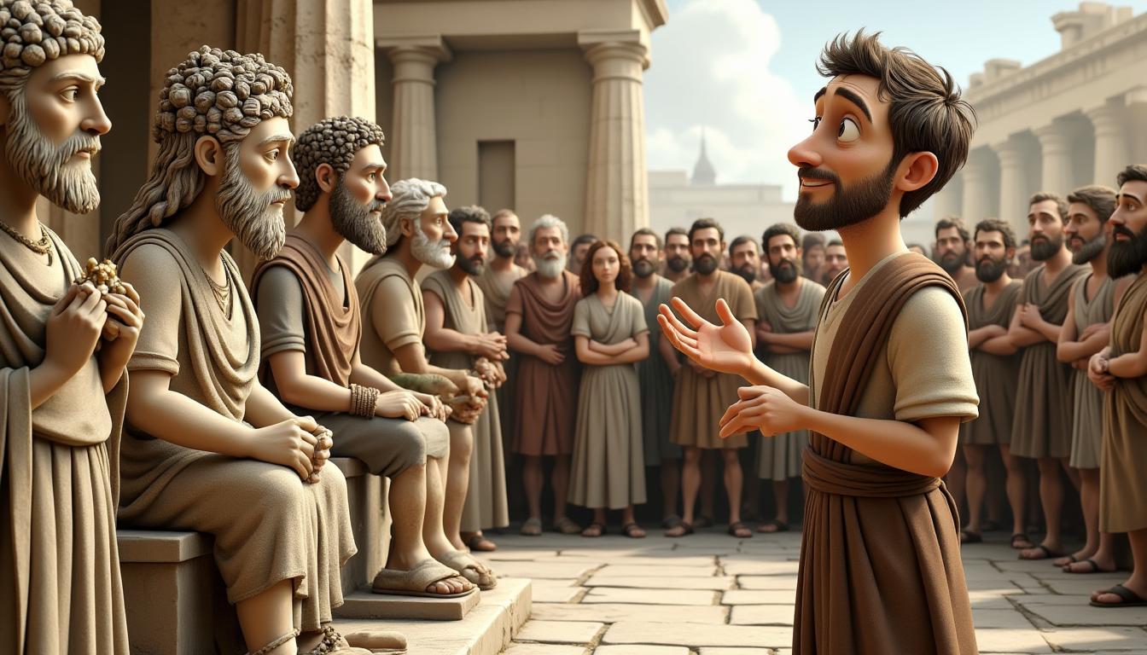
"THE UNKNOWN GOD"
ACTS 17:16–34

Slide 2
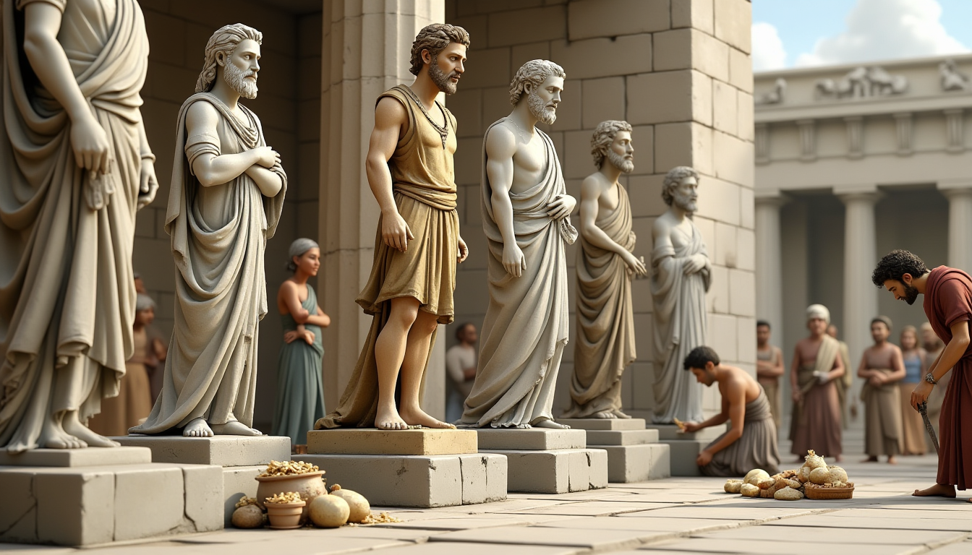
www.faithinthecloud.com
Paul arrived in the busy city of Athens while waiting for his friends. As he walked around, he noticed many statues and idols. These were not just decorations—they were false gods that the people worshiped. Paul felt sad because the people didn’t know the one true God.

Slide 3
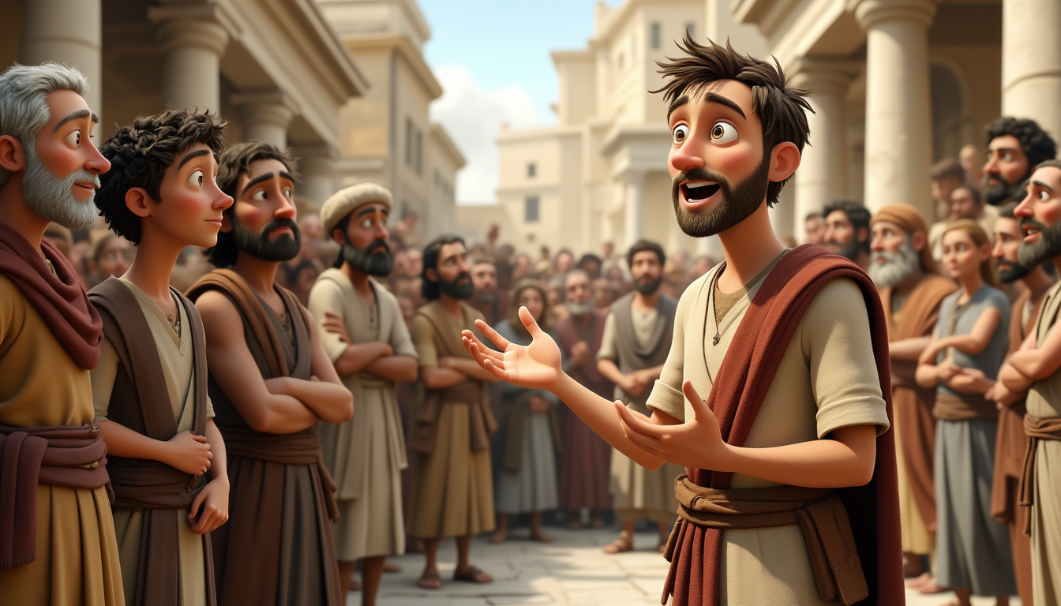
www.faithinthecloud.com
Every day, Paul went to the marketplace to talk to people about Jesus. Some were curious. Others were confused. “Who is this Jesus you're talking about?” they asked. Paul told them that Jesus died and rose again to save everyone who believes in Him.

Slide 4
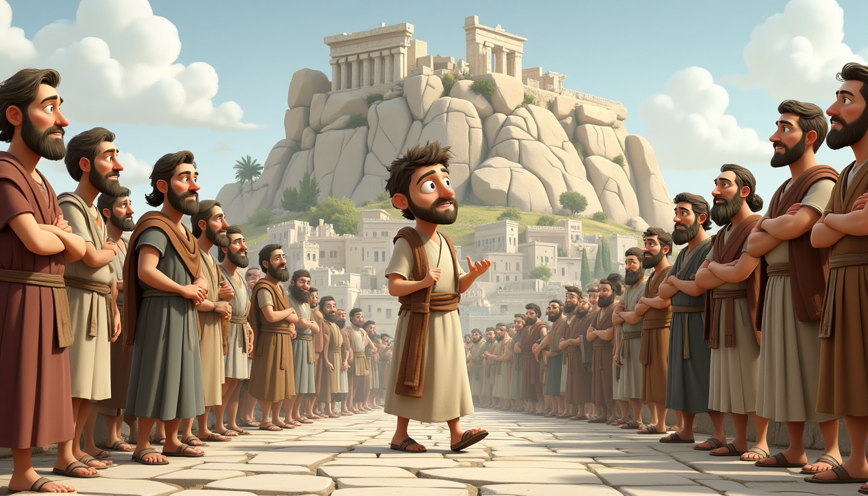
www.faithinthecloud.com
The people of Athens loved to hear new ideas. So they brought Paul to a special meeting place called the Areopagus. It was like a big classroom on a hill where people talked about important things. “Come, tell us more about this strange new teaching,” they said.

Slide 5
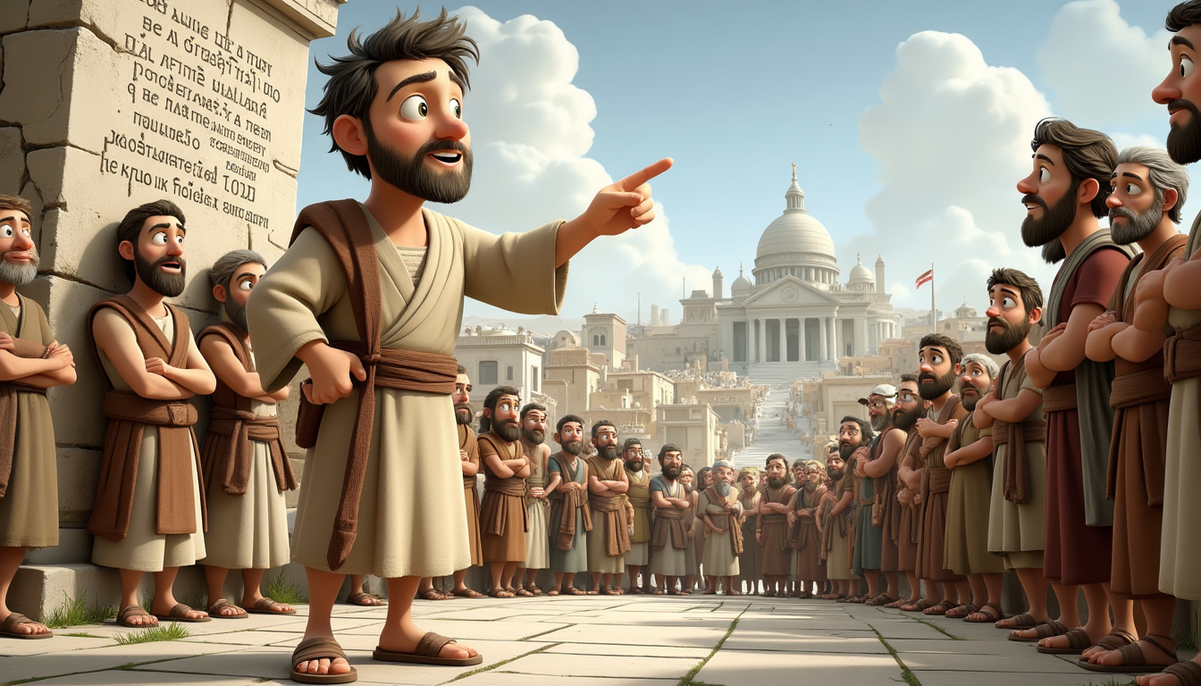
www.faithinthecloud.com
Paul stood up and said, “I saw that you have many statues of gods—even one that says ‘To the Unknown God.’ I want to tell you about that God. He is not unknown. He made the world and everything in it! He doesn’t live in temples or need anything from us.”

Slide 6
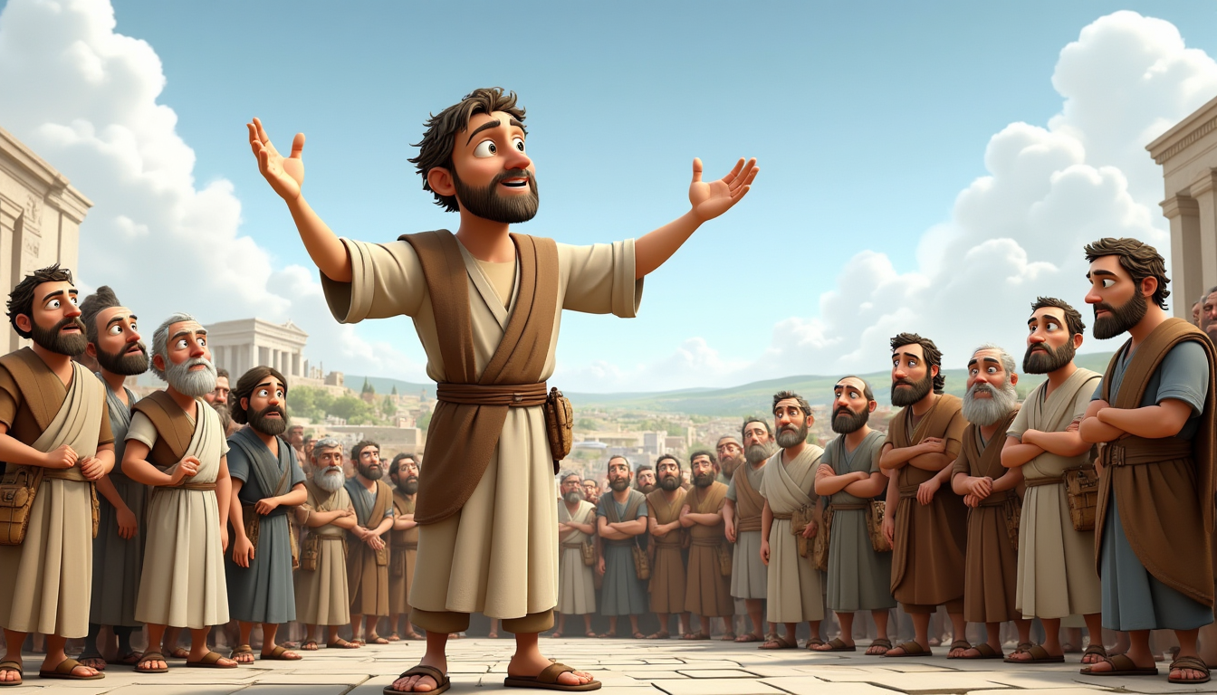
www.faithinthecloud.com
Paul continued, “God made all people so they would seek Him. Now, He calls everyone to turn away from sin because He will judge the world one day through a man He has chosen—Jesus. And God proved this by raising Jesus from the dead!”

Slide 7
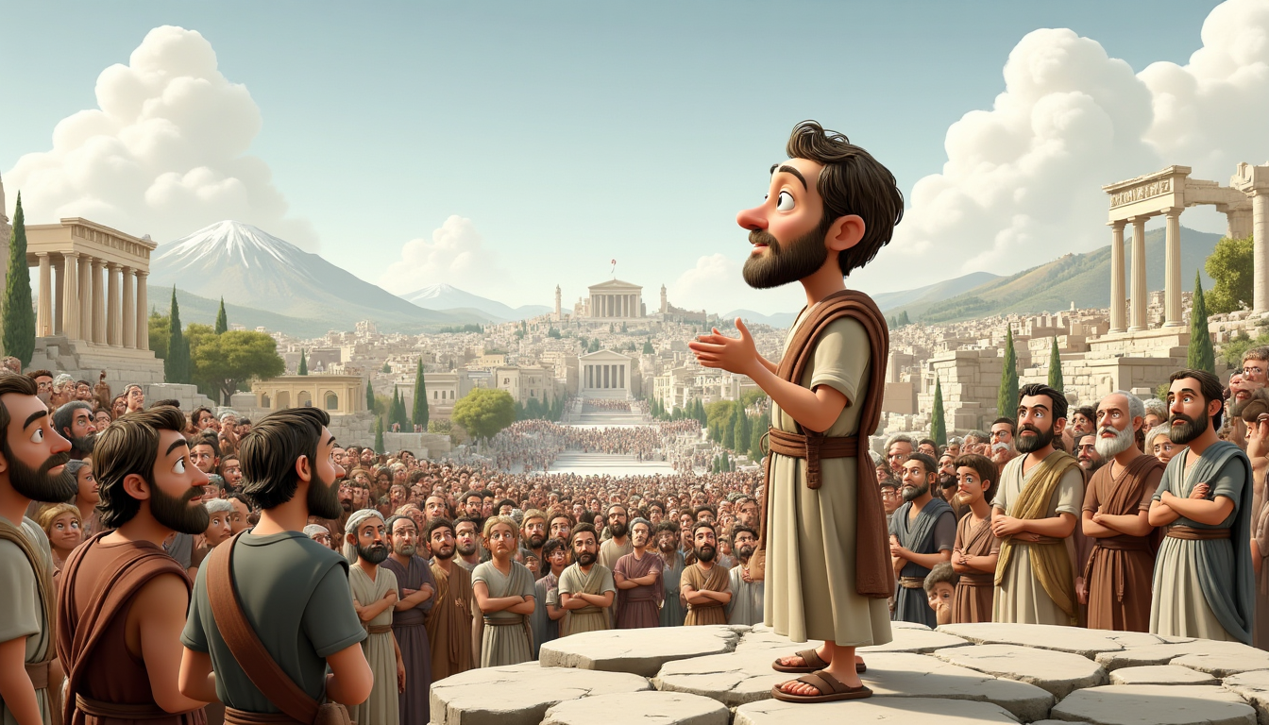
www.faithinthecloud.com
When the people heard about someone rising from the dead, some laughed. But others wanted to hear more. A few believed and followed Jesus that day, including a man named Dionysius and a woman named Damaris. Even in a city full of idols, the truth about Jesus reached open hearts.

