Slide 1
Watch the Video Here:
https://www.youtube.com/watch?v=jOXSvTa39UQ

Slide 2


Slide 3
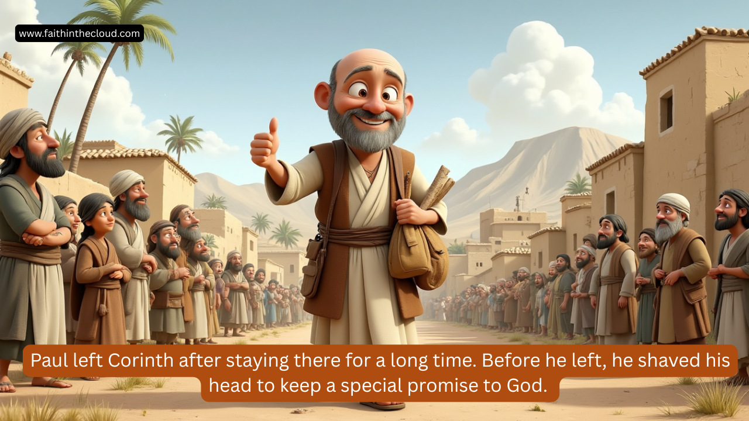

Slide 4


Slide 5
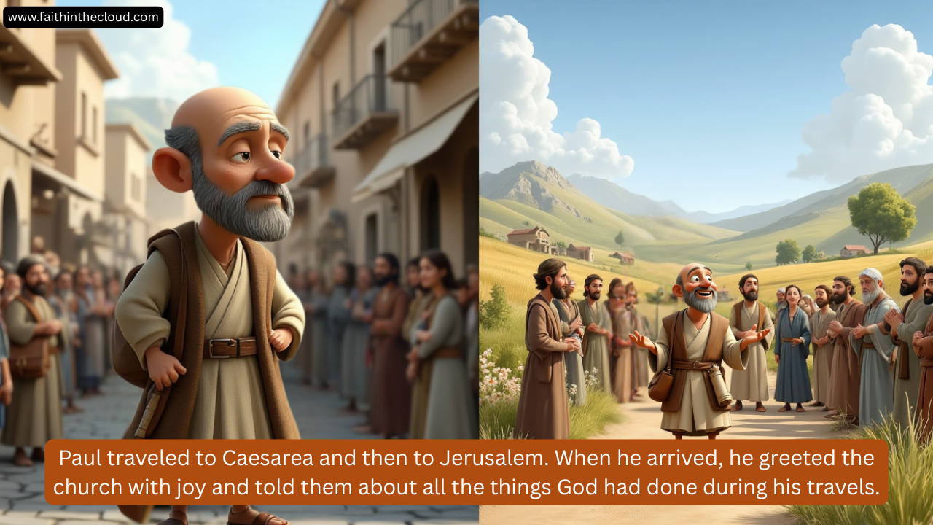

Slide 6
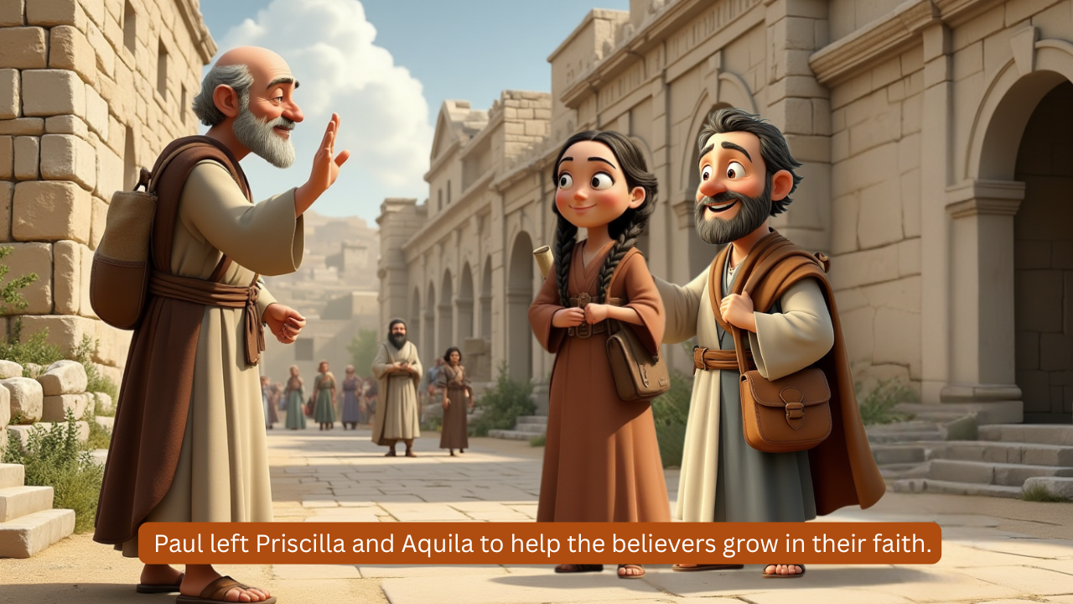

Slide 8


Slide 9
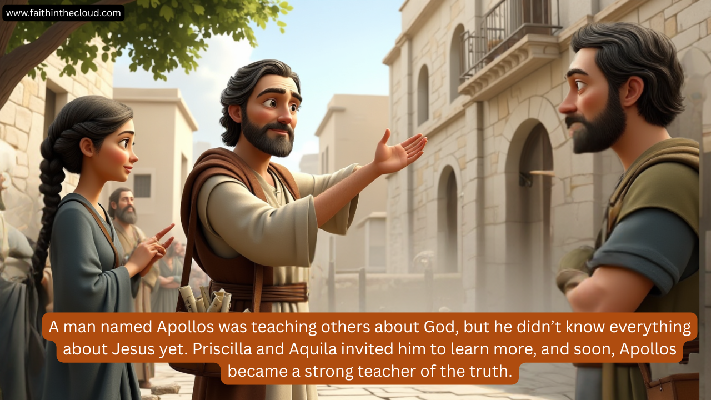

Slide 10


Slide 11
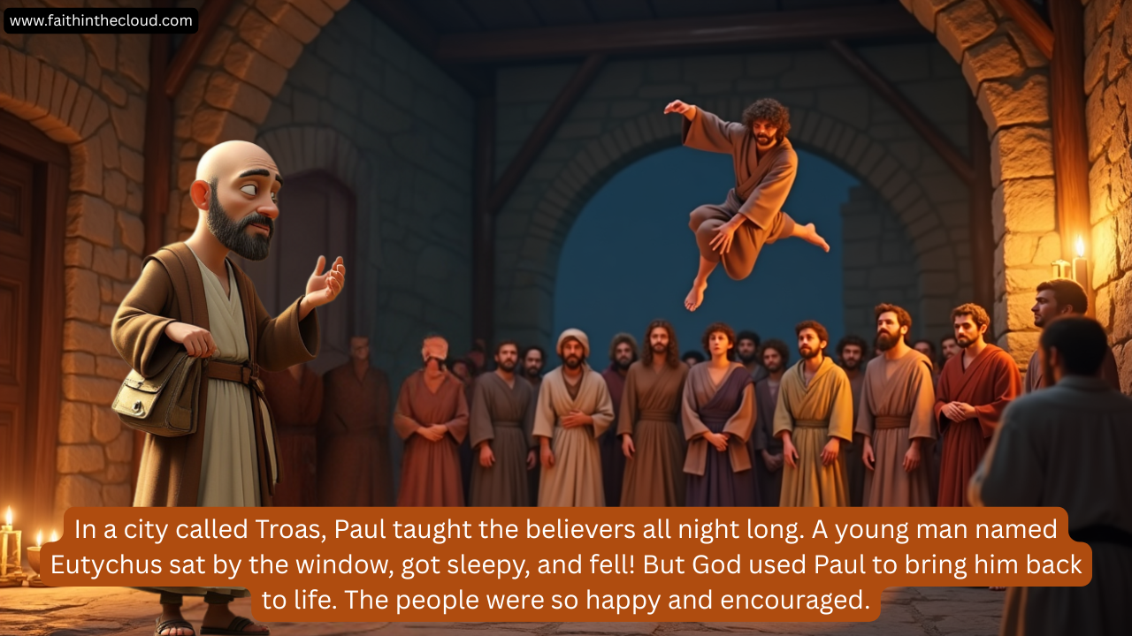

Slide 12
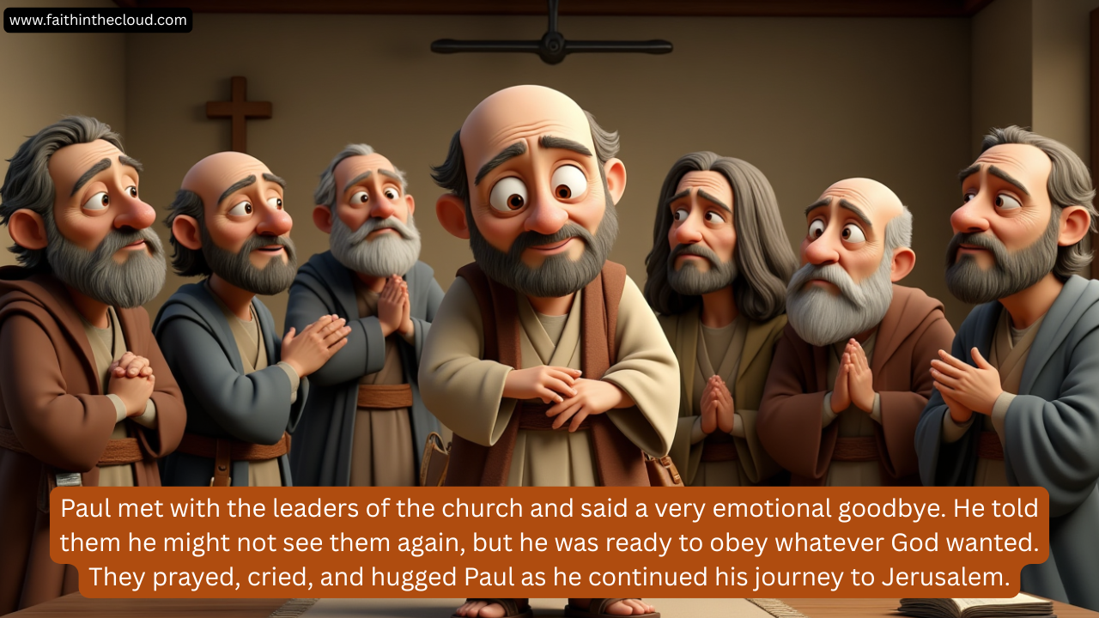

Slide 13
