Slide 1

THE CALLING OF
ABRAHAM
(GENESIS 12:1-9)

Slide 2
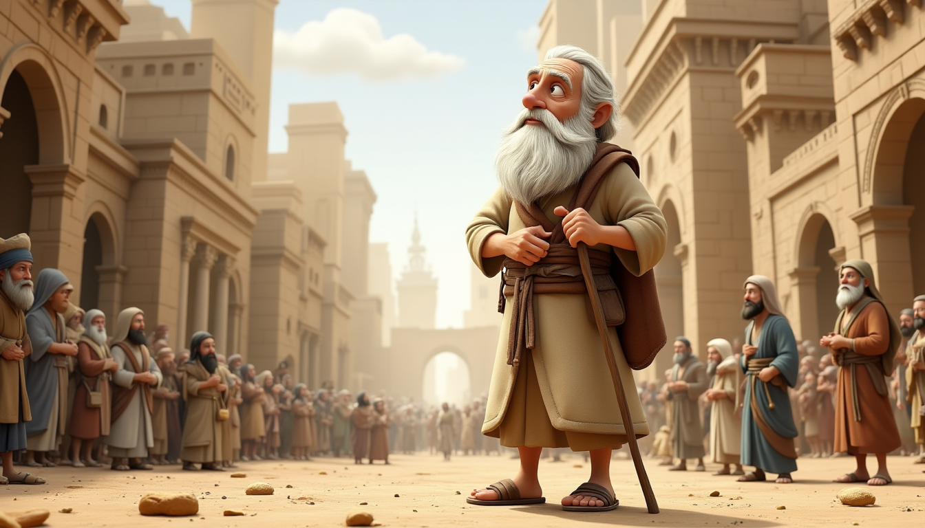

Abraham lived in Ur of the Chaldeans, a flourishing city filled with comfort and familiarity.

Slide 3

One night, God spoke to him, saying: “Go from your country, your people, and your father’s household to the land I will show you.” This was a bold call, requiring great faith.

Slide 4
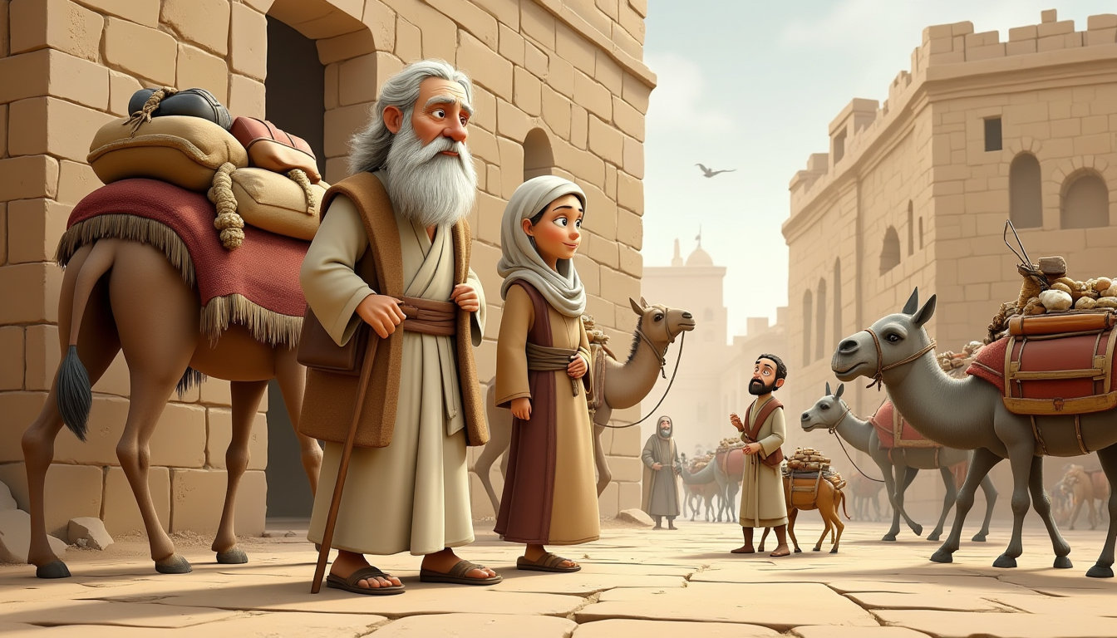
Without hesitation, Abraham obeyed. He gathered his wife, Sarai, his nephew Lot, and all their possessions. Leaving behind their homeland, they set out on a journey to an unknown land, believing in God's promise.

Slide 5
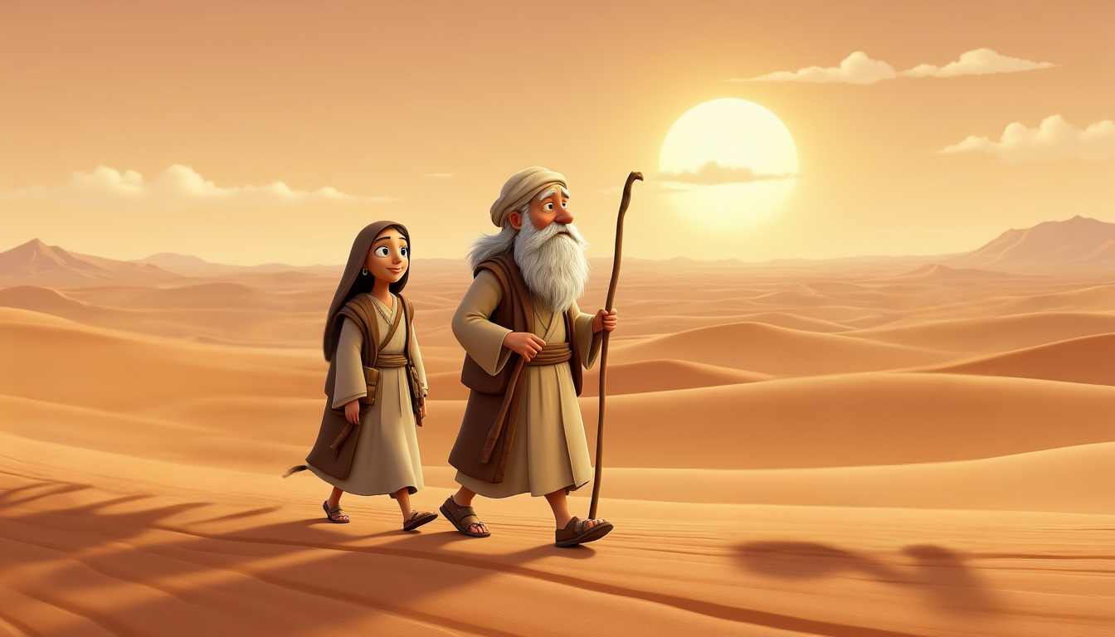


The path was long and uncertain. As Abraham and his family traveled through Canaan, they trusted in God's guidance. There was no clear map—only faith. Despite the challenges, they pressed forward, knowing the Lord was with them.

Slide 6
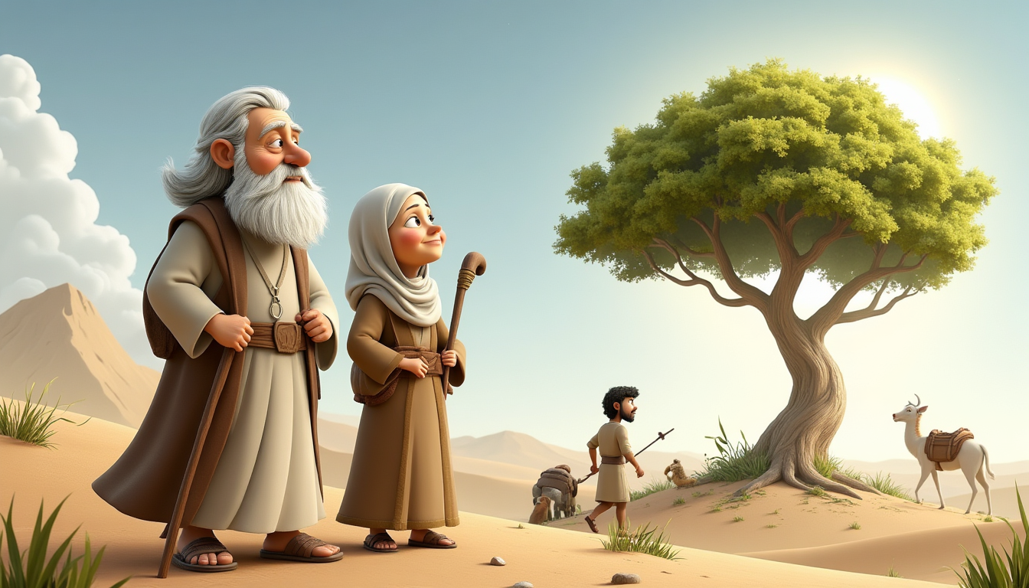
When Abraham reached Shechem, God appeared to him again, saying: “To your offspring, I will give this land.” In response,

Slide 7

Abraham built an altar and worshipped God, recognizing the fulfillment of His word

Slide 8
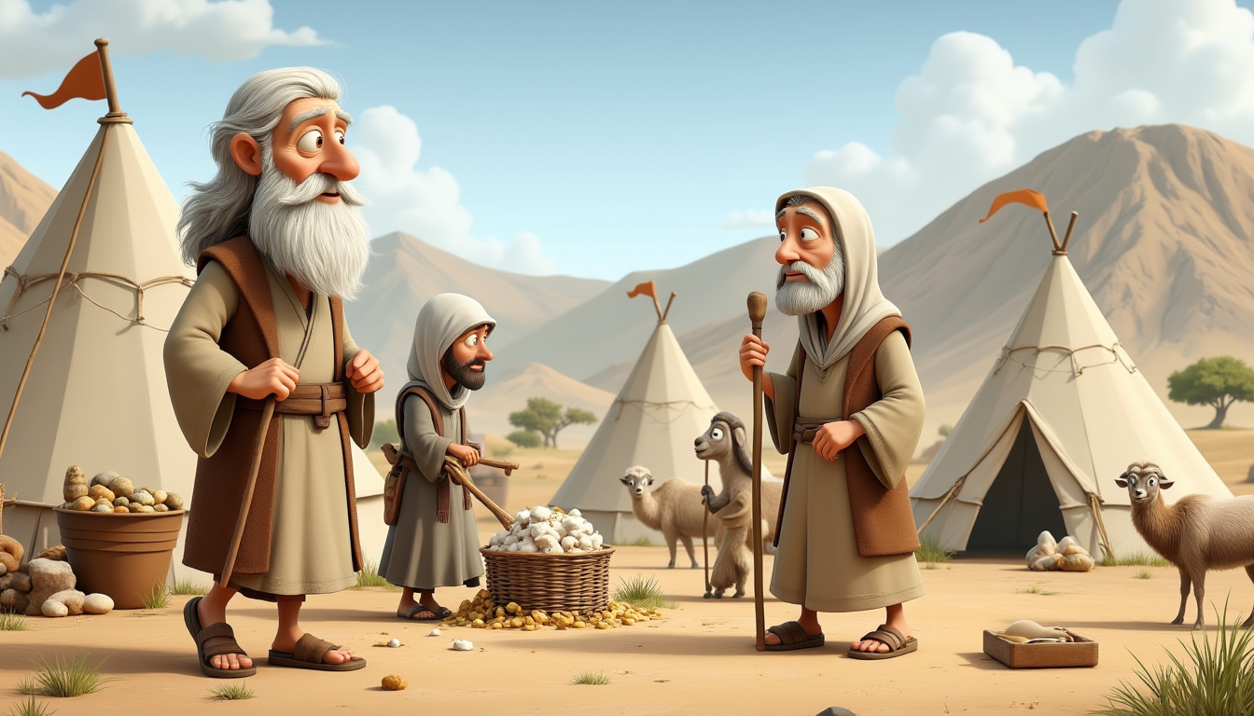
Abraham and his family moved further into the land of promise, setting up tents in various places, including Bethel and Ai. Each step required patience and trust, but God's presence remained constant.

Slide 9
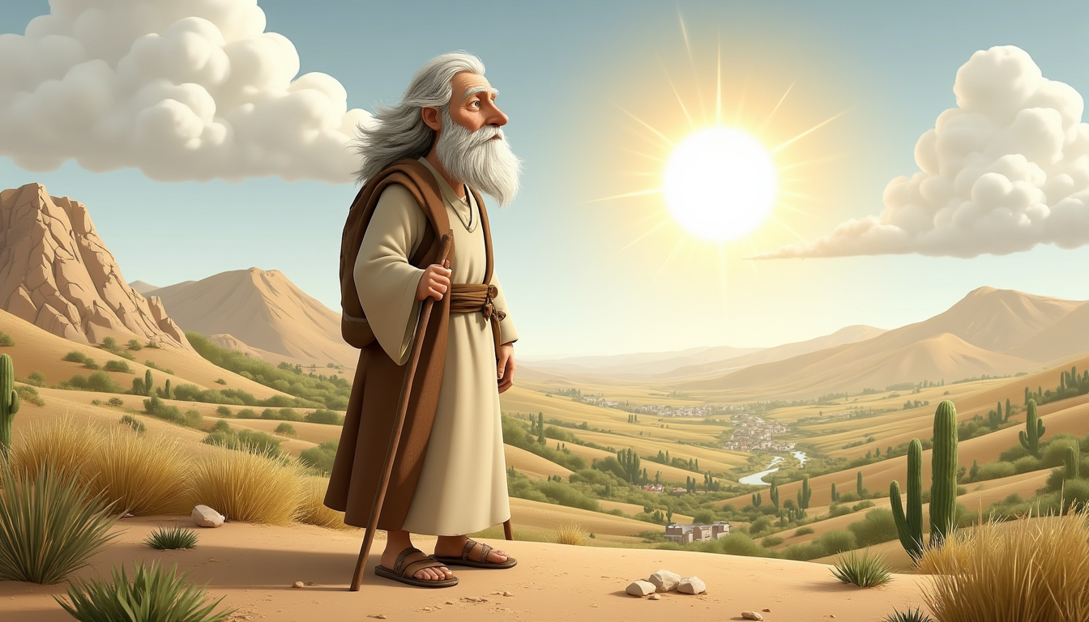
This journey was more than a relocation—it was the start of a divine covenant. Through Abraham, God would establish a great nation, fulfilling His plans for generations to come. His obedience shaped the course of history and remains an inspiring example of faith today.

Slide 10
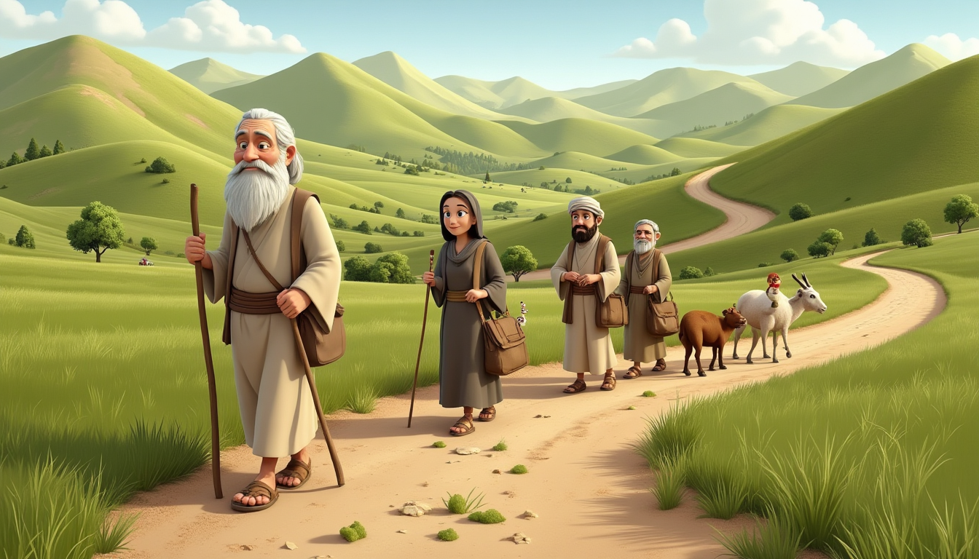
Abraham’s journey was one of faith—a trust that defied logic and comfort. When God called him to leave his home, there were no clear directions, no visible proof of the promise ahead. Yet, without hesitation, Abraham obeyed. Each step into the unknown was guided not by certainty but by belief in the One who sees the future.
His obedience led to blessings beyond measure, shaping the destiny of generations. His story reminds us that faith is not about knowing every detail—it’s about trusting God to lead the way, even when the path is unclear.

