Slide 1
Watch Video
https://www.youtube.com/watch?v=46EMlTLEctI

Slide 2


Slide 3
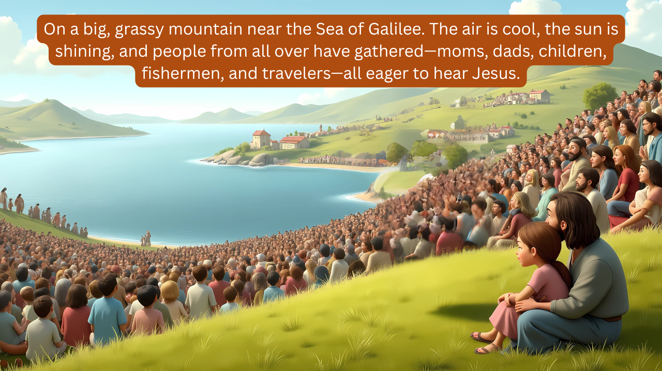

Slide 4


Slide 5


Slide 6


Slide 7


Slide 8


Slide 9


Slide 10


Slide 11


