Slide 1
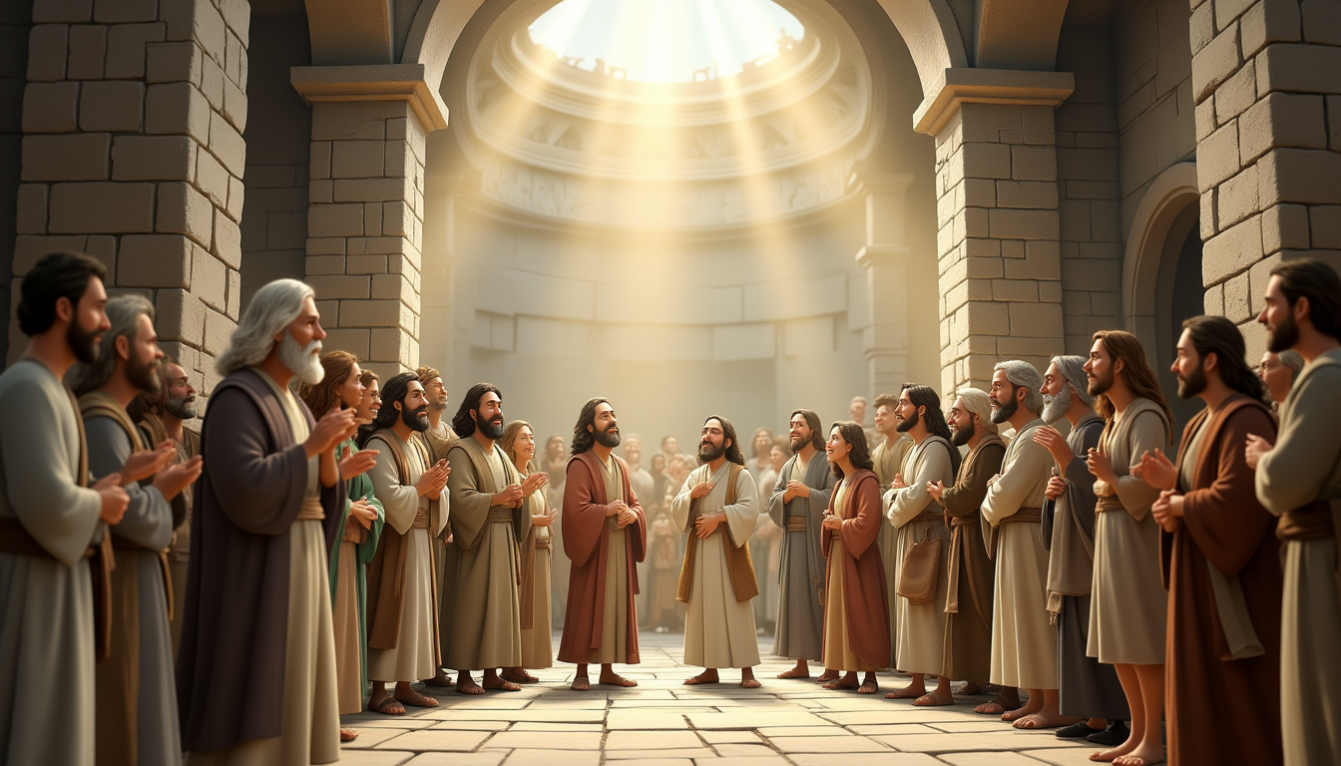
THE BEAUTIFUL LIFE OF THE EARLY BELIEVERS
(ACTS 2:42–47)

Slide 2
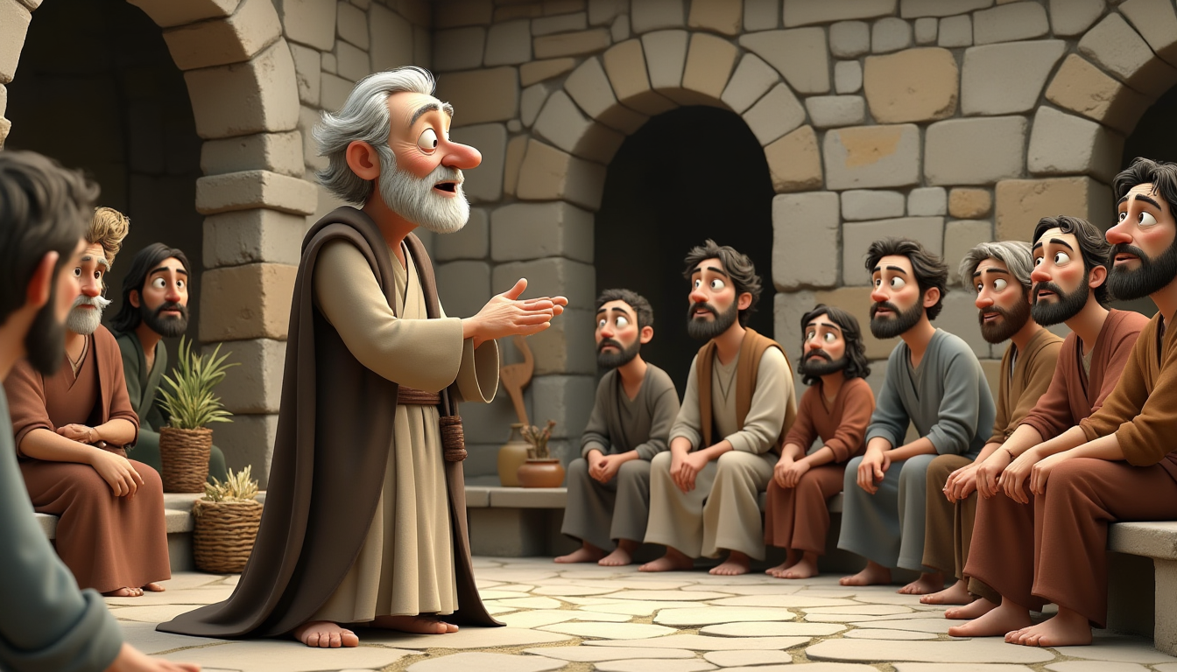

www.faithinthecloud.com
The early followers of Jesus were deeply committed. They gathered daily to learn from the apostles’ teachings, to pray together, and to share in fellowship. Their hearts were focused on knowing God more and loving one another.

Slide 3
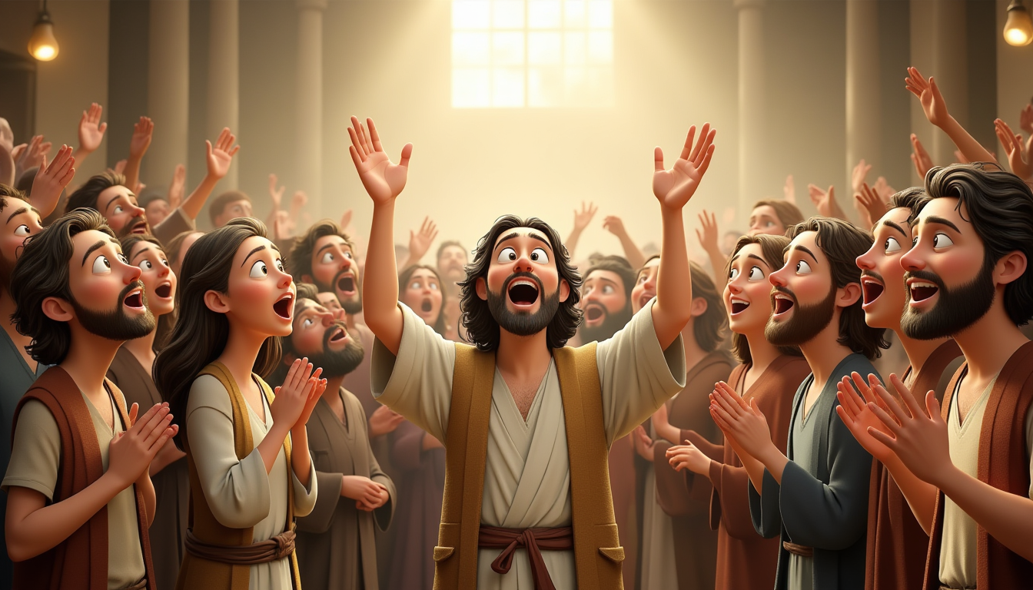
www.faithinthecloud.com
As they listened and prayed, miracles began to happen. The apostles performed many signs and wonders, and a sense of awe filled the whole community. Everyone could feel that God was truly with them.

Slide 4
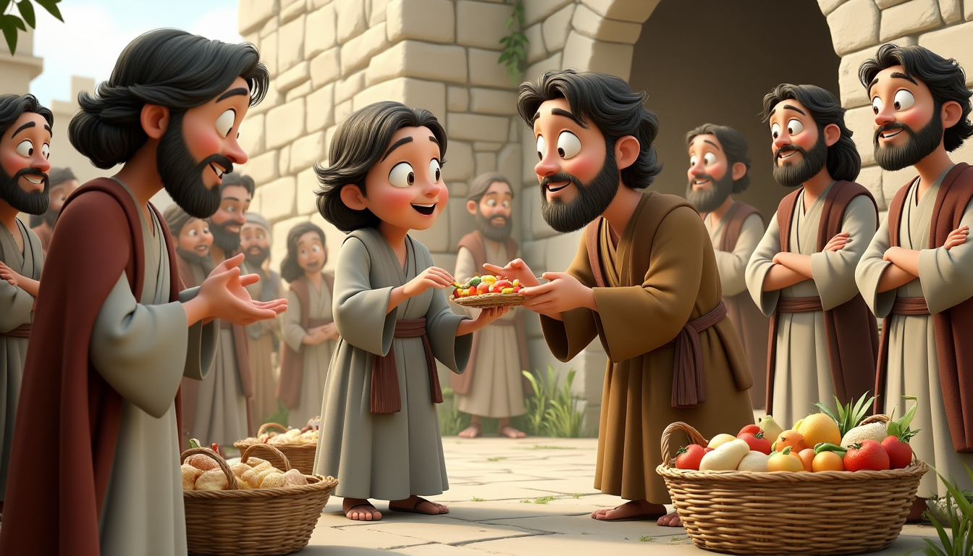
www.faithinthecloud.com
No one among them was left in need. Those who had more would sell their property or belongings and gladly help with those in need. They lived with open hands and open hearts.

Slide 5
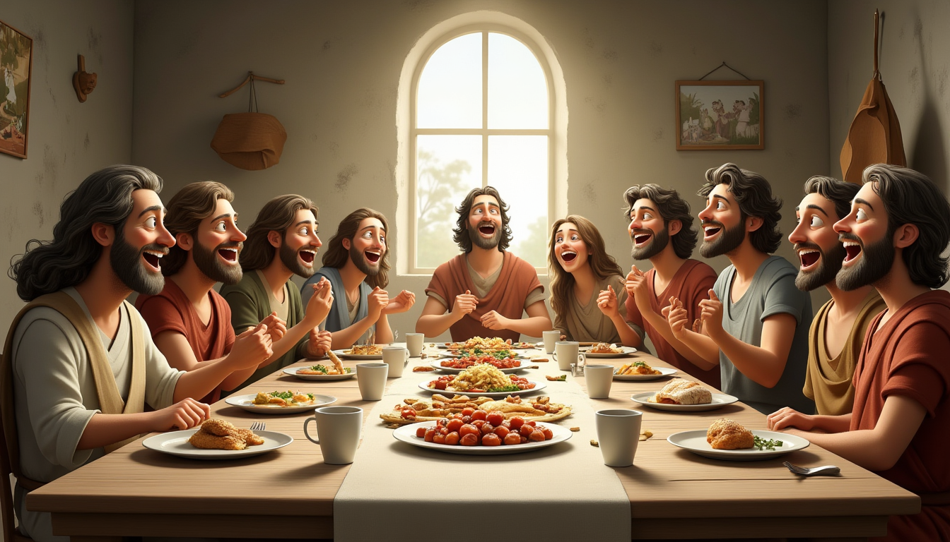
www.faithinthecloud.com
Each day, they went to the temple to worship God together. Afterwards, they gathered in homes, breaking bread and eating meals with joy and sincerity. Their togetherness was genuine and full of warmth.

Slide 6
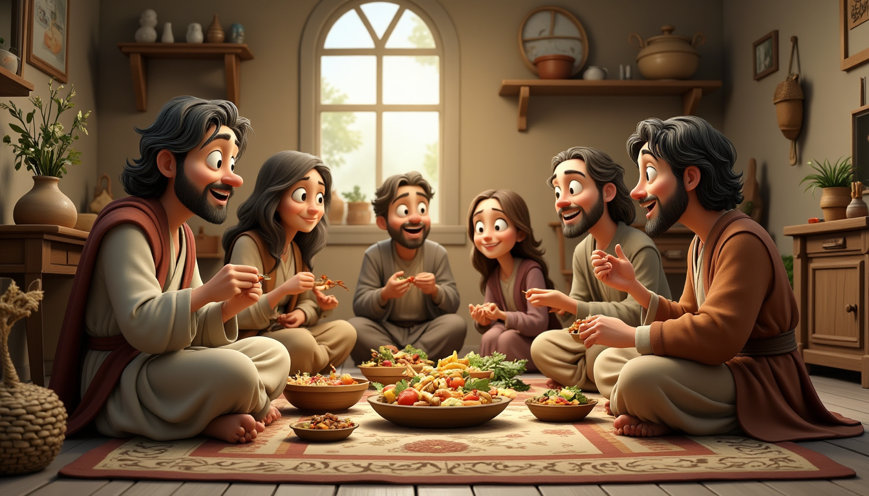
www.faithinthecloud.com
The people were full of praise and gratitude. Their lives reflected God’s goodness, and even those outside the community admired them. Their kindness and joy drew the attention of many.

Slide 7
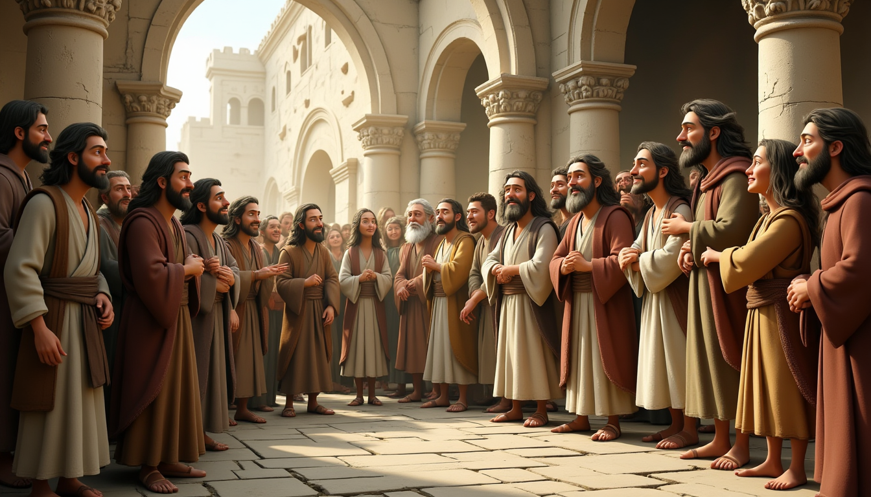
www.faithinthecloud.com
Because of their unity, love, and faith, God added more people to their group every single day. The church was growing—not through programs, but through the powerful presence of God in their lives.

