Slide 1
Play Video
https://www.youtube.com/watch?v=Kx11Zrmkxs0

Slide 2
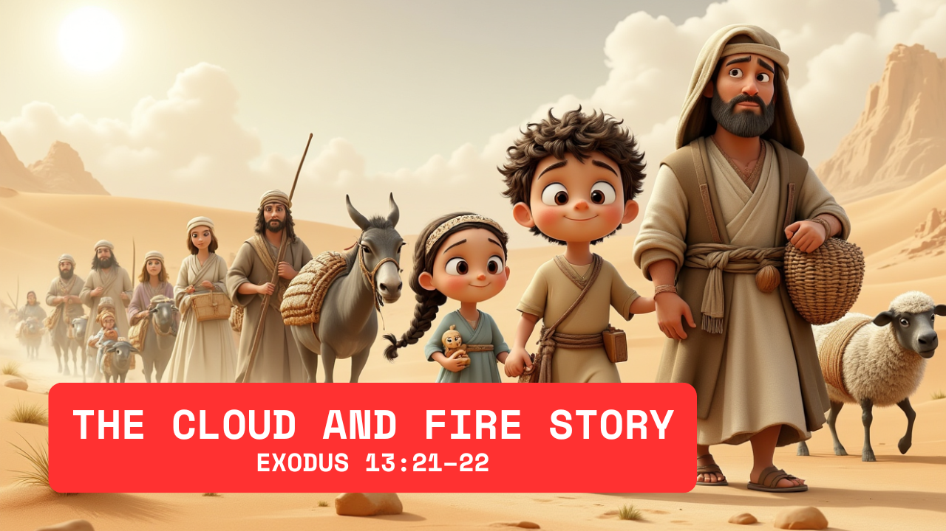

Slide 3
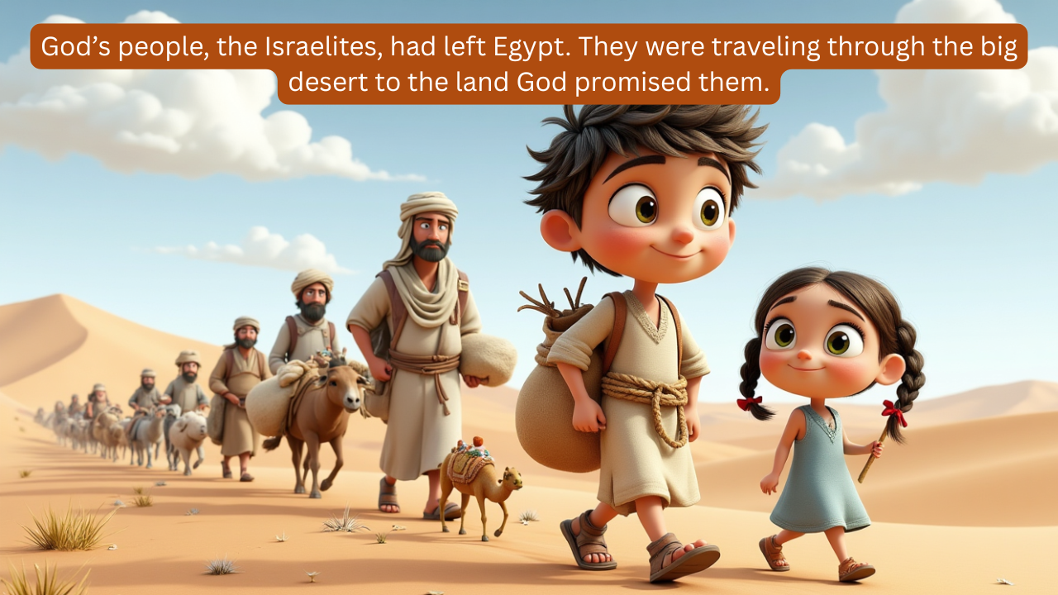

Slide 4
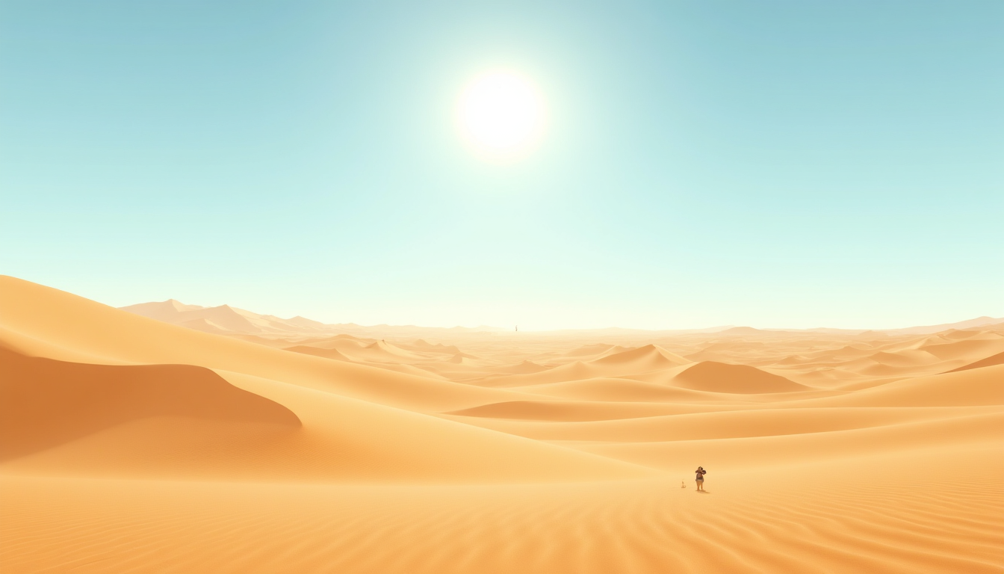
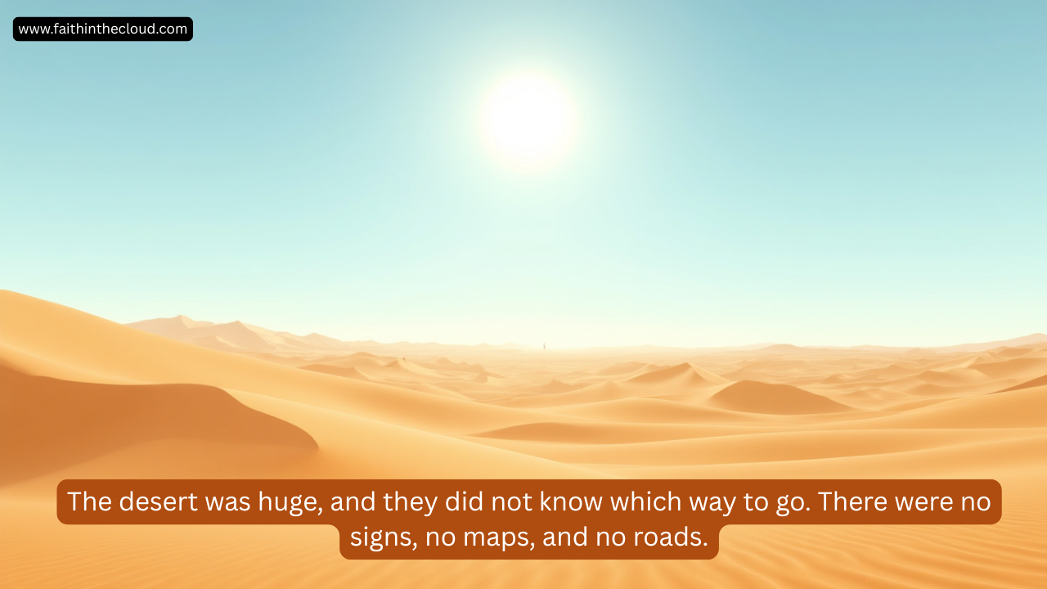
www.faithinthecloud.com
The desert was huge, and they did not know which way to go. There were no signs, no maps, and no roads.

Slide 5
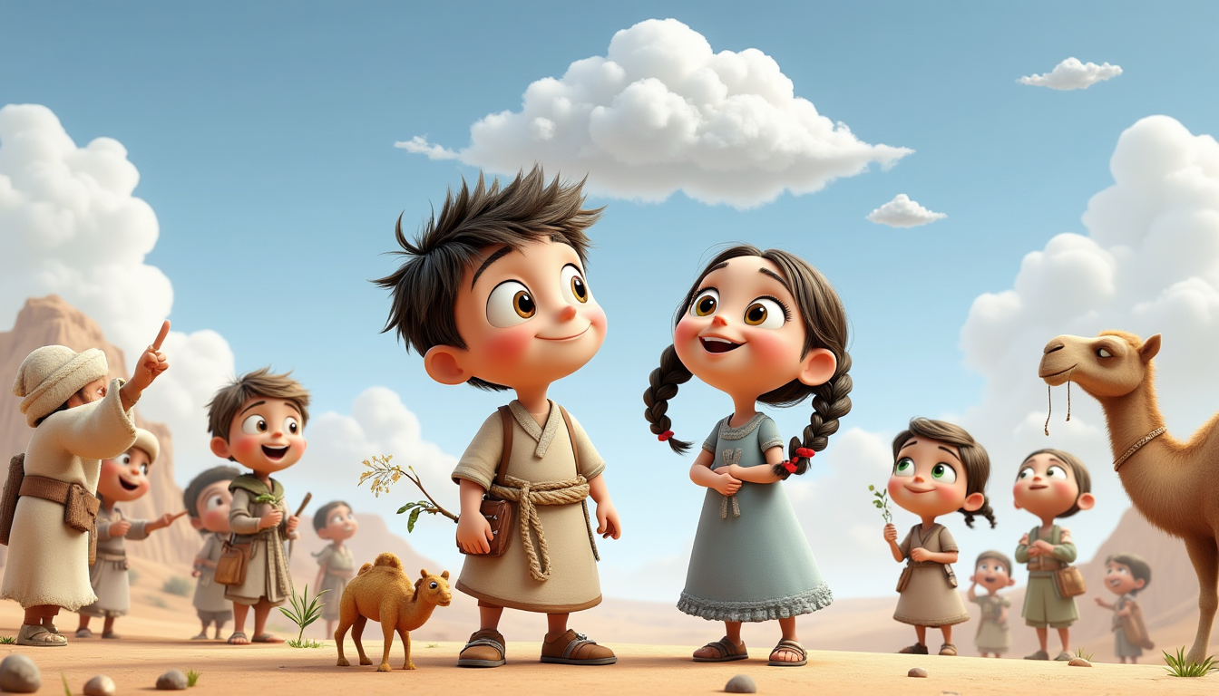
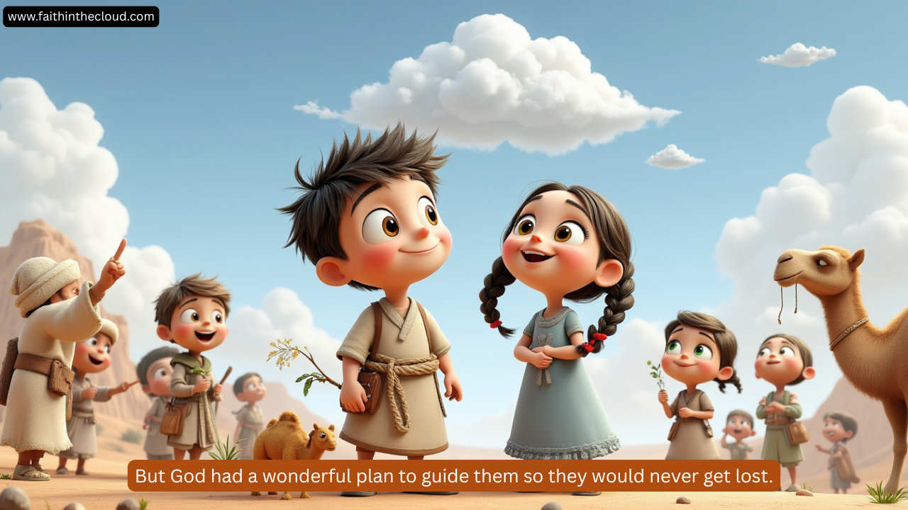
www.faithinthecloud.com
But God had a wonderful plan to guide them so they would never get lost.

Slide 6
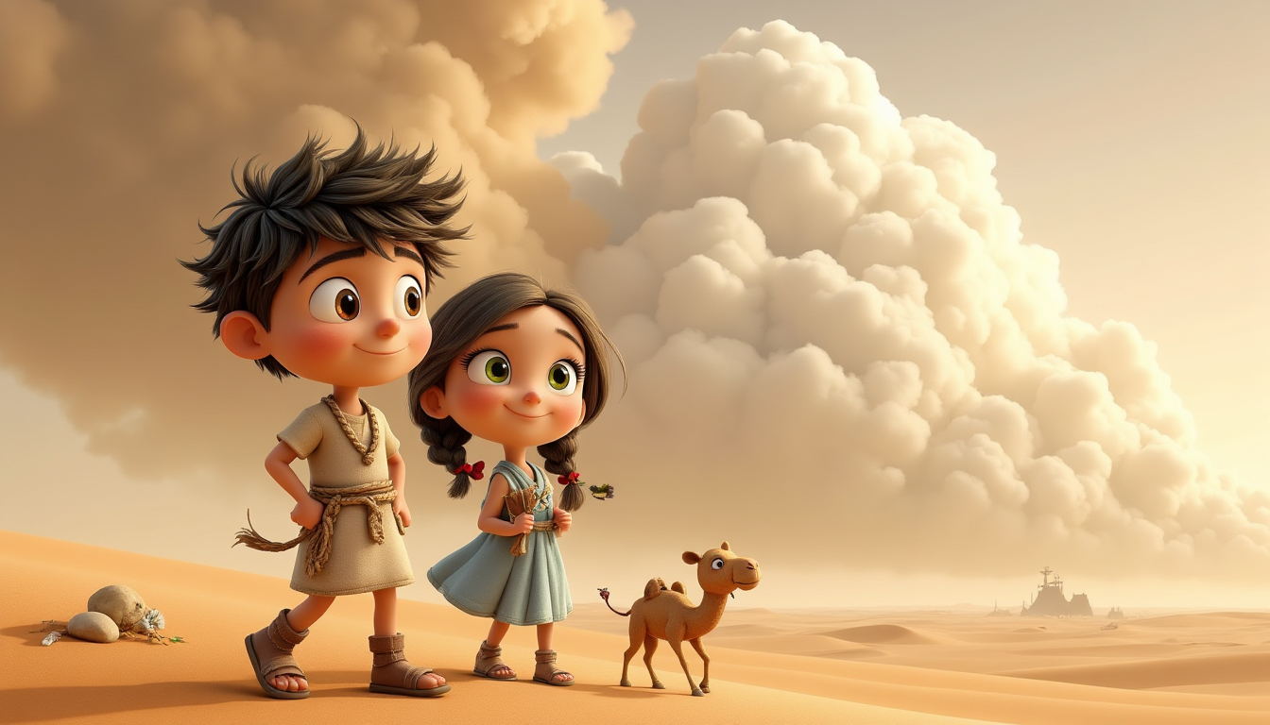
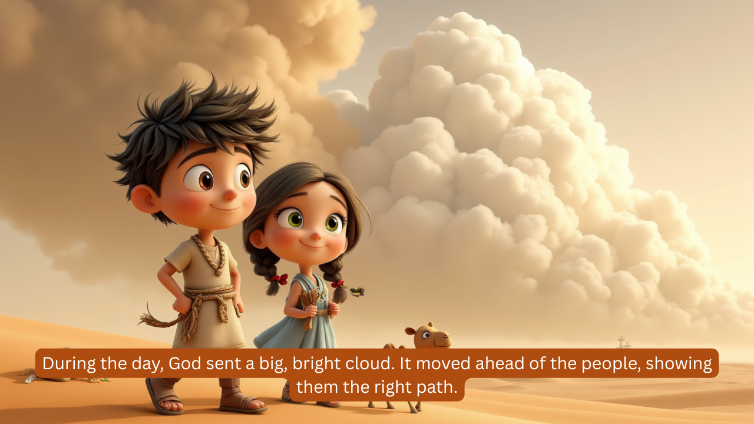
During the day, God sent a big, bright cloud. It moved ahead of the people, showing them the right path.

Slide 7
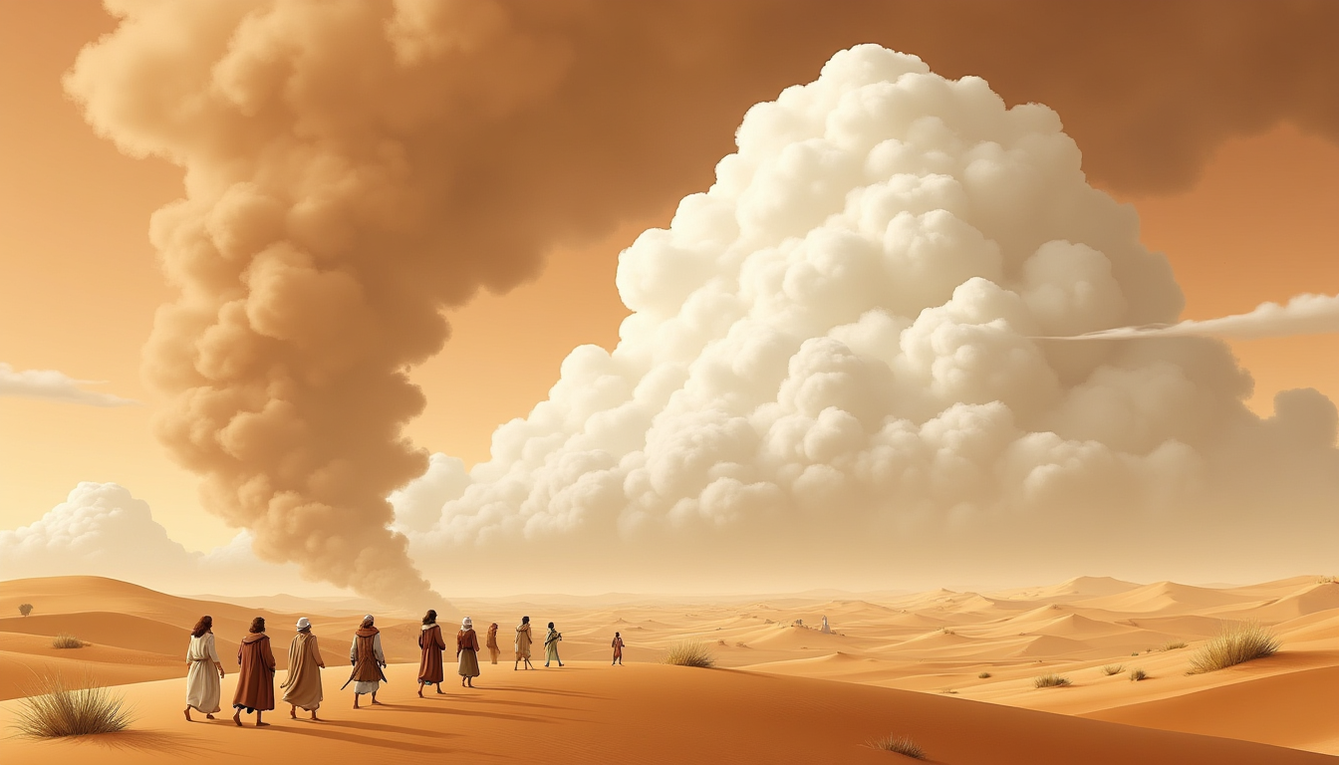
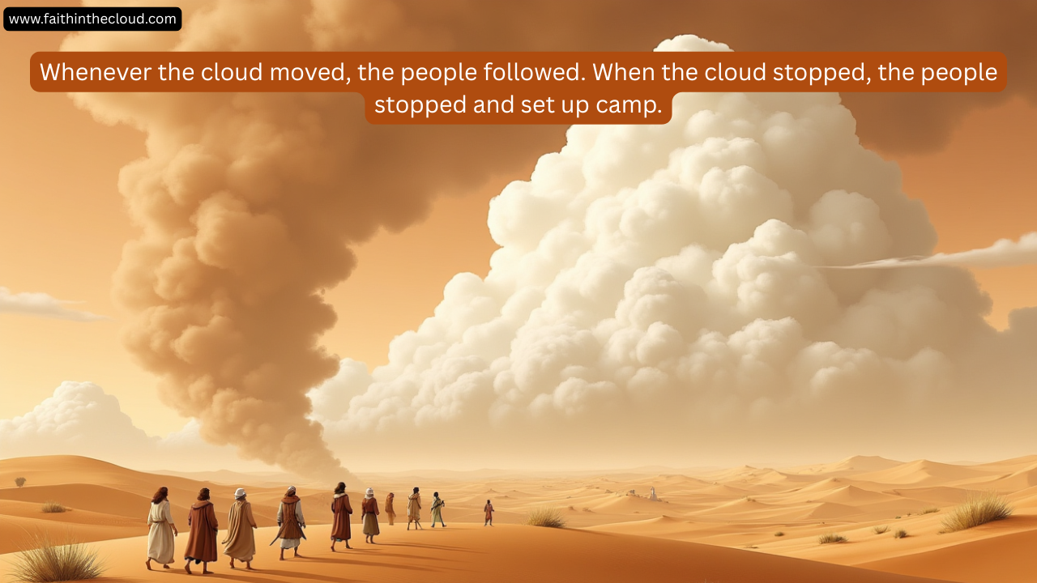
www.faithinthecloud.com
Whenever the cloud moved, the people followed. When the cloud stopped, the people stopped and set up camp.

Slide 8
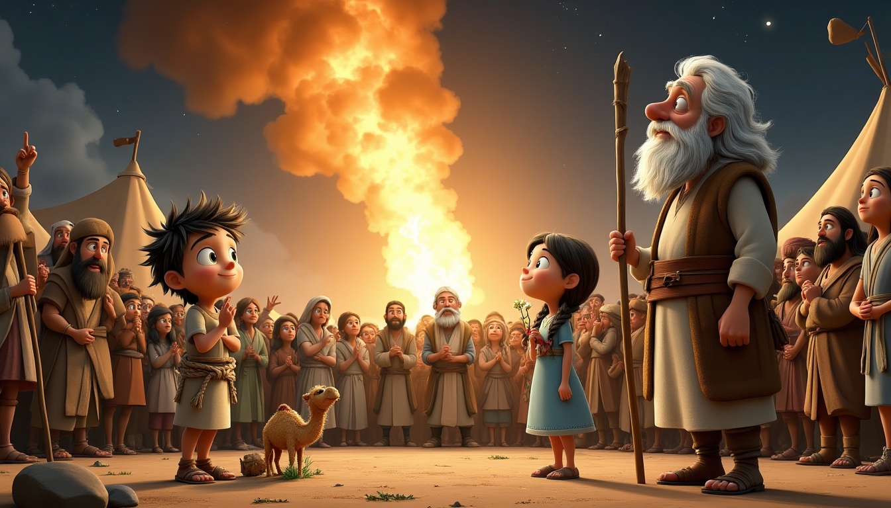
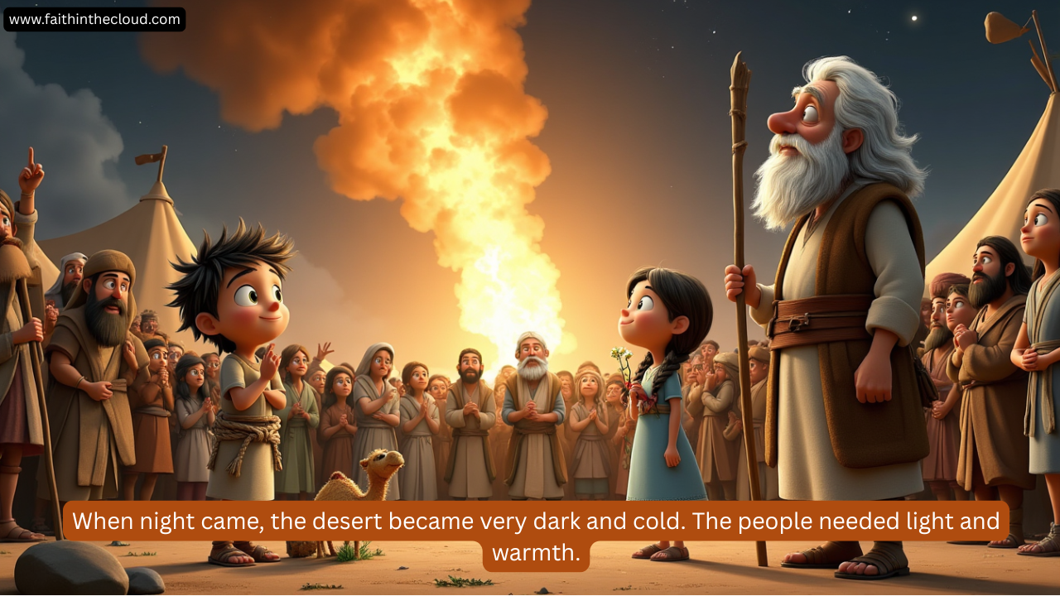
www.faithinthecloud.com
When night came, the desert became very dark and cold. The people needed light and warmth.

Slide 9

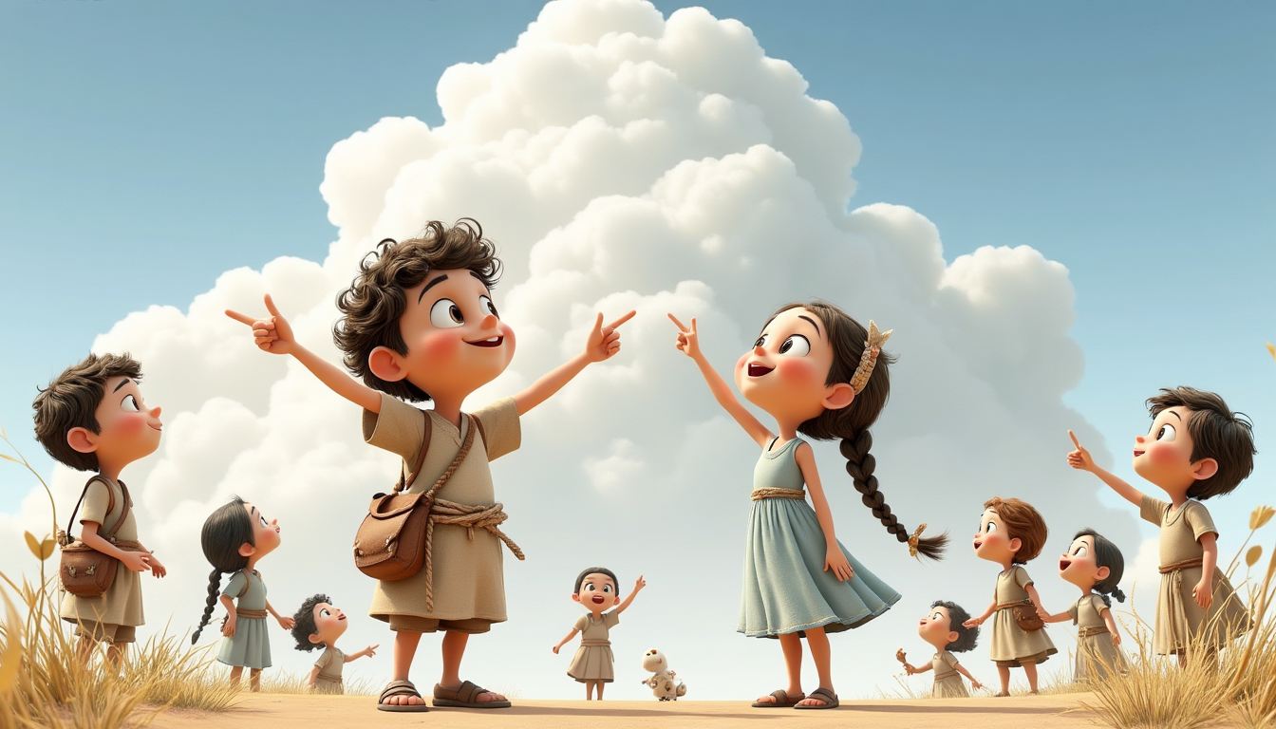
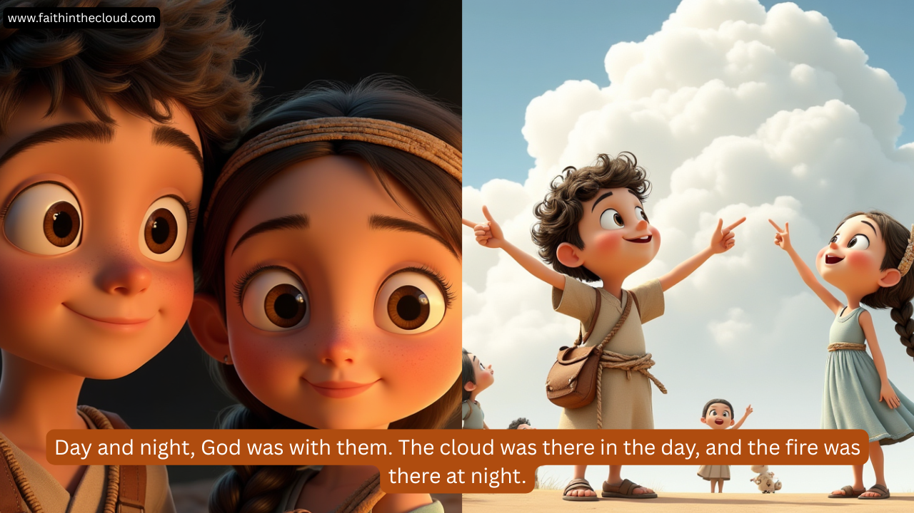

Slide 10
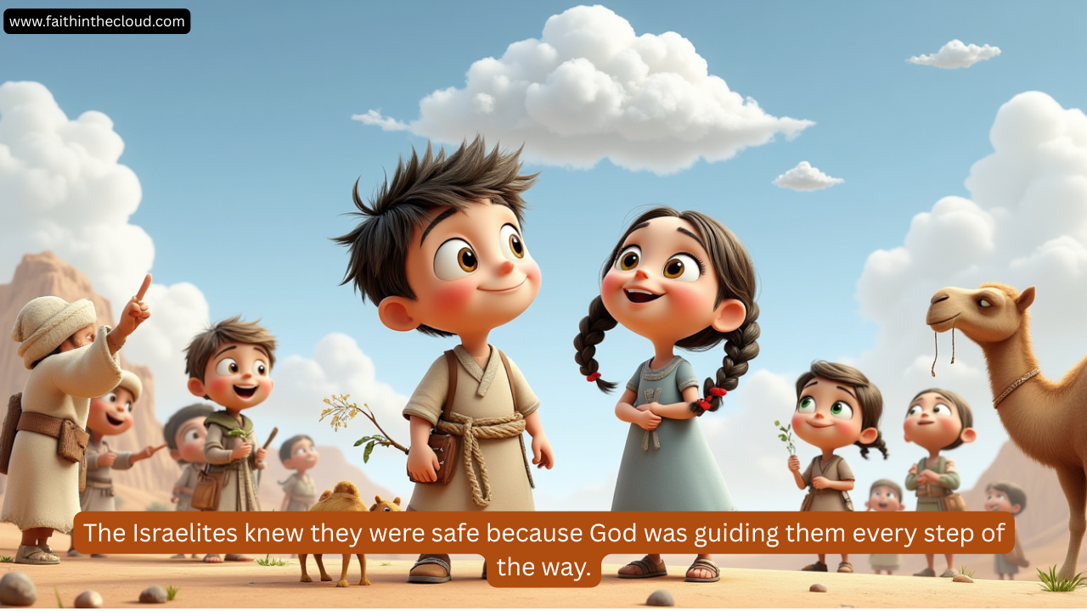

Slide 11
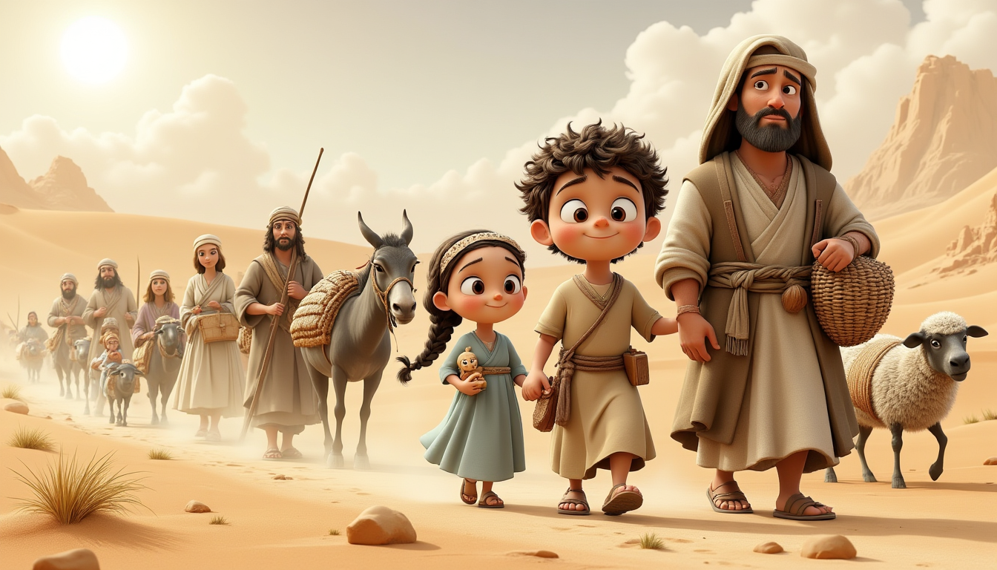
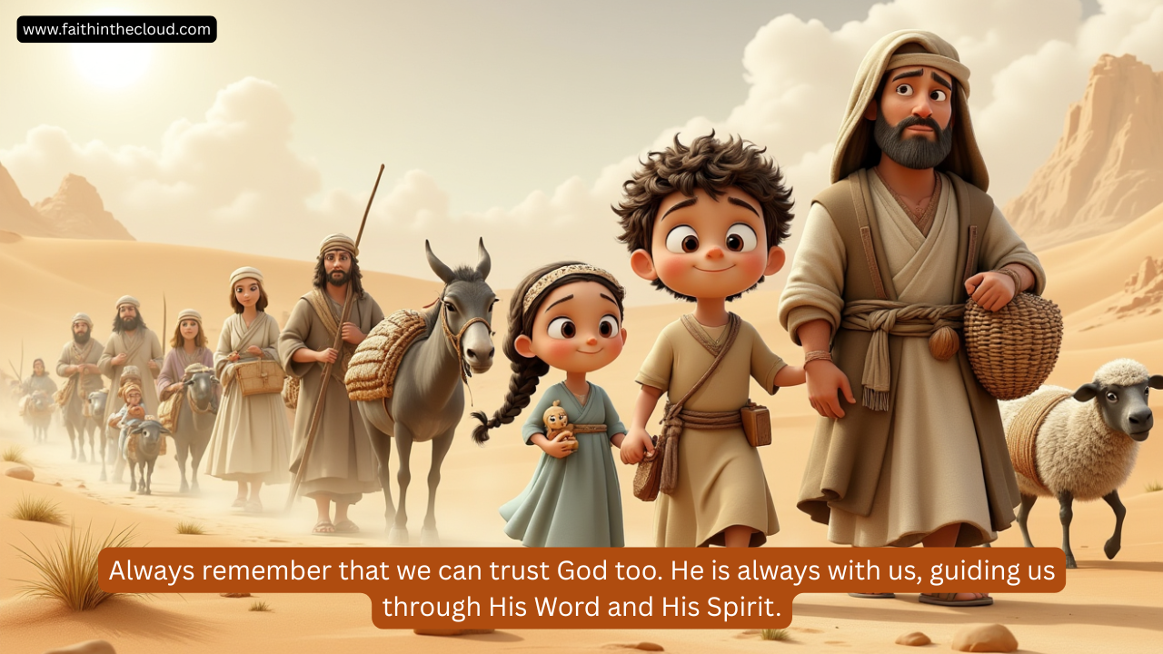
www.faithinthecloud.com
LESSONS TO REMEMBER
  GOD ALWAYS GUIDES His children.
  Even in dark times, God is our light.
  We can trust God because He never leaves us.

Slide 12
