Slide 1
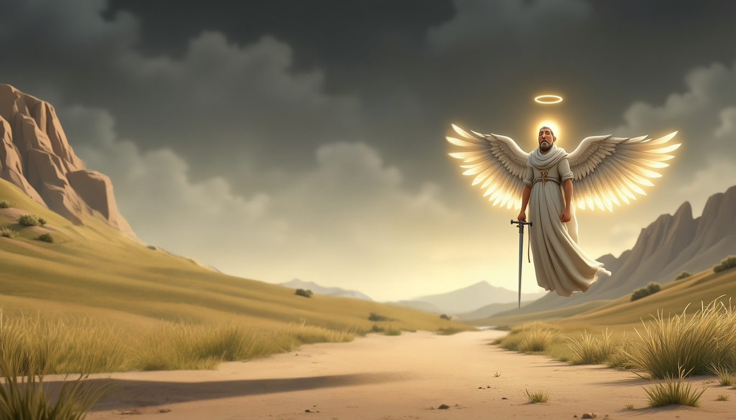
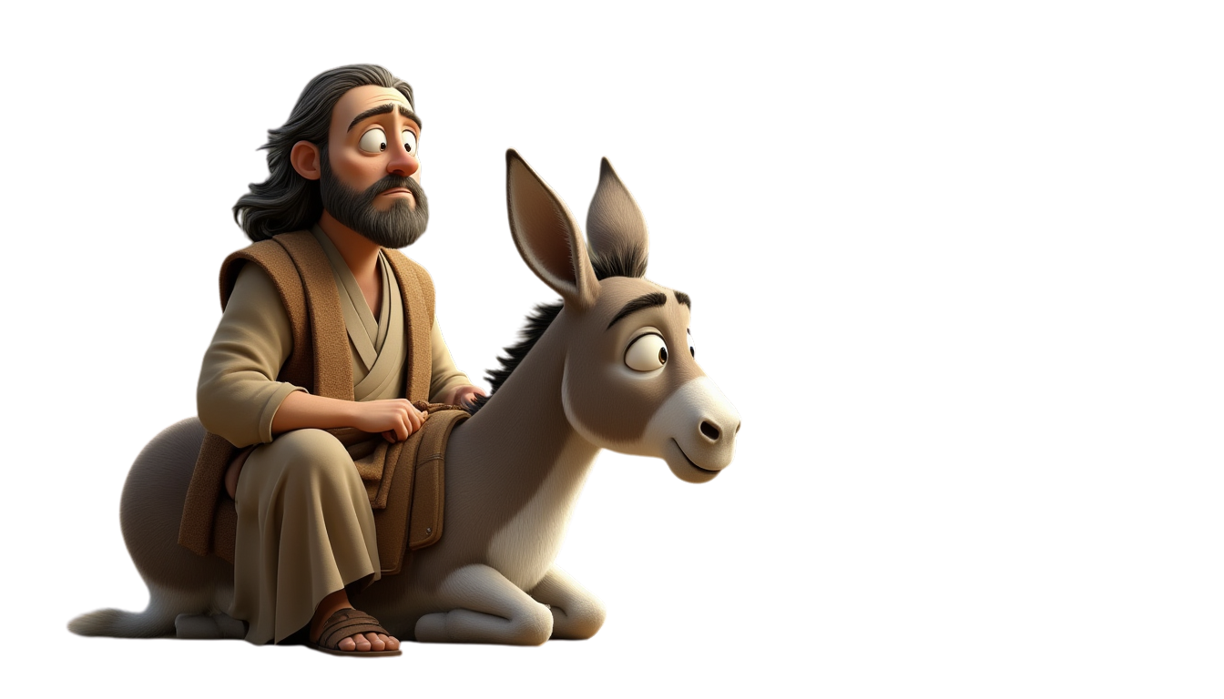
BALAAM
AND THE TALKING DONKEY
NUMBERS 22:21-35
www.faithinthecloud.com

Slide 2
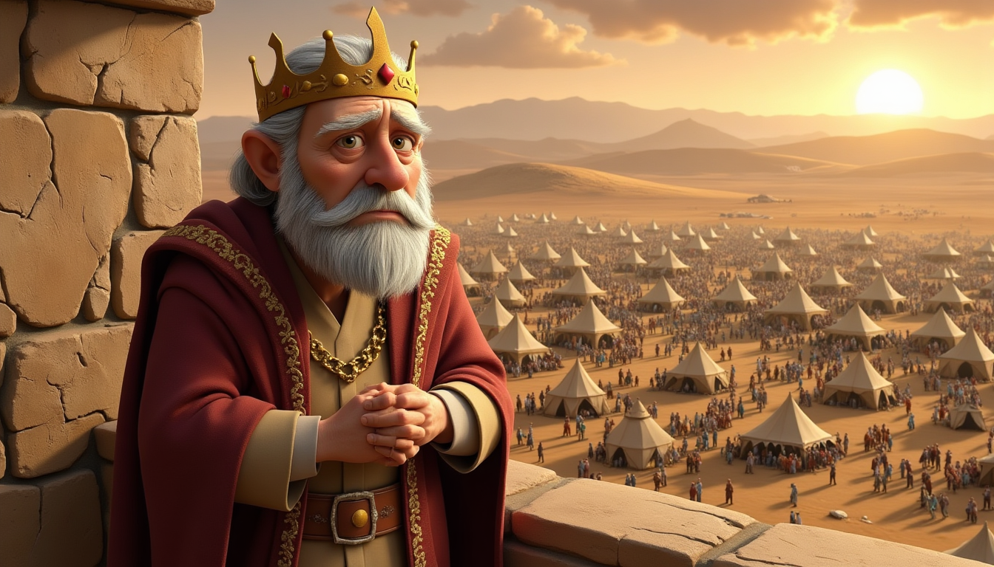
www.faithinthecloud.com
A king named Balak saw the Israelites and got scared because there were so many of them. He sent messengers to a man named Balaam and asked him to curse the Israelites. Balaam prayed to God, and God said, “No! These people are blessed.” So Balaam told the king’s messengers he couldn’t do it.

Slide 3
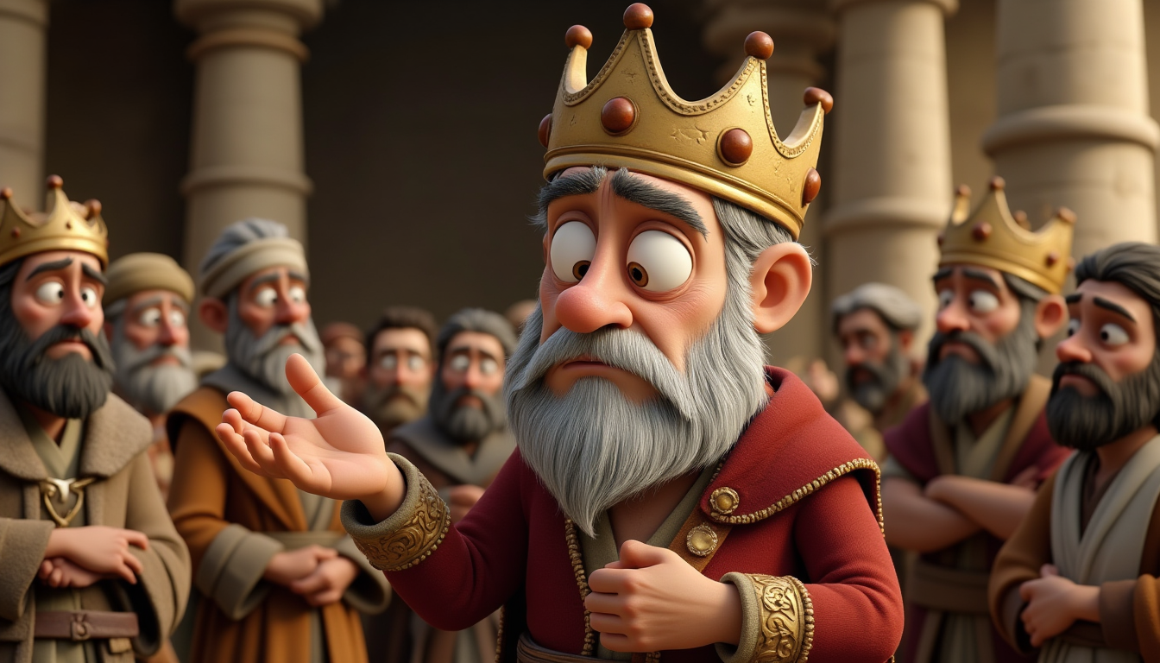
www.faithinthecloud.com
King Balak didn’t give up. He sent more important messengers and promised Balaam many gifts. Balaam asked God again, and this time God said, “Go with them, but only say what I tell you.” So Balaam got on his donkey the next morning and started the trip.

Slide 4
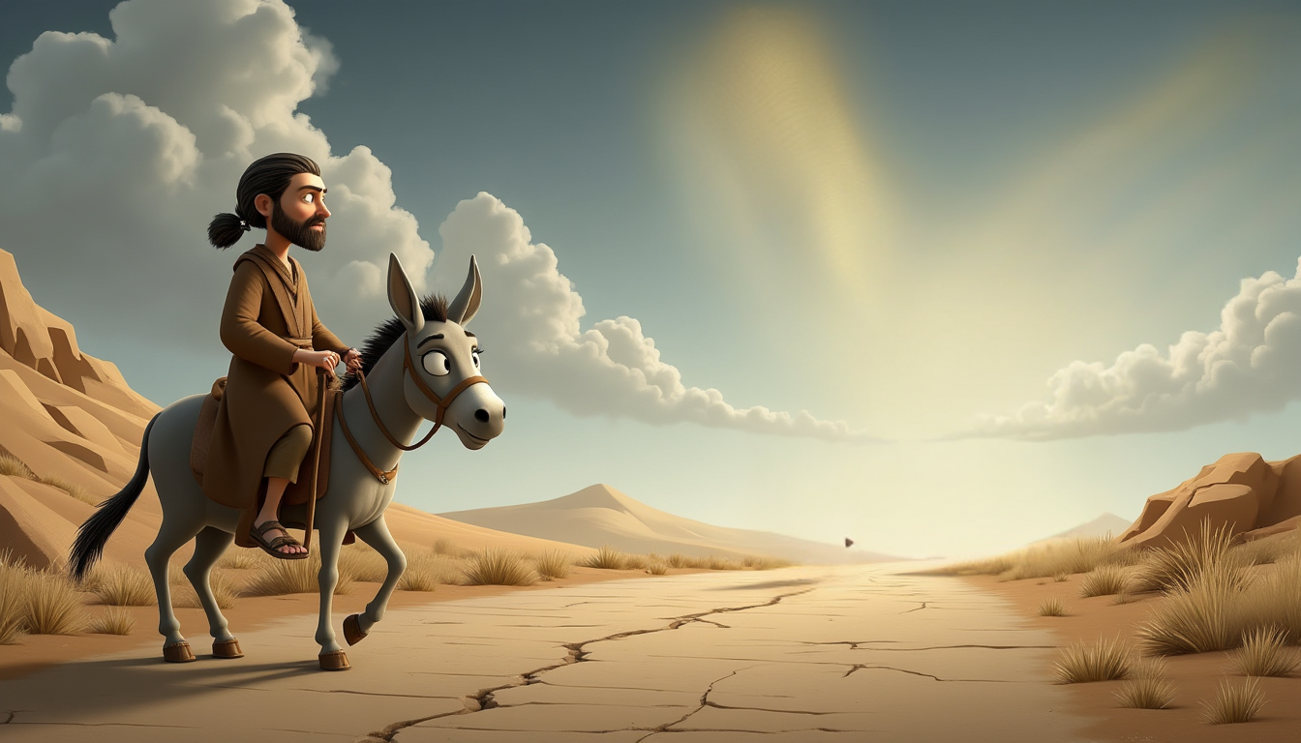

www.faithinthecloud.com
As Balaam rode his donkey, something strange happened. An angel stood in the road with a big sword, but Balaam couldn’t see it. The donkey saw it and turned off the path. Balaam didn’t understand and hit the donkey to stay on the road.

Slide 5
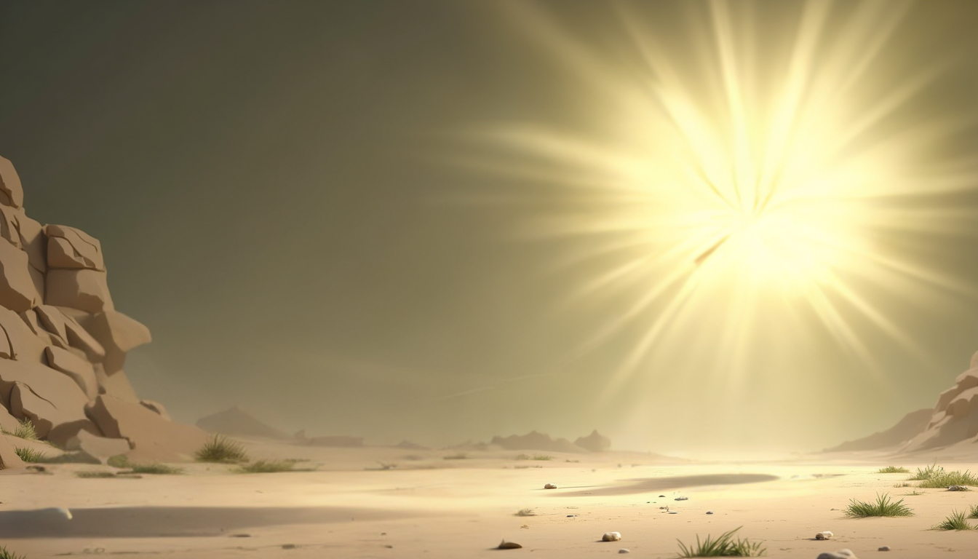
www.faithinthecloud.com
The angel appeared again in a narrow place. The donkey tried to squeeze by and hurt Balaam’s foot against the wall. Ouch! Balaam hit the donkey again. Then the angel appeared a third time where there was no room to go around. The donkey lay down. Balaam got even angrier and hit her again!

Slide 6
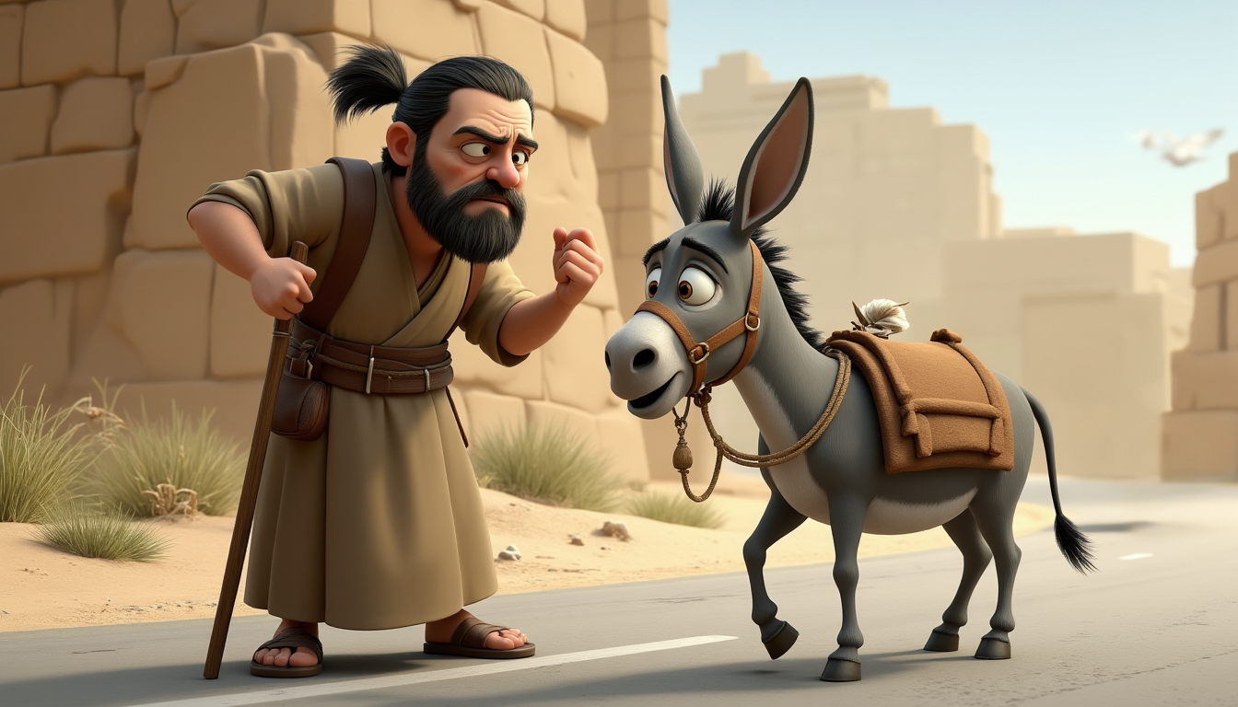

www.faithinthecloud.com
Abraham lived in Ur of the Chaldeans, a flourishing city filled with comfort and familiarity.
Suddenly, God made the donkey talk! She said, “Why are you hitting me? Haven’t I been a good donkey?” Balaam was so surprised—but he talked back! Then God opened Balaam’s eyes, and he saw the angel with the sword standing in the road!

Slide 7
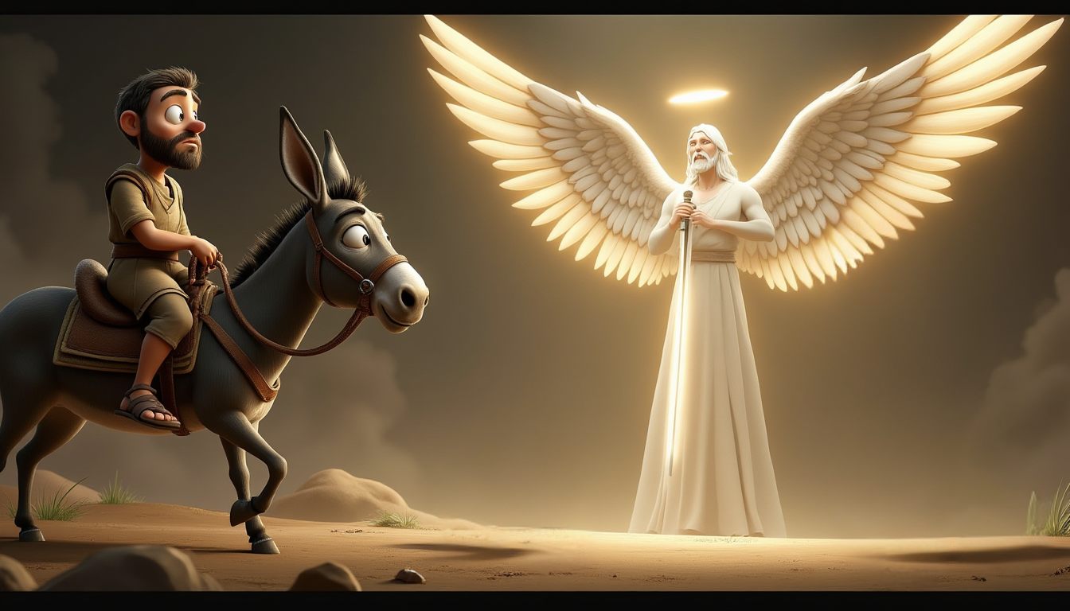
www.faithinthecloud.com
Suddenly, God made the donkey talk! She said, “Why are you hitting me? Haven’t I been a good donkey?” Balaam was so surprised—but he talked back! Then God opened Balaam’s eyes, and he saw the angel with the sword standing in the road!

