Slide 1
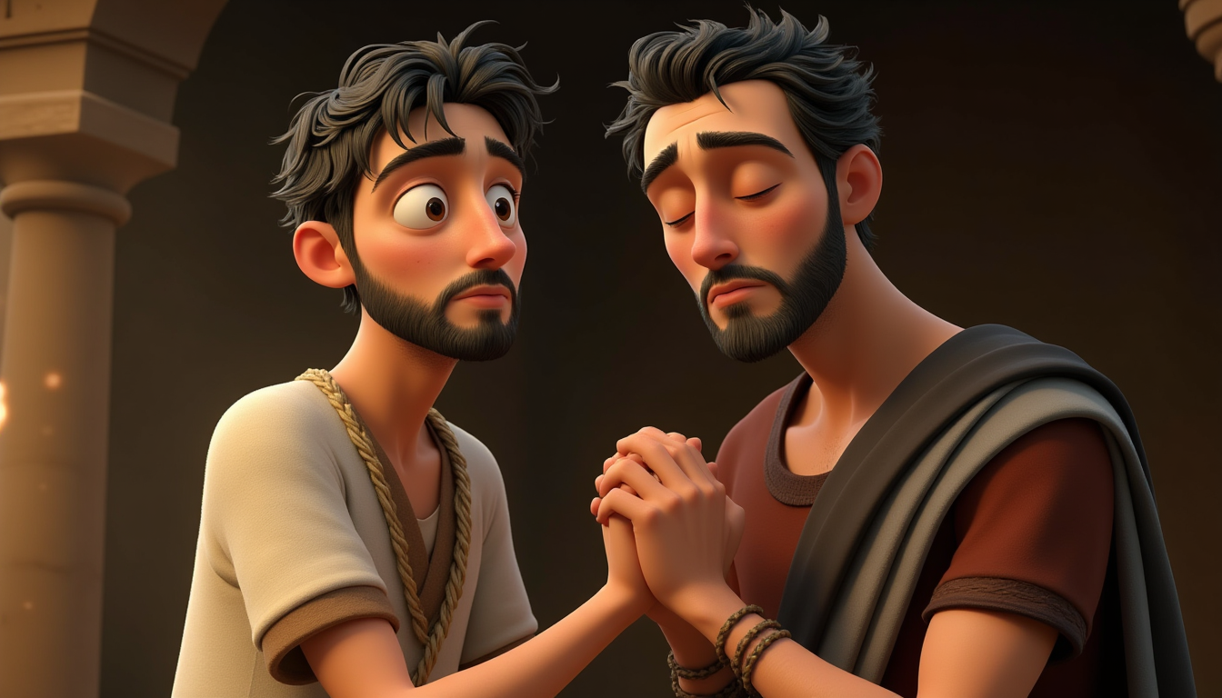
“ANANIAS AND SAUL”
(ACTS 9:10–19)

Slide 2
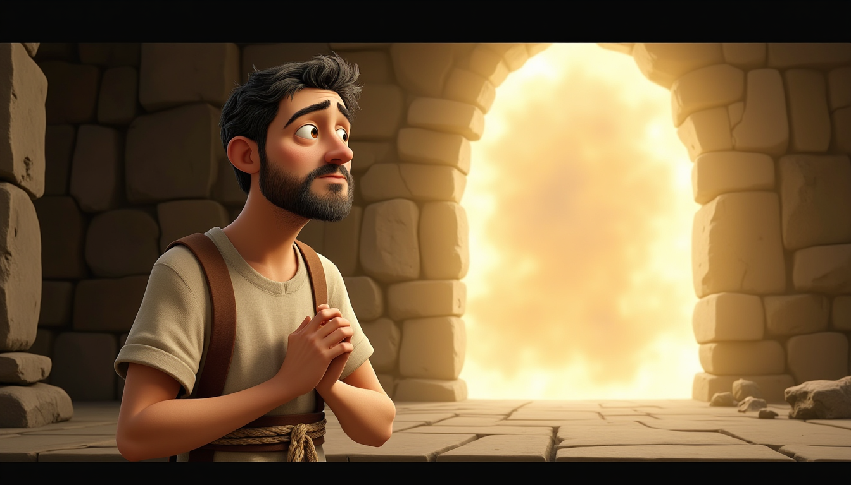
www.faithinthecloud.com
In the city of Damascus, there lived a good man named Ananias. One day, God spoke to him in a vision. “Ananias!” God called. “Yes, Lord,” Ananias answered right away. He was ready to listen.

Slide 3
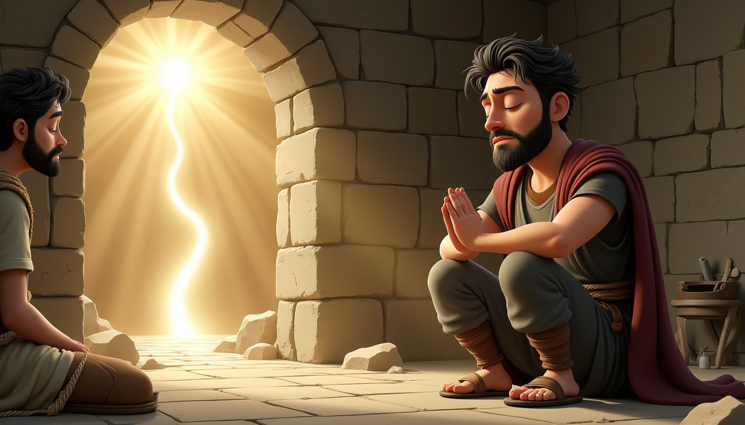
www.faithinthecloud.com
God told Ananias, “Go to the house of Judas. There’s a man named Saul there. He is praying to Me right now, and he saw a vision that you would come and help him see again.” God gave Ananias clear directions—just like a map!

Slide 4
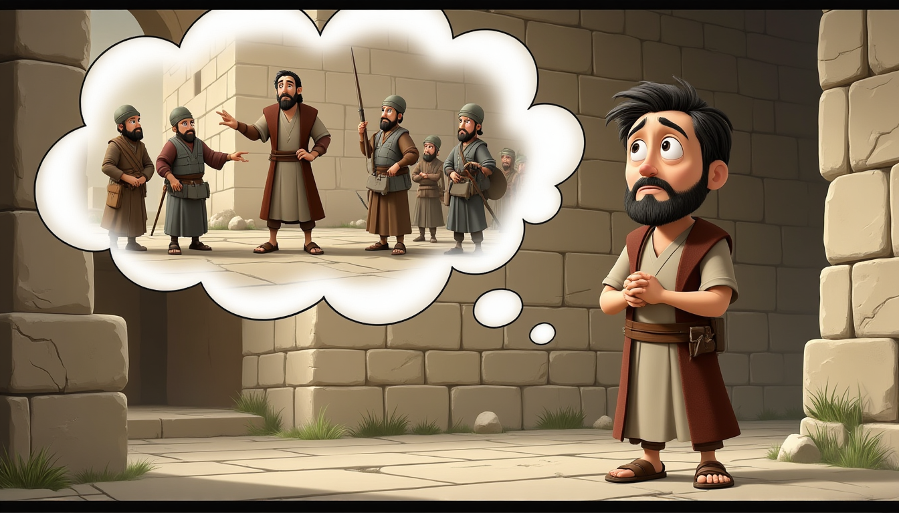
www.faithinthecloud.com
Ananias was scared. “Lord,” he said, “I’ve heard about this man. Saul hurt Your people! He even came here to arrest people who believe in You!”
Ananias didn’t understand why he had to help someone like Saul.

Slide 5
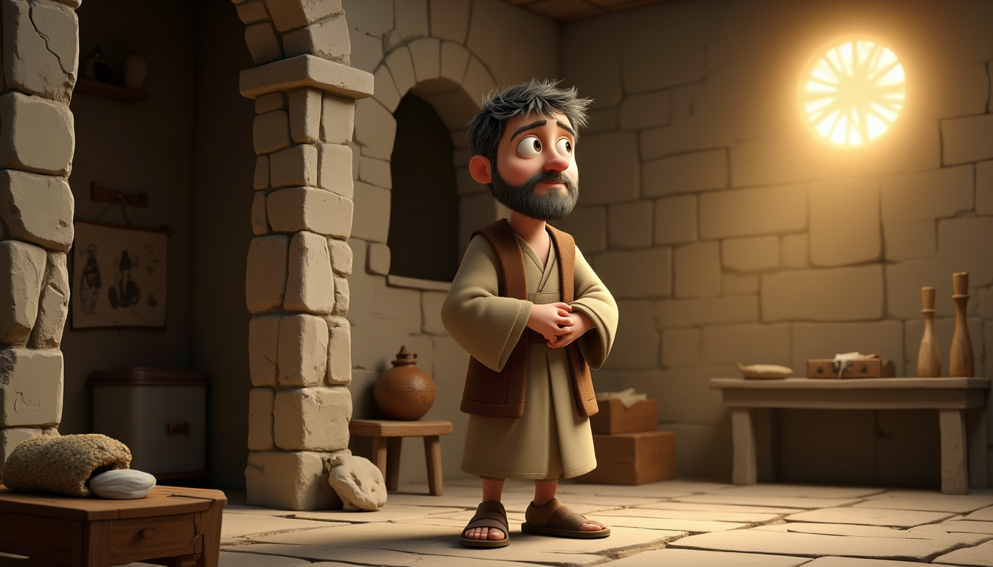
www.faithinthecloud.com
But God told Ananias, “Go! Saul is My chosen one. He will tell many people about Me—including kings and people from far away!” Even though Saul made bad choices before, God had a brand-new plan for his life!

Slide 6
www.faithinthecloud.com
Ananias trusted God and went to find Saul. He entered the house, laid his hands on Saul, and said, “Brother Saul, Jesus sent me so you can see again and be filled with the Holy Spirit.” Ananias was brave and kind—he called Saul his brother!

Slide 7
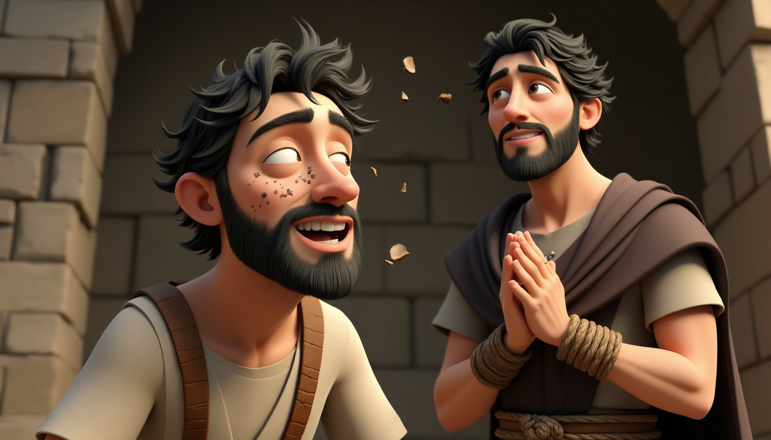
www.faithinthecloud.com
Right away, something like scales fell from Saul’s eyes, and he could see!

Slide 8
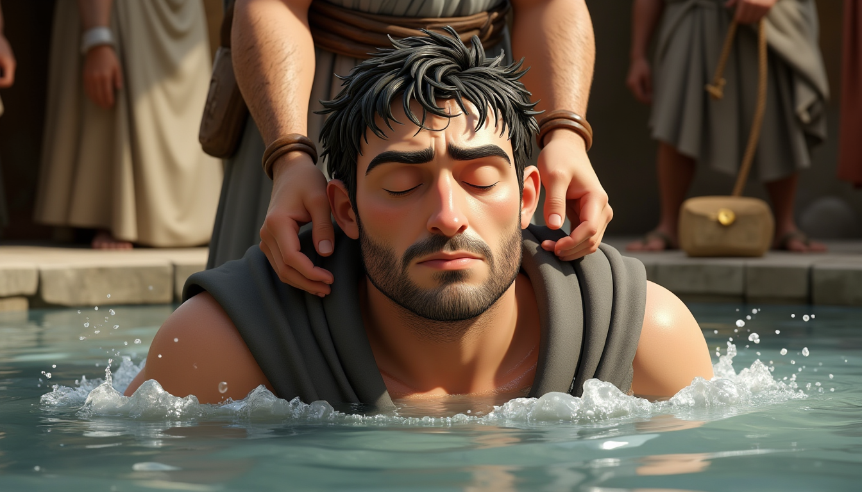
www.faithinthecloud.com
Saul stood up and got baptized. His heart was changed. God gave Saul a fresh start!

Slide 9
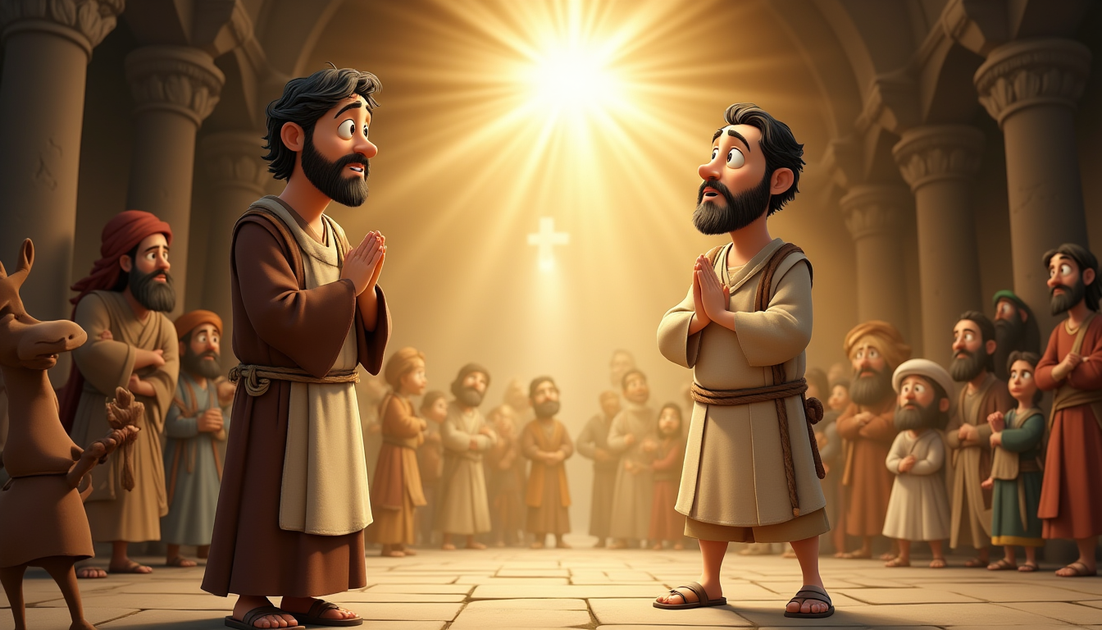
www.faithinthecloud.com
Saul ate some food and got his strength back. Now he was ready to tell everyone about Jesus—the same Jesus he once tried to stop. What an amazing transformation!

