Slide 1

Automated Mismatch checking in Carton Boxes with RFID Tags for Apparel Industry
SK MOHAN RAJU
Mohan@skminfosis.com

Slide 2


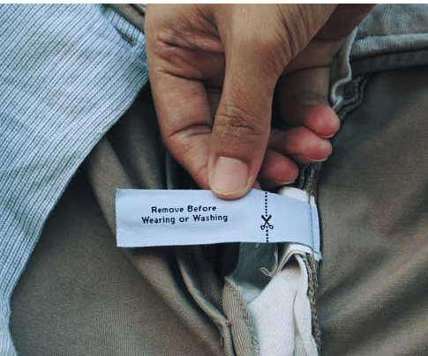
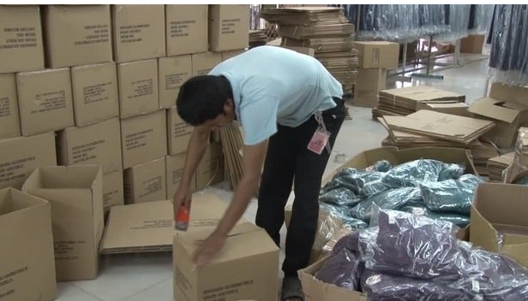
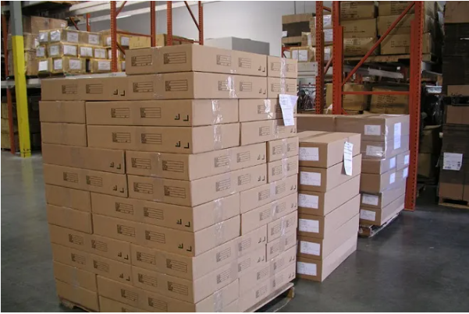
Present Process Flow
MNC clients are providing RFID tags to vendors to attach them in their garments for easy tracking and inventory purpose.
Vendors attach RFID tags during production as per clients requirements.
Finished garments with RFID tags are packed in Carton boxes with Packing list.
Garments with master packing list is shipped to the customer.

Slide 3
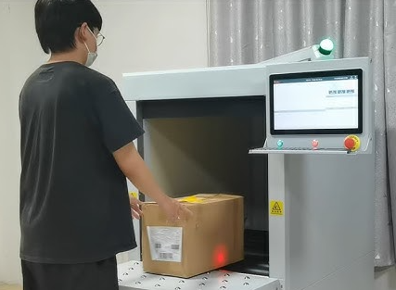



Challenges/Issues
Clients receiving the shipments scan the cartons and often face issues with mismatch in packing list.
Mismatch in counts inside the carton boxes like only 3 items instead of 4
Different styled garments mixed
Different colored garments mixed in Carton

Slide 4
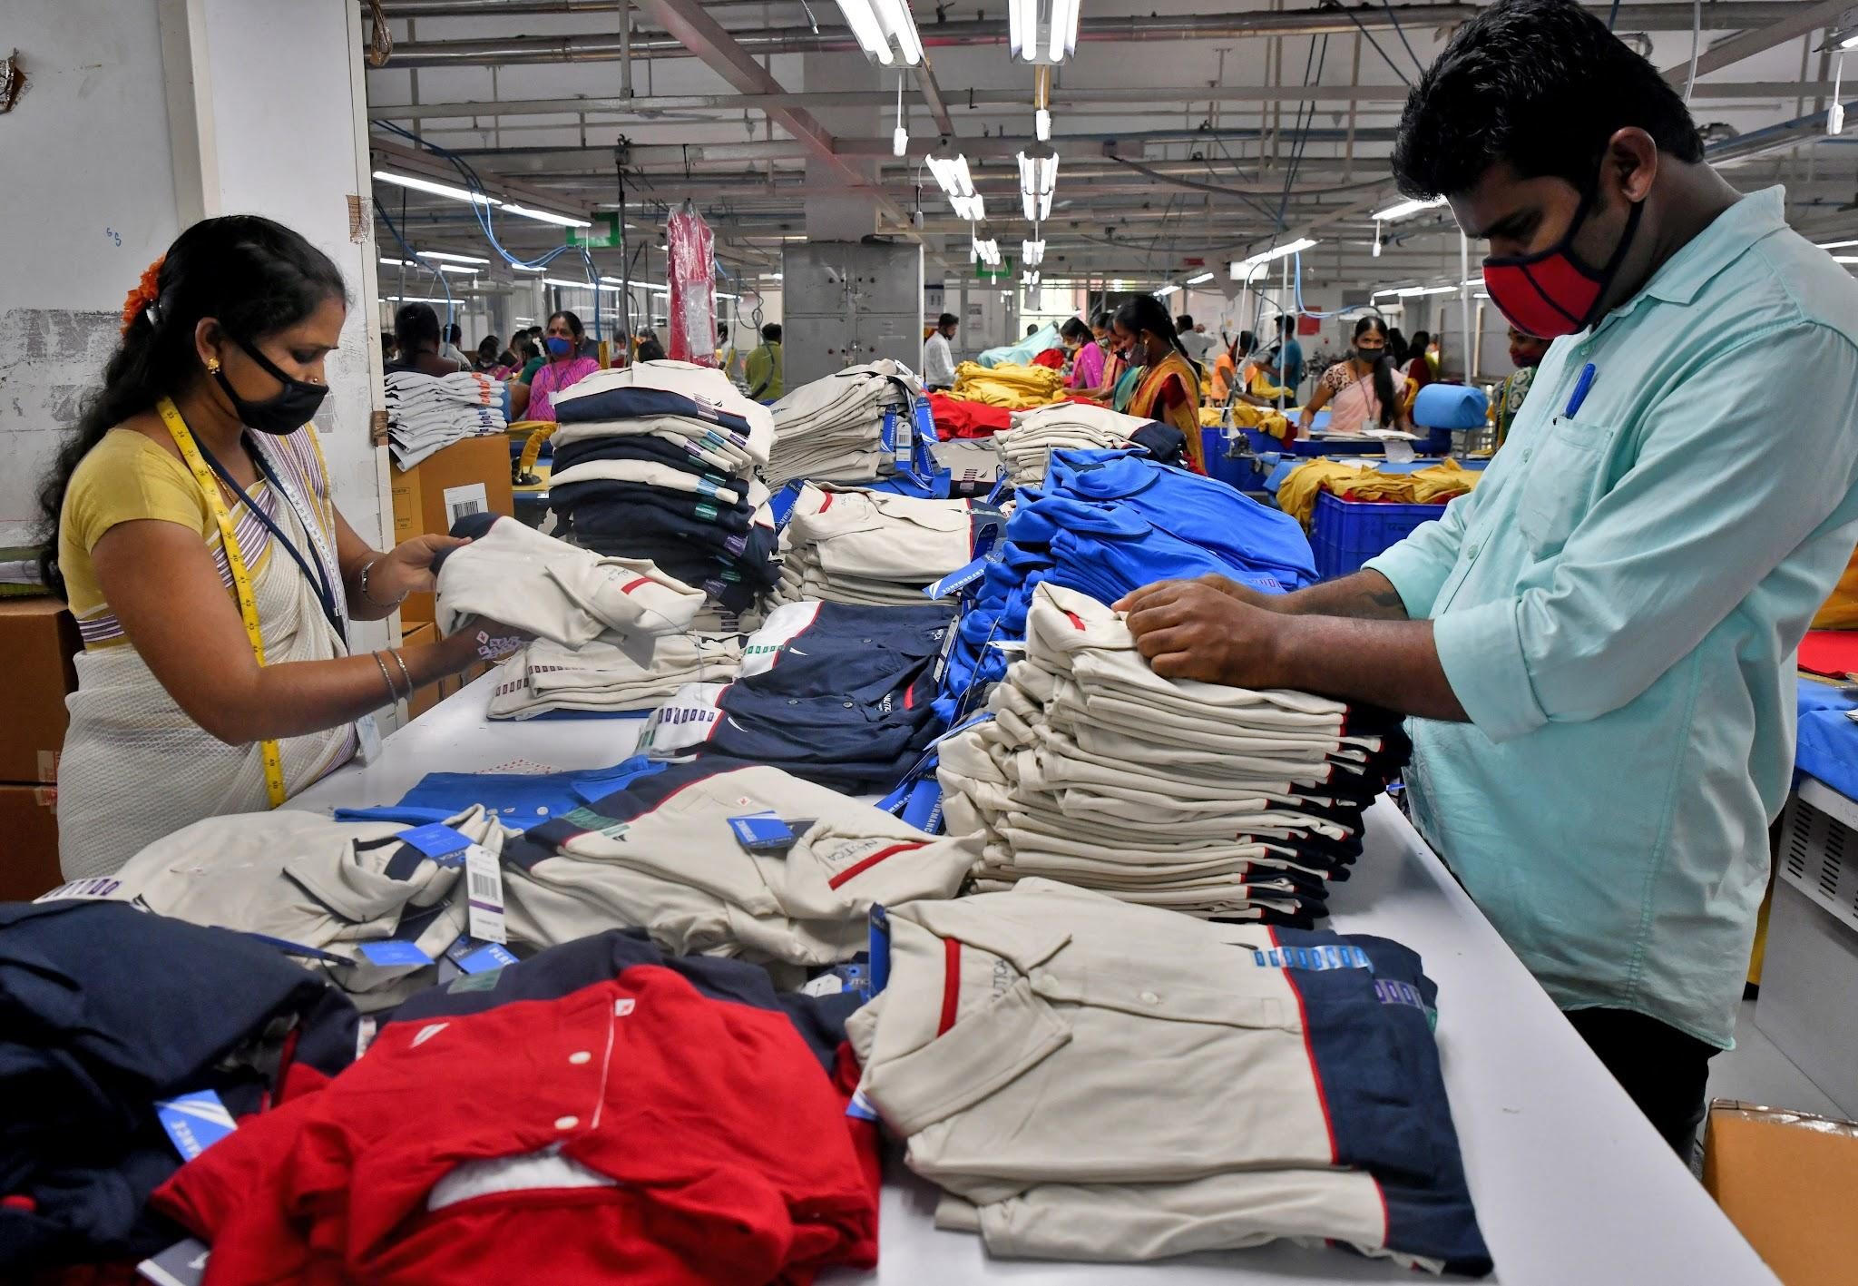
Implementation Design
Visualization of RFID System to eliminate packing errors.

Slide 5

RFID to eliminate packing errors
Individual Garments with Rfid tags in carton boxes are scanned and cross checked with the Rfid Tag pasted on carton.
If there is mismatch like Color, Size and Count alert is raised or packing list for the carton can be printed and sent for shipping.

Slide 6
Benefits of RFID Solution
RealTime Status
Live Monitor
Instant Bottleneck Insights
Realtime
Updates to Clients
Real Time view and insights of packing line for stakeholders thus enabling them to make quick data driven decisions.

Slide 7


What Makes
Us Unique
Company Managed by a seasoned Software Professional with 34 years of information technology experience and 20 years as a Business Owner.
One stop solution. We deliver the Hardware, Software and implement.
Decade of experience in RFID based automations.
Ten+ large scale RFID projects delivered across India.

Slide 8







Our RFID Projects
RFID Automation for Physical Fitness Evaluation Test
RFID driven Library Automation. Book Circulation, Anti Theft, Gate Entry and inventory tracking.

Slide 9
Thank You !
Thanks for spending your valuable time.
If you have any queries, need more info or demo, we will be happy to hear from you and provide customized solution according to your requirements.
SK Mohanraju
SKM Infosis, Chennai
Mb. : +91.8190993355
mohan@skminfosis.com

