Slide 1

SUCCEED AT INTERVIEW AND GET THE JOB
April 26 2024
Audencia Business School
Presented by: Emma, Rohan, Maëva, Simon, Iris

Slide 2

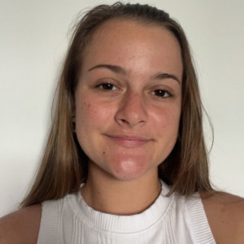



Our Team
Maëva
Emma
Simon
Iris
Rohan
1/22

Slide 3

TABLE OF
Contents
01
01
Introduction
02
Market
03
Competitors
04
Offerings
05
CRM proposals
06
Budget
07
Q&A
2/22

Slide 4
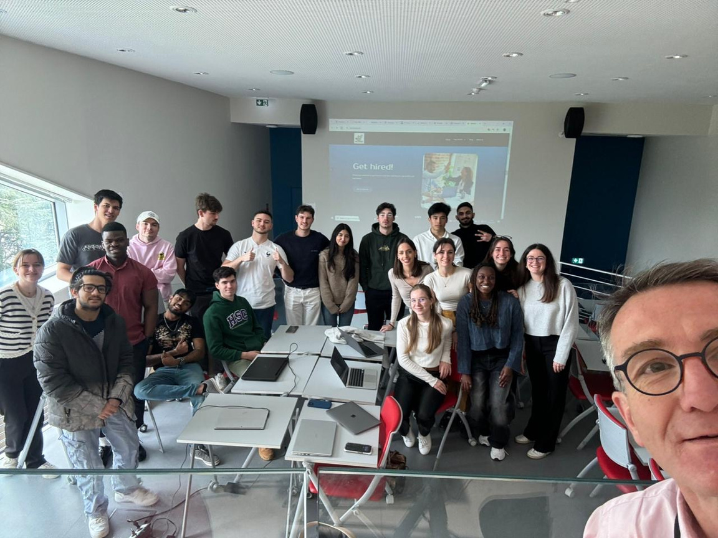




FACTS ABOUT THE COMPANY
Created in April 2024
Funder: Amaury Leclercq
Startup
21 employees
Revenu: none
3/22

Slide 5
“In order to get a job in your new field, a worker will have to re-educate themselves. They will have to go through the whole process of applying for interviews and waiting for replies. It is not easy but it can be done !”
4/22

Slide 6
PROBLEM/SITUATION
  Job seekers often face challenges during interviews, leading to missed opportunities and prolonged job searches.
  These challenges stem from a lack of confidence, preparation or understanding of effective interview strategies.
  Job seekers struggle to present themselves effectively to potential employers, hindering their chances of securing employment.
  A real need for solutions about succeeded interview, especially when economic Crisis
5/22

Slide 7
HOW WE ORGANIZE
  Understanding the subject and the Pain points of consumer
  Market Segmentation and Persona Development
  Competitors Analysis
  Building our Model or Offering
  Client Communication Strategy
6/22

Slide 8
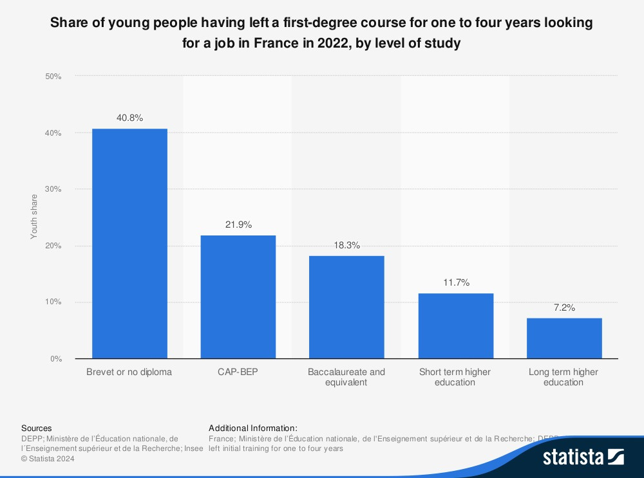
7/22

Slide 9
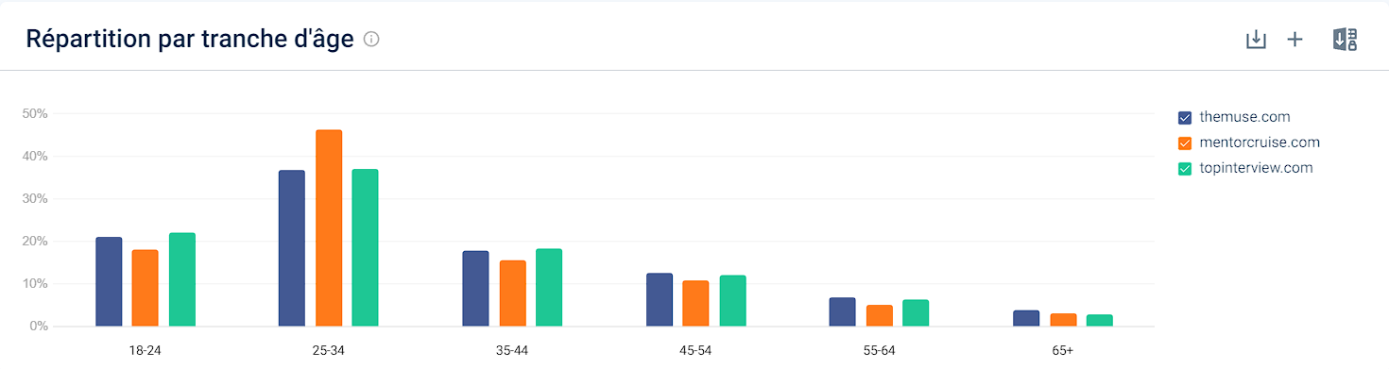
MARKET SEGMENT
First Target Market
8/22

Slide 10




ARTHUR
Situation:
Arthur is a 25-year-old recent graduate, He's ambitious and eager to kickstart his career, but struggling to land a job in his field.
Goals:
  Arthur needs to find ways to stand out from other applicants.
  Building his professional network and connecting with potential job leads is crucial.
  Maintaining a positive and motivated attitude despite rejections is key.
Frustrations
  Dependence: Relying on family or savings to make ends meet is a source of frustration. He longs to be financially independent.
  Feeling Lost: With no job prospects, Leo feels lost and unsure of his future career path.
  Self-Doubt: He starts questioning his abilities and whether he chose the right field of study.
Age : 25
Level of education: Bachelor to Master degree
Psyche: introvert
"I put so much effort into these applications, but it feels like nobody even sees them. It's getting hard to stay positive when you get nothing but radio silence."
9/22

Slide 11

CAROLINE
Situation:
Caroline is a 50-year-old woman, An enthusiastic career changer eager to network and explore new opportunities.
Discouraged and questioning her approach.
Goals:
  Caroline aspires to find a meaningful career that aligns with her interests.
  She wants to leverage her transferable skills.
  Maintaining a positive and motivated attitude despite rejections is key.
Frustrations:
  Limited Opportunities: Finding suitable job openings that don't prioritize recent graduates can be frustrating.
  Feeling Lost: Bridging the gap between her existing skills and the requirements of new careers can be challenging.
  Self-Doubt: Competing with younger applicants with recent education and relevant experience can be daunting.
Age : 50
Level of education: A whole career
Psyche: Determined but scared of being too old
"I know I have the skills and experience to succeed, but I worry that my age might hold me back”
10/22

Slide 12

Reason for targeting CAROLINE
44% of French are planning to switch
Estimated that most people will have 12 jobs during their lives.
The main reason is for a higher Salary
no actual data to back it up.*
11/22

Slide 13




COMPETITORS
  Interview Prep Videos
  Mock Interview Simulations
  Success Stories and Testimonials
  Interview template
  Interview preparation
  Mock Interview Sessions
  Interview Coaching Services
  Body Language and Communication Skills
  Interview scheduling
  Feedback collection
  Interview coaching
12/22

Slide 14


OFFERING
FREEMIUM
PACKAGE
  Newsletters and website content
  Free first call to understand the customer’s need and profil
  1 session
  3 sessions
  5 sessions
  59€
  159€
  250€
PREMIUM
  Personal coaching sessions
  Mock interviews with feedback and tips for improvement
Page 05 of 07
13/22

Slide 15
Service Feature of YoutheBest | Description | Customer Benefit
Mock Interviews | Conducting practice sessions with feedback. | Improves interview performance.
Career Coaching | Providing personalized advice and strategies. | Enhances career clarity and direction.
Skills Training | Courses covering specific interview techniques, stress management, efficient communication. | Enhances employability and job readiness.
Follow-up Support | Assistance after job placement for settling in. | Helps with successful job transition.
Online Resources | Access to articles, videos, and tutorials on Interview. | Provides continuous learning and support.
14/22

Slide 16
CRM | Proposal | Implementation | Outcome
Personalized Email Campaigns | Develop a series of automated email campaigns tailored to different segments of job seekers based on their career level, industry, and specific needs. | Targeted content addressing common pain points and providing valuable resources (interview tips, resume guides, and success stories) | Increased engagement and conversion rates as job seekers receive relevant and timely information.
Client Feedback Surveys | Implement a post-coaching or training feedback survey to gather insights from clients on their experience and satisfaction levels. | Create a customizable survey template and automate the sending of surveys after each coaching or training session. | Continuous improvement of services, ensuring that offerings meet the evolving needs and expectations of job seekers.
Appointment Reminders and Follow-ups | Implement automated appointment reminders and follow-up communications to enhance client engagement and retention. | Set up CRM triggers to send reminders for upcoming coaching sessions or interviews via email or SMS. Follow up with personalized messages post-session. | Improved client satisfaction and retention rates as job seekers feel supported and valued throughout their journey, leading to positive reviews and referrals.
15/22

Slide 17

Personalized Email Campaigns
Personalized email to follow our customer.
    Based emails through a specific data, the date of the interview
    The customer receive reminders:
      before: do they need supplement help for the interview
      during: remind them we are here, if any questions
      after: emails personalized to help them, giving them offers and support
16/22

Slide 18
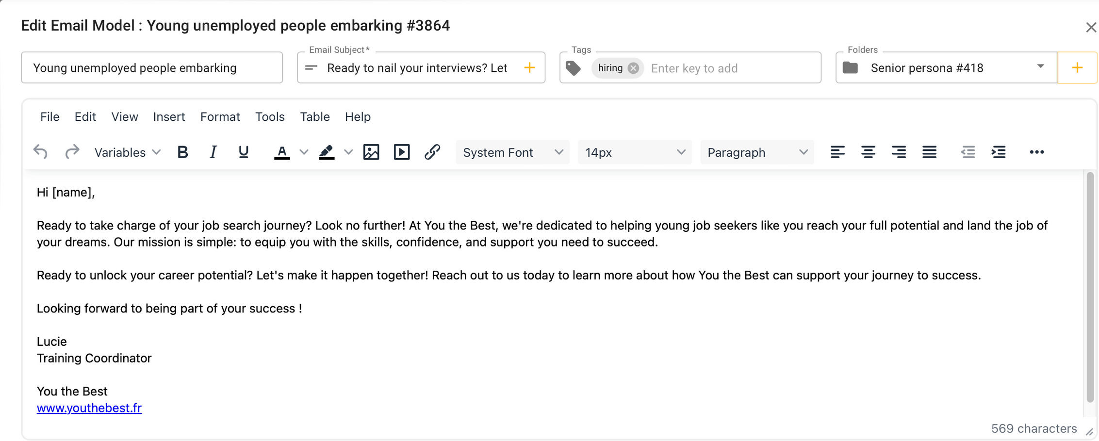
17/22

Slide 19
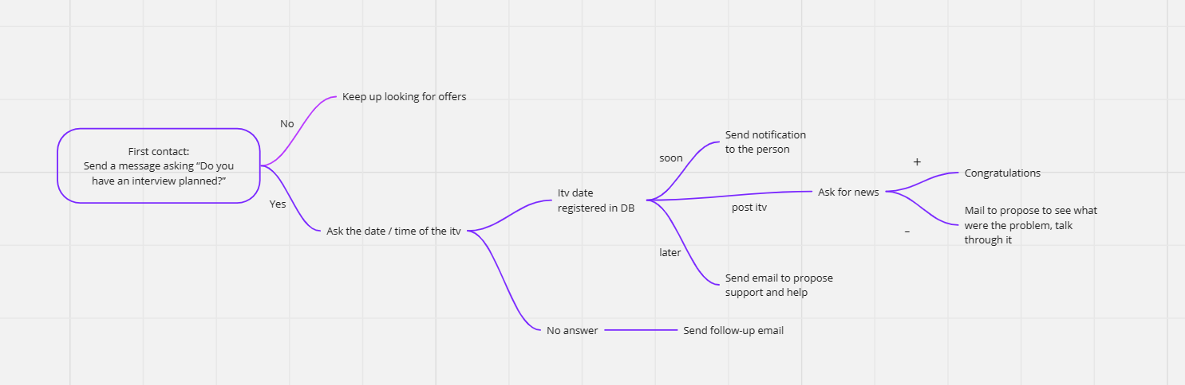
SCENARIO
18/22

Slide 20
COMMON CUSTOMERS QUESTIONS
"What types of job interview questions do you specialize in preparing candidates for?"
"What specific resources or materials do you provide with your subscription?"
"Can you customize coaching sessions based on my specific industry or job role?"
"Do you offer mock interviews as part of your coaching services?"
"Are there any additional features or benefits included in the subscription?"
"How frequently can I access coaching sessions with my subscription?"
"Do you provide feedback and follow-up support after coaching sessions?"
"Are there any success stories or testimonials from previous clients available?"
"Can I cancel or modify my subscription plan at any time?"
These questions will be answered in a specific section of the website and by the Chatbot
19/22

Slide 21
BUDGET
Customer service: 21k per year
Coaches : 19 euro per session
Newsletter writer : AI Tools like MailChimp / hubspot
Content creator : 36k per year
20/22

Slide 22

SUMMARY
  Understanding the problem
  Create a solution
  Engage with clients with offers :
  Free Content (videos, newsletters)
  Premium Content (coaching sessions)
  Different packages ( 1,3 & 5 sessions)
  Personalized E-mailing
All that to help you to get your Dream Job
21/22

Slide 23
Sure, here are five blog post ideas along with potential content suggestions:
1. **"Top 10 Most Common Interview Questions and How to Answer Them"** IRIS
- Content: Break down each question, provide tips on how to craft effective responses, and offer examples of strong answers. Include insights on what interviewers are looking for in each response.
2. **"The Power of Body Language: How to Ace Your Interview Non-Verbally"** EMMA
- Content: Discuss the importance of body language in interviews and provide tips on maintaining confident posture, making eye contact, and using gestures effectively. Offer advice on how to interpret and respond to the interviewer's body language cues.
3. **"Preparing for Different Types of Interviews: Phone, Video, and In-Person"**
- Content: Guide job seekers through the unique challenges and strategies for phone, video, and in-person interviews. Include tips on managing technical aspects, creating a professional environment, and adjusting communication styles for each format.
4. **"Mastering the Art of the Follow-Up: How to Leave a Lasting Impression After Your Interview"** MAEVA
- Content: Explain the importance of post-interview follow-up and provide guidance on crafting thoughtful thank-you notes or emails. Offer suggestions on what to include in the follow-up message and how to maintain professional communication with the interviewer.
5. **"Navigating Tricky Interview Situations: Addressing Resume Gaps, Salary Expectations, and Tough Questions"** SIMON
- Content: Address common concerns and challenges that arise during interviews, such as explaining resume gaps, discussing salary expectations, or responding to unexpected questions. Provide strategies for handling these situations gracefully and confidently.
Each of these topics aims to provide valuable insights and practical tips to job seekers preparing for interviews, aligning with your startup's mission to help them succeed in securing employment.

