Slide 1





Introspection
&
self-promotion
25 april 2024, Nantes
Presented By: Vansh, Peter, Mathew, Mila and Ilona
1

Slide 2









Vansh
Peter
Marketing Team
Mathew
Mila
Ilona
2

Slide 3

Overview
  What is the situation ?
  How did we proceed ?
  Fast facts You,TheBest
  Fast facts about the service
  Overall pictures of analysis
  Proposals
  Explanation
  Summary
3

Slide 4
“
80% of candidates use at least 5 websites to find a job
“
Source : StepStone, 2018
one of the world's leading job platform
4

Slide 5








WHAT IS THE SITUATION ?
We have identified 3 main problems:
Competitors :
Not enough free resources
Insufficient Post-Service Support
Calle Cualquiera 123, Cualquier Lugar
Lack of personalization
5

Slide 6
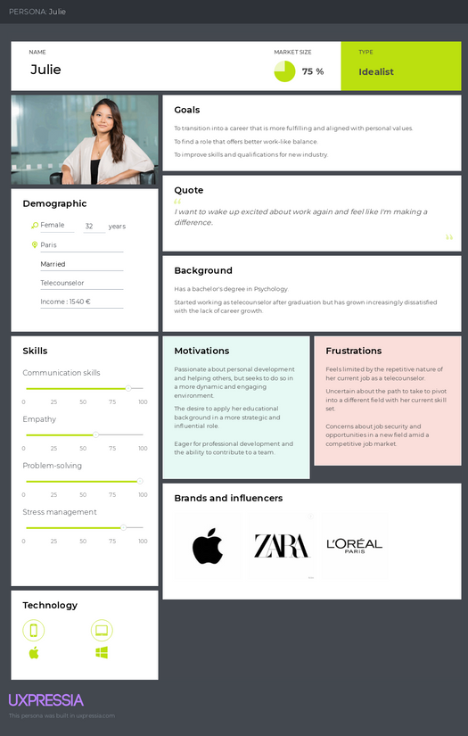



How did we proceed ?
01
02
03
Identify the personas
Choice of Marketing Channel
Freemium Model
6

Slide 7

Fast facts about You,TheBest
A start-up in the field of service for job seekers.
Founded by : Jane Doe, a former HR executive, and John Smith, a software developer
Private company
5
founded in :
2023
employees
KPI # 1
First-year estimated revenue : 50k

Slide 8

Fast facts about the service
Sector: Employment and Career Development Services
Business Model:
- Type: Technology-Driven Employment Services
- Monetization: Freemium model
Product Range:
- Free Offerings: Basic job advice, resume templates, interview tips, community forums
- Premium Offerings: Personalized coaching, advanced resume critiques, mock interviews, exclusive events, career tools
Service Details:
- Comprehensive Coaching
- Advanced Resume Tools
- Interactive Interview Prep
- Exclusive Networking
- Career Development Courses
KPI # 1

Slide 9

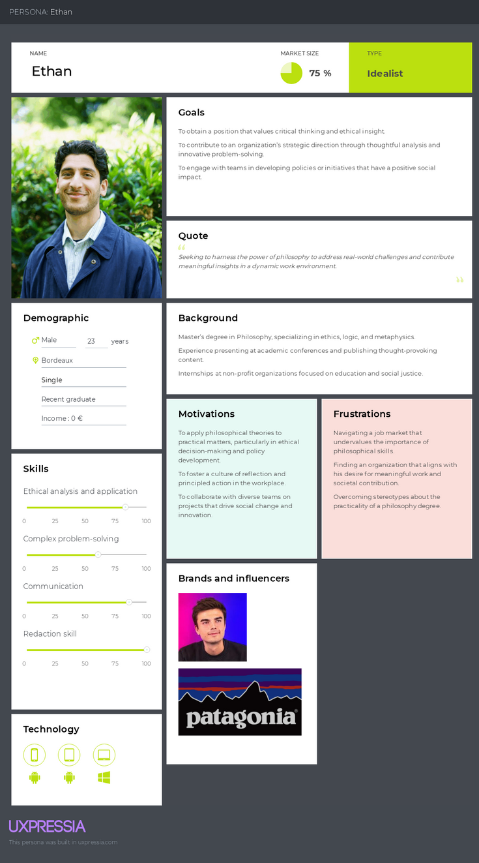
Fast facts about the persona
KPI # 1

Slide 10
JULIE

Slide 11

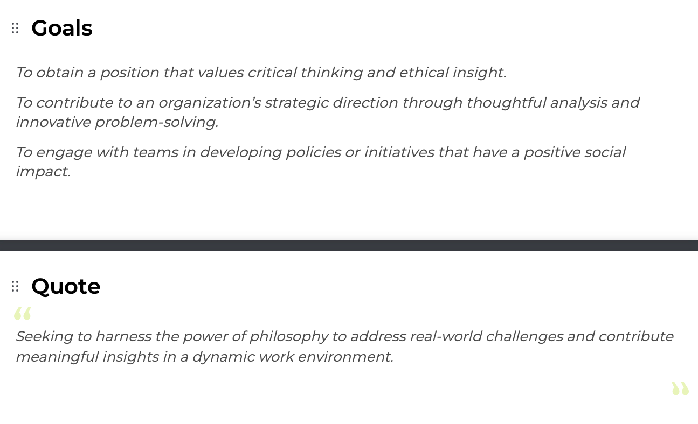
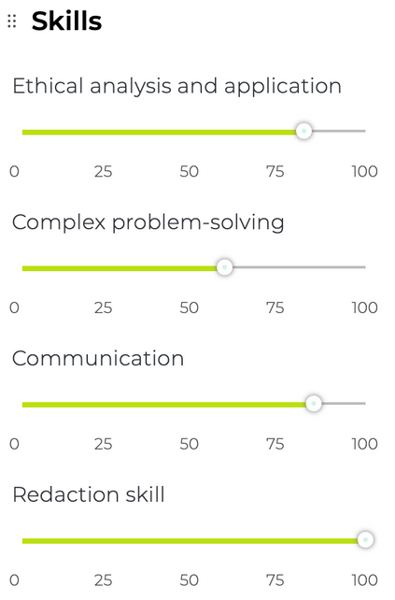
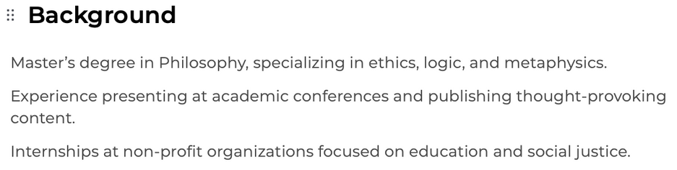
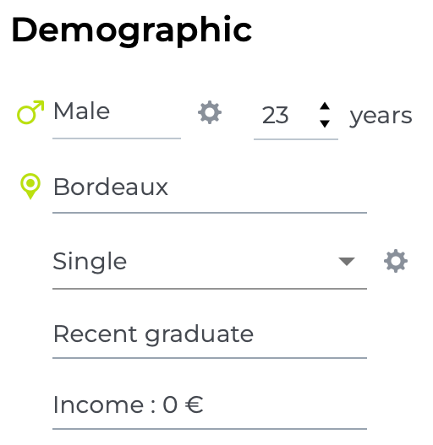
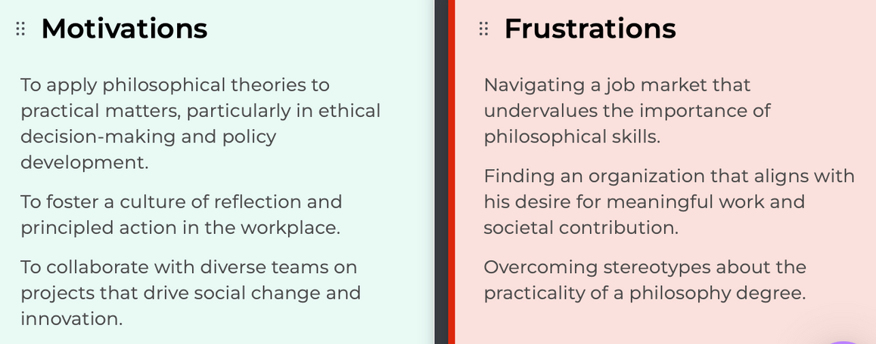

ETHAN

Slide 12

Overall picture of analysis
Main pains | How to solve problems ?
Lack of personalization | Customized Career Pathways
Not enough free resources | Open Access Resource Hub
Insufficient Post-Service Support | Continuous Engagement Program

Slide 13
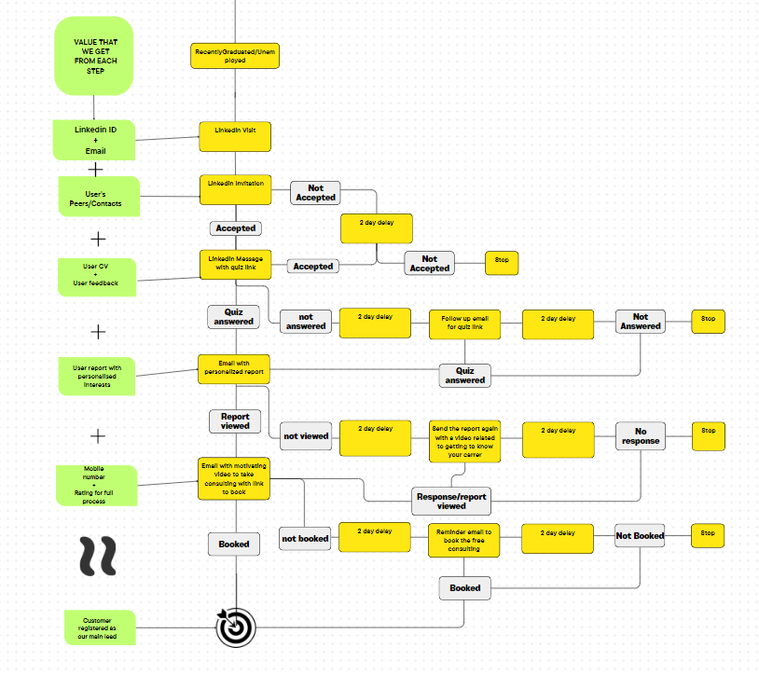
Proposals
Link

Slide 14
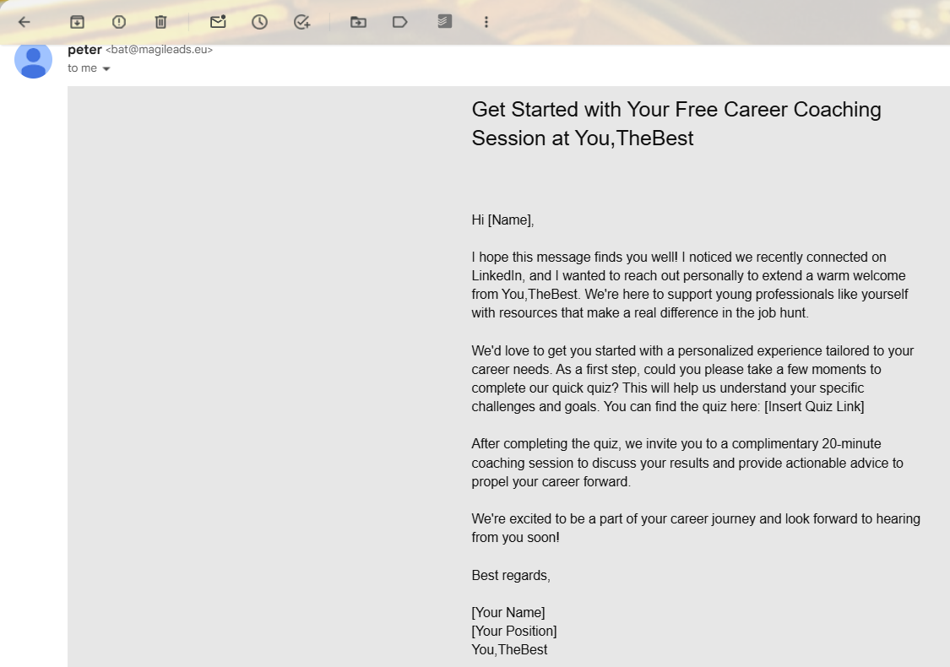
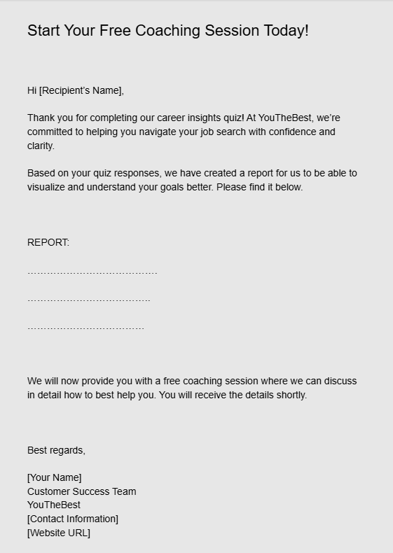
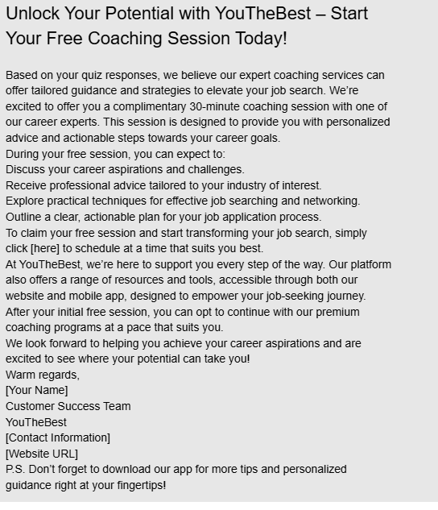

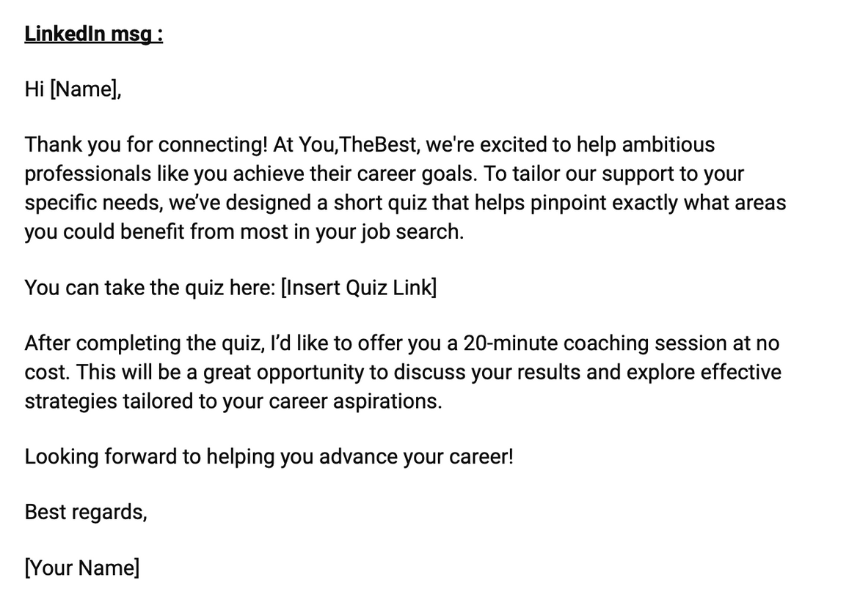

Slide 15
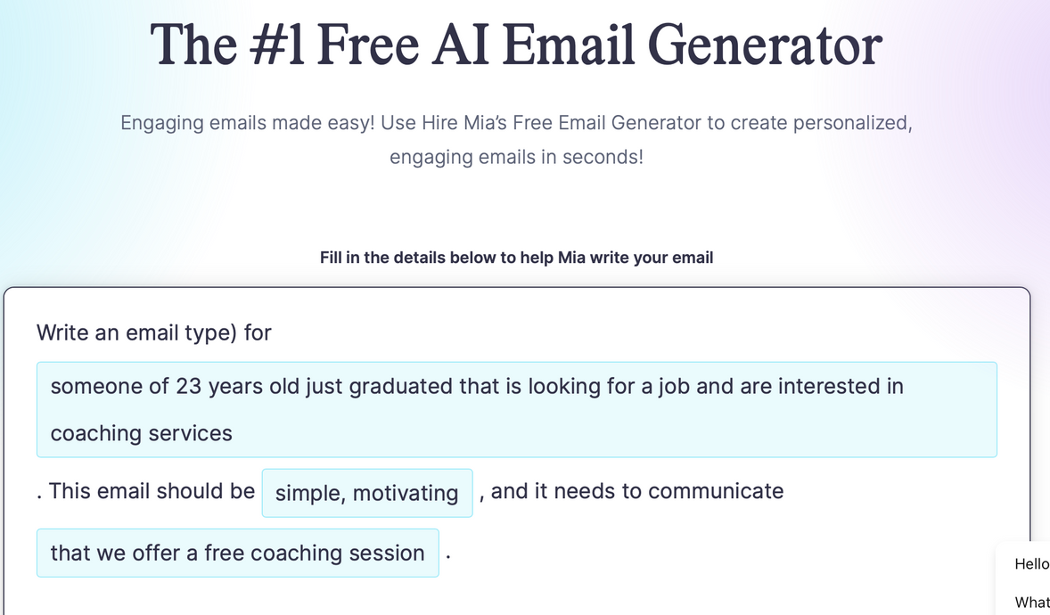
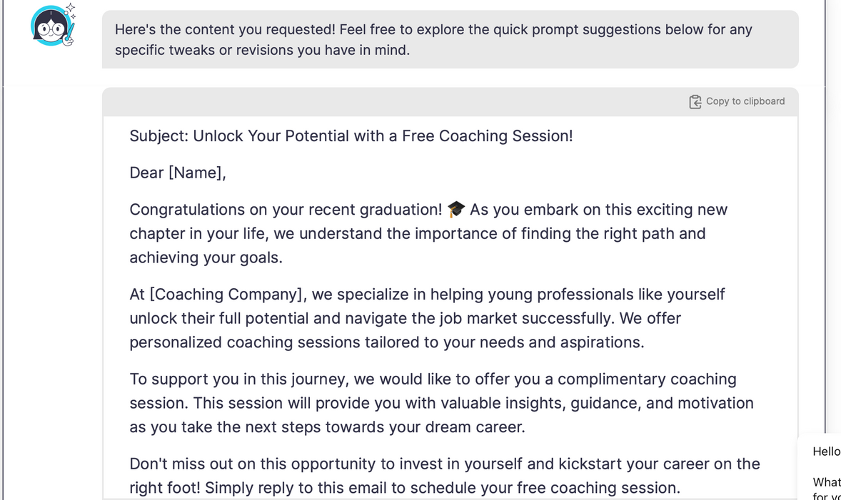
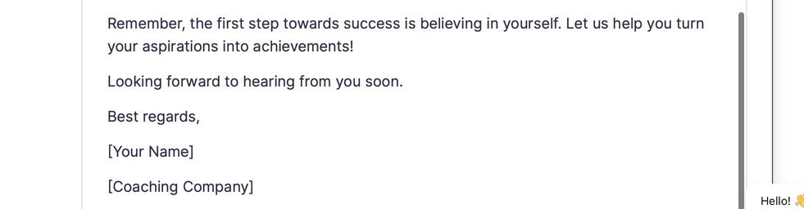
Emailing
KPI # 1

Slide 17

Summary
Competitors
Analysis on the market
  Finding typical customers
  Understanding how the markets works
  Who is in our market
  How do they operate
  What do they offer
  What are they lacking
Pain point of consumers
Operations
  Type of customers
  Their needs and goals
  How we will work
  Getting customers
  How we help them

Slide 18
THAK YOU FOR LISTENING !
ANY QUESTIONS?
Calle Cualquiera 123, Cualquier Lugar

