Slide 1


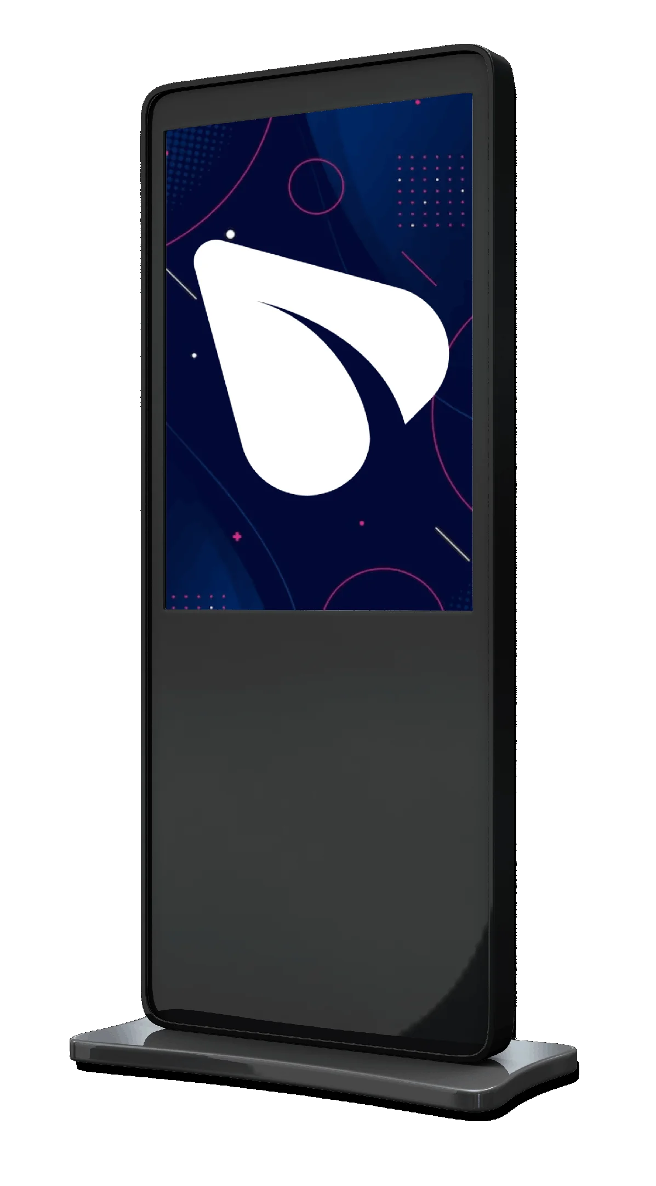

DIGITAL AND COST-FREE SOLUTION FOR IN-STORE ADVERTISING CAMPAIGNS

Slide 2
Who We Are?
We are a global company with a strong presence in Dubai, Turkey, Germany, and Azerbaijan. We work with over 100 hotels, hospitals, stores, and government institutions. We have recently started our operations in America as well.
In addition, we have begun partnerships with companies like iFix, Cellaris, and Walmart.
DIGITAL AND COST-FREE SOLUTION FOR IN-STORE ADVERTISING CAMPAIGNS

Slide 3
Traditional In-Store Ads
Bring your brand to life, offering multiple strategies to engage shoppers and adapt to evolving market trends.

Slide 4
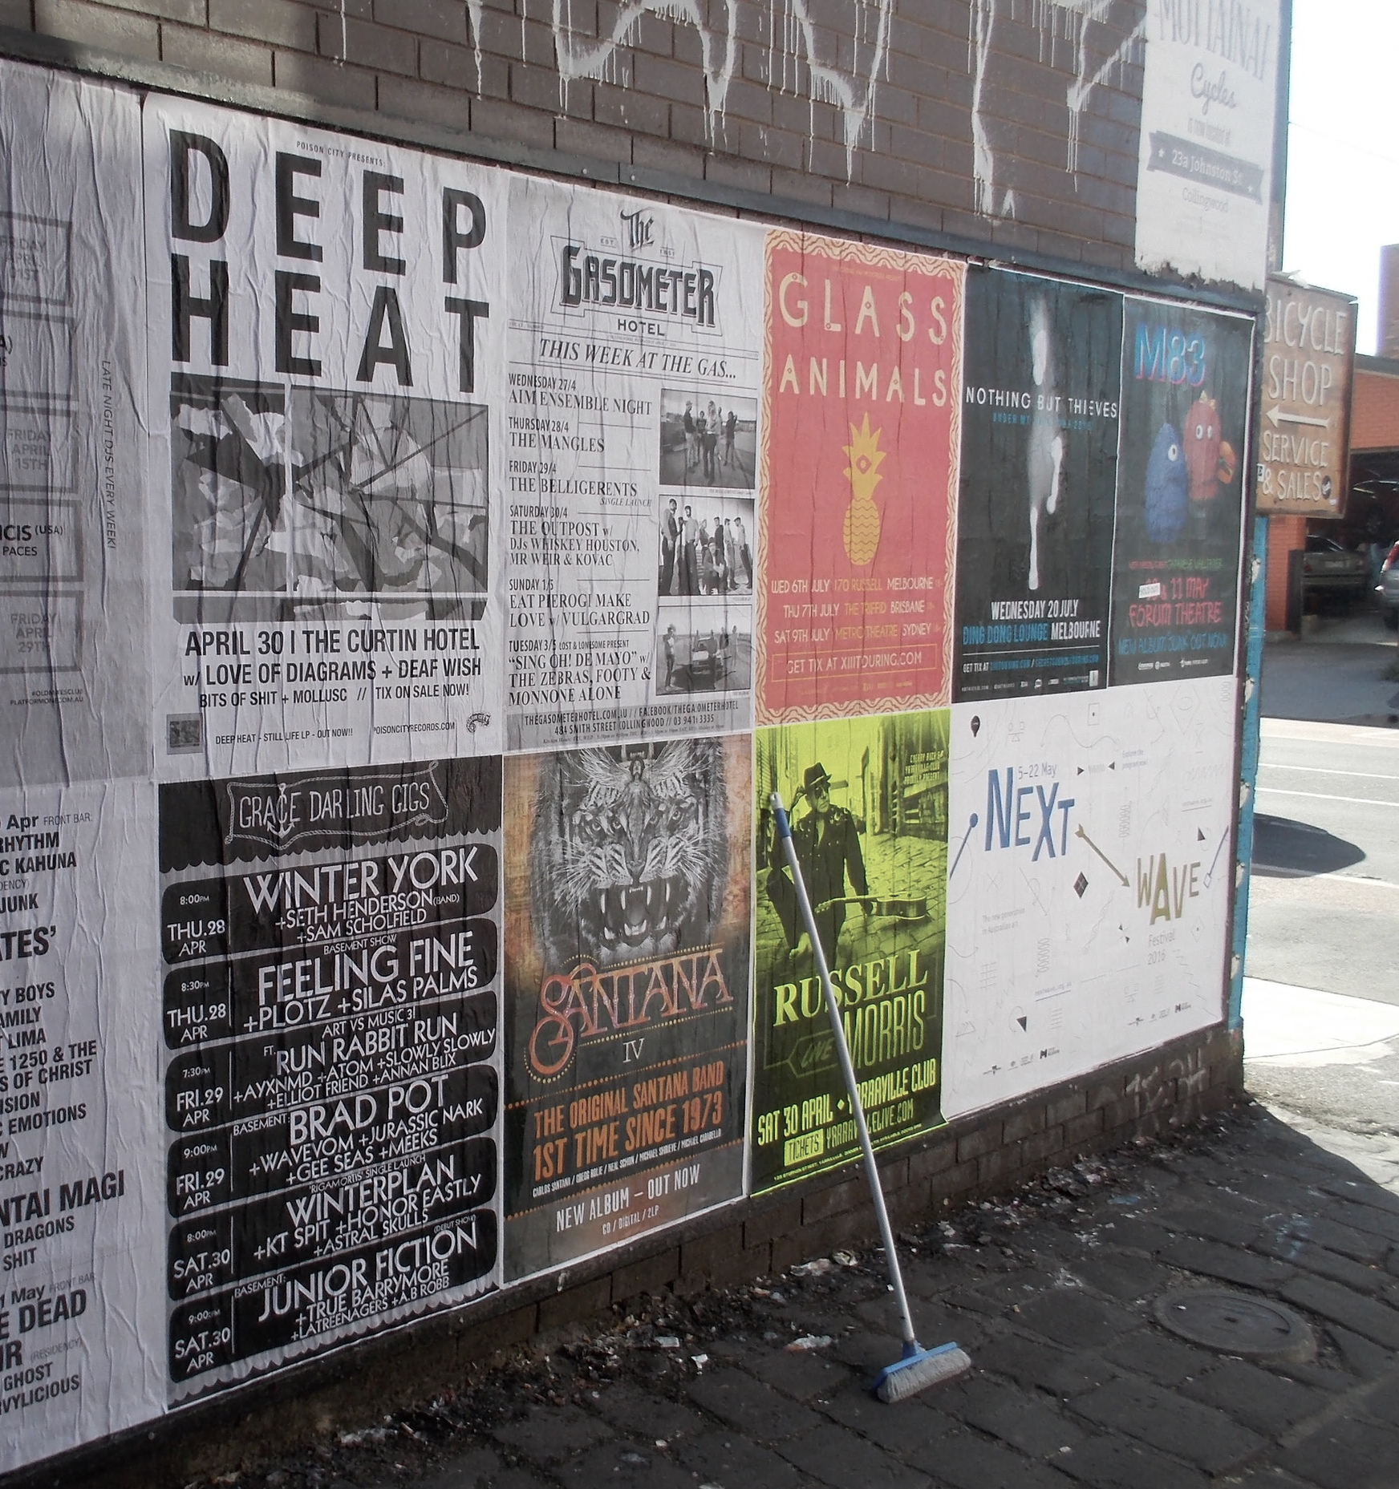
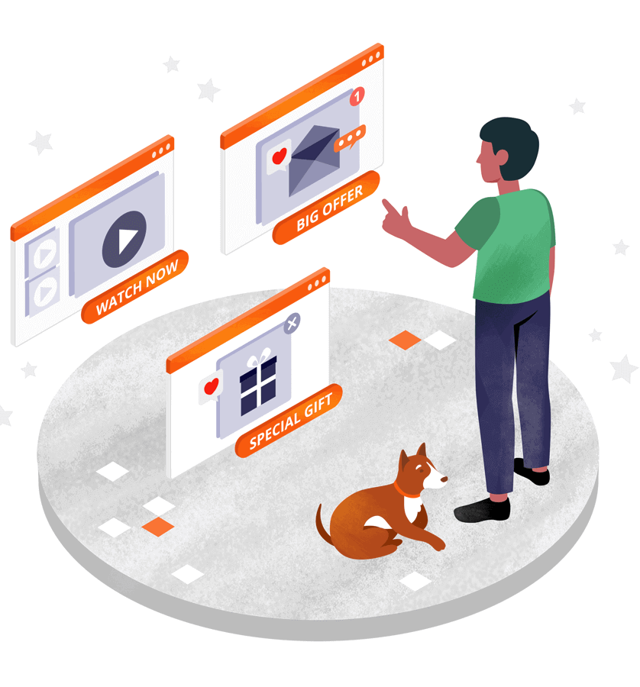
Companies set aside funds for advertising and marketing campaigns. These campaigns include TV commercials, social media posts, newspaper and magazine ads, brochures, and internal banners. All of these methods help present their products to customers.

Slide 5

In store Print Ads
Among these, print banners are one of the most expensive investments. Companies often overlook the full cost, which includes designing, printing, installing, and removing them. Once used, these banners become waste and cannot be reused. That's why we offer you a digital solution.

Slide 6
Digital Solution
Modern & Professional Look
Long-Term Durability
Elevate brand perception with sleek, high-tech displays.
Built to last, ensuring consistent performance and minimal downtime.

Slide 7


Digital Solution
Ultra-Clear Resolution
Enjoy crisp visuals that demand attention and deliver your message effectively. Every detail pops in vivid clarity, ensuring greater engagement from viewers.
Multiple Ad Slots
Run up to 25 different ads—from simple slideshows to high-impact videos and animations—on a single screen. Keep your promotions fresh and diverse without any additional overhead.

Slide 8

Benefits from Digital Screens
Promoting CVS Brand Offers & Loyalty Programs
Display exclusive discounts, ExtraCare rewards, and weekly promotions.
Highlight flu and COVID-19 vaccinations and health services.
Enhancing Customer Experience
Showcase health tips, seasonal campaigns, and educational content.
Create a modern and technology-driven in-store environment.
Pharmacy & Health Services Promotion
Advertise prescription discounts, MinuteClinic services, and medication reminders.
Share information about insurance partnerships and Medicare/Medicaid options.
Partner Advertising Opportunities
Offer premium advertising placements for CVS health and wellness brands.
Provide ad space to consumer brands sold in CVS stores for additional revenue.

Slide 9
Eco Media Offer's
We provide a comprehensive digital advertising package that offers a modern alternative to traditional print banners.

Slide 10
Eco Media Offer's
Free Digital Banner Get a high-quality digital banner at no extra cost.
Professional Installation Our team sets up your banner quickly and correctly.
Fully Insured Equipment Our equipment is fully insured, giving you peace of mind.
Centralized Content Control Easily update and manage your digital content from one place.
Affordable Support Enjoy monitoring and IT support for just $199 per month.

Slide 11

Included in Our Subscription
You can focus on what matters—your business—while we handle the rest.
5-Year Warranty
01
5-Year Term
02
All-Inclusive Service
monitor sizes, advertising goals, and budget—while enjoying the benefits of a secure 5-year term that provides long-term stability and support.
From delivery and installation to ongoing maintenance, everything is included in your monthly fee.

Slide 12
Boosted brand visibility
Your Own Advertising
Stronger customer engagement
Subscription Business Model
New revenue stream
Income from Partner Ads
Optimize expenses to boost net profit

Slide 13



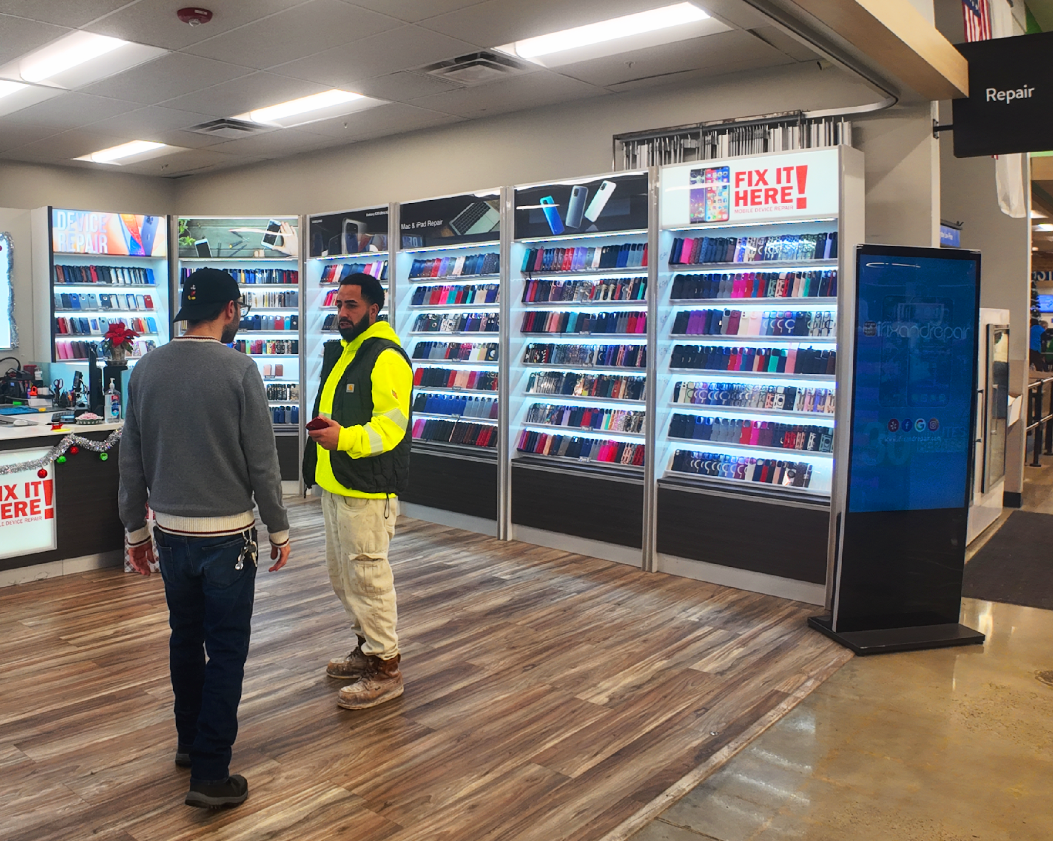
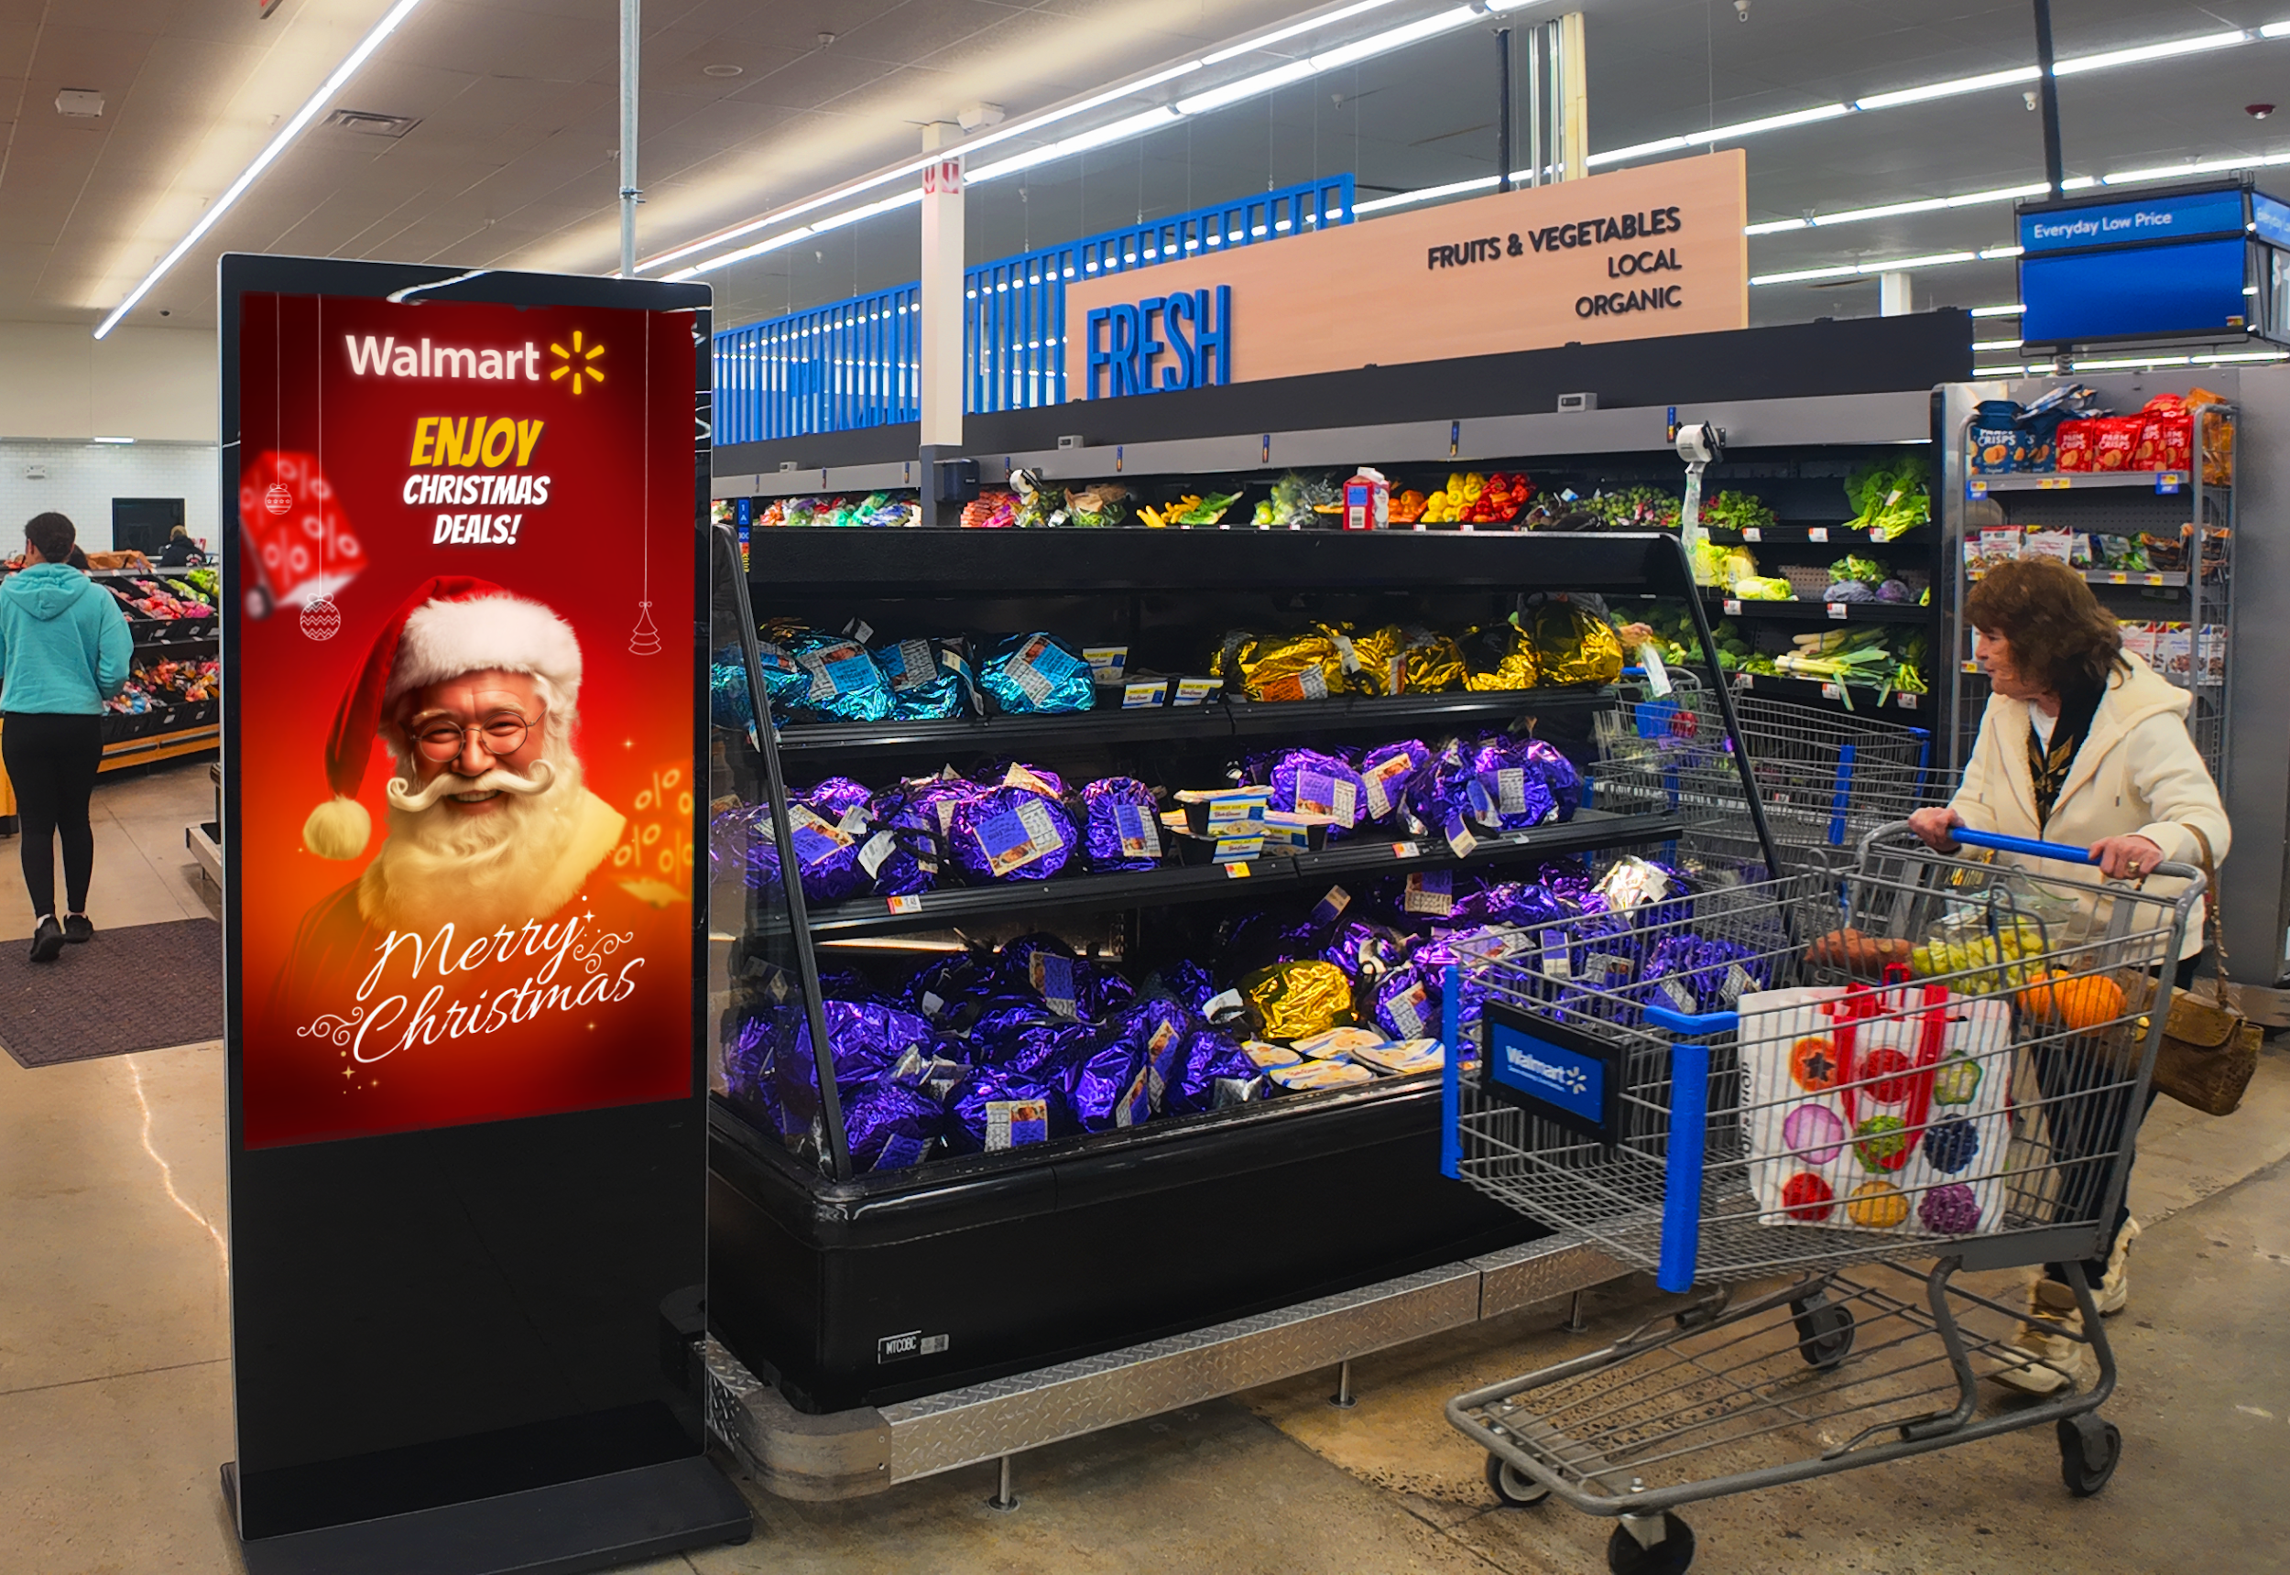
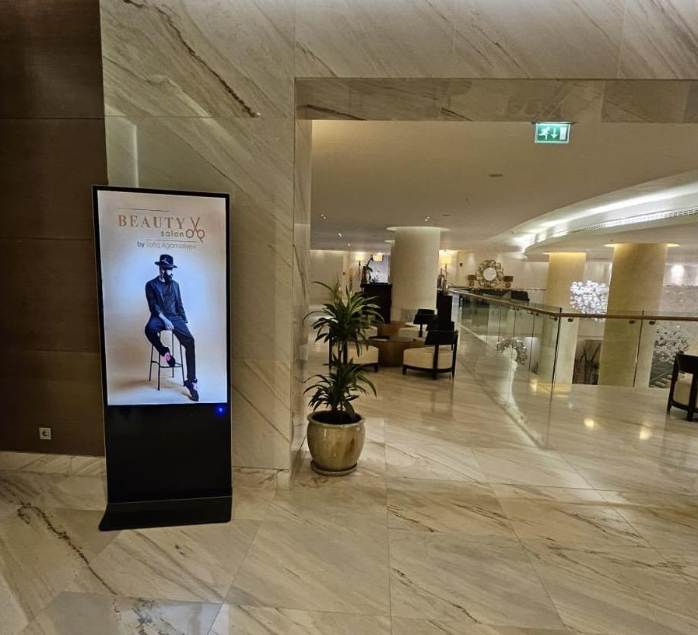
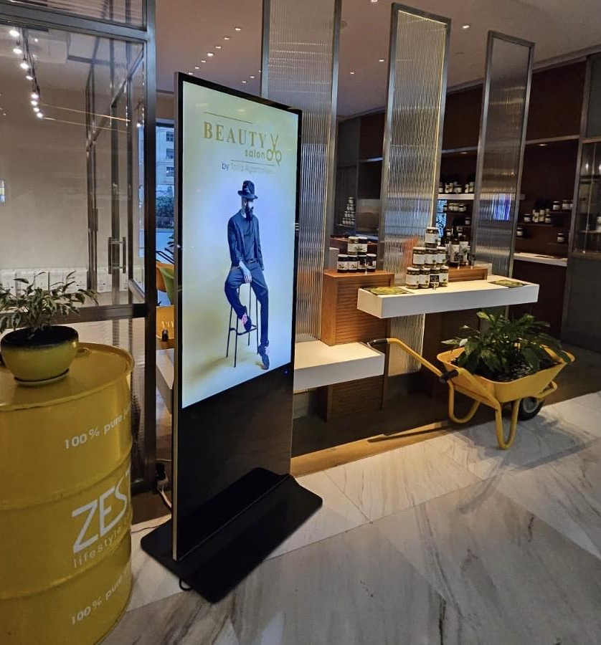
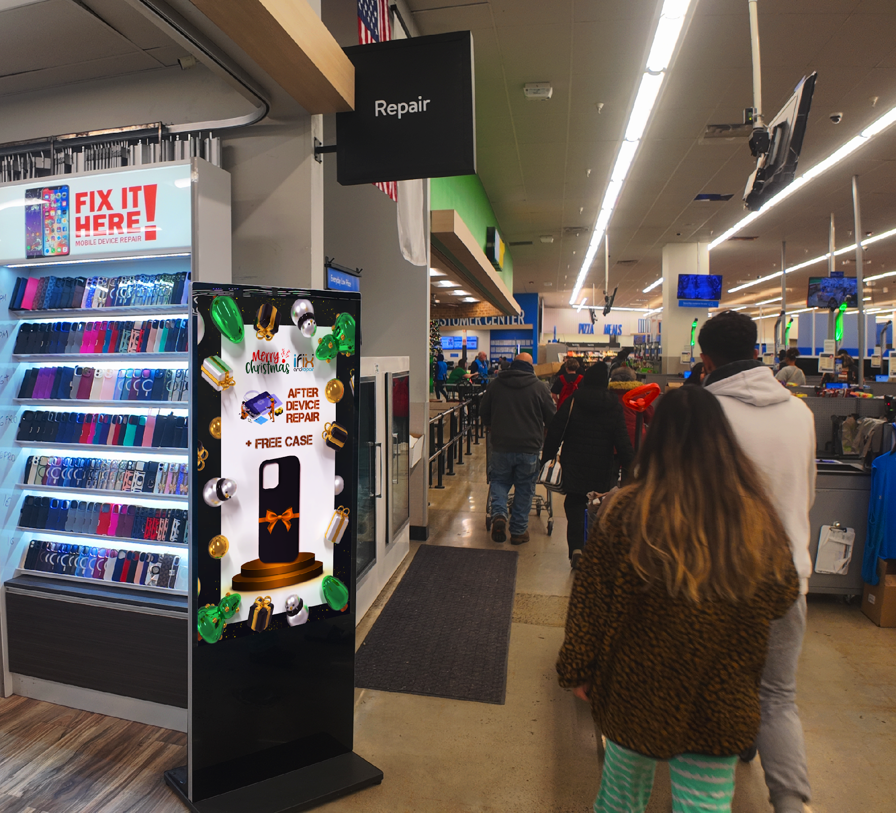
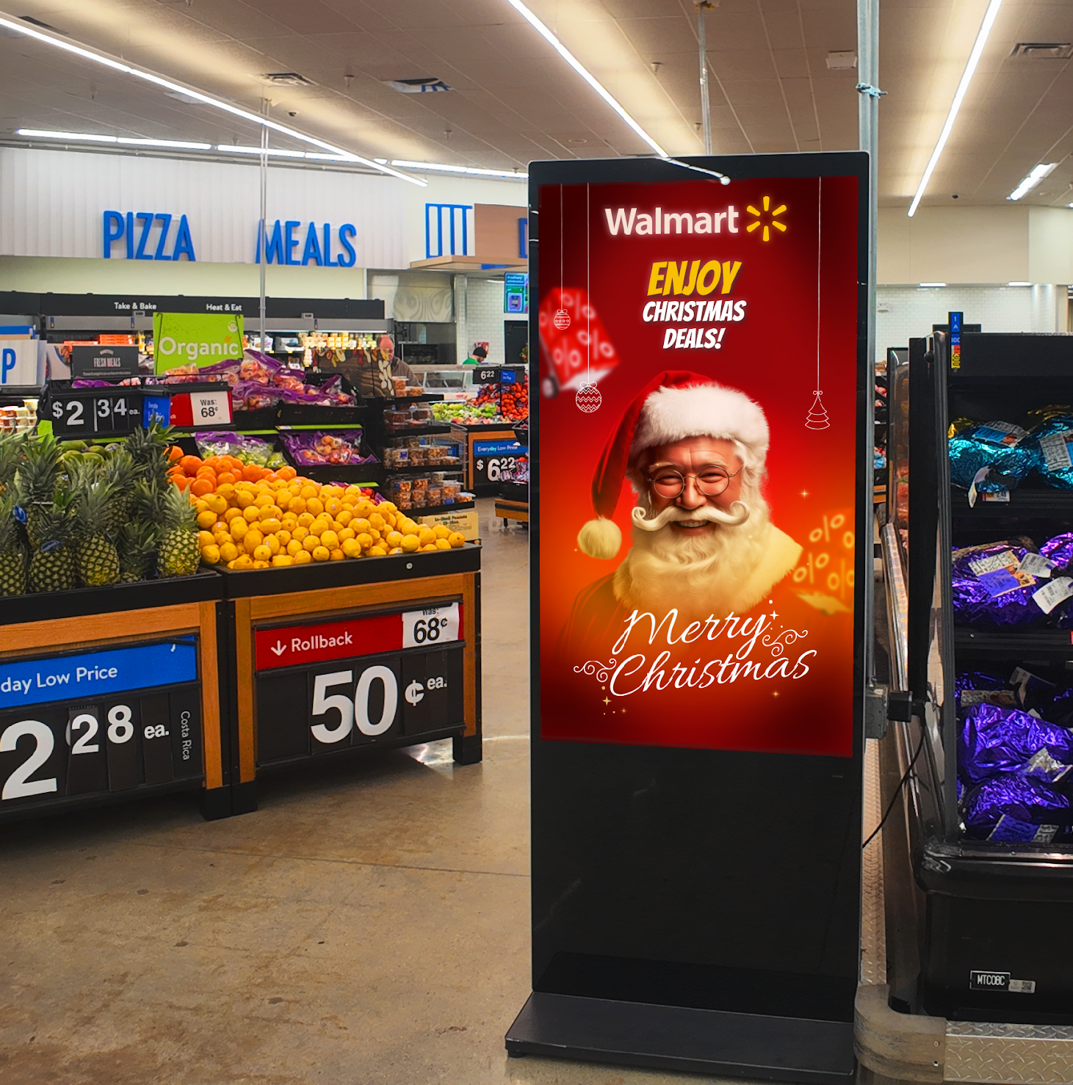
Our Partners

Slide 14

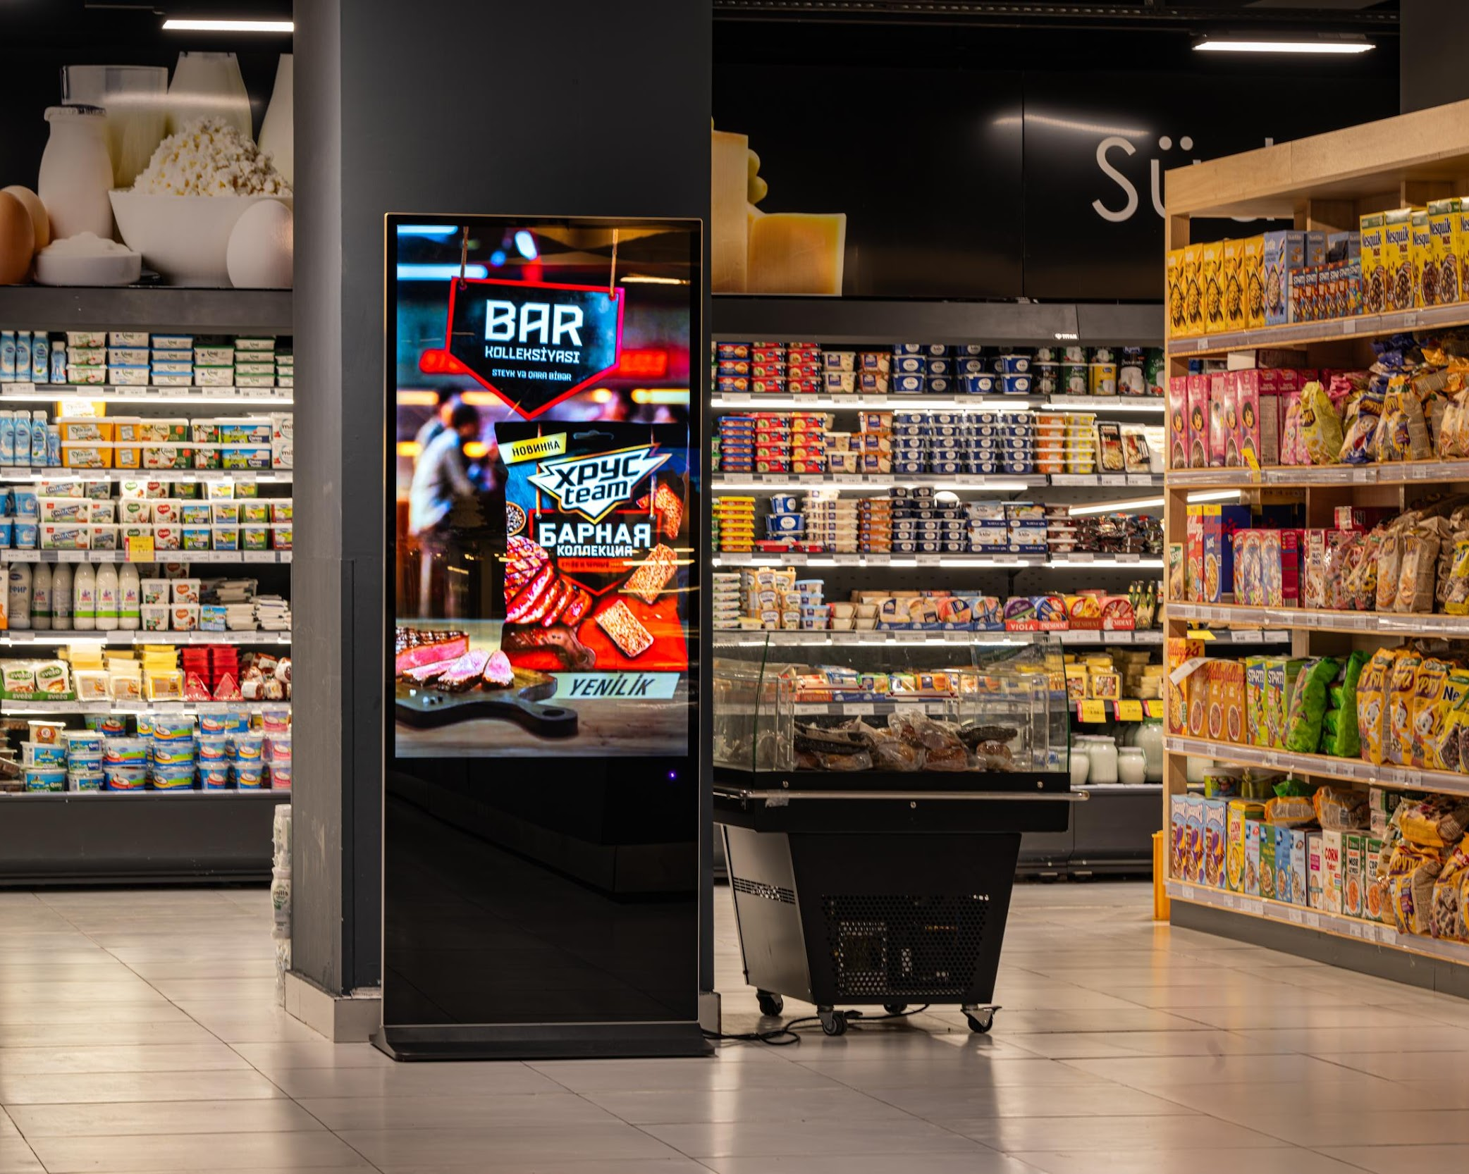
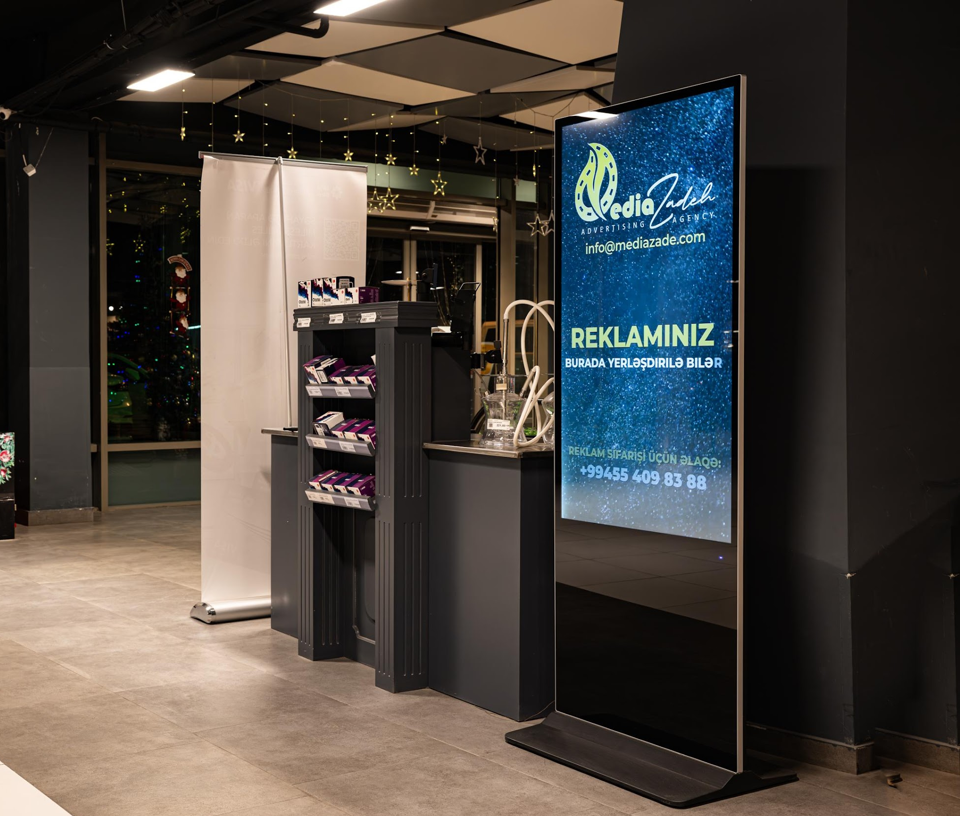
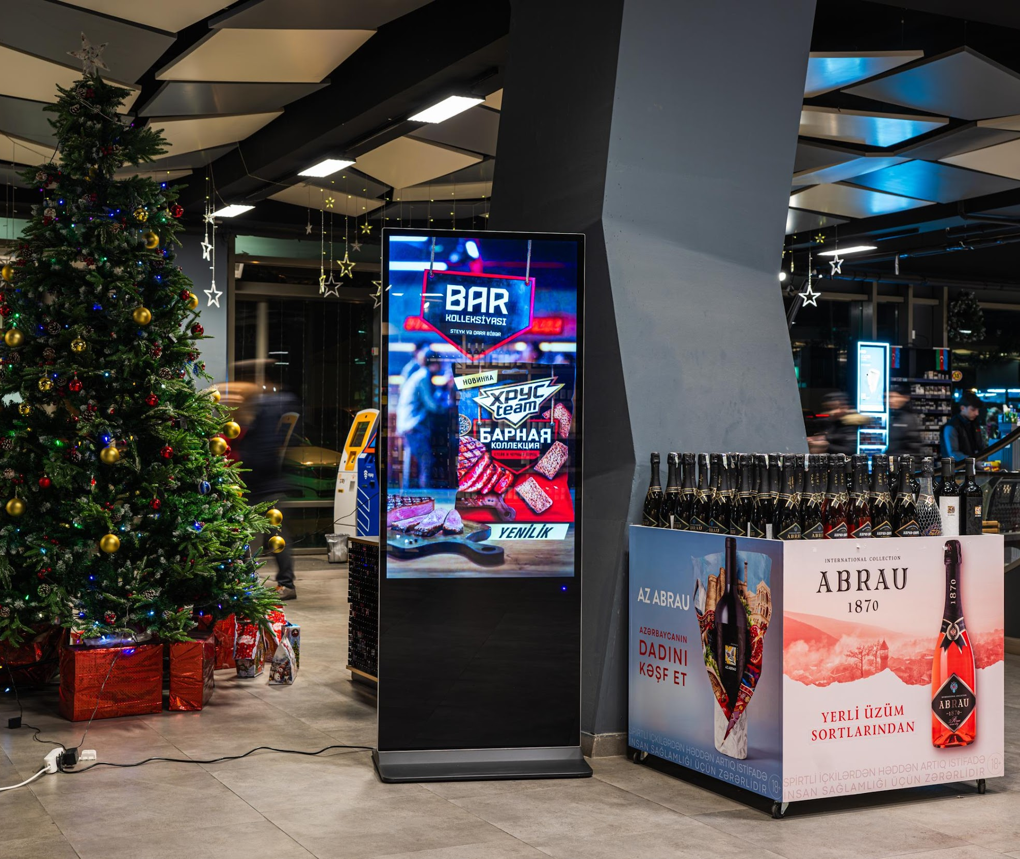
Our Partners

Slide 15
Why Go Digital?
Fast Tech Growth AI and digital tools are driving rapid change. Staying updated is key.
Stay Competitive Traditional methods can hold you back. Going digital keeps you in the race.
Cut Costs & Waste Digital saves money by eliminating printing, shipping, and installation costs, and reduces waste.
Boost Efficiency Digital systems offer quick updates and better control over your business.

Slide 16
Our Goal
Our partnership is built on helping companies cut down on spending for outdated print advertising, which in turn increases their revenue. This approach not only benefits your bottom line but also makes a significant positive impact on the environment. Together, let's unite, innovate, grow, and, most importantly, protect nature.

Slide 17
Do you have any questions?
agil@ecomediaservices.com
+1 401-286-1414
ecomediaservices.com

Slide 18
Simple Installation Process
A Smooth Transition from Paper to Digital.
Remove Old Banners: Clear out the clutter and stop contributing to paper waste.
Install LCD Monitors: Quickly mount and secure displays for maximum visibility.
Connect to Wi-Fi: Seamlessly integrate with your existing network.
Content Updates: Effortlessly refresh ads as often as needed.

Slide 19
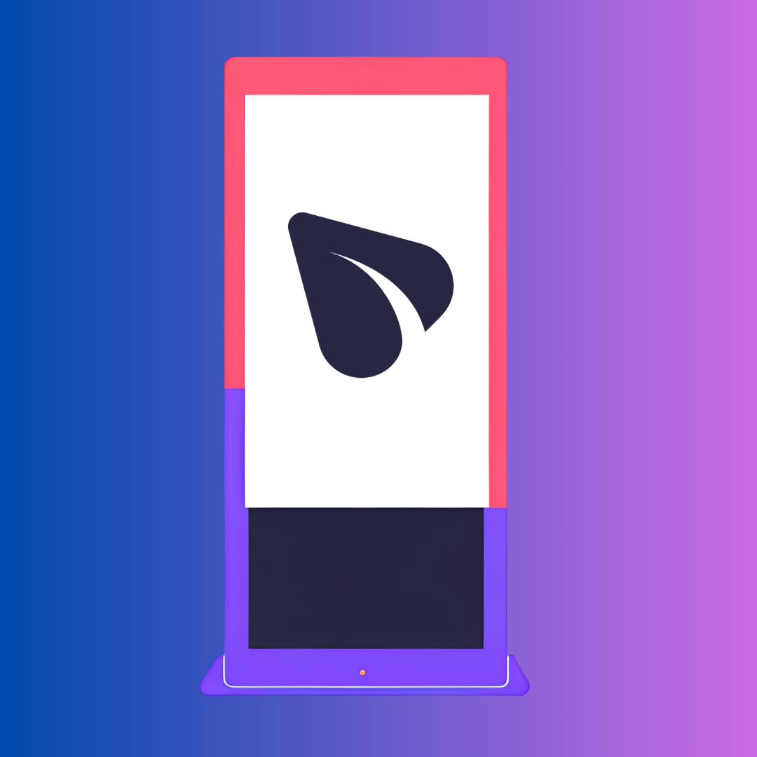
Centralized Content Control
We handle all monitor content from a dedicated, centralized system. Simply provide us with your ads, and our professional team will upload and schedule them for you—no additional software, hardware, or technical expertise required on your end.

Slide 20
Centralized Content Control
Single Control Center
Real-Time Updates
One platform ensures total consistency
Instantly replace or refresh content
Provide Ads
Included in Service
You provide ads, we integrate
No hidden fees, it’s included

Slide 21
Centralized Content Control
With our advanced centralized system, distance is no longer a barrier.
Whether your monitors are located in a single office building or spread across multiple countries, we can manage them seamlessly from our control center.

Slide 22
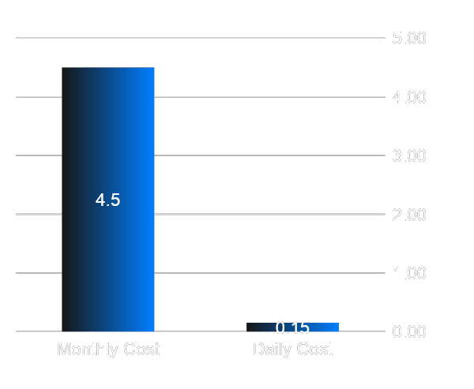
Why is Energy Consumption & Estimated Costs
Monitor typically consumes around 80–150 W. Daily Usage Time for example, if the monitor runs 10 hours per day.
Average Electricity Price Approx. USD 0.12–0.15 per kWh.
Daily Cost: 1 kWh × USD 0.12–0.15 =
USD 0.12–0.15
Monthly Cost (30 days): ~USD 3.60–4.50
Yearly Cost (365 days): ~USD 43.80–54.75

