Slide 1
Foshan You Dun Technology Co., Ltd.
Foshan You Dun Technology Co., Ltd. is a leading provider of innovative energy storage power supply solutions. Our mission is to empower our customers with reliable and efficient products that enhance their everyday lives.
Here are some key facts about our company:
Over 20 patents to protect our innovations
Products sold in over 50 countries worldwide
ISO9001 quality certification

Slide 2
"From the bustling streets of New York to the tranquil shores of Australia, our products have captured the hearts of over 50 countries worldwide. With innovative designs and top-notch quality, we have established a global reputation for excellence. Our commitment to customer satisfaction knows no bounds, as we continue to bring joy and convenience to homes and businesses across the globe. Join us on this remarkable journey as we spread our passion for quality and reliability to every corner of the world."

Slide 3
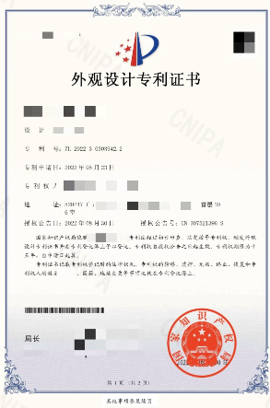
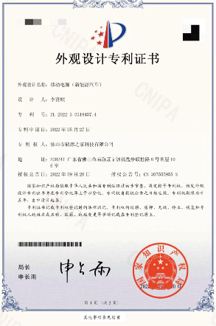
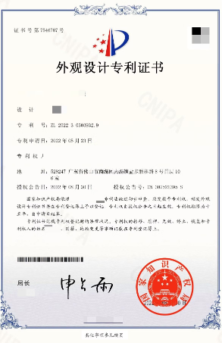
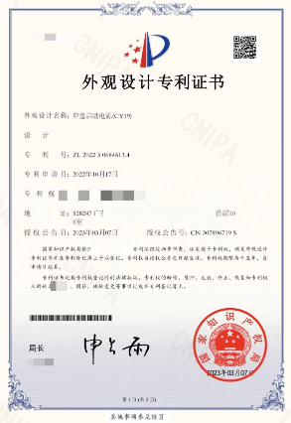
These are some of the patents we have been awarded

Slide 4
Company Overview
Innovative Solutions
Commitment to Quality
With a focus on precision engineering and rigorous testing, the company ensures its products meet the highest standards of safety and performance.
Foshan You Dun Technology Co., Ltd. is a leading provider of cutting-edge energy storage power supply solutions, including car emergency starting power, outdoor mobile power, and advanced car charging equipment.
Customer-Centric Approach
The company's dedicated team works closely with clients to understand their unique needs and deliver customized solutions that exceed their expectations.

Slide 5
Product Line
Car Emergency Starting Power Supply - Compact, high-capacity power bank with jumper cables to quickly start a dead car battery.
Outdoor Mobile Power - Rugged, weatherproof power station with multiple USB and AC outlets for charging devices on-the-go.
Mobile Power - Slim, lightweight power bank perfect for daily use, with fast-charging capabilities and long-lasting battery life.
Car Charging Equipment - Variety of car chargers, adapters, and accessories for powering and charging devices in your vehicle.

Slide 6
Car Emergency Starting Power Supply
Our Car Emergency Starting Power Supply is a powerful and portable device designed to jump-start your vehicle when you're stranded with a dead battery. With heavy-duty jumper cables and a high-capacity battery, it provides the reliable boost you need to get back on the road quickly.
Compact and easy to store, this emergency power supply is an essential item for every driver. It's built to withstand the rigors of the road, making it a trustworthy companion for your travels.

Slide 7
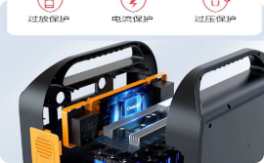
Outdoor Mobile Power
Versatile Power On the Go
Multiple Charging Outputs
Safe Electricity Protection Guarantee
Power for All Your Adventures
Our outdoor mobile power solutions provide reliable, portable electricity for all your off-grid needs, from camping trips to work sites.
Never worry about your devices running out of battery again - our outdoor power stations keep you connected and powered up.
With a variety of output ports, our outdoor power stations can charge phones, tablets, power tools, and more simultaneously.
Safe Electricity Protection: Temperature Protection Short Circuit Protection Overcurrent Protection Overdischarge Protection Current Protection Overvoltage Protection Intelligent Cooling Air

Slide 8
Outdoor Mobile Power
Our outdoor mobile power solutions are perfect for mobile charging needs. Compact and lightweight, these portable mobile power sources provide reliable backup power for your devices anywhere, anytime.
Our mobile power with high capacity battery and fast charging function, common scenarios: outdoor camping, outdoor dinners can keep your smartphone, tablet or camera, refrigerator, guitar, stereo and bring your own lighting equipment, USB powered devices running for hours.

Slide 9
Car Charging Equipment
Our car charging equipment provides a convenient and reliable way to keep your electric or hybrid vehicle powered up on the go. These durable, portable chargers are designed for use at home, work, or on the road.
With a range of charging speeds and compatibility with most vehicle models, our car charging solutions ensure you can quickly and safely recharge your car's battery whenever you need to.

Slide 10
Product Features and Specifications
1
Cutting-Edge Battery Technology
2
Compact and Portable Design
The sleek, lightweight form factor makes it easy to store in your car's glove compartment or trunk, ensuring it's there when you need it most.
Our car emergency starting power supply boasts a high-capacity lithium-ion battery that provides reliable and long-lasting power for jump-starting your vehicle.
3
Multiple Charging Outputs
4
Safety Features
With both USB and 12V DC ports, you can charge a variety of devices, from smartphones to laptops, keeping you connected on the go.
Advanced safety circuitry prevents short circuits, over-charging, and reverse polarity, ensuring a safe and worry-free user experience.

Slide 11
Customer Support and Warranty
Customer Support
Warranty
Repair Services
Our dedicated support team is available 24/7 to assist you with any questions or issues you may have. We pride ourselves on our responsive and personalized service.
All our products come with a comprehensive warranty, ensuring your peace of mind. We stand behind the quality and durability of our products and will promptly address any concerns.
If your device requires repair, our skilled technicians will quickly diagnose the issue and provide a swift, hassle-free repair service. We use only genuine parts to ensure the quality of our repairs.

Slide 12
Contact Information
Headquarter
Customer Support
Online Resources
Social Media
Foshan Yudun Technology Co. Ltd Beijiao, Shunde District, Foshan City, Guangdong Province, China, neighboring 2 Fortune 500 companies: (BGG Group and Midea Group)
Facebook: @Beck Peng LinkedIn: Foshan You Dun Technology Co., Ltd. Instagram: @youduntech
Phone: +86 13923060793Email: sales@start2car.com: Monday - Friday, 9AM - 6PM (GMT+8)
Website:https://start2car.com/ Product Manuals: www.youduntech.com/manuals FAQ:https://start2car.com/

