Slide 1
OASO Meeting #1
Wednesday, October 1st, 2025

Slide 2
Meeting 1 Agenda
Oklahoma Association of Sports Officials
Welcome – Bobby Kelley
You will find a single sign in roster floating around here using last year’s roster. If your name is on there, please first confirm all your information is correct, then sign the roster please. If your name is not on the roster, use the last page to write legibly you full name, email, cell number and OSSAA State ID if you have one and we will get you added to the roster for next week.
We communicate a few ways – there is an email distribution list, a Groupme app and then the website as well. If you are not on the email list/Groupme, Send an email to info@oaso.info and we can get you added.
02.

Slide 3
Meeting 1 Agenda
Oklahoma Association of Sports Officials
Introductions
Organization Information/Business
2024-2025 Playoffs Review Plus All State Officials
OASO Fee Schedule Review (Official’s Pay)
Meetings Sign In Changes
Arbiter Review (we need to get better!)
OASO Camp/Clinic Info
Hall of Fame Information
Rule Changes for the 2025-2026 season
03.

Slide 4
Introductions - OASO Officers
Bobby Kelley - President
Brad Johnson – Vice President
Operations
Larry Puyear - Secretary & Scrimmage Coordinator
Kevin Lynch - Public Relations
Ken Holdman – Vice President
Training & Camp Coordinator
Harold Meek – Recruiting Coordinator
Eric Mohaupt – Fundraising/Hall of Fame Chairman
Tyler Furnas – New Officials Training
04.
Johnny Johnson OASO Assigner

Slide 5
Introductions (members)
Around the room – Let us know your name, number of years officiating and where you are from, please!
1st year officials?
2nd year officials?
Move in officials?
05.

Slide 6
Meeting 1
Oklahoma Association of Sports Officials
2025-26 OOA EXECUTIVE BOARD
Region 1 – Jim Unruh (jsuns@hotmail.com)
Region 2 – Corey Inmon (inmoncorey@gmail.com)
Region 3 – Scott Pettus (rscottpettus@gmail.com) VP
Region 4 – David Garza (g2mac10@yahoo.com)
Region 5 – Larry Darter (ldarter68@gmail.com)
Region 6 – Mike Granger (mwgrange@yahoo.com)
Region 7 – Kevin Mykeloff (mykeloffk@yahoo.com)
Region 8 – Shawn Houk (louie3425@yahoo.com) President
42.
Notes:
Just wanted to say thank you to those of you that voted me onto the OOA Executive Board. I will be on the board for 1 more year For anyone that wants to run for the Region 7 rep spot it will be open in the Spring/Summer of 2025 for the next 2 year team. (Must live in TULSA County) You can only serve on the board for 2 consecutive terms. Let me know if you have anything you would like for me to present to the board. We were at the forefront of the playoff pay, changed the rules on who can be nominated into the OSSAA Hall of Fame. Most of the things we bring up are only recommendations but I do feel like Grant Gower listens to us. If you have anyone that you would like to nominate for the OSSAA HOF, please let me know and can help you start the process.

Slide 7
Meeting 1
Oklahoma Association of Sports Officials
Basketball Area Coordinators for the Tulsa Area:
Brad Johnson (brad.johnson338@gmail.com) 918-440-2695
Bobby Kelley (bkelleyok@gmail.com) 918-607-2055
If you have ejections or fights or anything crazy happening in officiating, please contact us before sending in reports to the OSSAA.
They also ask the area coordinators for playoff recommendations
42.
Notes:
Want to thank Mr. Bill Corbitt for his many years of being an area coordinator – he resigned that position this year and we just want to say – Thank you for your Service!

Slide 8
Meeting 1
Oklahoma Association of Sports Officials
OASO had 76 officials put in for the playoffs and we had 19 Officials work the State Tournament last year.
This is the most ever by our association and I am pretty sure it might be the most ever by any association.
12.
Notes:
One of our main areas for improvement is getting more Officials to the State Tournament in 2A-4A! If that is the level you want to get to, please let us know and we will work with you to make sure you are seen by those teams mostly during the regular season!

Slide 9
Meeting 1
Oklahoma Association of Sports Officials
Officials from our Association that worked the State Tournament last year:
5A/6A 5A/6A 3A-4A
Willie Weary Rick Smith Mark Mobra
Bobby Kelley Tyler Furnas Scott Brians
Kevin Lynch Larry Puyear Kevin Mykeloff
Brad Johnson Scott Davis Ray Wilson
Jasper Hooks Tony Gardner
Tyler Inman Thomas McBride
Pete Knutson Jarryd McCullough
Tyus Schweiger
12.
Notes:
One of our main areas for improvement is getting more Officials to the State Tournament in 2A-4A! If that is the level you want to get to, please let us know and we will work with you to make sure you are seen by those teams mostly during the regular season!

Slide 10
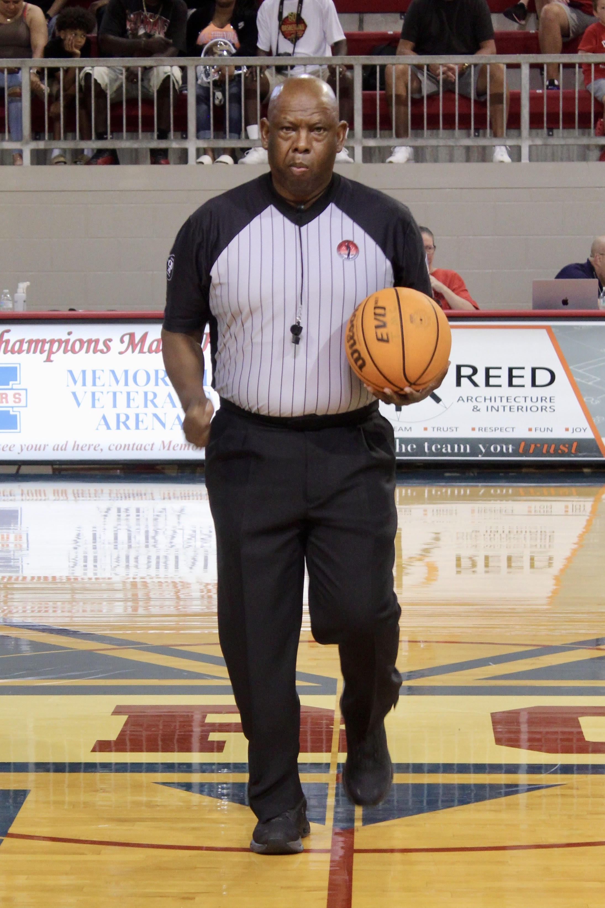
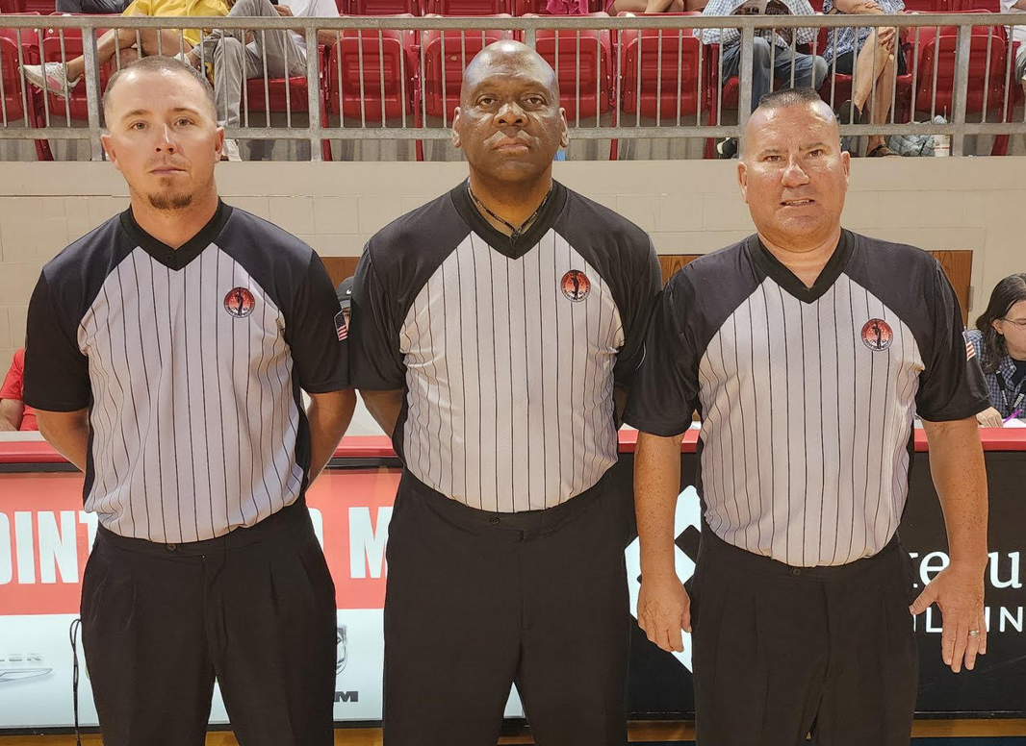
Meeting 1
Oklahoma Association of Sports Officials
Officials from our Association that worked the Large School Boys All State Game last year: Ken Holdman & Ray Wilson
If you have been officiating 20+ years and have not worked an All-State Basketball game (and you want to), please get with Kevin Mykeloff and he will put you on the list to be considered. This does not mean you will be selected – you will be considered.
13.

Slide 11
OASO Future Meetings
Next 3 Wednesdays: Oct 8th, 15th, 22nd and then two Thursdays 28th & Nov 4th
October 15th we will go over Part 1 of the test during meeting
The State rules meeting will be soon – we will update you on the date/time/location as soon as we know. If you can’t make it in person there will be a recorded version released sometime after the in-person meetings are over.
11.

Slide 12
OSSAA Meeting Sign in Changes
Oklahoma Association of Sports Officials
NEW THIS YEAR – to get credit for your 3 meetings you have to scan the OSSAA QR Code we will provide at the end of the meeting. The Roster does NOT get you credit for 3 meetings anymore (it is only a back up this year)
DO NOT try to cheat the system! The meetings are date stamped and IP stamped so the OSSAA can see when you signed in and who is signing in on what device. Don’t take a picture and send it to your buddy – they can see you were not at the meeting!
More on this later tonight.
07.

Slide 13
OASO Meeting Exemptions
Per OSSAA rules (and OASO) you are required to attend a minimum of 3 local meetings , such as this one.
If you are not going to be able to make 3 meetings due to conflicts such as work, school, church, kid’s games – please go to www.oaso.info and select the Meeting Exemption Request Form and fill that out and one of the OASO officers will review it.
One more important thing – you must be a paid member of the OASO to even be considered for a meetings exemption request.
12.

Slide 14
Scrimmages
Oklahoma Association of Sports Officials
Larry Puyear is the man for scrimmages
We may have signups for scrimmages but new this year, they will be assigned though Arbiter!
That means, you need to be registered with OASO to be assigned scrimmages and you will need to keep your availability up to date!
Nearly all scrimmages are now paid.
Please help out as much as possible!
Newer officials – great way to get your feet wet and be seen by coaches and veteran official.
Veterans – great way to get in shape and see some action before the season begins!
07.
Larry anything you would like to discuss?

Slide 15
Scrimmages
Oklahoma Association of Sports Officials
NEW THIS YEAR ON SCRIMMAGES
All Scrimmage will be assigned through Arbiter!
1.) we will need you to get registered with the OSSAA
2.) we will need you to get registered with the OASO
3.) we will need you to update your availability on Arbiter and keep it up to date – reminder it defaults to OPEN so you must go block dates you are not available.
07.

Slide 16
Meeting 1 – Association Info
Oklahoma Association of Sports Officials
How can I be a great OSAO member?
Glad you asked!!
If you are working for multiple organizations that is perfectly fine, just keep your availability up to date in each system! I.E Arbiter & Horizon
If you are doing college, if you can block off some Tuesday/Friday night games at not budge that would help us out.
If you have partners you would like to work with, let the assigners know, we will try to pair you up when possible (does not mean you will call together every night)
14.
Notes:
I think Brad wanted to say a few things here

Slide 17
Meeting 1 – Association Info
Oklahoma Association of Sports Officials
Turning back games – Just take your schedule and work it. If you must make a change because we know life happens, try to make it at least a week out. Day before not good, Day of - better be an emergency.
The more you turn back, the less likely we can use in the future – Too many puke backs and we will just give your games to those that want to work. If you give back a game, it will cost you that game, plus you will lose another game. Recap – you lose the one you give back and another of the assigner’s choosing.
Check Arbiter daily! Schools change stuff: times, locations even dates
The assigner may have to make changes due to puke backs – check Arbiter before you head out!
15.
Notes:
I think Brad wanted to say a few things here

Slide 18
Meeting 1 – Association Info
Oklahoma Association of Sports Officials
Accept the games when they are assigned so we can know they are covered and move on to the next ones. We can see when you look at them and let them sit there.
Checks – can take anywhere from a week to a month, please do not contact OASO officers about checks unless it has been over 4 weeks!
Arbiter Pay is here to stay – DO NOT ask a school that has paid extra to use Arbiter pay to send you a check!
We are NOT directory assistance! Arbiter has all paid members with phone numbers! We will also add an OASO Arbiter roster on our website under the members section. There is also the eligible officials list on www.ossaa.com
16.
Notes:
I think Brad wanted to say a few things here

Slide 19
Meeting 1 – Association Info
Oklahoma Association of Sports Officials
How can I be a great OSAO member?
Contact your partners & the schools, 1st of the week is a great time to do this for games Tuesday through Saturday. If you game is Monday, might want to contact everyone on Friday.
If you partner doesn’t show or is significantly late, we need to know.
If you partner shows up incapacitated in any way, we need to know (Drunk, high, whatever)
Big one here – Do NOT turn back games to go work an equal or lesser game. We talk to other assigners and we watch games on NFHS. Good way to lose the rest of your schedule. 6A = Class B as far as Varsity goes.
17.
Notes:
I think Brad wanted to say a few things here

Slide 20
Meeting 1 – Other Advice
Oklahoma Association of Sports Officials
Don’t run your fellow officials down to make yourself look better, major turnoff for assigners
Don’t be a know it all when someone tries to give you advice.
Don’t wear your uniform/jacket in the stands before or after you work
Don’t replace yourself on a game at any level – let the assigner know if you just can’t go. If you have someone in mind, you can let the assigner know, but sometimes there are circumstances where your replacement won’t work (or there is a better option)
18.
Notes:
I think Brad wanted to say a few things here

Slide 21
Meeting 1 - ARBITER
Oklahoma Association of Sports Officials
Some things we need to do a better job of this year with ARBITER:
1.) Make sure your contact information is public (so your partners and the schools can get ahold of you)
2.) Must keep your availability up to date (big problem last year) – If you take games in another association or platform, you have to block out your dates everywhere else. Very frustrating for the assigners when we get a game filled and then it is puked back because you didn’t update your availability. Double the work for assigners is not the way to move up. THIS includes Horizonwebref or other Associations!
3.) Check your schedule the day of the game to make sure nothing has changed! Not likely but sometimes we have to move officials around for a reasons such as injury, sickness or even games that were added at the last minute.
19.
Notes:
I think Brad wanted to say a few things here

Slide 22
OASO Arbiter Registration
https://app.arbitersports.com/registration/official/register/4736?org=169048&role=3
Oklahoma Association of Sports Officials
OASO Registration Link
Click on the Registration Link Above
You will have to register each season through Arbiter and pay the $35 OASO Association Fee to have the opportunity to receive games from the OASO for the 2025-2026 school year. There will be no exceptions – we are here to help you get registered.
​
If you are brand new select the Create One option above
​
Enter your email if you have ever registered on Arbiter (if you have registered with the OSSAA you already have an Arbiter login)
Then it will ask for your password (if you don’t know it, use the forgot password) OASO does not have, nor can we see, what your password is.
​
08.

Slide 23
OASO Mission
The primary purpose of this Association is to recruit, educate, equip, assign, and retain sports officials in the State of Oklahoma and surrounding areas. OASO is a 501 C 3 Non Profit organization that was created for the purpose of promoting the welfare of all American intercollegiate and interscholastic sports by the development and maintenance of a membership consisting of experienced and capable persons whose integrity is beyond reproach and who are actively engaged each year in officiating those games; and by fostering a high standard of ethics, encouraging fair play, sportsmanship, closer cooperation, and better understanding among sports officials, athletic representatives, coaches, players, athletic directors, and the media; and to provide their common interests in these activities.
13.

Slide 24
OASO Business
Our 2nd Annual OASO Charity Golf Tournament was a huge success! More sponsors than ever! 86 players including Officials, Coaches, AD’s & Sponsors. Come be a part of it next year! Even if you don’t golf, we need volunteers! Mark your calendar for Friday, July 10th, 2026 for next year at Indian Springs Country Club.
Recruiting Events – we have opportunities to set up at job fairs and other events throughout the year to recruit officials, let us know if you hear of any events and if you would like to work the booth.
14.

Slide 25
2024 - 25 & 25 - 26 Pay Schedule
Recommended: 3 person crews for all Varsity Contests (2A-6A Mandatory)
Varsity Pay: $80/game - $160 per set. If 2 person $100 per game
Single Varsity Games: $100 for 3 person, $120 for 2 person
Junior Varsity Pay (Including Sophomore games) $50/game
Single JV games = $75/game
Junior High (9th grade & below) $45/game
Single JH games = $65/game
Varsity Only Recommendation to schools (not required)
Mileage Fee (for one driver – usually the “R” of the crew)
Distance 0-29 miles – $0
Distance 30-60 miles flat rate - $25
Distance 60+ miles flat rate - $50
Since we are based out of Tulsa, mileage will be calculated from Tulsa to Game Site (not where we live)
16.

Slide 26
Playoffs & Pay
Oklahoma Association of Sports Officials
Already reviewed pay changes for the OASO Regular season. Want to emphasis the playoff pay changes from 2 years ago – very good most of the time!
Good news this year is on the playoff pay! The OSSAA approved pay raises for all sports 2 years ago. The increase was based off the average regular season pay for each sport and they were able to bring up the playoff game fee to that average or more. Included with this is a mileage increase from the old .35 cents per mile up to .65 cents per mile.
02.

Slide 27
Review of ossaa Pay Schedule
OSSAA Pay that was implemented two years ago for the playoffs:
Districts - $70 per game with .65 mile round trip
Regionals - $70 per game with .65 mile round trip
Area - $80 per game with .65 mile round trip
State - $95 per game with .65 mile round trip
17.
Notes:
Pay per game is fair and close to regular season but if you travel at all these check were $200 - $300 pretty regularly

Slide 28
Meeting 1
Oklahoma Association of Sports Officials
Inaugural OASO Basketball Camp/Clinic
Saturday, November 8th
$50 registration
3A – 6A at Broken Arrow High School
3A – B & NEW Officials at Lincoln Christian High School
OSSAA State Camp Credit included
35

Slide 29
Meeting 1
Oklahoma Association of Sports Officials
Inaugural OASO Basketball Camp/Clinic
Saturday, November 8th
$50 registration
Court Time, Evaluation, Classroom Time, Video Review
More Info to come – Register on www.oaso.info
35

Slide 30

Meeting 1
Oklahoma Association of Sports Officials
Broken Arrow Camp Registration
Experienced 6A – 4A Playoff Officials Only
41.

Slide 31

Meeting 1
Oklahoma Association of Sports Officials
Lincoln Christian Camp Registration
Experienced 3A – B & New Officials Only
41.

Slide 32
Meeting - Assigning & Games
Oklahoma Association of Sports Officials
Puke Back Rule – doesn’t matter who you are
It was way better last year but the puke back rule is still in place for 2025-2026.
If you give a game back, we will remove you from that date and another date of our choosing on your schedule.
19.

Slide 33
Meeting - ARBITER
Oklahoma Association of Sports Officials
Assigning and maintaining the schedule is very time consuming, more work for assigners = less work for you. ESPECIALLY repeat offenders.
If you accept a set of games, go work them.
Do NOT send someone else in your place ever. There are a number of reasons why we don’t want this. Official may be scratched by a team/location. We may someone waiting for an assignment. You can recommend someone to replace you, but do not make that decision on your own.
20.

Slide 34
Meeting 1
Oklahoma Association of Sports Officials
Reminder – Arbiter Availability is OPEN – you have to go in and block the dates you are not available.
If you also use HorizonWebRef (for INBC) it is the opposite – you automatically are NOT Available, you have to go in and open up the dates you can work.
If you get a game on one platform, please go block it in the other platforms you are using.
02.

Slide 35
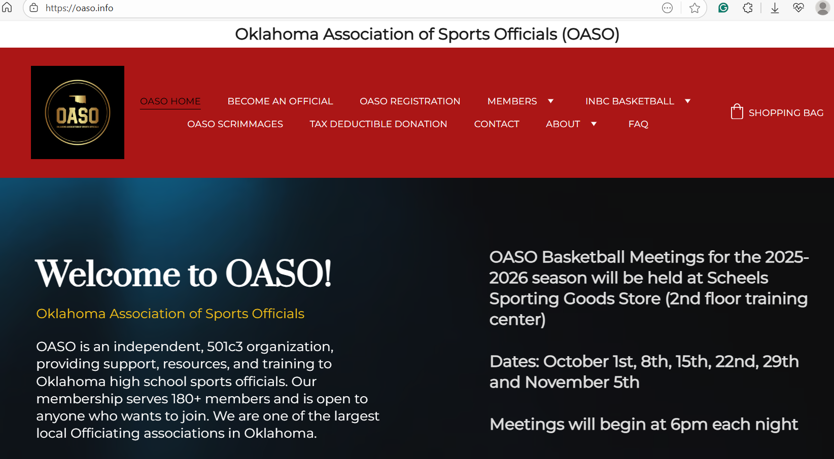
Meeting 1
Oklahoma Association of Sports Officials
41.
Notes:
The PowerPoints that we use for the Meetings will be under the member section – you will be able to click on the link when it is ready
Officials Roster – will be on here a week or so after the last meeting – Please use this and don’t call people all the time for phone numbers (especially ME)
Download it to your computer. Also, there is a roster available on ARBITER, Also there is an eligible official roster on the www.ossaa.com as well.
School/AD contacts – hard to keep this up to date – USE ARBITER FOR THIS

Slide 36
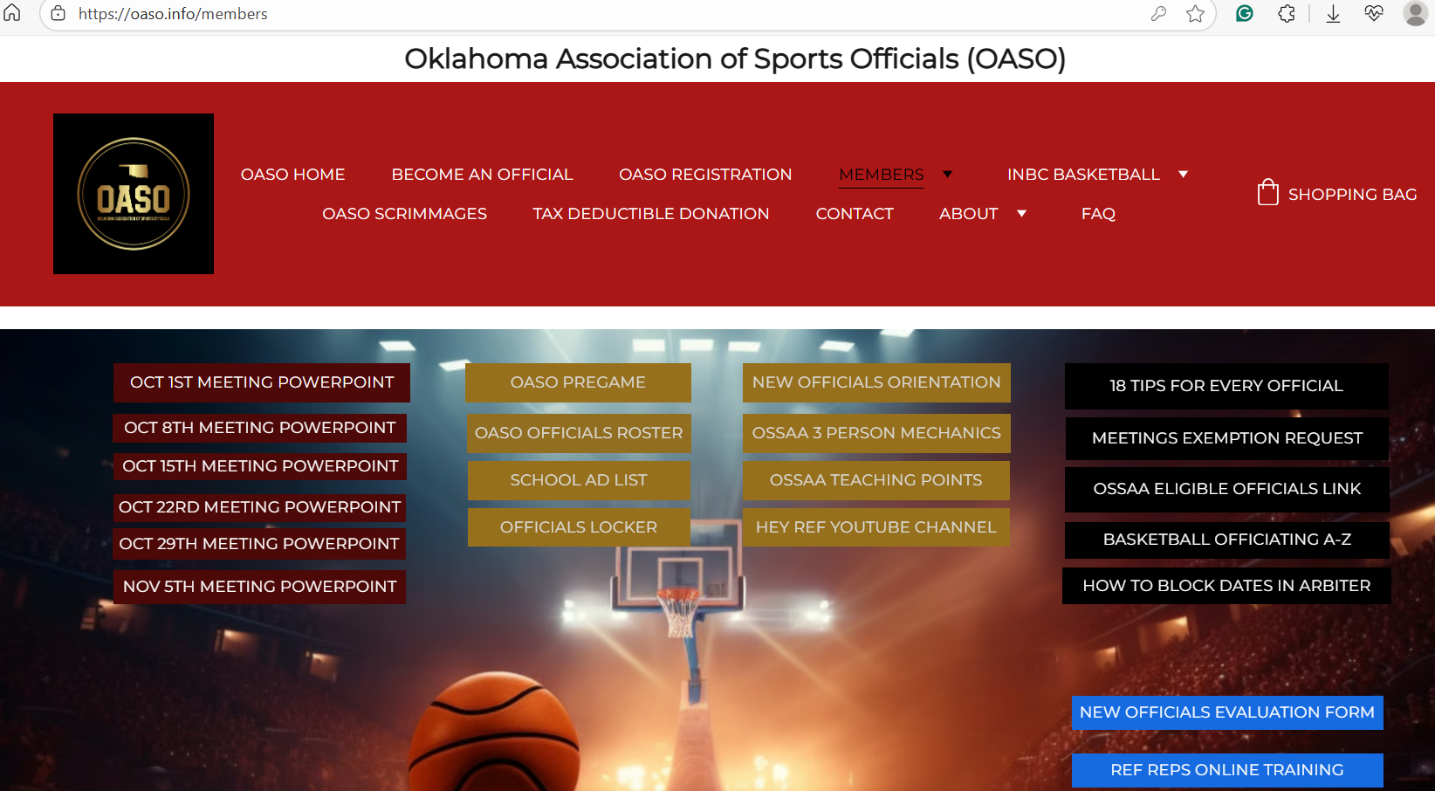
Meeting 1
Oklahoma Association of Sports Officials
41.
Notes:
The PowerPoints that we use for the Meetings will be under the member section – you will be able to click on the link when it is ready
Officials Roster – will be on here a week or so after the last meeting – Please use this and don’t call people all the time for phone numbers (especially ME)
Download it to your computer. Also, there is a roster available on ARBITER, Also there is an eligible official roster on the www.ossaa.com as well.
School/AD contacts – hard to keep this up to date – USE ARBITER FOR THIS

Slide 37
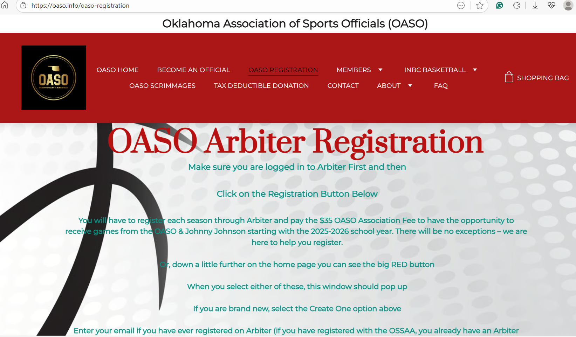
Meeting 1
Oklahoma Association of Sports Officials
41.
Notes:
The PowerPoints that we use for the Meetings will be under the member section – you will be able to click on the link when it is ready
Officials Roster – will be on here a week or so after the last meeting – Please use this and don’t call people all the time for phone numbers (especially ME)
Download it to your computer. Also, there is a roster available on ARBITER, Also there is an eligible official roster on the www.ossaa.com as well.
School/AD contacts – hard to keep this up to date – USE ARBITER FOR THIS

Slide 38
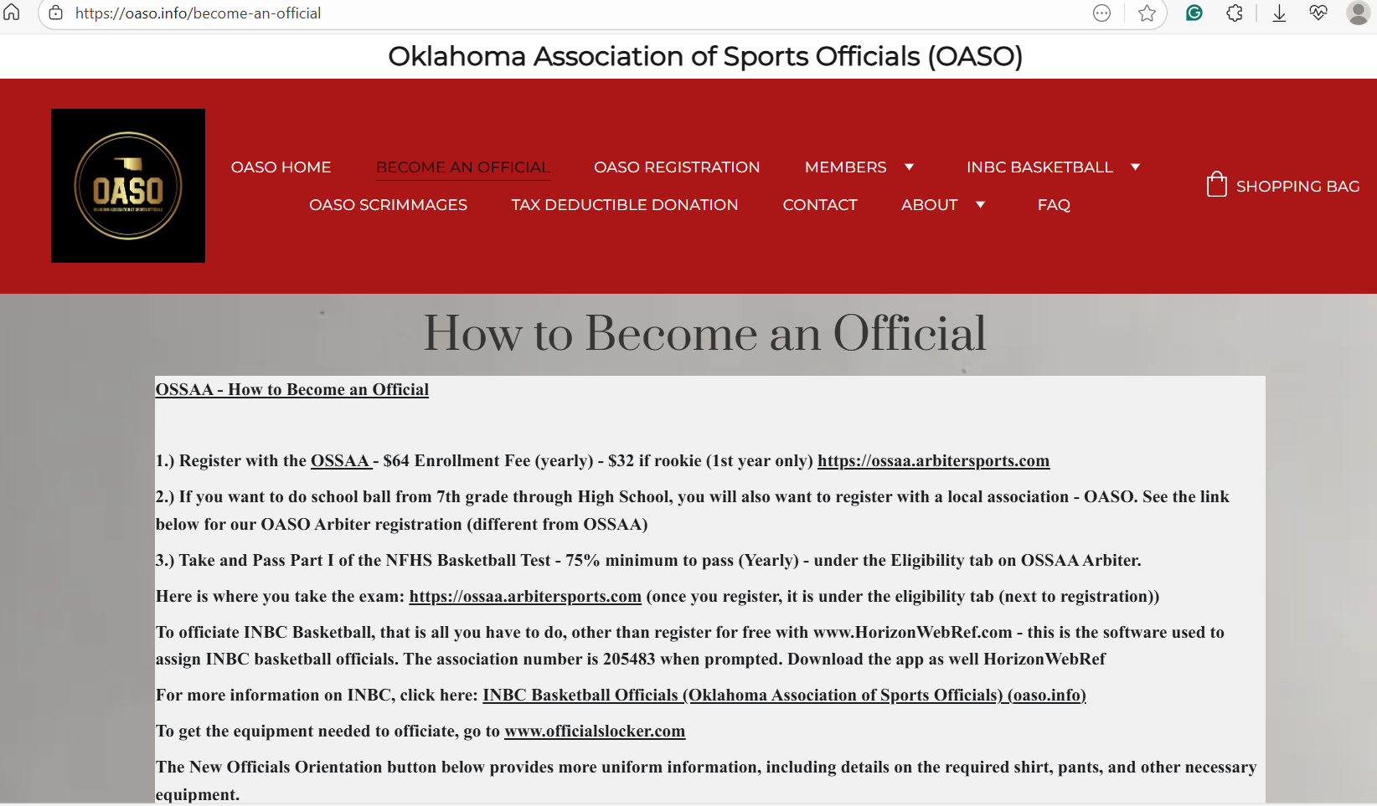
Meeting 1
Oklahoma Association of Sports Officials
41.
Notes:
The PowerPoints that we use for the Meetings will be under the member section – you will be able to click on the link when it is ready
Officials Roster – will be on here a week or so after the last meeting – Please use this and don’t call people all the time for phone numbers (especially ME)
Download it to your computer. Also, there is a roster available on ARBITER, Also there is an eligible official roster on the www.ossaa.com as well.
School/AD contacts – hard to keep this up to date – USE ARBITER FOR THIS

Slide 39
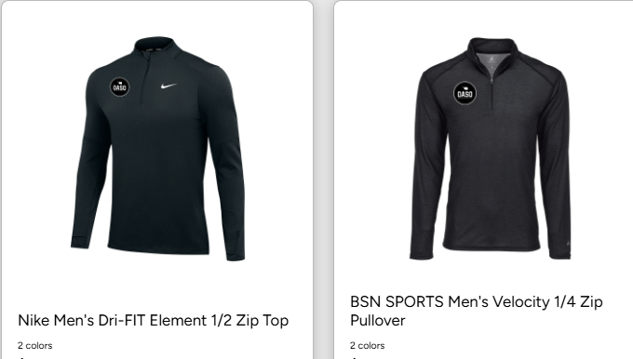
Meeting 1
Oklahoma Association of Sports Officials
OASO STORE
Get your team gear at the OASO Sprint Store 2025 My Team Shop by November 3rd! https://bit.ly/4godPnI
Shop Details
Organization Name
OKLAHOMA ASSC OF SPORTS OFFICALS
Store Name
OASO Sprint Store 2025
Access Code
HPRcfXcvkg
Open Date
07/31/25
Close Date
11/03/25
Customer #
16659960
41.
Notes:
The PowerPoints that we use for the Meetings will be under the member section – you will be able to click on the link when it is ready
Officials Roster – will be on here a week or so after the last meeting – Please use this and don’t call people all the time for phone numbers (especially ME)
Download it to your computer. Also, there is a roster available on ARBITER, Also there is an eligible official roster on the www.ossaa.com as well.
School/AD contacts – hard to keep this up to date – USE ARBITER FOR THIS

Slide 40
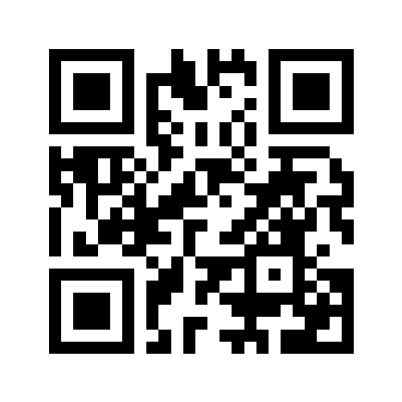
Meeting 1
Oklahoma Association of Sports Officials
www.oaso.info
QR Code Below:
41.
Notes:
The PowerPoints that we use for the Meetings will be under the member section – you will be able to click on the link when it is ready
Officials Roster – will be on here a week or so after the last meeting – Please use this and don’t call people all the time for phone numbers (especially ME)
Download it to your computer. Also, there is a roster available on ARBITER, Also there is an eligible official roster on the www.ossaa.com as well.
School/AD contacts – hard to keep this up to date – USE ARBITER FOR THIS

Slide 41
Assigning & Games
Oklahoma Association of Sports Officials
Does anyone have any questions over anything we have covered so far tonight?
20.

Slide 42
New Officials Breakout
Any Questions before we move on to breakout & Rule Changes for next year?
New Officials for sure and we recommend officials up to 2 years go, especially if you have questions
22.

Slide 43
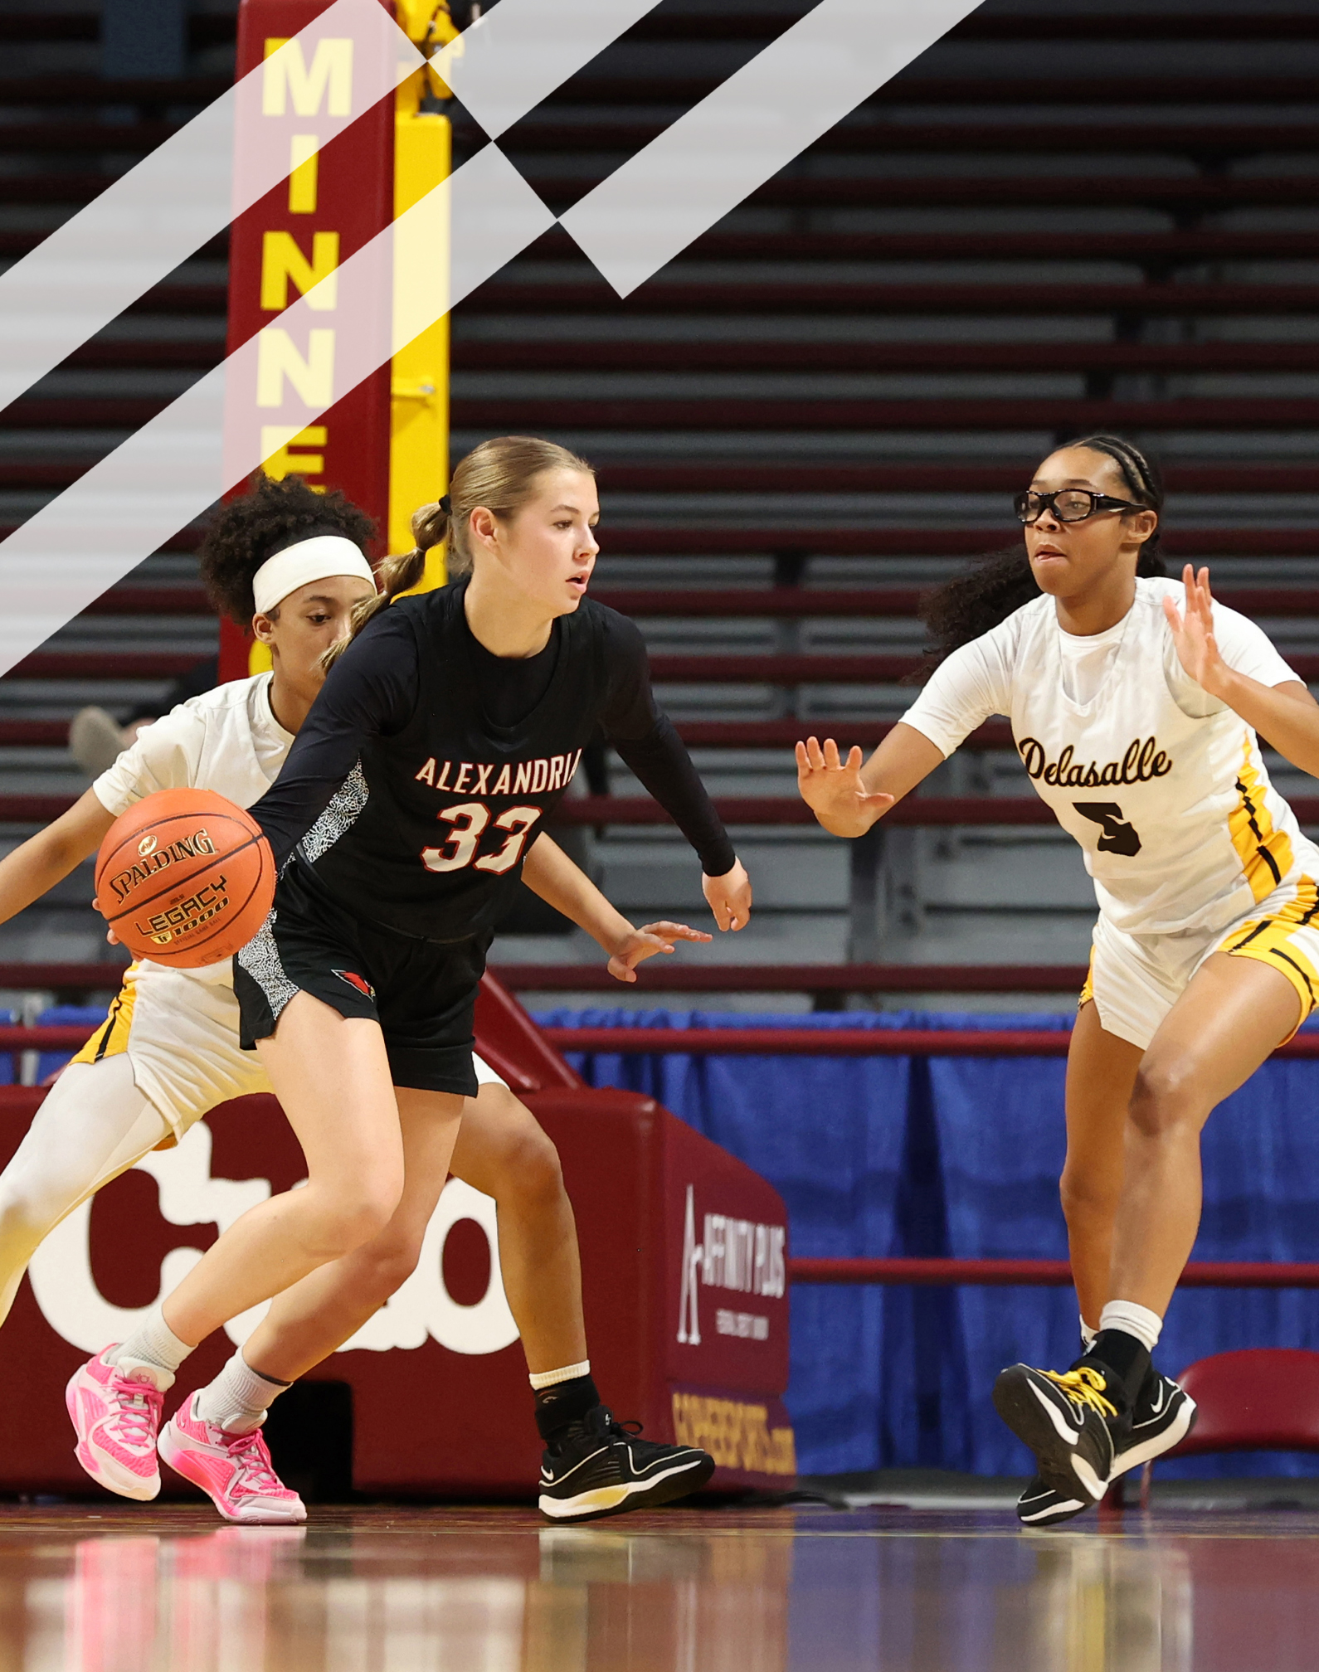
2025-26 NFHS
Basketball
Rules PowerPoint
Rules Changes
Editorial Changes
Mechanical Changes
Points of Emphasis

Slide 44
STUDENTS REMOVED FROM PLAY
IN ACCORDANCE WITH STATE LAW, ANY STUDENT REMOVED FROM PLAY MAY NOT RETURN TO PLAY WITHOUT WRITTEN CLEARANCE FROM A LICENSED MEDICAL PROVIDER TRAINED IN HEAD INJURY
EACH LOCAL SCHOOL DISTRICT MUST DESIGNATE THE PROVIDER AUTHORIZED TO PROVIDE THE CLEARANCE FOR THEIR DISTRICT IN ADVANCE OF THE SEASON. ONLY THE DESIGNATED PROVIDER MAY CLEAR A STUDENT FOR PLAY.
RETURN TO PLAY AND RETURN TO LEARN PROTOCOLS MUST BE FOLLWOWED PRIOR TO GAINING CLEARANCE.

Slide 45
SPORTSMANSHIP
IT IS THE RESPONSIBILITY OF EACH LOCAL SCHOOL DISTRICT’S ADMINISTRATION TO MAINTAIN A CLIMATE OF GOOD SPORTSMANSHIP AT ALL LEVELS IN ALL CONTESTS.
UNRULY BEHAVIOR SHOULD NOT BE TOLERATED AND ANY INDIVIDUAL, COACH, PLAYER OR SPECTATOR SHOULD BE REMOVED FROM THE AREA IMMEDIATELY TO ALLOW THE CONTEST TO CONTINUE WITHOUT THE DISRUPTION OF DISTRACTING INDIVIDUALS.
THE OSSAA ENCOURAGES ALL SCHOOL ADMINISTRATORS AND COACHES TO TAKE A STRONG STAND AGAINST UNSPORTSMANLIKE ACTS.

Slide 46

OSSAA SHOT CLOCK INFORMATION
ADOPTION: 2026-2027 Basketball Season for Classes 3A, 4A, 5A, 6A.
EXPERIMENTAL USE IN 2025-2026
  Must Get Approval (Google Form)
  Non-District Play Only
  Tournament Host Decides
  Agreed By Both Teams During Regular Season Play
  All Classes

Slide 47
OSSAA 35 SECOND SHOT CLOCK INFORMATION
Reset to 35 sec on all fouls/violations
Reset to 35 on an offensive rebound
Ten second count stays in effect with a manual count
Five second count stays in effect with a manual count
If shot clock malfunctions and does not work (one or both), the game is played/finished without using it.

Slide 48
NFHS Information

Slide 49


NFHS Digital
NFHS Digital is the New Publications Platform that includes:
  Rules Books
  Case Books
  Officials Manuals
  Policy Debate Quarterly
  Other NFHS Publications
Visit nfhs.org/NFHSDigital

Slide 50
NFHS Digital – Mobile App
Access via Mobile App:
  View available publications for sale
  View publications assigned to you
  Create comments and save notes
  Highlight important content to review later
  Available on App Store and Google Play

Slide 51
2025-26 NFHS Basketball
Rules Changes

Slide 52
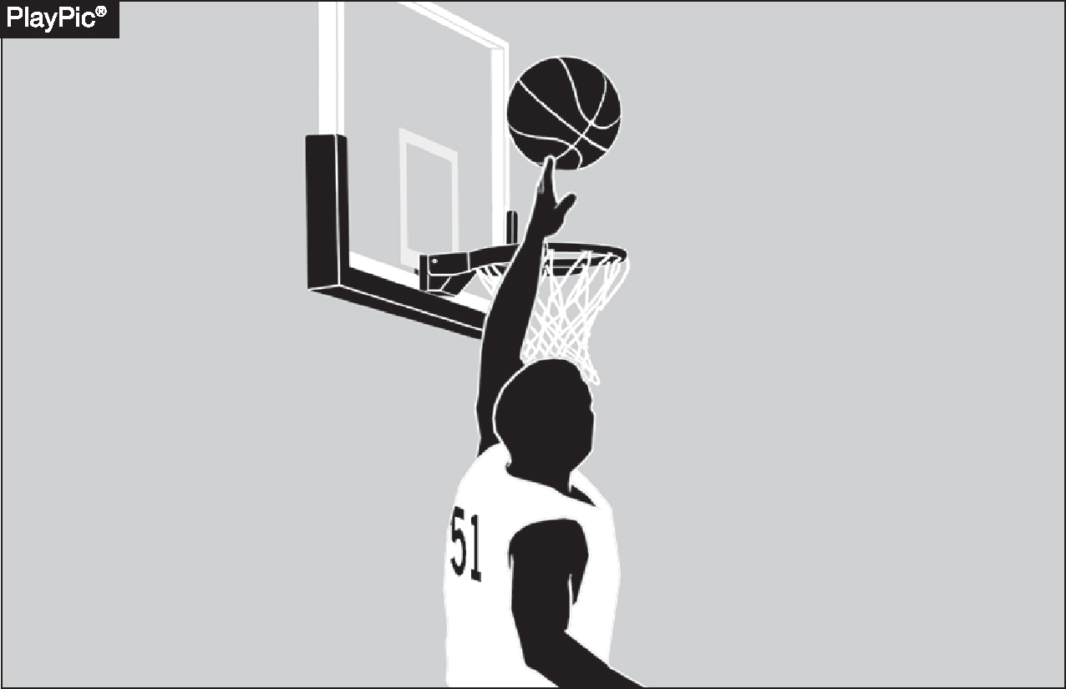
GOALTENDING
4-22-1
Goaltending occurs when a defensive player touches the ball during a try or tap for field goal while the ball is on its downward flight entirely above the basket ring level, has the possibility of entering the basket in flight and is not touching the basket cylinder.
Notes:
Goaltending occurs when a defensive player touches the ball during a try or tap while it is:
On its downward flight,
Entirely above the level of the basket ring,
Has a possibility of entering the basket, and
Is not touching the basket cylinder.
All these conditions must be met for the action to be ruled goaltending.
This rule protects legitimate scoring attempts and ensures defenders do not unfairly interfere with shots on their way to the basket.

Slide 53
GOALTENDING
4-22-2
Goaltending occurs when a defensive player touches the ball outside the cylinder during a free-throw attempt.
Notes:
Goaltending occurs when a defensive player touches the ball outside the cylinder during a free-throw attempt.
Even though the ball is not in the cylinder, any defensive interference with a free throw is considered goaltending.
This rule ensures free throws remain uncontested and scoring attempts are protected.
Proper enforcement maintains the integrity and fairness of free-throw situations.

Slide 54
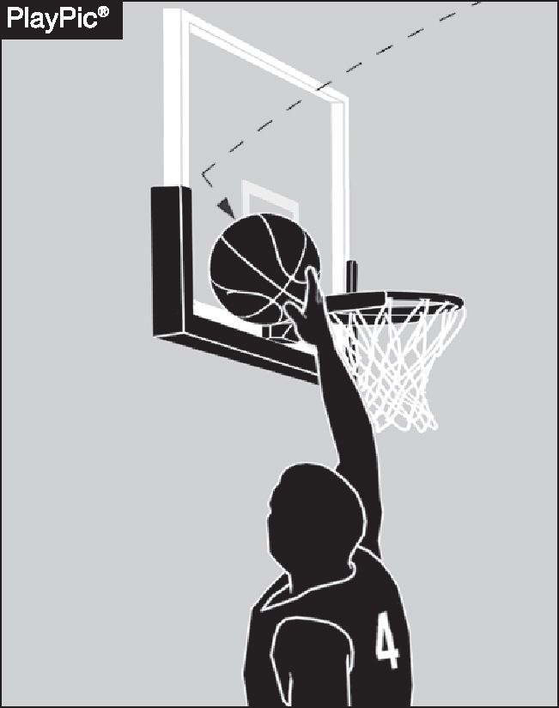
GOALTENDING
4-22-3 (NEW)
When the ball contacts the backboard, it is considered to be on its downward flight.
In such a case, it is goaltending when the ball is touched by a player as long as it has a possibility of entering the basket.
Notes:
When the ball contacts the backboard, it is considered to be on its downward flight.
If a player touches the ball after it hits the backboard, and the ball still has a possibility of entering the basket, it is considered goaltending.
This rule helps define the timing and legality of defensive plays involving the backboard.
Proper enforcement ensures fair scoring opportunities and prevents illegal interference with a shot attempt.

Slide 55
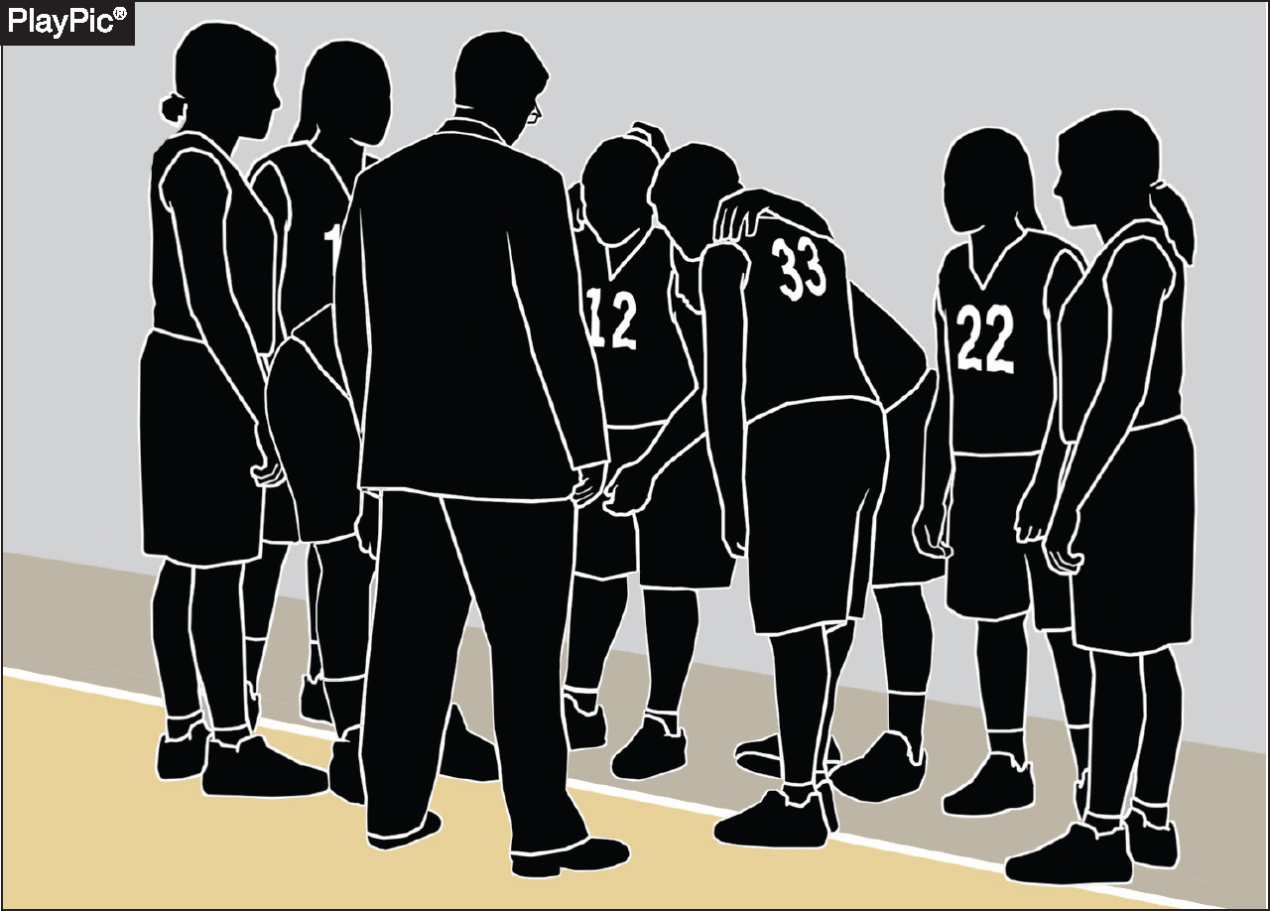
PLAYERS/BENCH PERSONNEL/ SUBSTITUTES/TEAM MEMBERS
4-34-1
A player is one of the five team members who are legally on the court at any given time, except during time-outs or intermissions. At which time they are considered bench personnel.
Notes:
A player is one of the five team members legally on the court during live play.
During timeouts or intermissions, those same individuals are considered bench personnel.
This distinction is important for determining roles, responsibilities, and potential penalties.
Helps officials and teams accurately apply rules regarding player conduct versus bench conduct.

Slide 56
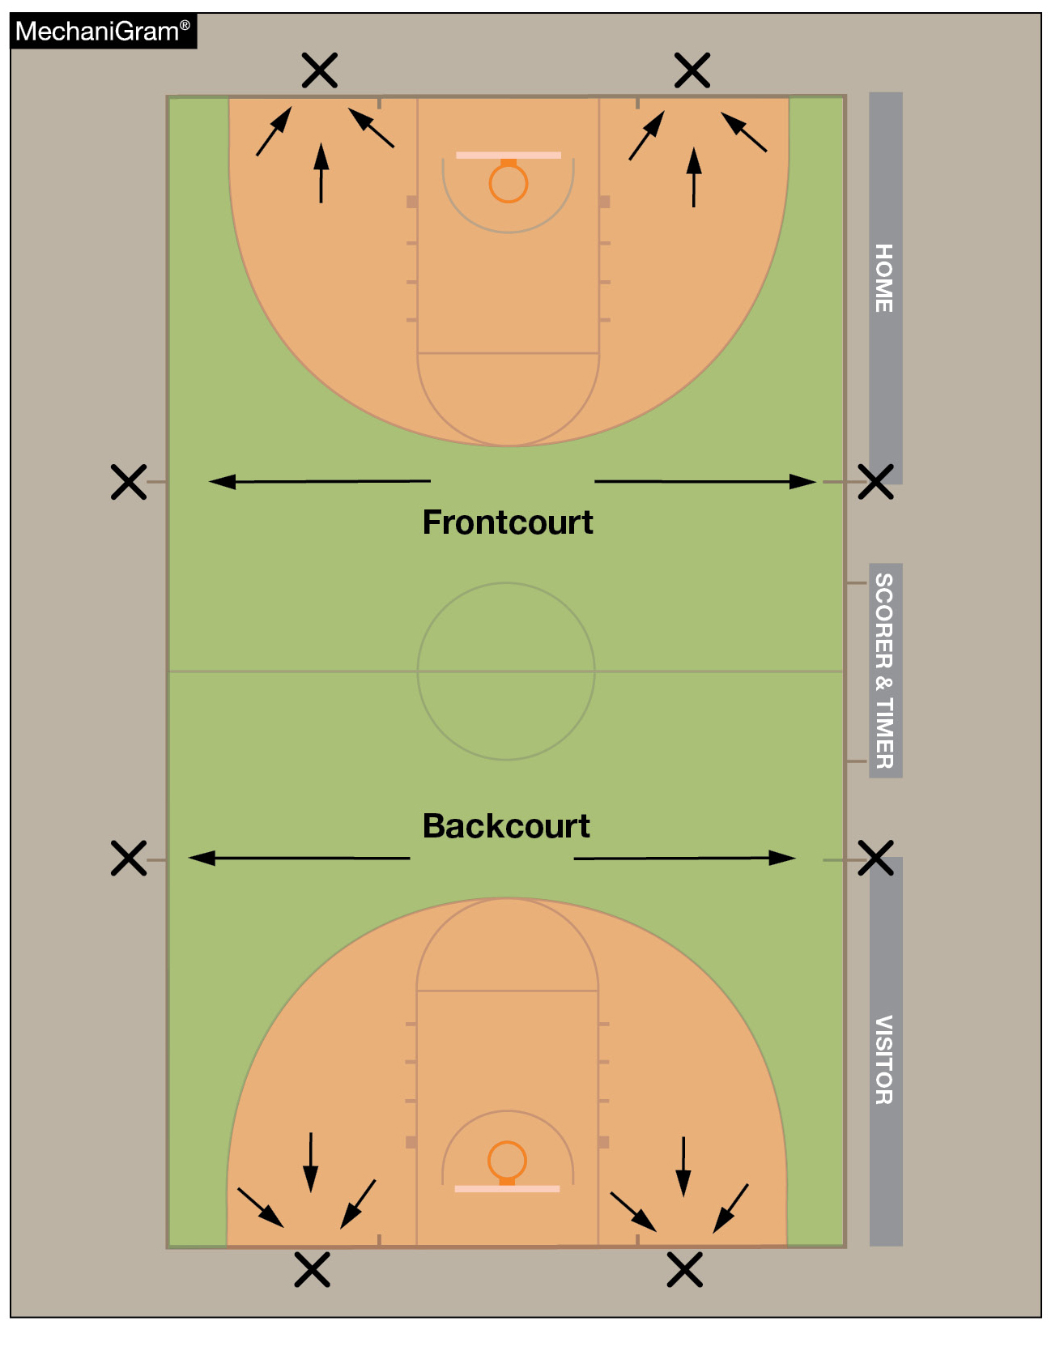
RESUMPTION-OF-PLAY PROCEDURE, THROW-INS 7-5-4
Officials shall determine the designated spot by using three-point line in the frontcourt or backcourt.
If the stoppage of play occurs on or within the three-point line, the designated spot shall be the nearest point on the end line three feet outside the lane line.
If the stoppage occurs outside the three-point line, the designated spot shall be the nearest sideline at the 28-foot-line.
Notes:
Officials determine the designated throw-in spot using the three-point line as a reference in both the frontcourt and backcourt.
If play is stopped on or within the three-point line, the throw-in spot is the nearest point on the end line, three feet outside the lane line.
If play is stopped outside the three-point line, the throw-in spot is the nearest sideline at the 28-foot line.
This guideline ensures consistency and clarity in locating throw-in positions after stoppages.
Proper enforcement promotes efficient game flow and fair placement of the ball during restarts.

Slide 57
THROW-IN PROVISIONS
9-2-11 (NEW)
The thrower shall not purposely and/or deceitfully delay returning after legally being out of bounds and then become the first player to touch the ball after returning to the playing court.
Notes:
A thrower shall not purposely or deceitfully delay returning to the court after legally being out of bounds during a throw-in.
The thrower may not be the first to touch the ball after re-entering the playing area in this manner.
This rule is designed to prevent deception and maintain fairness during throw-in situations.
Officials must watch for delayed or misleading movements by the thrower that could create an unfair advantage.
Enforcing this rule ensures proper conduct and positioning during and after throw-ins.

Slide 58
OUT OF BOUNDS
9-3-4 (NEW)
A player shall not purposely and/or deceitfully delay returning after legally being out of bounds and then become the first player to touch the ball after returning to the playing court.
Notes:
A player shall not purposely or deceitfully delay their return to the court after legally going out of bounds.
The player cannot be the first to touch the ball after re-entering the playing area in such a manner.
This rule prevents players from gaining an unfair advantage through deceptive tactics.
Proper enforcement supports fair play and integrity of on-court actions.
Officials must be alert to intentional delays or deceptive movements involving out-of-bounds situations.

Slide 59
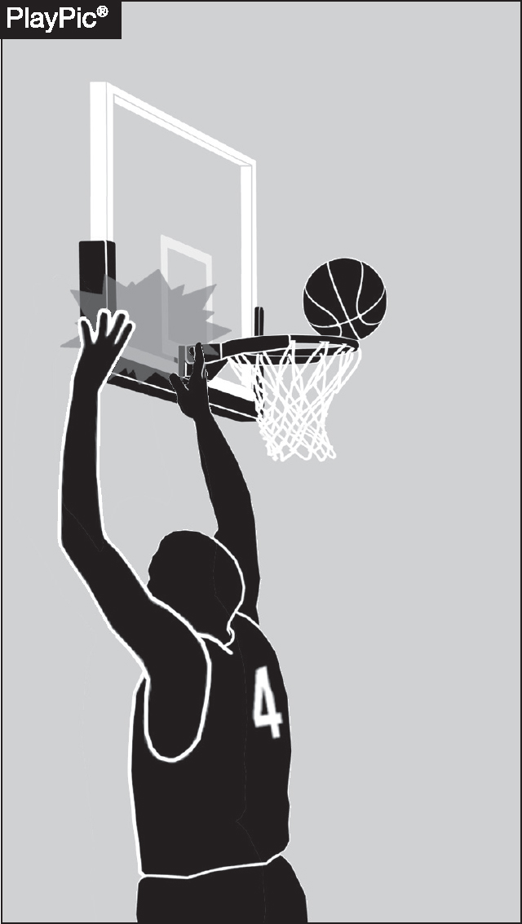
PLAYER TECHNICAL
10-4-4b
It is no longer an automatic technical foul if a player intentionally slaps or strikes the backboard or causes the ring to vibrate while a try or tap for the field goal is in flight or touching the backboard or is in the basket cylinder above the basket.
Notes:
It is no longer an automatic technical foul if a player intentionally slaps or strikes the backboard or causes the ring to vibrate while:
A try or tap for a field goal is in flight, or
The ball is touching the backboard, or
The ball is in the basket cylinder above the basket.
This represents a change in how such contact is penalized.
Officials now have discretion to assess the situation more carefully rather than issuing an automatic technical foul.
The rule aims to balance fair enforcement with avoiding overly harsh penalties for certain actions.

Slide 60
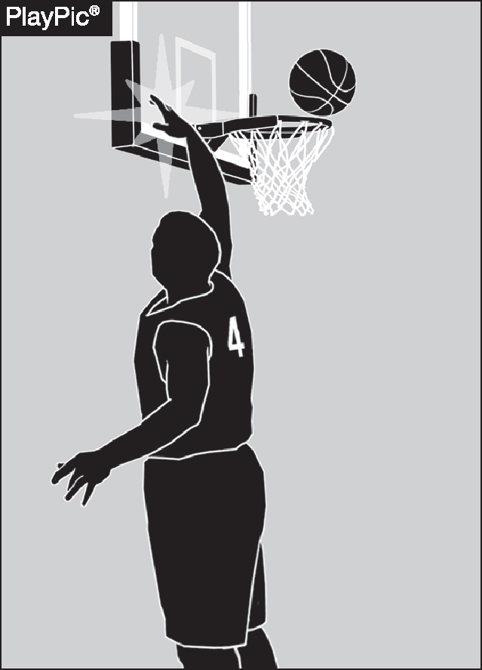
BASKET INTERFERENCE
4-6-1a, 4-6-1b
Basket interference now occurs when a player slaps or strikes the backboard causing the backboard or basket to vibrate while the ball is on or within either basket or is touching the backboard or within the cylinder.
Notes:
Basket interference is called when a player slaps or strikes the backboard, causing it to vibrate.
This applies while the ball is on or within either basket, or touching the backboard, or within the cylinder above the basket.
The rule prevents players from affecting the ball’s path by manipulating the backboard or basket.
Enforcing this maintains fair play and integrity of scoring opportunities.
Officials must be alert to such contact to properly apply basket interference penalties.

Slide 61
2025-26 NFHS Basketball
Editorial Changes

Slide 62
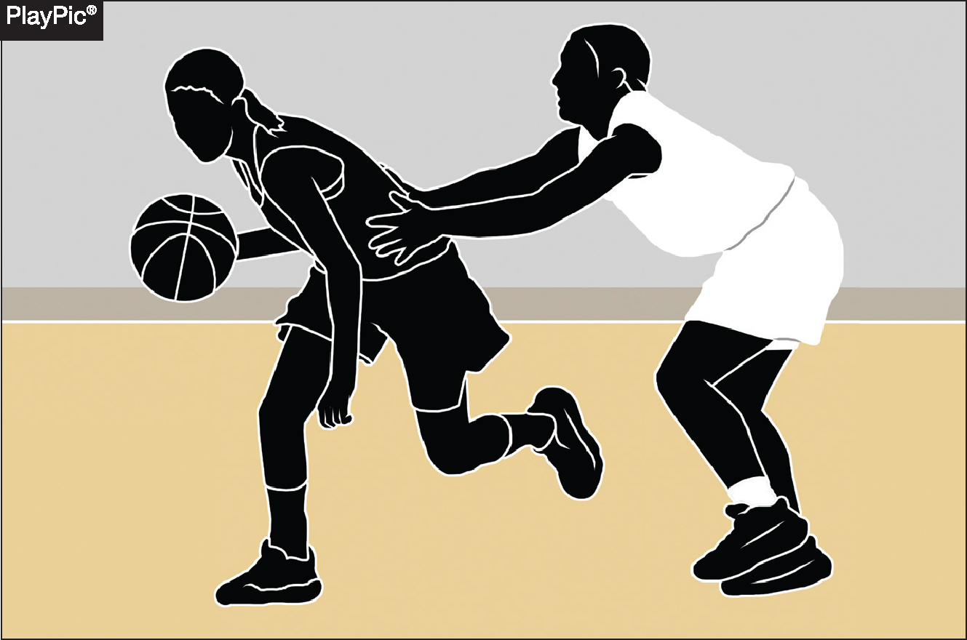
FOUL
4-19-3c
Contact — made with the sole intent to manipulate the clock — is no longer automatically categorized as intentional. Instead, officials are expected to judge contact based on more physical and safety-related criteria.
Notes:
Contact made solely to manipulate the clock is no longer automatically ruled intentional.
Officials are now expected to judge such contact based on physicality and safety concerns rather than intent alone.
The focus is on assessing whether the contact is excessive, dangerous, or compromises player safety.
This change encourages a more nuanced and fair evaluation of contact during the game.
Helps prevent automatic harsh penalties when the contact is minor and not unsafe.

Slide 63
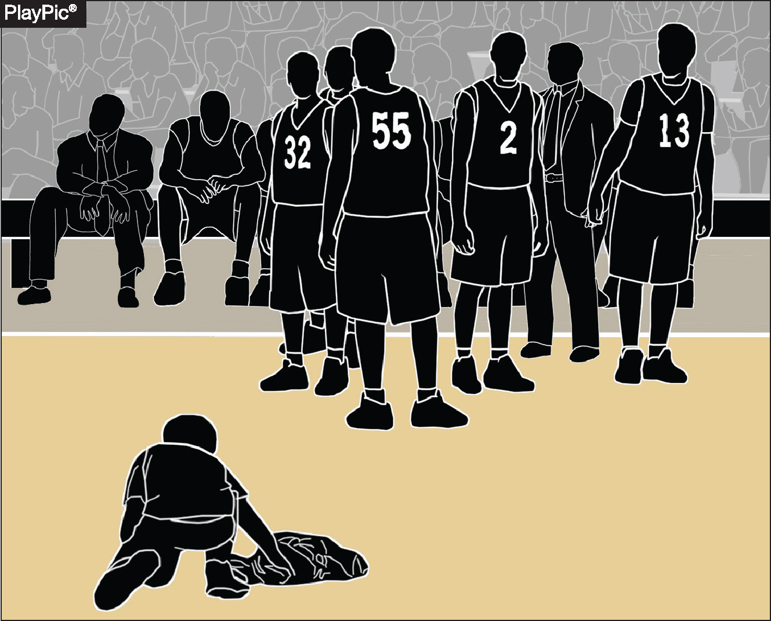
WARNING FOR DELAY
4-47
A warning to a team for actions that cause the game to be delayed is an administrative procedure by an official which is recorded in the scorebook by the scorer and reported to the head coach.
If a team’s actions do not delay a resumption of play, no warning is needed.
Notes:
A warning to a team for actions causing game delay is an official administrative procedure.
The warning is recorded in the scorebook by the scorer.
The warning is reported to the head coach by the official.
If the team’s actions do not delay the resumption of play, no warning is necessary.
This procedure helps maintain game flow and discipline.
Ensures teams are held accountable for delays that affect the pace of the game.

Slide 64
THREE-POINT TRY
5.2.1 SITUATION C
If the offense throws the ball from beyond the three-point line, when there is no possibility of the ball entering the basket from above and touching/deflection by another player causes the goal to be successful, it shall be a two-point goal.
Notes:
If the offense throws the ball from beyond the three-point line, but the ball cannot enter the basket from above (e.g., a throw that hits the backboard or rim in a way that it’s not a direct shot).
And if the ball is then touched or deflected by another player causing the ball to go in,
The resulting goal is counted as a two-point field goal, not three points.
This rule clarifies scoring when the shot attempt is not a direct successful three-point try.

Slide 65
JUMP-BALL ADMINISTRATION
6-3-2a, 6-3-5b
Prior to the ball being tossed for a jump ball, nonjumpers shall not move onto the center restraining circle (within three feet).
Until the tossed ball is touched by one or both jumpers, nonjumpers shall not take a position in any occupied space within three feet of the center restraining circle.
Notes:
Before the ball is tossed for a jump ball, nonjumpers must stay off the center restraining circle, maintaining a distance of at least three feet from it.
Until the tossed ball is touched by one or both jumpers, nonjumpers cannot occupy any space within three feet of the center restraining circle that is already occupied.
These rules help ensure a fair and safe jump ball procedure.
Proper enforcement prevents interference or congestion around the jump ball area.
Maintains clear boundaries for player positioning at the start of play.

Slide 66
2025-26 NFHS Basketball
Other Changes

Slide 67
CONTINUOUS MOTION
4.11.2 SITUATION (NEW)
Under NFHS rules, a player who is pivoting or stepping when fouled is considered to have begun the try attempt.
The player should be considered in the act of shooting if the player continues the motion and releases the ball on a try.
Notes:
A player who is pivoting or stepping when fouled is considered to have begun a try attempt.
If the player continues the shooting motion and releases the ball, they are considered to be in the act of shooting.
This rule helps determine when a foul results in shooting foul penalties (like free throws).
Proper application ensures accurate calls related to fouls during shooting attempts.
It clarifies the timing of when a try officially starts in relation to player movement and fouls.

Slide 68
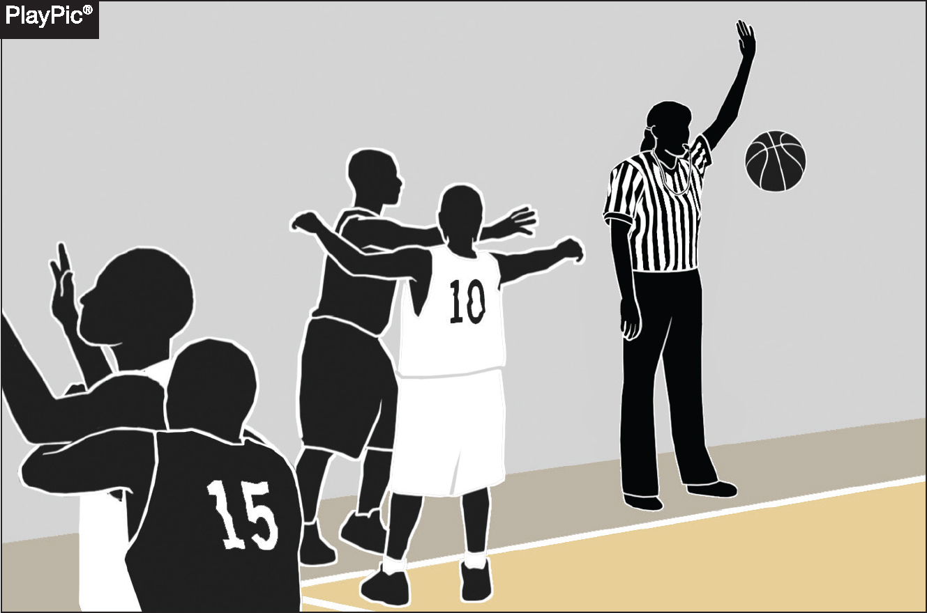
PLAYER AND/OR TEAM CONTROL
4.12.2 SITUATION C (NEW)
If an official blows an inadvertent whistle during the loose ball following a throw-in, the team making the throw-in remains in team control and should be awarded the subsequent throw-in that resumes play at the point of interruption.
Notes:
If an official blows an inadvertent whistle during a loose ball following a throw-in:
The team that made the throw-in retains team control.
That team is awarded the subsequent throw-in to resume play.
The throw-in occurs at the point where play was interrupted.
This ensures fairness by maintaining possession for the team that originally had control.
Proper enforcement helps prevent unintended advantages caused by officiating errors.

Slide 69
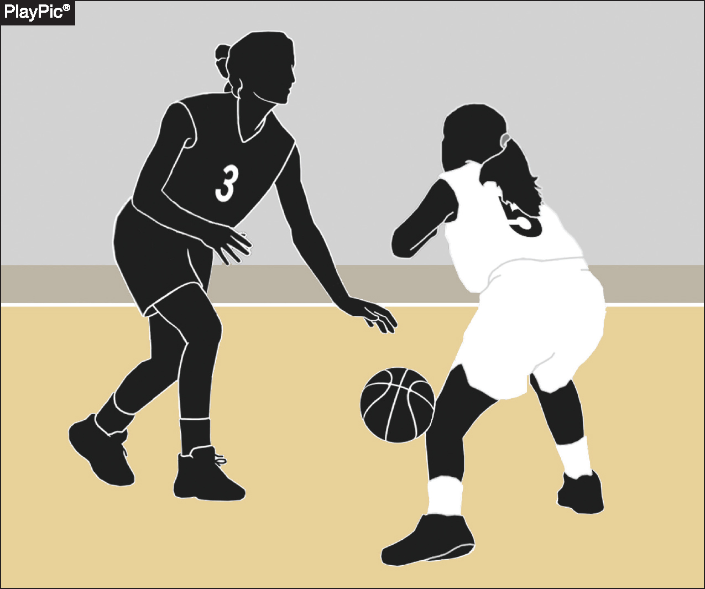
DRIBBLE — LEGAL AND ILLEGAL MOVEMENT
4.15 COMMENT
It is a dribble when the player is in control of the ball, bats, throws or pushes the ball to the floor, and is the first to touch the ball after it returns from the floor.
Notes:
This definition clarifies what actions constitute a legal dribble.
Proper recognition helps officials accurately distinguish between dribbling and other ball-handling violations.

Slide 70
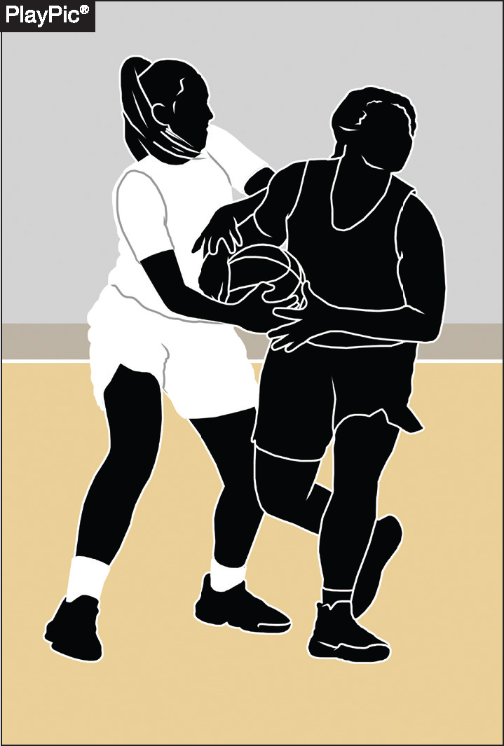
HELD BALL
4.25.1 SITUATION (NEW)
Two opponents do not need to both have two hands on the ball to cause a held ball.
When officials judge the ball cannot be controlled by a player without causing undue roughness, a held ball should be called.
Notes:
A held ball can be called even if only one opponent has two hands on the ball; both players don’t need to have two hands on it.
Officials should call a held ball when they judge that a player cannot control the ball without causing undue roughness.
The focus is on maintaining player safety and preventing excessive physical contact.
Proper enforcement helps ensure fair play and minimizes unnecessary roughness during ball contests.

Slide 71
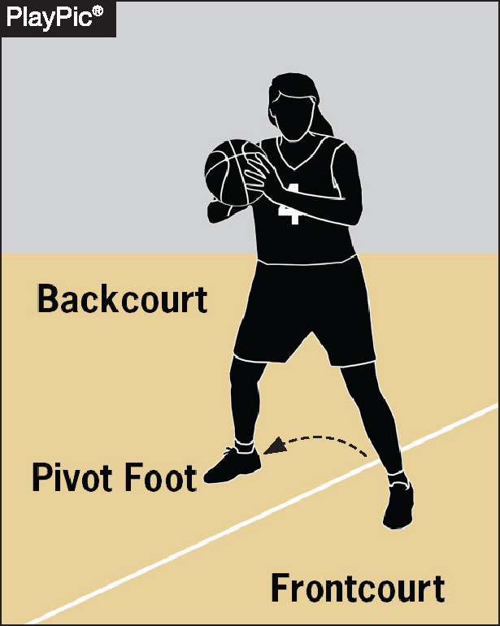
FRONTCOURT-BACKCOURT
9.9.1 SITUATION H (NEW)
It is a backcourt violation if an offensive player steps on, but not over, the division line, or steps into the backcourt.
Notes:
A backcourt violation occurs if an offensive player:
Steps on (but not over) the division line, or
Steps into the backcourt area.
The rule emphasizes that even touching the division line counts as a violation.

Slide 72
DELAY RETURNING TO COURT,
TEAM TECHNICAL
10.4.2 SITUATION B, 10-2-5
If all five offensive players fail to return to the court at approximately the same time, the offensive team is charged with a team technical foul.
Notes:
All five offensive players must return to the court at approximately the same time after a stoppage.
If the offensive players fail to do so, the team is assessed a team technical foul.
This rule promotes orderly and timely resumption of play.

Slide 73
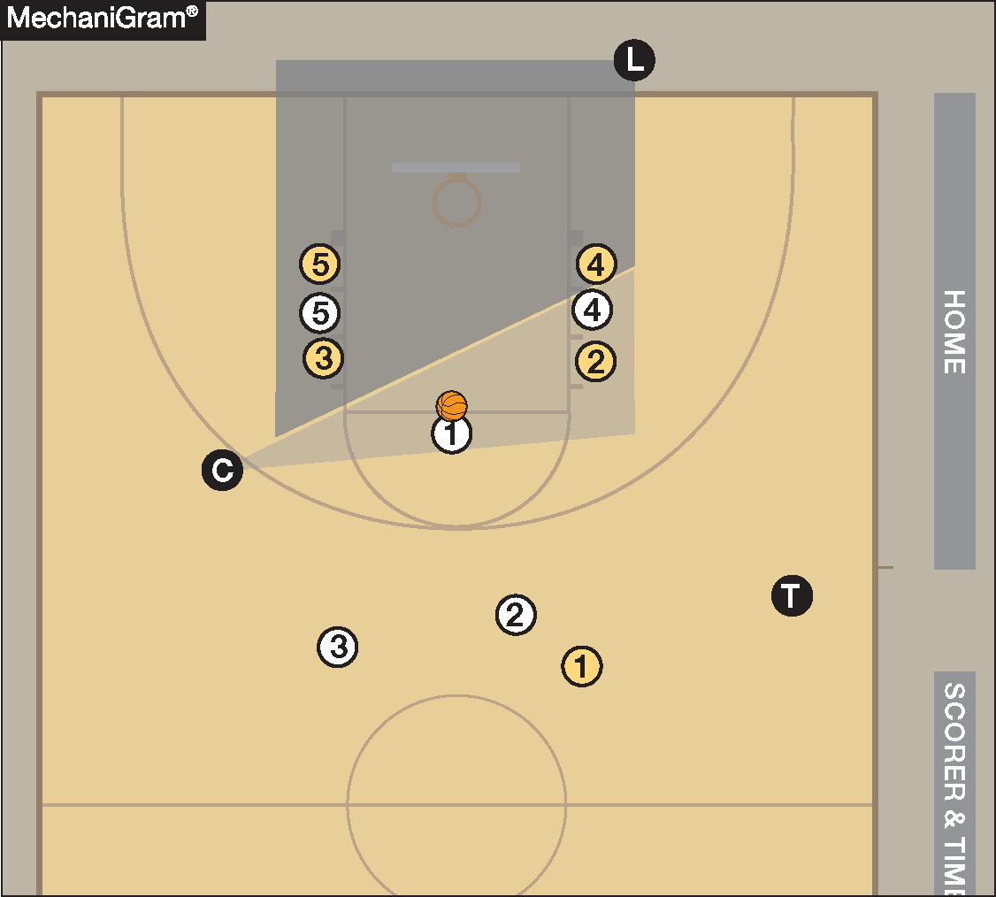
OFFICIALS MANUAL
RULE 5-11 COVERAGE
The trail official should assist the lead and center officials in monitoring free-throw lane activity and is primarily responsible for monitoring players above the free-throw line extended and outside the three-point arc.
Notes:
“Approximately the same time” means players must come back in a coordinated manner. It does not require simultaneous steps, but they must be clearly rejoining play together.
Applies only to the offensive team, likely because they control positioning for set plays after timeouts and can exploit delayed entry.
This is a team technical foul (not a player technical), so it doesn't count toward an individual player's technical foul total.

Slide 74
2025-26 NFHS Basketball
Points of Emphasis

Slide 75
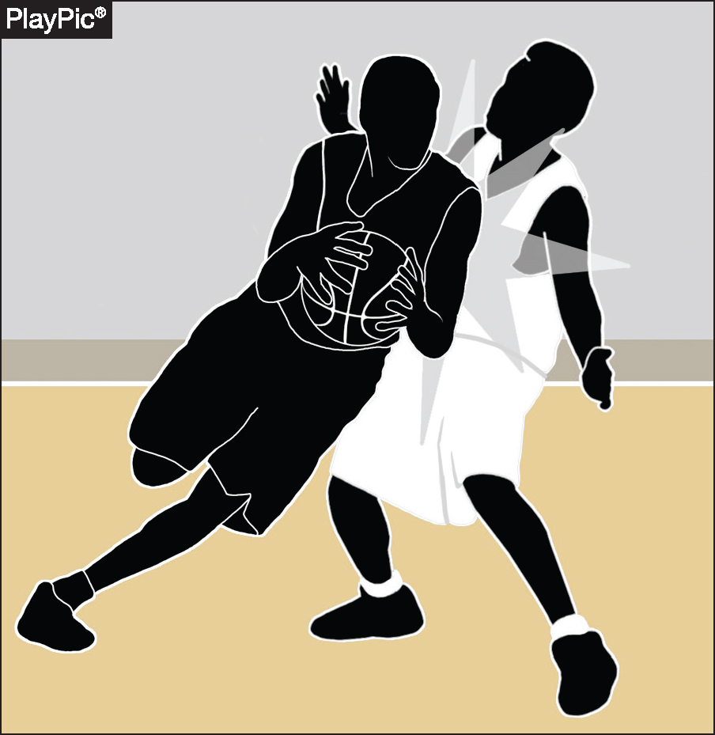
CONTACT ON THE BALL HANDLER
While hand-checking remains a known concern, other forms of illegal contact must also be recognized and penalized.
Defenders may not use their hips, torsos or other parts of the body to displace, re-direct or impede a ball handler’s freedom of movement.
Notes:
Goal: Freedom of Movement
The rule reinforces that ball handlers must be allowed to move freely, and any illegal restriction, even if subtle or non-hand-related, should be penalized.

Slide 76
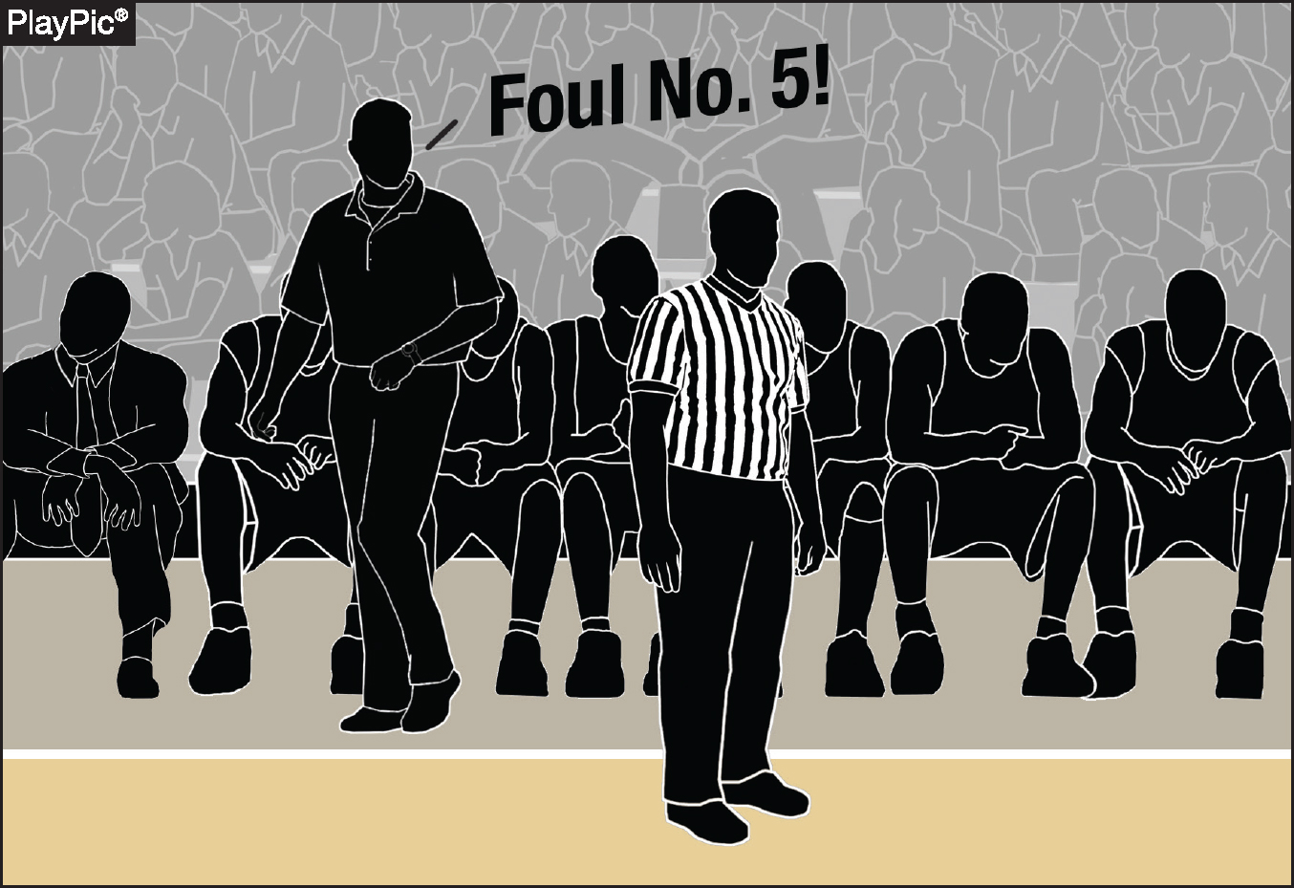
CONTACT ON THE BALL HANDLER
Particular attention is required in late-game scenarios. Not all fouls committed in the closing moments of a contest are necessarily intentional.
Determinations on such rulings must center on the acts themselves, not verbal directives coming from the coaching staff.
Notes:
Not All Late Fouls Are Intentional: A foul committed late in the game is not automatically intentional just because of the timing or situation.
Actions Over Instructions: The decision to call an intentional foul must be based on the nature of the contact, not on whether a coach verbally instructed their players to foul.
Focus on the Act, Not the Intent: Officials must judge the contact itself
Ensures Game Integrity: This guidance helps maintain fair play and prevents automatic assumptions about players’ motives during critical game moments.

Slide 77
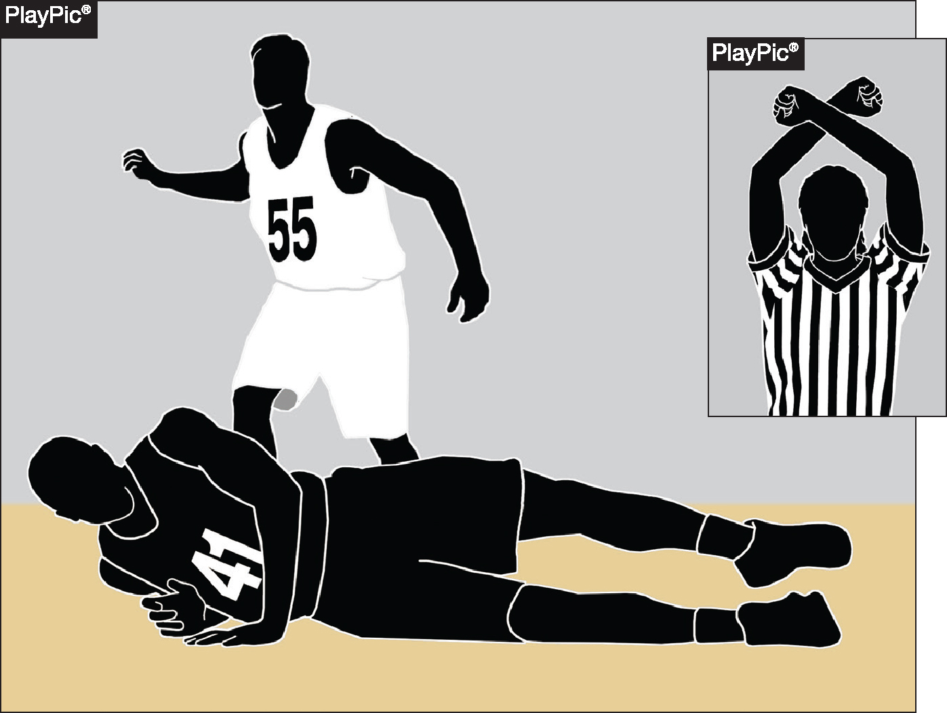
CONTACT ON THE BALL HANDLER
Contact that is excessive, clearly removes an opponent’s apparent advantage or does not constitute a legitimate basketball play should still be classified as an intentional foul.
Instructional emphasis must be placed on teaching players how to commit legal fouls within the parameters of the rules.
Notes:
1. Contact should be ruled intentional if it:
Is excessive,
Removes an opponent’s clear advantage, or
Is not a legitimate basketball play (e.g., grabbing, pushing, or wrapping up).
2. Instructional Emphasis for Coaches: Coaches must teach players how to commit legal fouls—within the rules and spirit of the game—not just how to stop the clock or interrupt play.

Slide 78
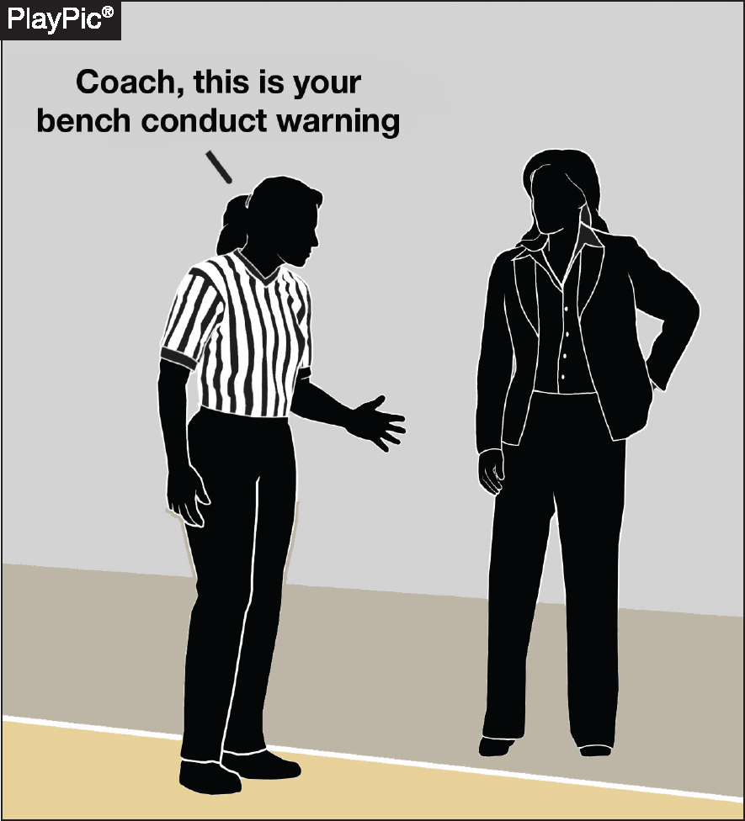
BENCH DECORUM, COMMUNICATION AND PLAYER ALTERCATIONS
Officials are expected to take a proactive role in managing coach and bench behavior, particularly regarding the conduct of head and assistant coaches.
Rule 4-48 (warning for coach/team conduct) should be applied early and consistently to prevent escalation and maintain game control.
Notes:
1. Proactive Officiating Required: Officials must actively manage coach and bench behavior throughout the game. Focus is especially on head and assistant coaches who set the tone for team conduct.
2. Rule 4-48 – Warnings for Conduct: Use Rule 4-48 (team/coach conduct warning) early and consistently:
Helps de-escalate potential issues.
Reinforces boundaries before misconduct becomes problematic.
3. Game Control & Professionalism: Timely application of warnings promotes respect for the game, helps maintain official authority, and ensures smooth game flow.
4. Prevention Over Reaction: The goal is to prevent escalation, not just react after it occurs.

Slide 79
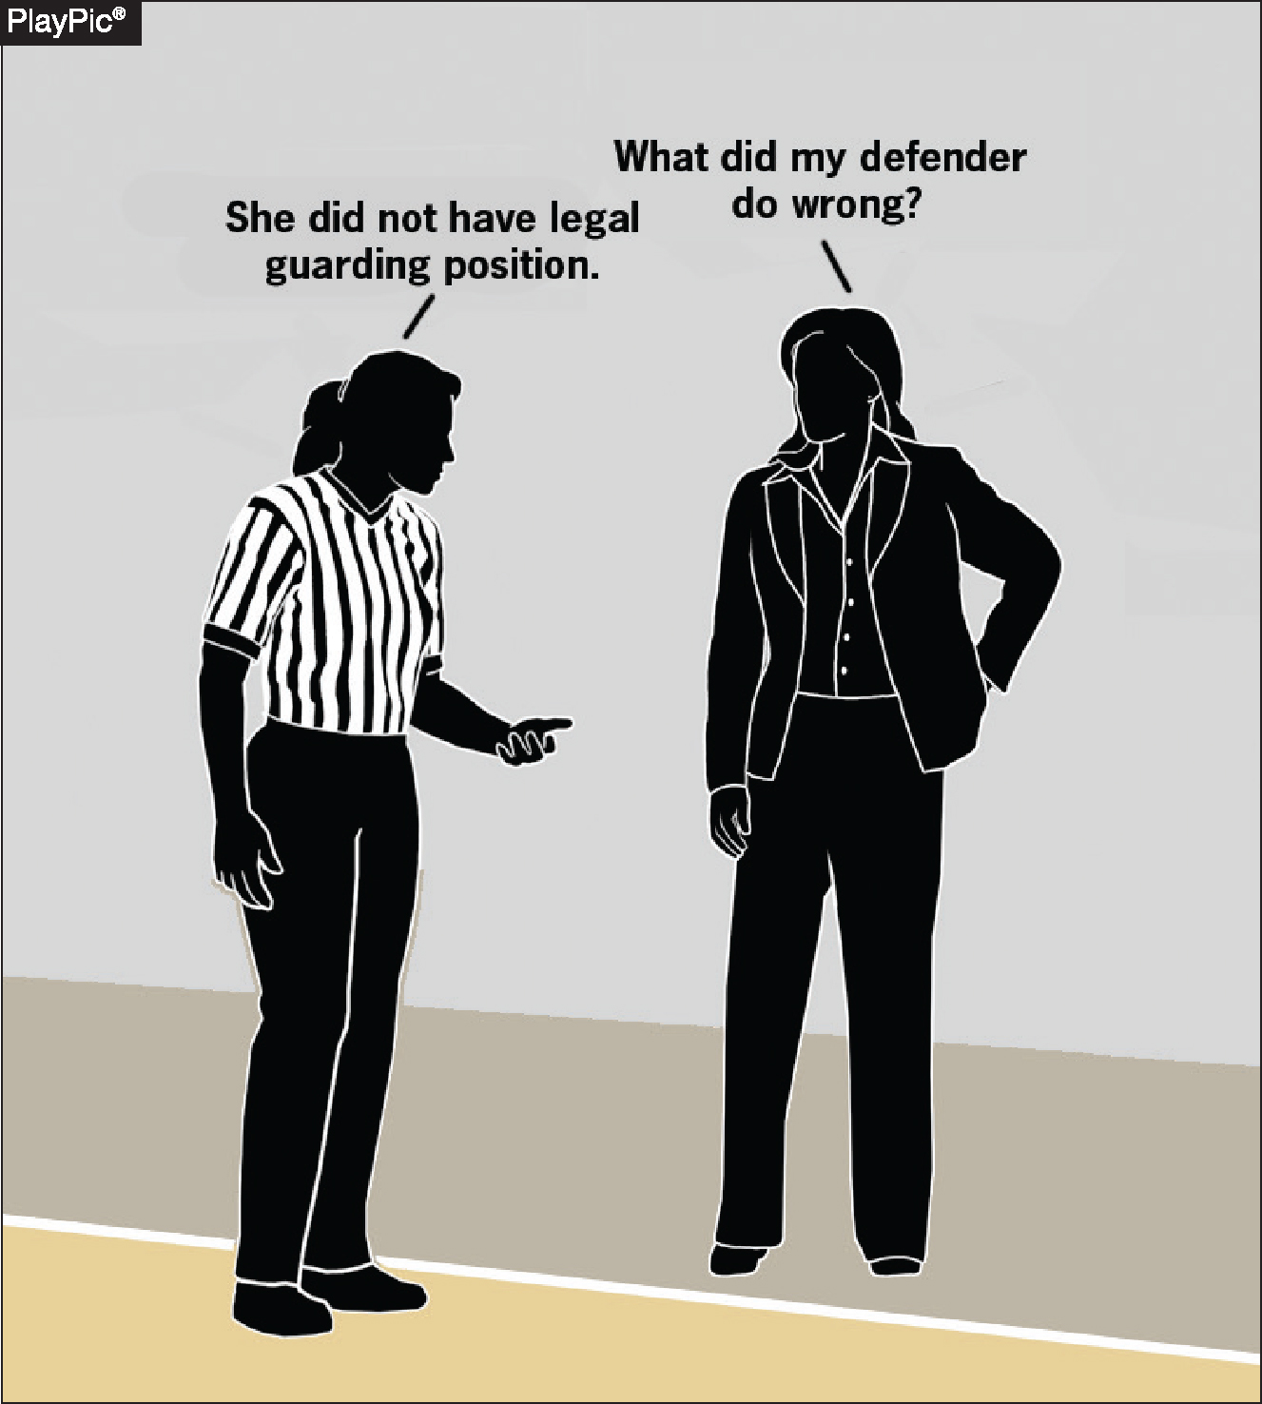
BENCH DECORUM, COMMUNICATION AND PLAYER ALTERCATIONS
Rules-based questions are appropriate and should receive a clear and informative response, as these interactions support the educational purpose of the game.
Rhetorical questions or comments not seeking clarification do not require a response.
Notes:
1. Support Educational Interactions:
Rules-based questions from coaches are appropriate.
Officials should respond with clear, informative answers to support the educational mission of high school athletics.
2. Distinguish Between Constructive and Rhetorical:
Genuine questions seeking clarification deserve a response.
Rhetorical remarks or emotional comments that do not seek understanding do not require a reply.
3. Promote Respectful Dialogue:
Encouraging meaningful communication helps build rapport and mutual respect between coaches and officials.
4. Stay Focused & Professional:
Officials should maintain composure and engage only in productive exchanges that contribute to game understanding.

Slide 80
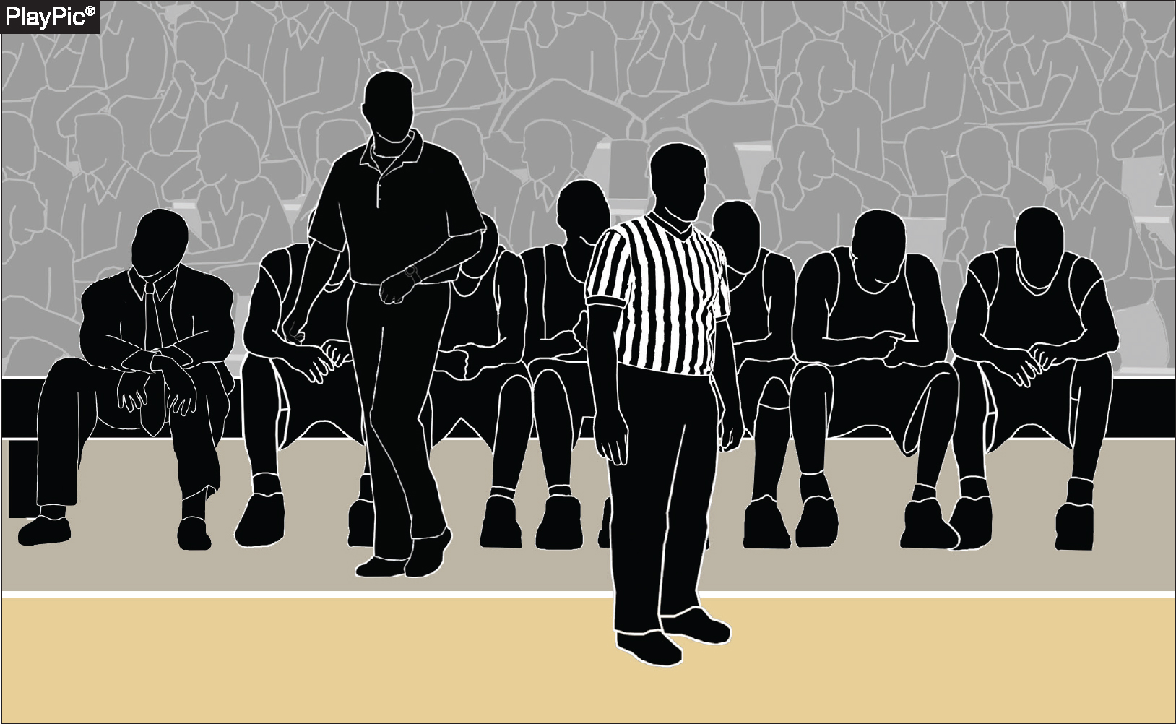
BENCH DECORUM, COMMUNICATION AND PLAYER ALTERCATIONS
Rule 10-5 spells out the privileges and restrictions for head coaches and bench personnel.
Only head coaches may stand and provide instructions to players during live-ball play. All other personnel must remain seated except during rule-specified situations such as timeouts or spontaneous reactions to exceptional play.
Notes:
1. Head Coach Standing Privilege:
Only the head coach is permitted to stand and instruct players during live-ball play.
2. Restrictions for Bench Personnel:
Assistant coaches and other bench personnel must remain seated during live-ball action.
They may only stand in limited, rule-specified situations (e.g.:
During a timeout
For spontaneous reactions to an exceptional play
To confer with the scorer’s table under rule-allowed circumstances)
3. Purpose of the Rule:
Maintains professionalism and clear authority from the sideline.
Prevents disruptive behavior and supports game management.
4. Consistent Enforcement:
Officials should monitor the bench area and apply Rule 10-5 consistently to ensure fairness and order throughout the game.

Slide 81
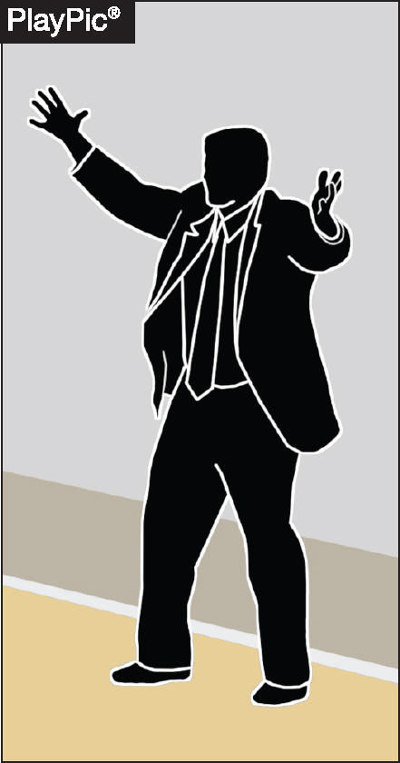
BENCH DECORUM, COMMUNICATION AND PLAYER ALTERCATIONS
Adherence to coaching-box boundaries is essential to maintaining safety and fairness.
Coaches stepping onto the court during live-ball play introduce potential safety concerns and must be addressed through rule enforcement.
Notes:
1. Coaching-Box Boundaries Must Be Respected:
Head coaches must remain within the designated coaching box during live-ball play.
Stepping outside the coaching box violates NFHS Rule 10-5 and compromises game decorum.
2. Safety Implications:
Coaches stepping onto the court during live play create potential safety hazards for players and officials.
Even brief encroachment may interfere with gameplay or official movement.
3. Fairness and Game Integrity:
Strict adherence ensures equal standards for both teams.
Prevents undue influence or distraction from the sideline during competition.
4. Enforcement Responsibility:
Officials must proactively monitor the coaching area.
Warnings or technical fouls may be issued if the behavior persists, in line with Rule 10-5 and Rule 4-48 (warnings).

Slide 82
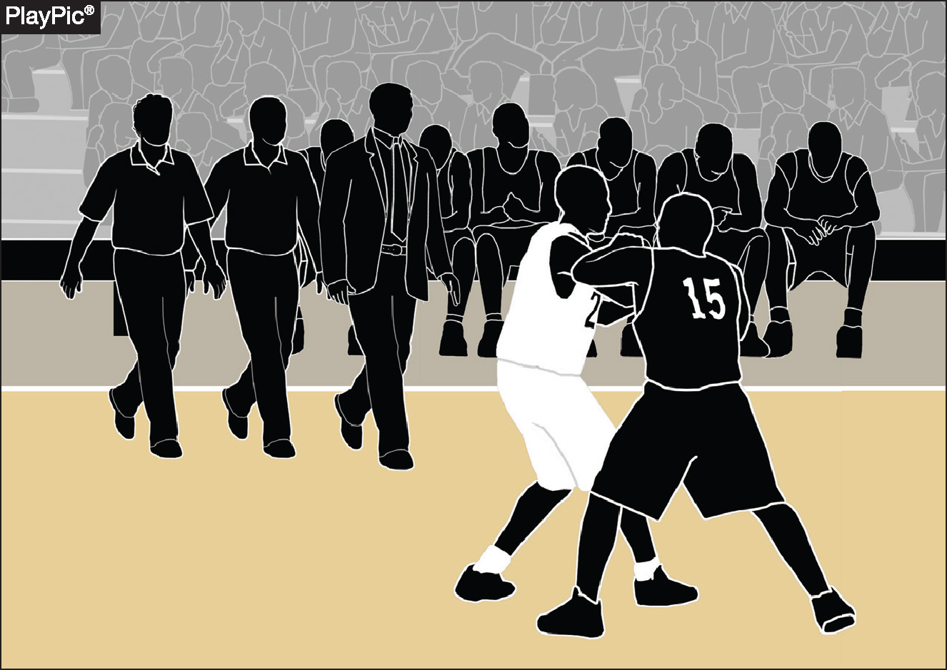
BENCH DECORUM, COMMUNICATION AND PLAYER ALTERCATIONS
The head coach holds primary responsibility for the prevention and de-escalation of potential altercations.
During an altercation, assistant coaches should be tasked with not only managing on-court players, but with controlling bench personnel.
Notes:
Primary Responsibility of the Head Coach: The head coach plays a crucial role in maintaining order and sportsmanship during a game. They are primarily responsible for identifying situations that could potentially escalate into conflicts and taking proactive steps to prevent them. This includes setting the tone for player behavior, communicating clearly with officials, and intervening early when tensions rise to de-escalate any brewing altercations.
Role of Assistant Coaches During Altercations: When an altercation does occur, assistant coaches have an important supporting role. They are tasked with managing the players who are actively participating on the court, ensuring they stay focused and do not escalate the situation further.
Additionally, assistant coaches must also control the behavior of bench personnel, including substitute players and support staff, to prevent the conflict from spreading or intensifying. This dual responsibility helps maintain overall team discipline and keeps the situation contained.

Slide 83
FAKING BEING FOULED
This point of emphasis reaffirms the adoption of rule 4-49 prior to the 2024-25 season, Warning for Faking Being Fouled, which addresses unsporting acts where players simulate illegal contact in an attempt to deceive officials and gain a competitive advantage.
Notes:
Officials must remain vigilant in detecting attempts by players to simulate fouls or illegal contact.
Consistently monitor player behavior to identify subtle or overt acts of deception.
Be ready to issue warnings or enforce penalties promptly to discourage faking fouls.
Maintain focus throughout the game, as players may try to exploit any lapse in officiating attention.
Uphold the integrity of the game by diligently enforcing Rule 4-49 to prevent players from gaining unfair advantages.
Use clear communication with players and coaches to reinforce that faking fouls will not be tolerated.

Slide 84
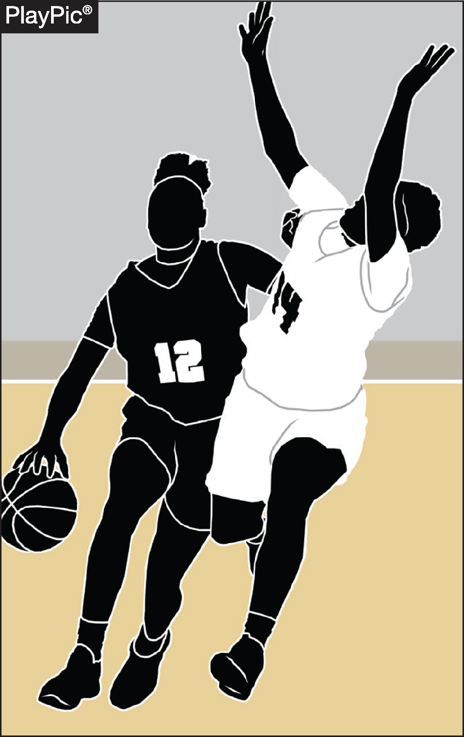
FAKING BEING FOULED
Examples of faking being fouled include head bobs by ball handlers, shooters who simulate being fouled during the act of shooting, and defensive players falling to the floor without contact.
Proper adjudication of these acts with the enforcement of rule 4-49 reinforces the importance of integrity in game play.
Notes:
Here are the key points related to examples of faking being fouled and Rule 4-49 enforcement:
Examples of faking being fouled include:
Ball handlers performing head bobs to simulate contact.
Shooters who exaggerate contact during their shooting motion.
Defensive players who fall to the floor without any contact to draw a foul call.
Proper enforcement of Rule 4-49 is essential in adjudicating these actions correctly.
Consistent rule enforcement discourages players from attempting to deceive officials and gain an unfair advantage.

Slide 85
Meeting 1
Oklahoma Association of Sports Officials
Any Questions about rule changes or anything we have went over tonight?
41.
Notes:
The PowerPoints that we use for the Meetings will be under the member section – you will be able to click on the link when it is ready
Officials Roster – will be on here a week or so after the last meeting – Please use this and don’t call people all the time for phone numbers (especially ME)
Download it to your computer. Also, there is a roster available on ARBITER, Also there is an eligible official roster on the www.ossaa.com as well.
School/AD contacts – hard to keep this up to date – USE ARBITER FOR THIS

Slide 86
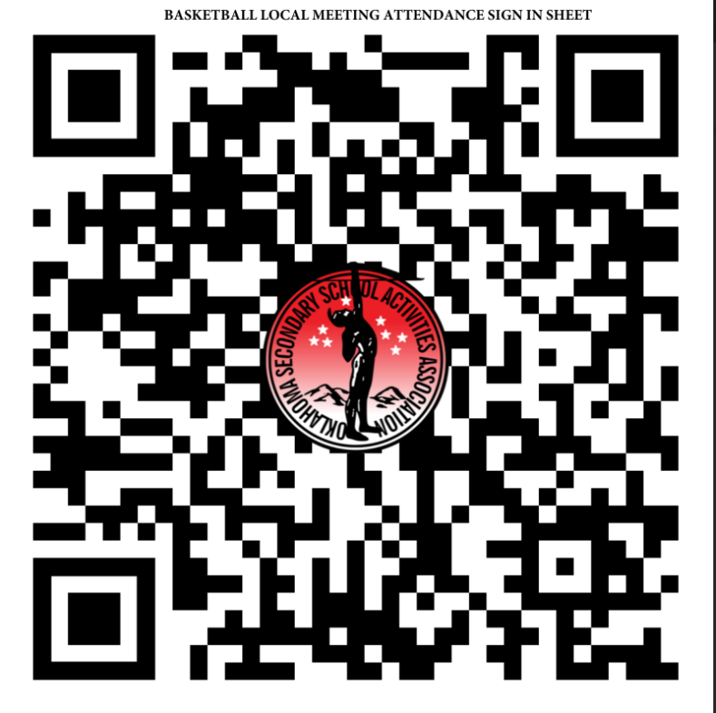
Meeting 1
Oklahoma Association of Sports Officials
36
Notes:
Lots of things on this main page – OSSAA Officials Playoff Pay Game Fees, How to Register as an official with the OSSAA, OSSAA State Meeting link along with the Eligible officials list.

Slide 87
Meeting 1
Oklahoma Association of Sports Officials
Reminder – Arbiter Availability is OPEN – you have to go in and block the dates you are not available.
If you also use HorizonWebRef (for INBC) it is the opposite – you automatically are NOT Available, you have to go in and open up the dates you can work.
If you get a game on one platform, please go block it in the other platforms you are using.
02.

Slide 88
Rule Changes for 2024 - 25 Season
Rule 1-19 Limits the use of electronic devices used during the game for the purposes of recording and tracking stats, reviewing or diagramming plays, or other similar contest related functions.
Rationale: Clarifies the type of electronic devices that are allowed during the game, prohibiting the use of voice and video recording devices word during a contest.
23.

Slide 89
Meeting 1 - OASO
OSSAA PLAYOFF ADVICE
**Pay attention for the email from Sheree about when to update your playoff availability, we try to send out an email reminding everyone as well. There is a separate one for State like the next week as well. She usually sends that out early February.
**If you are wanting to advance, the best way to give yourself every opportunity is to open your
Availability completely up. Thursday/Friday/Saturday each week. If you can work the afternoon
Games even better.
*You must be available Regionals weekend to even get on the playoff lists that goes out to the schools! We recommend all 3 days to give yourself the opportunity to come in on more lists.
**Don’t turn back games to the OSSAA if you want to work in the future! Make sure you add your
Conflicts of interest such as family playing on a team or if you recently graduated from a school,
Coaches you don’t get along with and such.
32

Slide 90
Contact your Partners & School
Importance of Contacting your partner(s) & the School (location of the game if neutral site) cannot be overstated here.
Be an official that is known for taking care of business!
Normally contact your partners first – I do it with a group text normally. Confirm they are still on the game.
Once you confirm that, then contact the school and confirm the date and time of your games and let them know when you will be there. Also, let them know the names of all officials on the crew.
Another piece of advice: get a cell phone of whoever will be in charge in case of bad weather, car breaks down, etc..
Keep in mind that some school districts have went to 4 day weeks (normally Friday off but I have heard there are a couple that are off on Mondays) Call ahead of time!

Slide 91
14 Keys to being a successful official
What are Coaches/Associations/Assigners & Other Officials looking for in a basketball official?
#1 – BE ON TIME EARLY
If you are early, you are never late
Don’t be that official that shows up right at game time or 2 minutes after. You have Site Admin wondering, you have your partners wondering and then they are calling the assigners
At least 45 minutes early for Varsity
At least 10-15 minutes early for everything else

Slide 92
14 Keys to being a successful official
What are Coaches/Associations/Assigners & Other Officials looking for in a basketball official?
#2 – TAKE CARE OF BUSINESS!
Take care of Registrations & Dues
Wear the proper equipment
Take tests, watch required videos
Go to required meetings
Do reports (such as ejection reports) as required in the proper timeframe

Slide 93
14 Keys to being a successful official
What are Coaches/Associations/Assigners & Other Officials looking for in a basketball official?
#3 – BE AVAILABLE & DEPENDABLE
As an assigner I have hear every possible excuse on why you have to give back games. Examples if you want to hear them? Not saying they aren’t true but as a pattern develops on you – assigners are less likely to assign you games (more work for assigners eventually = less work for you)
I will take a dependable AVERAGE official over an Undependable All Star official every day of the week and twice on Sundays!

Slide 94
14 Keys to being a successful official
What are Coaches/Associations/Assigners & Other Officials looking for in a basketball official?
#3 – BE AVAILABLE & DEPENDABLE
Be available – if you are not working, a quick way to get in the assigner’s good graces is to be available and volunteer to go when the call goes out. If you want to move up to more games/better games - be available and dependable. Let the assigner know that they can call you in a pinch – Have bag, will travel!
Never give your games to someone else without the assigner’s blessings (many reasons why)

Slide 95
14 Keys to being a successful official
What are Coaches/Associations/Assigners & Other Officials looking for in a basketball official?
#4 – APPEARANCE – LOOK THE PART
Even if you are a bit overweight, buy pants/shirts that fit. Make sure your shirt stays tucked in, wash your uniform daily (don’t stink). Don’t have a wrinkled shirt or pants – keep them neat.
Fix your hair (if you have any). Shave and all that hygiene stuff!
Smell good, chew gum or mints to keep from having bad breath

Slide 96
14 Keys to being a successful official
What are Coaches/Associations/Assigners & Other Officials looking for in a basketball official?
#4 – APPEARANCE – LOOK THE PART
Get a new shirt/pants every year or two – keep those white stripes bright!
Get new shoes often, if you officiate a lot I recommend at least 2 pair, rotate them in and out and they will last longer
Add gear to your arsenal each year – nice bag/extra whistles, a way to keep your shirt tucked in such as a rubber belt or suspenders, a massage gun, some 800’s ☺
Get in shape/stay in shape – I know this one is a bit tougher but it is a fact that an official in good shape gets a lot more slack from coaches/players/fans than the person that is not in shape.

Slide 97
14 Keys to being a successful official
What are Coaches/Associations/Assigners & Other Officials looking for in a basketball official?
#5 – SIGNALS & PRESENTATION
Practice your signals in the mirror at home (arm extended, emphatic calls when needed, how hard you blow your whistle, how you wave off a basket)
Communicating to the table is HUGE – Slow down, look the scorekeeper in the eyes (this also allows you to make sure they are looking so you don’t have to do it twice) Good crisp two handed signals for reporting fouls, communicate the type of foul, how many shots if shooting free throws, let your partners (and everyone else) know where the ball is going to next be put in play

Slide 98
14 Keys to being a successful official
What are Coaches/Associations/Assigners & Other Officials looking for in a basketball official?
#6 – STUDY THE RULEBOOK
No matter what level you are working, know the basic rules of the age group or the league you are calling in.
The more you know the rules, the more confident and comfortable you are going to be applying them to your game.
Same for mechanics, know where you should be and what you should be looking at. The game gets easier to call once you have a grasp on both of these!

Slide 99
14 Keys to being a successful official
What are Coaches/Associations/Assigners & Other Officials looking for in a basketball official?
#7 – BE A GOOD COMMUNICATOR
Contact your partners at least a day before you game (especially if you are the R but even if you are not the Referee – if you haven’t heard from R – call or text!)
Contact the school at least a day before your games (R’s responsibility)
Have a solid pregame in the lockerroom with your partners, with the captains, with the coaches and the table crew – be cordial

Slide 100
14 Keys to being a successful official
What are Coaches/Associations/Assigners & Other Officials looking for in a basketball official?
#7 – BE A GOOD COMMUNICATOR
Talk to your partners, let them know when you warn a coach or player so we don’t all warn the same people.
Get together at timeouts and talk, get together after a technical – make sure we know what we are doing and where we are going.
Make eye contact with your partners before putting the ball in play
Talk to players during the game: Hands off, don’t hold, get set on screens, on the release during free throws (or the rim if free thrower or anyone outside the lane)
Fill out required reports – be prompt on ejections as the coach or player is likely going to have to sit and the state or organization you are calling for needs to know.

Slide 101
14 Keys to being a successful official
What are Coaches/Associations/Assigners & Other Officials looking for in a basketball official?
#8 – TAKE CARE OF TROUBLE
We are not going out looking for trouble but if/when it rears its ugly head take care of it.
We control the Coaches and Players with warnings/technicals/ejections
If it is the table or fans – get administration involved if you can.
Not looking for interaction with fans but we can stop the game until the problem is rectified by Game Administration.
Know that when these interactions occur there is now a great chance you are going to be on video – so stay professional and under control, let others be the ones acting like idiots!

Slide 102
14 Keys to being a successful official
What are Coaches/Associations/Assigners & Other Officials looking for in a basketball official?
#9 – CHOOSE YOUR BUDDIES WISELY
Careful who you hang out with
Work with officials that want to get better. Stay away from the lazy ones that are the constant complainers about not getting certain games. Don’t get labeled with them!
Get with a willing mentor – if you are not working go watch their games. Work youth games with them if they are willing. Go to scrimmages with them as well and absorb all you can.
Word spreads fast if you have potential or you are working hard to get better. Coaches, other officials, even Fans will spread the news if you can work. Word also spreads fast if you are negative and/or lazy as well though!

Slide 103
14 Keys to being a successful official
What are Coaches/Associations/Assigners & Other Officials looking for in a basketball official?
#10 – LISTEN WAY MORE THAN YOU SPEAK
This includes when interacting with administration, coaches and other officials.
Don’t get labeled a know it all that has an answer for everything or even worse a one upper - as others will give up helping you really quickly.

Slide 104
14 Keys to being a successful official
What are Coaches/Associations/Assigners & Other Officials looking for in a basketball official?
#11 – REVIEW VIDEO WHEN AVAILABLE
You probably look different on video than you do in your mind..
Watching video will allow you to see what your mechanics look like and what you need to work on there.
Also your positioning on the court can be critiqued along with calls/no calls
All good things to learn from.

Slide 105
14 Keys to being a successful official
What are Coaches/Associations/Assigners & Other Officials looking for in a basketball official?
#12 – AVOID CONFLICTS OF INTEREST
Do not take games where you have a conflict of interest.
Graduated from Jenks/Union 3 years ago, probably shouldn’t work there.
Got kids/cousins/cousins kids/friends kids that play on a team, probably best to avoid those games.
The coach is your brother-in-law – pass on that one..
We don’t ever want to appear to be impartial or for someone to find out these things above after a tough call in a close game.
Really just saving you here from losing a friendship or getting in trouble. Just scratch those games, you don’t need the headache!

Slide 106
14 Keys to being a successful official
What are Coaches/Associations/Assigners & Other Officials looking for in a basketball official?
#13 – IT’S NOT DOG EAT DOG
Don’t criticize other officials or question their calls/style. We are supposed to be on the same side!
Don’t throw your partner(s) under the bus with the coaches!
Be happy for your fellow officials success and keep working to attain your goals.
Putting others down to prop yourself up rarely ends well for you in the end.
If you don’t agree with advice that another official gives you, take it with a grain of salt and bounce it off someone you trust.

Slide 107
14 Keys to being a successful official
What are Coaches/Associations/Assigners & Other Officials looking for in a basketball official?
#4 – BEWARE OF SOCIAL MEDIA
Never hash it out in public
Problems with teams/fans/other officials? Stay away from putting it out on Facebook, Twitter, Instagram, TikTok, Snap or whatever other new social media apps are out there.
Don’t argue with idiots on social media, you cannot win – there are too many of them!
Just expect that someone out there is waiting for one of us to say something controversial or do something stupid and then it will be all over the news – Spreading like wildfire!
Just assume someone is always watching your actions on and off the court because they just might be.

Slide 108
Thank You
Wednesday, October 11th, 2023

Slide 109
OASO Hall of Fame
More information to come – we are working on this
33

Slide 110
In Memoriam
Is there anyone that we lost in the past year?
34

Slide 111
OASO
New Officials Orientation

Slide 112
How to Become an OSSAA Official
Who can be an OSSAA official?
Any person of good character
Registered sex offenders or registered violent crime offenders are not eligible
Must be 16 years old to enroll
Requirement to officiate high school age participants – official must be at least a high school senior

Slide 113
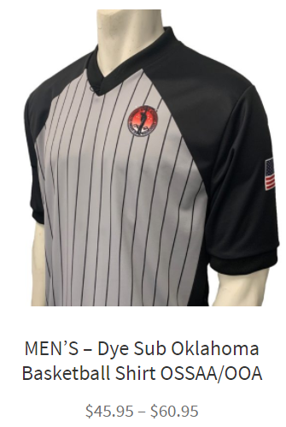
OASO New Officials Orientation
Required Shirt
OOA Shirt at 2 locations:
www.officialslocker.com
www.refereescall.com
Notes:
Ranges from $20 - $45

Slide 114
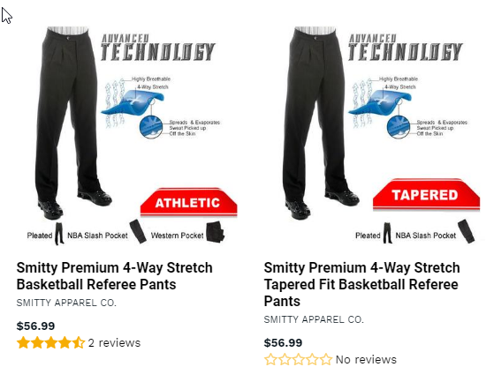
Pants Required
Notes:
No belt loops – pants can range from $30-$75 depending on what brand

Slide 115
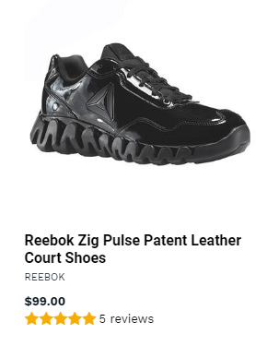
Shoes Required
Notes:
You can spend from $40 - $250 on shoes, I recommend a good pair as you will want to keep your feet comfortable.

Slide 116
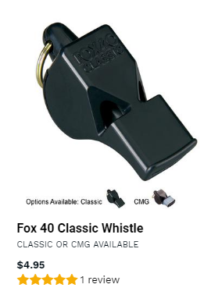
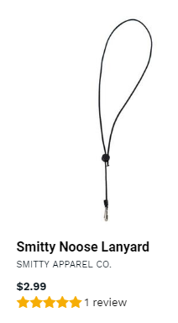
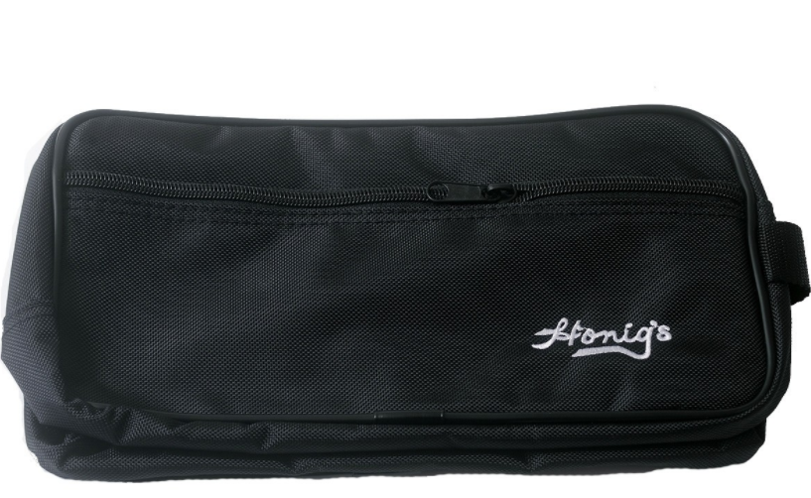
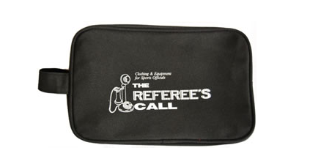
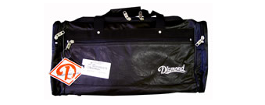
Whistle & Lanyard required
Notes:
Whistle $7 - $10 bucks, Lanyard $4-$5 bucks, Whistle Bag - $10, Equipment bags can be from $20-$100

Slide 117
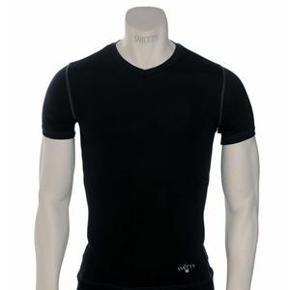
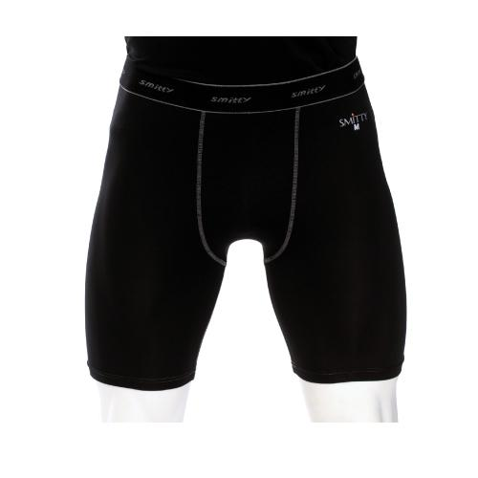
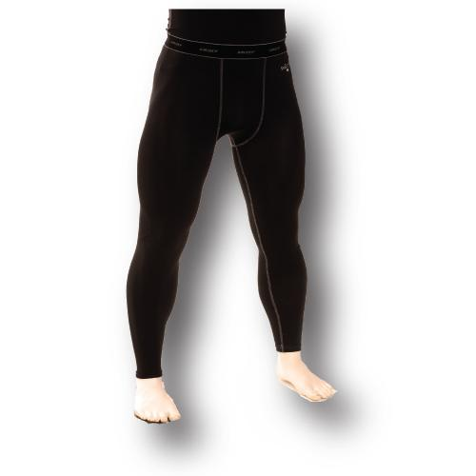
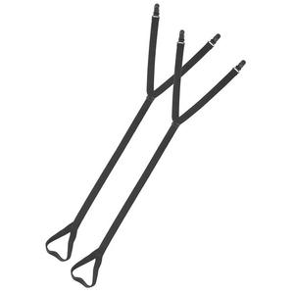
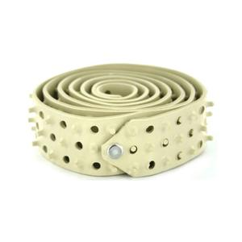
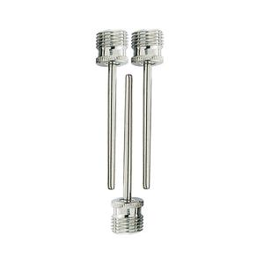
Extras
Notes:
Undershirt - $20 Tights $20 Full Length Tights $28 Stirrups - $10 Rubber Belt $17

Slide 118
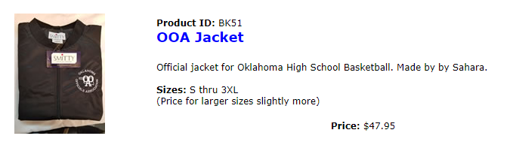
Jacket Required for Varsity
Notes:
I think this may only be available with at the referee’s call in OKC and it is $48

Slide 119
OASO New Officials Orientation
Youth League Games
I assign games on Saturdays mainly starting in December through March. To work those games you will need to register (for free) at www.horizonwebref.com Assn # is 205483 (Registration is free)
Johnny also assigns youth games and Junior High games as well and Brad and I help him with that – those games are assigned on Arbiter under OASO association.
Notes:
Horizon Notes – When registering, you are not done until you verify a phone number and then add your availability on the calendar.

Slide 120
OASO New Officials Orientation
Things you will need to do:
-- Register for OASO on Arbiter
  Take part 1 of the test – we will go over the test during the meeting 3 or 4 – it won’t be exactly the same but you will get to confirm a lot of the answers
  Watch the Concussion Video (www.nfhslearn.com)
  Watch the Heat Video (www.nfhslearn.com)
  Watch the Implicit Bias Video (www.nfhslearn.com)
  Go to a State Meeting – either locally or Online later

Slide 121
OASO New Officials Orienation
Things you will want to do:
  As many scrimmages as you can – even if you have to do them for free. Get out there and work, especially with veterans who can help.
  Find a mentor (solid veteran)
  Let Johnny, Brad and/or Bobby know you are available – sometimes on short notice
  Be dependable – if you take an assignment, don’t bail. Never replace yourself on a game, call the assignor.
  Go to camps in the summer if you want to get better.

Slide 122
OASO New Officials Orientation
Things that can help
NASO: further insurance coverage, annual Summit, VIP card, discounted Referee magazine, www.naso.org, NFHS: rules authority, publications to buy – www.nfhs.com, learning resources – www.nfhs.org Optional costs $109/year
Dress for success – looking good is half the battle – when you show up and when you officiate
Never officiate games where you have a conflict of interest (i.e. your kid or any family is playing, or you coach at that school or your kid goes to that school)

Slide 123
OASO New Officials Orientation
Places to buy officiating equipment:
www.officialslocker.com
Resources:
www.referee.com
NFHS Rules book, Case book, Officials Manual (you will get this packet from the OSSAA after you register)
Questions?
Notes:
If you want the rulebook or casebook early you can buy it online at Amazon – search for NFHS Basketball rule book and or Basketball case book. Then you can have it on your phone and or computer browser. $6.99 I believe.

