Slide 1
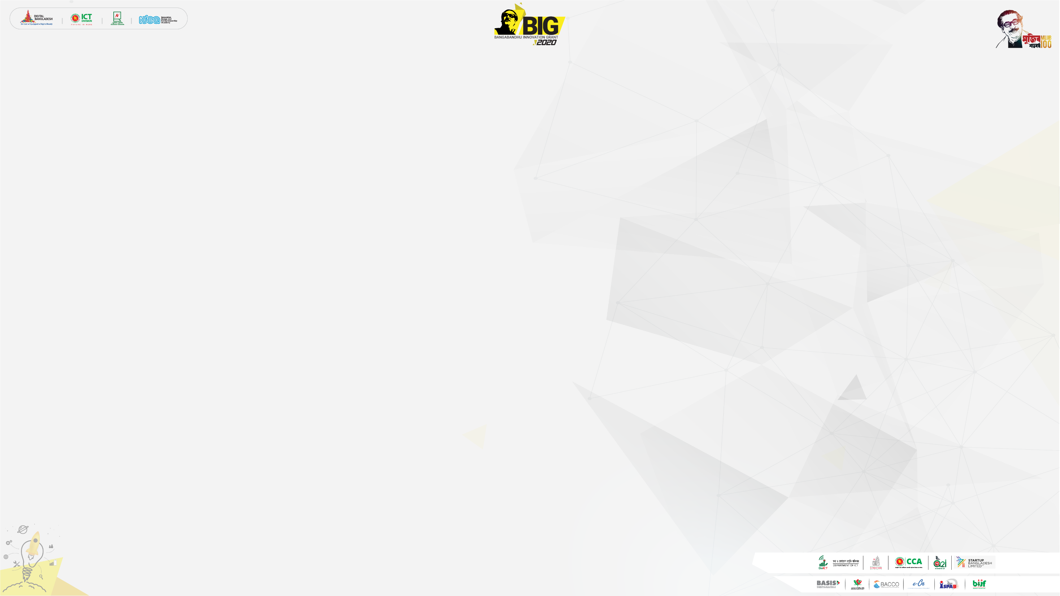


Bangabandhu Innovation Grant-2020 Pitch Deck
ROBO REHAB

Slide 2




Introduction
Project:
Company Name:
Company Logo:
ROBO REHAB
1. Rehab Science Hospital
2. A Manufacturing company
Tag Line:
“Health Solution by
Technological Innovation”

Slide 3



Introduction
Location of Operations:
Mission & Objectives
of the Startup:
DHAKA
Description of Product or Service:

Slide 4


Introduction
Mission & Objectives
of the Startup:
Science & Technology
Artificial Intelligence (AI)
Augmented reality (AR)
Virtual Reality (VR)
Objectives:
>>>
Healthcare + Engineering + Technology

Slide 5
Introduction
Location of Operations:
Mission & Objectives
of the Startup:
DHAKA
Description of Product or Service:

Slide 6
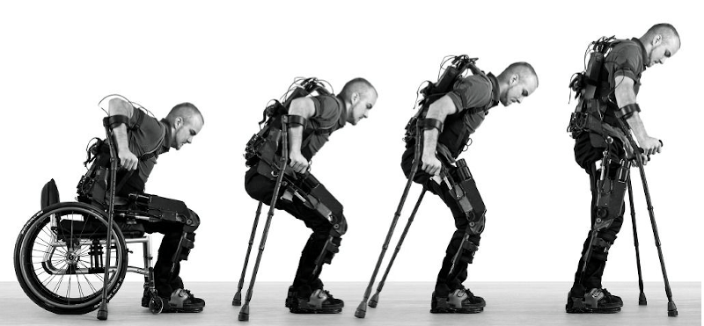
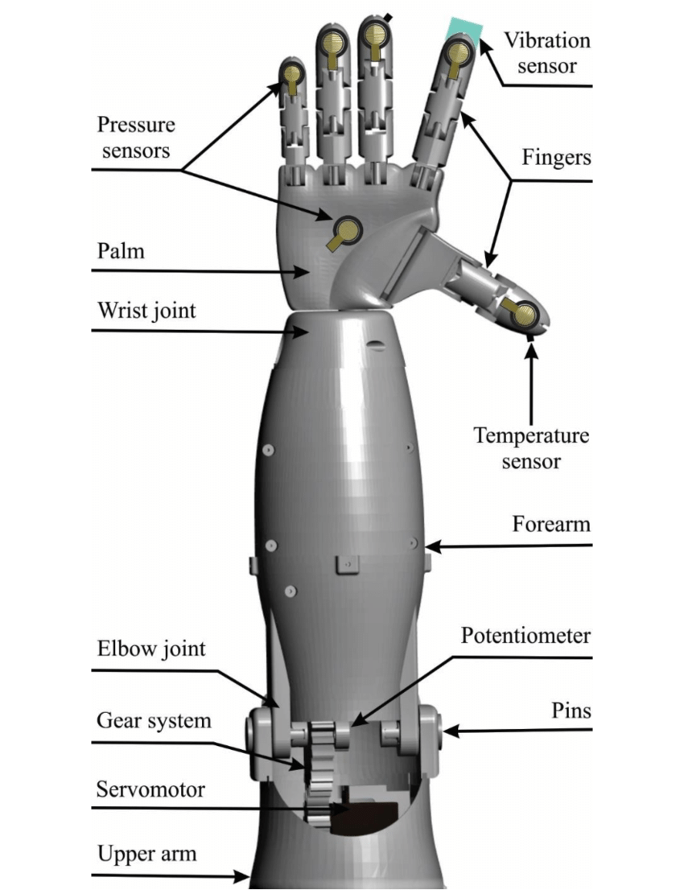
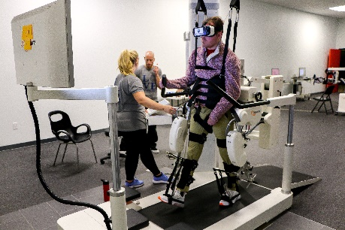
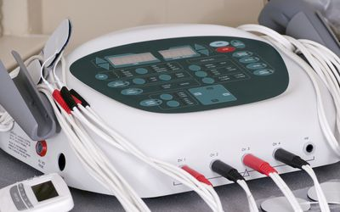

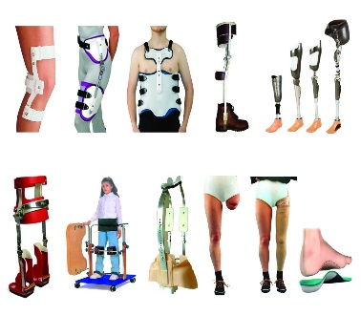
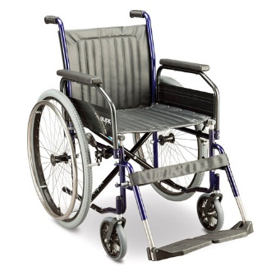

Introduction
Description of Product or Service:
Exoskeleton
Bionics
VR Therapy
Neurotechnology
Biophysical Therapy
Assistive Technologies
Electric Wheelchair
Manufacturing Company

Slide 7
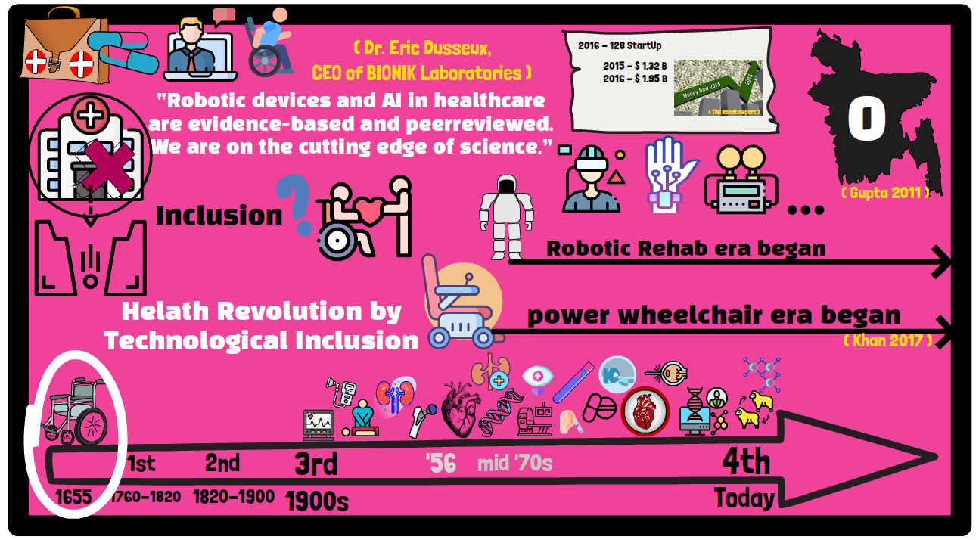
Problem Statement
What is the problem we are trying to solve?

Slide 8

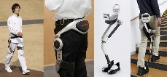
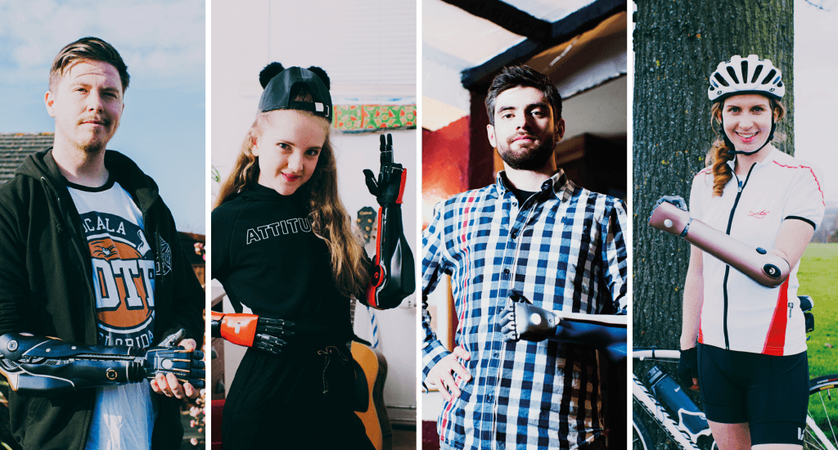
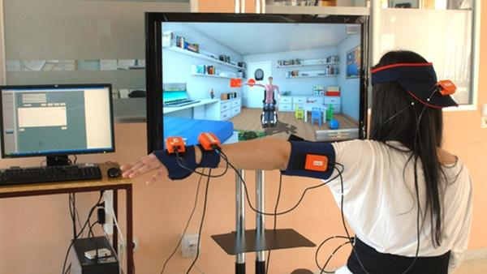
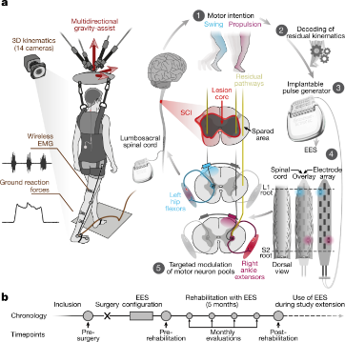
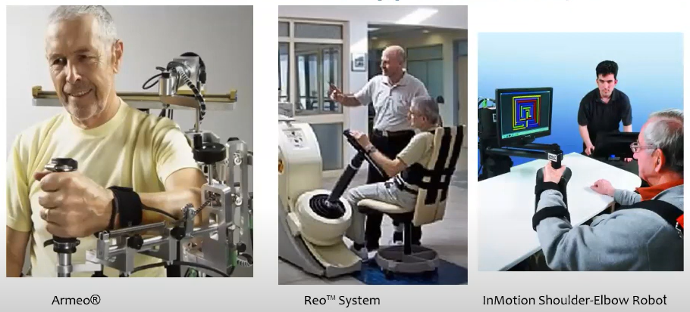
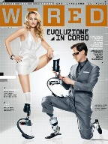
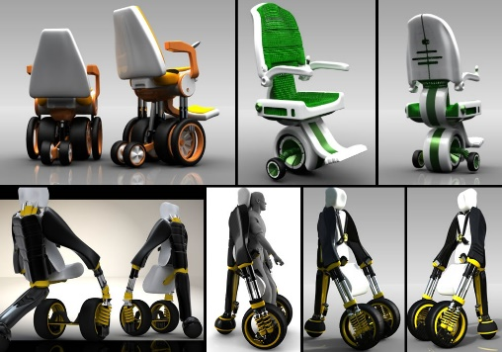
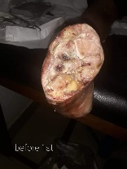
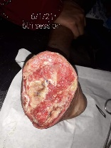
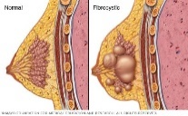
Solution Statement
What is our solution to the Problem?
Solutions
Exoskeleton & Robotic Devices
Bionics
VR Therapy
Neurotechnology
Biophysical Therapy
Assistive Technologies
Electric Wheelchair
Manufacturing Company

Slide 9
Solution Statement
What is our solution to the Problem?
Solutions
Exoskeleton & Robotic Devices

Slide 10
Solution Statement
What is our solution to the Problem?
Solutions
Exoskeleton & Robotic Devices
Bionics
VR Therapy
Neurotechnology
Biophysical Therapy
Assistive Technologies
Electric Wheelchair
Manufacturing Company

Slide 11
Solution Statement
What is our solution to the Problem?
Solutions
Bionics

Slide 12
Solution Statement
What is our solution to the Problem?
Solutions
Exoskeleton & Robotic Devices
Bionics
VR Therapy
Neurotechnology
Biophysical Therapy
Assistive Technologies
Electric Wheelchair
Manufacturing Company

Slide 13
Solution Statement
What is our solution to the Problem?
Solutions
VR Therapy
Neurotechnology

Slide 14

Solution Statement
What is our solution to the Problem?
Solutions
Exoskeleton & Robotic Devices
Bionics
VR Therapy
Neurotechnology
Biophysical Therapy
Assistive Technologies
Electric Wheelchair
Manufacturing Company

Slide 15
Solution Statement
What is our solution to the Problem?
Solutions
Biophysical Therapy

Slide 16
Solution Statement
What is our solution to the Problem?
Solutions
Exoskeleton & Robotic Devices
Bionics
VR Therapy
Neurotechnology
Biophysical Therapy
Assistive Technologies
Electric Wheelchair
Manufacturing Company

Slide 17
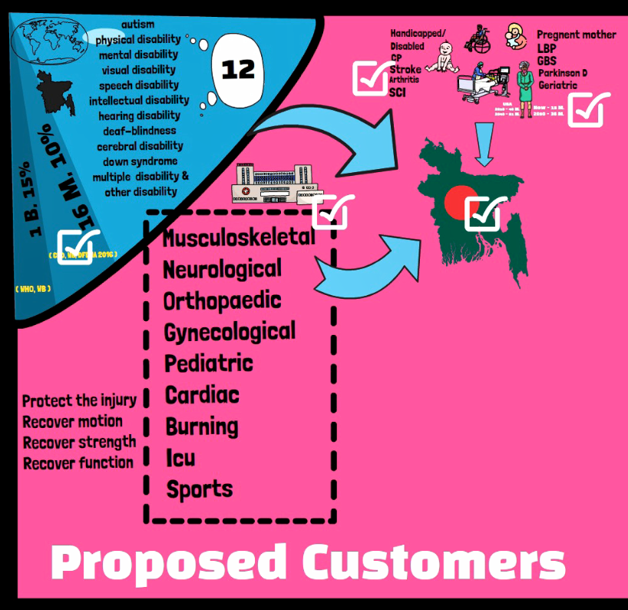
Market Size
Describe:
the target market
the total market size
the market share that the company will target

Slide 18
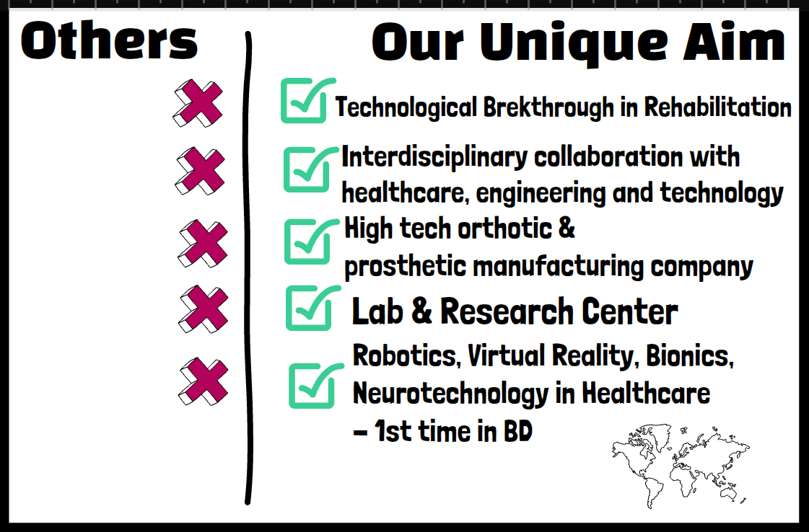
Competitive Advantage
Describe:
Direct and indirect competitors
Your competitive advantage

Slide 19
Funding Request
Describe:
Amount requested: $100K
Industry focus:
Venture stage: Idea Level
Timeline to achieve profitability: 1-2 Years
Monthly burn rate:

Slide 20
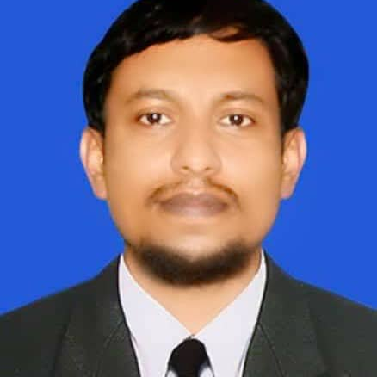
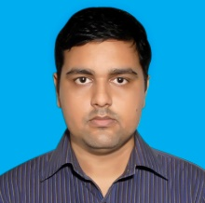
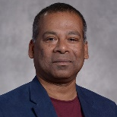
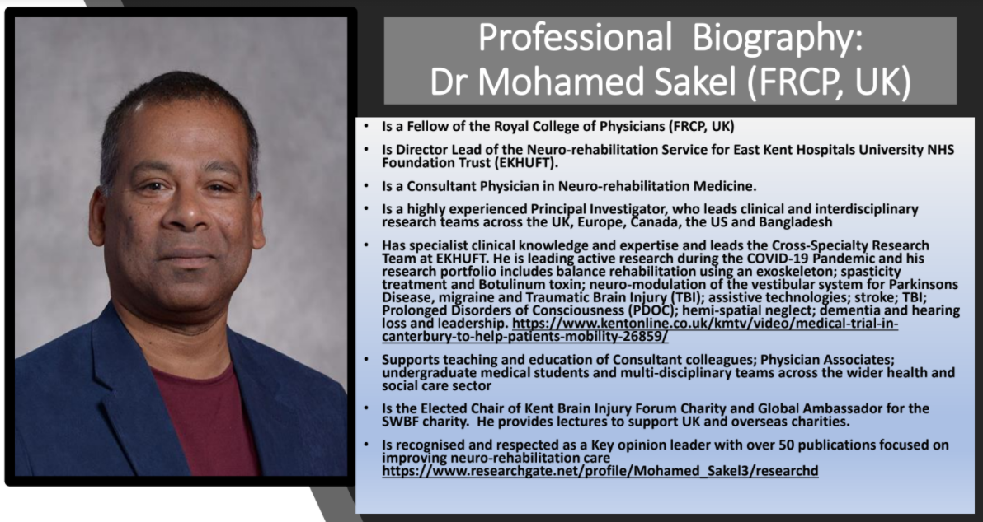
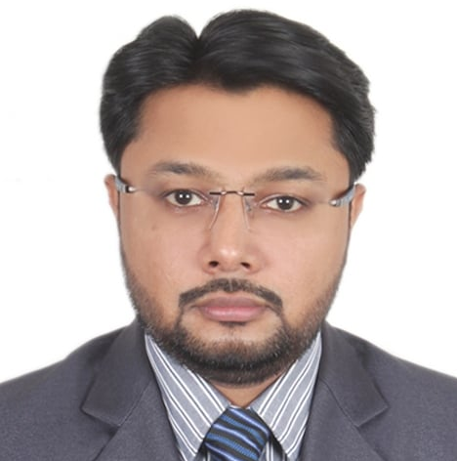
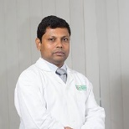
Management Team
Describe: Team members – names & titles. Relevant knowledge, skills, experience. Advisors, Board members, Investors
TEAM
Advisor & Board Members
Founder
Gausul Azam Ranju
Physiotherapist and In-charge
Department of physiotherapy
BGC Trust Medical College & Hospital
Chandanaish, Chittagong
Md. Zahid Hossain
Lecturer of Physiotherapy
Jashore University of Science & Technology (JUST)
Former Faculty of Bangladesh Health Professions Institute (BHPI), CRP
Treasurer of Bangladesh Physiotherapy Association (BPA)
Former Clinical Physiotherapist, CRP
Former Organizing Secretary of BPA
K M Amran Hossain,
Lecturer, Bangladesh Health Professions Institute (BHPI)
Organizing Secretary, Bangladesh Physiotherapy Association
Australia Awards Fellow in Public Health Leadership (University of Melbourne)
ASCoN award for best oral presentation (2020);
SCS Gold Medal Award (2020)
Reviewer, International Journal of Mental Health & Addiction (Springer Nature)
Reviewer, Global Heart
Editorial Coordinator, Bangladesh Physiotherapy Journal
Dr. Md. Feroz Kabir, PT
Assistant Professor and Chairman, Department of Physiotherapy and Rehabilitation, Jashore University of Science and Technology.
Clinical Neurodynamics (NDS, Australia), Manipulative Therapy (Capri, India)
Dip. Osteopath (OCO, Canada), Cert. Gen. Med. (DU)
Senior Physiotherapist (Former), Dhaka University Medical Center & Hospital and
Center for the Rehabilitation of the Paralyzed (CRP), Savar, Dhaka.
Consultant Physiotherapist, BRB Hospitals Ltd.
Elected Joint Secretary, Bangladesh Physiotherapy Association (BPA)

Slide 21
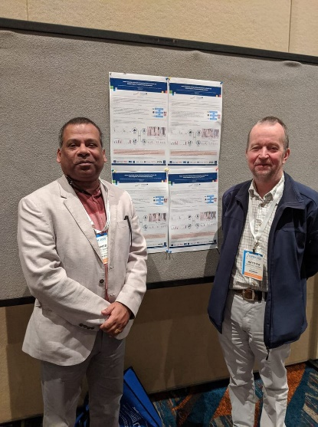
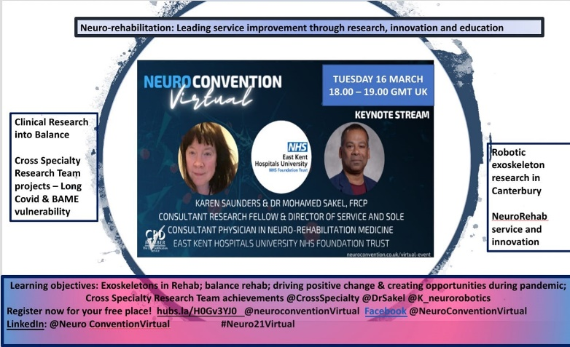
Management Team
Advisor & Board Member’s Expertise
Neuro Convention on Robotics in neuro-Disability & rehab during Covid-19.
Innovation Award nomination: European Neuro-Convention March 2020.
Presenting ADAPT Neurotechnology project, France -UK partnership.
Guness, Shivanand P., Farzin Deravi, Konstantinos Sirlantzis, Matthew G. Pepper, and Mohammed Sakel. “Development and Evaluation of a Mouse Emulator Using Multi-Modal Real-Time Head Tracking Systems with Facial Gesture Recognition as a Switching Mechanism.” In Pattern Recognition. ICPR International Workshops and Challenges, edited by Alberto Del Bimbo, Rita Cucchiara, Stan Sclaroff, Giovanni Maria Farinella, Tao Mei, Marco Bertini, Hugo Jair Escalante, and Roberto Vezzani, 218–32. Lecture Notes in Computer Science. Cham: Springer International Publishing, 2021. https://doi.org/10.1007/978-3-030-68790-8_18.
Birch, Nick, Jon Graham, Tom Priestley, Chris Heywood, Mohamed Sakel, Angela Gall, Andrew Nunn, and Nada Signal. “Results of the First Interim Analysis of the RAPPER II Trial in Patients with Spinal Cord Injury: Ambulation and Functional Exercise Programs in the REX Powered Walking Aid.” Journal of NeuroEngineering and Rehabilitation 14, no. 1 (June 19, 2017): 60. https://doi.org/10.1186/s12984-017-0274-6.
Hossain, M. A., K. M. A. Hossain, M. Hossain, I. Rahaman, and F. Taoheed. “Effectiveness of Gait Training Supported by Overhead Harness in Patients with Spinal Cord Injury (SCI) at Rehabilitation Centre in Bangladesh.” Int J Neurorehabilitation 5, no. 332 (2018): 2376–0281.

Slide 22
Technology Strategy
Describe:
Product architecture overview
Key technologies & platforms:
Scalability/Security/Deployment plan:
Integration with other products/services

Slide 23
Business Strategy
Describe:
Product Plan:
Partnerships: -
Marketing plan (web/social/electronic/print): web social media, print media, exhibition awareness program.
Sales plan (direct/indirect/channels): Hospital, Rehabilitation center, Individual Client, NGO.

Slide 24
Financial Strategy
Describe:
Funding sources & amount
Use of funds
Revenue model
Cash flow projection

Slide 25
Implementation Plan
Describe:
Quarterly Plan (4 Qtrs.) - Business
Quarterly Plan (4 Qtrs.) - Technical
Quarterly Plan (4 Qtrs.) - Financial
1st Phase: Installation
2nd Phase: Production
3rd Phase: Trial and Feedback
4th Phase: Product Delivery and Feedback

Slide 26

N.B:
All the Materials Used in Here are Copyrighted.

