Slide 2
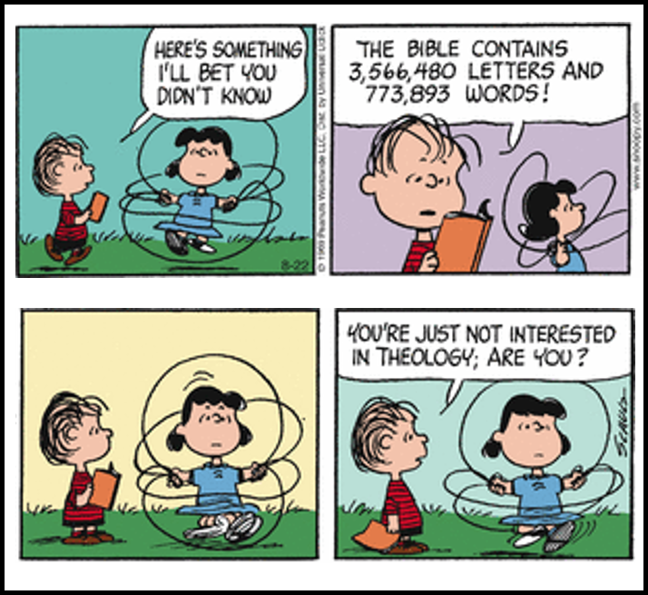
Foundations

Slide 3
Foundations

Slide 4
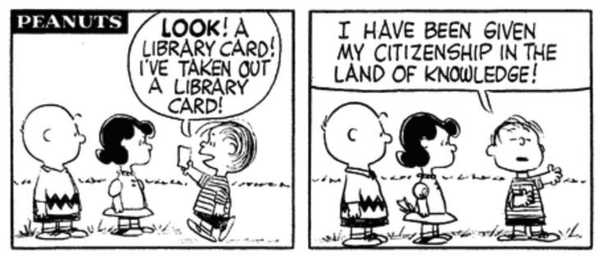
Foundations

Slide 6
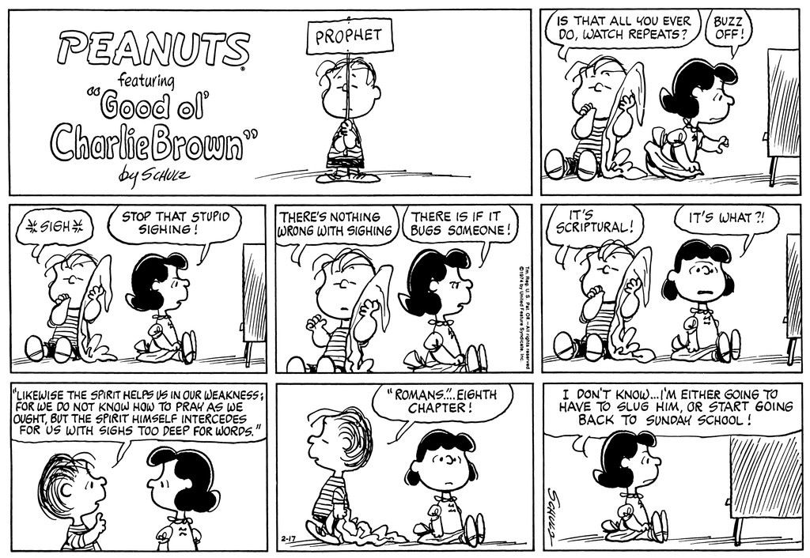

Slide 7
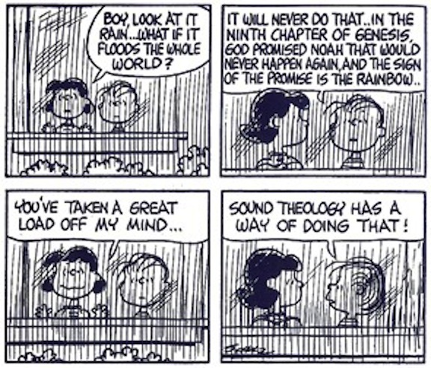

Slide 8
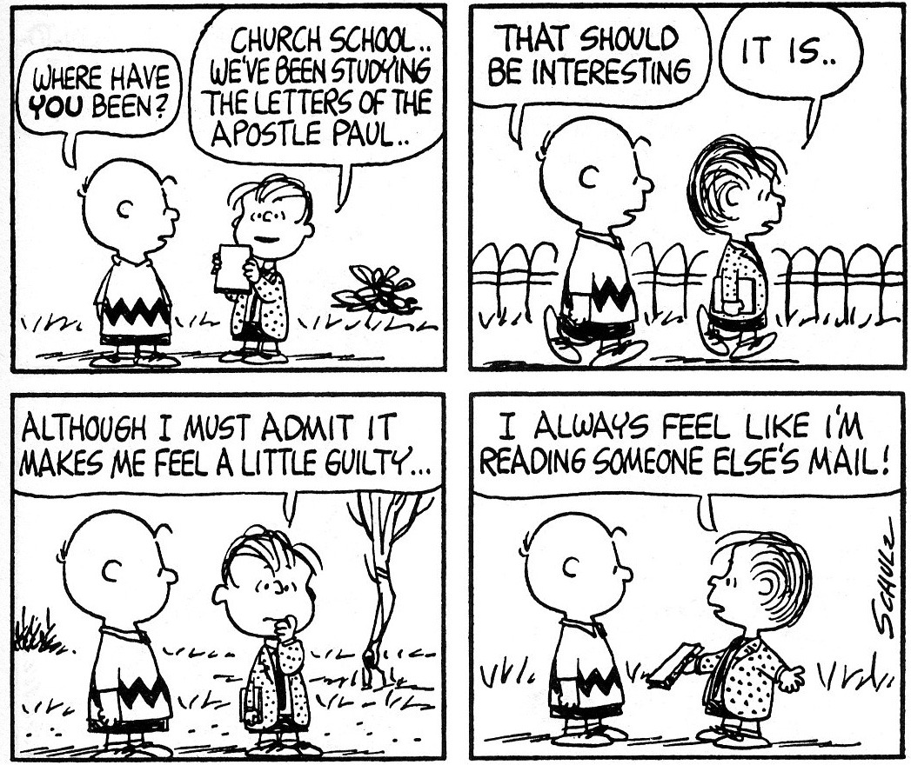

Slide 9
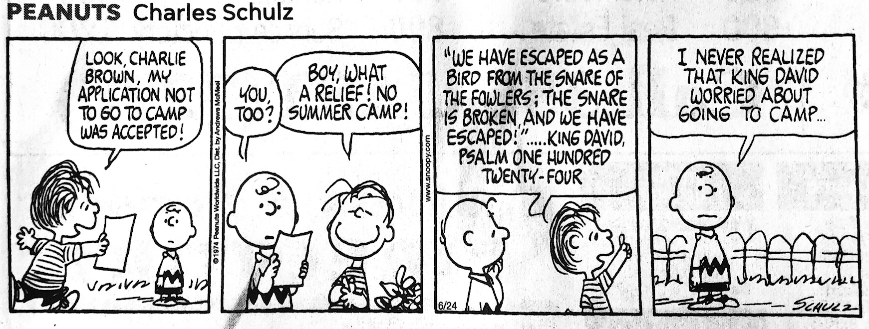

Slide 12
Quotes from the Book of Hezekiah…
“The road to hell is paved with good intentions” ...
“Charity begins at home” ...
“The seven deadly sins” ...
“to thine own self be true” ...
“Money is the root of all evil” ...
“God works in mysterious ways.” ...
“God forgives those who forgive themselves”
Cleanliness is next to godliness
God helps those who help themselves

Slide 13
Why do we want to know the Bible Better?

Slide 14
Bible Facts
20 Million Bibles sold each year
It is the all time best seller (5-6 Billion copies)
Bible sales in 2024 increased 22% over 2019 (books did 1%)

Slide 15
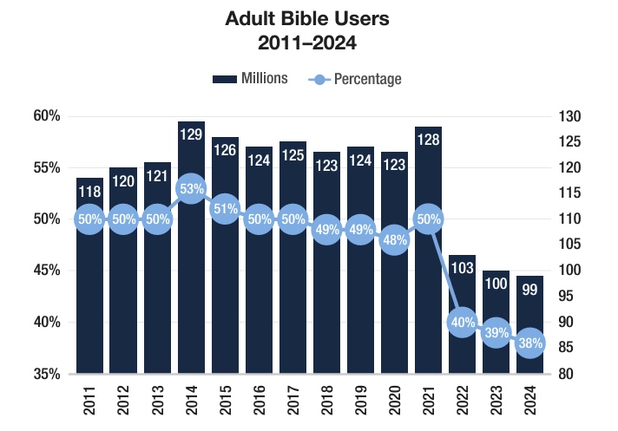
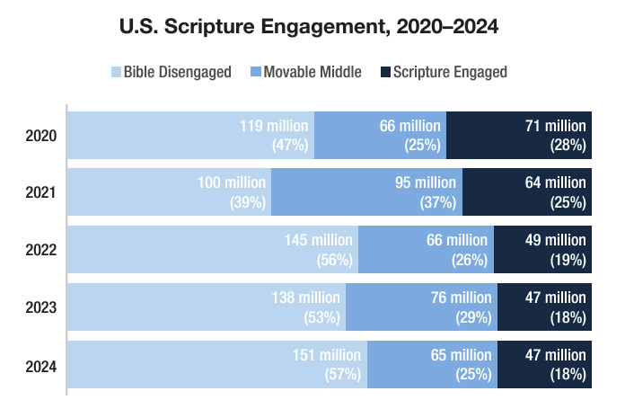
Bible Facts

Slide 16
Overall Objectives
Grow to know God greater
Grow in obedience to him

Slide 17
The Overall Process
Observation
What do we see?
Interpretation
What does it mean (especially to the original audience)?
Application
What should I do about it?

Slide 18
Foundations
Value of Studying
Object that is Studied
Content being Studied

Slide 19
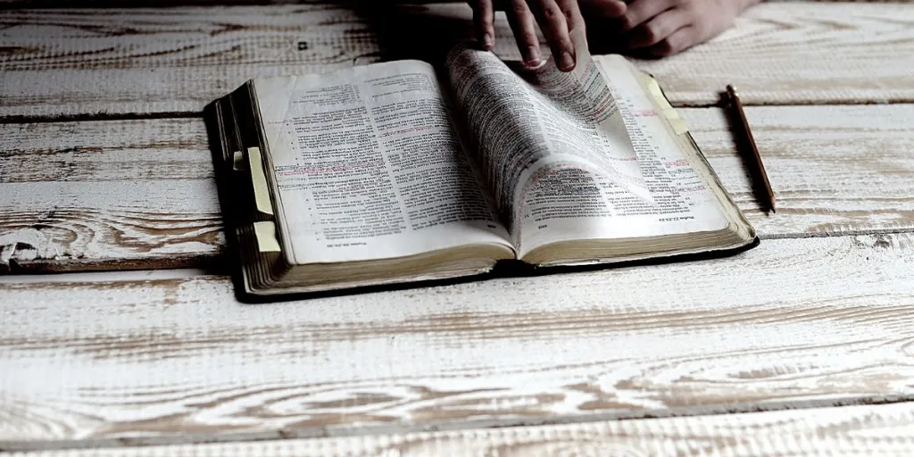
Reading vs Studying

Slide 20
Reading vs Studying
¹⁰ For Ezra had set his heart to study the Law of the Lord, and to do it and to teach his statutes and rules in Israel.

Slide 21
Reading vs Studying – Ezra 7:10
¹⁰ For Ezra had set his heart to study the Law of the Lord, and to do it and to teach his statutes and rules in Israel.

Slide 22
Reading vs Studying
דָּרַשׁ dāraš: A verb meaning to seek, to inquire of, to examine, to require. Figuratively, it may refer to seeking out or inquiring about lovers (Jer. 30:14) or to care for Zion (Jer. 30:17). It denotes inquiring about persons (2 Sam. 11:3) or their welfare (souls)(Ps. 142:4[5])
Notes:
Warren Baker and Eugene E. Carpenter, The Complete Word Study Dictionary: Old Testament (Chattanooga, TN: AMG Publishers, 2003), 249.

Slide 23
Reading vs Studying – Ezra 7:10
¹⁰ For Ezra had set his heart to study the Law of the Lord, and to do it and to teach his statutes and rules in Israel.
Notes:
Set up time…prioritize

Slide 24
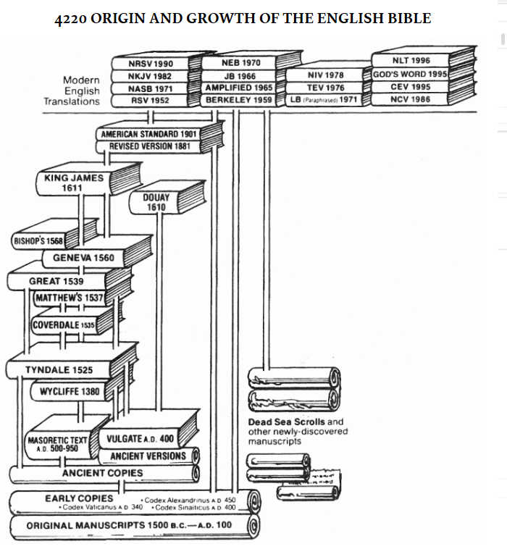
Bible Versions

Slide 25
Our Bible: Book vs Library

Slide 26
Bible Versions
Notes:
1947-1956

Slide 27
Bible Versions

Slide 28
Google Translate…
Notes:
Warren Baker and Eugene E. Carpenter, The Complete Word Study Dictionary: Old Testament (Chattanooga, TN: AMG Publishers, 2003), 249.

Slide 29
Google Translate
Notes:
Warren Baker and Eugene E. Carpenter, The Complete Word Study Dictionary: Old Testament (Chattanooga, TN: AMG Publishers, 2003), 249.

Slide 30
Think of Translating
Raining cats and dogs
Jesus is the bread of life
Notes:
Warren Baker and Eugene E. Carpenter, The Complete Word Study Dictionary: Old Testament (Chattanooga, TN: AMG Publishers, 2003), 249.

Slide 31
Bible Versions

Slide 32
The Most Unread portion of the Bible….
Notes:
Warren Baker and Eugene E. Carpenter, The Complete Word Study Dictionary: Old Testament (Chattanooga, TN: AMG Publishers, 2003), 249.

Slide 33
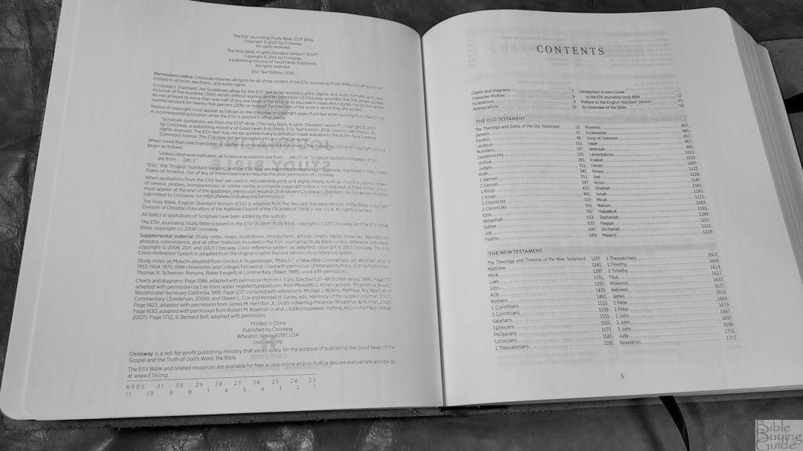
The Most Unread portion of the Bible….
The Introduction
Notes:
Warren Baker and Eugene E. Carpenter, The Complete Word Study Dictionary: Old Testament (Chattanooga, TN: AMG Publishers, 2003), 249.

Slide 34
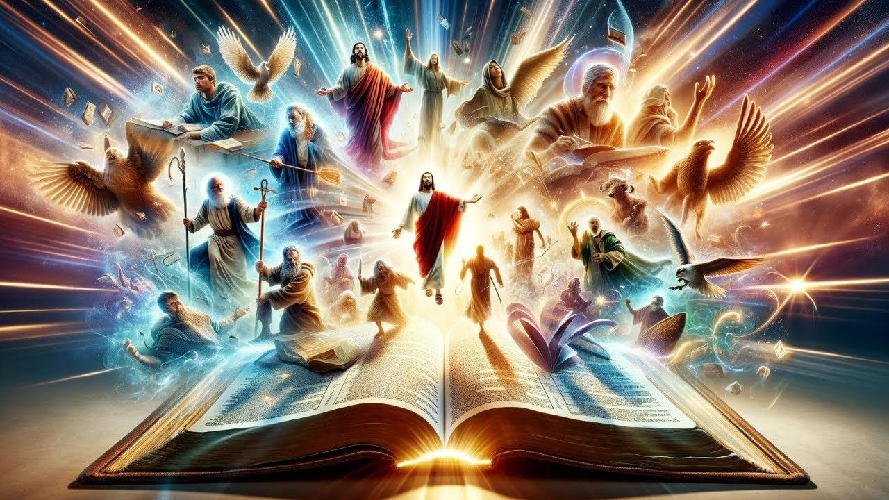
The Big Picture – The Bible Narrative

Slide 35
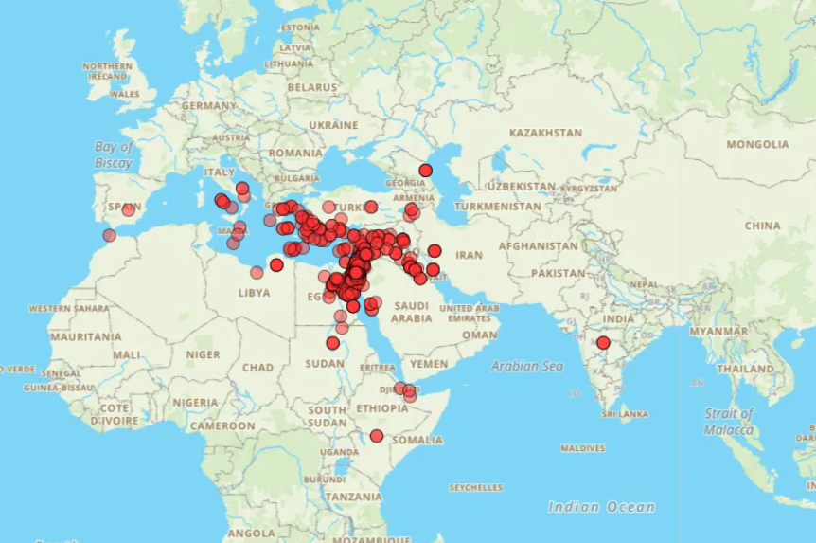
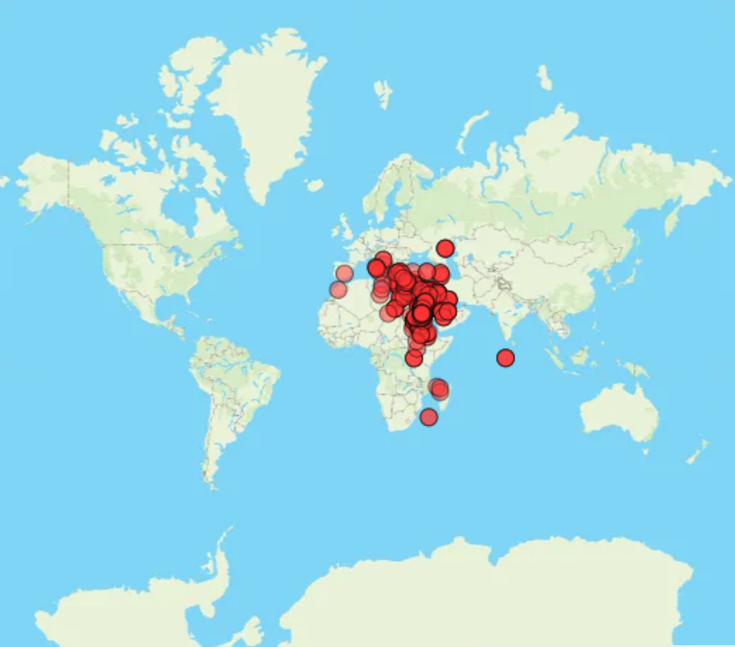
Geography
Notes:
http://www.about-jesus.org/all-bible-places-map.htm

Slide 36
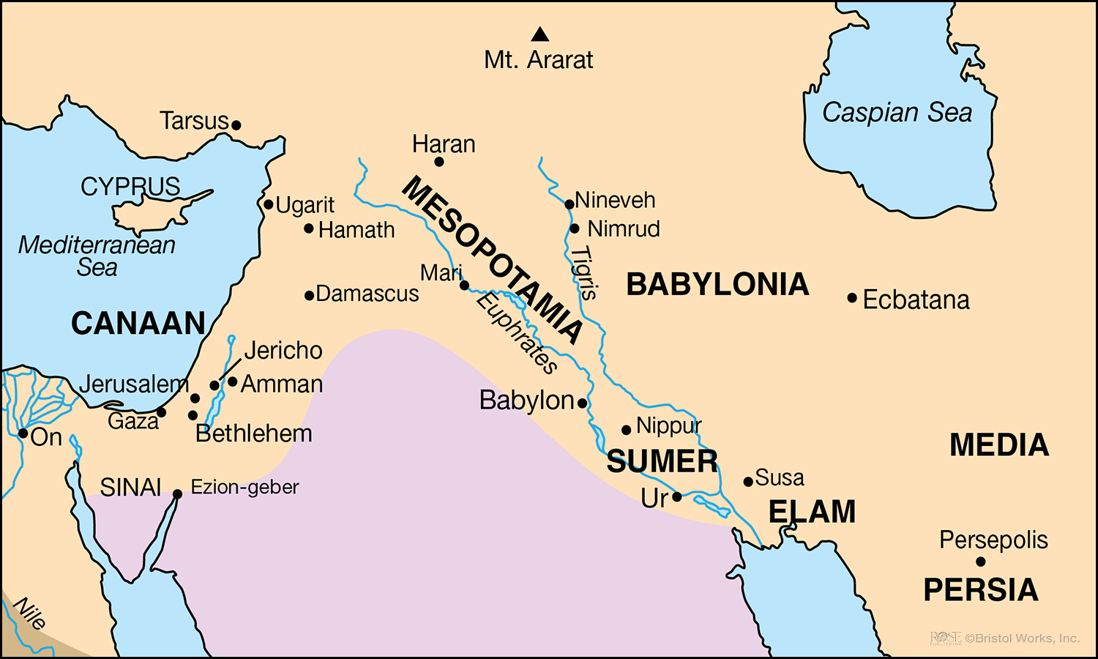
Geography - OT

Slide 37
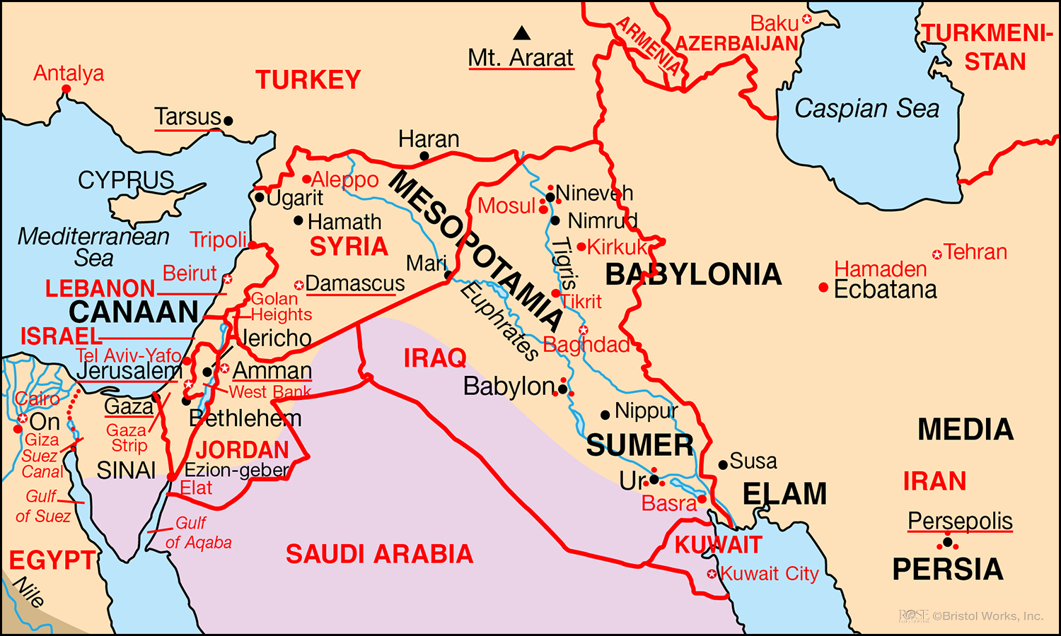
Geography - OT

Slide 38
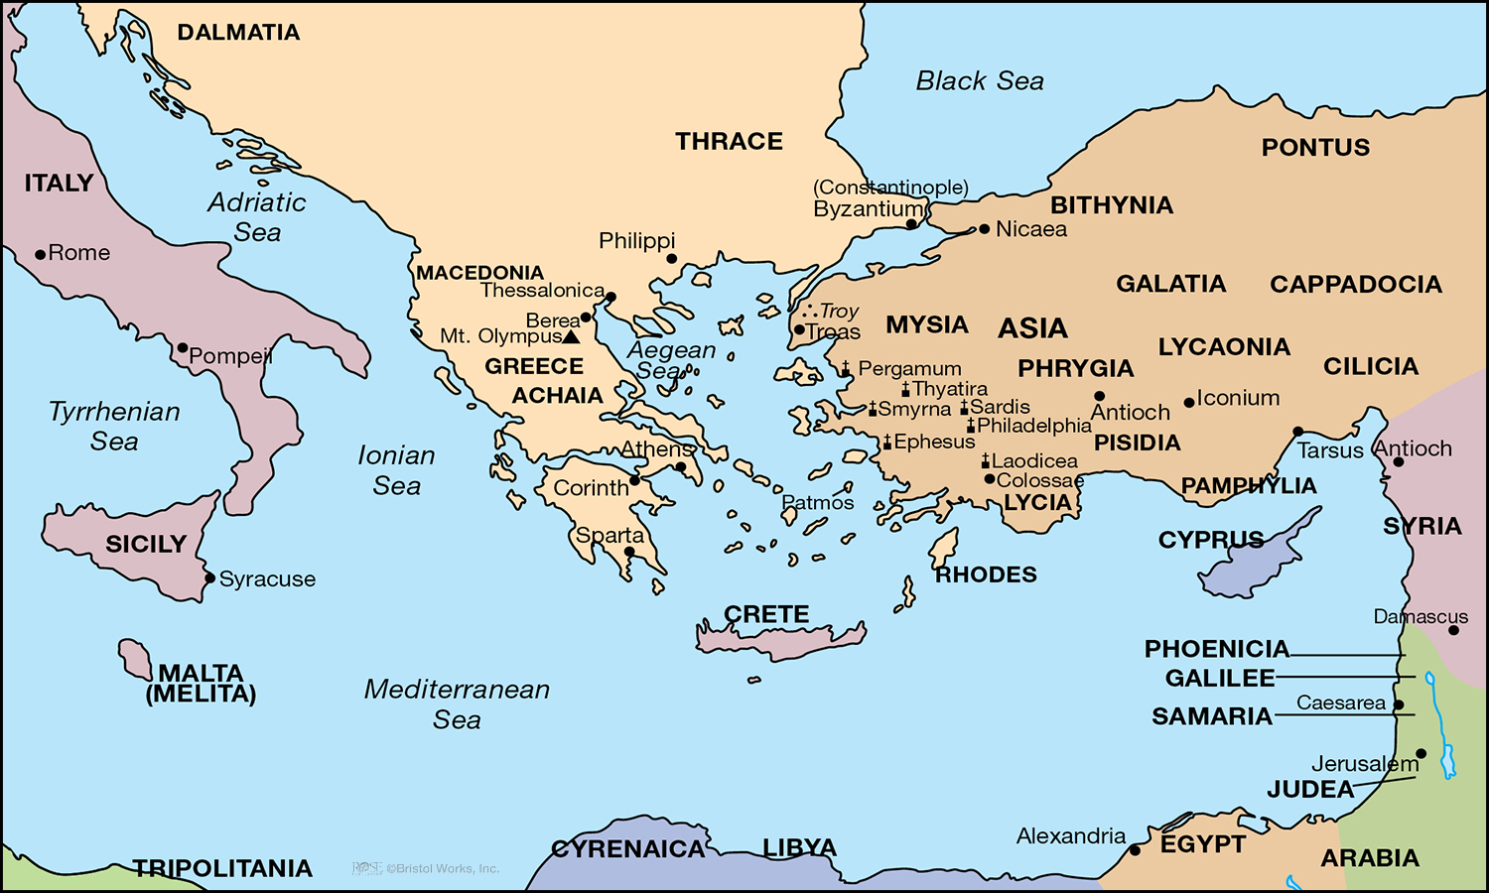
Geography - NT

Slide 39
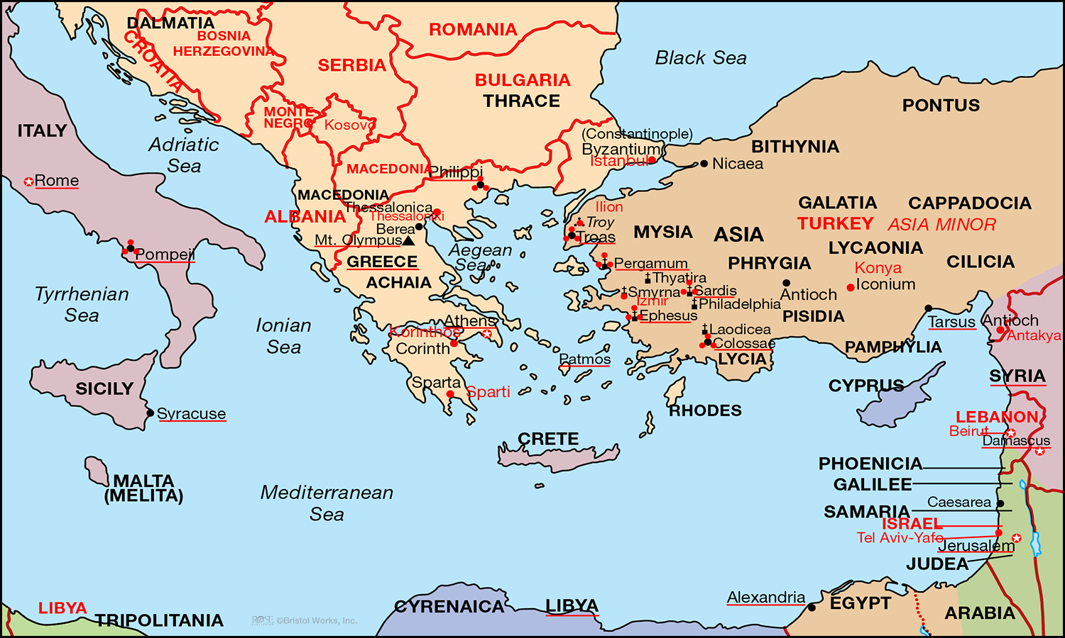
Geography - NT

Slide 40
Summary
This is a journey to know God better…not about collecting facts
It is going to take effort and time – so purposefully plan
There is a process to help overcome some of the challenges
Therefore:
Set your heart to study
Grow in your love for God’s Word
Know the Biblical narrative

Slide 41
For Next Week
For Next Week:
Identify as many errors as you can in the “April Fool”
Read the introduction to your Bible
Read Proverbs 3:1-12 each day
For yourself:
Read “The Student and the Fish”
Fill out the “Time Budget” sheet
Identify your “2025 Verse”

