Slide 1




© 2026 Money Strong. All Rights Reserved.
Notes:
Thank you for that introduction.
Money strong is grateful for the opportunity to contribute to Sustainability Victoria's financial capability and security workshop.
MS acknowledges all Aboriginal and Torres Strait Islander peoples as the traditional Custodians of the lands on which we meet today - the traditional lands of the Wurundjeri Woi-wurrung people of the Kulin Nation.
We pay respect to Elders, past and present.
We also would like to acknowledge the vision of the program being delivered by Evo Workshops for Sustainability Victoria's team.

Slide 2


Welcome to
Financial Safety & Security
by money strong
Empowering Financial Confidence, Capability & Security
Notes:
Welcome.
Today is all about financial safety and security.
Having economic safety and security isn't a luxury nor something we can put our head in the sand about;
it’s a prerequisite for a confident, secure life and impacts all aspects of our lives.
Who is Money Strong?
MS is a trusted non advice professional service, helping to normalise money conversations and supporting professionals wanting to understand their behaviours, build financial confidence, capability and strengthen their economic security.
Because, the number one issue we see is people not taking action.
They find themselves stuck, unsure, overwhelmed and not understanding why or what to do about it.
At their core - we find they do not understand their problems and gaps.
We know though having implementing tried and tested behavioural frameworks - that we help people to understand what these may be.
To meet reality where it is at, whatever their current reality may be.
To then go on to take action towards economic safety and security and:
1. earning more
2. managing it better and/or
3. being ready to multiply money and grow wealth.
Because reality is the only place from where change can actually happen.

Slide 3
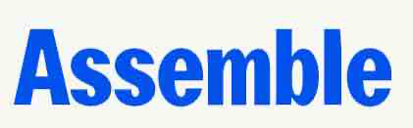






Notes:
We've also delivered our proven programs and workshops into organisations.
For example - visionary organisations like:
Assemble - delivering housing solutions differently and supporting residents to manage money well to support them saving a deposit.
BridgeIT - an incredible Social Enterprise providing homes to 16–21-year-old women and gender diverse people who have experienced the out-of-home care system or homelessness.
YMCA active programs for Merri-bek council delivering financial wellbeing for women, many of whom are from diverse backgrounds.
Whether that is in-person or online, MS supports organisations to build this capability in their people or clients.

Slide 4
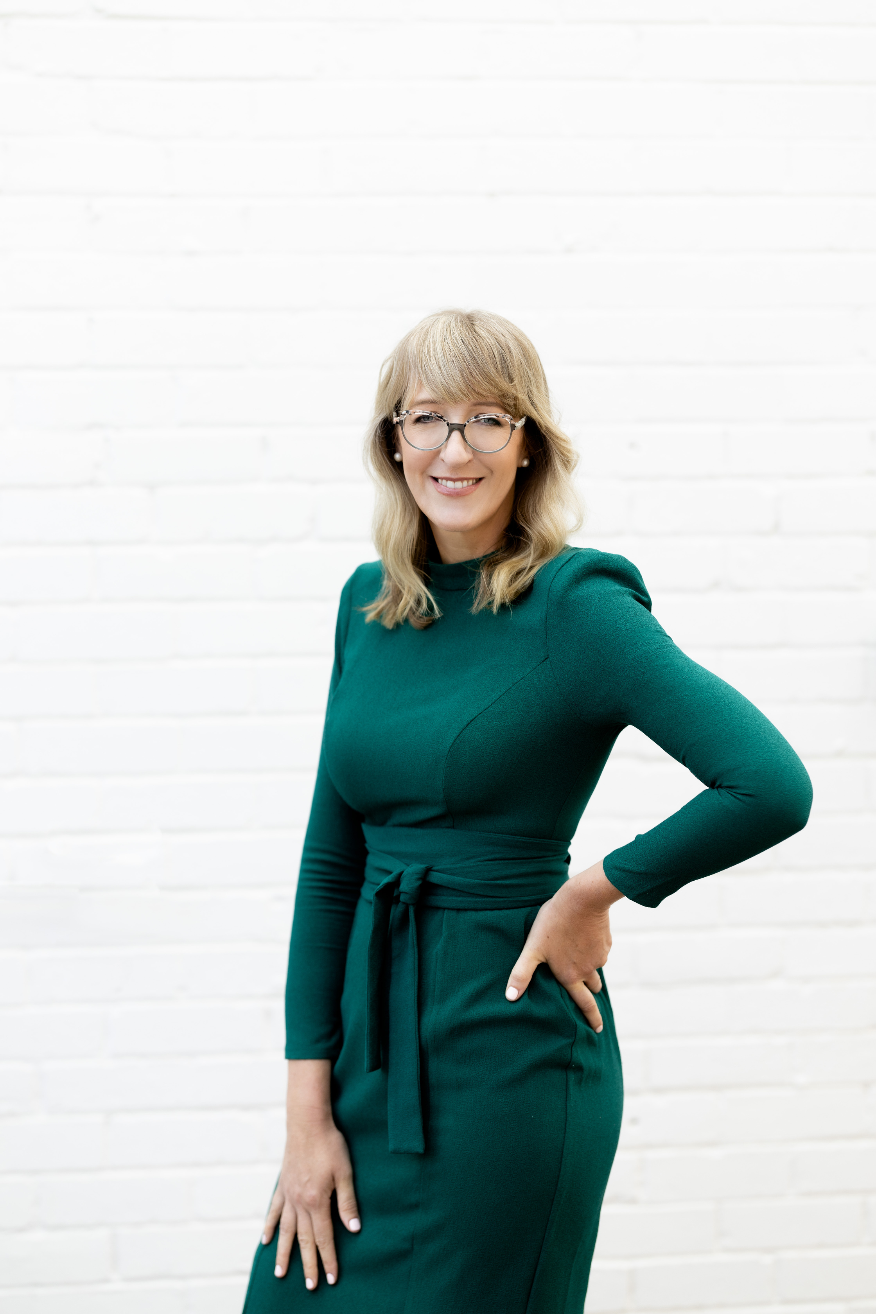
Megan Christie
Certified Money Coach (CMC)
Financial Educator
25+ years financial services
Mum of two young boys
Community advocate and volunteer
Pro bono financial literacy programs
Regular on Southern FM radio
Basketball coach - under 10s
Notes:
Introduction
Hello, I'm Megan Christie, your presenter for today.
With over 25 years of experience in accounting, financial planning, and superannuation, I have spent the last four years specialising in behavioural money coaching.
So, why focus on money coaching?
Money remains one of the last great taboos; we find it easier to discuss topics like sex and death than we do money.
Additionally, many of us have not been taught how to manage finances effectively.
Through my advisory work, I realised that many individuals require a different type of support.
Common challenges include feelings of fear, being overwhelmed, or navigating life transitions that can really find people stuck.
Money can be a source of sustenance and joy, yet it can also lead to significant stress.
It does not discriminate. It can affect individuals at any income level.
I have since come to understand money really has an inner and an outer reality.
Our beliefs, habits, and fears—often unconscious - play a crucial role in how we experience money in our lives.

Slide 5


Marion Mays
Founder of money strong
philanthropist
Financial services innovator
30+ Years Financial Services
Certified Money Coach (CMC)
Mother
Advocate for social change
Wanna be organic farmer
Notes:
I also want to introduce Marion Mays - also is in the room today.
Marion is Founder of money strong and has over 30+ years across property and financial services.
The past decade has seen her operating her own business supporting 100s of professionals, across C-Suite, CEOS, couples and single mums in strengthening their relationships with money (and getting incredible outcomes).
With 55 years of experience between us - nothing shocks us with money - we've seen it all.
So let's normalise talking about money and building financial wellbeing, safety and security.

Slide 6


NON ADVICE SPACE
The information in this presentation and the links provided are for general information and for educational purposes only.
Your personal circumstances are unknown to the presenters and therefore this information should not be taken as constituting professional advice.
Please always seek your own independent advice from a suitably licensed expert such as a qualified financial planner before making any financial decisons.
Notes:
Straight up - we must state this is a non advice space.
This presentation is general information.
We do not take into account your personal situation or needs, nor do we recommend products or provide personal recommendations in any way.
Importantly you should always seek your own advice from a suitably licensed expert.

Slide 7
Agenda:
The Why - financial safety matters
The Practical - strategies for greater safety and security
The Real - ways you too can improve your financial wellbeing and security
One in session activity + take away exercises
Notes:
Today's session is all about Safety and Security
The number one issue we see is people do not understand their core problems and gaps with their money.
In other words, they are not able to meet reality where it's at.
Reality is the only place where change can actually happen.
Most people do not understand the different kinds of help available
This is also an active session today.
We will help each of you to begin to putting in place what you need to feel safe and secure with money.
So the agenda today is focussed on 3 key areas:
1. We start with the Why around financial wellness and security - (because if it was about the how we would all be doing it).
2. The practical - An overview of the concepts that are proven to build financial security & safety
3. How to implement it yourself - the How (and what options can help next)
And if you want support - we have proven short programs at an employer and individual level that bring real results quickly.

Slide 8

The Current Financial Eco System
in Australia
Financial Planners
Certified Money Coaches
15,000
200
27,000,000 Australians need help with Money
Financial Counsellers
Fin Influencers
1,500
Too many
Notes:
Most people do not understand the full options of the current financial eco system- this is where people get stuck.
-Lets look at the facts,
where you can get help.
We are a population of approx 27 million people
There are 15,500 financial planners in Australia
Financial Planners (FPs) provide strategic, product-based advice, focusing on areas such as insurance, investments, and superannuation.
Due to the shortage of supply, pricing is substantial with the average cost now being $8,100 for advice. With ongoing annual cost (source ABS jess brady).
To be advice ready you need to have:
1- earning good money & have money to invest
2-have your money management sorted
3-Be clear on your values & any behavioural issues impacting your use of money.
At the other end of the spectrum, there are
Financial Counsellors about 1,500 at last count, they offer free support to people needing help with debt management, gambling issues or financial abuse
If you're in financial hardship you can contact the national debt helpline or a financial counsellor
The other support available if you are not in hardship and not advice ready is A Certified money coach. Well established in the U.K & USA markets here in Australia at a guess we are about 200 Certified coaches.
CMC's help with money blocks, behavioural issues, money management, education and helping you set up and automate your money matters that is values aligned for you.
And lastly when it comes to influencers, it's crucial to follow those who are reputable and knowledgeable, focusing on education rather than promoting products. (check for product sponsorship or paid promotion by influencers).
When choosing the right help for where you are at right now, It's important to note the demand far exceeds the supply

Slide 9




The pillars of financial wellbeing
How is your relationship with your money?
How does this impact your financial wellbeing and economic security?
Confidence
(the inner self)
Capability
(the practical)
Security
(the protection)
Feeling calm and balanced with your money?
Comfortable with the "how-to”?
Are you life "curveball-proof?”
Notes:
So what to do?
To begin,
Step 1 is understanding our relationship with money,
Do You avoid it, neglect it, abuse it or are scared of using, spending, investing it?
(pause)
Our work - whether that is with CEOS, C-Suite, single mothers tells us irrespective of income, job, marital status - we find most people come up against a money problem at some stage of life.
Our model breaks this down for you into 3 pillars:
1. confidence,
2. capability
3 and security.
So what do we mean about the Framework:
Pillar 1: Financial Confidence (The Inside): Emotional relationship with money. scared to invest, reckless with money, completely avoid it.
Pillar 2: Financial Capability (The Doing): understanding financial concepts, how to manage money, invest, implement risk mitigation
Pillar 3: Financial Security Putting in place the safety precautions, emergency funds, income buffers, insurance, Estate planning.

Slide 10
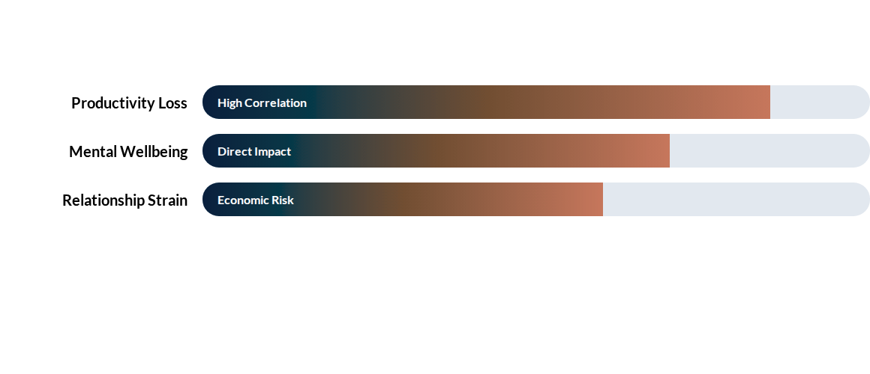
The impacts
Notes:
We all know not having safety and security with money affects mental health, our work and our personal lives/relationships.
The data is telling
Productivity: 1 in 4 (25%) of Australian workers say financial stress directly affects their ability to perform their job effectively (AMP 2024).
The "Silent" Burden: 1 in 3 stressed Australians keep financial secrets from their partners due to "embarrassment or guilt" (AMP 2024).
Money and Relationship stress is a primary reason for breakups.
Avoidance, shame, overwhelm, lack of knowing where to start keep people stuck in financial stress and poor well being.

Slide 11

Isolate your main money problem
What is your current money challenge ?
Making /earning Money
Managing Money
Growing Money
Is your money being used to serve your best life?
Do you know how to make Money from Money?
Are you under
earning?
Notes:
At the end of the session - we Now that you've done your financial gap self assessment.
Once you have your report , you will be able to understand clearly what Gaps you have and where to get help.
For now, using your intuition & real life results with money,
Have a go at isolating your money challenge
Is it making money, taking care and managing your money
or multiplying money by growing it with investments
Pause.
I would invite you now to write down at a guess, what your core money problem.

Slide 12

Building blocks
Have an emergency fund $2,000 or $5,000 or $15,000
for unexpected events - dental bill, pet bill, car breakdown.
Have an income safety buffer
1, 2 or 3 months net salary (or more - 6 months salary)
Protect your financial reputation - credit score
Pay bills and debts on time (incl. utilities and phone)
Limit how often you apply for credit
Keep credit card balances low
Avoid payday loans and buy-now-pay-later (traps)
Notes:
So now lets get started now with some of the solutions and practical proven ways you can close your gaps,
The basics:
An emergency fund
An income safety buffer in the event of redundancy, illness, loss of job
Know your financial reputation, get a copy of your credit score and check it for accuracy.

Slide 13
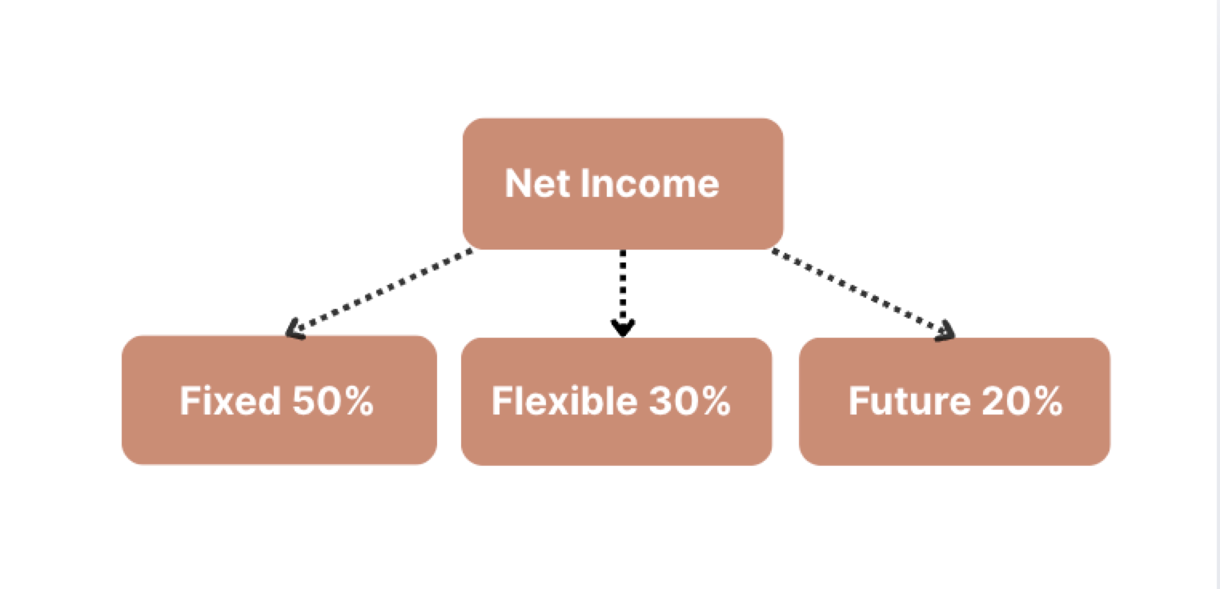

Systems matter
Fixed 50% ?
Fun 30% ?
Future 10% ?
Notes:
The highest value action you can take is after today is:
Taking care of your money
Managing it well, is easy and simple with a proven system
Our clients use this method
Breaking cost into 3 categories
Fixed cost- necessity, rent, mortgage, food, petrol, insurance
Fun cost- entertainment, shopping, etc
Future fund- saving/investing for your future self

Slide 14
Risk mitigation - get organised
Protect what maters: your income, your life, your health as these are your greatest assets.
Relationships: none of us can outsource responsibility with money (especially in our relationships - STDs, coercive control) and now elder abuse.
Estate planning: Wills, POA, EPOA and binding Nominations (and having these in a system to easily access)
Notes:
For a greater level of safety and security,
When you get your report , check you score and Gaps,
Do you have BASICS in place
Protection: income, life (death), trauma, TPD insurance =explain one sentence here.
Many children
Relationships - check credit scores, understand BFA;s
Estate planning- you have worked hard, make sure your assets/wealth go where you want and treated correctly tax wise.

Slide 15
Compound Interest - heard of it?
The 8th great wonder of the world....
Notes:
Now over to growing our money so that our futures selves have the security they need.
Compound interest - what it means?
8th great wonder of the world according to Einstein.
Compounding adds the interest / earnings and goes again. Interest on interest.
Regular amounts matter.
Over time it acts like a snowball, causing your savings (money attracts money).
Note: Can also work the opposite - or debt (debt attracts debt) faster over time.

Slide 16
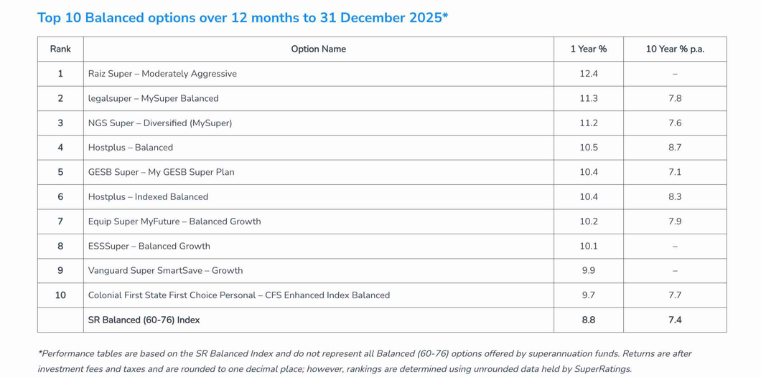
Is your super fund on the list ?
Find out:
What is the balance?
What was the performance last year, 5, 10 years?
Do you have a binding death benefit nomination?
Do you have insurances?
Do you know how to top up your super?
Tip: Have you done a lost super search?
https://moneysmart.gov.au/how-super-works/find-lost-super
Source:
https://www.superratings.com.au/2026/01/20/media-release-2025-top-super-performers-revealed/
Notes:
The one thing we all have in common is that we are all investors, in the form of superannuation - your future fund.
Its important that you Pay attention. Its your money
Heres what you need to know.
Know what the balance is.
What was the net performance (after fees and taxes) last year, 5, 10 years?
Super ratings provides a top performers list over different time horizons.
The longer performance over time can be a huge difference, we're meaning $100s of $1000 after fees or lower returns.
So yes, do you know how much the fee’s were you paid last year?
Do you have insurances?
A binding death benefit nomination?
Or know what these are and what is available?
Have you ever done a lost super search?
Maybe a long lost retail or hospitality job saw this sent over to the ATO.

Slide 17
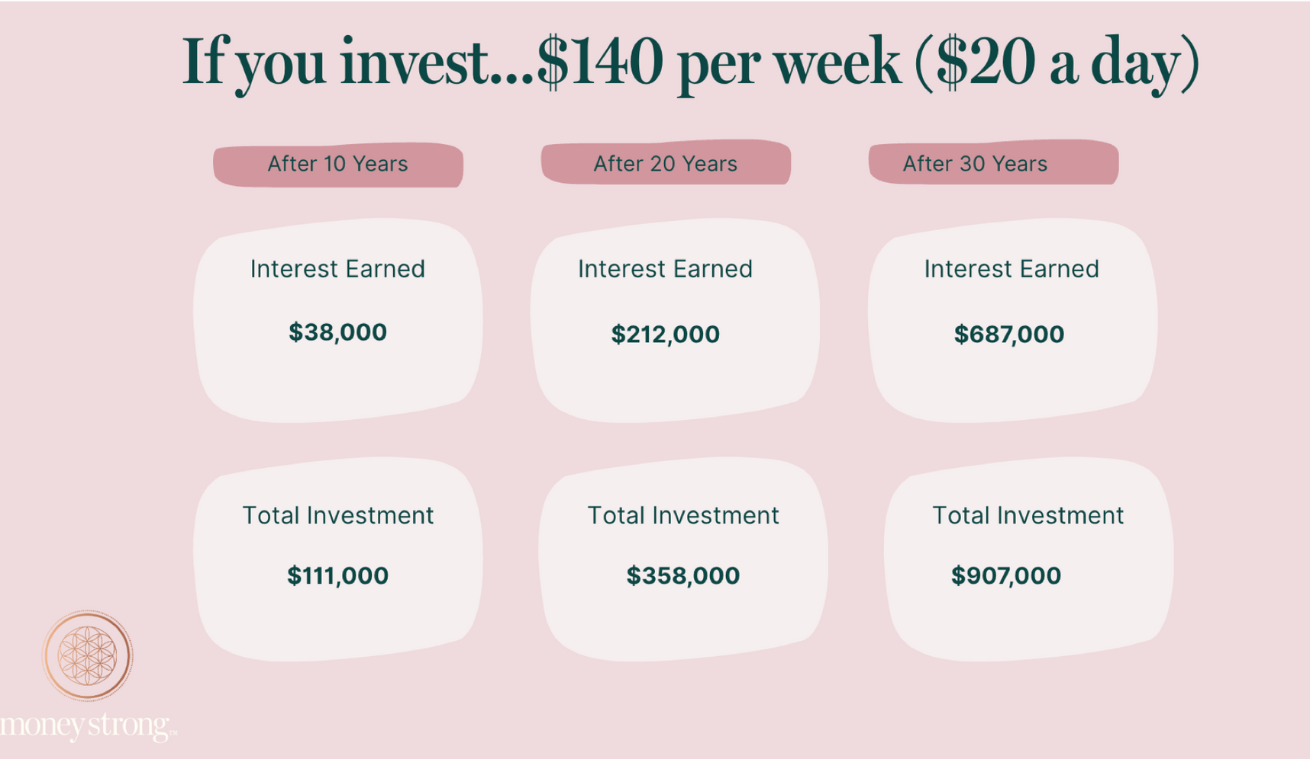
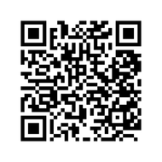
Micro investing? It can seriously add up
Easy decision?
Buy lunch?
Buy random stuff?
Save it?
Invest it?
Source: moneysmart.gov.au/savings caluclator - assuming 8% return longterm
Notes:
Now for those of you not investing outside of super, you can take baby steps via micro investing, with little as $5
Why this works is, the risk is low and as humans we learn by doing & building confidence, even whilst we have fear. We just lower the stakes
It's straightforward, with low-cost options available, especially if new to investing.
And its easy
1-you can automate your $5,
2-You can top up your spend to round up for investing
3-you can use their rewards system to earn real dollars not points
The key is to make it a normal habit as part of your money safety & security plan.

Slide 18
Next steps: to action
Do the financial gap self-assessment. Read the report thoroughly.
Isolate your money problem and get the appropriate support “successful people ask for help and get the help they need”
Organise and automate your money to reverse engineer your life and retirement goals to match
Remember - Successful People ask for help and get the support they need.
Notes:
The Importance of Small Yet Significant Steps
1. Acknowledge Your Current Situation
Begin with a self-assessment gap test to meet your reality where it stands.
Make sure to read your report in detail.
2. Identify Financial Challenges
If you’re facing issues with confidence or capability, pinpoint your financial concerns.
Remember, successful individuals seek assistance and obtain the support they require.
3. Streamline and Automate Your Finances
Consider reverse engineering your life and retirement goals to ensure they align with your financial organisation and how you want to live day to day with your money.

Slide 19
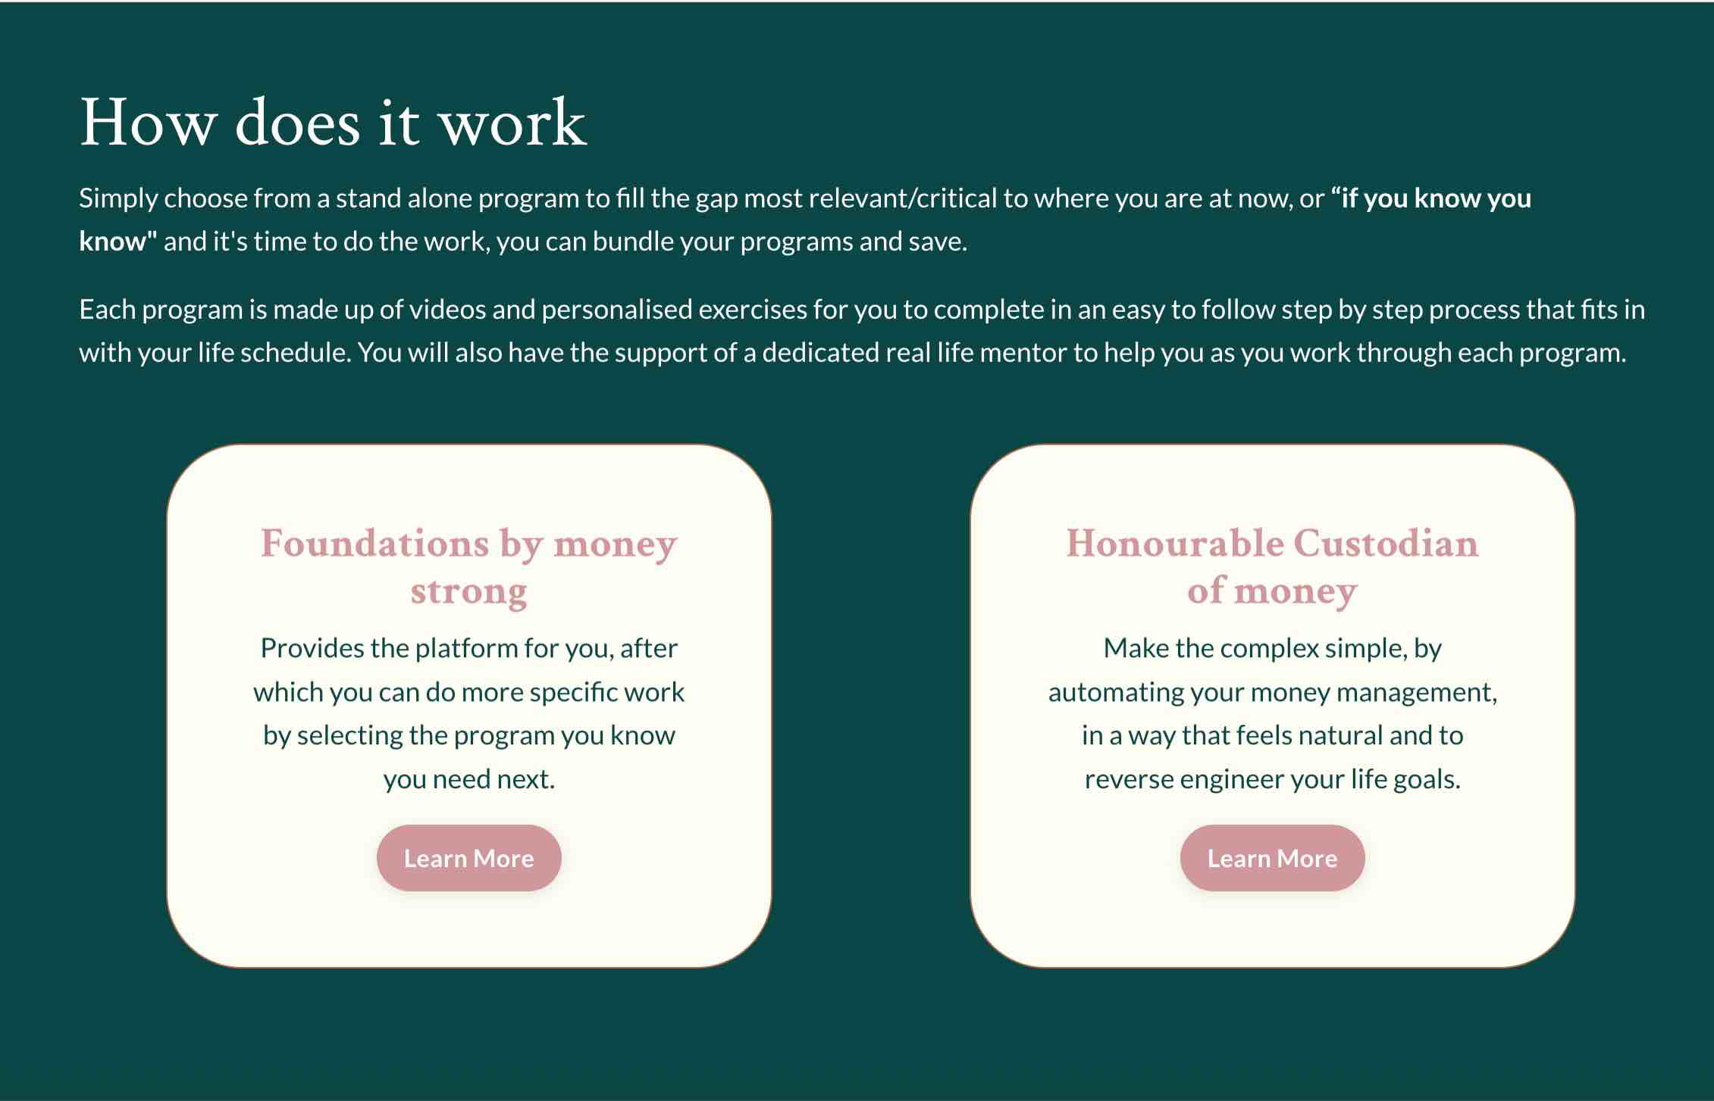

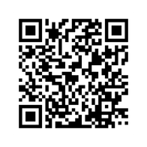
Time for you to do a Finanical Reset?
Notes:
We trust that todays presentation achieves as promised,
1- helping you know where you are currently at and if you have any gaps,
2- Has demonstrate how easy it is to have financial safety and security by using a proven method
3-Helped you to understand the right place to get help for where you are right now.
And if you are interested in getting more support money strong can do this via your employer or directly with a range of short proven programs that deliver results quickly.
As I mentioned earlier,
We have short proven programs that we deliver to groups via their employers and to individual personally.
On screen you'll see the online
Foundations - This addresses financial confidence, under earning, money blocks etc
Honourable Custodian - How to manage automate and take care of your money for success.

Slide 20
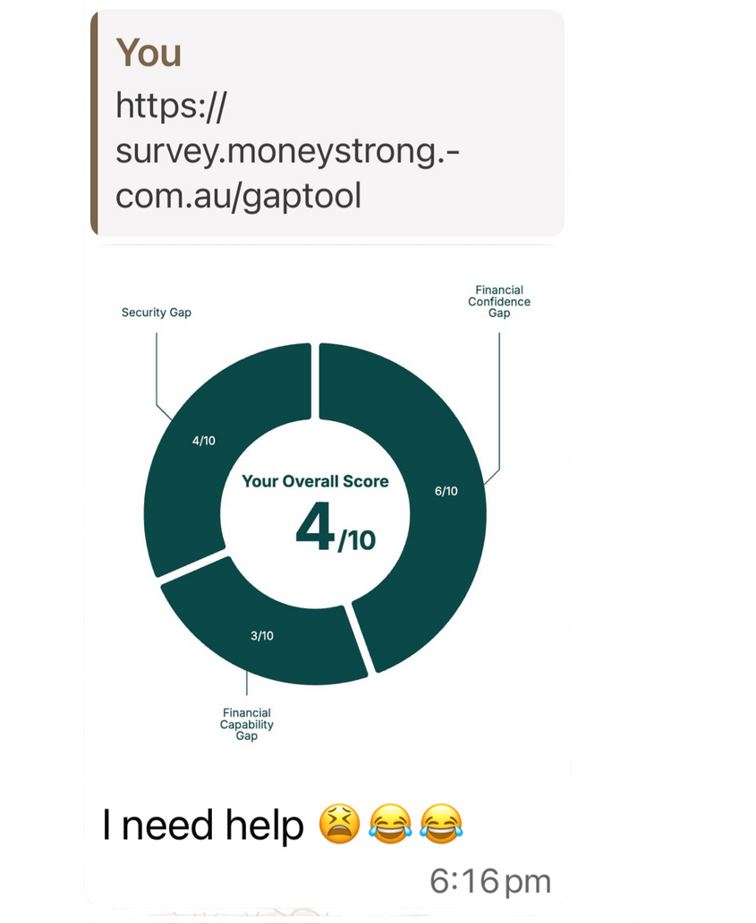
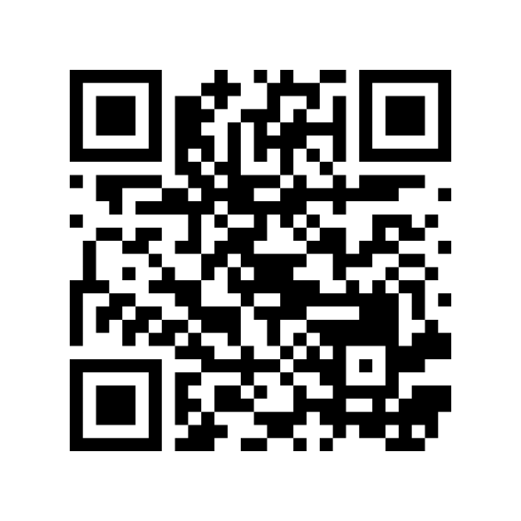
You too can self assess your
own finanical Gaps
Feel free to complete now or at the end of the session
Notes:
After 10 years of working with people we realised the number one issue is people did not want to pay a stranger, share their most intimate information & fears to get clarity about what they needed to do.
So we built a self assessment tool that you can use from the privacy of your own phone in under 3 minutes and get clarity on where you sit with your confidence, capability & security.
As well as where you have Gaps.
I'll invite each of you to take the Gap self assessment now,
Once you complete it a full report will be sent to your email address.

Slide 21

Thank you.
Questions?
moneystrong.com.au
© 2026 Money Strong. All Rights Reserved.
Notes:
We do all have the resources.
We do have the tools.

