Slide 1
Project elder
MAY 25, 2022

Slide 2
background
Options to sell Elder Wand
Current solution: Elder Wand Shop separate from HP Shop in US. UK will continue to be on HP Shop
HP Shop US warehouse fulfillment cannot manage inventory quantity. Note, US inventory almost double UK quantity
Elder Wand product is paid and operated by Home Entertainment which is different from HP Shop business entity
Preferred solution: Elder Wand to be sold on HP Shop US, similar to UK Shop. In order to do this, the below must be done.
HE-onboarded warehouse that can handle the inventory fulfillment is onboarded and integrated with HP Shop instead of the new platform. Either way, an integration needs to happen with this higher-fulfillment capacity warehouse.
Home Entertainment and HP Shop business entities handle revenue reconciliation post invoicing. Home Entertainment pays for fulfillment. Revenue comes in through HP Shop entity. Revenue reconciliation will be done by business finance teams (HP Shop submits revenue earned from Elder Wand).

Slide 3
Pros and cons of current solution
PROS:
Elder Wand Shop if separate, allows for a focused checkout funnel flow, with reduced options for user to come out of the purchase funnel.
Revenue and invoicing will be done on the correct business entity without any business reconciliation work.
CONS:
There will be two separate carts if user decides to buy items from HP Shop as well as the Elder Wand. The customer journey is disjointed and user will have to checkout and enter payment information twice if they want to buy the wand and other HP Shop items.
Having separate Shop platforms for a Harry Potter product may confuse our customers/brands and may not understand why the shops are not together.

Slide 4
Pros and cons of preferred solution
PROS:
Provides the user/our fans an easy way of purchasing the wand and other Harry Product Shop items. There is one easy checkout and payment flow process.
Products’ selling power can be leveraged to promote each other, via add-ons to the cart, increasing AOV.
The existing Harry Potter Shop already has recurring visitors, existing fanbase that the Elder Wand can leverage. Some will be existing account holders which will make checkout and payment process easier.
CONS:
There will be more options for the user/customer to go outside of the elder wand purchase/checkout funnel flow on HP Shop.
Pre-Sale is not supported at the moment. Will need to work with VaynerCommerce to add functionality.
Business will have to do revenue reconciliation work.
Impacts the Customer Support Model for Elder: Salesforce Service Cloud and Zendesk support tool differences, and a new CS team is being hired for the new HPShop US Warehouse.

Slide 5
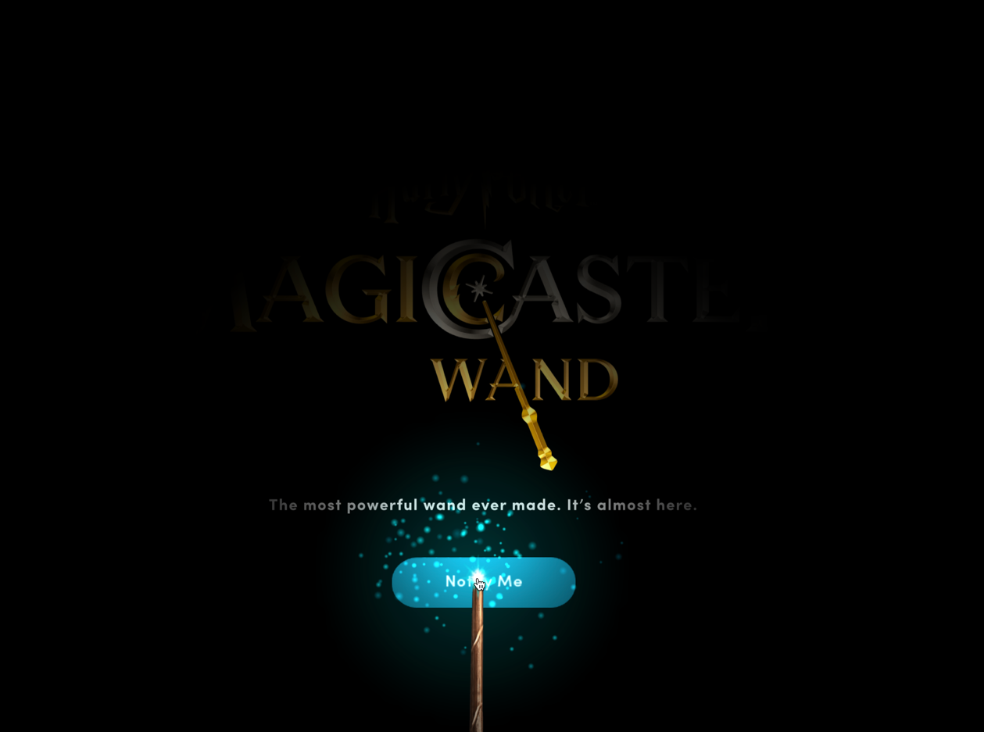
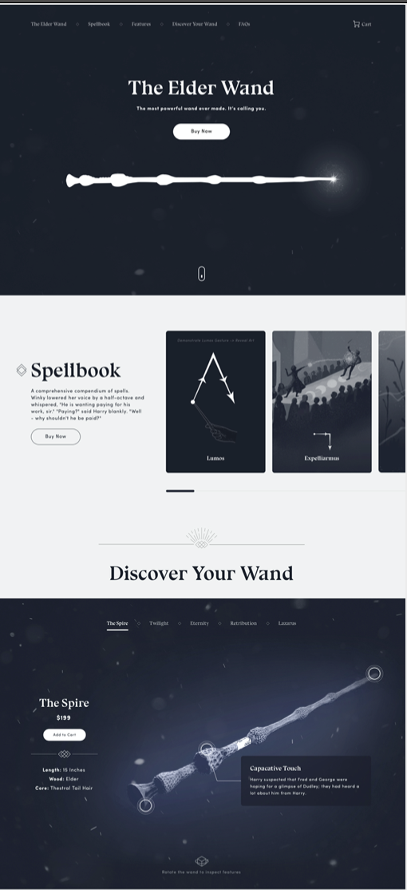
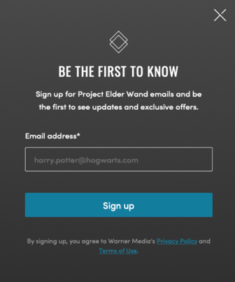
DESIGN
TEASER/COMING SOON PAGE WITH SIZZLE REEL – EMAIL SIGN UP Product Reveal | EXCLUSIVE WWD PRE-ORDER HPFC Pre-order Opens | GENERAL PRE-ORDER Rest of Range Open to Pre-Order | GENERAL PURCHASE Available for Purchase (end of Pre-Order Window
7/26 | 8/12 (48 hours) | 8/14 | 11/25

Slide 6
Customer journey options with pros & cons

Slide 7
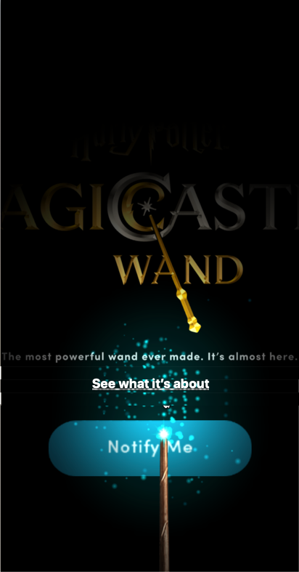
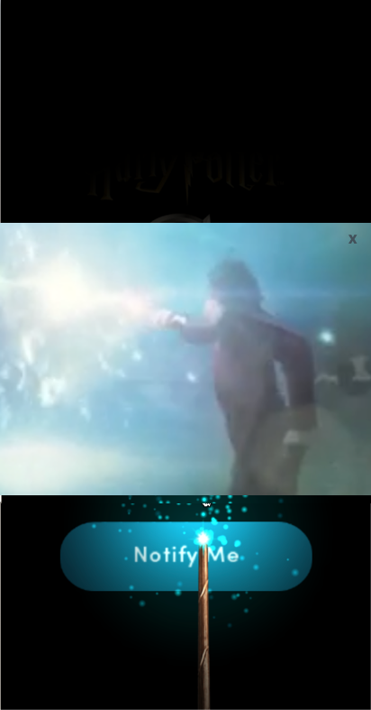
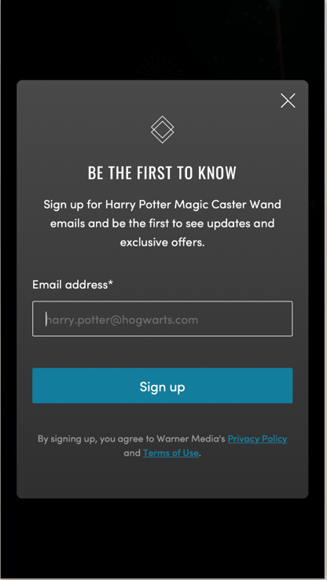
Teaser site | COMING SOON – Us or uk
Subject to change – the designs are mocks for concept and flow purposes only
Magic Caster Wand Coming Soon Teaser Page
Magic Caster Wand Coming Soon Teaser Page with reel
Magic Caster Wand Coming Soon Notification Sign Up
User sees the wand interactive page
User clicks on 'See what it's about' or a CTA that will allow them to see/skip to the teaser reel.
User can watch teaser reel or has the ability to close out the reel.
User signs up to get notified when elder wand becomes available to purchase

Slide 8
Elder wand on harry potter shop us or uk
PREFERRED SOLUTION OVERALL
CX JOURNEY
Pros:
User can select multiple items from HP Shop along with Elder Wand purchase
User can use the same cart for Harry Potter Shop Items and Elder Wand
One checkout process flow if user has both Harry Potter Shop Items and Elder Wand
Smoother checkout process compared to other solutions
Cons:
More options for customer to come out of Elder Wand Funnel checkout flow
SALES & MARKETING
Pros:
Can use upsell, add-ons and bundling sales strategies.
One funnel for social and marketing promotions to direct customers.
Increase AOV
One unified brand customer-optics
One marketing strategy and leverage power and user base of each platform
Pre-Order window provides members CLV
Cons:
N/A
TECHNICAL EFFORT
Pros:
Easier to implement since HP Shop already exists
Easier reporting since reports and analytics interface already exist
Easier to integrate and analyze data from customers shopping Elder Wand and HP Shop
Cons:
Need to create a separate and a consolidated report for Elder Wand and Shop specific performance
OPS EFFORT
Pros:
Can use existing infrastructure from HP Shop
Cons:
Need to figure out how warehouse cost will be charged to correct business entity post-invoicing

Slide 9
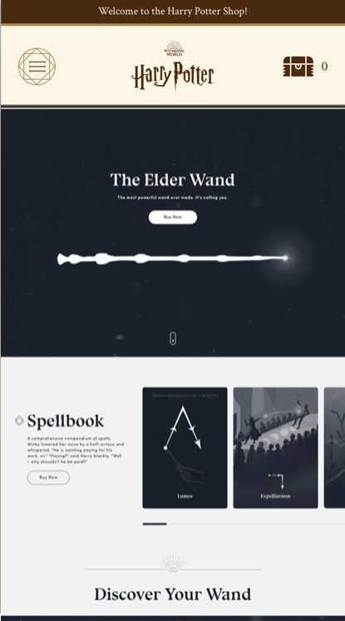
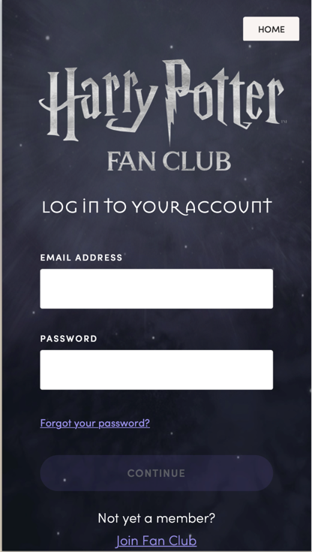
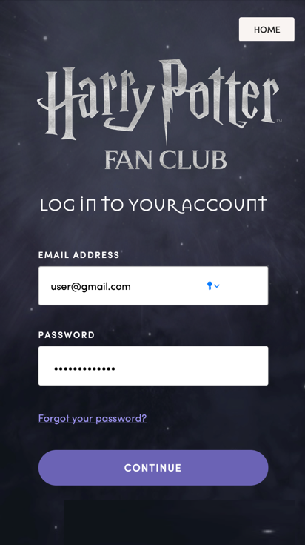
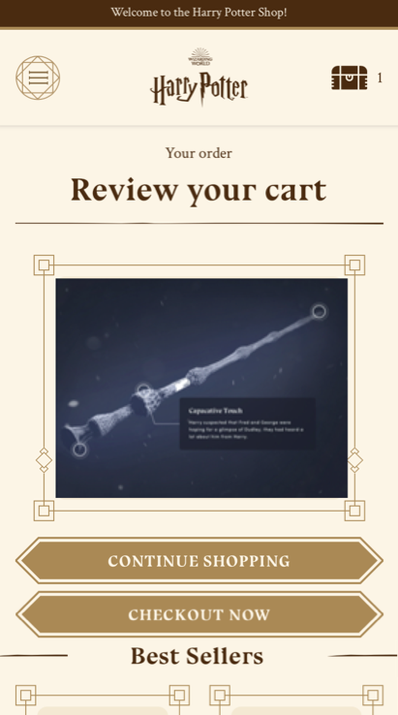
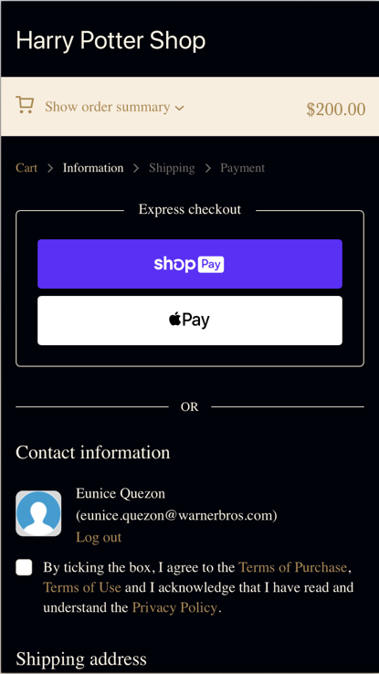
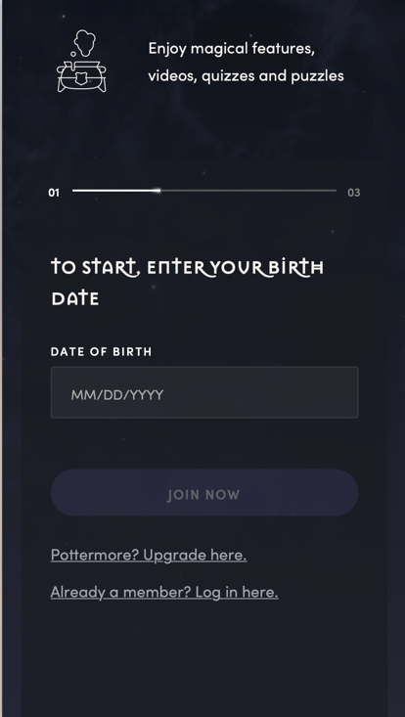
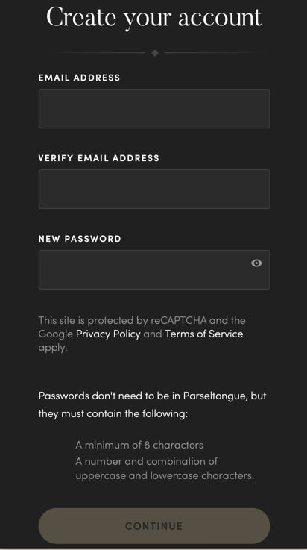
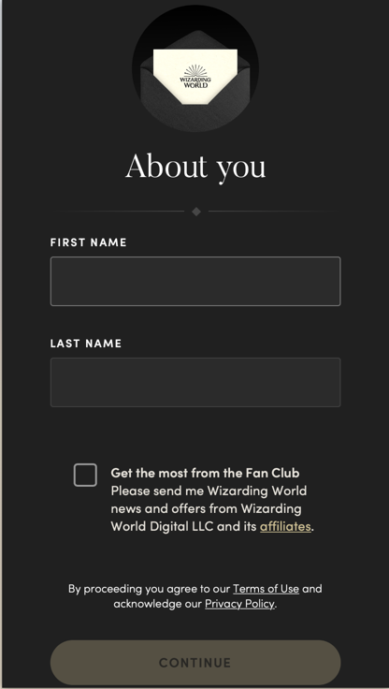
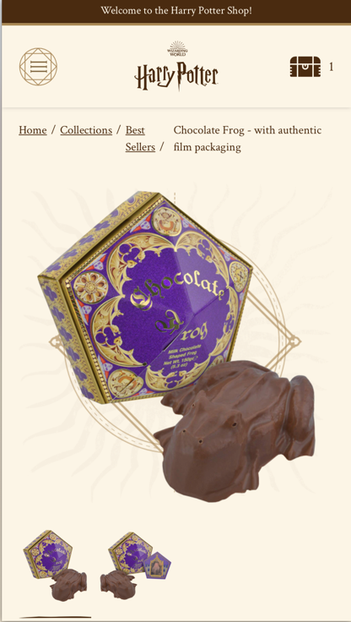
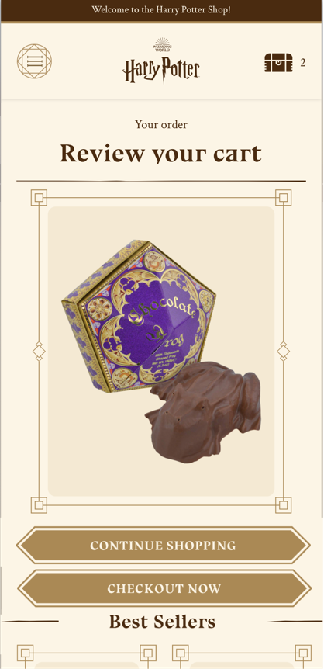
Exclusive pre-order on harry potter shop us or uk
Subject to change – the designs are mocks for concept and flow purposes only
PREFERRED SOLUTION OVERALL
SIGN IN/SIGN UP FROM HP SHOP
PURCHASE AND CHECKOUT FLOW (ON HP SHOP SHOPIFY CHECKOUT)
HP Shop Home Page
HPFC Sign In/Sign Up
HPFC Sign In
HP Shop Cart
HP Shop Checkout
From
‘Buy Now’
Sign In
From
‘Checkout Now’
Sign Up
From ‘Continue Shopping’
HPFC Sign Up Age Gate
HPFC Sign Up Step 1
HPFC Sign Up Step 2
HP Shop Home Page
HP Shop Product Details Page
HP Shop Cart
HP Shop Checkout
v
Add HP Shop item to cart
Elder Wand in same cart as HP Shop product merch add-on
Same checkout as Elder Wand, providing one checkout process with merch add-on

Slide 10
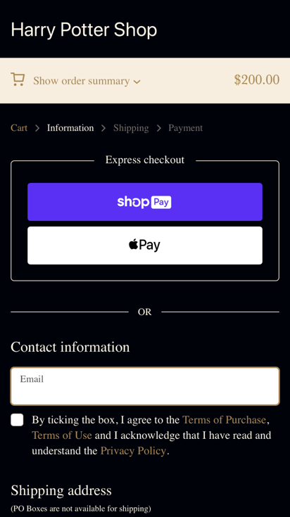
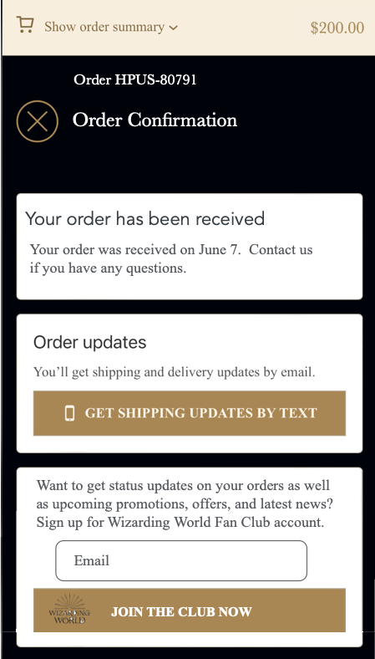
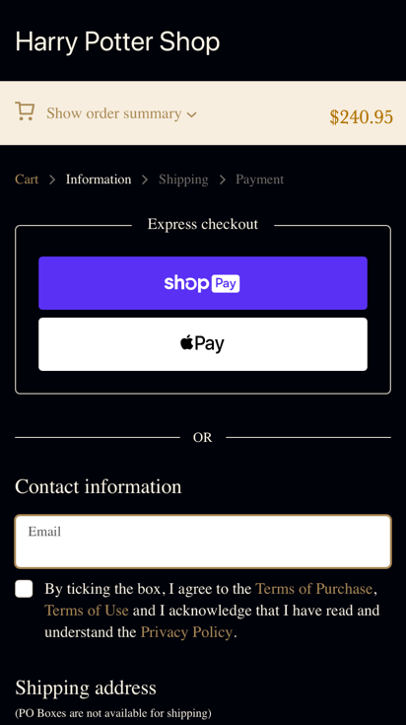
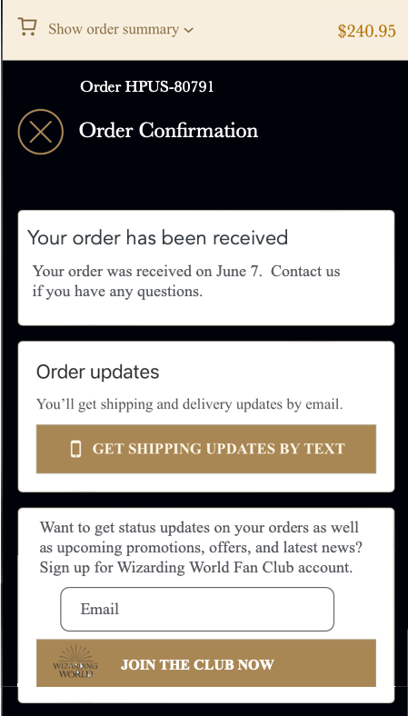
OPEN ORDER on harry potter shop us or uk
Subject to change – the designs are mocks for concept and flow purposes only
PURCHASE AND CHECKOUT FLOW (ON HP SHOP SHOPIFY CHECKOUT)
SIGN IN/SIGN UP POST-PURCHASE FROM HP SHOP
HP Shop Home Page
HP Shop Cart
HP Shop Checkout
HP Shop Receipt Confirmation with account creation option
HPFC Sign In/Sign Up
From
‘Buy Now’
From ‘Continue Shopping’
A similar receipt confirmation is sent to user's email – can also provide reg conversion there
Account creation post purchase no merch add-on
HP Shop Home Page
HP Shop Product Details Page
HP Shop Cart
HP Shop Checkout
HP Shop Receipt Confirmation with account creation option
HPFC Sign In/Sign Up
Same cart as Elder Wand, allowing merch add-on
Elder Wand in same cart as HP Shop product merch add-on
Same checkout as Elder Wand, providing one checkout process with merch add-on
A similar receipt confirmation is sent to user's email – can also provide reg conversion there
Account creation post purchase with merch add-on

Slide 11
Elder wand separate platform as harry potter shop us (UK will be on harry potter shop)
CX JOURNEY
Pros:
Reduces user options to come out of Elder Wand checkout funnel. Note: If we remove Harry Potter Shop and WWD links, it will be even more focused.
Cons:
Disconnected carts between Elder Wand and Harry Potter which can cause customer confusion.
More complex reroute for user who navigates between HP Shop and Elder Wand.
Two different checkout flows.
SALES & MARKETING
Pros:
1. N/A
Cons:
Upsell, add-ons and bundling are not possible with two separate shop platforms.
Marketing different platforms can be confusing and if not careful, may cause customer marketing fatigue if schedule alignment is off.
TECHNICAL EFFORT
Pros:
1. Can leverage commerce technology not yet on HP Shop
Cons:
New platform to stand up with separate agreements.
More complex reroute for user who navigates between HP Shop and Elder Wand.
More UI and Design considerations for two different shops.
OPS EFFORT
Pros:
Invoicing and charges separate
Cons:
Need to figure out warehouse different needs

Slide 12
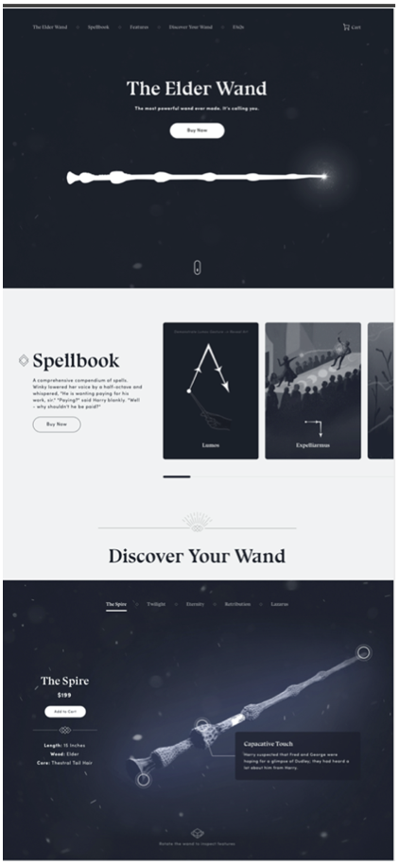
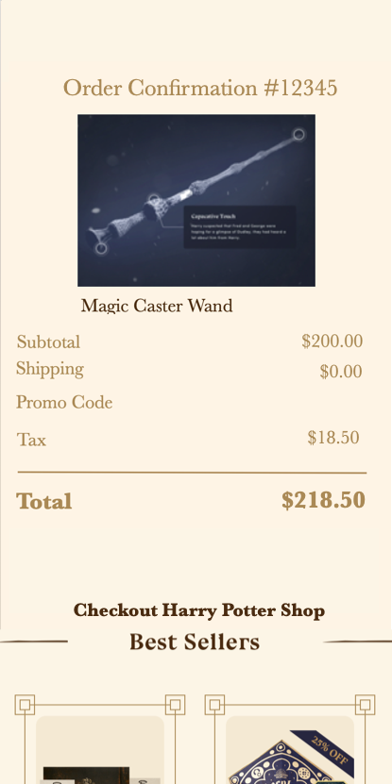
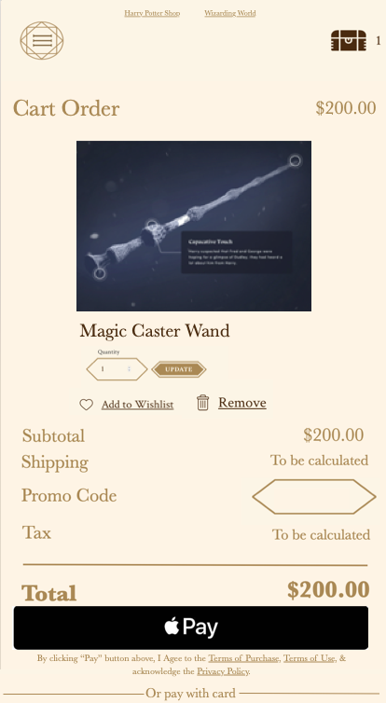
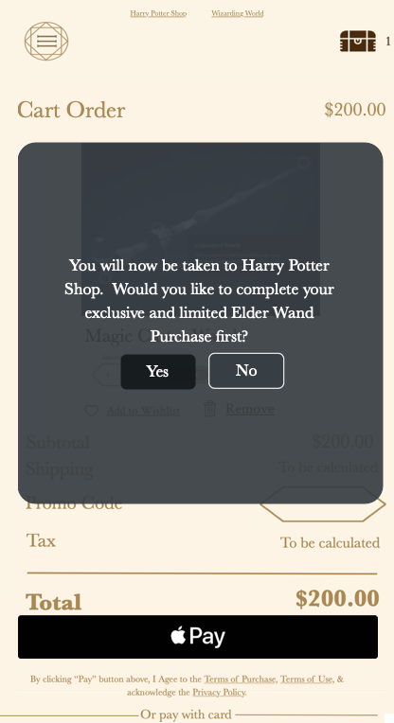
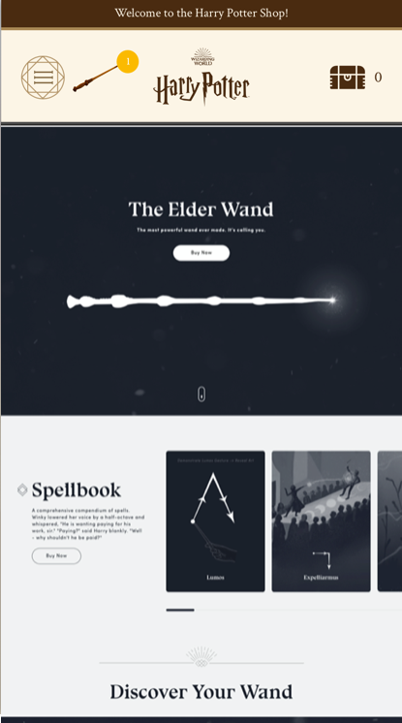
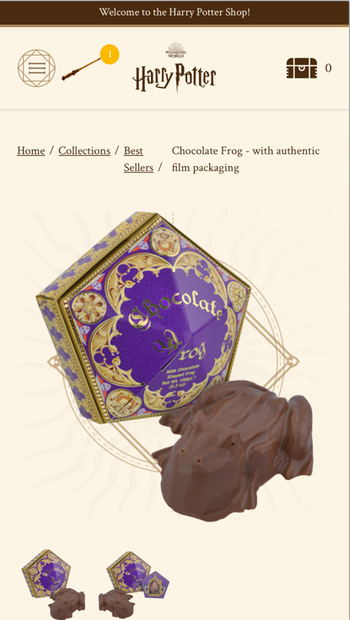
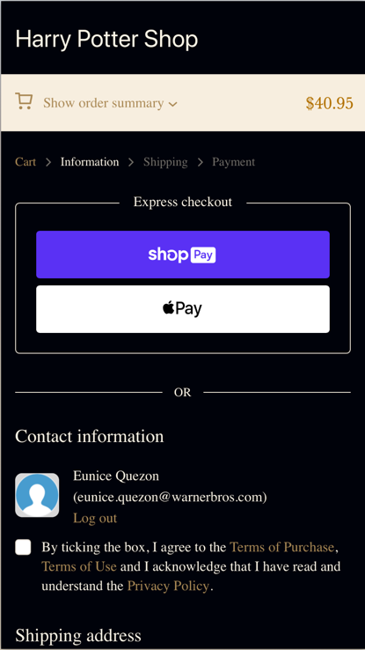
Exclusive pre-order ON us elder wand shop
Subject to change – the designs are mocks for concept and flow purposes only
USER JOURNEY BEGINS ON ELDER WAND SHOP
SIGN IN/SIGN UP FROM ELDER WAND SHOP
PURCHASE AND CHECKOUT FLOW (ON COMMERCE STRIPE CHECKOUT)
Elder Wand Shop Home Page
HPFC Sign In/Sign Up
HPFC Sign In
Elder Wand Shop Checkout
Elder Wand Shop Receipt Confirmation
HP Shop Home Page
From
‘Buy Now’
Sign In
From
‘HP Shop Link’
Sign Up
Clicks/Taps Harry Potter Shop Link before completing elder wand checkout
User can click on Harry Potter Shop link or Best Sellers items on Receipt Confirmation page. System can also redirect user to Harry Potter Shop after wand purchase.
Elder Wand Shop Checkout – redirect msg
PURCHASE AND CHECKOUT FLOW (ON HP SHOP SHOPIFY CHECKOUT)
HPFC Sign Up Age Gate
HPFC Sign Up Step 1
HPFC Sign Up Step 2
HP Shop Home Page with Nav Wand Link
HP Shop PDP with Nav Wand Link
HP Shop Cart
HP Shop PDP Checkout
Yes
No
A CTA needed for user to get back to Elder Wand Cart
Cart without Elder Wand
Checkout without Elder Wand

Slide 13
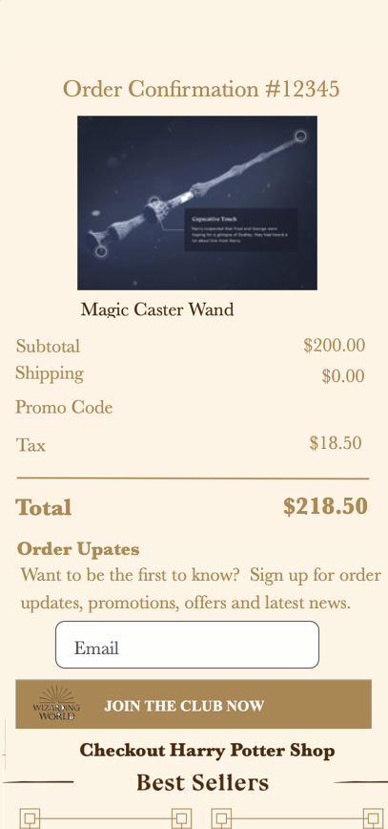
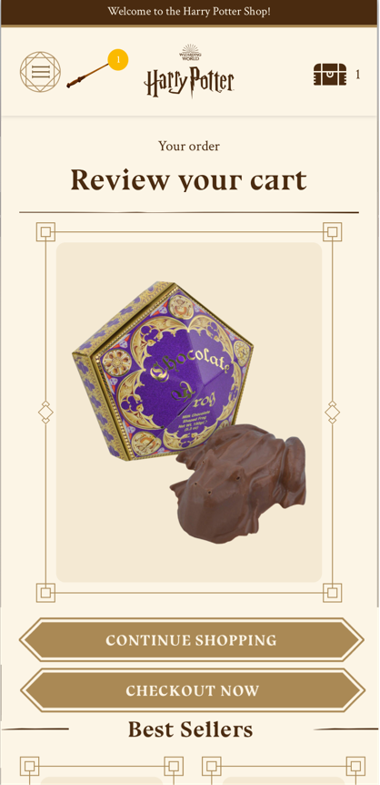
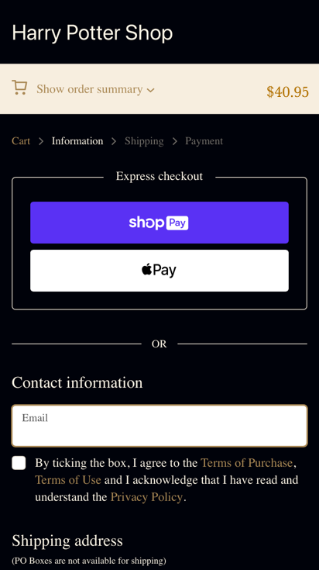
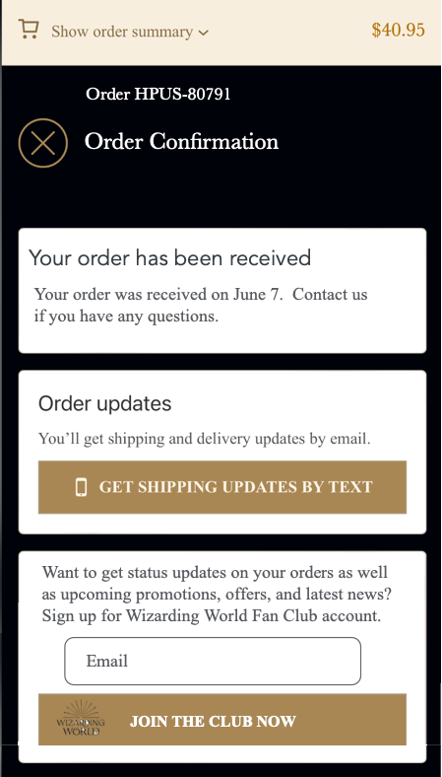
OPEN PURCHASE ON us elder wand shop
Subject to change – the designs are mocks for concept and flow purposes only
USER JOURNEY BEGINS ON ELDER WAND SHOP
PURCHASE AND CHECKOUT FLOW (ON COMMERCE STRIPE CHECKOUT)
SIGN IN/SIGN UP POST-PURCHASE FROM ELDER WAND SHOP
Elder Wand Shop Home Page
Elder Wand Shop Cart
Elder Wand Shop Receipt Confirmation
HPFC Sign In/Sign Up
Elder Wand Shop Home Page (Signed In)
From
‘Buy Now’
Sign In or Sign-Up Process
Clicks/Taps Harry Potter Shop Link before completing elder wand checkout
Account creation post-purchase on Elder Wand Shop
PURCHASE AND CHECKOUT FLOW (ON HP SHOP SHOPIFY CHECKOUT)
SIGN IN/SIGN UP POST-PURCHASE FROM HP SHOP
Elder Wand Shop Checkout – redirect msg
HP Shop Home Page with Nav Wand Link
HP Shop PDP with Nav Wand Link
HP Shop Cart with Nav Wand Link
HP Shop PDP Checkout
HP Shop Receipt Confirmation with account creation option
HPFC Sign In/Sign Up
HP Shop Home Page (Signed In)
Sign In or Sign-Up Process
A CTA needed for user to get back to Elder Wand Cart
Account creation post-purchase on HP Shop
A CTA needed for user to get back to Elder Wand Cart after account creation

Slide 14
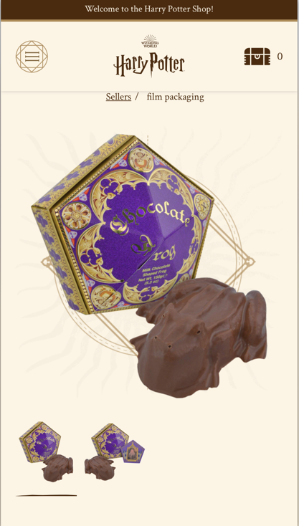
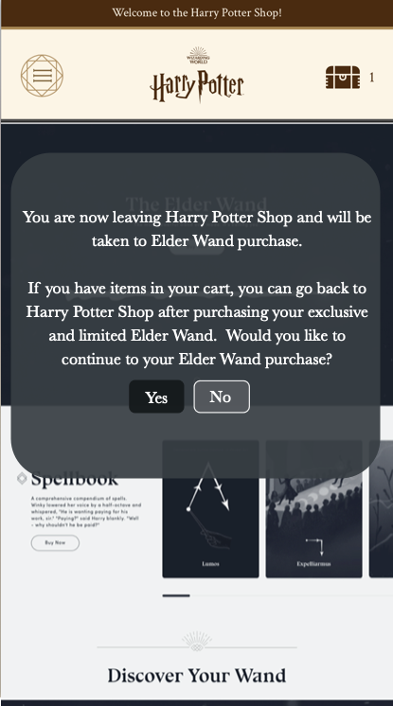
Exclusive pre-order ON us elder wand shop
Subject to change – the designs are mocks for concept and flow purposes only
USER JOURNEY BEGINS ON HARRY POTTER SHOP
PURCHASE AND CHECKOUT FLOW (ON HP SHOP SHOPIFY CHECKOUT)
PURCHASE AND CHECKOUT FLOW (ON COMMERCE STRIPE CHECKOUT)
HP Shop Home Page
HP Shop Product Details Page
HP Shop Cart
HP Shop Checkout
Elder Wand Shop Checkout
Elder Wand Shop Receipt Confirmation
System can attempt to re-route user back to HP Shop cart
From
‘Checkout Now’
From ‘Continue Shopping’
SIGN IN/SIGN UP FROM HP SHOP ELDER WAND PRODUCT
HP Shop Home Page
HP Shop Home Page - redirect msg
HPFC Sign In/Sign Up
HPFC Sign In
HPFC Sign Up Age Gate
HPFC Sign Up Step 1
HPFC Sign Up Step 2
From ‘Buy Now’
Sign In
Since Elder Wand is not on HP Shop and is on its own platform, every time a user clicks on Elder Wand ‘Buy Now’, a message will appear informing the user that they will be taken out of HP Shop.
Sign Up

Slide 15
OPEN PURCHASE ON us elder wand shop
Subject to change – the designs are mocks for concept and flow purposes only
USER JOURNEY BEGINS ON HARRY POTTER SHOP
PURCHASE AND CHECKOUT FLOW (ON HP SHOP SHOPIFY CHECKOUT)
SIGN IN/SIGN UP POST-PURCHASE FROM HP SHOP
HP Shop Home Page
HP Shop Product Details Page
HP Shop Cart
HP Shop Checkout
HP Shop Receipt Confirmation
HPFC Sign In/Sign Up (Post-purchase)
HP Shop Home Page
From
‘Checkout Now’
Sign In or Sign-Up Process
From ‘Continue Shopping’
Account creation post-purchase on HP Shop
PURCHASE AND CHECKOUT FLOW (ON COMMERCE STRIPE CHECKOUT)
SIGN IN/SIGN UP POST-PURCHASE FROM ELDER WAND SHOP
HP Shop Home Page
HP Shop Home Page - redirect msg
Elder Wand Shop (no pre-order sign up)
Elder Wand Shop Checkout
Elder Wand Shop Receipt Confirmation
HPFC Sign In/Sign Up (Post-purchase)
Elder Wand Shop Home Page
System can attempt to re-route user back to HP Shop cart to complete pending purchase
From ‘Buy Now’
Sign In or Sign-Up Process
Since Elder Wand is not on HP Shop and is on its own platform, every time a user clicks on Elder Wand ‘Buy Now’, a message will appear informing the user that they will be taken out of HP Shop.
Account creation post-purchase on Elder Wand Shop

Slide 16
Future use cases

Slide 17
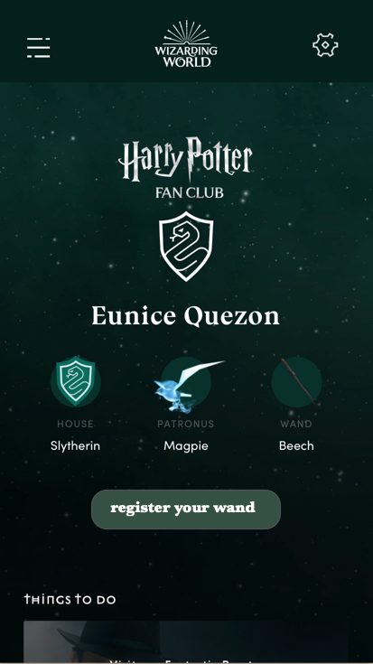
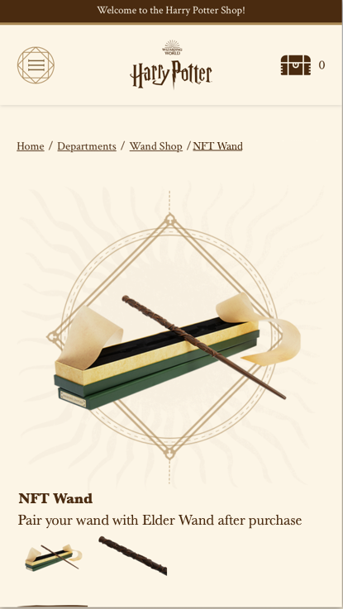
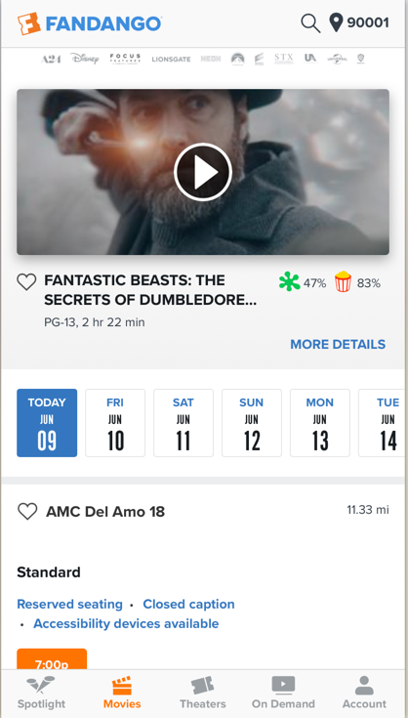
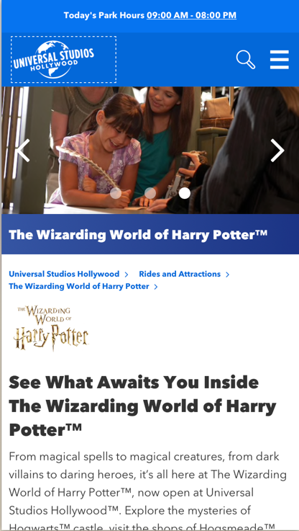
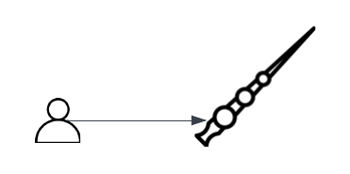
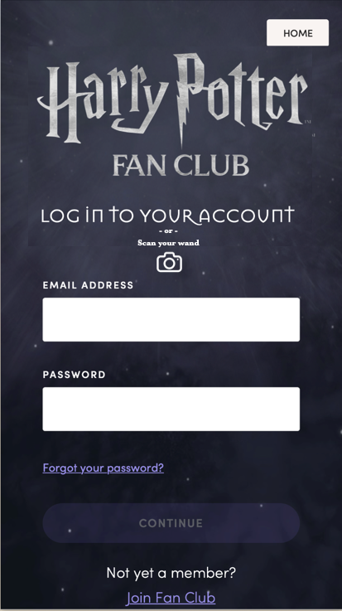
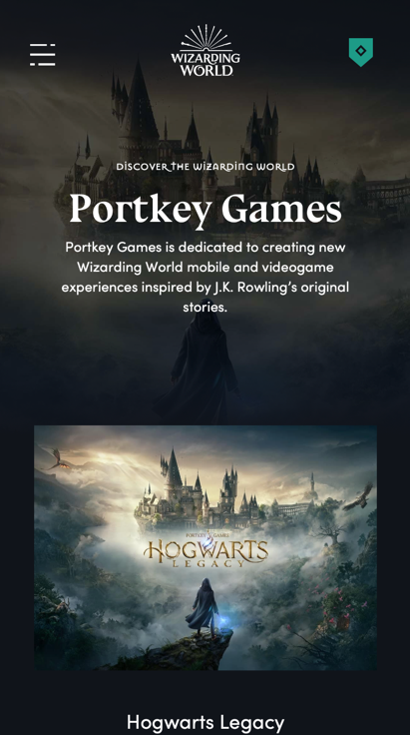
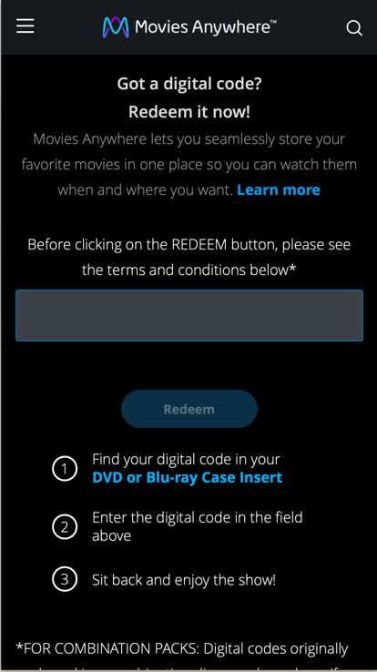
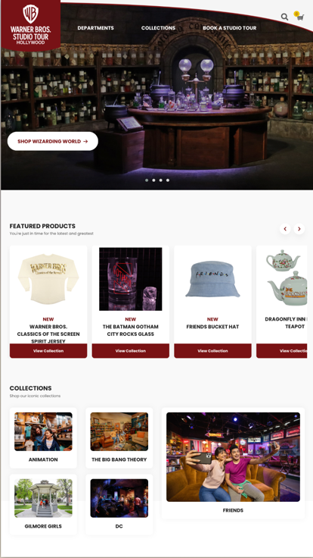
FUTURE VISION – uSE CASES
These are some conceptual product possibilities and are not set or part of any project timelines currently
USER REG
HP SHOP
THEATRE
ADVENTURE PARKS
Register Elder Wand to unlock an AR/VR experience on WWD
Sell Digital Wands with NFT that can also be paired with Elder Wand
Enter your movie ticket and gain access to AR/VR experience on WWD with Elder Wand
Scan Elder Wand at the Harry Potter Universal for some specific fan experience
LOG IN
Recognize our fan using the wand
Serial number only
USER REG
WWD
HOME ENT
STUDIO TOURS
Upsell physical wand and enhance the registration AR/VR experience immediately
Exclusive access to worlds with AR features using the wand and purchase NFT digital assets
Enter your Home Ent digital movie code and gain access to AR/VR experience on WWD with Elder Wand
Scan Elder Wand at the Harry Potter portion of the studio tour and along with WWD, use to enhance specific fan experience
Higher-priced NFT QR Code

Slide 18
Privacy and compliance

Slide 19
Privacy & compliance – coming soon page us and uk
Questions:
Shall we change the company name from Warner Media to Warner Bros. Discovery ?
Stakeholders are WB Home Entertainment, Wizarding World and Harry Potter Shop which will all be marketing campaign and CRM sources. They are all on the affiliates list https://www.warnermediaprivacy.com/policycenter/b2c/affiliateslist/.
Do we still need to list them out individually in the sign up?
Seeing that WWD is a joint-venture, do we also need to list their terms and privacy policy even though they are already listed in the affiliates list?
Shall we use the verbiage below with no checkbox for any user in US or UK? (see previous doc provided by Privacy and Compliance for reference).
What about children? Do we allow access to sign up? If so, do we add the children privacy policy? If so, where?
Links | URL
Privacy Policy | https://www.warnermediaprivacy.com/policycenter/b2c/WME/
Terms of Use | https://policies.warnerbros.com/terms/en-us/
Affiliates | https://www.warnermediaprivacy.com/policycenter/b2c/affiliateslist/
Children Privacy Policy | https://policies.warnerbros.com/privacy/children/
WWD Privacy Policy | https://www.wizardingworld.com/privacy
WWD Terms | https://www.wizardingworld.com/terms
WWD affiliates | https://my.wizardingworld.com/affiliates
By entering your email address, you agree to receive updates about the Elder Wand and news, ads and offers ­from Warner Bros. Discovery and its affiliates [link]. To withdraw your consent and to learn more about your rights and how to exercise them, see options available in the Privacy Policy [link]. Terms of Use [link], Privacy Policy [link]

Slide 20
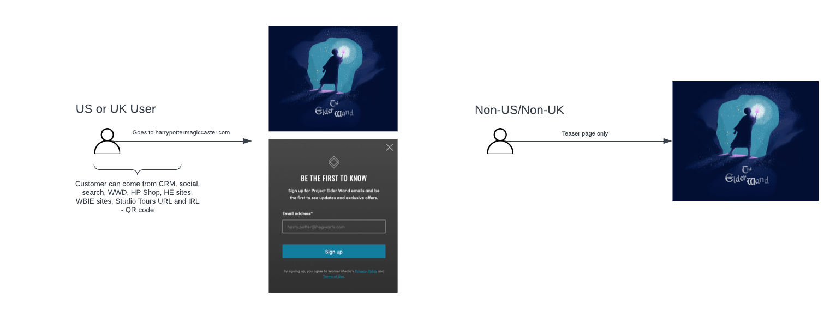
Privacy & compliance flow – coming soon

Slide 21
Privacy & compliance flow – pre-order window

Slide 22
appendix

Slide 23
Teaser site | COMING SOON – Us or uk
CX JOURNEY
Pros:
Interactive wand provides customer a teaser of one of the ways the wand works digitally.
Teaser reel bridges the wand to what made it popular...the content
Skip and stop options allows user to access the sign-up notification.
Cons:
More steps/time to get to sign-up notification especially if same user has been on the page before.
SALES & MARKETING
Pros:
Teaser reel captures audience/fans of the movies.
Cons:
N/A - Ensure social and marketing strategies align with the Coming Soon page and is enough to 'tease' and pique interest from our fans.
TECHNICAL EFFORT
Pros:
Teaser wand already developed and complete
Cons:
Need additional reel implemented with teaser launch timeline coming soon.
OPS EFFORT
Pros:
N/A
Cons:
Approvals needed in use of teaser reel.

Slide 24
WHAT AND WHY PROJECT ELDER
Continue to engage and learn about our Warner Bros Discovery Fans through our Harry Potter Brands using SMART technology.
DRIVER | VALUE
Provide fans an interactive way of using the Harry Potter wand and our brand apps and platforms | Increase Harry Potter fan traffic and engagement Increase WBD brand awareness Increase WWD/Harry Potter subscription conversion
Provide use of SMART technology to our fans and how they interact with our products so that we can continue to provide what they want. | Increase knowledge of our fans using machine learning tools to gather data Cost savings and efficient iterations by providing lean features backed by user data through use of build-measure-learn model
Provide a way for fans to purchase the wand and increase its use through new app interactions, interactions at studio tours, and interactions with movie content | Increase brand revenue through wand purchases Increase brand revenue through in-app purchases Increase brand revenue through studio tours IR/VR interaction Increase movie viewership purchase through IR/VR incentives

Slide 25
Teams & stakeholders
 | Fan Engagement/Tech | Stakeholders - Home Entertainment | WWD | Harry Potter Shop US and UK
Product and Design | Product: Ariel Bailey, Rob Kamphausen Product Tech/e-Comm: Imran Saadi, Eunice Quezon Program: Shelita Edwards Project/Ops: Nicole English UI/UX: Doug Parker, Uyen Cao, Jeff Huang | Jessica Schell, Kristina Fugate, Nicole Coleman, Angie Lai, Anselm Gunsch | Tony Zito,
Legal | Pooja Teckchandani | Amber Franklin, Michelle Fowler, Sandra Panattoni, Cherilynn Kehrli
Privacy & Compliance | Christine Santariga (Isobel Morada), Federico Thomas, Scott Baxter (EMEA)
Accessibility | Janet Ritz, Spencer Garfinkel
Marketing |  | Kristina Fugate, Nicole Coleman, Angie Lai | Lux Paterson
Social/Paid Media
Data Analytics | Simrit Pal
CRM | Ira Espinoza, Salesforce | Adam Mitchell, Dan Harrington, Salesforce
Reporting | Kiran Raj, Tableau Team
Customer Support | Orlando Lewis, Mike Kim, Joe Schumacher

Slide 26
WHO WHEN WHERE how
 | TEASER/COMING SOON PAGE – EMAIL SIGN UP | EXCLUSIVE PRE-ORDER | GENERAL PRE-ORDER | GENERAL PURCHASE
WHO | Anyone in the US and UK who | US and UK users who sign up on WWD or have an existing WWD account May have a 48-hour exclusive Wand SKU on 8/12 | US and UK users open to anyone including guest pre-order SKU open to general | US and UK users open to anyone including guest checkout Multi SKUs open to general
WHEN | 7/26 | 8/12 | 8/14 | 11/25
WHERE | US: standalone online site UK: Harry Potter online Shop RW: Not available/Teaser Page only | US: standalone online site UK: Harry Potter online Shop RW: Not available/Teaser Page only Brick-and-mortar/Tours: Not available | US: standalone online site UK: Harry Potter online Shop RW: Not available/Teaser Page only Brick-and-mortar/Tours: Not available | US: standalone online site UK: Harry Potter online Shop RW: Not available/Teaser Page only Brick-and-mortar/Tours: Not available
HOW | Teaser wand concept, tease logo, eventually a “notify me” CTA, press materials | Wand concept, app and product exclusive SKU details. Pre-order and shipping availability. Exclusive SKU | Wand concept, app and product SKU details. Pre-order and shipping availability. SKU open to general US and UK including guest pre-order | Wand concept, app and product SKU details. Customer experience and support. Ability to purchase and open to general US and UK including guest checkout Multi SKUs open to general

Slide 27
Marketing campaign

