Slide 1
Ecomm q4 2021 – q1 2022
12/02/2021

Slide 2
agenda
REVIEW ROADMAP
PRODUCT FEATURES THROUGH END OF YEAR:
Notify Me When Back In Stock
Motion Graphics – Peacemaker Beat
Faceted Search/Enhanced Search
PRODUCT OTHER:
NPS Survey
Year-end analysis KPIs to OKRs (DC and DC Shop)
Peacemaker Moment Planning and Strategy
CODE FREEZE:
Target QA testing of remaining items 12/8
Code freeze 12/8-12/15

Slide 3
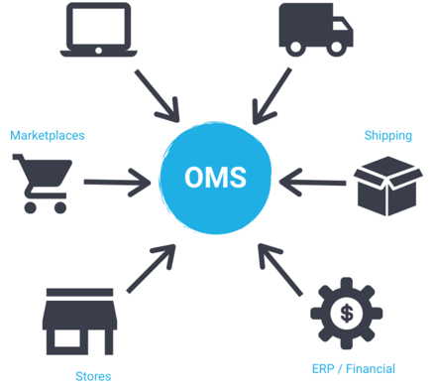
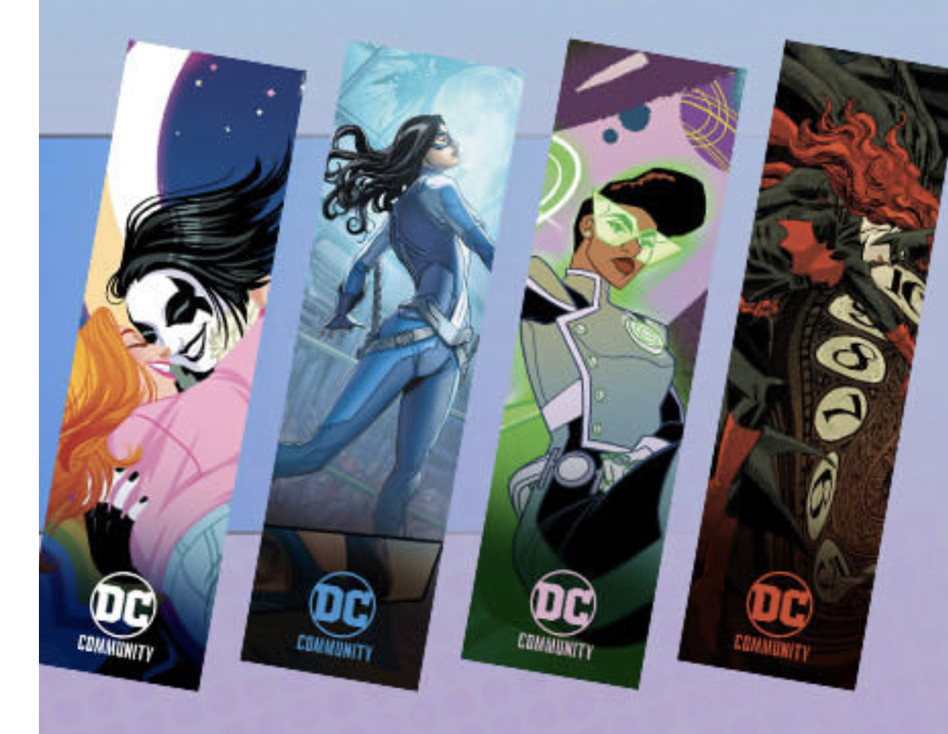
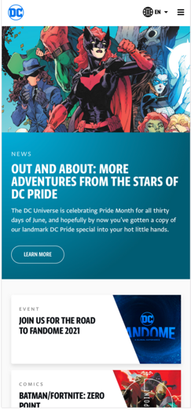
E-COMM ROADMAP Q4 2021 – Q1 2022
Collectibles, Skateboards, Skate decks, Super pets
Personalization
Stripe Orders API
Phone Cases, Jan TBD Skateboards, Skate decks, Super pets
Looney Tunes Shop Redesign
Harry Potter Shop e-Comm migration
CRM NPS Survey
DC Single Identity - unification
Motion Graphics
OCT
NOV
DEC
JAN
FEB
MAR
Tech:
Stripe Orders API
Mobile device variants
Motion graphics
Merch & Legal:
ZSJL Funko ingest
Disrupt Sports Mobile Device enhancements
Tech:
Stripe Orders API
Faceted Search/Enhanced Filters
Notify Me When Back In Stock
Code Freeze 12/08-12/15
Activations/Beats
Peacemaker theatrical/HBO Max release planning and strategy
Podcast 12/7
CRM & Analytics
NPS Survey
Year-end analysis to KPIs
Next year goals and KPIs
Tech:
DC “unification”
DC Single Identity
CMS assessment and migration
DC Hub Canada rollout (Jan-Feb)
Activations/Beats
Peacemaker Release 1/13/22
Batman theatrical/HBO Max release planning and strategy
Tech:
Looney Tunes Shop redesign or WB Shop turnover
Harry Potter Shop migration
Abandon Cart
Personalization
Merch & Legal:
McFarlane collectibles
Disrupt Sports Skateboards, Skate decks, with Personalization
Super Pets
Fifth Sun Tumblers
Tech
DC Universe Unified platform Internationalization rollout (English-speaking)
CMS migration
Search and Discovery
Activations/Beats
Batman Release Mar-2022
Subject to change

Slide 4
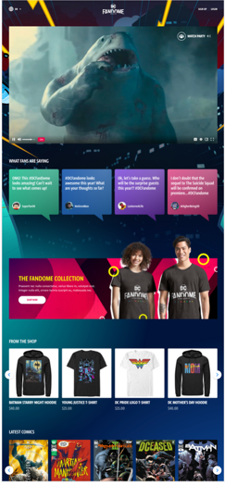
DC UNIVERSE ROADMAP 2021
DC FanDome 10/16
DC Workshop 2021 Fraud mitigation
DC Single Identity - unification
DC Universe all platforms International rollout
DC Global Gateway 12/07
NPS Survey
OCT
NOV
DEC
JAN
FEB
MAR
Tech
FanDome 10/16
Content
Creative assets
QA/UAT
Marketing Pages – Believe in Wonder, Milestone
Twitch integration
DC Kids FanDome
FanDome Launch 10/16 TBD
Features/Activations
Video event
Private chat/watch party
Games/Prizes
Tech
Fraud Mitigation/Prevention
DC Universe Hub/Global Gateway dev work
DC Workshop 2021
Goals and KPIs
Single Identity
Internationalization
CMS
Search and Discovery
Tech
DC Universe Hub/Global Gateway 12/07
Origin Story dev work
Code Freeze 12/08-12/15
Activations/Beats
Peacemaker theatrical/HBO Max release planning and strategy
Podcast 12/07
CRM & Analytics
NPS Survey
Year-end analysis to KPIs
Next year goals and KPIs
Tech
DC “unification”
DC Single Identity
CMS assessment and migration
DC Hub Canada rollout (Jan-Feb)
Activations/Beats
Peacemaker Release 1/13/22
Batman theatrical/HBO Max release planning and strategy
Tech
International rollout (English-speaking)
CMS migration
Search and Discovery
Activations/Beats
Batman Release Mar-2022
Subject to change

Slide 5
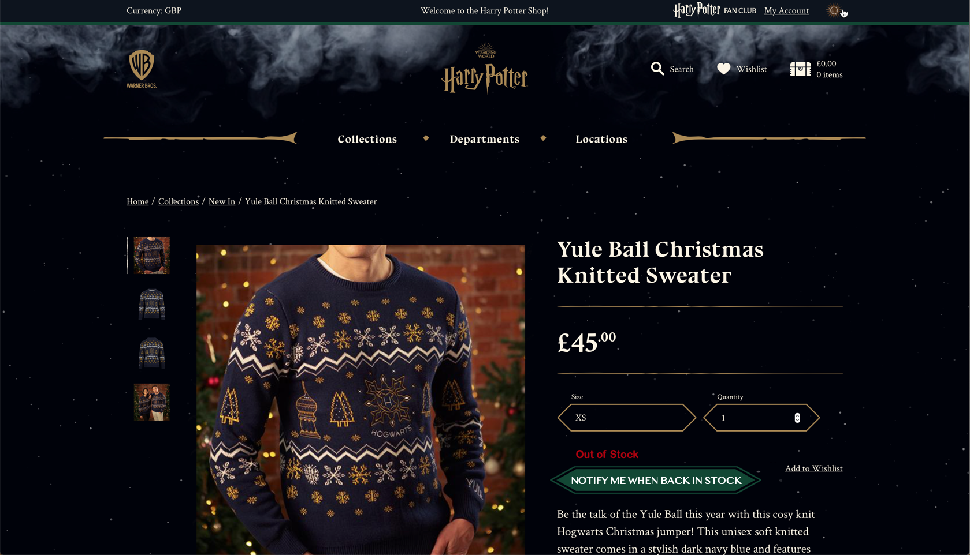
NOTIFY ME WHEN BACK IN STOCK
Provides customers lifetime value – letting them know we will cater to their needs
KPIs – how many sale conversions driven from notify me

Slide 6
PEACEMAKER BEAT MOMENT
Peacemaker Theatrical/HBO Max release January 13, 2022
Use of Motion Graphics on Shop
Peacemaker Trailer
Peacemaker Comics Art
DC sites cohesiveness start
Site redirects to create a story for Peacemaker
DC ‘premium’ start
YouTube content of Podcast to display on Shop
John Cena and James Gunn to wear DC Shop merch during podcast episodes
DC Comics YouTube channel –Jason Dimberg to research if cost benefit to display shop carousel on DC Comics YouTube Peacemaker podcast episodes is worth it
HBO Max subscription shop discount offer
Note: Showing podcast YouTube and Trailer on shop creates premium experience and allows fans to get excited about Peacemaker – emotional motivation to buy. Increase user session and engagement on the site.

