Slide 1
DC Universe Ideation
2022
SEPTEMBER 03, 2021

Slide 2
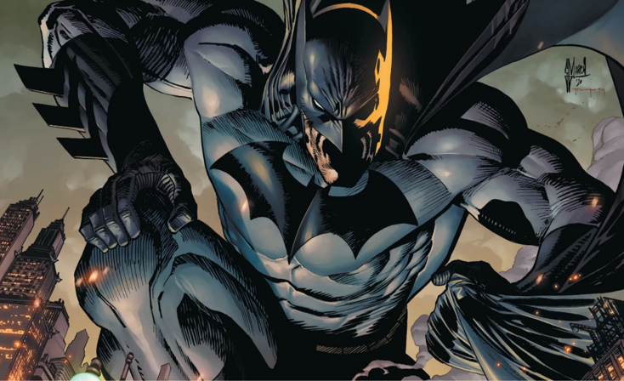
DC MISSION STATEMENT
Provide an exclusive DC Universe experience to all DC Fans

Slide 3
LONG-TERM GOALS – 4 PILLARS
BUILD A RELATIONSHIP WITH OUR FANS
LEARN ABOUT OUR FANS
UNDERSTAND OUR FANS
COMMUNICATE WITH OUR FANS
GATHER AND DISCOVER
WHO OUR DC FANS ARE USING OUR EXTENSIVE PLATFORMS AND OUR MAJOR EVENTS/PROGRAMS
UNDERSTAND OUR FANS NEEDS THROUGH SEGMENTATION AND COHORT ANALYSIS
FROM DATA GATHERED FROM DC PLATFORMS AND MAJOR EVENTS
EASILY COMMUNICATE WITH OUR FANS THROUGH OUR CHANNELS
HAVE OUR FANS EASILY FIND US AND KNOW WHO WE ARE
PROVIDE AN EXPERIENCE THAT IS SEAMLESS, RELIABLE AND VALUABLE TO OUR FANS
WHAT WE KNOW SO FAR:
Cohort who know DC only through our movies
Cohort who love DC through RPG/interactive experiences
Cohort who love DC Comics and all things DC – DC SuperFan
DC’s Mission: Provide an exclusive DC Universe experience to all DC Fans

Slide 4
ONE BRAND – ONE PLATFORM
DC
SINGLE-SIGN-ON
DC.COM
COMMUNITY
COMMUNITY.DC.COM
SUBSCRIPTION
DCUNIVERSEINFINITE.COM
SHOP
SHOP.DC.COM
GAMES-NFTs-METAVERSE
MY DC
ORIGIN STORY
AVATAR
MY TOKENS, NFTs, REWARDS, LOYALTY POINTS
MY SUBSCRIPTION HISTORY, MY ORDER HISTORY

Slide 5
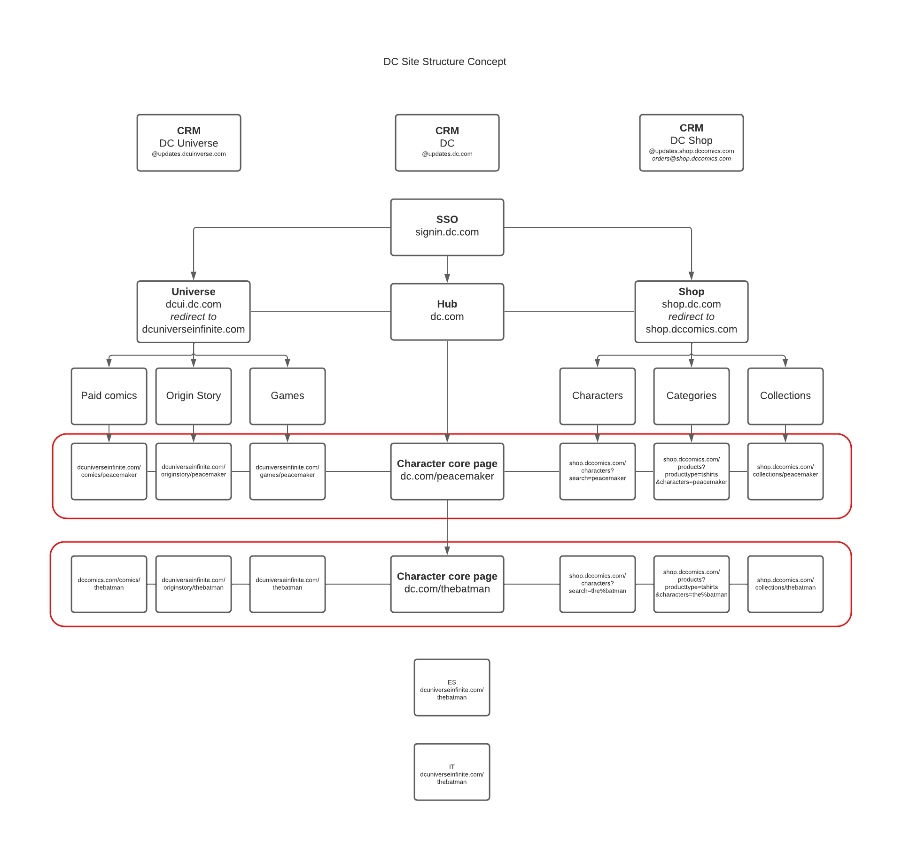
ONE BRAND – ONE PLATFORM

Slide 6
FANS WHO KNOW DC THROUGH MOVIES
Stats:
Suicide Squad 2021 – 2.8M streams; $26.5M OWE Box Office
Zack Snyder’s Justice League – 1.8M streams; 2.3% HBOMax subscription increase; 28M trailer views
WW84 – 14.5M streams; According to Nielsen, the film earned 2.252 billion minutes of viewership during the week of December 21-December 27, making it the most-watched SVOD content in that span

Slide 7
HOW DO WE CAPITALIZE THE MOVIE VIEWERSHIP MARKET?
Subscriber count best this year-to-date 284K
YouTube 3.69M
Instagram 11.5M
Facebook 6.2M
Twitter 4.2M
Movie Market
Millions in viewership

Slide 8
ANALYSIS OF LANDING PAGE AS-IS MOBILE
New fan – hard to know where to go or start
Latest releases geared towards existing fans
Quick analysis of landing page above the fold

Slide 9
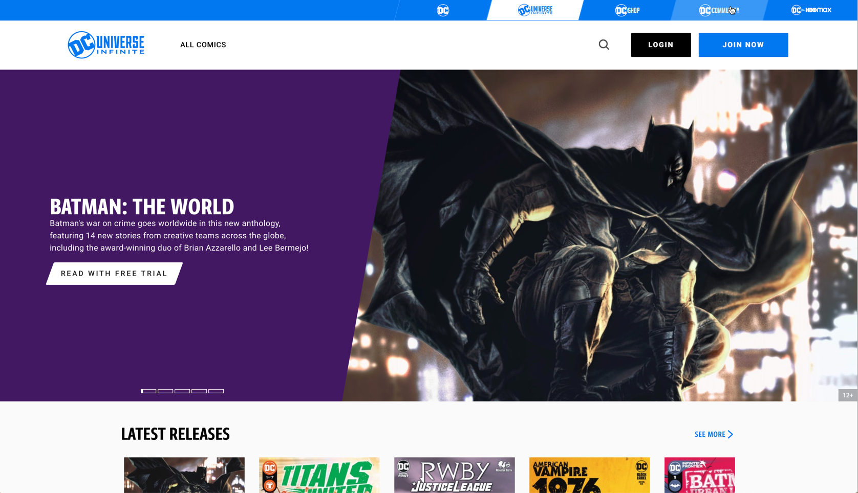
ANALYSIS OF LANDING PAGE AS-IS DESKTOP
New fan – hard to know where to go or start
Latest releases geared towards existing fans
Quick analysis of landing page above the fold

Slide 10
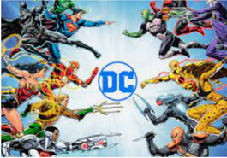
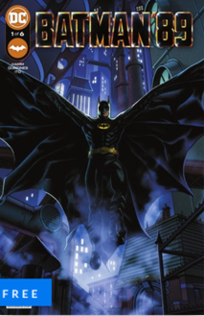
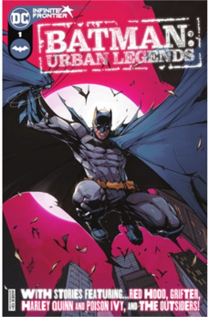
IDEAS MOBILE
User signs up to provide more info about their current relationship with DC (marketing opt-in sign-up)
Not sure where to go? Start here
DC Multiverse
About DC Multiverse (short desc)
Top 3 suggested reads
First comic is free to read with free subscription.
Next comics paid registration.
Goes to: DC Multiverse Collection Page (no reg to see – paid-reg to read )
Collection of comics, series, issues of different multiverses
Faceted Search should be available to filter for multiverses and characters
Shop carousel related to multiverse and changes on faceted search
Engagement path
DC Origins
About DC Origins (short desc)
Top 3 suggested reads
First comic is free to read with subscription.
Next comics paid registration.
UNIVERSE
Goes to: DC Origins Collection Page (no reg to see – paid-reg to read)
Collection of comics, series, issues of different character origins
Faceted Search should be available to filter for characters
Shop carousel related to multiverse and changes on faceted search
upsell path
Discover your origin
Goes to: Origin Story quiz (paid-reg)
Engagement path
Build your avatar
Goes to: Avatar builder (paid-reg)
Engagement path
Compete in multiverse
Goes to: gamified participation, i.e., Fortnite, Twitch (paid-reg)
Social Community
Customer Loyalty
Customer Lifetime Value

Slide 11
DC
“The brands that win are the brands that tell a great story. When it comes to transmedia storytelling, the brands that win are the brands that tell many great stories and are able to connect them all together.” —Mitch Joel, President of Mirum, a global marketing agency
Overall Goals

Slide 12
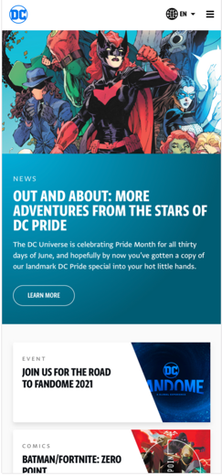
DC Universe Hub
Next Up: DC Universe Hub
We’ve already started a more focused strategy and execution plan by scoping out features into a package that provides a story to our fans. Here’s a high level:
On Brand – Single-Sign-On registration experience, Landing Page Hub, One CRM email, one domain
Storytelling – The landing page will be an unveiling of a story with each chapter having an upsell to conversion goal.
Mobile first – design with mobile in mind first. Studies show that most engagement sites stats have a higher percentage of mobile usage, with DC ranging from 57-65%. Mobile web designs are looking more like mobile apps, providing components that are easily executable on a smaller scale screen.

Slide 13
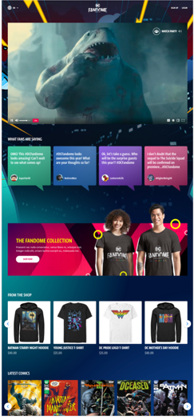
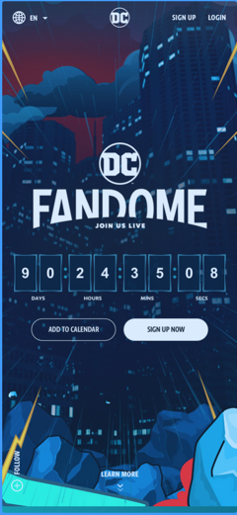
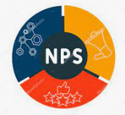
DC ROADMAP 2021
DC FanDome 10/16
Road-to-FanDome 8/31
Activations
DC Single Identity Nov TBD
NPS Survey
Ratings & Reviews
AUG
SEP
OCT
NOV
DEC
Road-to-FanDome 8/31
Registration/Geo unblock
Segment/Analytics
Registration/CRM/SFMC
FAQs/Creative assets 8/9
China version
QA/UAT
RTF Launch 8/31 6a ET/9a PT
Activations Sept
F2R Comics
Batman Week
Sweepstakes Trivia
CRM Scavenger
FanDome 10/16
Content
Creative assets
QA/UAT
FanDome Launch 10/16 TBD
Features/Activations
Video event
Private chat/watch party
Games/Prizes
Registration V2 Nov TBD
DC ecosystem SSO
Landing Page Hub
Segment/Analytics
CRM/SFMC – Registration benefits
Features/Activations
Multiverse
Origin Story
Avatar
NFT
Gamification
Loyalty Programs
CRM Dec TBD
NPS Survey
Customer Care feedback
Planning
2022 strategy and Execution Plan of 2022 Roadmap
Subject to change

