Slide 1
DC FanDome DC Shop Product Brief
Aug-Oct 2021
JULY 4, 2021

Slide 2
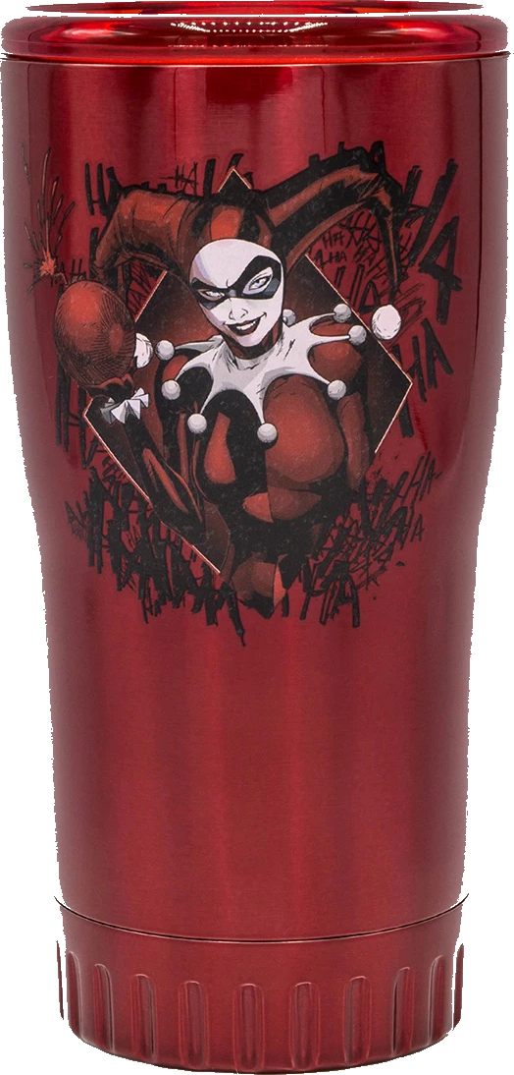
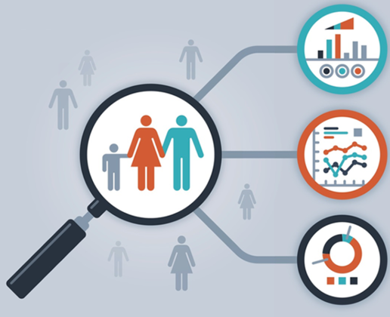
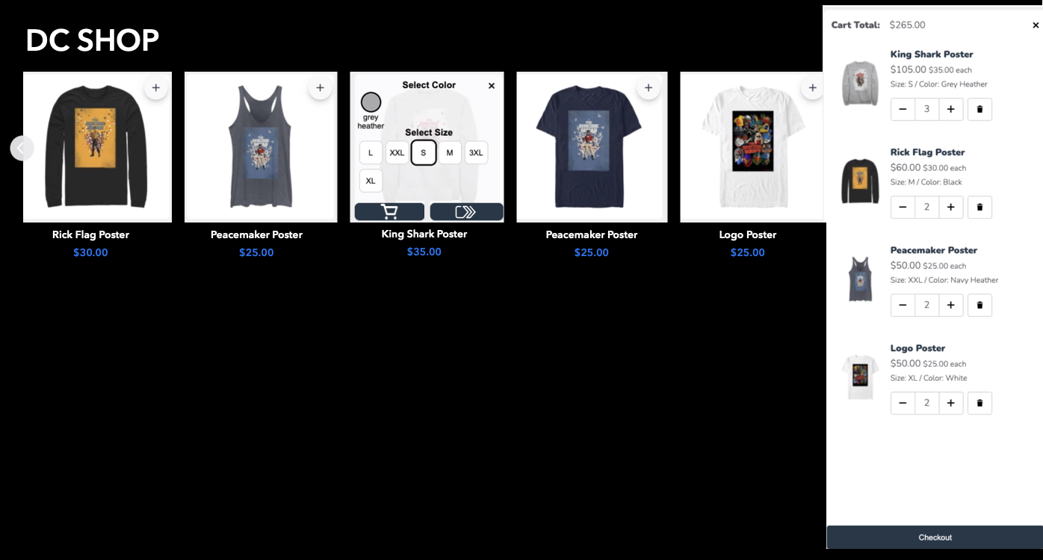
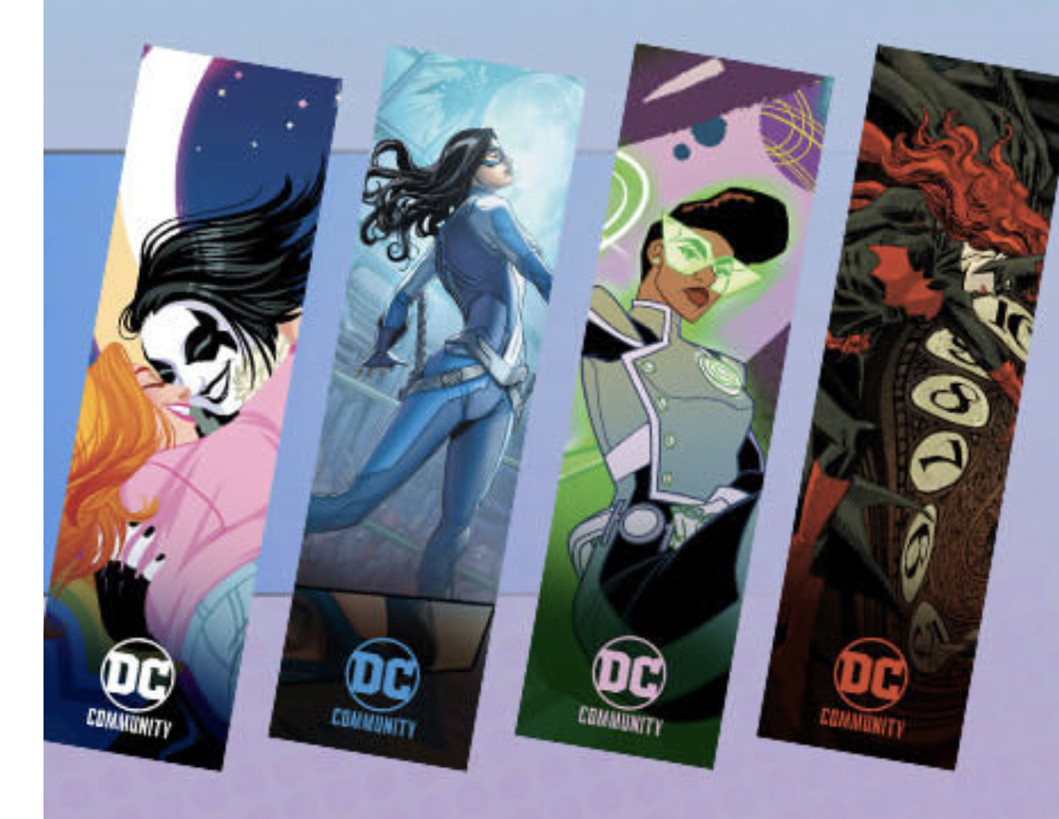
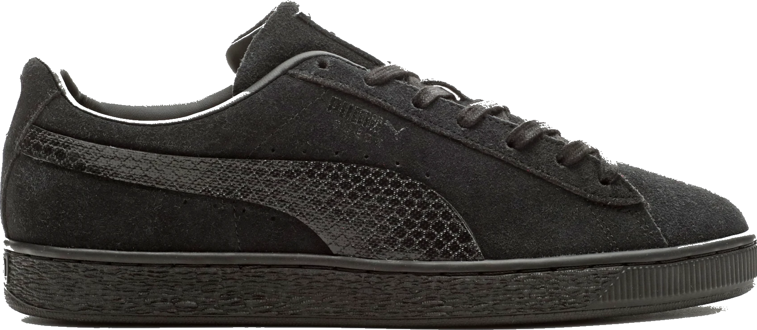
DC FANDOME DC SHOP ROADMAP 2021
i18n
Suicide Squad Tumblers, Puma
Ratings & Reviews Product reviews, peer Q&A, Sharing
Merch Ideas: DC Book Club wallpaper to decals Collectibles, Funko Pop, Decal on snowboards, skateboards, game console
Embeddable DC Shop component DC market penetration strategy by way of Shop
DC Single Identity One sign up/sign in experience across DC platforms
JUN
JUL
AUG
SEP
OCT
Suicide Squad Release Aug. 6
Road-to-FanDome
End-Aug thru Oct. 16
DC FanDome
Event Oct. 16
Tech:
Vendor Integration Optimization
Embeddable carousel component
Merch & Legal: Contracts:
Tervis - tumblers
McFarlane – collectibles
Funko and 3G – Funko & Warehouse
Disrupt Sports – Specialty items
Tech:
Vendor Integration
Localization
Globalize:
- CMS
- PIM
- Ordering System
- Discounts
- Payments
- Shipping
- Discounts
- Invoicing
- Order Notifications
- Billing
- USD conversion
Tech:
Single-Sign-On
- Account Management
- Guest conversion
Personalization:
- Demographics
- Location
- Social info
Faceted Search
Fuzzy Search
Tech:
Customer Cross-Platform data analytics
Hyper-personalization:
- CRM
- Abandon Cart
- Recommendations
- Attachments (upsell)
- CXM – Support
- Wish List/Save Later
- Reviews
- Q&A
- CS reviews response
Tech:
Prep for Batman Release Jan 2022
Hyper-personalization analytics
Predictive modeling analytics
Merch:
NPS Survey
Prep for Batman Release Jan 2022
Subject to change

Slide 3
Market Penetration & Development
Embeddable DC Shop component – this game-changing shop component is embeddable in just about any site, which can be used to penetrate existing or develop new markets. It can serve as a gateway to subscription conversion by way of Global Navigation. See next slide for more details (developed by Sr. Full Stack Engineer, Michael Pourshalimi). Rob/Imran to demo.
Internationalization (i18n) – opening our shop to international markets to increase our reach and connect with fans outside of US.

Slide 4
DC Shop Embeddable Carousel
Key Features:
Uses open-source and most preferred code, allowing it to be embeddable on most sites today.
Entire purchase flow can be done directly on the embedded site, allowing for a smooth transaction conversion.
Mini cart can be turned off to prevent overlay of a site’s design (i.e., DC FanDome art banner, video, etc.). Instead, a smaller bag icon can be used to checkout.
Stylesheet (i.e., background theme, font, etc.) can be modified to match site in which it is embedded.
Event and Site Ideas:
DC Shop standalone carousel is embeddable on just about any site today as it uses the latest open-source code. It can be used to penetrate a desired market and combined with DC Global Nav, can serve as a gateway for customer conversion on DC platforms and HBO Max.
Comic-Con
X-Games
Fit-Con
July 23-25, 2021
Jan 2022
Jan 2022
Fortnite World Cup
Q2 2022

Slide 5
Product Development and Diversification
Vendor Onboarding Optimization – optimize our vendor integration to allow for quicker onboarding and selling of a variety of product lines on our site (developed by Sr. Staff Engineer, Anshul Kumar).
Specialty Products (Disrupt Sports) – Disrupt Sports is one of our onboarding partners that specializes in sports products, gaming, and fitness. Having this option will allow us to determine whether to diversify or not diversify in both products and market. See next slide for ideas.
Amazon warrior Penthiselea in WW and ZSJL is crossfittter Brooke Ence
ZSJL Zeus is Spanish bodybuilder Sergi Constance
Fitness market?
Superman knee sleeves
Batman lifting belt
Crossfit market?
WW Lasso Jump rope
WW wrist wraps

Slide 6
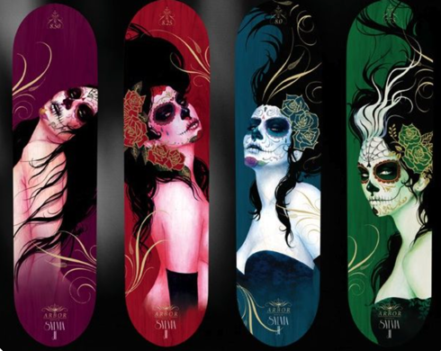
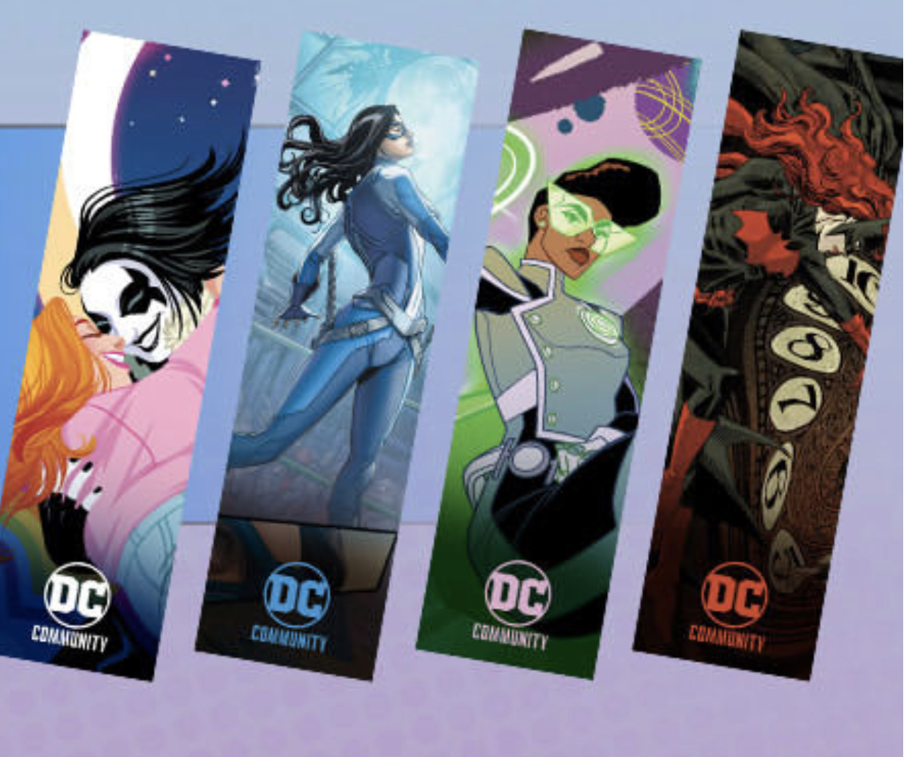
Diversification - Merch Ideas
DC Book Club Wallpaper
Arbor Snowboards for concept only
Arbor Skateboards
For concept only
DC Book Club Wallpaper Download + Decal & Disrupt Sports
Disrupt Sports Vendor – customizable skateboards, snowboards, surfboards using decals.
Use downloadable DC Book Club Wallpaper to convert into Decal with Disrupt Sports
September through November - snow gear sales peak season
New target market – snowboarders, outdoor adventurers

Slide 7
Personalization to Hyper-Personalization
Single-Sign-On (SSO)– Provide the ability for our fans to sign up or sign in on DC and have access to all DC Platforms, including DC Shop (Engineers: Eric Chazan, Chris Porch, Aaron Tidwell, Harshil Shah, Phil Walton)
Shop Account Management – with SSO, provide a way for customers to track and manage orders, view purchase history, and manage payment options.
Guest to Customer checkout – provide a way for customer to choose to create an account after purchase, optimizing customer conversion while retaining ease of guest checkout.
Customer Data Mining Cross-Platforms – with SSO, enhance customer data mining and integration to cross platforms. For DC Shop, collect customer demographics, location, social, and purchase behavior (Data Lead: Nikhil Bhat)

Slide 8
CRM and CXM
CRM – with SSO, features available:
Abandon cart tracking, personalized product recommendations and attachments (upsell)
CXM – with SSO, features available:
Wish List and/or Save Later, product reviews, product sharing, Q&A, customer service response chat.
NPS Survey – send NPS survey to our customers to further understand their needs and improve the shop and DC platforms experience from feedback.

