Slide 1
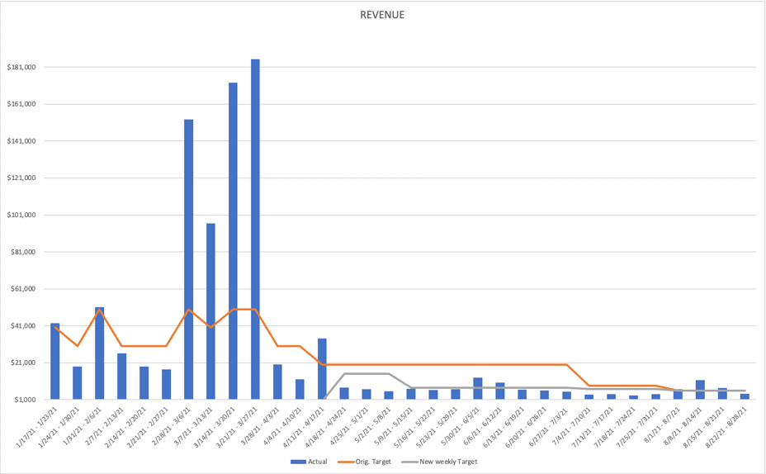
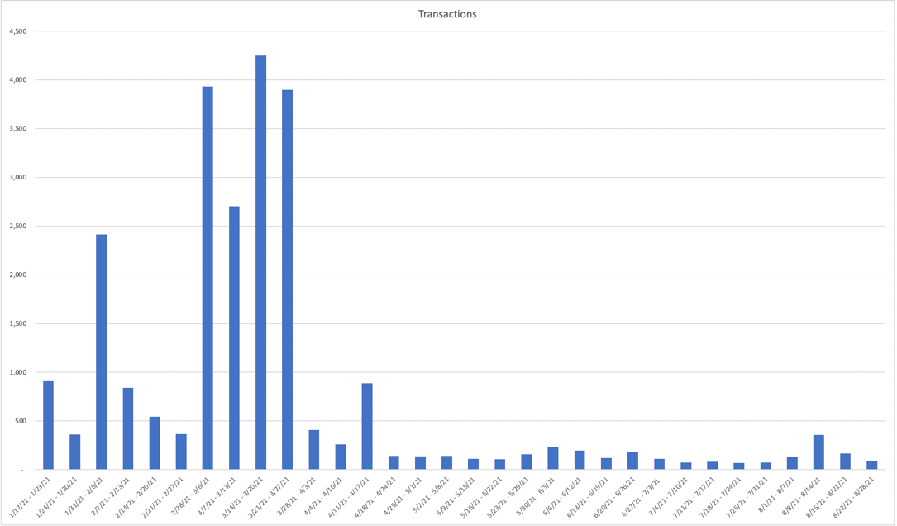
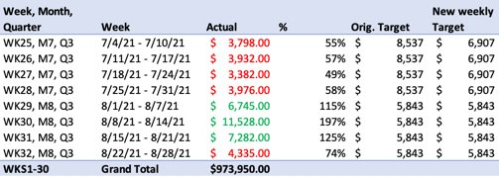
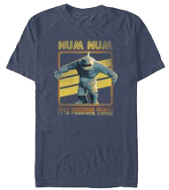
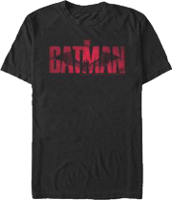
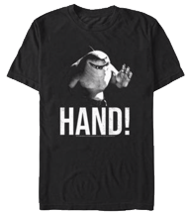
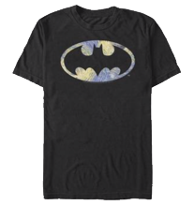
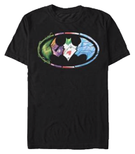
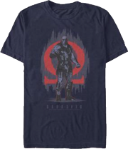
DC SHOP ANALYSIS REPORT
SUMMARY-TO-DATE 2021 JANUARY 19-AUGUST 28
WEEKLY 2021 AUGUST 22-28
Revenue Chart (weekly-to-date)
Transactions Chart (weekly-to-date)
INSIGHTS:
Week 32 sales decreased by 40% as expected following big campaign pushes from the previous 2 weeks.
Conversion at 2.27% minutely decreasing every week.
Transactions to date at 24K with an AOV continuing to be at $52.
Top 5 sales moving towards Batman merch with Suicide Squad fave King Shark still in spot 1 and 3.
Target for Q3 at 3% with 4 weeks remaining.
Summary: Suicide Squad release on Aug. 6 almost doubled weekly sales. King Shark character dominated merch sales.
Transactions 24,462
32nd week 90 -46%
31st week 162
Average Order Value $52 USD
32nd week $49 +13%
31st week $43
Weekly sales
Top 5 week of August 22-28
Top 5 of all time
Quarter Targets
Revenue $973,950 USD*
32nd week $4,335 -40%
31st week $7,282
Conversion rate 2.27%
32nd week 0.84% -25%
31st week 1.12%
Conversion rate average 2-5%, desired e-comm target >10%.

Slide 2
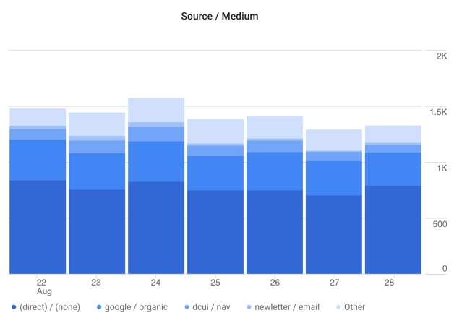
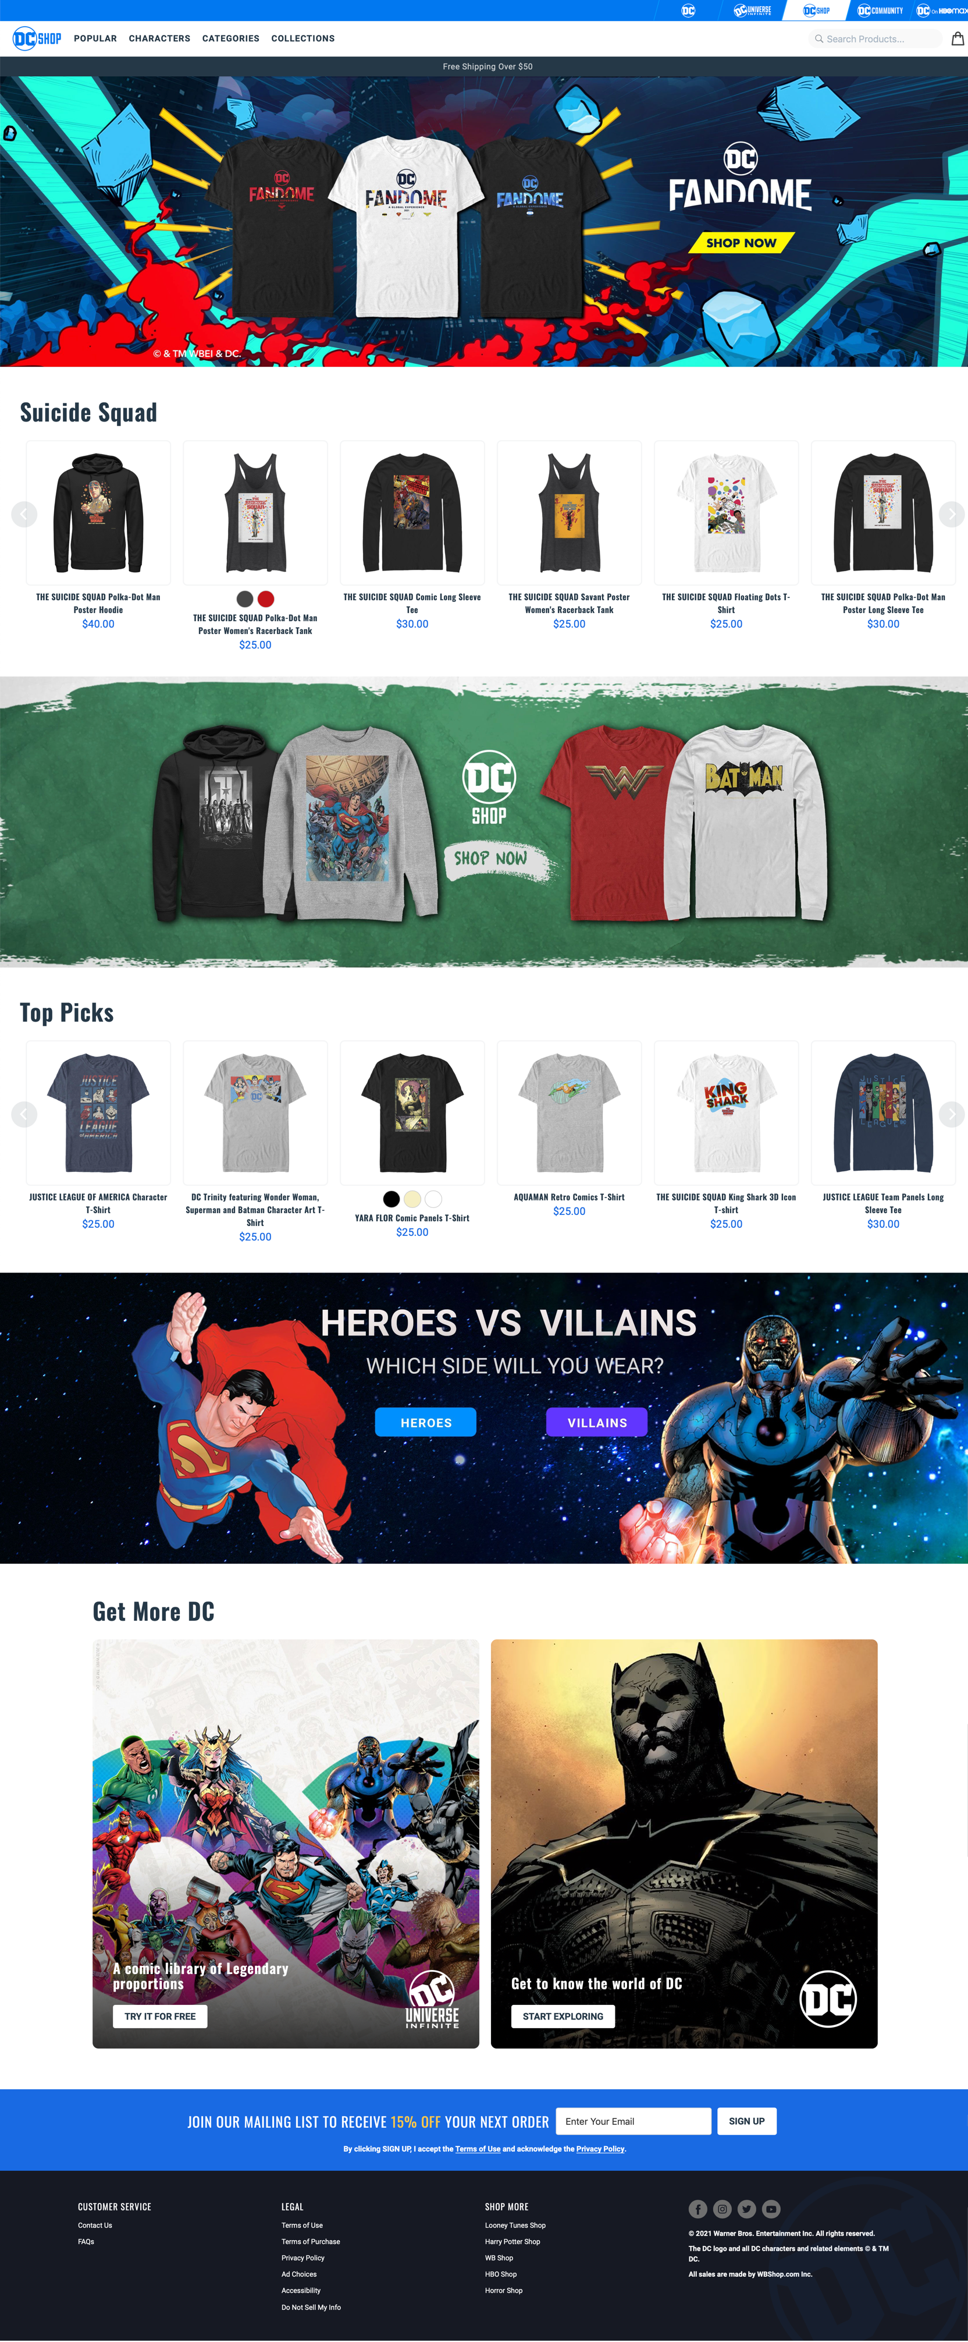
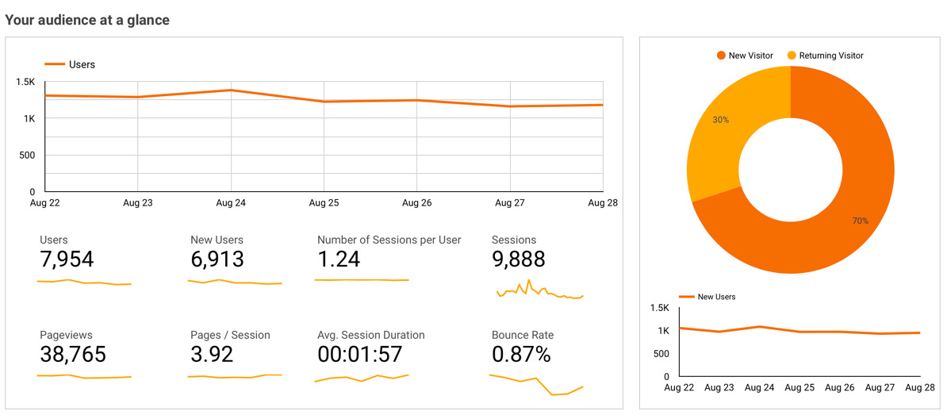
DC SHOP ANALYSIS REPORT
SUMMARY-TO-DATE 2021 JANUARY 19-SEPTEMBER 04
WEEKLY 2021 AUGUST 29-SEPTEMBER 04
Top Acquisition Sources/Conversion this week
#1 – Direct 55% / 0.63%
#2 – Google/Organic 22% / 1.13%
#3 – DCUI Nav 8% / 1.15%
#4 – madmagazine.com/ref 1.66% / 0%
#5 – WarnerBros/shop 1.64% / 0%
#6 – Shop newsletter 1.35%/6.74%
#7 - dccomics /web 1.34%/ 0%
#8 – dccommunity/Nav – 0.88% / 0%
#9 – IG shopping – 0.73% / 0%
#10 – DC newsletter – 0.63% / 1.49%
Top Searches by pageviews this week
#1 – Batman 17.08%
#2 – Harley Quinn 5.92%
#3 – Superman 5.47%
#4 – Funko 4.56%
#5 – All Characters 3.19%
#6 – King Shark 2.73%
#7 – Justice League 2.51%
#8 – Logo 2.51%
#9 – Wonder Woman 2.51%
#10 – Young Justice 2.28%
Top Unique Pageviews/$Value this week
#1 – Landing Page 43% / 32%
#2 – Products 6% / 163%
#3 – Characters 4% / 105%
#4 – Heroes Collection 3% / 111%
#5 – Suicide Squad Collection 3% / 151%
#6 – Villains Collection 2% / 56%
#7 – Batman Characters 2%/ 95%
#8 – Checkout 1% / 1,051%
#9 – Sort by Newest 1% / 115%
#10 – Shirts Collection 1%/ 157%
User Traffic 535,588
32nd week 7,954 -28%
31st week 10,983
Unique Pageviews 3,476,092
32nd week 38,765 -30%
31st week 55,362
Total Sessions 851,310
32nd week 9,888 -28%
31st week 13,693
Bounce Rate 4.04%
32nd week 0.87% +30%
31st week 1.23%
INSIGHTS:
Traffic continues to be sourced through direct access to our site. Highest conversion remains to be shop newsletters.
Highest Searched continues to be Batman, supported by top 5 merch purchases.
Funko still in top 5 as we prep for FanDome Funkos
Summary: This week is lower than previous 2 weeks spikes while the shop preps for Road-to-FanDome launch.

Slide 3
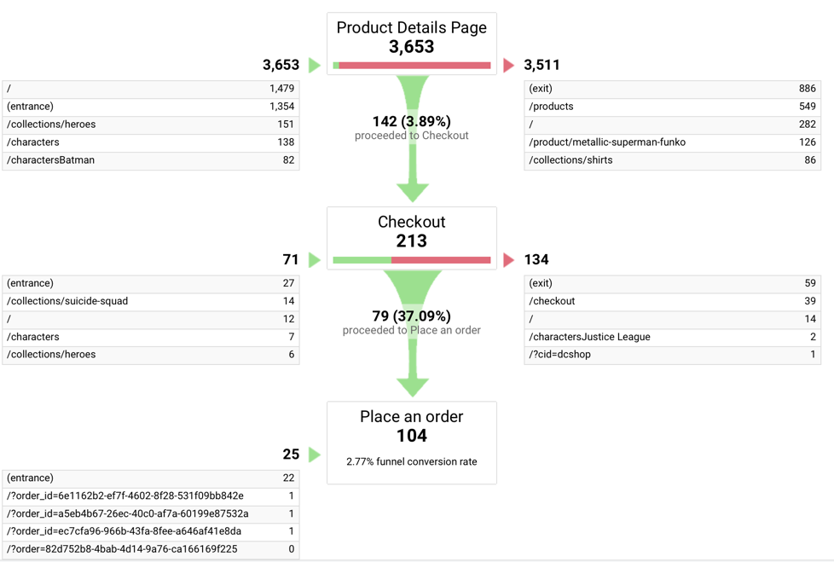
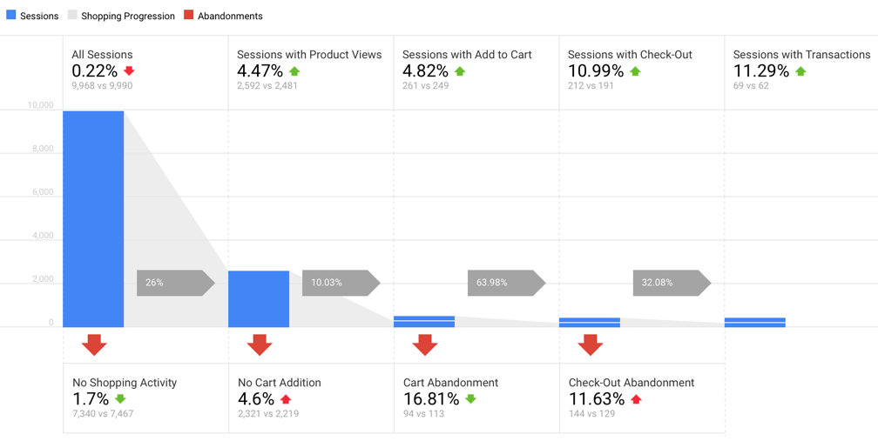
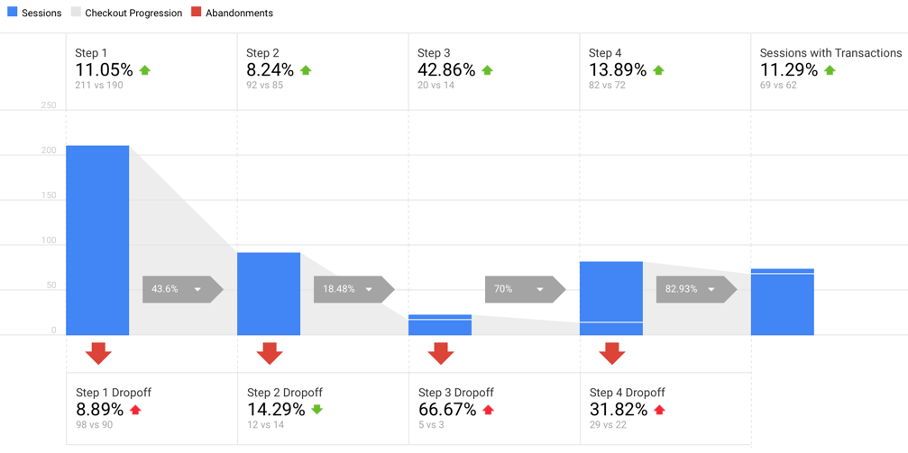
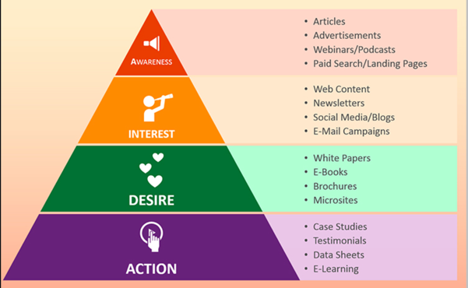
DC SHOP FUNNEL VISUALIZATION & AIDA GOALS
WEEKLY 2021 AUGUST 01-07 – needs update
Funnel Visualization & AIDA GOALS
With the 8,183 (+.18%) users visiting the site, 36,852 (+2%) pageviews, and 3,653 (+) product detail views, around 104 (+) purchases were made. Checkout funnel conversion at 2.77% (last week at 2.22%).
Shopping session increased this week including sessions with transactions.
Customer Checkout session also increased in sessions, though drop off relatively higher from previous week.
SUMMARY: The Suicide Squad theatrical and HBOMax release is generating the traffic coming from DC and into DC Shop. Therefore, a slight uptick on overall user activity and sessions of the shop.

Slide 4
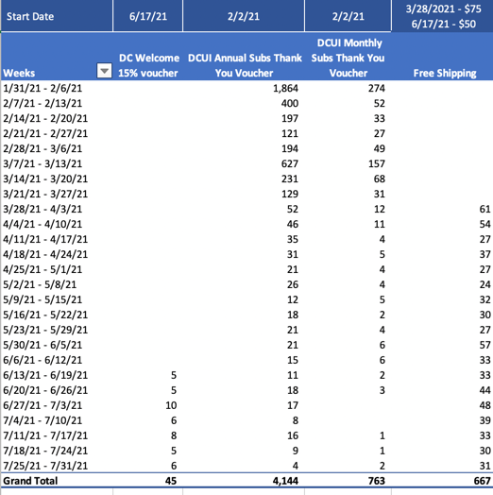
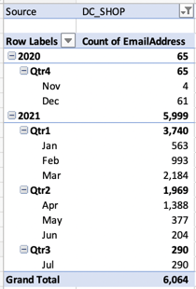
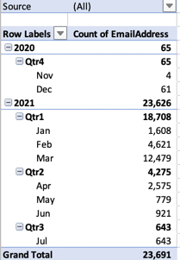
DC Shop Coupons, Discounts, DCUI Vouchers
SUMMARY-TO-DATE 2021 JANUARY 19-AUGUST 07
WEEKLY 2021 AUGUST 01-07 – needs update
Newsletter sign ups total through July 31
Total 6,064
Total email captured through July 31 (includes emails opted in through purchase)
Total 23,691
DCUI Voucher Email campaign send 02-Feb-2021
45,438 annual subscribers $25
95,224 monthly subscribers $10
449 internal $25
Total 141,111 emails sent
DCUI Voucher as of 7/24:
$25 annual vouchers used: 4,140
$10 monthly vouchers used: 761
Total: 4,907
(3.5% redeemed of total sent of 141,111)

Slide 5
DC SHOP ANALYSIS REPORT
REVENUE PACE CHART AND PREDICTIVE ANALYSIS
INITIAL Q3 - MONTH 7
Q3 merch moments
Suicide Squad 8/6
Road-to-FanDome 8/26-10/16
Batman The World 9/14
(DCUI Fortnite 9/16)
Custom Comic Twitch E-Sports 9/20
WW Month 10/1
Q3 site optimization
Internationalization efforts
Unified Identity
Faceted Search Filters
Q3 Objectives
Can carry over to next quarter(s) depending on priorities
100%
$1,138,256
Q3 Marketing, Social and CRM strategies
Paid Search
CRM – Reco engine, Abandoned
Social Shops
Majority of Q3 sales predicted to be during RTF. Weekly targets similar to this year’s ZSJL weekly sales.
Month 9 Aug 29-Sep 25: 65% at $739,866
Weekly target $184,967
Q3 CXM Improvements
SSO
Ratings and Reviews with moderator
E-commerce UGC (photos, social image posts)
Personalization
Q&A on products
65%
$739,866
Small increase as new merch types are integrated
Month 8 Aug 1-28: 32% at $364,242
Weekly target $91,060
Initial baseline for Q3 based on merch moments ramp up. July lower targets as product plus market expansion and prep for RTF are underway.
Month 7 Jul 4-31: 3% at $34,148
Weekly target $8,537
M7 TOTAL: $15,089 44% of $34,148
Negative $19,059
32%
$364,242
3%
$34,148 > $15,089

Slide 6
DC SHOP ANALYSIS REPORT
PREDICTIVE MODELING
DC FanDome
SSO framework and solution reusability already in place. Workstream starting this week.
Personalized CRM Reco engine: Targeted emails, social marketing campaigns
Targeted merch recommendations: Shop personalized merch UI algorithm
DC Digital Platform Release strategy alignment – strategic timing/release of product features; merch release; marketing campaigns; social campaigns across platforms
DC Digital Platform synergy x 2 – content and fan engagement activities with must-touchpoints across platforms
INITIAL Q3 – MONTH 7
Increased access to fans and personalization – Road-to-FanDome
+3-5M possible additional international users with an additional 40% in revenue from international. Workstream in progress with DCUI team
Release strategy alignment: Suicide Squad release 8/6 – marketing campaigns
DC Digital Platform synergy build up – content and fan engagement activities with must-touchpoints across platforms
36%
100%
Q1 Performance Metrics
WEEKS 1-4: $138,759 USD
WEEKS 5-8: $285,640 USD
WEEKS 9-12: $390,048 USD
Q1 total: $814,447 USD almost double $458,919 USD
65%
$739,866
100%
$1,138,256
34%
85%
$390,048
Q2 Performance Metrics
WEEKS 13-16: $53,887 USD
WEEKS 17-20: $32,564 USD
WEEKS 21-24: $28,074 USD
Q2 total: $114,525 USD, -50% of original target
62%
$285,640
100%
30%
32%
$364,242
100%
$239,018-> ADJUSTED $118K -> ACTUAL $114,525
34% -> 38%
$81,266 ->
$90,175 ->ADJUSTED $30K -> ACTUAL $32,564
36% -> 40%
$94,956 -> ADJUSTED $30K -> ACTUAL $28,074
30%
$138,759
30% -> 23%
$71,705 ->
ACTUAL $53,887
3%
$34,148 > $15,089

Slide 7
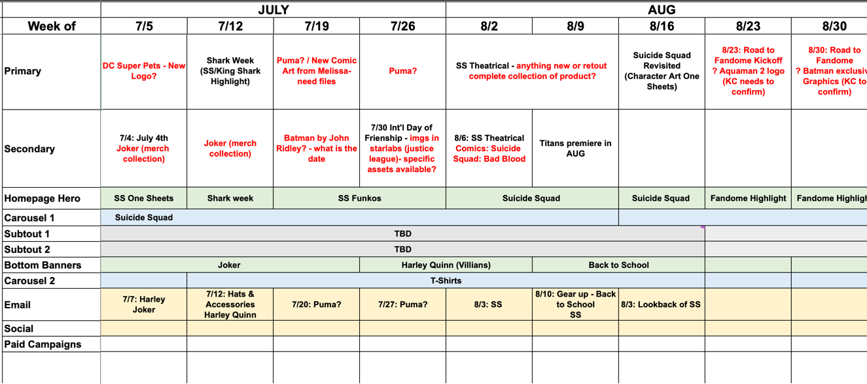
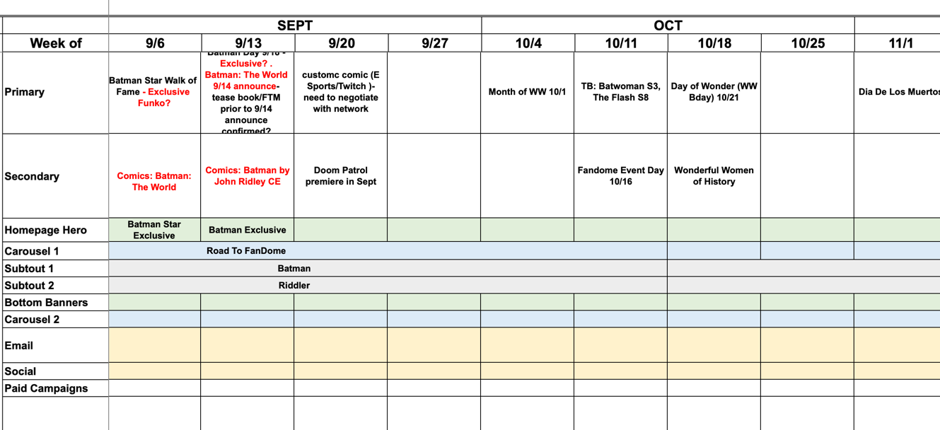
DC SHOP ANALYSIS REPORT
MERCH CALENDAR – JULY THRU OCT 2021
MERCH PLANS & STRATEGY:
Onboarding Hybrid Air Waves which sells hats and bags.
Onboarding Disrupt Sports next week which sells specialized merchandise like surfboards, snowboards, decals, fitness equipment.
Subject to change

Slide 8
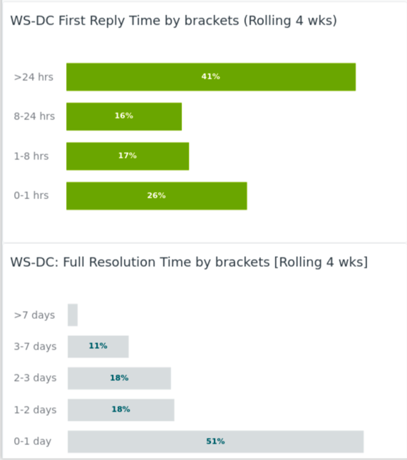
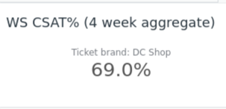
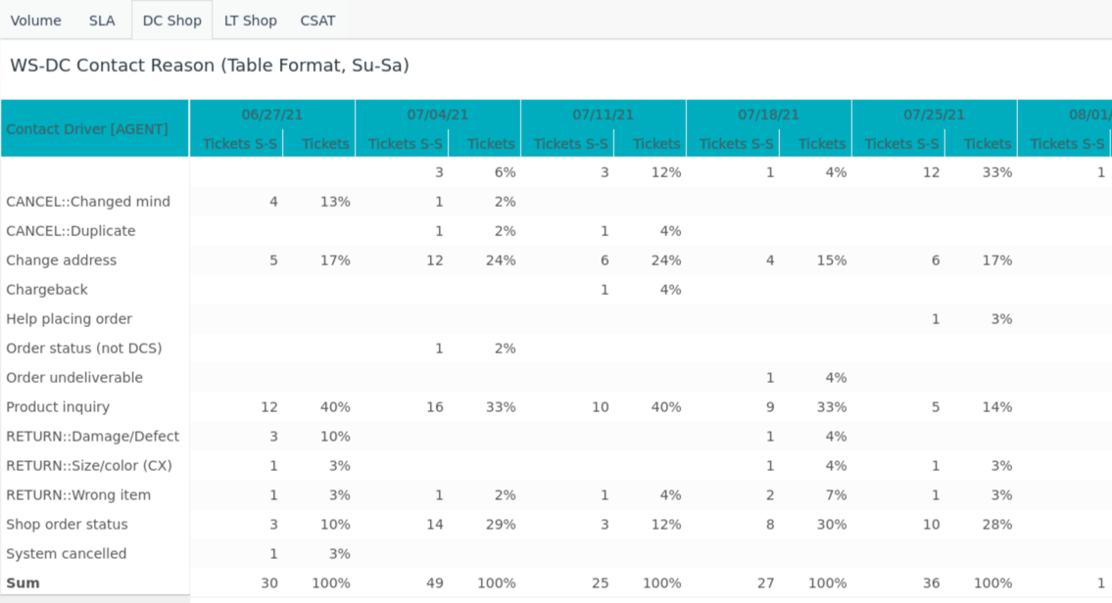
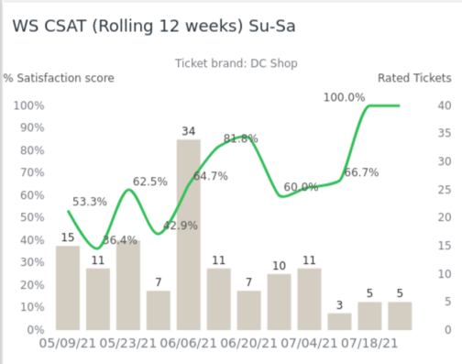
CUSTOMER CARE WEEK REPORT
WEEKLY 2021 AUGUST 01-07 needs update
Highlights for the week:
Week 28, customer contacts increased slightly this week at 36 (previously 28) with customers calling in about their Funko Pop purchases.
CSAT continues to increase at 69.0% (previously 66.7%)
Customer Care SLA > 1 day remain increased as well at 51% previously (46%)
We continue to monitor customer care SLAs to gauge as we prep for Q3/Q4 when we open up ratings and reviews from customers. See report in sharepoint for more details.
Sharepoint version: Customer Care Weekly Report
Customer weekly report and highlights provided by Mike Kim

Slide 9
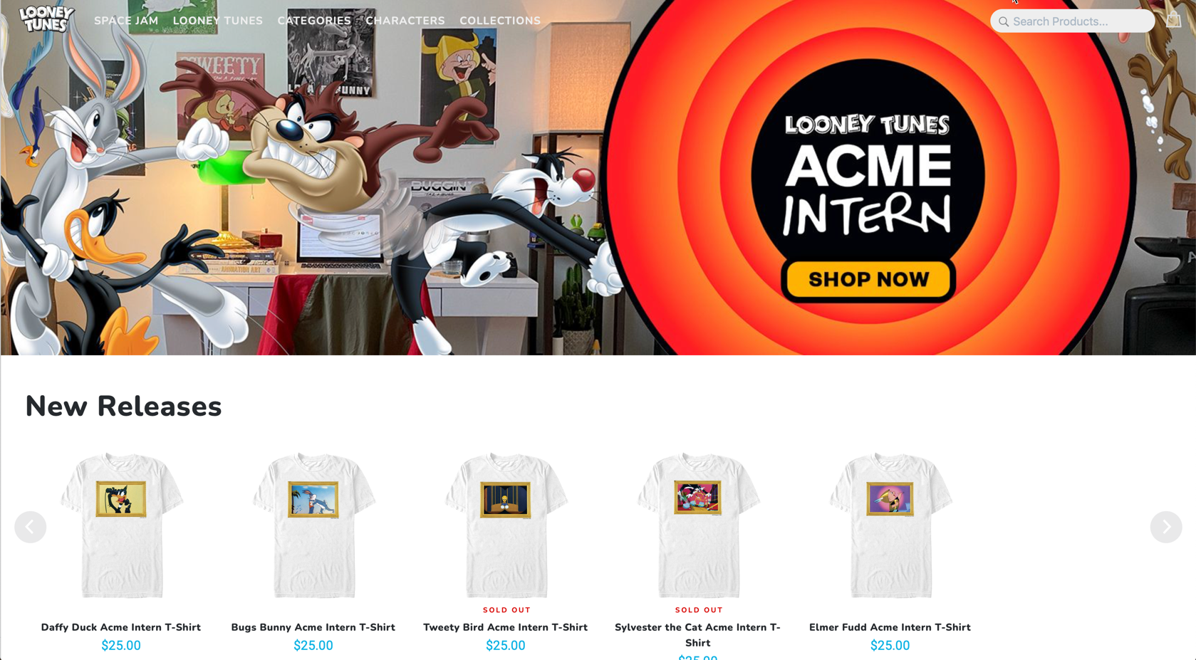
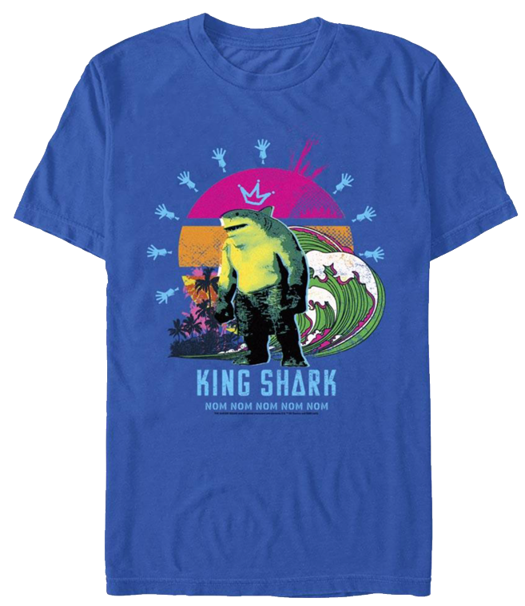
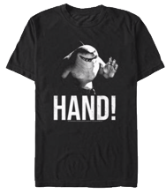
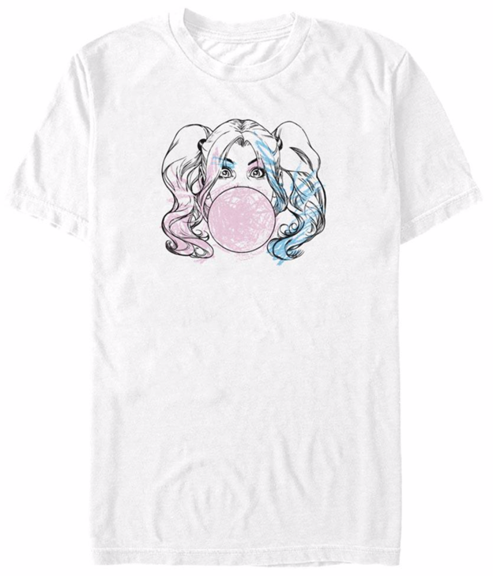
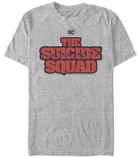
ECOMM & MORE
DC Shop
Last Week - Tech
Embed Carousel updates - Increased query efficiency cutting down time by 90%; - Integrated platform-wide currency code mapping to handle currency formatting - hide carousel if products not available in country
- Cross platform analytics implemented to track conversions and campaigns across platforms by anonymous Ids and signed in users -Implemented quick checkout as a config feature flag so users can checkout a product with a single click.
Vendor testing and onboarding
Continue i18n for mid-Sept launch target
RTF assets delivered
CMS preview functionality – before deploying changes to Prod
Looney Tunes Shop
Last Week – Merch
SS WK30 $11.5K +70% previous
WK30 M8 Q3 GTD - $963K
#1 – SS King Shark Crown Tee – 19 units
#2 – SS King Hand Tee – 19 units
#3 – SS Harley Quinn Bubble Gum – 14 units
#4 – SS Movie logo – 12 units
#5 – SS King Shark Feeding Time - 11 units
Last Week – Merch
ACME Intern WK30 $2.5K -32%
WK30 M7 Q3 GTD - $31.5K
#1 – Bugs Bunny & LeBron James Tee – 4 units
#2 – Tune Squad Let’s Play Kids’ Tee – 3 units
#3 – Monstars Bupkus Hoodie from Space Jam – 3 units
#4 - Lola Bunny It’s On and Poppin’ Crew Sweatshirt – 3 units
#5 – Looney Tunes Characters T-Shirt from Looney Tunes – 3 units
Last Week - Tech
Sweepstakes analysis
Product re-strategy with Sam Bushy
This Week - Tech
Merch support and merch re-strategy
Regression testing on LT Shop – eComm tech stack is shared – DC Shop RTF and i18n changes no impact
O&O
Last Week
Pause – Jen Sheu taking on the updates
This Week
Territory office agents training on CMS
Territory office agents training on Crowdin’
Setting up individual training sessions with territory agents
This Week – Tech
QA testing
Continue performance/load testing
Continue analytics testing
Accessibility testing
I18n work for mid to late September launch
This Week - Merch
TBD
This Week – Merch
Continue SS merch re-tout
Prepping new products for RTF

Slide 10
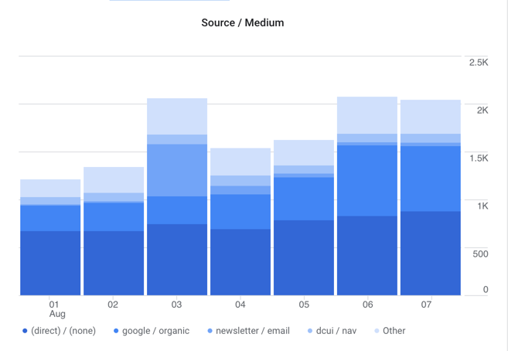
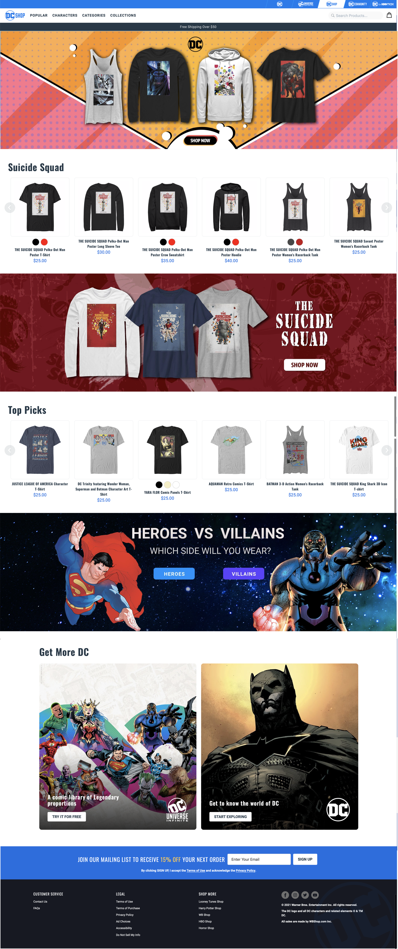
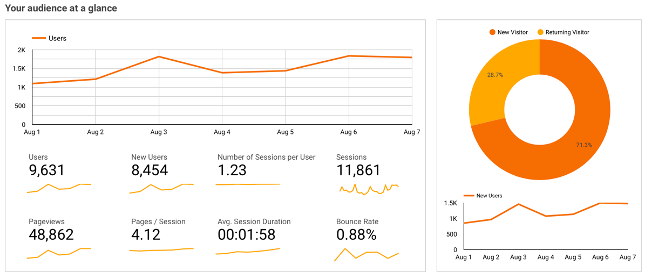
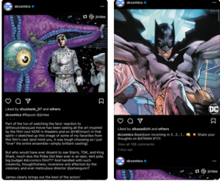
DC SHOP ANALYSIS REPORT
SUMMARY-TO-DATE 2021 JANUARY 19-AUGUST 07
WEEKLY 2021 AUGUST 01-07
Top Acquisition Sources/Conversion this week
#1 – Direct 45% / 0.72%
#2 – Google/Organic 25% / 1.4%
#3 – Shop newsletter 6%/1.69%
#4 – DCUI Nav 6% / 1.4%
#4 – dcuniverseinfinite.com/ref 5% / 0%
#5 – WarnerBros/shop 2% / 0.43%
#6 – dccomics /web 2%/ 2%
#7 - madmagazine.com/ref 1.64% / 0%
#8 – dccomics/web – 2% / 1.14%
#9 – bing/organic – 1% / 2.7%
#10 – IG referral - 1% / 3.17%
Top Searches by pageviews this week
#1 – Batman 15%
#2 – Funko 9%
#3 – Suicide Squad 7%
#4 – Superman 5%
#5 – Harley Quinn 4%
#6 – Wonder Woman 4%
#7 – Justice League 3%
#8 – Steppenwolf 3%
#9 – King Shark 2%
#10 – Rick Flag 2%
Top Unique Pageviews/$Value this week
#1 – Landing Page 40% / 32%
#2 – Products 8% / 101%
#3 – Suicide Squad Collection 4% / 118%
#4 – Characters 4% / 109%
#5 – Villains Collection 3% / 55%
#6 – Products sort by Newest 3% / 83%
#7 – Heroes Collection 3%/ 54%
#8 – Batman Characters 2% / 72%
#9 – checkout 1% / 1,118%
#10 – Shirts Collection 1%/ 232%
User Traffic 507,732
29th week 9,631 +18%
28th week 8,183
Unique Pageviews 2,526,710
29th week 39,620 +30%
28th week 30,429
Total Sessions 811,594
29th week 11,861 +19%
28th week 9,968
Bounce Rate 4.20%
29th week 0.88% +20%
28th week 1.09%
INSIGHTS:
User traffic this week again driven mostly from referrals and Suicide Squad promotions.
Shop Newsletter is #3 this week with 1.69% conversion.
Bing/organic is new at #9 with 2.7% conversion.
IG referral also at 3.17% conversion, largest this week.
Summary: The release of Suicide Squad along with its week-long campaigns has helped increase traffic and overall activity on shop.

