Slide 1

DC Shop Roadmap
JULY-DECEMBER 2021
JULY 7, 2021

Slide 2
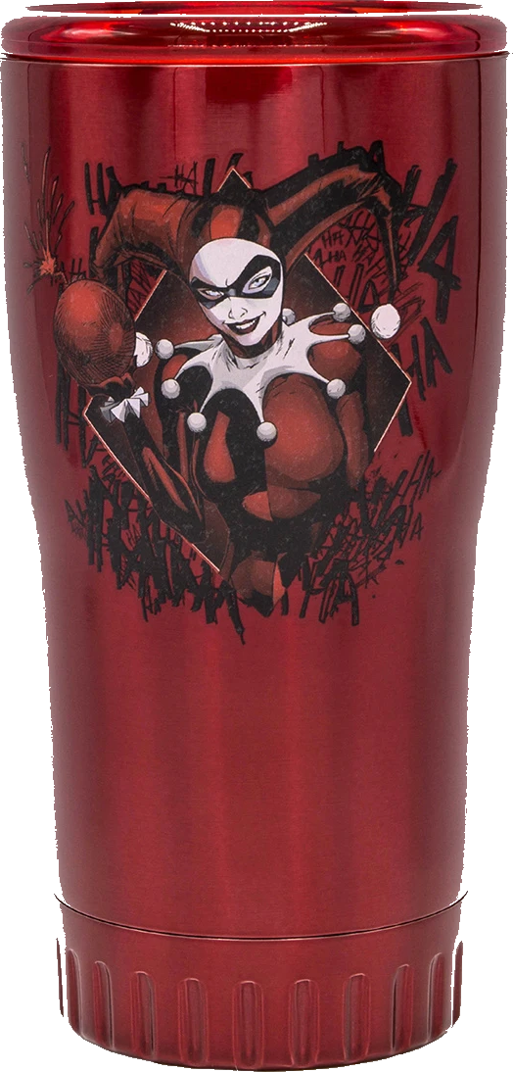


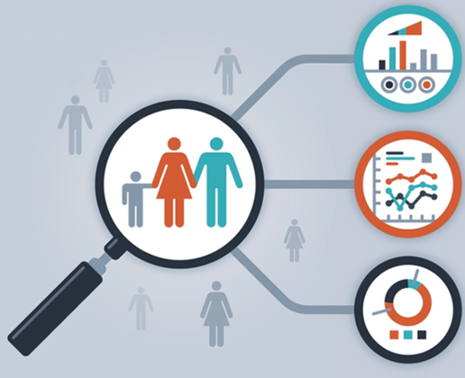



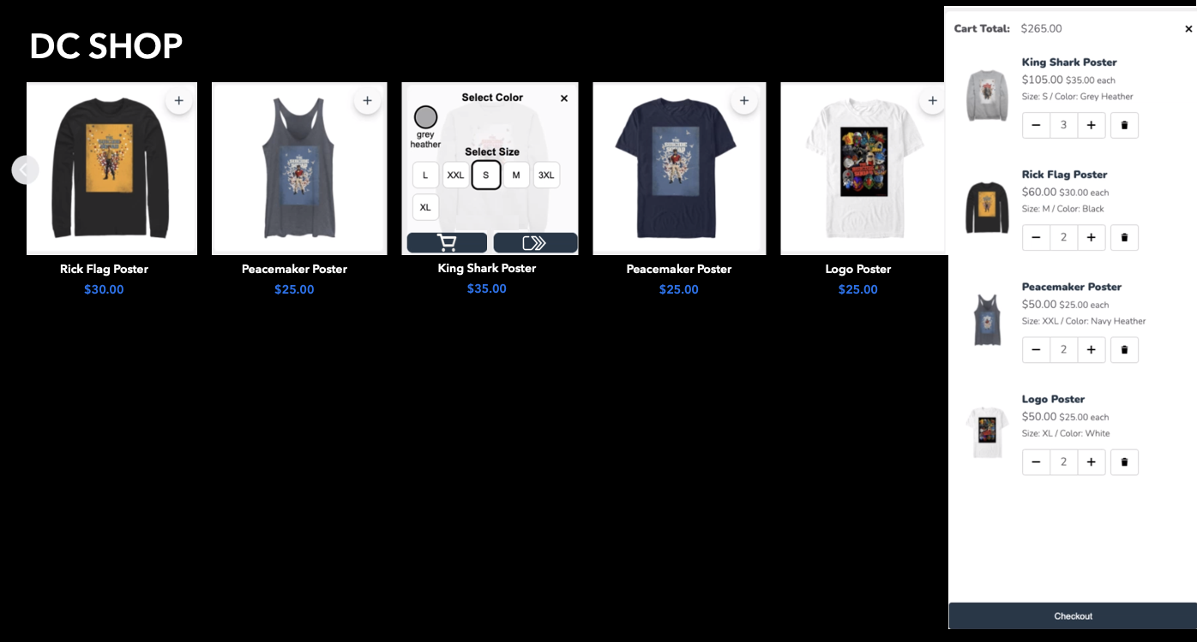
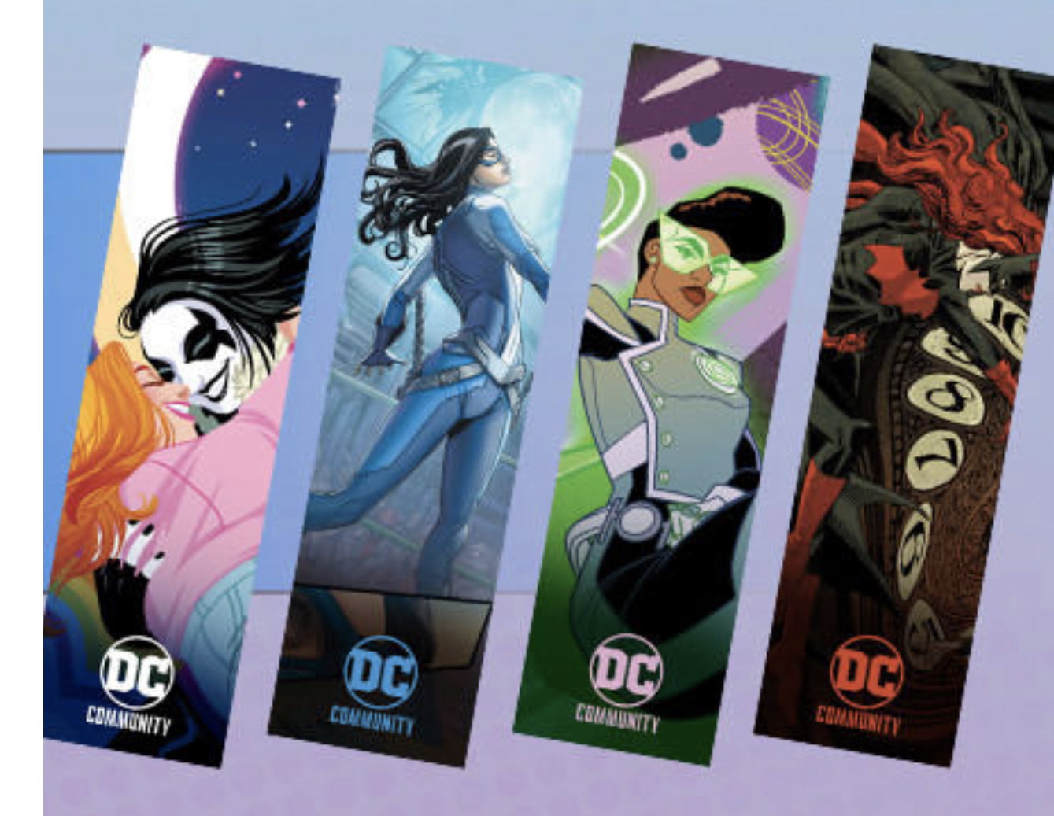


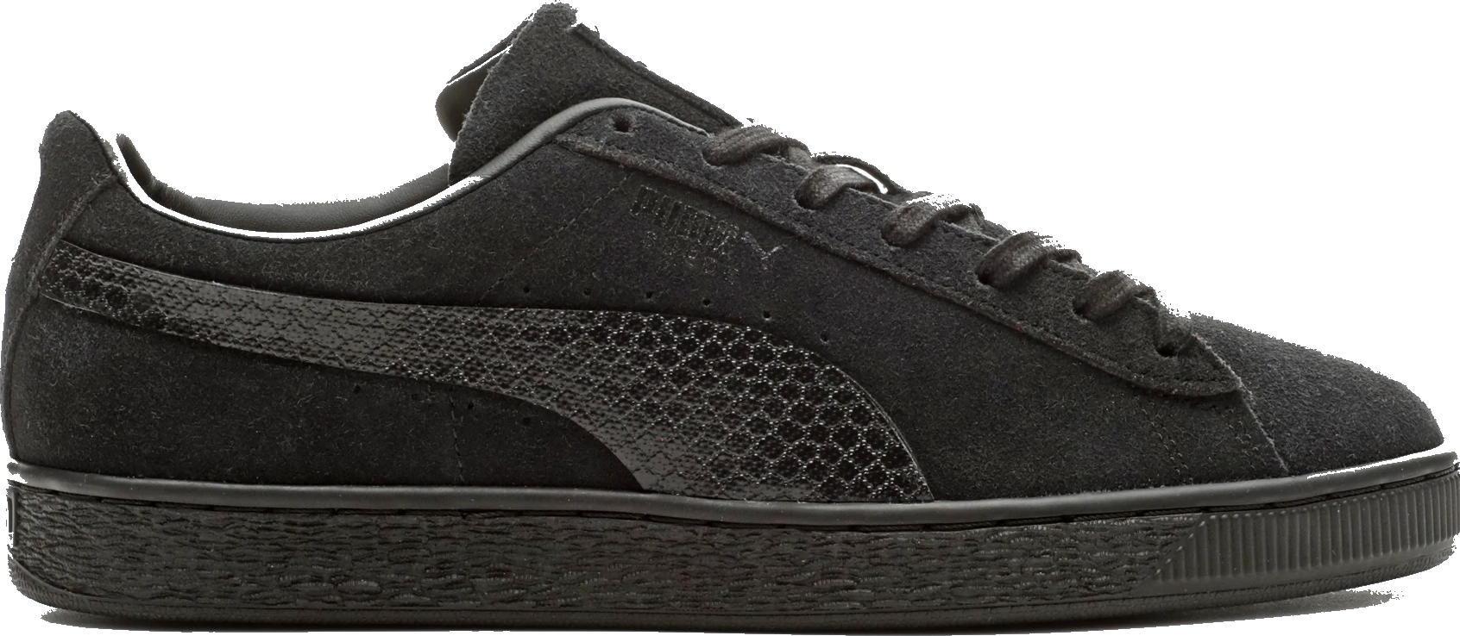



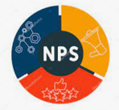



DC SHOP ROADMAP 2021
i18n
Batman the world
Suicide Squad
Tumblers, Puma
Ratings & Reviews
Product reviews, peer Q&A, Sharing,
NPS Survey
Merch Ideas: DC Book Club wallpaper to decals
Collectibles, Funko Pop, Decal on snowboards, skateboards, game console
DC Single Identity
One sign up/sign in experience across DC platforms,
cross-platform analytics
Embeddable DC Shop component
DC market penetration strategy by way of Shop
JUN
JUL
AUG
SEP
OCT
NOV
DEC
Suicide Squad Release Aug. 6
Road-to-FanDome
End-Aug thru Oct. 16
DC FanDome
Event Oct. 16
Tech:
Vendor Integration Optimization
Embeddable carousel component
Sweepstakes
Merch & Legal:
Contracts:
Tervis - tumblers
McFarlane – collectibles
Funko and 3G – Funko & Warehouse
Disrupt Sports – Specialty items
Lunar – specialty books
Tech:
Vendor Integration
Product Bundling
Localization
Globalize:
- CMS
- PIM
- Ordering System
- Discounts
- Payments
- Shipping
- Discounts
- Invoicing
- Order Notifications
- Billing
- USD conversion
Tech:
Unified Identity
- Account Management
- Guest conversion
Personalization:
- Demographics
- Location
- Social info
Faceted Search
Fuzzy Search
Tech:
Customer Cross-Platform data analytics
Hyper-personalization:
- CRM
- Abandon Cart
- Recommendations
- Attachments (upsell)
- CXM – Support
- Wish List/Save Later
- Reviews
- Q&A
- CS reviews response
Tech:
Prep for Batman Release Jan 2022
Hyper-personalization analytics
Predictive modeling analytics
Merch:
NPS Survey
Prep for Batman Release Jan 2022
Subject to change

Slide 3




ECOMM ROADMAP 2021
i18n
Ratings & Reviews
Product reviews, peer Q&A, Sharing,
NPS Survey
User and Nav enhancements
Registration, Account management, user segmentation, faceted search
DC Single Identity
One sign up/sign in experience across DC platforms,
Cross-platform analytics
Embeddable DC Shop component
DC market penetration strategy by way of Shop
JUN
JUL
AUG
SEP
OCT
NOV
DEC
Tech:
Vendor Integration Optimization
Embeddable carousel component
Sweepstakes
Merch & Legal:
Contracts:
Tervis - tumblers
McFarlane – collectibles
Funko and 3G – Funko & Warehouse
Disrupt Sports – Specialty items
Lunar – specialty books
Tech:
Vendor Integration
Product Bundling
Localization
Globalize:
- CMS
- PIM
- Ordering System
- Discounts
- Payments
- Shipping
- Discounts
- Invoicing
- Order Notifications
- Billing
- USD conversion
Tech:
Unified Identity
- Account Management
- Guest conversion
Personalization:
- Demographics
- Location
- Social info
Faceted Search
Fuzzy Search
Tech:
Customer Cross-Platform data analytics
Hyper-personalization:
- CRM
- Abandon Cart
- Recommendations
- Attachments (upsell)
- CXM – Support
- Wish List/Save Later
- Reviews
- Q&A
- CS reviews response
Tech:
Prep for Batman Release Jan 2022
Hyper-personalization analytics
Predictive modeling analytics
Merch:
NPS Survey
Prep for Merch moments 2022
Subject to change

Slide 4
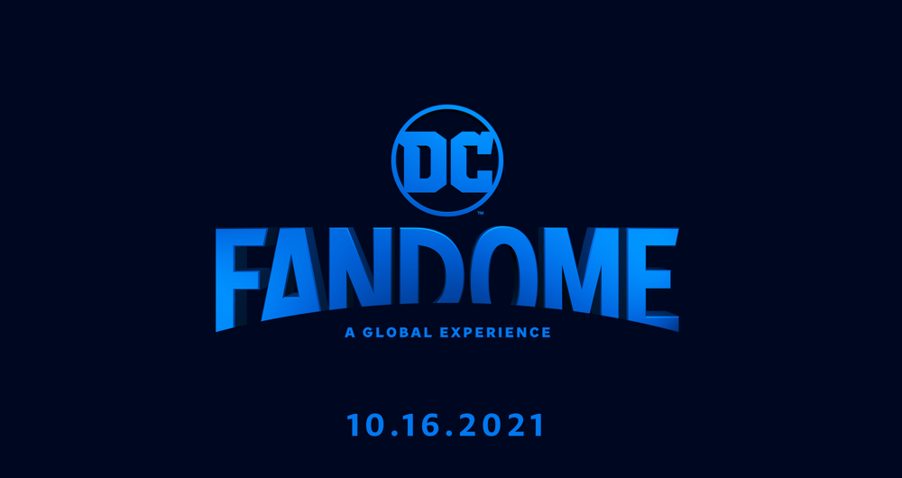
Road-to-fandome

Slide 5
Why Road-to-FanDome?
“Data is the new oil” - Jack Ma, Founder of Alibaba
Our Road-to-FanDome is explicitly a way to let our fans know about our DC FanDome event. More than that, our execution on Road-to-FanDome will be a hotbed of data to better understand and to provide to our fans, as they navigate their way through an aggregated experience of our DC platforms and more.

Slide 6
IMMEDIATE GOALS
KPIs:
Increase DCUI Subscriber count by ‘n’%
Increase DCUI ARPU (paid subscribers) by ‘n’%
Increase AOV on DC Shop by ’n’%
Meet quarterly target sales for DC Shop
ACTION: Provide value proposition to the fans. What do they get by subscribing that they can’t get anywhere else and is worth their $ and time?
EXAMPLE IDEAS:
For registered users:
Exclusive access to first-look content
Exclusive access to DC Shop merch not sold anywhere else
Exclusive access to site functions (i.e., a Fan ’collage’ Page where registered users can upload UGC, etc.)
Exclusive access to certain influencers, talent, etc.

Slide 7
LONGTERM GOALS
KPIs:
Increase CLV
  Increase engagement (traffic + session)
  Increase purchase frequency
  Increase gross margins
  Reduce churn rate
ACTION: Provide a curated experience for the fans where events and offerings they receive are of what they value the most on DC.
EXAMPLES:
Based on data analysis of our customer behavior and journey throughout FanDome
Provide bundled digital + physical offerings based on fan’s most visited/searched/purchased/read character (i.e., access Harley Quinn exclusive comics release and Harley Quinn tee for $45).
Provide different purchasing offerings (i.e., subscribe and save 10% off your monthly purchase from DC Shop)

Slide 8
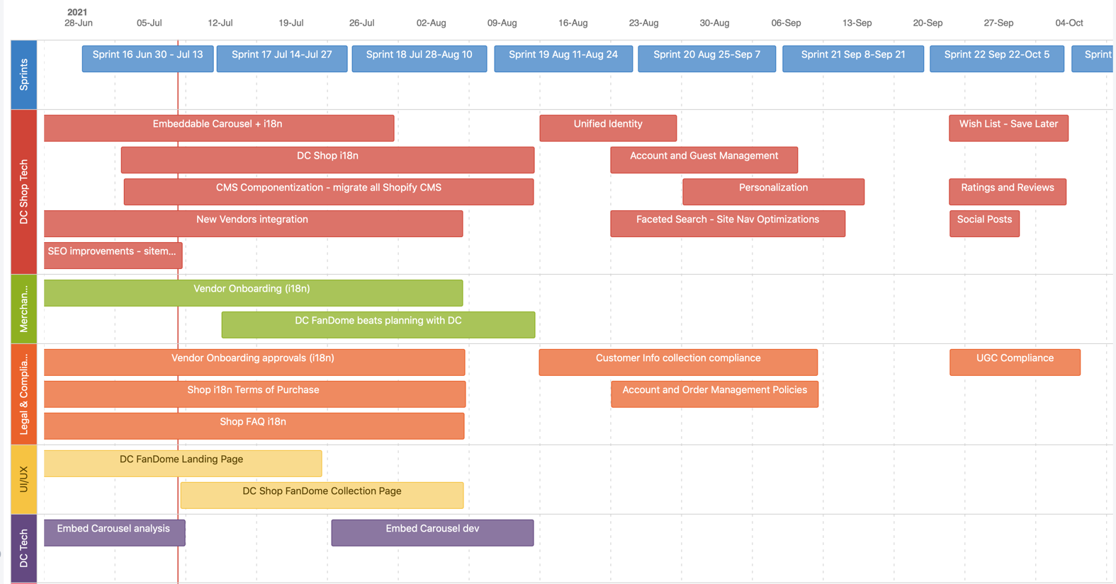
DC SHOP FANDOME SPRINTS BY WORKSTREAM

Slide 9
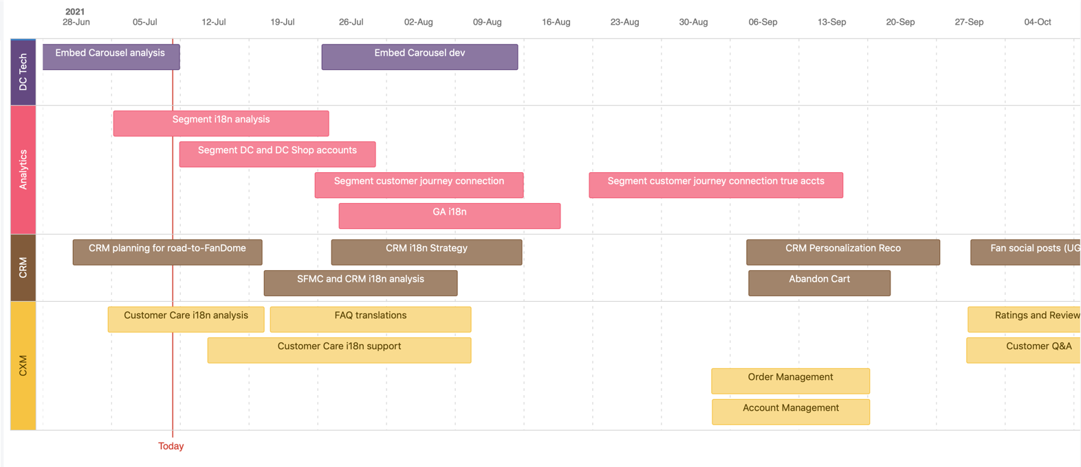
DC SHOP FANDOME SPRINTS BY WORKSTREAM

Slide 10
DC FANDOME DC SHOP STRATEGY ROADMAP AUG-OCT 2021
JUL
AUG
SEP
OCT
NOV
MOMENTS/BEATS |  | Suicide Squad Aug. 6 |  | DC FanDome even Oct. 16
STRATEGY
PRODUCT DEVELOPMENT
SALES & MERCHANDISING
MARKETING & PUBLICITY
DATA ANALYTICS
CRM
What’s the storyline from Aug through Oct and how can each workstream below support the story?
i18n
Embed DC FanDome video on DC Shop?
Embed shop carousel on DC FanDome landing page
Unified identity
registration
DRAFT
Cross-platform data analytics
Personalized CRM

Slide 11

Dc shop

Slide 12
Market Penetration & Development
Embeddable DC Shop component – this game-changing shop component is embeddable in just about any site, which can be used to penetrate existing or develop new markets. It can serve as a gateway to subscription conversion by way of Global Navigation. See next slide for more details (developed by Sr. Full Stack Engineer, Michael Pourshalimi). Rob/Imran to demo.
Internationalization (i18n) – opening our shop to international markets to increase our reach and connect with fans outside of US.

Slide 13


DC Shop Embeddable Carousel
Key Features:
Uses open-source and most preferred code, allowing it to be embeddable on most sites today.
Entire purchase flow can be done directly on the embedded site, allowing for a smooth transaction conversion.
Mini cart can be turned off to prevent overlay of a site’s design (i.e., DC FanDome art banner, video, etc.). Instead, a smaller bag icon can be used to checkout.
Stylesheet (i.e., background theme, font, etc.) can be modified to match site in which it is embedded.
Event and Site Ideas:
DC Shop standalone carousel is embeddable on just about any site today as it uses the latest open-source code. It can be used to penetrate a desired market and combined with DC Global Nav, can serve as a gateway for customer conversion on DC platforms and HBO Max.
Comic-Con
X-Games
Fit-Con
July 23-25, 2021
Jan 2022
Jan 2022
Fortnite World Cup
Q2 2022

Slide 14
Product Development and Diversification
Vendor Onboarding Optimization – optimize our vendor integration to allow for quicker onboarding and selling of a variety of product lines on our site (developed by Sr. Staff Engineer, Anshul Kumar).
Specialty Products (Disrupt Sports) – Disrupt Sports is one of our onboarding partners that specializes in sports products, gaming, and fitness. Having this option will allow us to determine whether to diversify or not diversify in both products and market. See next slide for ideas.
Amazon warrior Penthiselea in WW and ZSJL is crossfittter Brooke Ence
ZSJL Zeus is Spanish bodybuilder Sergi Constance
Fitness market?
Superman knee sleeves
Batman lifting belt
Crossfit market?
WW Lasso Jump rope
WW wrist wraps

Slide 15
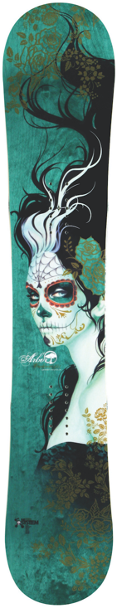
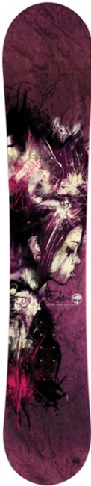
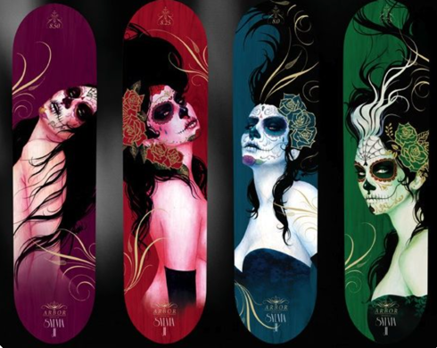
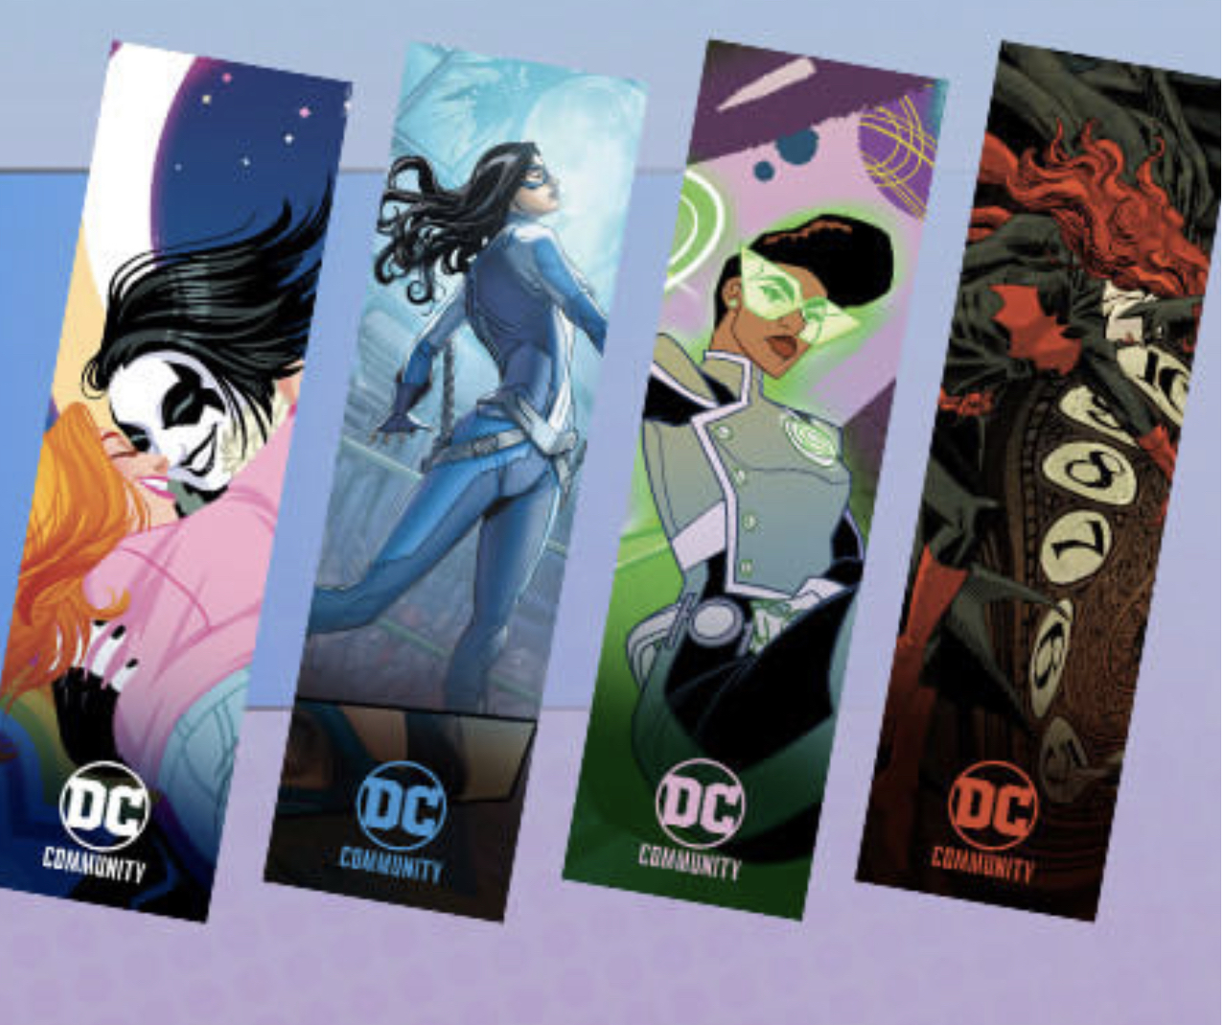
Diversification - Merch Ideas
DC Book Club Wallpaper
Arbor Snowboards for concept only
Arbor Skateboards
For concept only
DC Book Club Wallpaper Download + Decal & Disrupt Sports
Disrupt Sports Vendor – customizable skateboards, snowboards, surfboards using decals.
Use downloadable DC Book Club Wallpaper to convert into Decal with Disrupt Sports
September through November - snow gear sales peak season
New target market – snowboarders, outdoor adventurers

Slide 16
Personalization to Hyper-Personalization
Single-Sign-On (SSO)– Provide the ability for our fans to sign up or sign in on DC and have access to all DC Platforms, including DC Shop (Engineers: Eric Chazan, Chris Porch, Aaron Tidwell, Harshil Shah, Phil Walton)
  Shop Account Management – with SSO, provide a way for customers to track and manage orders, view purchase history, and manage payment options.
  Guest to Customer checkout – provide a way for customer to choose to create an account after purchase, optimizing customer conversion while retaining ease of guest checkout.
Customer Data Mining Cross-Platforms – with SSO, enhance customer data mining and integration to cross platforms. For DC Shop, collect customer demographics, location, social, and purchase behavior (Data Lead: Nikhil Bhat)

Slide 17
CRM and CXM
CRM – with SSO, features available:
Abandon cart tracking, personalized product recommendations and attachments (upsell)
CXM – with SSO, features available:
Wish List and/or Save Later, product reviews, product sharing, Q&A, customer service response chat.
NPS Survey – send NPS survey to our customers to further understand their needs and improve the shop and DC platforms experience from feedback.

