Slide 1


Slide 2
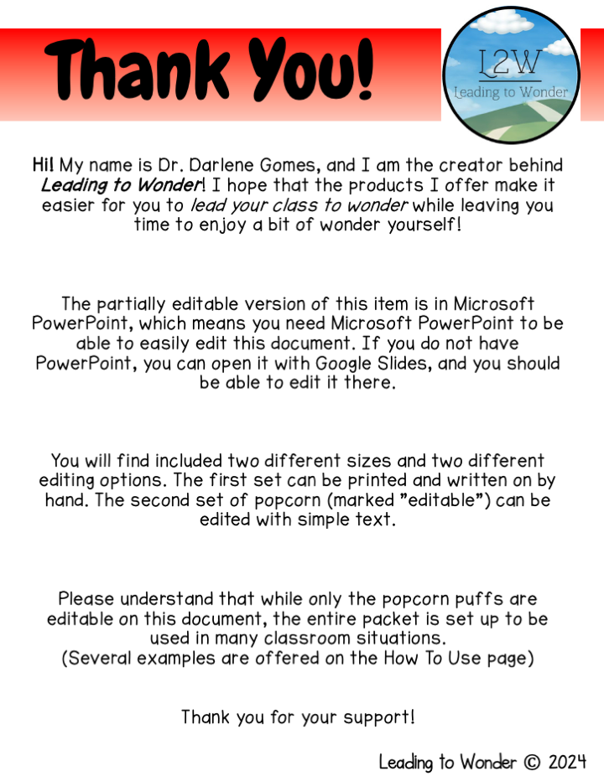

Slide 3


Slide 4


Slide 5







Connect with Me!
I would love to have you join me in
Leading to Wonder©!
Sign up for the Leading to Wonder newsletter
Visit the Leading to Wonder website
Email Dr. Darlene Gomes
Visit Leading to Wonder on Instagram
Visit Leading to Wonder on Facebook

Slide 6


Slide 7


Slide 8


Slide 9


Slide 10

Click
to
Edit
Click
to
Edit
Click
to
Edit
Click
to
Edit
Click
to
Edit
Click
to
Edit
Click
to
Edit
Click
to
Edit

Slide 11


Slide 12
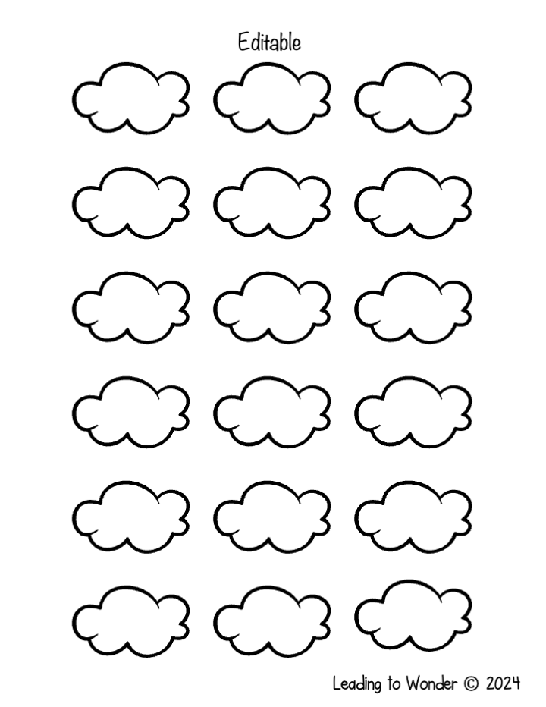
Text
Text
Text
Text
Text
Text
Text
Text
Text
Text
Text
Text
Text
Text
Text
Text
Text
Text

Slide 13


