Slide 1
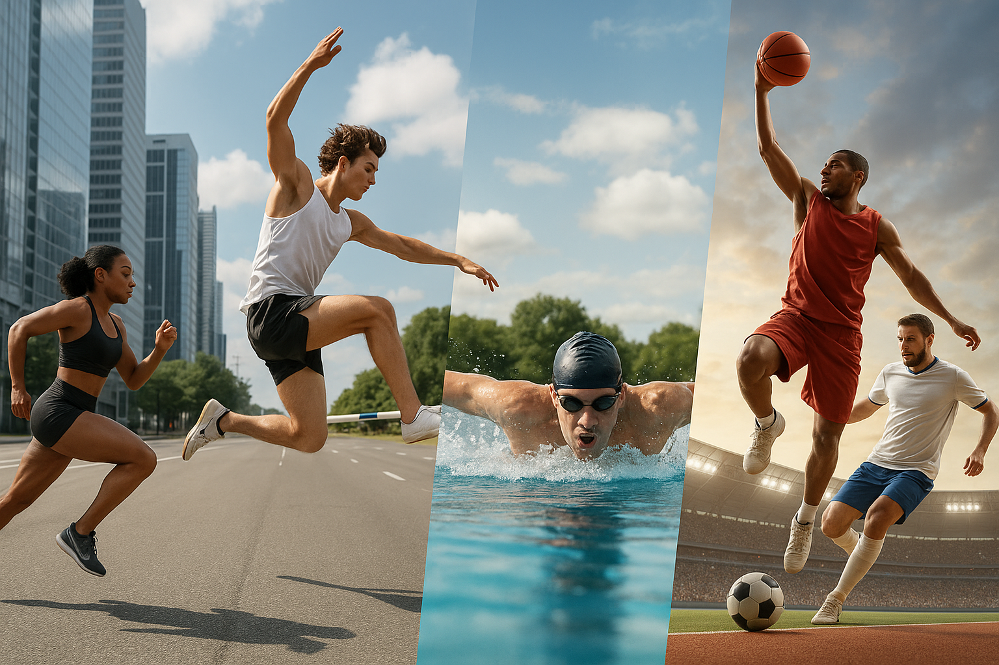
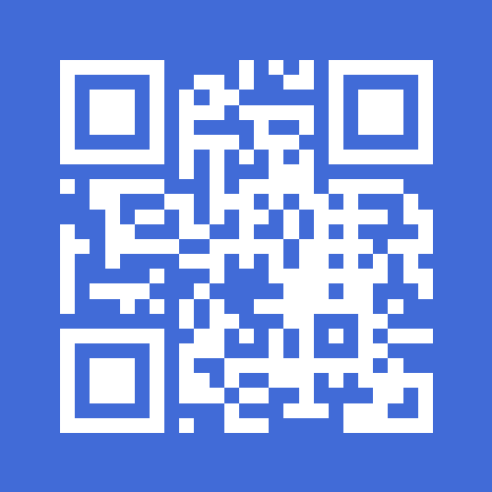

Turn Passion into Recognition

Slide 2
Pre-MVP Stage Pilot Launch Planned: Q2 2026
Presented by: Daniel Neves Zanon Founder & CEO
Contact: daniel.neves.zanon@nextsporter.lu www.nextsporter.lu

Slide 3
NextSporter is an upcoming global digital platform designed to connect athletes of all levels with clubs, agents, scouts, fans, and sports institutions.
Currently in the research and validation phase, the platform is set to launch its first pilot in Q2 2026.
Our mission is to bridge the gap between talent and opportunity by building an inclusive, data-powered ecosystem where athletes can:
Create performance-based profiles
Share videos and stats
Be discovered by clubs and agents
Access real career opportunities
At the same time, organizations can:
Discover and track talent
Manage athlete groups
Gain data-driven insights
NextSporter is not just a platform — it's a movement to transform how sports talent is seen, supported, and elevated.

Slide 4
While the sports world is more digitally connected than ever, millions of talented athletes remain invisible to those who could help advance their careers.
Key challenges include:
Lack of access to professional networks for amateur and emerging athletes
Fragmented digital presence (social media ≠ credibility)
Clubs and agents struggle to find verified, data-backed talent
No centralized, multi-sport platform to manage athlete visibility and growth
Result: Potential is lost, careers are delayed or never started, and opportunities go unnoticed — especially in underrepresented regions and disciplines.

Slide 5
NextSporter is the first global platform built to unify the sports ecosystem — from amateur athletes to professional organizations — with a structured, data-integrated environment.
What we offer:
Performance-based athlete profiles with stats and video uploads
Smart integration with external performance tracking tools
AI-enhanced video analysis to support athlete credibility
Direct, verified connections between athletes and clubs, agents, or federations
Tools for career discovery, talent scouting, and group management
Our key differentiator: We don’t just promote visibility — we create an entire ecosystem where athletes can grow, be discovered, and connect with real opportunities.
NextSporter empowers futures, not just feeds.

Slide 6
A seamless journey for athletes, clubs, and agents:
Profile Creation Athletes, clubs, agents, and federations build tailored profiles.
Data Collection & Integration Stats are pulled from third-party systems or added manually. Videos are analyzed using AI.
Connection & Discovery Athletes connect with clubs, get scouted, and explore real opportunities.
Team & Talent Management Clubs and agents organize athletes into squads, monitor performance, and manage career growth.
Communication & Engagement Secure messaging and content sharing tools connect the entire sports community.
Everything in one place — smart, credible, and built for impact.

Slide 7
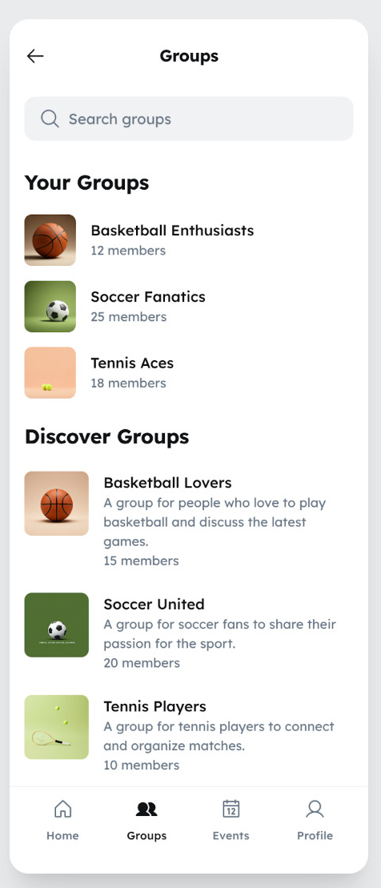
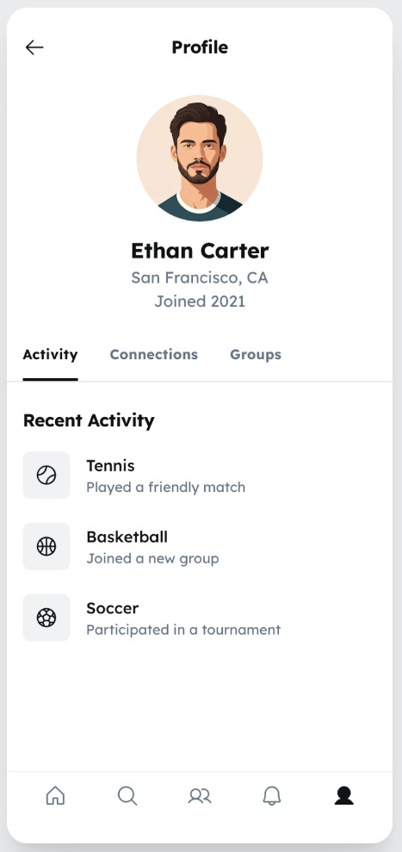
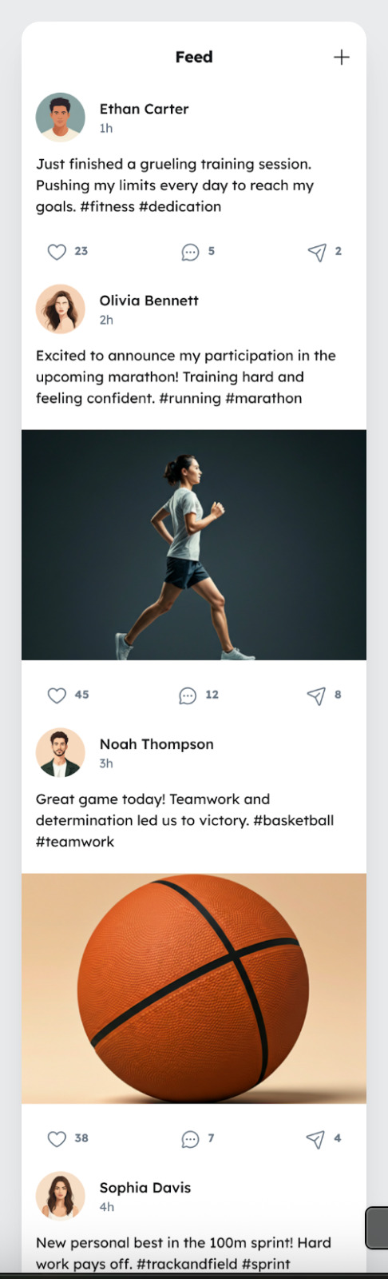
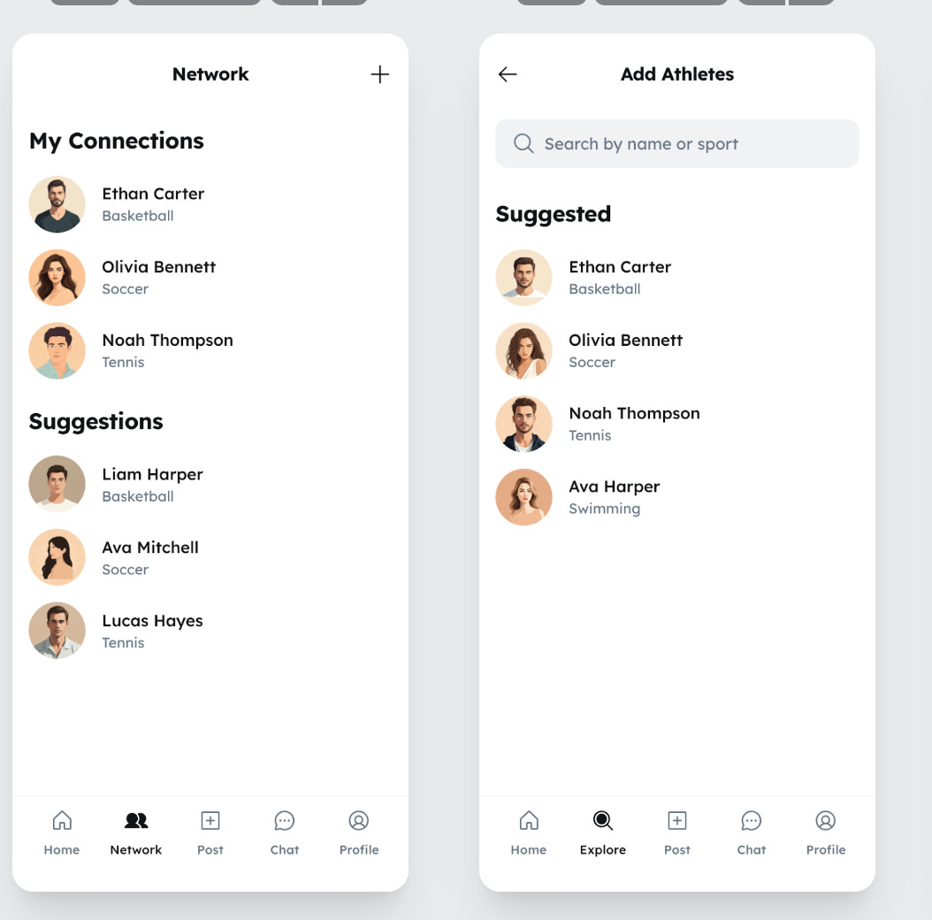
Feed
Share progress, videos & milestones
Network
Build sport-specific connections
Groups
Join sport communities by interest or region
Post
Engage with the community like a PRO
Athlete Profile
Personal info & performance activity

Slide 8
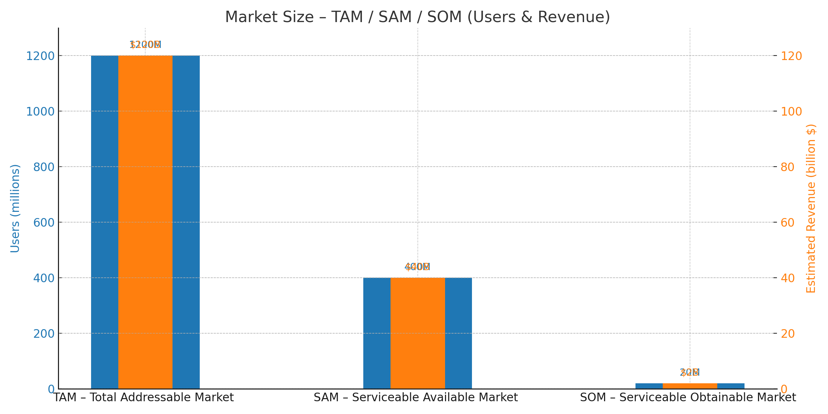
Total Addressable Market (TAM):
1.2 billion athletes globally
Estimated $120 billion opportunity
Serviceable Available Market (SAM):
400 million athletes in high-participation sports
~$40 billion market scope
Serviceable Obtainable Market (SOM):
20 million athletes realistically reachable in first 3–5 years
~$2 billion in potential revenue
Key Insight:
NextSporter targets a massive, underserved global market by focusing on the mid-tier segment — amateur and semi-pro athletes — often left behind by traditional systems.

Slide 9
Why NextSporter is Different
✅ Inclusive, multi-sport support — not limited to one discipline
✅ Integration with external stat-tracking platforms and devices
✅ AI-enhanced video analysis for performance validation
✅ Verified links between athletes and organizations (with athlete consent)
✅ Tools for both individual visibility and organizational squad management
✅ Dual-value platform: for athletes and clubs/agents
✅ Modular, scalable architecture for global rollout
✅ Full data ownership and privacy compliance for users
We go beyond “social” — we build a reliable, structured, and scalable sports ecosystem.

Slide 10
NextSporter monetizes through a hybrid strategy combining freemium access, tiered subscriptions, and B2B services.
Revenue Streams:
Freemium for Athletes Free access for basic profile creation and video uploads.
Subscription Plans $20/month for non-professional athletes $200/month for semi-professionals $2,000/month for professionals $20,000/month for clubs and institutions
Commission-Based Marketplace (Phase 2+) Paid trials, recruitment, and visibility boosting features
Strategic Partnerships Federations, academies, and talent programs (custom dashboards, analytics licensing)
Data & Insights (ethical and anonymized) Trends, performance analysis, and benchmarking tools
Our business model enables scalability while promoting accessibility and global adoption.

Slide 11
2025 – Research & Foundation Phase
Q3: Market research, brand strategy, MVP scope, prototyping
Q4: Landing page, waitlist, partner outreach, advisor onboarding
2026 – Build, Test & Pilot Launch
Q1: MVP development, alpha testing, feedback cycles
Q2: Public pilot launch (Brazil, Portugal, France), early user growth, first campaigns
2026 – Growth & Platform Expansion
Q3: Enhance AI video analysis, integrate stat platforms, add dashboards
Q4: Expand to more sports/regions, begin monetization, launch content/community layer
Tracking Tools
Agile sprints, OKRs, milestone reviews, early user feedback loops
Vision 2027+
Multi-sport global presence
Full-featured athlete marketplace
Sponsorship & endorsement engine
Integration with wearables and federated systems

Slide 12
We’re seeking partners, investors, and collaborators who believe in the future of athlete empowerment.
Current Needs:
💰 Pre-Seed / Seed Investment
Funding MVP development, early marketing, team expansion
Target raise: $150K–$250K (pre-seed)
🤝 Strategic Partnerships
Clubs, agents, federations, and academies
Universities, incubators, and innovation hubs
🧠 Technical & Operational Support
Developers (mobile/web), AI analysts, infrastructure experts
Integration with performance tracking tools
🌍 Regional Ambassadors & Pilot Testers
Athletes and organizations willing to co-create and test the platform
Let’s build the future of sports visibility — together.

Slide 13
Turn Passion into Recognition
Let’s create the world’s most inclusive sports platform — together.
Thank you for your time and belief in the future of athletes worldwide.

