Slide 1
SGA Budget Update: January 2026
Prepared By: Christian Dunn, Student Body Treasurer

Slide 2
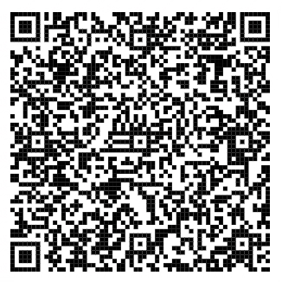
Scan the QR code to explore our full budget, spending, and ledgers.

Slide 3
Categories | Subcategories | Totals Spent 1/13/26 | Amount Allocated | Amount Remaining
Stipends |  | $4,535.03 | $10,000.00 | $(5,464.97)
Committee Budgeting |  | $127.60 | 2000 | $(1,872.40)
Advertising |  | $147.30 | $1,000.00 | $(852.70)
Cabinet Member Trainings |  | $177.15 | $2,000.00 | $(1,822.85)
Elections |  | $- | $50.00 | $(50.00)
Membership | Name Tags, Misc. | $288.00 | $600.00 | $(312.00)
Executive Programming | 105th Anniversary, Cap and Gown Rentals, Retreat, Conferences | $880.69 | $4,200.00 | $(3,319.31)
SGA Events | SGA Events, Inauguration, Meeting Rooms | $386.67 | $4,600.00 | $(4,213.33)
Office | Misc./Supplies | $624.96 | $1,200.00 | $(575.04)
Emergency Funds |  | $- | $2,350.00 | $(2,350.00)
Uncategorized |  | $2,348.69 |  | $2,348.69
Total |  | $9,516.09 | $28,000.00 | $(18,483.91)
 | $28,000.00
Remaining | $(18,483.91)

Slide 4
SBAC Ledger
Conferences
Current Amount: $31,508.07
Amount Given: $10,491.93
Projects
Current Amount: $41,502.06
Amount Given: $497.94
(please apply for SBAC!!!)

Slide 5
SBAC 101: An Orientation
January 27th from 1-2:30
February 4th from 5-6
Both orientations will be held in the UC Auditorium.
Anyone can attend.
Open Q&A at the end!

Slide 6
Any Questions?
Contact SBAC@cmich.edu for SBAC related questions
Contact DUNN@CR@cmich.edu for SGA Budget related questions.

