Slide 1
SGA Budget Update: February 2026
Prepared By: Christian Dunn, Student Body Treasurer

Slide 2
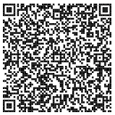
Scan the QR code to explore our full budget, spending, and ledgers.

Slide 3
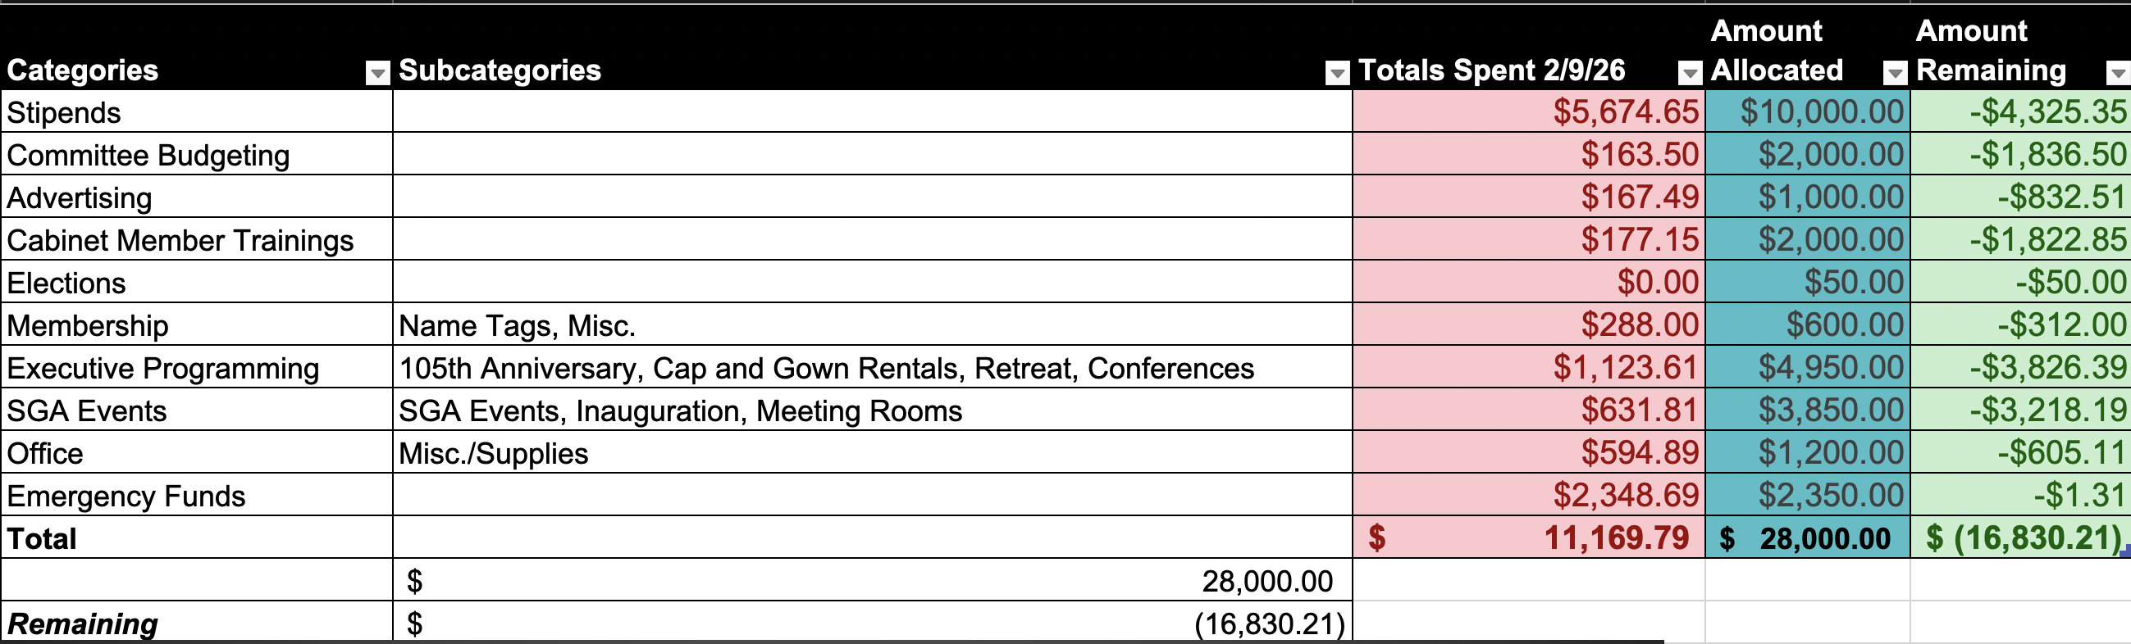
We spent about $1,653.70 in January

Slide 4
SBAC Ledger
Conferences
Current Amount: $ 8,661.66
RSO Conferences Funded: $33,338.34
Projects
Current Amount: $39,372.03
RSO Projects Funded: $2,627.97
(please apply for SBAC!!!)
(please apply for SBAC!!!)

Slide 5
SBAC 101: An Orientation
At the RHA Dream Conference!!!!
Anyone can attend.
Open Q&A at the end!

Slide 6
Any Questions?
Contact SBAC@cmich.edu for SBAC related questions
Contact DUNN@CR@cmich.edu for SGA Budget related questions.

