Slide 1
MISSION ZERO Returning to the Core Mission
A Ministry Turning Point Approach

Slide 2
INTEGRATION AND ASSESSMENT
Understanding your WHY
Why do you exist
What made you start this ministry
Why do you get up every morning
Understanding and remembering your why gives you the motivation to get up and fight tomorrow’s battle AND it becomes the reason why others invest and engage with your ministry
Where have you been
What has God accomplished through your ministry
What is your roadmap
How do others see your ministry and effectiveness - honest assessment

Slide 3
INTEGRATION AND ASSESSMENT
Where are you today
What is the state of your organization?
Is it true?
What do the staff and those you serve say?
Do you have a social media presence? What does it say?
What have you tried?
What has worked
What hasn’t worked
Where do you feel the most lost and in need of the most care and support?
Not just finance and accounting - in the ministry, personal matters?

Slide 4
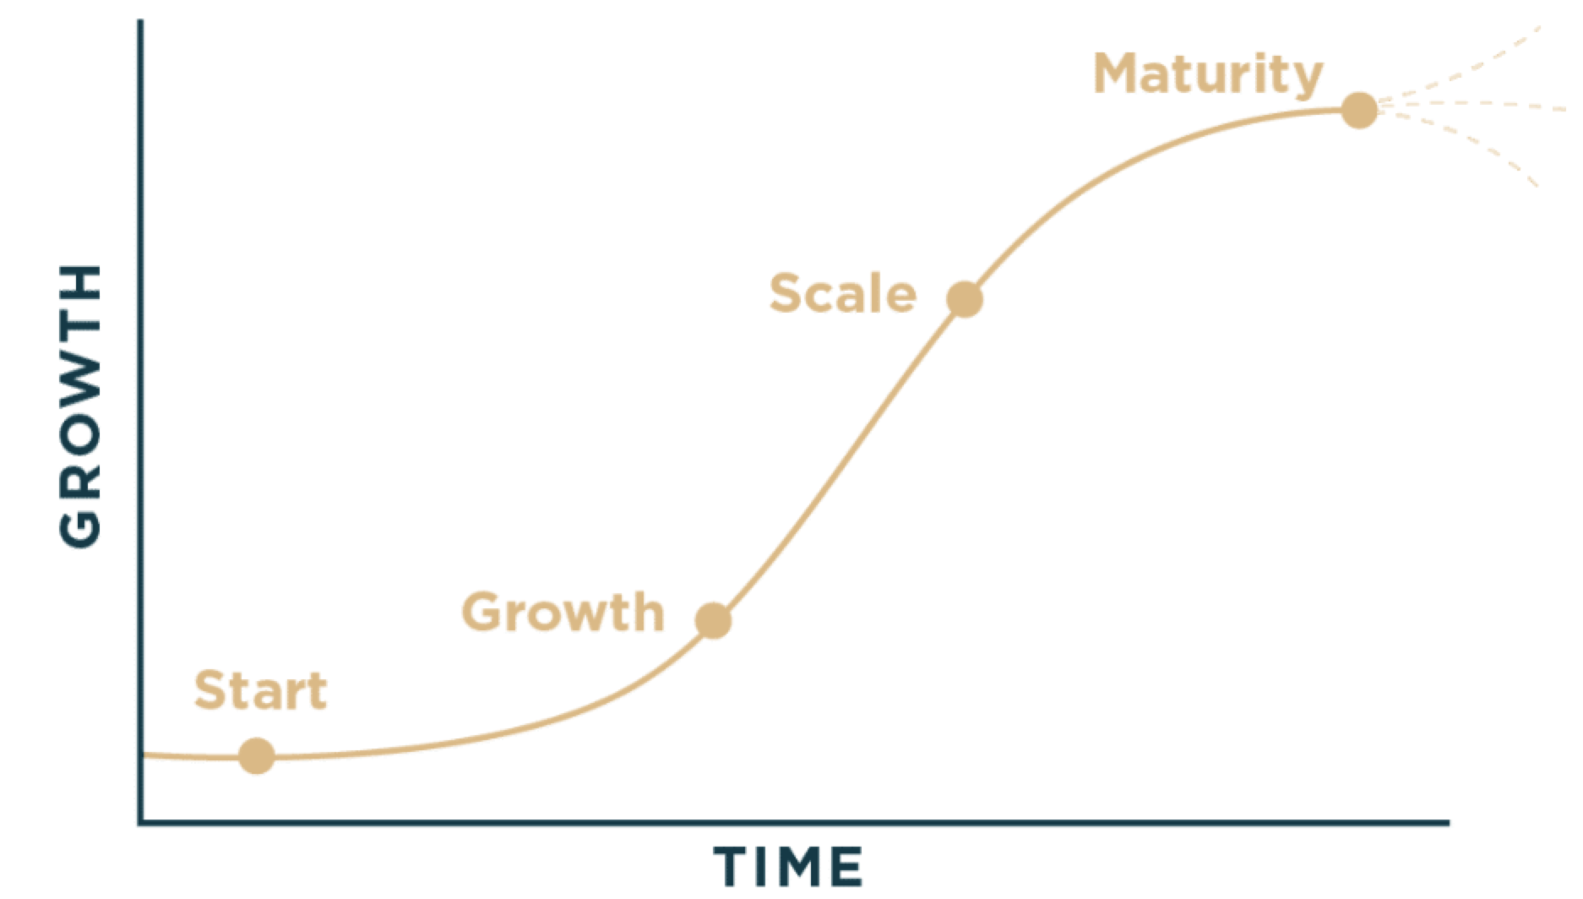
WHERE ARE YOU TODAY?

Slide 5
Early Growth (bottom of the S): The organization is building momentum. Reinvention here isn’t usually needed yet—focus is on proving the model and scaling impact. Middle Growth (steep upward climb): Energy and growth are strong, but systems often lag behind. Small reinventions here (process improvements, structure, donor systems) help sustain the climb. Maturity / Plateau (top of the S): This is the critical moment. Growth slows, enthusiasm wanes, and what once worked begins to stagnate. This is the best time to reinvent—before decline sets in. 👉 An organization should begin to reinvent itself at the top of the S-curve, while still strong but approaching plateau. If reinvention is delayed until decline, the changes become reactive, painful, and often too late. Reinventing early ensures the ministry launches onto the next growth curve while resources, trust, and energy are still intact.
WHERE ARE YOU TODAY ON THE S-CURVE?

Slide 6
THE ROAD AHEAD
Reality
• Honest assessment of current cash flow, debts, and obligations
• Transparent communication with board, staff, and key stakeholders
Stabilize the Situation
• Cut unnecessary expenses without cutting core mission
• Prioritize payroll, essential programs, and critical obligations
• Negotiate with vendors and lenders
Rebuild Trust
• Strengthen accountability and internal controls
• Provide clear, regular financial reporting
• Share a hopeful but realistic turnaround plan with donors
Reignite the Mission
• Recast vision: why this ministry matters now
• Engage donors with stories of impact, not just needs
• Align budget with mission priorities
Chart the Path Forward
• Create a 1-year sustainability plan
• Explore partnerships, new revenue streams, and grants
• Build reserves for long-term resilience
Transparency
30 - 60 Days
3 Months
6 Months
1 - 2 Years
THE FOUNDATION: YOUR WHY

Slide 7
SHARING THE LOAD
Reality
REMEMBERING YOUR WHY
MISSION FORWARD | MINISTRY LEADER
Create a clear analysis of financial pitfalls with story telling, trend, budget review | Inform the story
 | Communicate with key individuals the state of the organization
• Honest assessment of current cash flow, debts, and obligations
• Transparent communication with board, staff, and key stakeholders

Slide 8
SHARING THE LOAD
Stabilize the Situation
REMEMBERING YOUR WHY
MISSION FORWARD | MINISTRY LEADER
Analyze vendors and expenses and suggest changes | Decide and Implement changes
 | Identify key operations and obligations
Explore possible debt solutions | Explore and implement possible debt solutions
• Cut unnecessary expenses without cutting core mission
• Prioritize payroll, essential programs, and critical obligations
• Debt consolidation or other options

Slide 9
SHARING THE LOAD
Stabilize the Situation
REMEMBERING YOUR WHY
Why Stabilizing the Situation Matters Most
When a ministry is underwater, it can be tempting to jump straight into new fundraising or bold vision casting. But without first stabilizing the financial foundation, those efforts collapse under unresolved crises.
Stabilization is about survival with integrity. It ensures payroll is met, essential programs continue, and obligations are honored. These steps may not be glamorous, but they protect the ministry’s credibility and reassure both staff and donors that leadership is facing reality with courage and responsibility.
Stabilization also restores confidence and buys time. Cutting unnecessary expenses, negotiating with creditors, and prioritizing essentials demonstrates wise stewardship. Donors are far more likely to invest in a vision once they see the ministry is steady enough to carry it forward.
Finally, stabilization creates the platform for renewal. Once the bleeding stops and trust is rebuilt, the ministry can pivot from crisis management to mission momentum. In short: before growth can happen, stability must come first.

Slide 10
SHARING THE LOAD
Stabilize the Situation
REMEMBERING YOUR WHY
Why Stabilization Is Painful but Necessary Stabilizing the situation is often the hardest step because it requires tough choices—cutting non-essential expenses, pausing beloved programs, and confronting financial realities that can feel discouraging. It disrupts routines and can create tension among staff and stakeholders. Yet this painful process is what allows the ministry to regain footing. By facing the hardest truths first, the ministry earns credibility and clears the way for genuine renewal.
TOOLS:
RIO CHART
PRIORITIZATION MATRIX
ZERO BASED BUDGET

Slide 11
SHARING THE LOAD
REMEMBERING YOUR WHY
Rebuild Trust
MISSION FORWARD | MINISTRY LEADER
Review Internal Controls, Compliance Issues and Suggest Solutions | Decide on appropriate changes and implement
Generate regular financial reports
 | Engage with donors, host fundraising events, invite donors to be a part of the solution “Shared Mission” Anchor Gifts, Momentum Gifts, Create Ownership through Vision, Relational Invitations
• Strengthen accountability and internal controls
• Provide clear, regular financial reporting
• Share a hopeful but realistic turnaround plan with donors

Slide 12
SHARING THE LOAD
REMEMBERING YOUR WHY
Reignite the Mission
MISSION FORWARD | MINISTRY LEADER
Can assist with some recasting. Depending on financial condition, can consider other outside consultants. | Vision refresh, Mission alignment, Strategy development and execution. Team Retreat and Building. Include Board and Elders.
Can assist with developing some storytelling. | Share vision with donors through stories, remember
Budget and cash flow modeling with program and ministry imperatives. | Inform budget decisions and budget approval and execute
• Recast vision: why this ministry matters now
• Engage donors with stories of impact, not just needs
• Align budget with mission priorities

Slide 13
SHARING THE LOAD
REMEMBERING YOUR WHY
Rebuilding Trust and Reigniting the Mission
After the painful work of stabilization, the journey enters its most hopeful stage—rebuilding trust and reigniting the mission. This is where ministries experience fresh vision, renewed energy, and donor encouragement. It’s the stage that shifts the story from crisis to opportunity.
Rebuilding trust means showing consistency, accountability, and transparency. Donors and staff see that the organization has not only survived but is stewarding well. From that trust grows the freedom to reignite the mission—to dream again, to refresh programs, and to communicate impact in a way that excites donors.
This part of the turnaround journey is often the most life-giving, because it involves hope, creativity, and seeing God’s faithfulness unfold. But it is also only possible when a stable financial foundation has been laid.

Slide 14
SHARING THE LOAD
Chart the Path Forward
REMEMBERING YOUR WHY
MISSION FORWARD | MINISTRY LEADER
Develop long term strategy | Inform needs, long term vision, goals, and dreams. Remember Your WHY
 | Development Team and ongoing fundraisers and donor development. Storytelling, public engagement, partnerships with other ministries.
Help execute sustainability plan | Execution
• Create a Long-Range sustainability plan
• Explore partnerships, new revenue streams, and grants
• Build reserves for long-term resilience

Slide 15
LONG RANGE MINISTRY PLAN
FULFILLING YOUR WHY
This stage is for the growth minded visionary that constantly sees the future.
Elements:
Strategic Goals and objectives (3, 5, 10 years)
Operational plan
Program development roadmap
Staffing needs
Infrastructure needs
Processes and systems
Financial plan
Long term donor development
Reserve planning
Capital funding and God-sized dreams
Risks and Contingency planning
Crisis response
Financial, legal, operational risks
Risk mitigation
Planning for contingencies and fall back
Measurement and Evaluation
Gated Processes
KPI trends
Donor trends and engagement, volunteerism, storytelling
Constant S-Curve evaluation and reinvention mindset

Slide 16
LONG RANGE MINISTRY PLAN
FULFILLING YOUR WHY
Operational Plan
Financial Plan
Measurement and Evaluation
Strategic Goals & Objectives (3, 5, 10 Years)
Risk Management

