Slide 1

Old Habits, New Tools:
Encouraging Engaged Learning with AI

Slide 2

ISSUE: OFFLOADING EFFORT
There has been a timeless temptation to off‑load effort.
Parents "helping" with science‑fair volcanoes.
Peer "collaboration" or group work where one person does the work.
Remember the "Don't trust Wikipedia" days?).
Online answer bank sharing.
GenAI amplifies this issue by generating increasingly complex, human-like solutions faster every day.

Slide 3

ISSUE: ASSESSMENT INTEGRITY
Assessment integrity has always been a struggle.
Online courses use systems like Respondus Monitor, which many find problematic.
Some courses have gone back to bluebook testing, a throwback to yesteryear, but deemed essential.
Students would copy text from books, websites, or peers, and now AI. The generative nature makes it harder to model appropriate use.
AI-generated content can be so polished that it becomes even harder to distinguish between genuine understanding and superficial completion.
GenAI amplifies this issue by generating increasingly complex, human-like solutions faster every day.

Slide 4

So, What Do We Do?
Below are some ideas. Which work? Which don't? Do you have ideas?

Slide 5

Policies Often Just Need a Refresh
Instead of starting from scratch, many existing academic integrity policies can be adapted to account for generative AI. The key is to refresh them with clarity and focus on learning outcomes.
Focus on Learning Goals
Adapt Existing Guidelines
Shift emphasis from tool avoidance to developing skills.
Integrate AI use into current academic integrity frameworks.
Clarify Expectations
Provide explicit instructions on acceptable and unacceptable AI usage.

Slide 6


Practical Guidance for Students (and Those Who Help Them)
1
2
Collaborate, Don't Delegate
Verify Everything
Peer review is healthy; having someone else do the work is still off‑limits.
Treat AI outputs like any web source - double‑check facts before trusting them.
3
4
Master Process Before Product
Beware "Illusions of Knowing"
Like showing your math work, focus on how you reach an answer, not just the final result.
Memorizing solutions can feel like learning, but real understanding sticks only when you solve problems yourself.

Slide 7

Assessment Redesign: Beyond "Don't Cheat"
Shift Deliverables
Evidence of Process
Emphasize oral defenses, in-class mini-builds, whiteboard explanations, or reflective memos on AI-assisted work.
Require version histories, prompt logs, screenshots, or "compare/critique" artifacts demonstrating the student's journey and original thought.
Authentic Tasks
Assign work using local data, fieldwork, interviews, or course-specific datasets that generic AI models cannot easily solve.

Slide 8

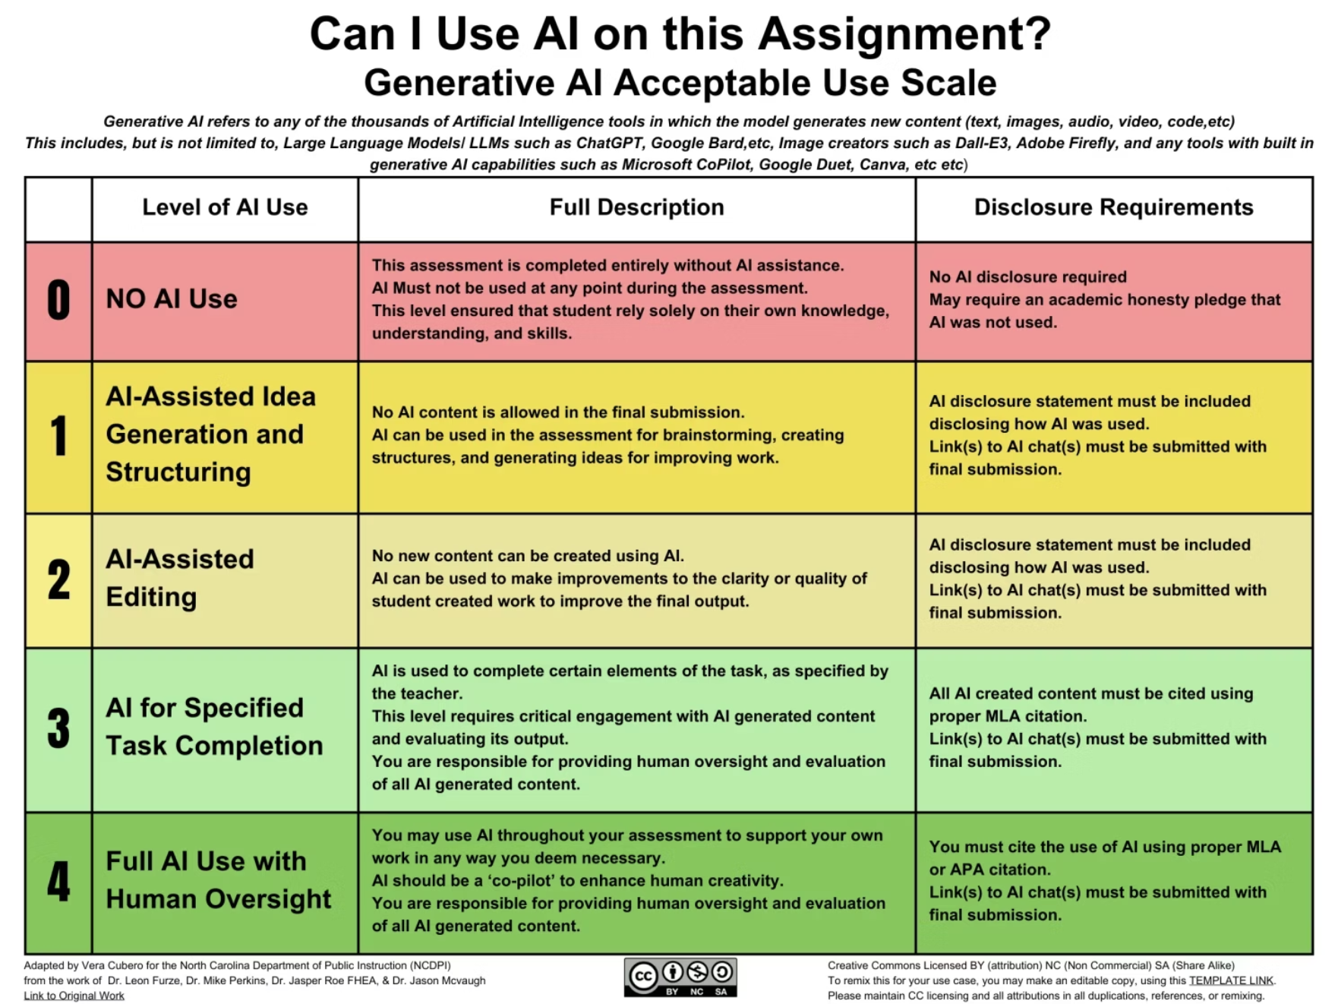
AI Use Policies Students Can Actually Follow
Permission Grid
Attribution Norms
Detection Stance
Provide a clear, assignment-specific matrix of what's allowed, encouraged, needs citation, or prohibited when using AI.
Offer simple citation templates for AI prompts and model assistance, empowering students to be transparent in their work.
Acknowledge the limits of AI detection tools and emphasize learning-focused integrity practices over a tech arms race.

