Slide 1


AI PATHWAYS Medical Education
Chris Shaltry, Ph.D.
Education, Technology, and Innovation Specialist
College of Human Medicine College of Osteopathic Medicine
shaltryc@msu.edu
Notes:
One photo, many possibilities… Created with Midjourney.

Slide 2
AGENDA
8:30-8:45 Arrival and breakfast
8:45-8:55 Wellness Activity
8:55-9:55 AI Part I: Orientation/Using Copilot
9:55-10:05 Break
10:05-10:15 Jana
10:15-11:20 AI Part II: Exploring Advanced AI Use
11:20-11:30 Wellness Activity

Slide 3
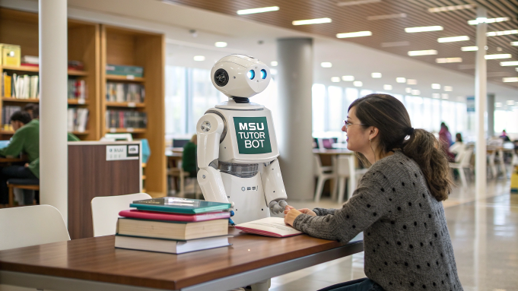
ORIENTATION - AI IN SCHOOL
Students must avoid illusions of knowing (retrievalpractice.org).
Student Internet use has promoted dysfunctional learning² and led to negative learning outcomes long before AI.
AI is amplifying these issues.
To ensure AI is used productively, we MUST UNDERSTAND IT.
Our job isn't to wish it [AI] away but to figure out how to harness its inherent properties for our pedagogical goals. And here's the exciting part – many of us are discovering that this shift is absolutely possible through smart implementation, built on shared knowledge from training, courses, and certification processes. ¹
Notes:
Does AI Kill Critical Thinking? Maybe Not If We Use It Right.
Fewer students are benefiting from doing their homework: an eleven-year study: Educational Psychology: Vol 42, No 2
The Impact of Generative AI on Critical Thinking: Self-Reported Reductions in Cognitive Effort and Confidence Effects From a Survey of Knowledge Workers

Slide 4
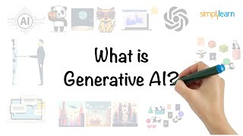
ORIENTATION - WHAT IS AI?
Notes:
What is AI (artificial intelligence)? | McKinsey

Slide 5
ORIENTATION - WHAT IS AI?
Five things you really need to know about AI
AI is as old as your grandparents – AI has been around since at least the 1940s, with its roots in artificial neural networks. These systems learn and improve over time and are already widely used in things like recommendation algorithms, facial recognition, and social media feeds.
AI can’t feel or think – Despite sounding human-like, AI doesn't actually understand what it's saying. It doesn’t have emotions, thoughts, or motivations—it's just a sophisticated tool predicting text responses based on patterns.
AI makes stuff up – AI chatbots can generate false or misleading information, a phenomenon known as "AI hallucinations." They predict words probabilistically and don't inherently verify facts, which means their responses can sometimes be inaccurate.
AI can sound racist and sexist – Since AI learns from human-created data, it can pick up biases, including racist or sexist content. If trained on biased or harmful data, it may produce biased outputs, making ethical safeguards essential.
AI has incredible potential – While there are risks, AI also has vast potential to improve fields like healthcare, education, and automation. It has already helped discover new drugs, detect cancer more effectively, and assist with complex information processing.
Notes:
What is AI (artificial intelligence)? | McKinsey
Five things you really need to know about AI - BBC

Slide 6











ORIENTATION - WHAT IS AI?
Foundation Models (GenAI systems upon which most AI applications are built)
Can be used as standalone applications.
Can be used to power applications and agents.
Notes:
What is AI (artificial intelligence)? | McKinsey

Slide 7
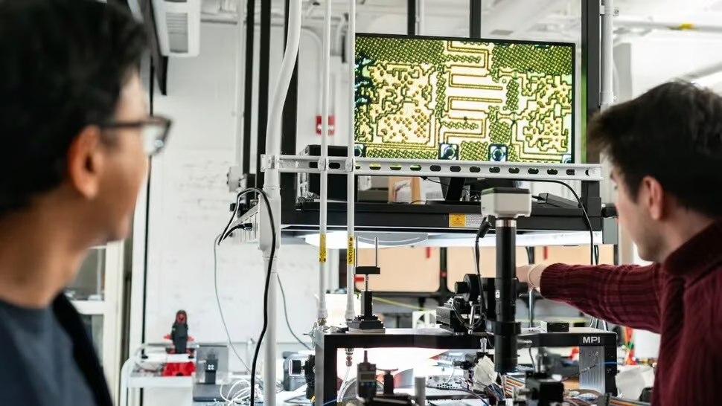

ORIENTATION - WHERE IS AI NOW?
Researchers used AI to design complex wireless chips in mere hours—an achievement that would take human engineers weeks. The AI-created chips performed better than traditional designs but were structured in ways that human designers couldn't fully comprehend. ¹
Teamwork with robots: Helix allows two robots to work together on tasks with new items they’ve never seen before.
One neural network: Helix uses a single neural network to learn all behaviors without needing specific adjustments for each task. ²
Notes:
Source: Forward Future newsletter, 2/21/25
Figure.ai Helix news.
Fun AI-generated video shorts of otters

Slide 8
USING AI: WHEN TO USE AI AND WHEN NOT TO
15 Times to Use AI:
Quantity Work: Generate numerous ideas quickly.
Expert Assessment: Use AI where you can judge its output.
Summarizing: Summarize large texts with low error risk.
Translation: Convert content for different audiences.
Unblocking: Get past creative blocks with AI suggestions.
Superior Performance: Use AI when it’s better than available expert humans, and outcomes cannot be worse.
Contextual Help: Get insight into context or details.
Variance: Generate diverse solutions for selection.
Proven Tasks: Use AI for tasks research shows it’s good at such as coding.
Perspective Testing: Understand different viewpoints.
Entrepreneurial Tasks: Stretch expertise across disciplines.
Specific Perspectives: Simulate reactions from personas.
Ritual Work: Automate required tasks with limited purpose.
Second Opinions: Validate conclusions with AI.
AI Superiority: Use AI where it outperforms humans.
5 Times Not to Use AI:
Learning New Ideas: AI summaries don’t replace deep learning and can lead to dysfunctional, illusory learning.
High Accuracy: Avoid AI where errors are unacceptable.
Understanding Failures: Don’t use AI if you can’t spot its errors.
Effort-Based Tasks: Struggle is essential for some tasks (e.g., writing, theorizing).
AI Limitations: Avoid tasks AI is known to perform poorly. Trial and error, and sharing information with peers, is vital to figuring this [Jagged Frontier of AI abilities] out.
Notes:
15 Times to use AI, and 5 Not to by Ethan Mollick, professor, Wharton School.

Slide 9
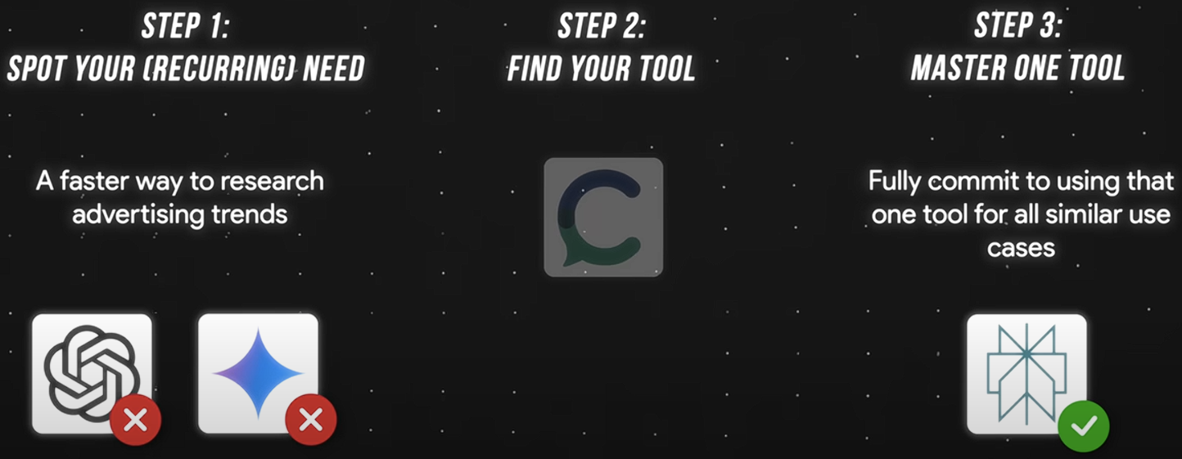
USING AI: AVOID AI TOOL OVERLOAD
Notes:
From the video: You're Not Behind: Become AI-Native in 2025 https://youtu.be/j63bBK_ct-M?si=4FrIqeqgf0dVXGds

Slide 10
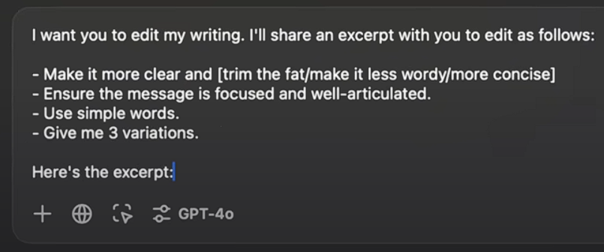
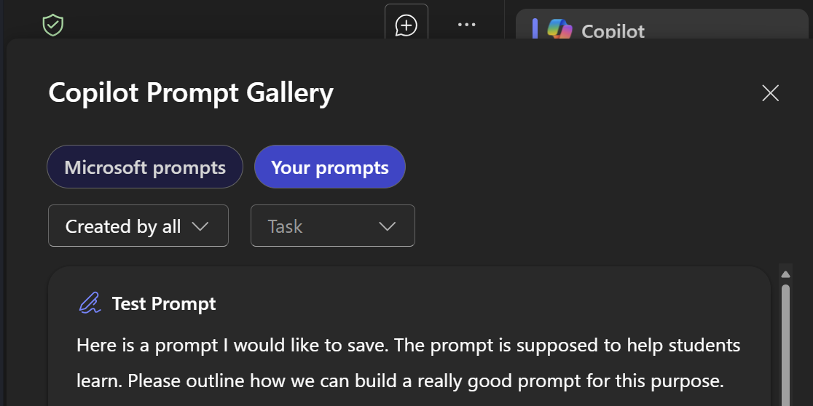
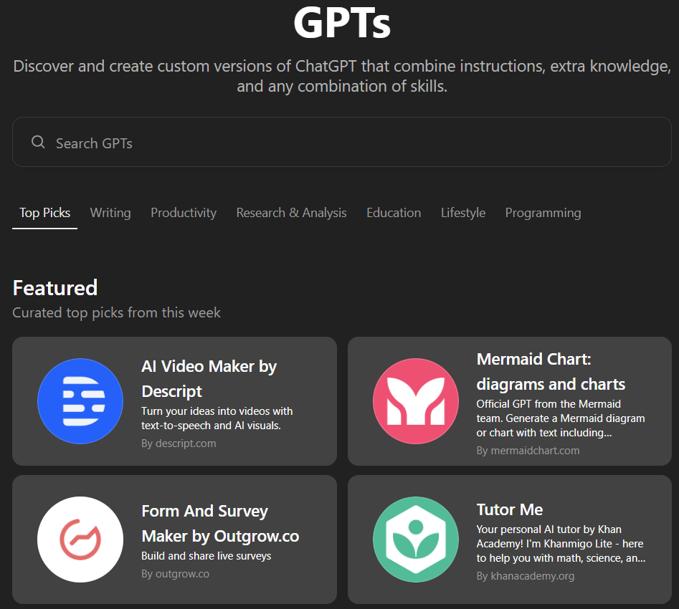
USING AI: AVOID PROMPT FATIGUE
OUR FOCUS TODAY
Notes:
From the video: You're Not Behind: Become AI-Native in 2025 https://youtu.be/j63bBK_ct-M?si=4FrIqeqgf0dVXGds

Slide 11
USING AI: MICROSOFT COPILOT
Open MSU Copilot (http://copilot.microsoft.com) on your laptop and sign in with your MSU NetID.
[if using a tablet or phone, download the Microsoft Copilot app and sign in with your MSU NetID]
Microsoft Copilot video tutorials (fantastic series for beginners from Microsoft)
How Teachers Can Use Copilot (4:05 - easy and quick strategies for using Copilot)
Explore in groups of two or three.
Share your experience with your table / whole group.
BEGINNER ACTIVITY #1
Notes:
From the video: You're Not Behind: Become AI-Native in 2025 https://youtu.be/j63bBK_ct-M?si=4FrIqeqgf0dVXGds

Slide 12
ACTIVE LEARNING LEVEL KEY
"I am not familiar with how AI is used in higher education."
"I have a general idea of AI tools like ChatGPT or Grammarly but have not used them much (or at all) in an educational setting."
"I have used AI tools such as ChatGPT or MSU Copilot to perform tasks such as question writing."
"I have leveraged advanced AI tools such as ChatGPT bots for tutoring, and NotebookLM and Napkin.ai for curriculum development.”
You will find this icon at the end of each activity. Select the link to access guided questions to report out and share what you have learned.
BEGINNER ACTIVITY
INTERMEDIATE ACTIVITY
ADVANCED ACTIVITY
REPORT OUT

Slide 13
GUIDED EXPLORATION OF MSU COPILOT
BEGINNER ACTIVITY #1
Choose Your Path
Reflect on an aspect of your work you're curious about enhancing with AI.
Examples: lesson planning, creating assessments, explaining complex topics, summarizing concepts at multiple levels, writing questions/rationales, grading student writing.
Start the Conversation
Open your chosen AI ( use MSU Copilot).
Try a simple prompt like: "I'm a teacher exploring how AI can help with [YOUR CHOSEN ASPECT]. What are some ways you could assist me?" OR try out an example prompt on the next slide.
Free Exploration
Follow your curiosity! Ask follow-up questions based on the AI's responses.
Wondering about useful AI apps for education? Try asking with a prompt like, “Give me five highly rated AI apps for medical school instructors.”
Reflection Prompt
Ask the AI: "What are some potential benefits and challenges of using AI for [YOUR CHOSEN ASPECT] in education?"
REPORT OUT
→ continue to the next slide for EXAMPLE PROMPTS →

Slide 14
BEGINNER ACTIVITY #1
EXAMPLE PROMPTS
BEGINNER ACTIVITY #1
Generate quiz/exam questions + rationales: "Create multiple-choice questions for a pharmacology course on drug interactions. Include rationales for correct and incorrect options, focusing on real-world scenarios students may encounter in clinical practice."
Generate learning objectives: "Develop learning objectives for a module on cardiovascular health aimed at second-year medical students. Ensure objectives are specific, measurable, and aligned with core competencies in clinical knowledge and patient care."
Differentiate content for multiple learner levels: "Explain the pathophysiology of diabetes mellitus at three levels: for undergraduate pre-med students, first-year medical students, and advanced medical students preparing for clinical rotations."
Accessibility: Generate alt-text for charts, images and graphics: "Provide alt-text for the attached image." (does not work with MSU Copilot)
Brainstorming new ideas and perspectives: "Brainstorm innovative ways to teach complex anatomy topics to students, incorporating digital tools and 3D models to enhance student engagement."
Create your own Virtual Patient description: "Develop a virtual patient scenario for students to practice diagnosing and treating acute myocardial infarction. Include patient history, symptoms, lab results, and potential treatment pathways."

Slide 15
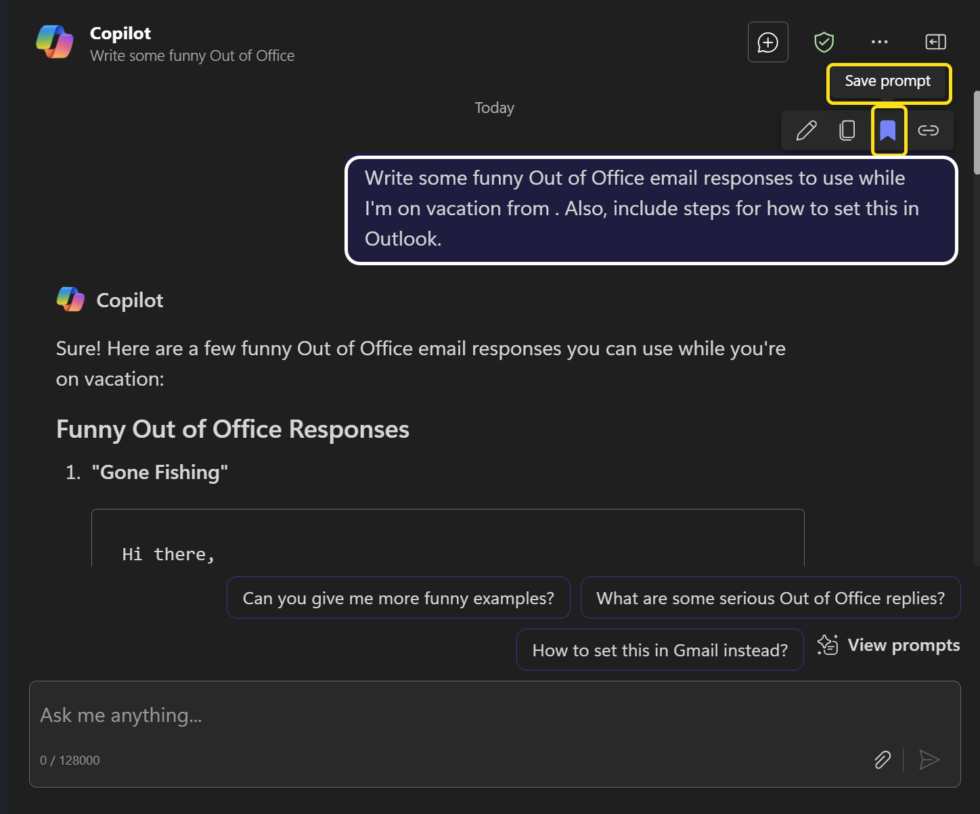
BEGINNER ACTIVITY #1
SAVING YOUR PROMPT IN MSU COPILOT
BEGINNER ACTIVITY #1
To save your prompts in MS Copilot:
After running the prompt, scroll to the prompt, hover over the bookmark symbol and select “Save prompt.”
"Alien Abduction"
Hello,
I've been abducted by aliens and taken to a galaxy far, far away. I'll be back on [Return Date]. If you need immediate assistance, please contact [Colleague's Name] at [Colleague's Email]. Otherwise, I'll get back to you once I've returned to Earth.
Regards,

Slide 16
GENERATING QUALITY MC QUESTIONS WITH AI
INTERMEDIATE ACTIVITY #1
Activity Instructions
Use MSU Copilot to generate multiple-choice questions (MCQs) on an education topic.
Focus on creating high-quality, accurate questions.
Select an Education Related Topic
Choose a topic relevant to you.
Examples: Cardiology, Neurology, Pharmacology, Educational Psychology
Generate MCQs Using ChatGPT
Craft prompts to elicit good questions.
Example Prompt: "Create three multiple-choice questions with four options each on the mechanisms of action of beta-blockers, suitable for second-year medical students."
Input prompts and review AI-generated questions.
Review and Refine Questions
Evaluate the accuracy and quality of the questions.
Practice modifying prompts or questions as needed.
Discuss insights with nearby participants, facilitator or whole group.
REPORT OUT

Slide 17
SIMULATING DOCTOR PATIENT CONVERSATIONS
INTERMEDIATE ACTIVITY #2
In this activity, you will…
Use the Dartmouth Patient Actor App to simulate clinical interactions.
Focus on improving communication and diagnostic skills.
Engage with the App
Select a case scenario from the app.
Conduct a virtual patient interview.
Practice establishing rapport and gathering patient history.
Reflection and Discussion
Share experiences and challenges faced during the simulation.
Discuss potential applications in education.
Consider the benefits and limitations of AI simulations.
Discuss insights with nearby participants, facilitator or whole group.
REPORT OUT

Slide 18
INTERMEDIATE ACTIVITY #3
DIFFERENTIATING LEARNING MATERIALS
INTERMEDIATE ACTIVITY #3
Select a Topic and Levels
Choose a topic and identify three student levels (e.g., beginner, intermediate, and advanced).
Craft Your Prompt
Create a prompt for ChatGPT using this template: "Create three brief explanations of [YOUR TOPIC] for different student levels: A simple explanation for [beginners], A more detailed explanation for [intermediate] learners, An [advanced] explanation with deeper concepts. Each explanation should be 2-3 sentences long."
Generate Content
Sign in to your favorite GenAI application (e.g., ChatGPT, MSU Copilot).
Input the prompt above and review the AI-generated explanations.
Discuss and Reflect
Share experiences and challenges faced generating differentiated content.
Discuss potential applications in education.
Consider the benefits and limitations of AI for differentiating course content.
Discuss insights with nearby participants, facilitator or whole group.
REPORT OUT

Slide 19
SUPPORTING CLINICAL REASONING
INTERMEDIATE ACTIVITY #4
In this activity, you will…
Use OpenEvidence to explore AI-driven medical information retrieval.
Analyze the reliability of AI-generated content.
Information Retrieval Exercise
Search for evidence-based information on a complex clinical topic.
Compare AI-generated summaries to your own knowledge and peer-reviewed literature.
Critical Evaluation
Assess the accuracy and completeness of the AI information.
Identify any discrepancies or biases.
Integration into Teaching
Discuss how to incorporate AI tools into journal clubs or small group sessions.
Consider strategies to prevent over-reliance on AI, ensuring students develop strong clinical reasoning skills.
Reflect on potential pitfalls of shortcuts in research and clinical practice.
REPORT OUT

Slide 20
HOW DO WE TRAIN STUDENTS IN APPROPRIATE AI USE?
ADVANCED ACTIVITY #1
Read the points below, and brainstorm ideas with colleagues and AI on how we could train (the how) and educate (the why) students in appropriate use of AI in school.
AI in education can be deceptively simple.
AI is not a single entity, rather a complex domain of continually evolving benefits, limitations, affordances, constraints, and potential dangers.
While it promises tailored learning experiences, personalized feedback, and automation of routine tasks, its implementation demands careful consideration.
Each application of AI in education brings unique challenges—balancing innovation with ethical use, safeguarding data privacy, and maintaining fairness.
Educators and policymakers must navigate these nuances to ensure AI enhances the educational experience without compromising the integrity of human-centered learning.
In this intricate landscape, the effectiveness of AI lies not just in its capabilities but in how thoughtfully and responsibly it is integrated into the educational ecosystem.
REPORT OUT
Notes:
Image AI generated in ReCraft v3.

Slide 21
CREATING A CUSTOM BOT FOR STUDENT SUPPORT
ADVANCED ACTIVITY #2
In this activity, you will…
Create a custom GPT designed to answer student questions on a specific subject or course.
Choose Your Focus
Select a specific subject or course you teach.
Identify common questions or areas where students often need support.
Access GPT Builder .
Log into your ChatGPT Plus account at ChatGPT.com.
Click on "Explore GPTs" in the left menu and then "Create a GPT" in the top right corner.
Define Your GPT
Name your GPT (e.g., "Human Anatomy 101 Assistant").
In the configuration, briefly describe its purpose: "You are an AI assistant designed to help students with questions about [YOUR SUBJECT]. Provide clear, concise explanations suitable for [GRADE LEVEL] students."
REPORT OUT
→ continued on the next slide →

Slide 22
CREATING A CUSTOM BOT FOR STUDENT SUPPORT
ADVANCED ACTIVITY #2
Set Behavior and Knowledge
Add key instructions like:
"Always provide explanations at an appropriate level for [X YEAR] med students."
"Include simple examples or analogies to illustrate concepts."
"If a question is unclear, ask for clarification before answering."
Add 2-3 sample Q&As typical for your subject.
Test Your GPT
Use the preview mode to test your GPT.
Ask it 1-2 common student questions.
Refine its responses if necessary.
Reflect and Share
With a partner or small/whole group, discuss:
The subject/course you chose for your GPT.
One effective response your GPT provided.
How you might use this GPT to support student learning outside of class.
REPORT OUT

Slide 23
SHARING YOUR AI EXPERIENCE IN A CRITICAL WAY
ADVANCED ACTIVITY #3
In this activity, select an AI application you have used before. Using the prompts below and the “Report Out” feature of the workshop, share your personal experience and insights with colleagues. Application Selection and Personal Reflection - Choose an AI tool (e.g., a medical practice tool, academic search tool, automated feedback tool) that you have used. - Outline its key features and describe how it has influenced your professional or teaching practice. Experience Sharing and Peer Discussion - Discuss the benefits, challenges, and unexpected outcomes you encountered. - Share examples of how this tool has streamlined tasks or enhanced learning in your context. Critical Reflection - Evaluate the tool’s reliability, ethical implications, and potential positive and negative impacts. - Identify what worked well and areas needing improvement, especially regarding accuracy. Integration into Teaching - Brainstorm ways to incorporate your AI experiences into classroom discussions or professional development sessions. - Develop strategies for demonstrating the tool’s practical applications while encouraging critical evaluation among students.| - Consider creating case studies or role-playing scenarios to illustrate both the opportunities and limitations of AI in educational settings.
REPORT OUT
Notes:
Image AI generated in ReCraft v3.

Slide 24
EXPERIENCE REPORT OUT
What is one key insight you gained about using AI in medical education from today’s activities?
How do you see AI supporting (but not replacing) your role as a medical educator?
What is one potential challenge of using AI in teaching, and how might you address it?
Share via our Google Doc or oral Q&A
Notes:
Choose whichever method you like, and we will reconvene to share.

Slide 25

Thank you for your time.
Questions?

