Slide 1


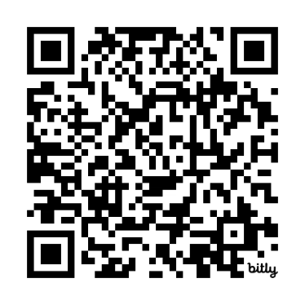
AI in Learning Series:Study Strategies with NotebookLM
Part I – Principles of Productive AI Use
Kim Pfotenhauer, D.O., FACOFP, DABOMAssistant Dean, Clerkship EducationCollege of Osteopathic Medicinepfotenha@msu.edu
Chris Shaltry, Ph.D.Education, Technology and Innovation SpecialistCollege of Osteopathic Medicine / College of Human Medicineshaltryc@msu.edu
bit.ly/LM-FOR-LEARNING

Slide 2

What We'll Cover Today
1
Foundational Principles of AI Use:
2
NotebookLM Introduction:
Four key principles for effective AI integration in learning
Features and capabilities of this AI study companion
3
Practical Applications:
4
Advanced Techniques:
Generating flashcards, self-quizzing, concept mapping, and creating podcasts
Five powerful strategies to enhance your study workflow
5
Collaborative Live Demo:
What could you use this for? We will explore use cases in a live NotebookLM and then discuss.

Slide 3

Quick Poll:
How often do you use AI in your studies?
Enter the # for your answer in chat…(1) Frequently(2) Occasionally(3) Never
Have you heard of NotebookLM?

Slide 4

Principle #1: Focus on Foundations, Not Tools
AI is evolving far too fast to master every tool. Focus first on effective learning strategies. Talk with others and follow quality channels and school recommendations for effective apps.
Prioritize Core Learning Strategies:
Use AI as a Means, Not the Goal:
Focus on strategies like active recall, spaced repetition, and metacognition—these principles remain effective regardless of which AI tools or platforms are trending.
Evaluate each tool (like NotebookLM, ChatGPT, Anki, etc.) by how well it supports your learning objectives, not by its novelty or feature set.

Slide 5

Principle #2: Context Matters – Professional vs. Student AI Use
Professional use AI…
Students use AI…
ChatGPT: "Act like an intern."
ChatGPT: "Act like a Socratic tutor."
Streamlining tasks
Active practice
Achieving performance goals
Achieving learning goals
Watch Out
In some cases, when students use AI the same way professionals do, it can short-circuit the learning process and lead to shallow understanding or poor long-term outcomes.

Slide 6



Principle #3: Productive Struggle
Learning with AI Is Like Triathlon Training
Goal: Get There Faster?
Goal: Build Endurance?
Using power-boost shoes could help you reach the finish line faster, but it won’t make you a stronger or better runner — and they’re not allowed in triathlons.
Requires consistent effort and structured practice to build the endurance, strength, and technique needed to compete effectively.
Effective learners balance productive struggle with intentional AI support. In learning — as in training — the hard parts are often the point.

Slide 7

Principle #4: Match AI Use to Your Learning Goals
Ask First
Support Not Replace
What is my learning goal?
Use AI only where it supports the goal, not where it replaces key learning tasks.
Example
Goal: Reinforcing concepts from a large amount of study material.
Use AI: For actively learning the content (e.g., create quizzes to test your knowledge).
Avoid AI: For answering questions and helping you memorize answers to questions about the content you loaded.

Slide 8

Key Takeaways
1
Focus on Foundations, Not Tools
2
Context Matters: Professionals vs Students
3
Don't Skip the Struggle
Like triathlon training, effective learning requires productive struggle to build cognitive strength.
Build core knowledge and skills rather than chasing every new AI platform.
Professionals optimize for performance while students should prioritize learning outcomes.
4
Match AI Use to Learning Goals
Ask what your goal is first, then use AI only where it supports rather than replaces key learning.

Slide 9

Quick Poll:
Which key takeaway resonates most with you?
Enter the # for your answer in chat…
(1, 2, 3 or 4)
1
Focus on Foundations, Not Tools
2
Distinct Needs, Distinct Uses
Build core knowledge and skills rather than chasing every new AI platform.
Professionals optimize for performance while students should prioritize learning outcomes.
3
Don't Skip the Struggle
4
Match AI Use to Learning Goals
Like triathlon training, effective learning requires productive struggle to build cognitive strength.
Ask what your goal is first, then use AI only where it supports rather than replaces key learning.

Slide 10

AI in Learning Series:Study Strategies with NotebookLM
Part II – Applying What You've Learned

Slide 11





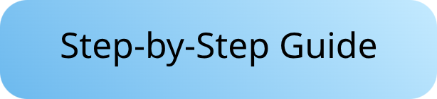
Meet NotebookLM — A Powerful Study Companion
Upload and Organize Sources
Import lectures, articles, and textbooks; keep your notes structured and accessible.
Summarize Content and Create Study Guides, Podcasts, FAQs, Mindmaps and more.
Generate concise summaries and audio content to reinforce learning.
Produce Quizzes and Ask Questions
Test your knowledge with auto-generated quizzes and organize your spaced repetition and interleaving efforts.

Slide 12

Example Use: Generate Anki Flashcards
Example prompt:
Export to Anki
Create a deck of flashcards from the following text. The questions should be specific and the answers should be concise. Format the output as 'Question:\nAnswer:\n'
Create Cloze Deletions
Save as CSV files for direct import, creating cards 10x faster.
Transform Content
Generate fill-in-the-blank cards for pathways and anatomical relationships.
Convert dense lectures into high-yield flashcards using specialized prompts.

Slide 13

Example Use: Self-Quizzing with AI Feedback
Custom Questions
Detailed Explanations
Generate practice tests focused on your specific needs.
Receive comprehensive feedback on every answer.
Board-style clinical vignettes
Pathophysiology connections
System-specific reviews
Clinical correlations
Gap Analysis
Track weak areas for targeted review sessions.
Performance metrics
Improvement suggestions

Slide 14
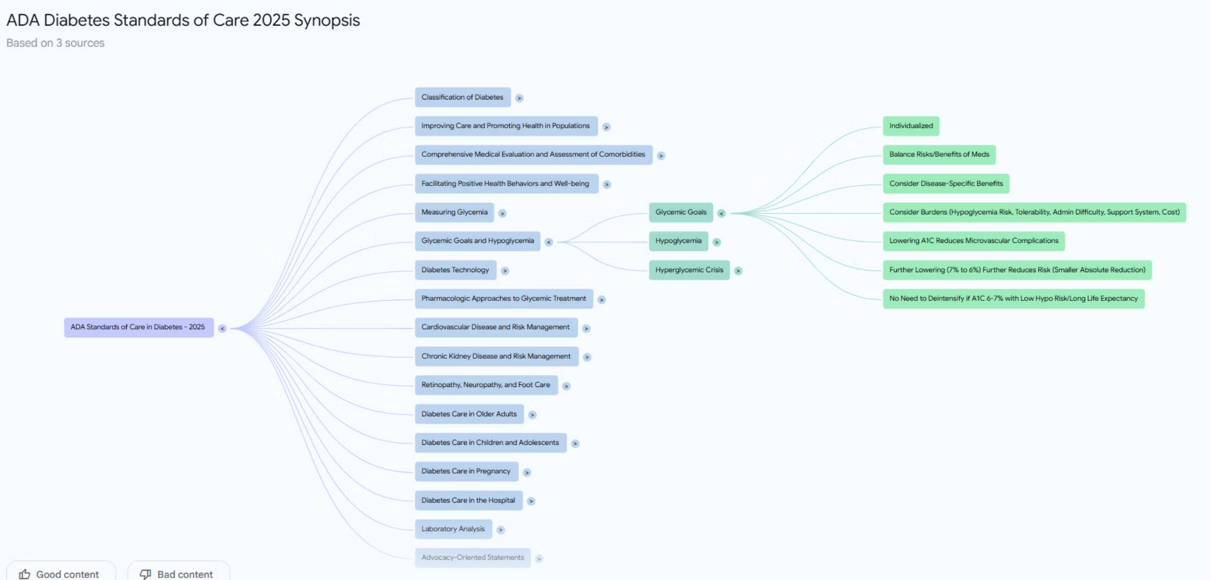
Example Use: Building Concept Maps & Pathways
Visualize Relationships
Export Visuals
Create Hierarchies
Link Presentations
Connect related medical concepts into meaningful structures.
Save maps for comprehensive exam preparation.
Organize pathophysiology concepts from general to specific.
Connect symptoms to underlying disease mechanisms.

Slide 15
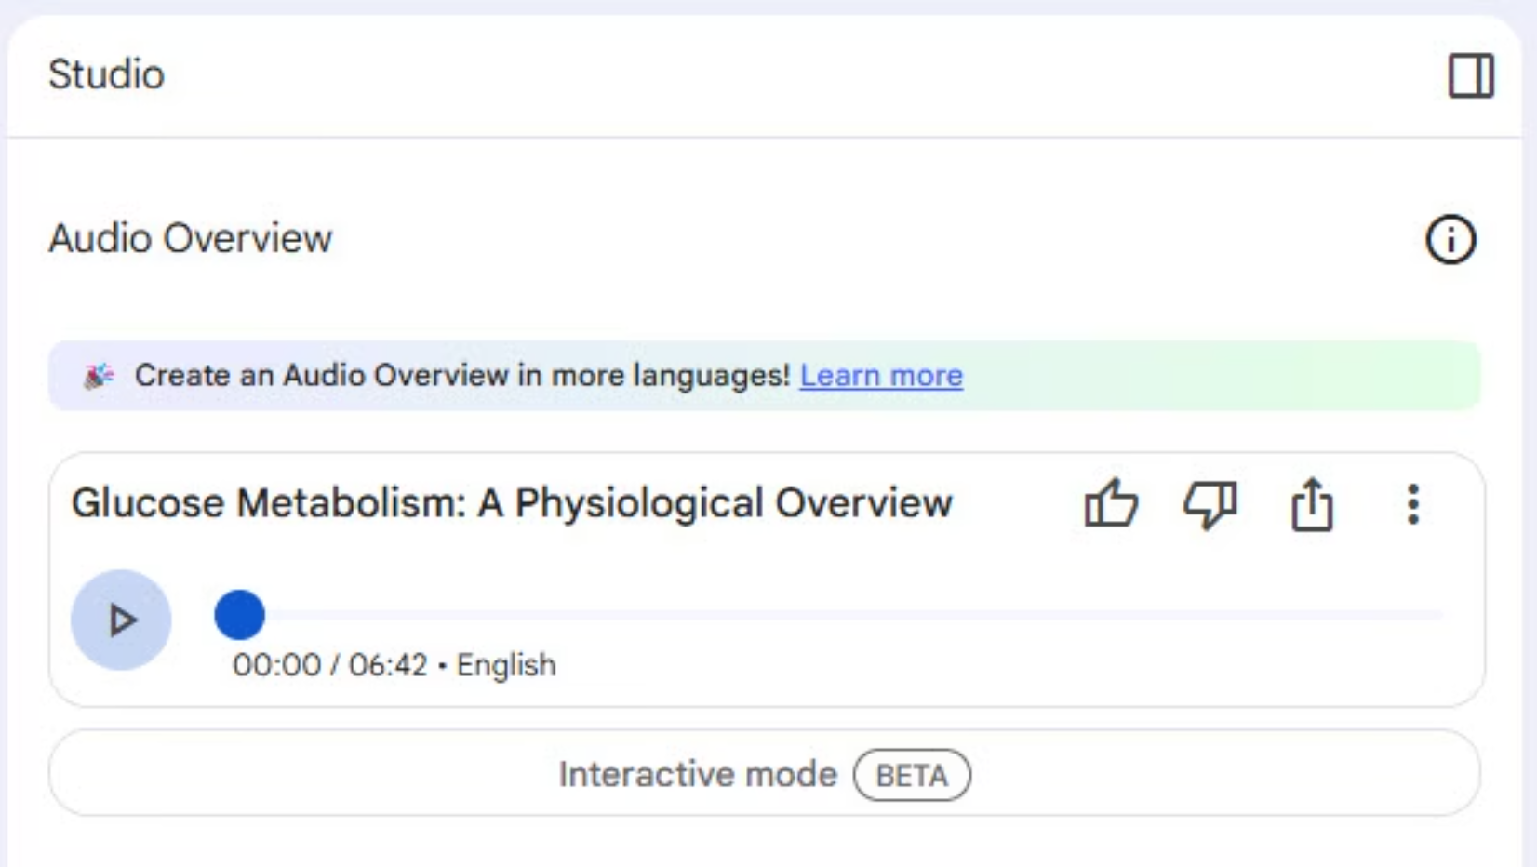
Example Use: Create a Podcast
Review difficult material in a unique way.
Keep topics very narrow.
Better for review than initial learning.
Review on the go.

Slide 16
5 Advanced NotebookLM Study Techniques
Socratic Questioning Practice
Ask NotebookLM to quiz you using Socratic questioning (e.g., “Ask me about this mechanism using Socratic questioning.”).
Teach-Back Summaries
After studying a topic, write your own summary, upload it, and ask NotebookLM to act as a “junior student” and challenge your explanation.
Gap Identification
Upload appropriate source material and ask NotebookLM what concepts might be missing or underexplained based on the uploaded source.
Active Recall Generator
Generate open-ended questions rather than multiple choice and then request feedback on your answers. Strengthens deeper retrieval practice versus passive recognition.
Step-by-Step Mechanism Checks
Walk through a biochemical or physiological pathway, and ask NotebookLM to point out where your logic might break down based on your notes.

Slide 17

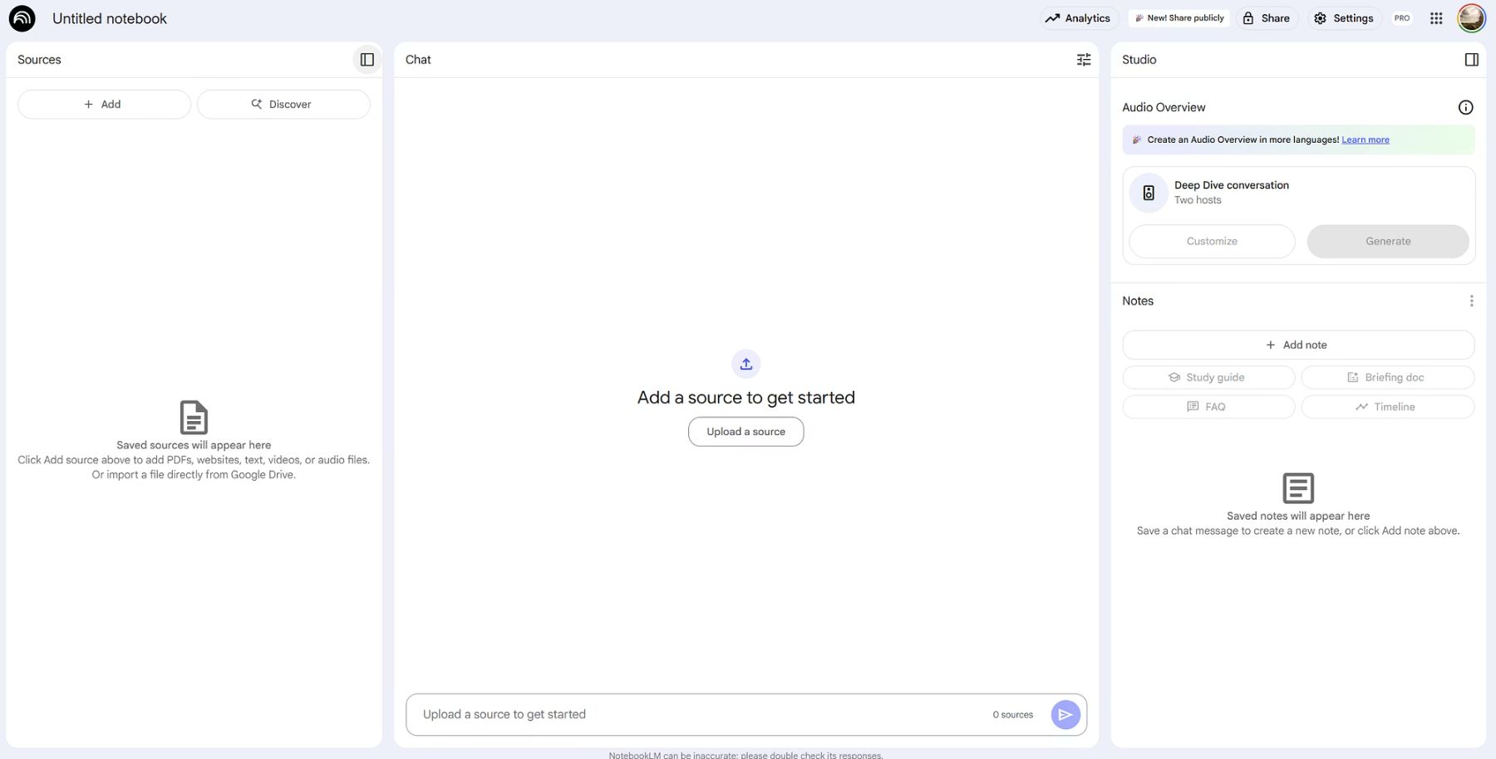
Collaborative Live Demo
How could you use NotebookLM in your studies?

Slide 18


Consider the Guidelines for MSU Students Using Generative AI Before Using NotebookLM
1
🔍 Check Before You Use
Review your syllabus and assignment rules.
Ask your instructor or supervisor if unsure — before deadlines.
2
🧠 Use AI Ethically & Transparently
Maintain academic and research integrity.
Cite AI sources when used.
Your work = your responsibility.
3
🔐 Protect Your Privacy
Don't share personal info or login credentials.
Use trusted platforms and follow MSU data guidelines.
4
⚠️ Understand AI's Limits
AI can produce inaccurate, biased, or misleading content.
Treat AI as a tool to support learning — not replace it.
Be sure to check the MSU Generative Artificial Intelligence (AI) Reminders and Guidance for Students page for more information and details on these guidelines before uploading anything into an AI driven system.

