Slide 1
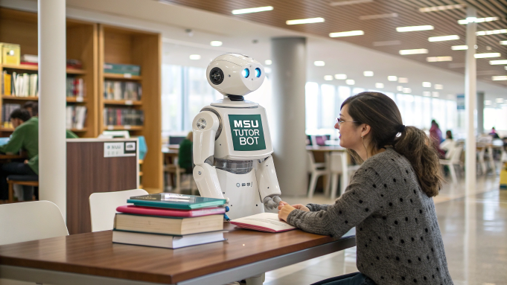


INNOVATION PATHWAYS
AI FOR EDUCATORS
Chris Shaltry, Ph.D.
Education, Technology, and Innovation Specialist
College of Human Medicine
College of Osteopathic Medicine
shaltryc@msu.edu

Slide 2
AGENDA
15 MIN: Workshop purpose, goals, and background info on AI in education.
25 MIN: Choose your own AI adventure! Select an activity, explore and share.
20 MIN: Sharing, Q&A and reflection survey.
ACCESSIBILITY: Let me know if you need extra help. Google AI Studio “Share your screen” may provide assistance.

Slide 3
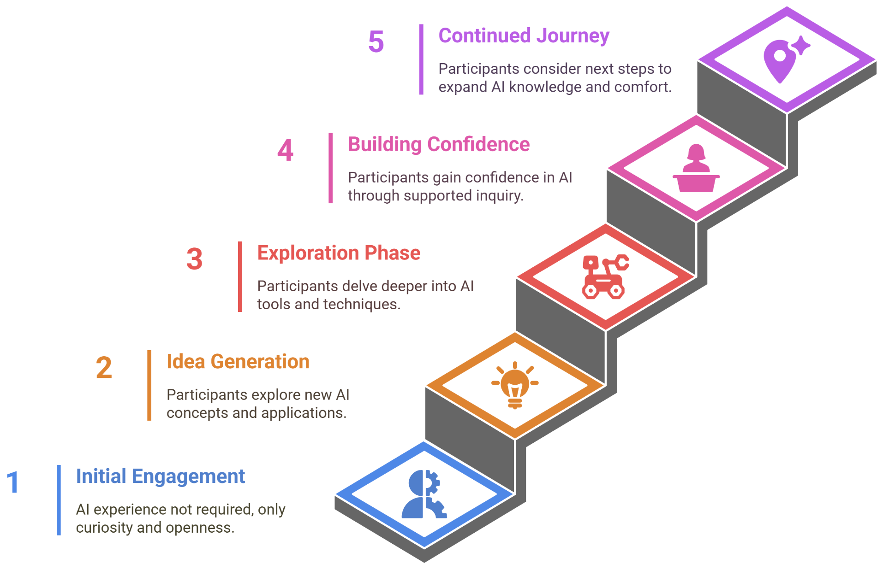
WORKSHOP GOALS

Slide 4
AI CONCERNS
WHAT ARE YOUR CONCERNS ABOUT AI?
YOUR OWN USE?
STUDENT USE?

Slide 5
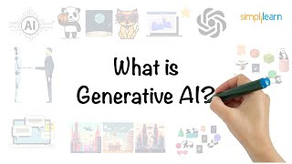
BACKGROUND: WHAT IS AI?
Notes:
What is AI (artificial intelligence)? | McKinsey

Slide 6
EXAMPLES OF AI USE IN HIGHER ED:
Composing email, evaluate tone, professionalism, etc.
Tutorials and assistance (e.g., D2L/Graphpad).
Brainstorming/idea generation (e.g., I have an idea, what do you think?)
Understanding concepts (e.g., explain X in simple terms)
Research a topic that would take a long time (e.g., ChatGPT Deep Research)
Student support (e.g., AI course tutors)
Lecture video script generation.
Feedback on writing (e.g., emails, course content).

Slide 7

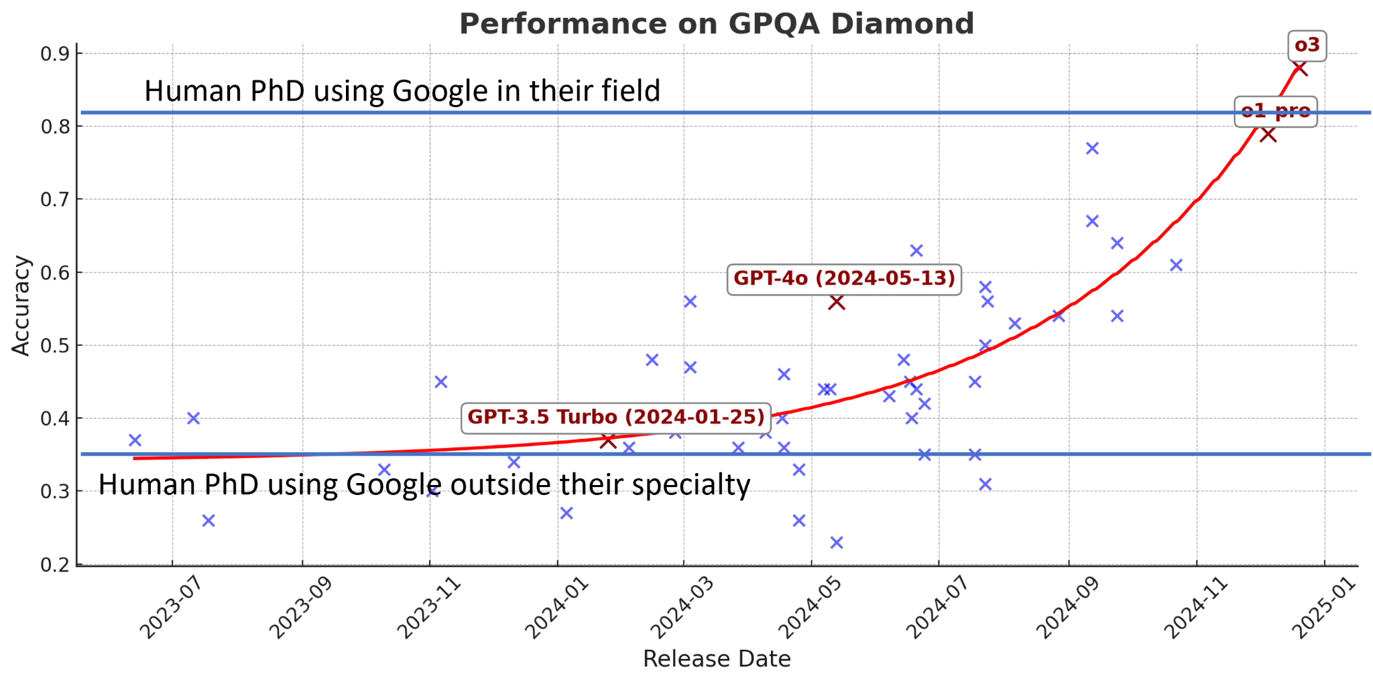
BACKGROUND: AI VS HUMAN THINKING
Notes:
The Graduate-Level Google-Proof Q&A test (GPQA) is a series of multiple-choice problems that internet access doesn't help PhDs with access to the internet get 34% right on this test outside their specialty, 81% inside their specialty. It illustrates how reasoning models have sped up the capability gain of AI. Data source.
From Ethan Mollick’s blog post, “The End of Search, The Beginning of Research.”

Slide 8
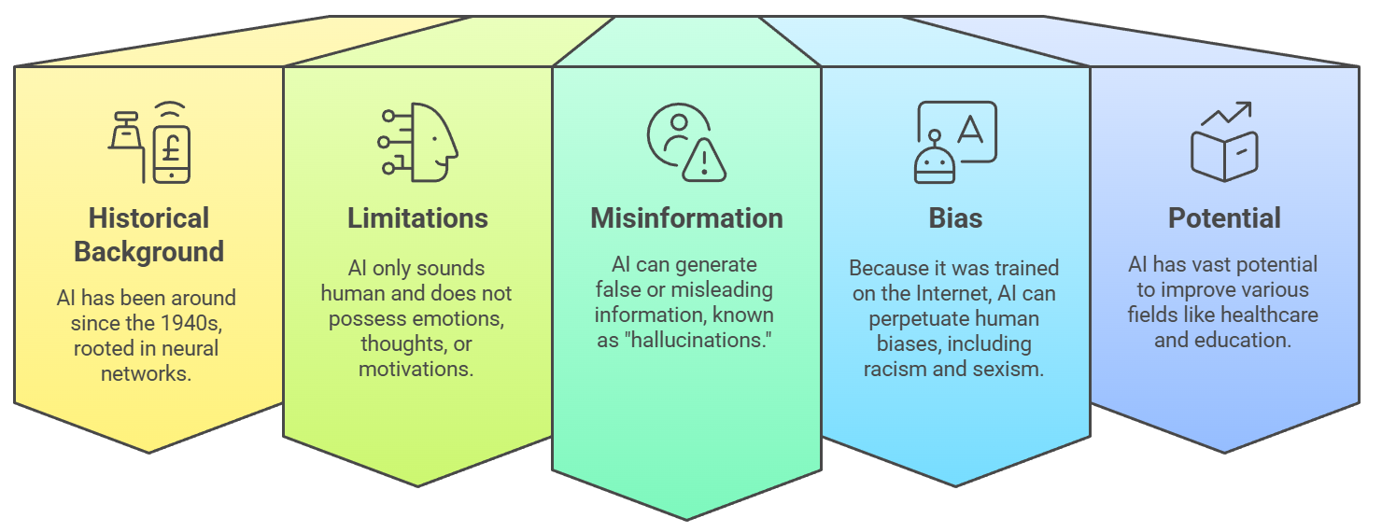
BACKGROUND: LIMITATIONS OF AI
Similar to the Internet
Notes:
Five things you really need to know about AI - BBC

Slide 9
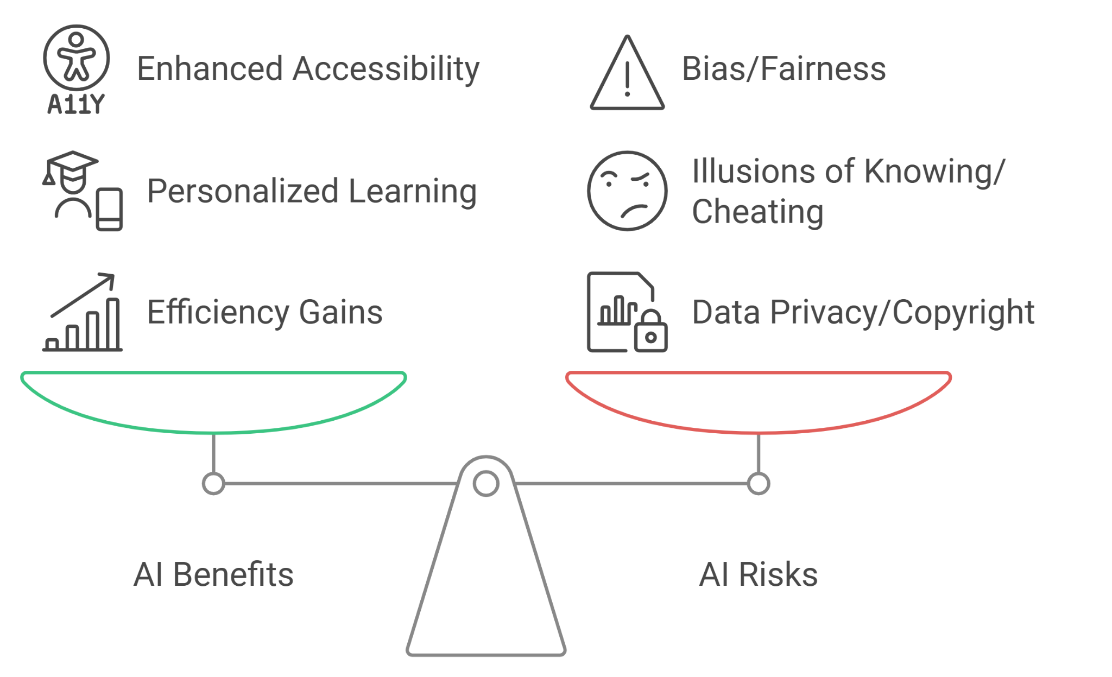
PROS AND CONS OF AI IN EDUCATION

Slide 10





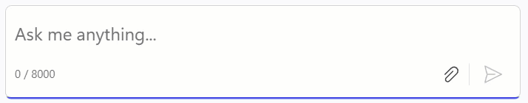





BACKGROUND: IS ALL AI THE SAME?
Foundation Models (FMs)
GenAI systems that power AI applications.
Different capabilities and “personalities.”
ChatGPT
Claude
Gemini
Grok
Copilot
FMs can be used as standalone
Applications for direct inquiries.
FMs can also be used to power
AI applications.

Slide 11
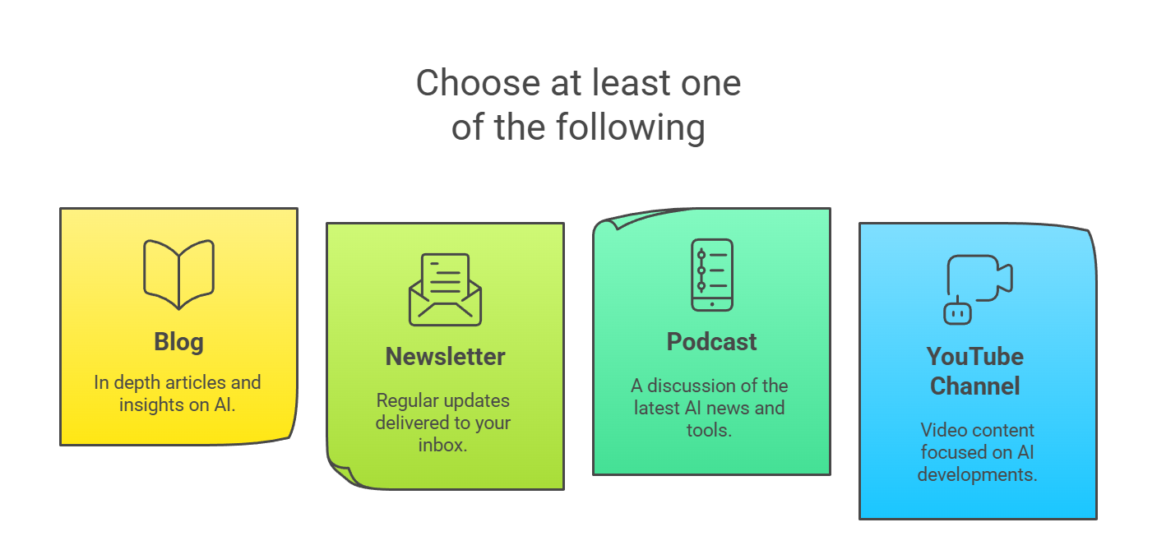
BACKGROUND: HOW DO I KEEP UP WITH AI PROGRESS?
Choose at least one of these
information source types to follow:
One Useful Thing
AI in Education
ForwardFuture
AI for Humans
Notes:
These are some of my favorite media channels for keeping up with AI.

Slide 12
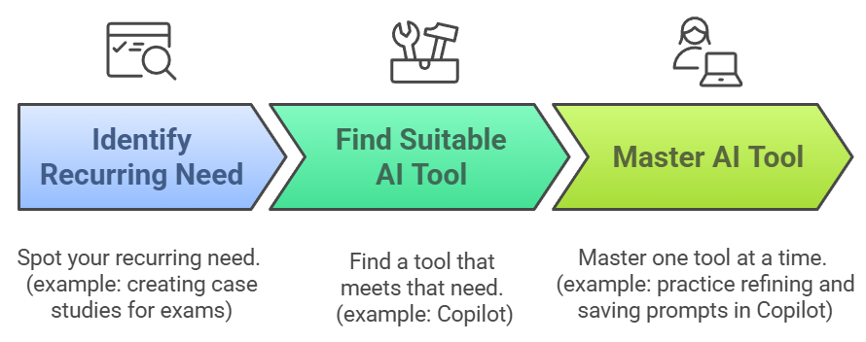
BACKGROUND: HOW DO I KEEP UP WITH AI TOOLS?
Notes:
These are some of my favorite media channels for keeping up with AI.

Slide 13
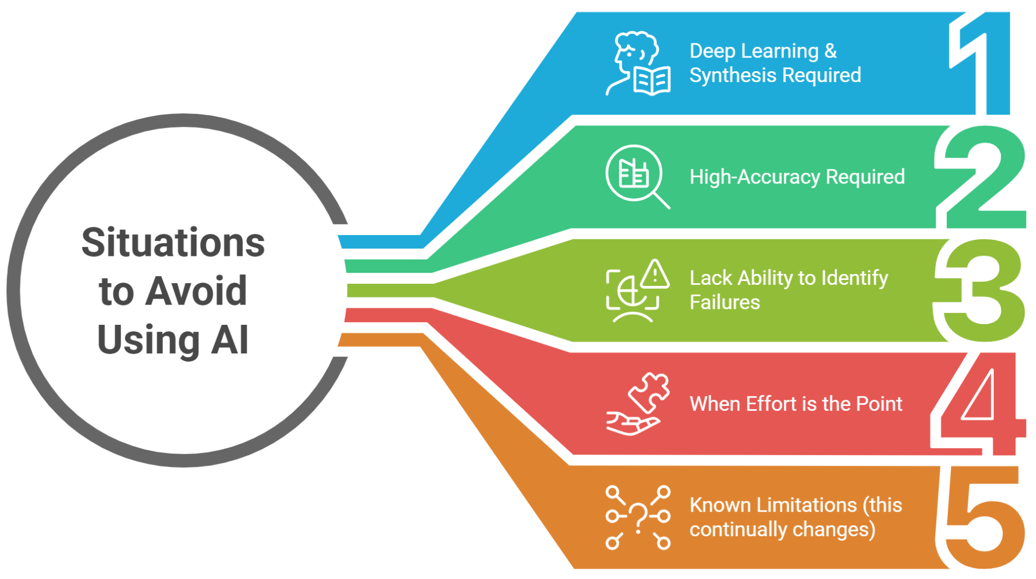
BACKGROUND: WHEN NOT TO USE AI
Notes:
15 Times to use AI, and 5 Not to by Ethan Mollick, professor, Wharton School.

Slide 14
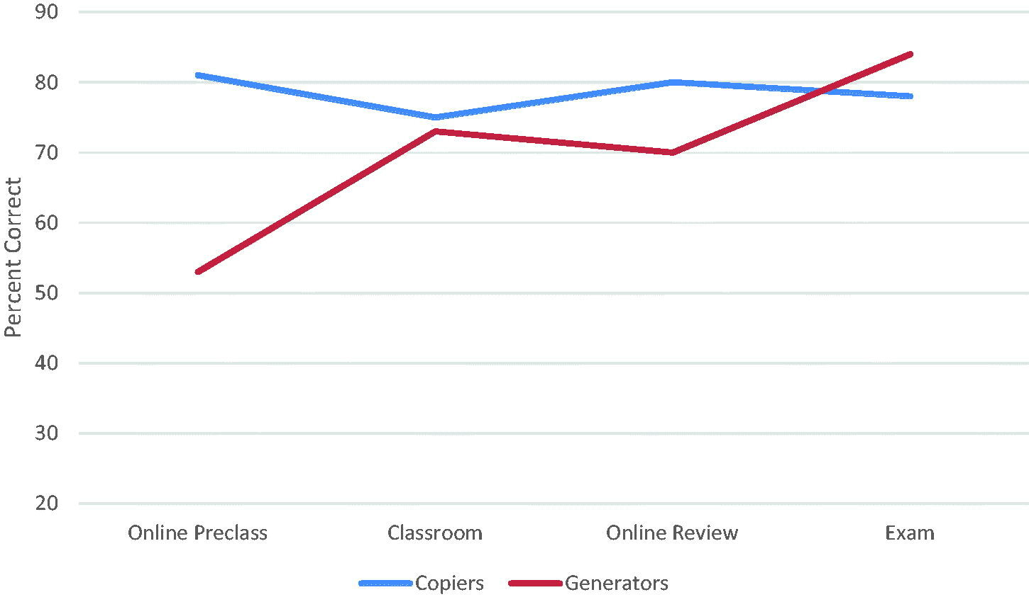
BACKGROUND: THE IMPACT OF AI ON LEARNING
This study found student Internet use promoted dysfunctional learning² and negative learning outcomes (before AI).
To ensure AI is used productively, we MUST UNDERSTAND IT.

Slide 15
WORKSHOP ACTIVITIES
Use the key below to determine the best level for you, then explore the corresponding activities in the upcoming slides with one or more others. We'll come together at the end to share and discuss our experiences.
"I am not very familiar with the use of AI in higher education, or I have a basic understanding of AI tools like ChatGPT and Grammarly but have limited or no experience using them in an academic setting."
"I have used AI tools such as ChatGPT or MSU Copilot to perform tasks such as question writing."
"I have leveraged advanced AI tools such as ChatGPT bots for tutoring, and NotebookLM and Napkin.ai for curriculum development.”
BEGINNER
ACTIVITY
INTERMEDIATE
ACTIVITY
ADVANCED
ACTIVITY

Slide 16
FLOW PROMPTING WITH MSU COPILOT
BEGINNER
ACTIVITY #1
Open MSU Copilot (http://copilot.microsoft.com) using your MSU NetID.
(You can download the Microsoft Copilot app if using a phone or tablet.)
Try a practice prompt such as "Create two multiple-choice questions on [topic of your choice] and provide rationales for each answer.”
Save the prompt. Select this link for a demonstration (may take time to load).
Practice guiding AI as you might an assistant (e.g., Please format the questions using 5 answer choices) until your interactions flow in a conversational way.
Challenge: Can you figure out how to combine your conversation with AI into a single prompt and save it?
GOAL: Gain confidence conversing with AI.

Slide 17
AI APPS
INTERMEDIATE
ACTIVITY #1
Think about a recurring need you have (e.g., creating diagrams for your PowerPoint lectures).
Find an AI app that might help with your recurring need. Browse my favorite apps below, the FutureTools library, try Perplexity Search or ask a colleague. [remember, Copilot and ChatGPT are also AI apps!]
Learn by doing! Jump in and practice with the app. Does this app fit the need(s) you identified above? What was exciting? Frustrating?
Elicit (research) | Napkin (diagrams) | Midjourney (images) | Elevenlabs (audio)
GOAL: Identify an AI app to assist with a recurring need.

Slide 18
CASE STUDY:
BALANCING AI ASSISTANCE AND ACADEMIC RIGOR
ADVANCED
ACTIVITY #1
This case explores the challenge of integrating AI-powered writing tools in higher education while maintaining academic integrity and critical thinking. Dr. Olivia Patel must find a way to balance AI’s benefits with strategies that prevent student over-reliance and ensure meaningful learning.
Access case details here.
GOAL: Devise solutions to a problem involving AI in education.

Slide 19
CASE STUDY:
RETHINKING ASSESSMENT IN THE AGE OF AI
ADVANCED
ACTIVITY #2
This case examines the challenge of maintaining academic integrity in assessments as AI tools make it easier for students to complete homework with minimal effort. Dr. Marcus Lee must develop a grading model that ensures genuine learning and academic integrity.
Access case details here.
GOAL: Devise solutions to a problem involving AI in education.

Slide 20
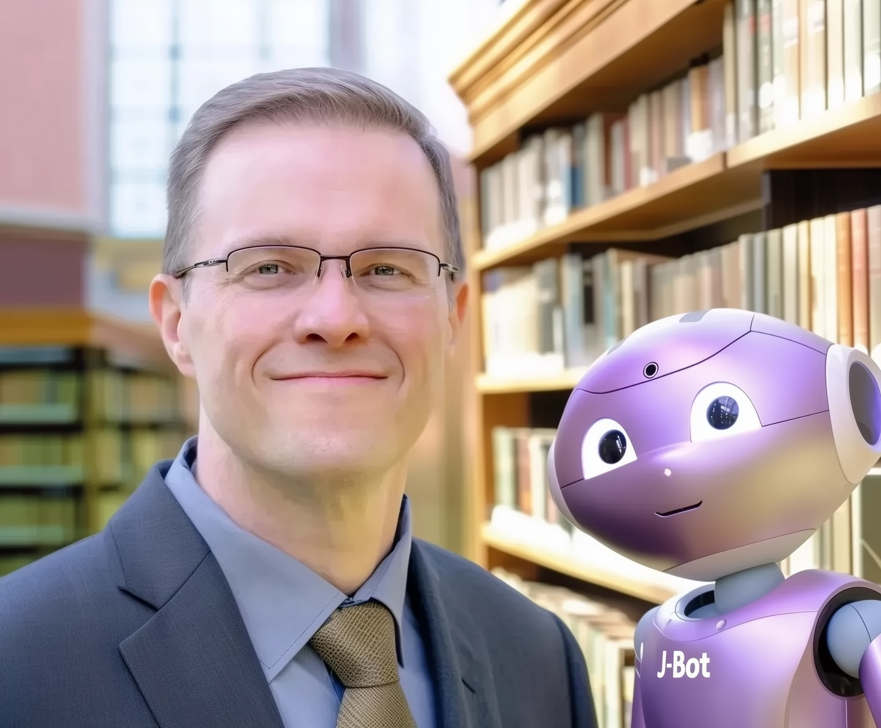
Thank you for your time.
Questions?

Slide 21


