Slide 1

Growing and Caring for your Kefir Culture
Inspired by the guerilla cheesemaker
David Asher,
Author of The Art of Natural Cheesemaking,
and a workshop at EcoFarm 2016
Keli Rutan-Jorgensen, May 5, 2020
PLEASE NOTE I have a soil science background and am NOT a nutrition or health consultant

Slide 2
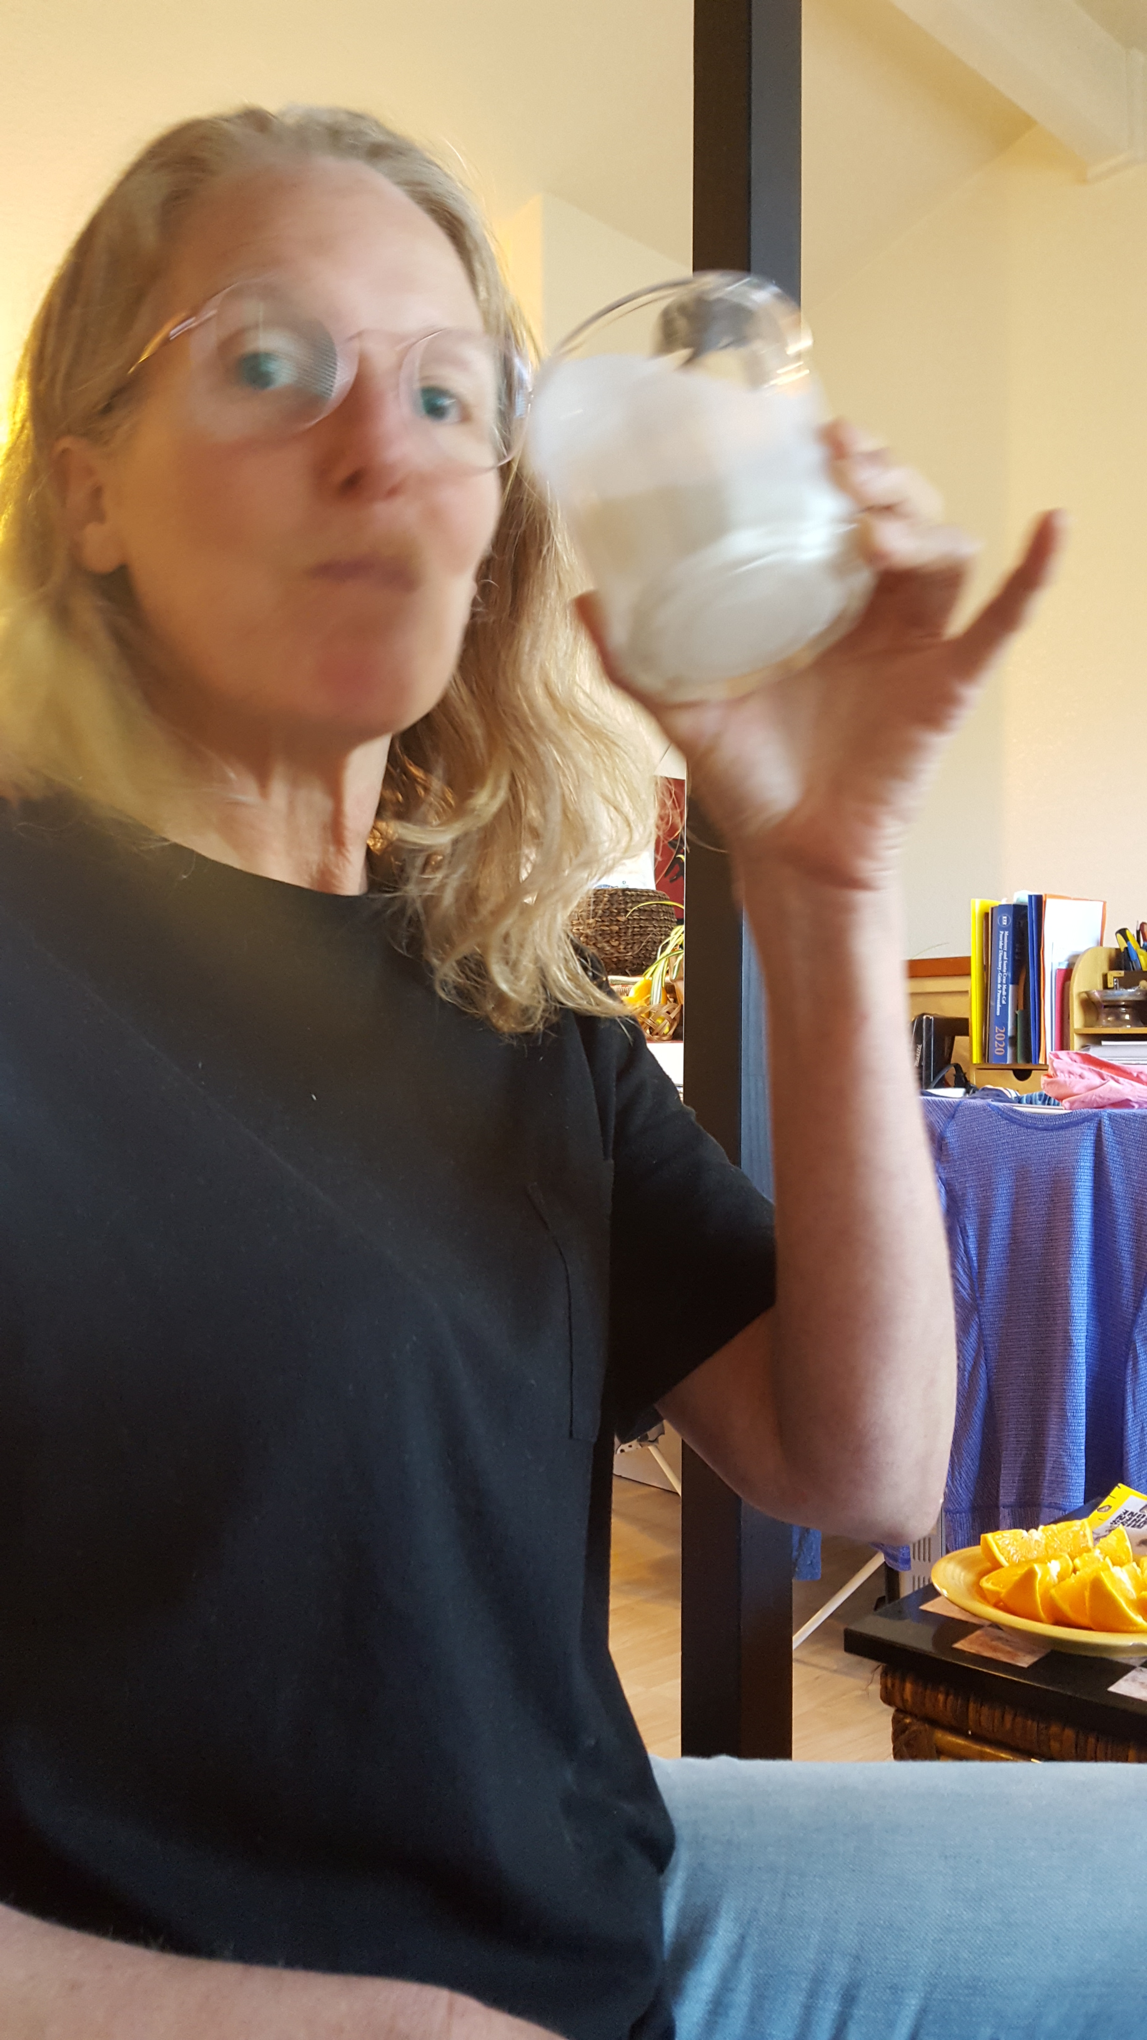
Thank you for letting me share with you about kefir.
Here’s what we’ll look at in the following slides:
Kefir is a fermented drink made from milk.
It’s good for you!
A kefir culture is easy to care for.
There are a lot of ways to enjoy kefir.

Slide 3
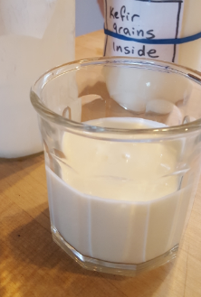
1. What is kefir?

Slide 4
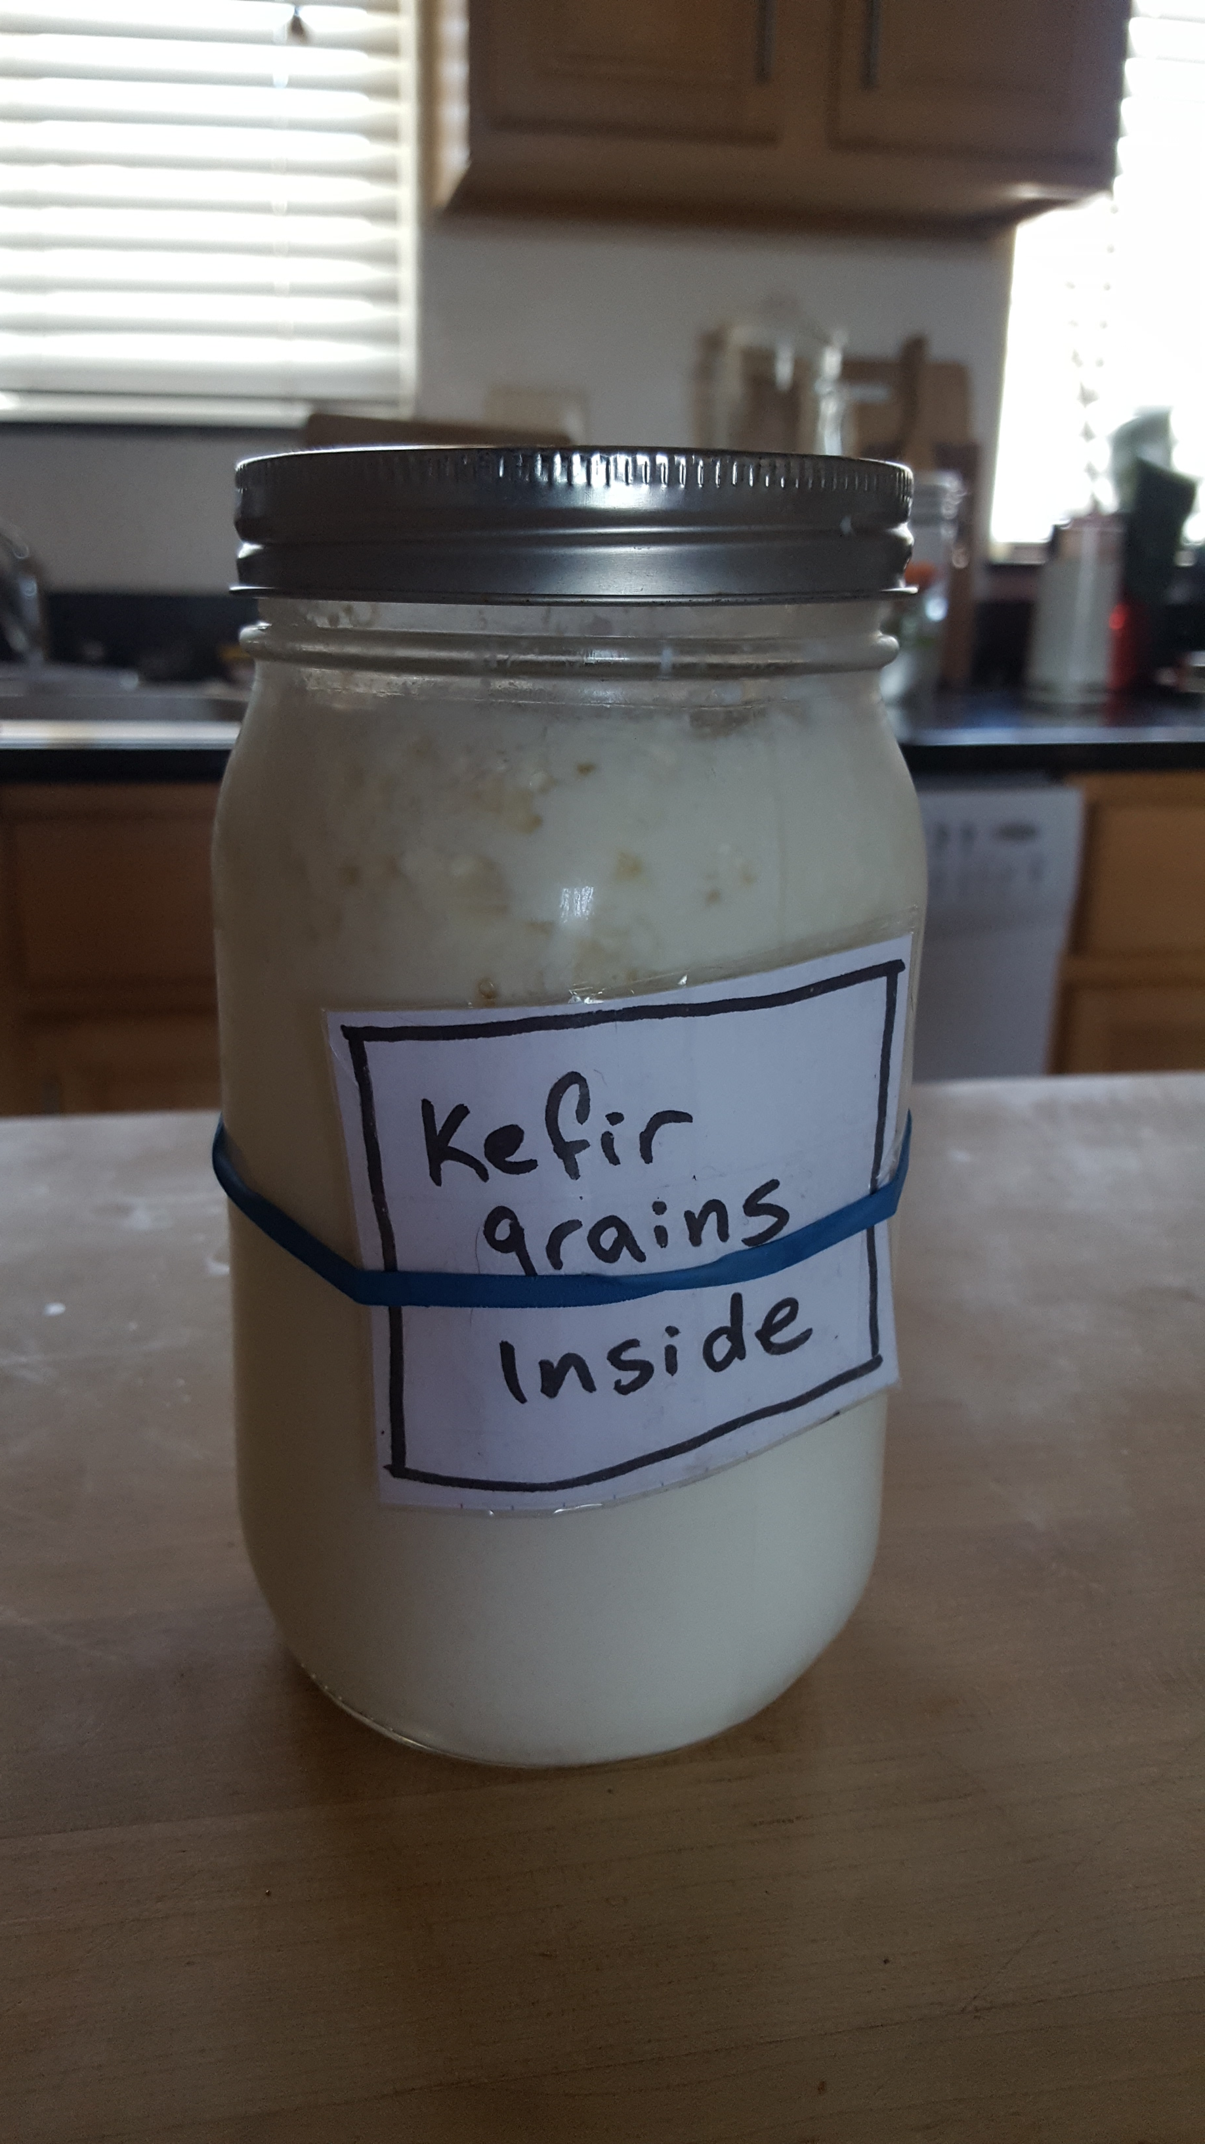
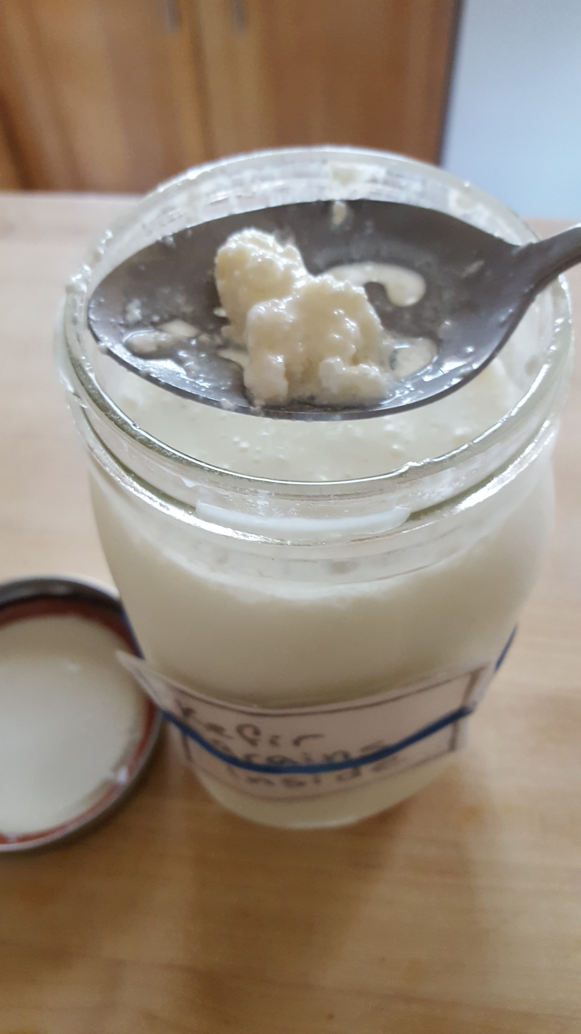
Kefir is a raw, cultured dairy product
Kefir is a tangy, creamy, slightly effervescent yoghurt-like drink.
Like yoghurt, kefir is made with a culture that is added to milk.
After it thickens, the kefir culture is taken out.

Slide 5
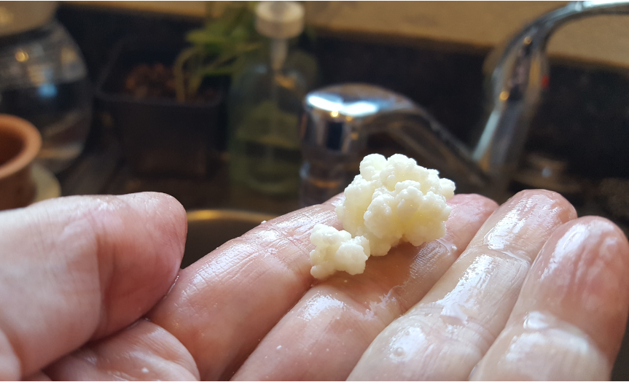
Kefir culture is made from grain-sized colonies of microbes, called SCOBY.
SCOBY is a Symbiotic Community of Bacteria and Yeasts
Kefir is just like kambucha, only cuter!
Kefir culture contains the biota of raw milk.

Slide 6
2. Kefir is good for you
Kefir comes from the Turkish word keyif, meaning “feeling good.”

Slide 7
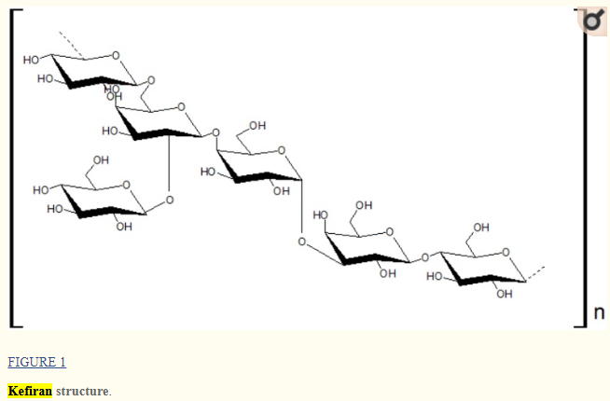
Kefir is good for you
Kefir has high levels of vitamin B-12, calcium, magnesium, vitamin K-2, biotin, folate, enzymes and probiotics
Kefir is a great probiotic.
  Contains tens or even hundreds of strains of bacteria and yeast
Kefir improves lactose digestion and tolerance in adults with lactose malabsorption.
Kefir can relieve symptoms of IBS and other digestive maladies related to imbalanced microbial balance of the gut
Some doctors recommend about 8 oz kefir per day.

Slide 8
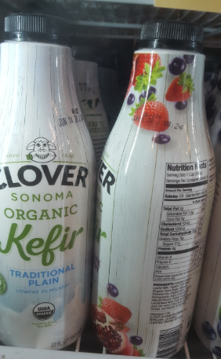
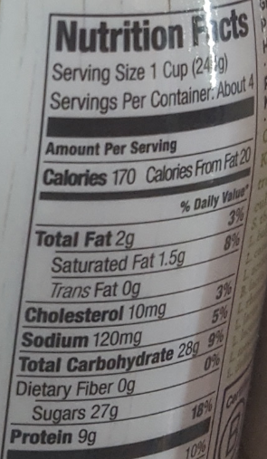
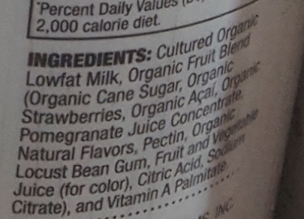
There are many reasons to love your kefir culture
You can buy kefir in the store, so that is nice.
Store bought kefir will have only a handful of microbial strains.
It will have lots of other ingredients you might not want.
Note the sugar content.
This 4-cup bottle costs $5.00 at New Leaf in Santa Cruz.

Slide 9
3. Caring for your kefir culture

Slide 10

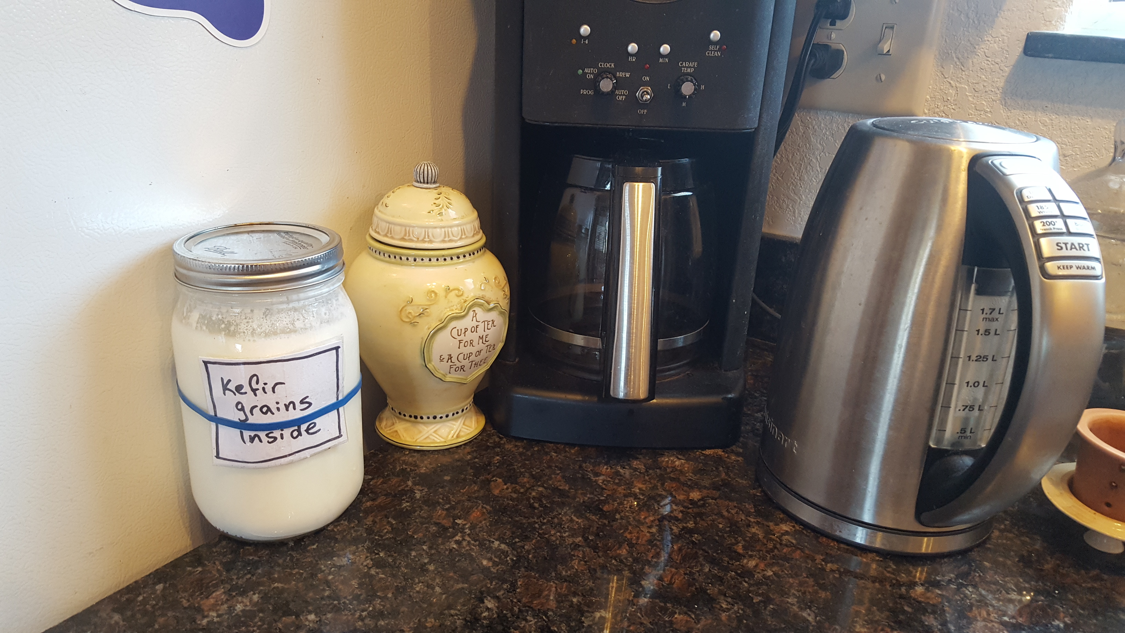
A kefir culture is your cheese-making pet.
You feed your culture, and it feeds you kefir.
Grains can be dried and sealed indefinitely
  Just like a dairy sea monkey
Simple directions:
  Put one grain into ½ c milk.
  Let it sit out for 24 hours or until milk sets.
  To get your grains to grow, feed them every day.
Grains are low-maintenance. If you don’t feed them, they can last in the fridge for up to 3 months.

Slide 11
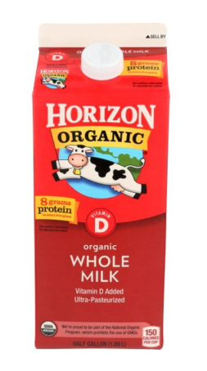

Kefir cultures can die.
Feed them with fresh milk.
Watch out for Ultra-Pasteurized milk!
Fortunately, kefir culture is the original gift culture.
Share your kefir babies! Give them away and they might come back to you.
Or find them online!

Slide 12
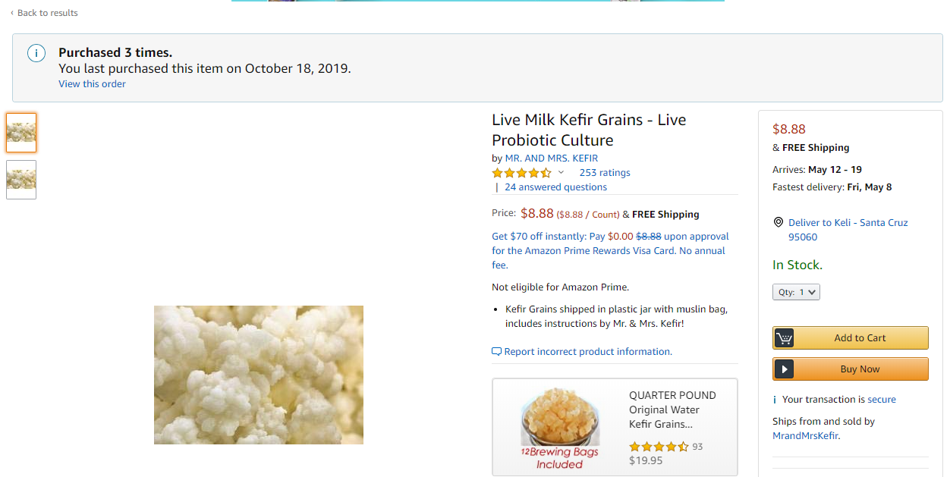
Mr. & Mrs. Kefir sell their kefir babies on Amazon

Slide 13
4. Many ways to enjoy kefir

Slide 14
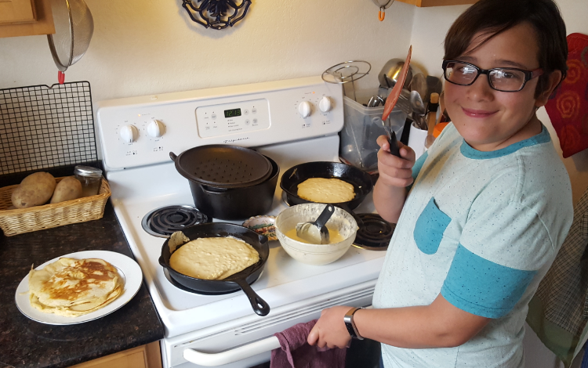
4. Kefir can be put to work in many ways
Drink it plain, or with a dash of salt or mint leaves.
Mix into smoothie.
Use it wherever yoghurt or buttermilk is called for in a recipe.
Kefir grains can also be added to other liquids.
You can make coconut kefir, water kefir.

Slide 15

Add a kefir grain to make sodas
In 24 hours it turns a sweetened liquid to soda
  A few days later it turns to an alcoholic beverage
Grape juice → wine
Apple juice → apple cider
Orange juice → mimosa

Slide 16
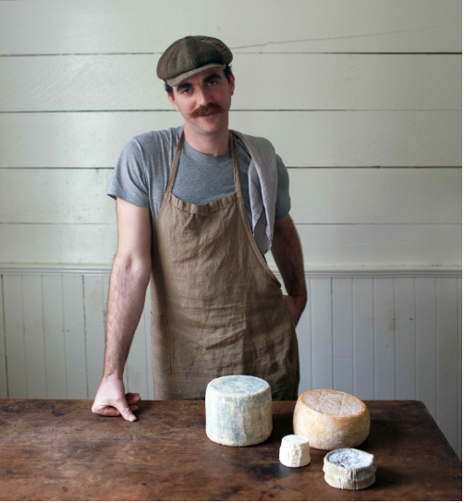
Kefir can be used for even more goodies
You can make yoghurt with kefir grains
You can add it to cream to make a cultured butter
Other cheeses you can make include crème fraiche, aged chevre
See David Asher’s The Art of Natural Cheesemaking for these and many more recipes

Slide 17
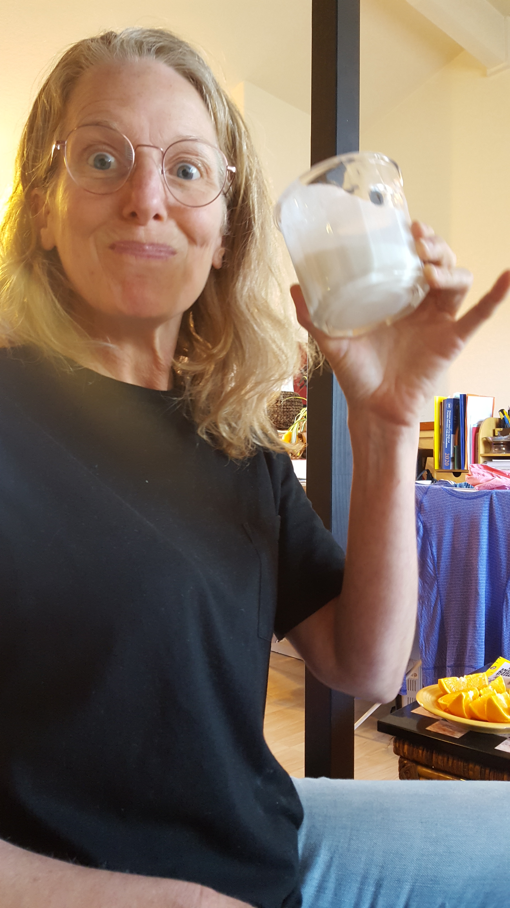
Thanks for letting me share my kefir culture with you
Kefir is a fizzy yoghurt drink.
Kefir is so good for you!
Your kefir culture can be like a member of your family.
There are a lot of ways to enjoy kefir.

Slide 18
If you’re looking for more info. . .
On the science of kefir composition: Milk kefir: composition, microbial cultures, biological activities, and related products. Frontiers in Microbiology. 2015. https://www.ncbi.nlm.nih.gov/pmc/articles/PMC4626640/
On how to care for and use your kefir: The Art of Natural Cheesemaking by David Asher, Chelsea Green. 2015.
On the importance of healthy gut microflora: The Secret Life of your Microbiome. 2017. by Susan L Prescott, MD, PhD, Alan C Logan ND. New Society Publishers.
On how to make water kefirs: https://www.culturedfoodlife.com/learn-how-to-make-water-kefir/

Slide 19
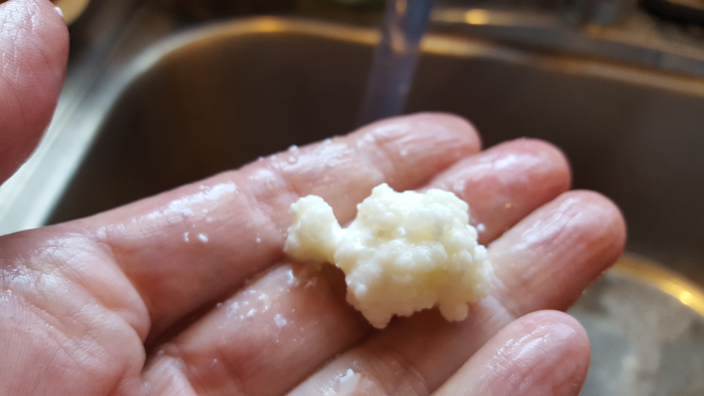
Questions?
Thank you!

