Slide 1
Ancient Africa
A Quick Understanding of Pre-Colonized Africa

Slide 2
AFRICA
Africa, The Continent
54 Countries and 9 Territories
1.1 Billion people, 15% of world population
Largest Country: Algeria.
Largest City: Lagos, Nigeria (pop. 21 million_
Longest River: Nile (4,258 miles), longest river in the world. That’s like driving across the entire United States and coming back to the Midwest!
Highest Mountain: Mt Kilimanjaro (Tanzania)
3000 different people groups and 2000 languages.
Religion: Primarily Christians, Muslims.

Slide 3
Physical Features of Africa
To Understand the people of Africa, you have to understand the areas they live. Africa is a large continent with A LOT of different ecosystems. Deserts, famous and important rivers, rainforests and savannah all create a very different lifestyle!

Slide 4
Ancient Civilizations
Many ancient civilizations in Africa are not as well documented as Egypt and others because there wasn’t a push for a written language, so the history is less specifically known.
Kush ruled over a large section of northeastern Africa and most of the history of this civilization is known from Egyptian sources. It was an economic center with a market on ivory, incense, iron, gold. It was a military rival of Egypt and even rule Egypt in the 25th dynasty. The Kushites worshipped some of the Egyptian gods, mummified their dead and built their own pyramids.
2500 BC is where historical accounts placed this civilization. Egyptians believed it was the Land of the Gods, rich in ebony, gold, myrrh, exotic animals. During Queen Hatshepsut reign in Egypt, 15th century BC, supposedly huge caravans went on trade missions to Punt. The exact location of Punt still isn’t confirmed, though scientists studied a mummified baboon that was gifted to Egypt at one point and they think it might be over Ethiopia and Eritrea.
Carthage, which is ancient Rome’s rival in the Punic Wars. 8th or 9th century BC as a Phoenician settlement in now Tunisia and sprawling along the northern sea side of Africa. Carthage eventually expanded some influence into Spain and the Mediterranean. Carthage wanted to expand into Rome, thus the Punic Wars. There were three bloody Punic Wars in 264 BC through 146 BC, Rome clearly winning.
Kingdom of Aksum, during the rise and fall of the Roman Empire. Huge trade of gold and ivory between Europe and Far East. This kingdom actually had a written language, Ge’ez. It also had it’s own architectural style in massive stone obelisks. It was the first African kingdom to become Christian. It also made a military alliance with the Byzantines.
Mali Empire. 1200 BC Sundiata Keita, a leader known as the “Lion King” led a revolt against a Sosso king and united his subjects into a new state and covered most of Western Africa.
Songhai Empire
The Great Zimbabwe

Slide 5
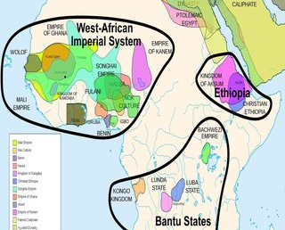

Slide 6
The Famous Civilizations
Ancient Egypt
Kingdom of Ghana
Mali Empire
Songhai Empire
Kush
Kingdom of Aksum
Central African Kingdoms
Ancient Carthage

Slide 7
Bantu People
The Bantu people are indigenous people of Africa who were located in central Africa and then migrated throughout the continent. They represent many different languages that have a similar base language. They migrated most likely due to overpopulation and a search for resources.

Slide 8
Kush (Nubia)
Kush was very similar to Egypt in government, culture and religion. They built pyramids, worshipped Egyptian gods, and mummified the dead. They traded with other cultures with their gold and iron.
First established around 1070 BCE and lasted over 1400 years.
Priests were the most important social class outside of the Pharoah and ruling class. Farmers were respected as they provided food for the country. They were so powerful, they got to decide when it was time for the Pharoah to die.
In art from the period, Kushites are often depicted with archers.
Piye, a leader of Kush, defeated Egypt at one point and became Pharoah of Egypt.

Slide 9
Aksum (Axum)
On the southern coast of the Red Sea. The countries Eritrea, Ethiopia, Sudan, Yemen and southern Saudi Arabia of today were the land of Aksum.
Legend has it the kingdom was established by the son of King Solomon and the Queen of Sheba. It was formed around 400 BCE and was well established until they were conquered in 940 CE
King Ezana was the most well known king, he conquered Kush and converted to Christianity.
It was perfectly located to be a trade center with many waterways– The Red Sea, the Gulf of Aden, and the Nile River. Adulis was the main port city.
Being a trading culture, they were influenced by the people they came in contact with like the Greeks, Romans, Egyptians, and others.
They didn’t build pyramids but instead built tall towers called stelae.
The most famous is the Obelisk of Axum.

Slide 10
The ghana empire
From 300-1100 CE. Formed first when a number of Soninke tribes united under one king, Dinga Cisse. Ghana means “Warrior King”. The people actually didn’t call it Ghana, they called it “Wagadu”.
They mined iron and gold.
They were pressured from Muslims in the north to convert to Islam and refused. Eventually, it broke down and became a part of the Mali Empire.

Slide 11
Empire of mali
1235 CE-1600 CE
Sundiata Keita was the first ruler of the Malinke people. It took over many people groups, including the Empire of Ghana.
While there were many people groups in the empire, they had similar languages and cultures. Farmers were highly regarded, then artisans. Other castes (groups) were fisherman, scribes, civil servants, soldiers and slaves.
Islam was important to the Mali culture.
Mansa Musa was extremely rich and became famous due to a famous trip to Mecca. He brought camels loaded with gold and a massive display of wealth. Was taken over by the Songhai Empire.

Slide 12
Songhai Empire
1464-1591
The first leader was Sunni Ali, who was being held prisoner by the Mali Empire until he escaped and overtook the city of Gao, then slowly conquering surrounding areas until they were in control.
Askia Muhammad became the leader of Songhai in 1493 and created the Askia Dynasty. He was a devout Muslim and solidified the importance of that religion in the area.
Slaves were very important in the Songhai culture– they were typically captives of war and were used to transport goods on trade routes across the Sahara Desert to Morocco and the Middle East. They were also sold to Europe and the Americas.

Slide 13
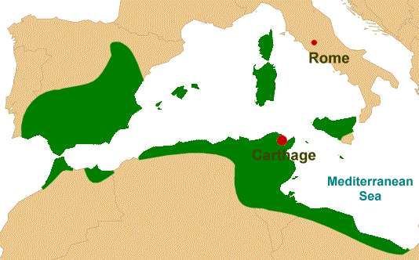
Ancient Carthage
The City of Carthage was a major power in the Mediterranean from 650 BCE-146 BCE. C
They found a number of wars over control of Sicily and they were called the Greek-Punic Wars. Neither side ever gained full control of the island. Carthage owned Western Sicily, while Greeks had the East.

Slide 14
Ruins of carthage

Slide 15
Carthage Facts
Julius Ceasar rebuilt Carthage after the Punic Wars and it became an important city of the Roman Empire.
The word Punic comes from “Punicus” which is what the Romans called the people of Carthage.

Slide 16
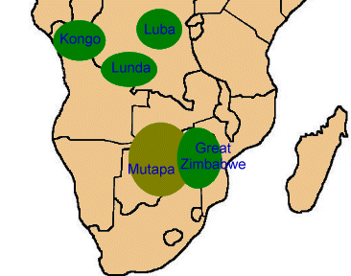
The kingdoms of central africa
Zimbabwe- 1200 CE- 1400 CE
Kongo – 1300s-1914 – King was called the Monikongo. They had a slave trade with Portugal and Manikongo Afonso I attempted to stop it.
Luba- 1585-1889
Lunda- 1665- Created by the brother of the king of Luba.
Mutapa-1430-1759 became wealthy through gold and ivory trading.

Slide 17
Africa Colonized

