Slide 1



“She was more patient than nurse” The Transformation and Empowerment of the Nurse as a Wounded Healer in Michael Ondaatje´s The English Patient
Yasmeen Al Jaabari

Slide 2





The English Patient
INTRODUCTION
Transformation and Empowerment of the Nurse as a Wounded Healer
The Concept of the “Wounded Healer” a Term Initially Coined by the Psychologist Carl Jung (1951)
Arnold Van Gennep’s (1960) “Rites of Passage”
Victor Turner´s (1969) Concept of Liminality.

Slide 3

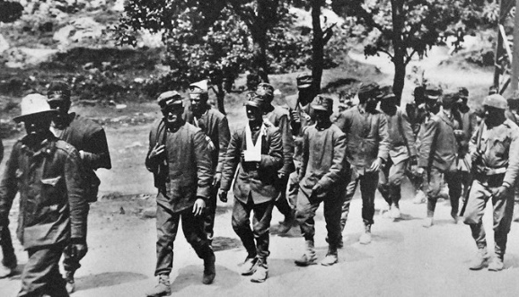

The English Patient
Context of Research: The Richness of Themes in the Novel such as History, Storytelling and British Colonialism.
“Ondaatje is a poet with a mythic imagination and this novel unfolds in prose of such breathtaking lyric and muscular beauty that the reading of it becomes almost a physical experience” (The Irish Times).

Slide 4

The English Patient
Research Question: How does Hana´s Traumatic Experiences and Vulnerability Contribute to her Self-Discovery and Ability to Establish a Therapeutic Relationship with the Other Characters.
Significance: An analysis of the Trope of the Nurse as the Embodiment of Hana’s Journey Towards Physical and Emotional Healing

Slide 5
The English Patient
Research Methods
The Wounded Healer: Carl Jung (1951) in “Fundamental Questions of Psychotherapy” “It is his [the wounded physician’s] own hurt that gives the measure of his power to heal” (1954: 116).
Victor Turner's (1969) in The Ritual Process Discuss the Concept of “liminality”, which Involves a Process of Transition, an Ambiguous Zone That Resides “betwixt and between’ Defined States of Culture and Society” (1969: 107) .
Arnold van Gennep’s (1960) in The Rites of Passage Which is Distinguishes by Three Phases: “rites of separation, a transition rite, and an incorporation”.

Slide 6



The English Patient
Research Activity
Examination of War as the First Liminal Period
Exploration of the Characters as Wounded Healers
Study of the Villa as the Second Liminal Period and a Place of Recovery and Return
Evaluation of the Significance of the Death of the English Patient

Slide 7




The English Patient
Results
Understanding Wounded Healer, Liminality, and Rites Of Passage in Characters' Transitions and Their Ability to Resume Normal Lives.
Hana, a Multidimensional Character, Discovers Identity Through Connections with Male Characters in an Italian Villa.
War Traumas Transform Characters, Especially in Gendered Contexts, Affecting Their Rite of Passage and Understanding. Post-war, They Gain Knowledge but Remain Fragile, Adapting to Traumatic Circumstances.
Characters Navigate Transformative Villa, Recovering From War Traumas, Understanding Dynamics, and Identities. Returning Plays a Crucial Role in Character Rituals, Influencing Journeys and Contributing To Recovery.

Slide 8

Conclusion
Hana's Traumatic Experiences and Vulnerability Contribute to Her Self-discovery and Therapeutic Relationships.
Hana's True Nature and Identity are Revealed Through Her Sensitive Role as a Wounded-healer in an Italian Villa.
Characters are Transformed by War Trauma, Particularly in Gendered Contexts. Hana's Recovery Journey, Complex Relationships, and Identity as a Young Woman Grappling with Trauma all Contribute to Her Understanding of Who She is and Her Development of Therapeutic Relationships.

Slide 9


THANK YOU
Welcome to Questions

