Slide 1
nextAgen
VISION AI
USE CASES
Comprehensive Guide Across Industries
Powered by Nextagen Analytics
2026

Slide 2
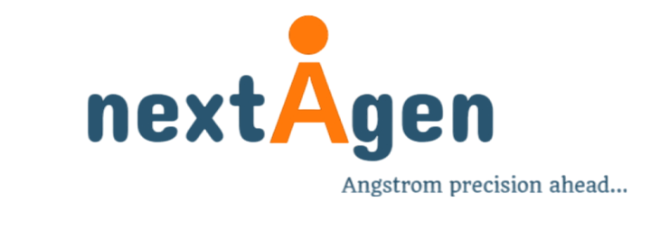
The Vision AI Revolution
Vision AI deploys advanced computer vision algorithms powered by deep learning to achieve continuous, real-time visual intelligence across industries.
🏪
🏙️
🏭
🏥
🌾
Retail
Smart Cities
Manufacturing
Healthcare
Agriculture
Loss prevention, queue management
Traffic, parking, surveillance
Defect detection, maintenance
Fall detection, diagnostics
Crop health monitoring
20+ Transformative Use Cases with Measurable ROI

Slide 3
🏪 Retail & Commercial
Loss Prevention & Self-Checkout Security
Problem Statement
Vision AI Solution
1.4-2.0% revenue loss from shrinkage
Sweet-hearting: not scanning items
Human staff can't monitor 8-12 stations
Traditional security is reactive
Overhead cameras detect discrepancies
Real-time gesture recognition
94.7% detection accuracy
Instant staff mobile alerts
62%
$850K
18mo
96%
Shrinkage Reduction
Annual Savings
ROI Period
Customer Satisfaction

Slide 4
🏙️ Public Safety & Smart Cities
Traffic Congestion & Wrong-Way Detection
Problem:
300-400 annual fatalities from wrong-way drivers
Conventional sensors can't identify specific hazards
Delayed 911 information
AI Solution:
Vehicle trajectory analysis
Real-time wrong-way detection
Automatic variable message sign alerts
Impact
68% reduction in wrong-way incidents
42% faster emergency response
$3.2M annual savings per 100km

Slide 5
🏭 Manufacturing, Energy & Mining
Industrial Defect Detection
Solar Panels & Electronics PCB Inspection
Challenge & Solution
Microscopic cracks (0.05mm) reduce efficiency 15-25% but invisible to human eye
Manual inspection: 75-82% detection rate at 1000+ units/hour
Vision AI: 16K resolution cameras + CNN (YOLO, EfficientDet)
Multi-spectrum: RGB + UV + Infrared for comprehensive defect analysis
>98.5%
76%
$3.8M
18mo
Detection Rate
Warranty Claim ↓
Annual Savings
ROI

Slide 6
🏥 Healthcare & Life Sciences
Slip and Fall Detection
Results
Critical Problem:
800K annual hospitalizations from falls
50% mortality if patient lies >1 hour
$850K average lawsuit settlement
AI Solution:
Privacy-preserving skeletal tracking
96.3% fall detection accuracy
71% reduction in fall-related injuries
92% of falls discovered within 60 seconds
(vs. 18 minutes manual discovery)
$620K annual savings from reduced liability
(200-bed facility)
Privacy-first design: No facial recognition, silhouette-based only

Slide 7
🌾
Agriculture & Environmental Monitoring
Crop Health & Stress Monitoring
Drone-Based Multispectral Imaging for Precision Agriculture
Traditional Challenge:
Manual inspection: <5% farmland coverage
Damage visible only after 20-30% crop loss
Blanket pesticide application wastes inputs
Vision AI Approach:
Drone multispectral: RGB + NIR + Red Edge
NDVI identifies stress 7-10 days before visible
AI classifies: pest, nutrient, water, disease
Prescription maps for variable-rate application
Impact on Farm Operations
+18% Yield Increase
Early intervention
-34% Pesticide Reduction
Targeted application
$180/acre Additional Revenue
Corn & soybeans
12 months ROI Period
500+ acre operations

Slide 8
Measurable Business Impact Across All Domains
Industry
Key Metric
Improvement
Annual Savings
Retail & Commercial
Shrinkage Reduction
62-73%
$420K-$1.2M
Smart Cities
Incident Reduction
68-92%
$1.8M-$3.2M
Manufacturing
Defect Detection
76-88%
$3.8M-$4.2M
Healthcare
Fall-Related Injuries
71%
$620K
Agriculture
Yield Increase
+18%
$180/acre
Typical Facility ROI: 12-24 Months | Continuous 24/7 Monitoring | >95% AI Accuracy

Slide 9
nextAgen
The Vision AI Transformation
Vision AI represents more than incremental improvement—
it fundamentally reimagines operational excellence.
✓ Continuous 24/7 Monitoring
✓ Proactive Intelligence
✓ Measurable ROI (12-24 months)
✓ Enterprise Scalability
Nextagen Analytics
contact@nextagen.in | +91 2654059388
www.nextagen.in
Specialized in Enterprise-Grade Vision AI Solutions

