Slide 1
HERBAL MEDICINE
SIDDHARTH K

Slide 2
Herbal Medicines Definition

Slide 3
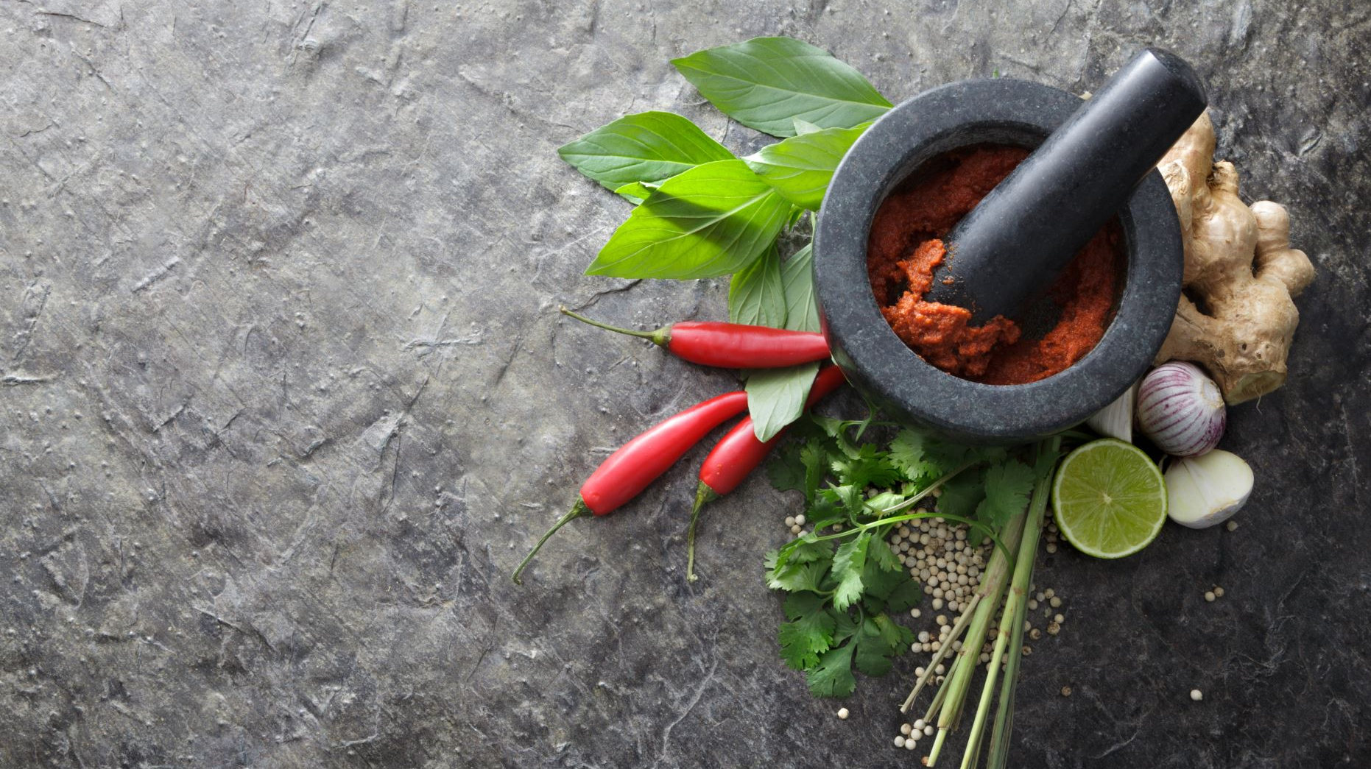
Herbal medicines refer to preparation made from parts of plants , viz. roots , stems, bark , leaves and flowers or seeds used for prevention or treatment of diseases.

Slide 4
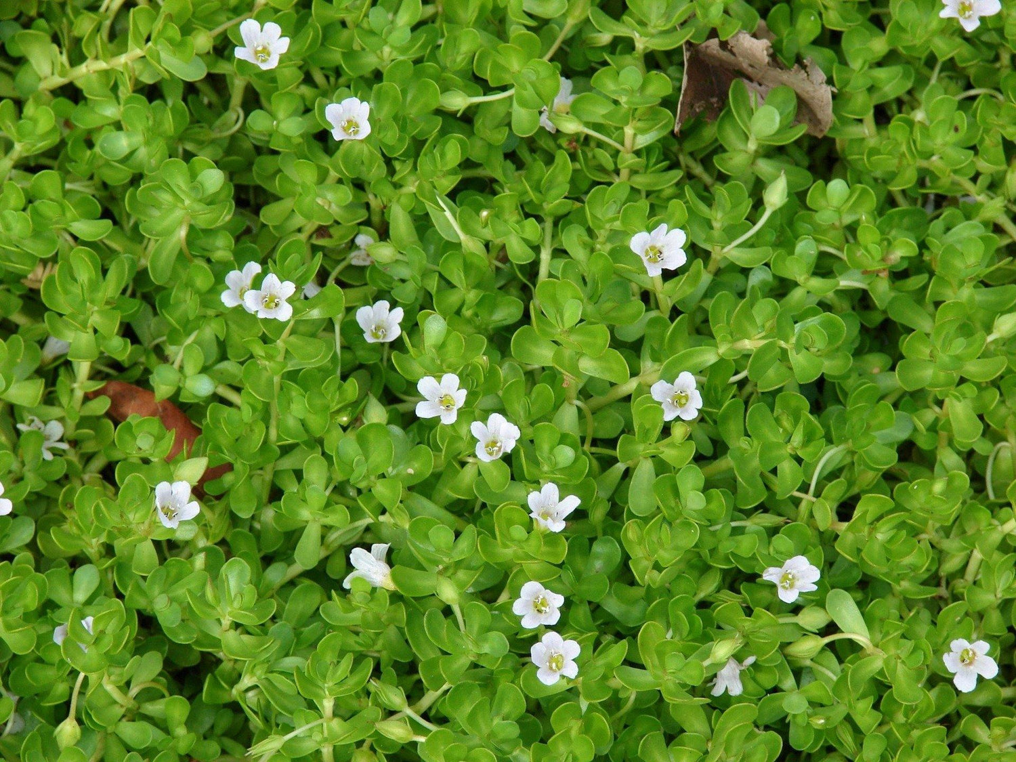

Slide 5
Bacopa monnieri ( Brahmi )

Slide 6
Uses
Cognitive disorders
Depression
Anxiety
Insomnia
Panic attacks
Blood pressure normalization

Slide 7
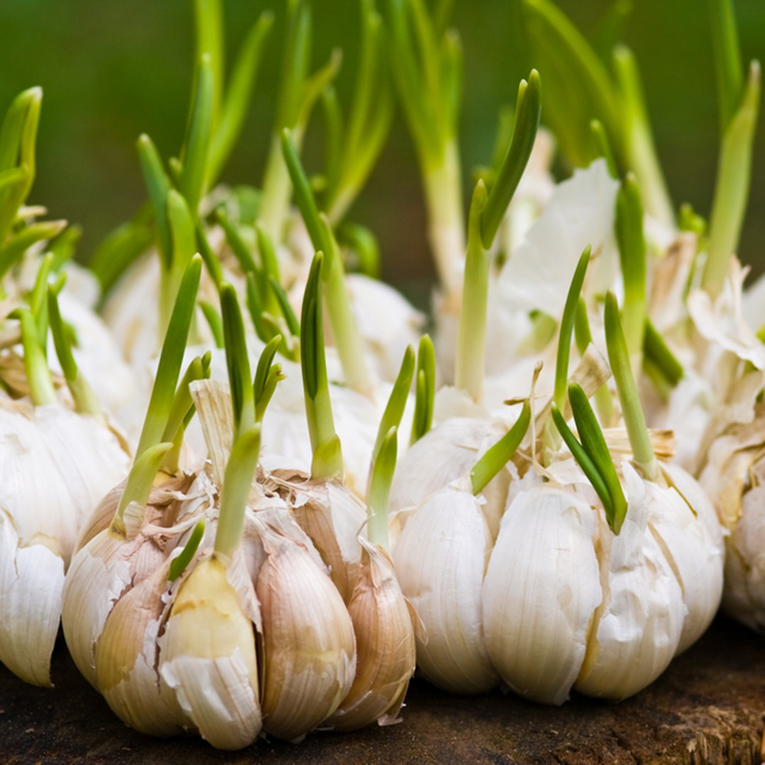

Slide 8
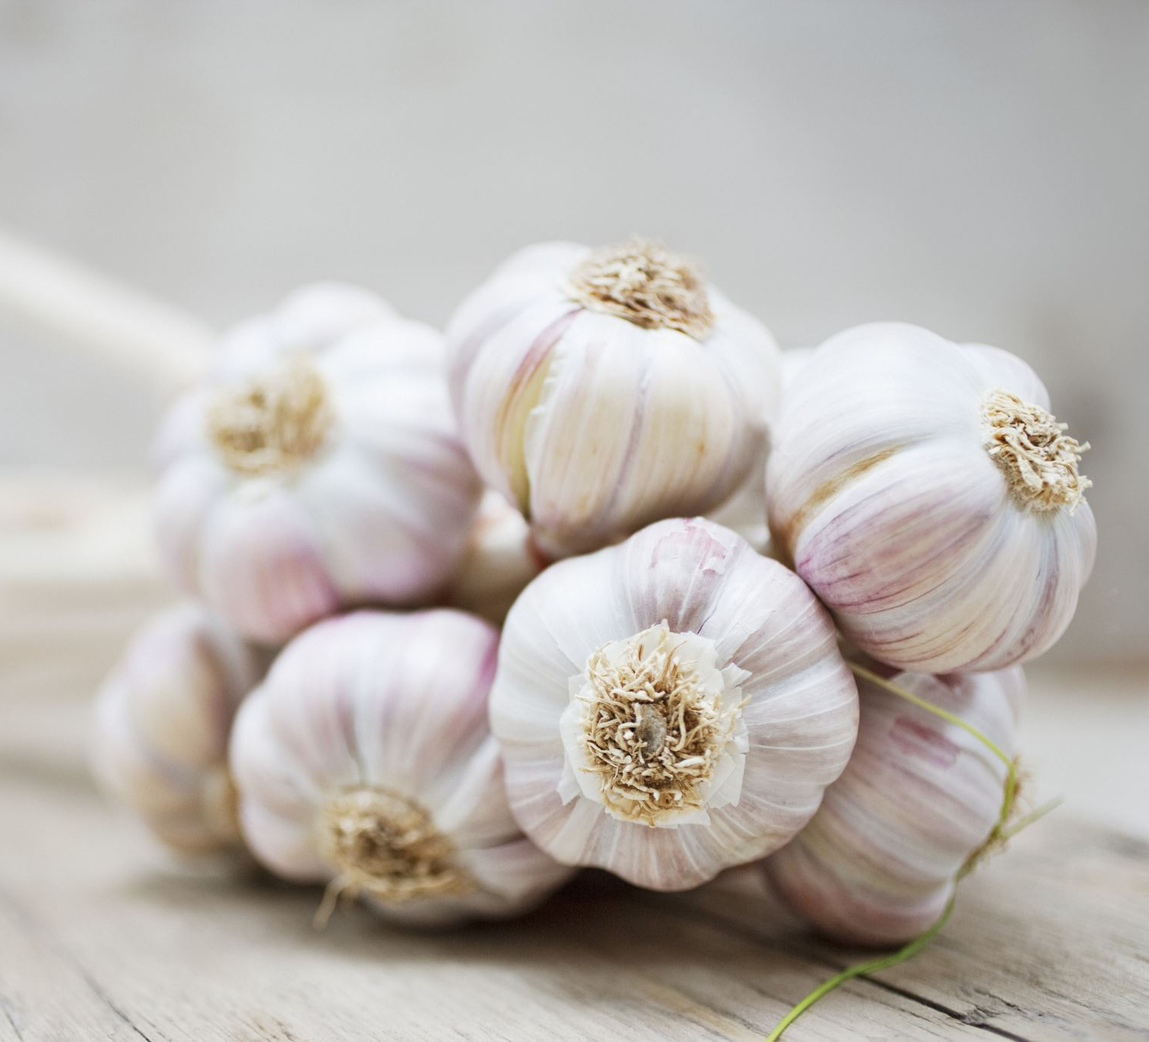
Allium sativum (Garlic)

Slide 9
Used as fresh garlic pods or powder or oil
Active compounds are Organosulfur compounds ( allicin ) used to decrease
inhibits blood lipids ( inhibits HMG CoA reductase ) , for cold symptoms and as antioxidant
Antihypertensive , antiplatelet
Adverse effects when large amounts taken .
Gastric irritation .

Slide 10
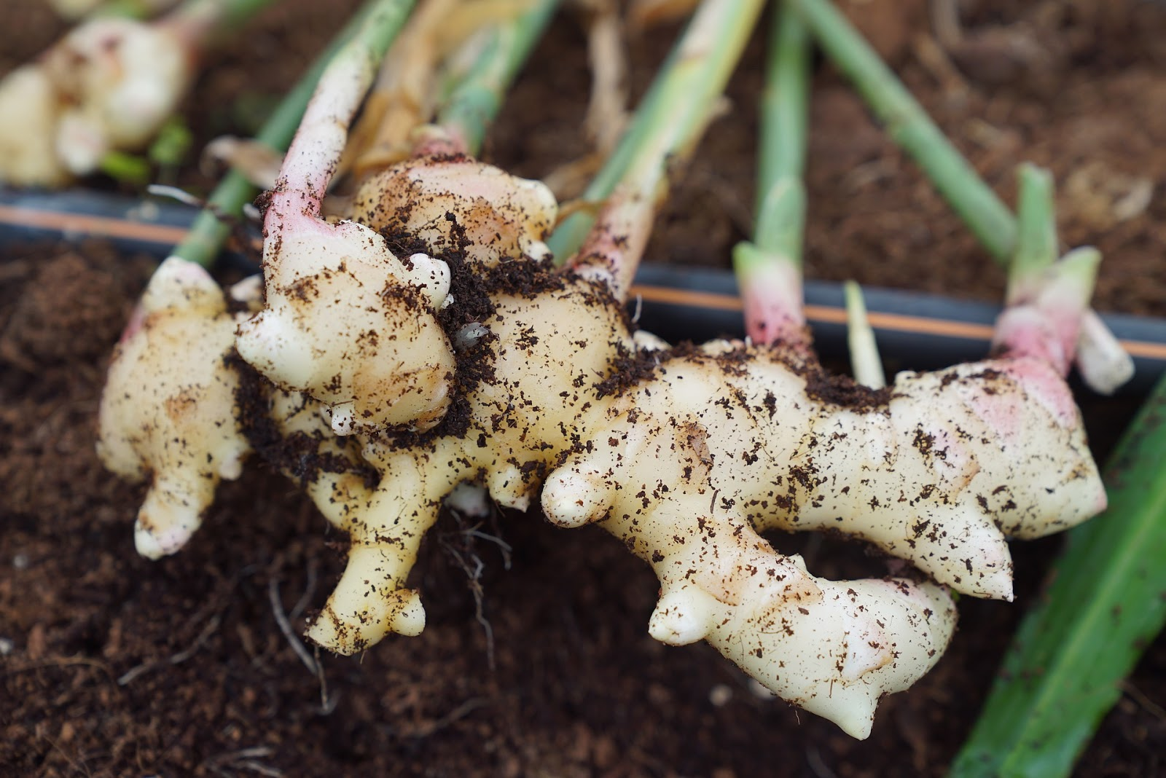

Slide 11
Zingiber officinalis ( Ginger )

Slide 12
Fresh and rhizome powder is used as
Digestive
Carminative
Appetite stimulant
Antiemetic
Active compound is Gingerol .

Slide 13
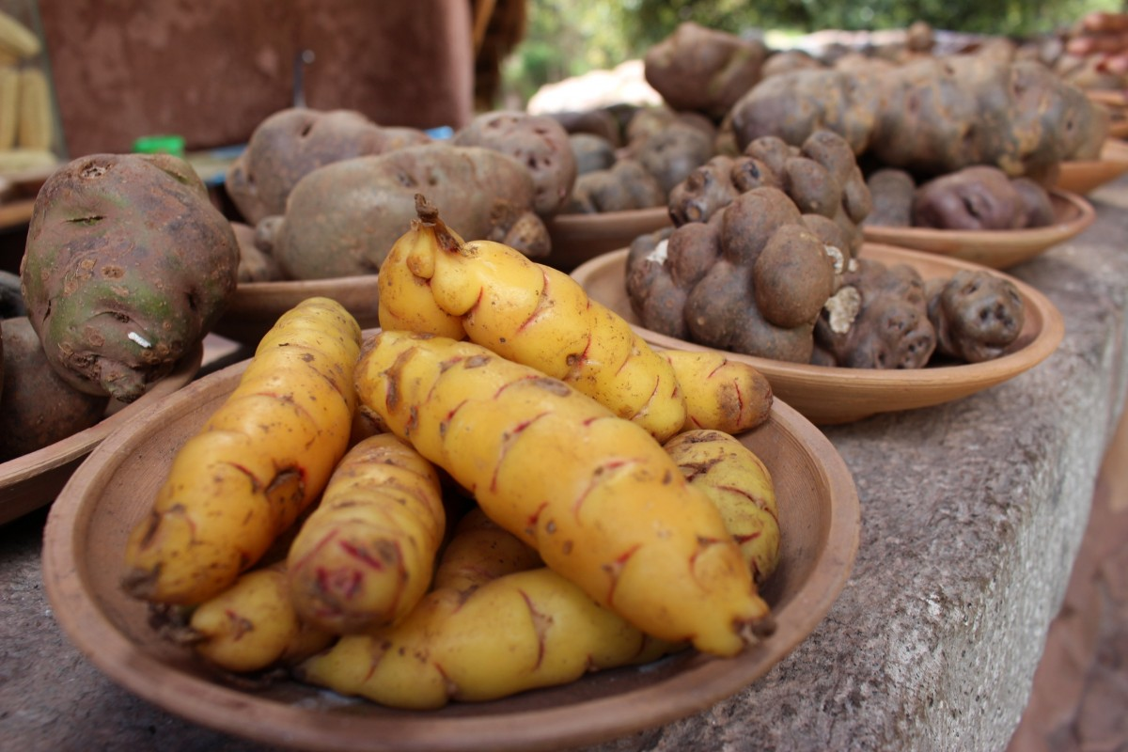

Slide 14
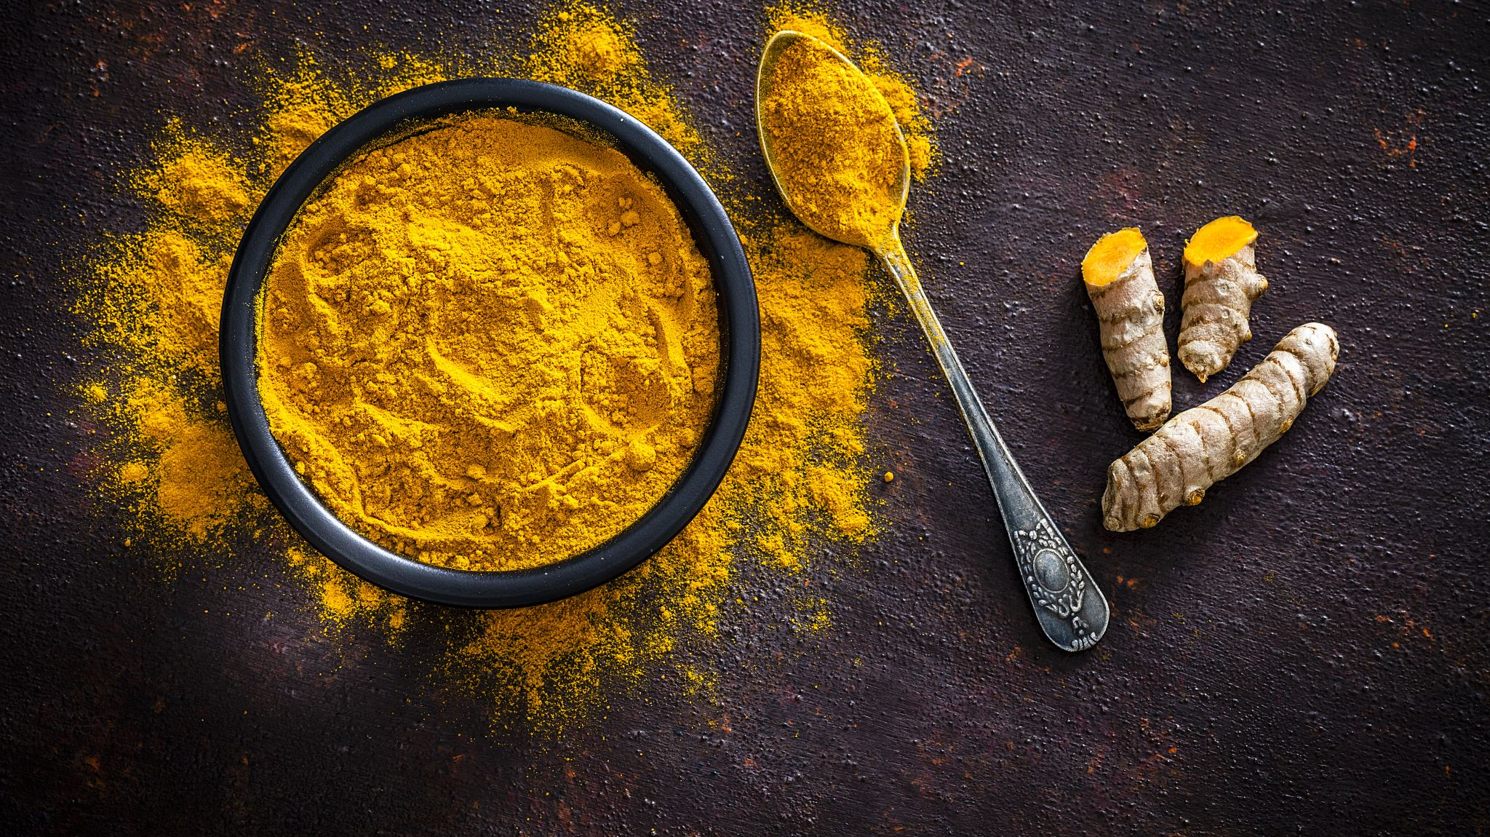
Curcuma longa ( Turmeric )

Slide 15
Active Compound :
Curcumin
Anti inflammatory
Antioxidant

Slide 16
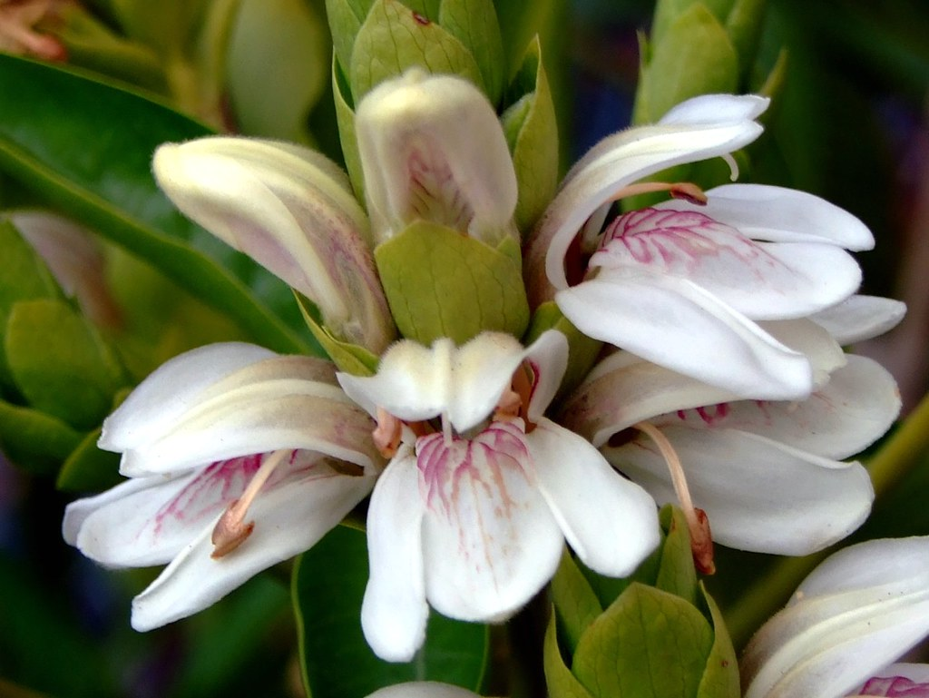

Slide 17
Adhatoda vasica ( Vasaka )

Slide 18
Expectorant used in
Bronchitis
Cough
Major Active Ingredient
Vascicine

Slide 19
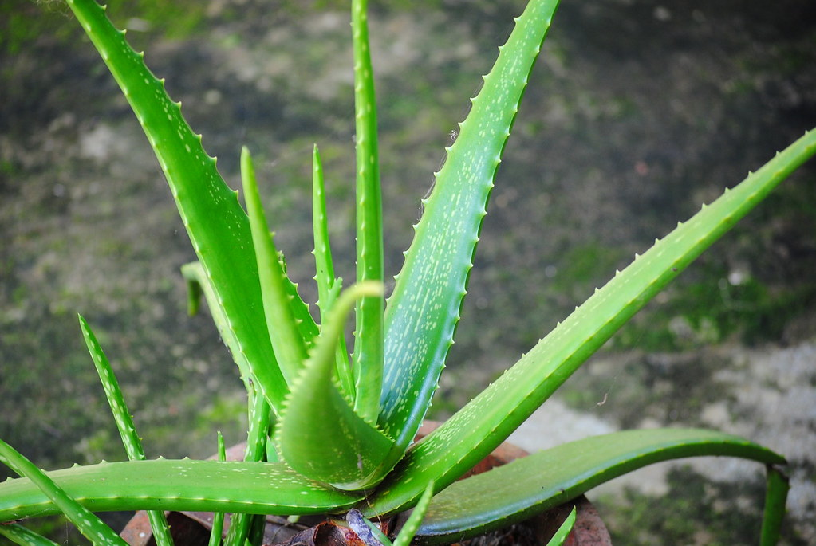

Slide 20
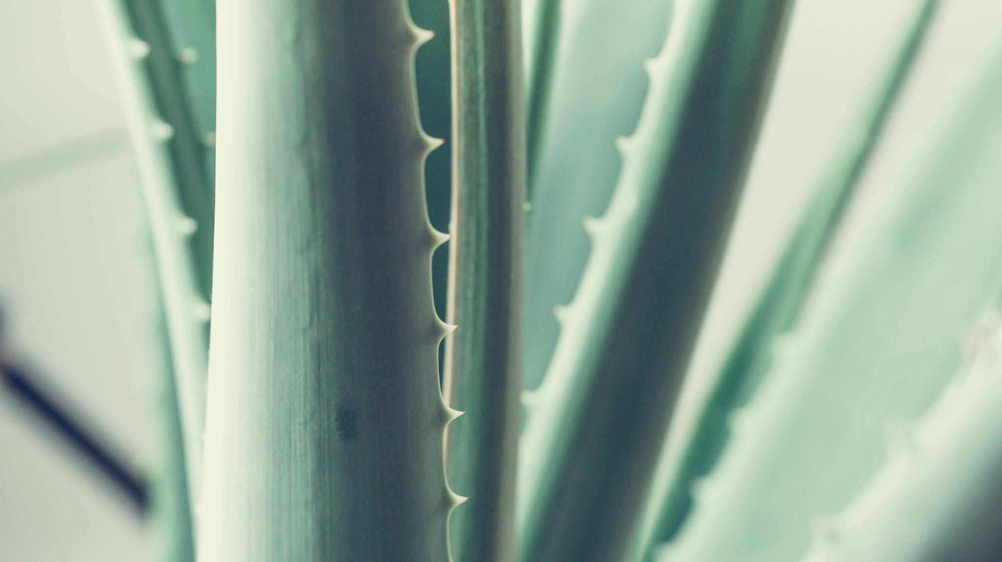
Aloe vera

Slide 21
Benefits of Mucilaginous Pulp
Moisturiser
Anti-ageing for skin
Used on burns
Oral flavouring agent
Treat constipation
Alleviates irritable bowel syndrome
Acts as an antioxidant

Slide 23
Picrorrhiza kurroa ( kutki )

Slide 24
Major Active ingredient
Bitter Glycosides
( Picroside )
Cholerectic
Hepatoprotective
Antivertigo
Reduce Lipids

Slide 25
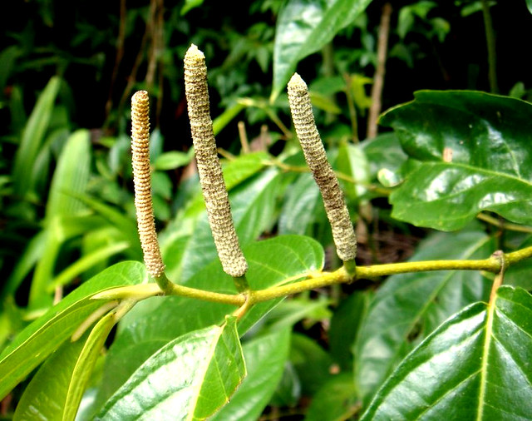
This Photo by Unknown Author is licensed under CC BY-SA

Slide 26
Piper longum ( Long pepper , Pipli )

Slide 27
Treat
Chronic Bronchitis
Asthma
Respiratory Infections
Constipation
Primary Active Compound
Piperine
Bitter
Stimulates Appetite .
Hepatoprotective .

Slide 28
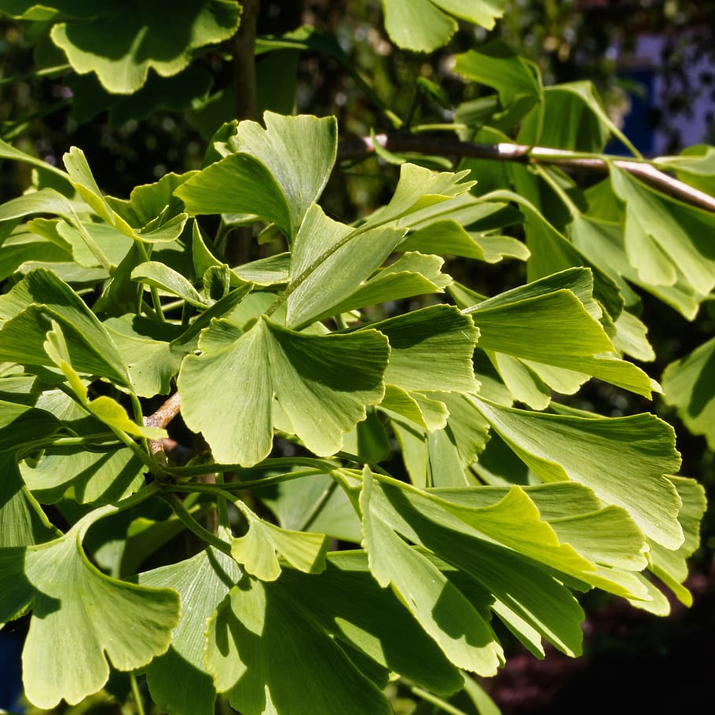

Slide 29
Ginkgo biloba

Slide 30
Cognition Enhancer .

Slide 31
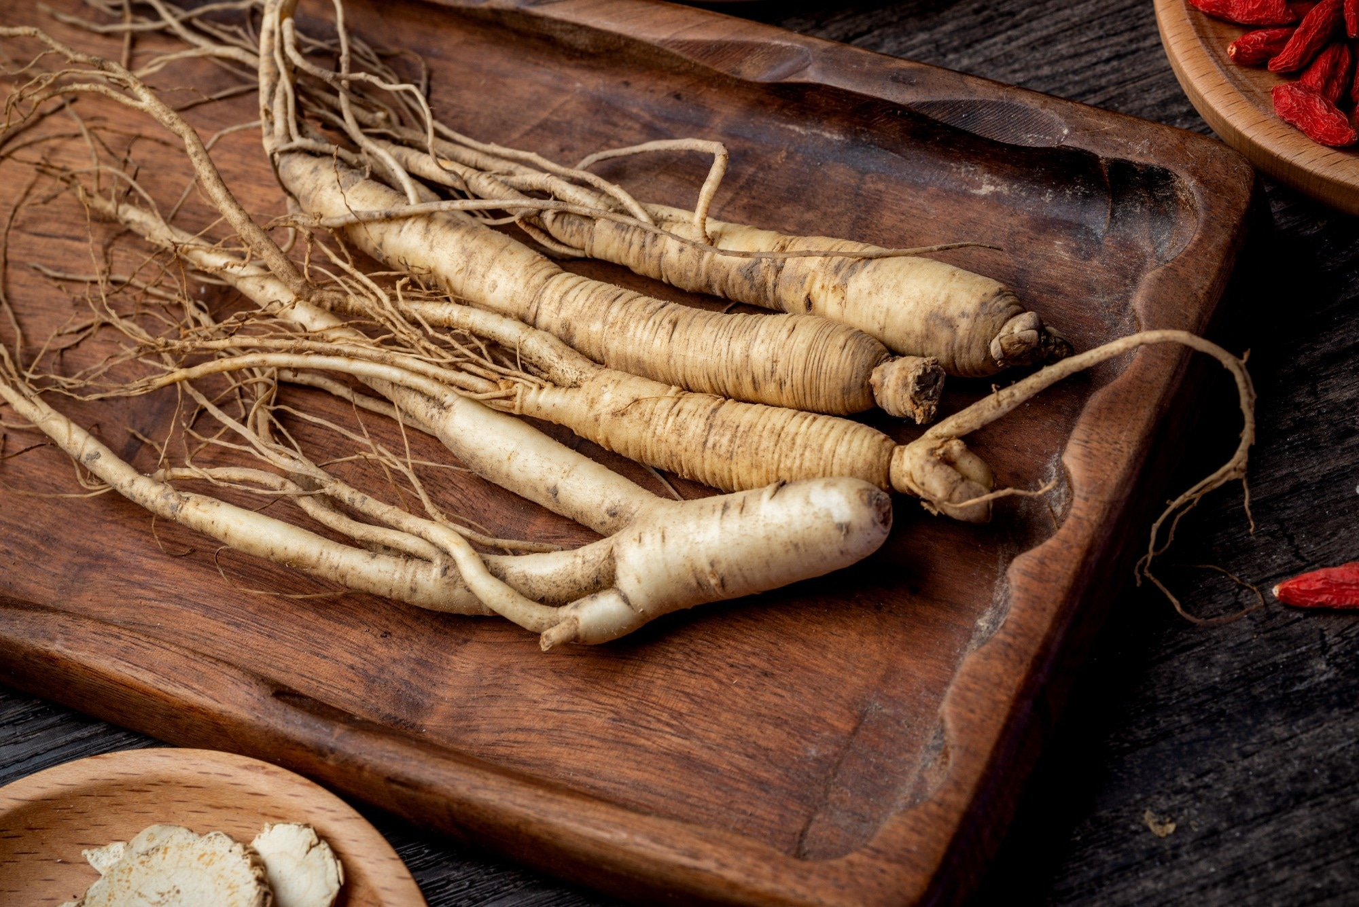

Slide 32
Panax giseng ( Ginseng )

Slide 33
Reduce Stress
Reduce Blood Sugar
Immunomodulator

Slide 34
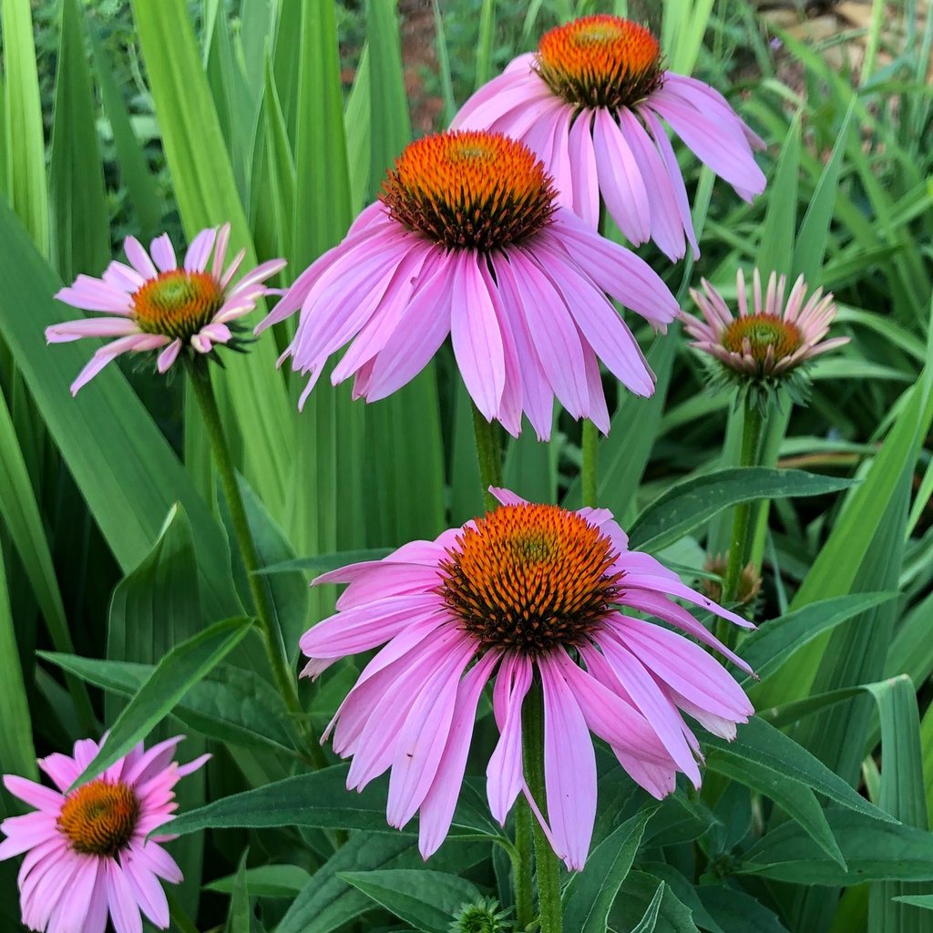

Slide 35
Echinacea purpura ( Cone flower )

Slide 36
Immunomodulatory
Anti inflammatory

Slide 37
THANK YOU

