Slide 2
PRESENT PERFECT SIMPLE vs SIMPLE PAST
(HAVE + PARTICIPLE)
traveled
Last summer my brother _____ to Las Vegas
(travel)
has traveled
That’s the only time he _____ in his life, though
(travel)

Slide 3
PRESENT PERFECT SIMPLE vs PRESENT PERFECT CONT.
(HAVE + PARTICIPLE)
(HAVE + BEEN + ING)
has traveled
My sister _____ to Las Vegas many times
(travel)
has been reading
Recently, my sister _____ an interesting book
(read)
has been
She said: “It _____ very interesting so far”
(be)

Slide 4
PAST PERFECT vs SIMPLE PAST
(HAD + PARTICIPLE)
got
called
As soon as I _____ home, my wife ____ me
(get) (call)
had never eaten
I tried sushi yesterday. Up until then, I _____ Asian food
(never/eat)
texted
had already bought
By the time you ____ me, I _____ the pizza
(text) (already / buy)

Slide 5
REPORTED SPEECH
George to Peter: “Please buy some sushi”
George told Peter to buy some sushi
The teacher to my class: “Have you learned the song?”
The teacher asked us if we had learned the song

Slide 6
It’s considered impolite to blow your nose in Japan
Blowing your nose in Japan IS CONSIDERED impolite
What’s a night owl?
What’s a power napper?
What’s hijacking?

Slide 7
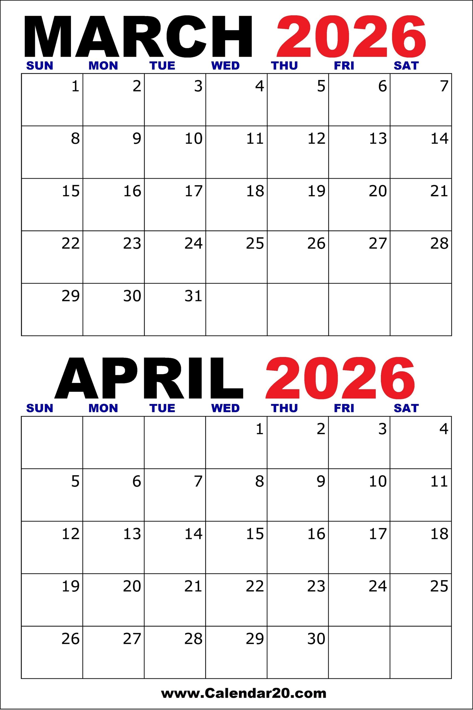
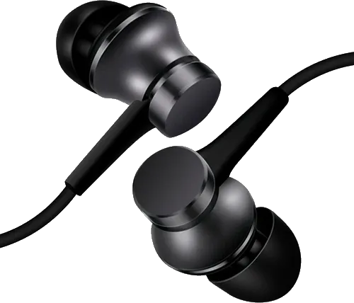
TODAY
2nd EXAM
Musical
Challenge
Computer lab L51
10am Don’t stop believin’
11am Have you ever seen the rain?
12pm Have you ever seen the rain?
1pm Have you ever seen the rain?
SPRING BREAK
Turn left
as soon as you clear access
(downstairs)
First day from break
video
Notes:
https://play.blooket.com/play?hwId=69bdec256a2a0d9a4796af2d

Slide 8
Blooket we played in class, so you can practice
https://play.blooket.com/play?hwId=69bdec256a2a0d9a4796af2d

