Slide 1


Mercer Island High School Boys Swive
2025-2026 Parent Meeting

Slide 2
Boosters!
Fees
Extra Pool Time (Thanksgiving)
Shirts
Senior Banners
Suits
Banquet
Snacks and drinks at meets etc
Booster Fee Ask:
$300
Booster Parents
Dawn Lee: President
Petra Jennings: Volunteer Coordinator
Christopher (Topher) Lucas: Treasurer
Eileen: Booster Secretary and Communications
Tracie Simpson: Sponsorship
Liz Carson: Apparel
Kara Lucas: Hospitality
Stephanie Kornblum Community Liaison
Isabella Fu: Meet Coordinator
Open Vacancies:
State Chair
Senior and Banquet Chair
Notes:
Dawn and Topher

Slide 3
Parent Expectations
Volunteer
At least 3 timing shifts at meets
Or be a specialized volunteer: officials, computer, scoreboard
Support your athlete
Support the coaching staff
Support and talk to each other
Notes:
Petra to Tim

Slide 4
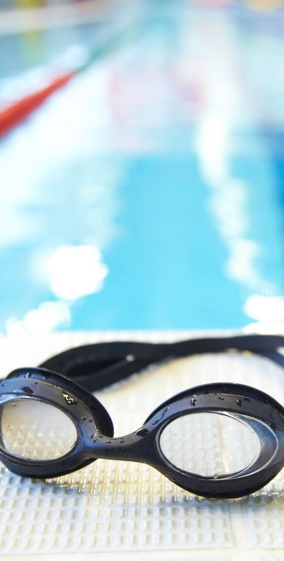
Communication
Team website
www.swimMIHSdive.com
Instagram
Swim.MIHS.dive
TeamSnap Emails from Boosters
Ask another parent!
Ask a coach:
Tim Chung Swim Coach
Ed Artis Dive Coach
Karl Maclan Swim Coach
Elysse Forrester Swim Coach
Email
Tim.Chung@mercerislandschools.org

Slide 5
Practice Times
SWIMMING
Monday Through Friday: 3:30 – 5:30
Monday AM: 5:30 – 7:00 AM
Wednesday AM: 6:30 – 8:00 AM
Friday AM: 5:30 – 7:00 AM
Thanksgiving: 9:00 – 10:30 AM at Mercer Island Beach Club
Winter Break: Dec 22, 23, 26 , 30, 31 and Jan 2 and 5: 10:00 – 12:00 PM at Mercerwood Shore Club
DIVING
Monday, Tuesday, Wednesday: 4:00 – 5:30 PM @ MSC
Must have 7 practices before attending the first swim meet
Calendar link is found www.swimMIHSdive.com

Slide 6
MERCER ISLAND BOYS SWIMMING
MERCER ISLAND BOYS DIVING
ATTENDANCE POLICY
REQUIRED DAYS
• Practice is required Monday–Thursday.
• Friday is optional but encouraged and may be used to make up one missed required day within the same week
TO MAINTAIN SAFETY, TEAM DEVELOPMENT AND LINEUP CONSISTENCY
• A first unexcused absence may affect relay placement in the next meet.
•Repeated unexcused absences may impact eligibility for the next dual meet
CONSECUTIVE ABSENCES
• Repeated consecutive absences will limit the athlete's opportunity to compete in future meets
MEET ELIGIBILITY
• Must attend practice the day before a meet
REQUIRED DAYS
• Practice is required two days a week.
TO MAINTAIN SAFETY, TEAM DEVELOPMENT AND LINEUP CONSISTENCY
•Divers may not miss more than two meets during the season.
CONSECUTIVE ABSENCES
• Repeated consecutive absences will limit the athlete's opportunity to compete in future meets

Slide 7
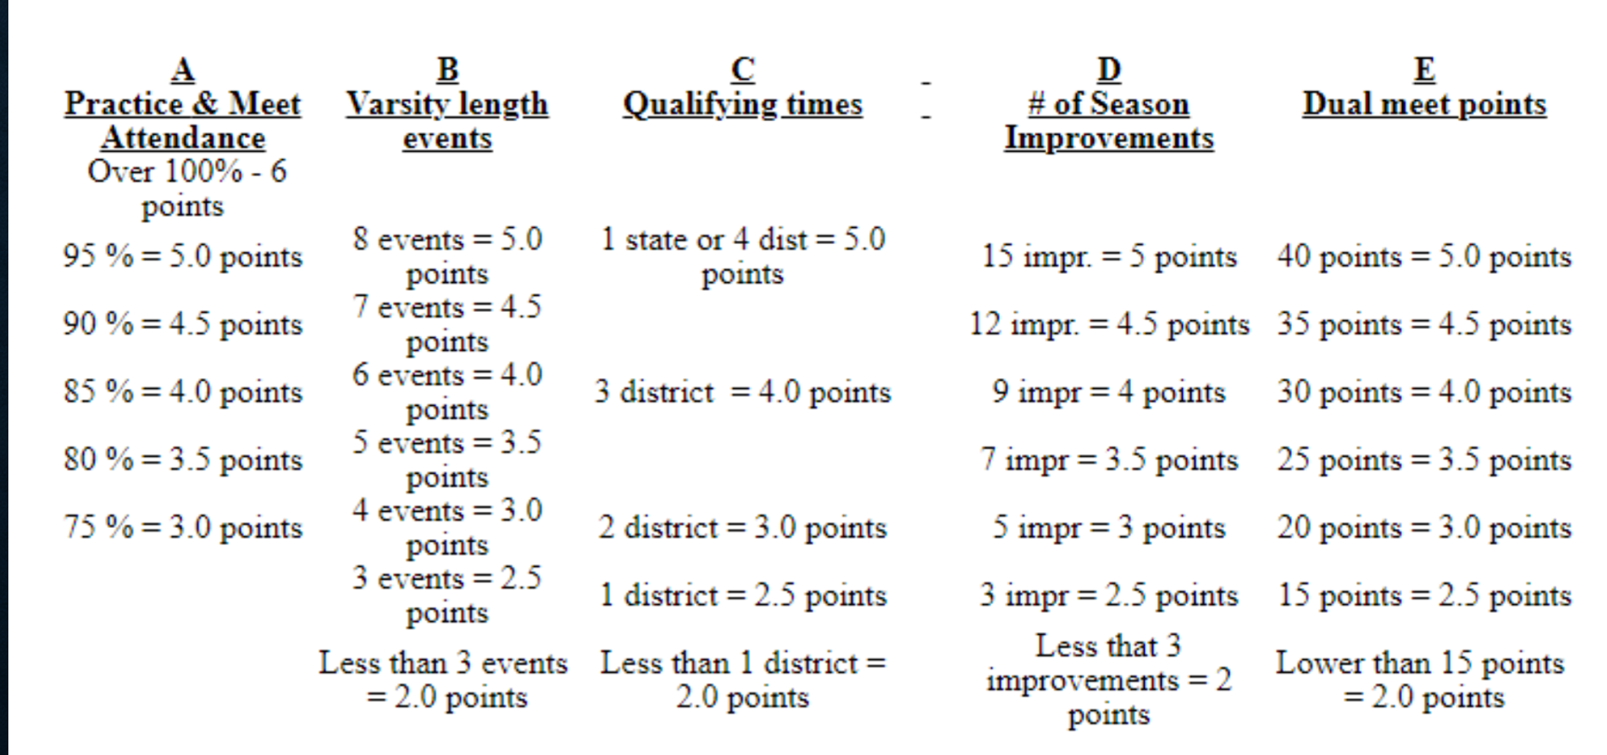
Lettering Standards
Attend 75% of all REQUIRED practices (exceptions: excused school activities)
Policy emphasizes the importance of all aspects of high school swimming.
16 points across A+B+C + (D or E)
85 % Attendance required for MIHS PE CREDIT

Slide 8
Meet Schedule
REGULAR SEASON MEETS
Nov 25 @ 3:30 PM Intersquad Meet
Dec 4 @ 3:30 PM Vs Eastlake at MW
Dec 11 @ 3:30 PM Vs Newport at MW
Dec 18 @ 4:00 PM @ Issaquah at BOEM
Jan 8 @ 3:30 PM Vs Skyline at MW
Jan 10 Kentridge Invite KCAC
Jan 15 @ 3:30 PM @ Bellevue at MW
Jan 22 @ 3:00 PM @ Redmond at Redmond
Jan 29 @ 3:30 PM Vs Hazen at MW
POST SEASON MEETS
Kingco Feb 6-7
Districts Feb 13-14
State Feb 19-21

Slide 9
Practice Standards
Swimmers must be able to swim a 50 of each stroke (all but 1 must be legal)
Swimmers must be able to swim a 200 free without stopping
Swimmers must be comfortable to dive from the edge of the pool or blocks
Genuine positive attitude to improve and learn

Slide 10
Student-Athlete Expectations
Attend classes
Abide by the athletic code
Bullying in any form will not be tolerated
Be the best teammate
Have Fun
Communicate with coaches

Slide 11
Rules, No Exceptions
17.25.2 Schools may allow, once during the season, a student to miss school practices or games for two or more consecutive days in order to participate on a non-school team or teams. 17.25.3 Students shall not compete in the uniform of the school at non-school events. School uniforms, football helmets and shoulder pads may be worn only during the WIAA season for that sport except during Washington State Coaches Association feeder or all state contests. NOTE: Uniforms are considered to be the school issued contest uniform (practice or shooting shirts are not classified as school uniforms) and are defined in the adopted rule book for each specific sport.
17.25.4 Penalties A. If a school gives students special treatment or privileges, the school must report he violation to its league to determine appropriate penalties. B. Penalties assessed to the student for violating this rule are determined by the local school district
Basically: 2 or more consecutive missed practices is a warning. The second time it happens, a violation has occurred, and the coaches need to report the violation which would likely be a suspension from the team.

