Slide 1






Gorakshya Hydropower Limited Kathmandu -9, Battisputali

Slide 2



Slide 3
Progress on Headwork / Intake
Particulars | Progress %
Flood Wall | 100%
Weir | 95%
Under sluice | 95%
Gravel Trap | 75%
Settling Basin | 45%
Total | 82%

Slide 4
Progress on Hydro Mechanical Intake
Particulars | Particulars | Progress %
Undersluice | Stop Log Frame | 100%
 | Main Gate Frame | 100%
Trash Passage | Stop Log Frame | 100%
 | Main Gate Frame | 100%
Gravel Trap | Intake Gate Frame | 100%
Settling Basin | Inlet Seal Beam | 100%
 | Inlet Seal Gate | 50%
 | Inlet Vertical Gate Frame | 50%
Total |  | 88%

Slide 5
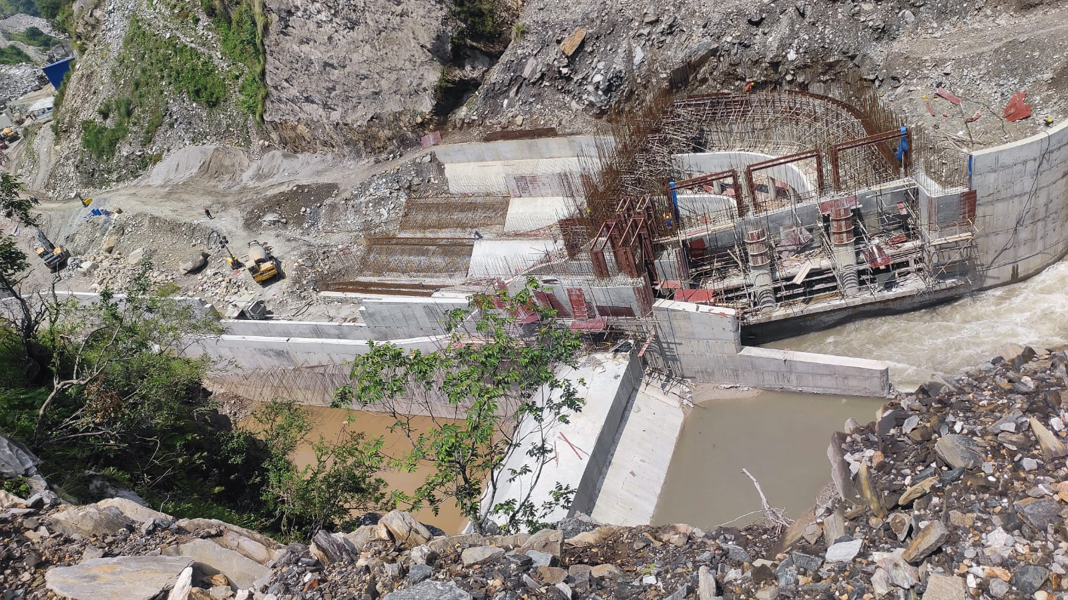
Headworks

Slide 6
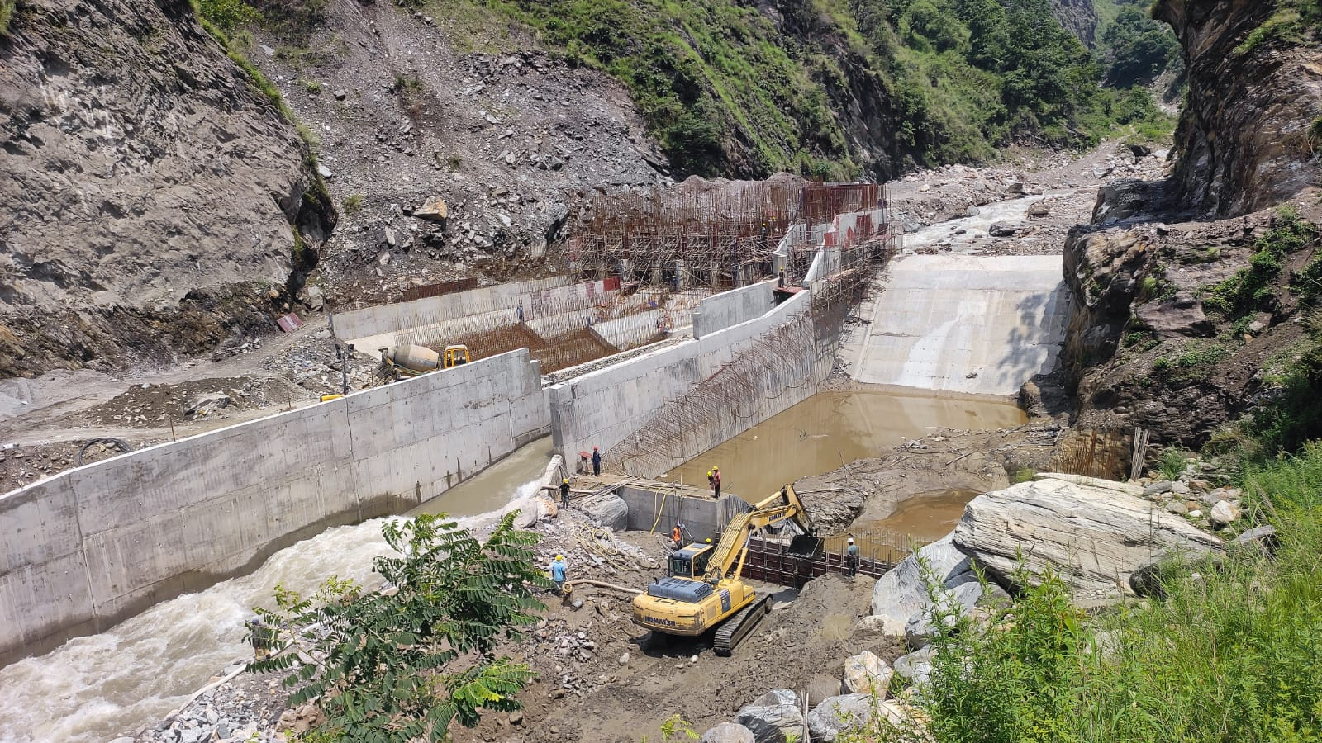
Headworks

Slide 7
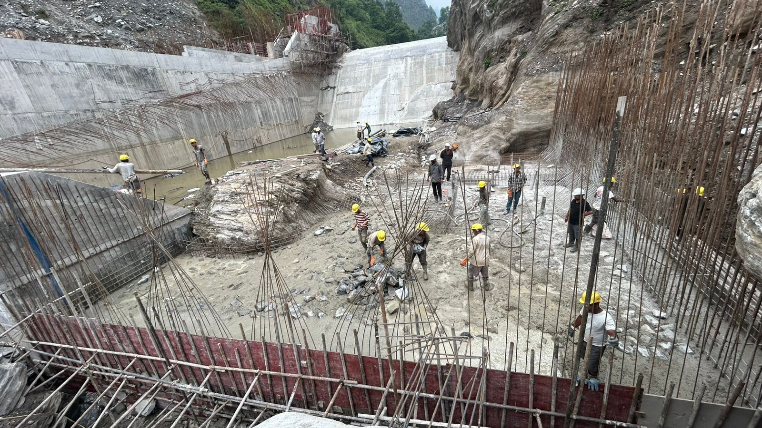
Weir

Slide 8
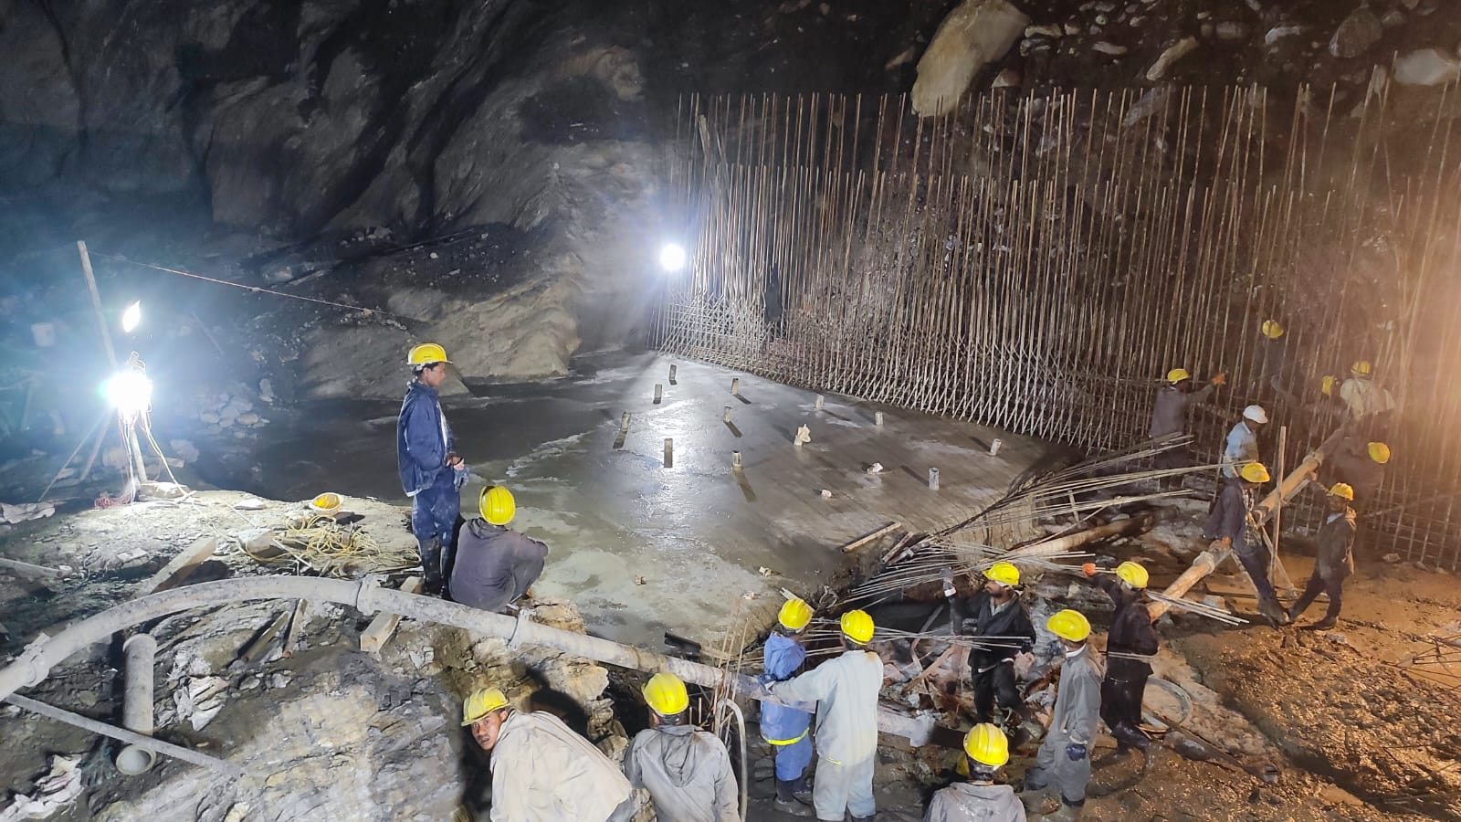
Weir

Slide 9
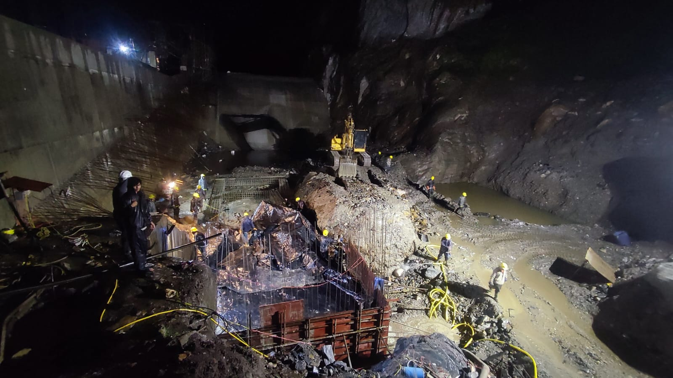
Concrete Casting at Weir

Slide 10
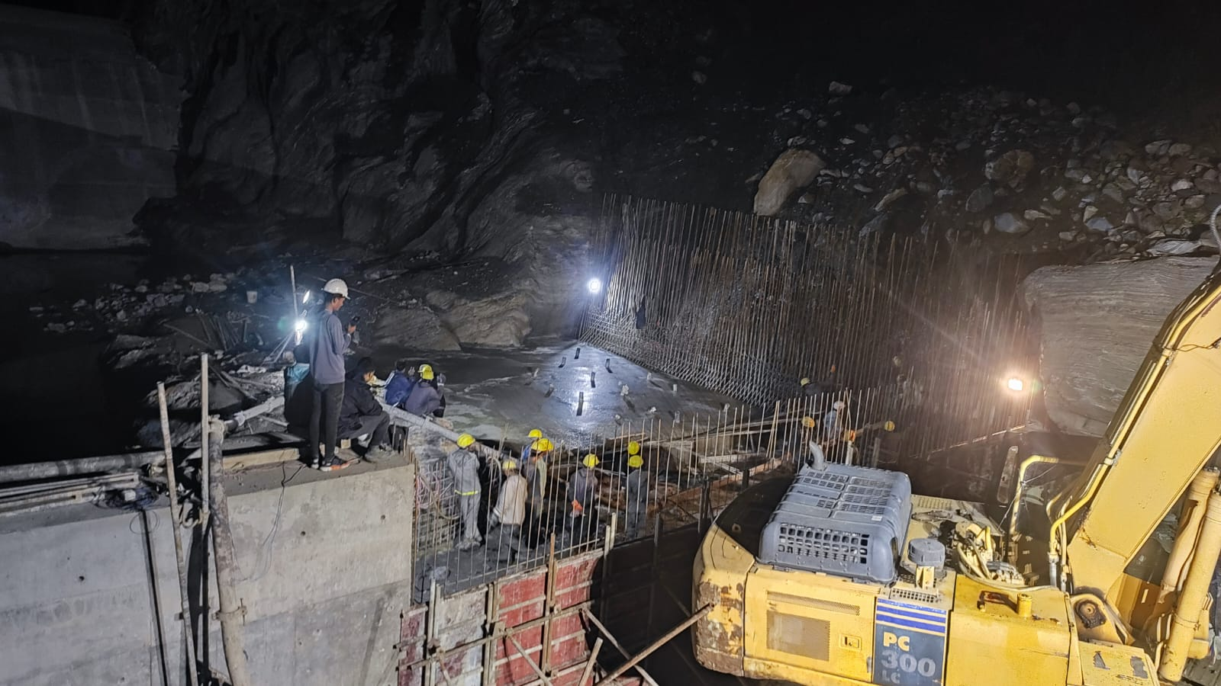
Concrete Casting at Weir

Slide 11
Concrete Casting at Weir

Slide 12
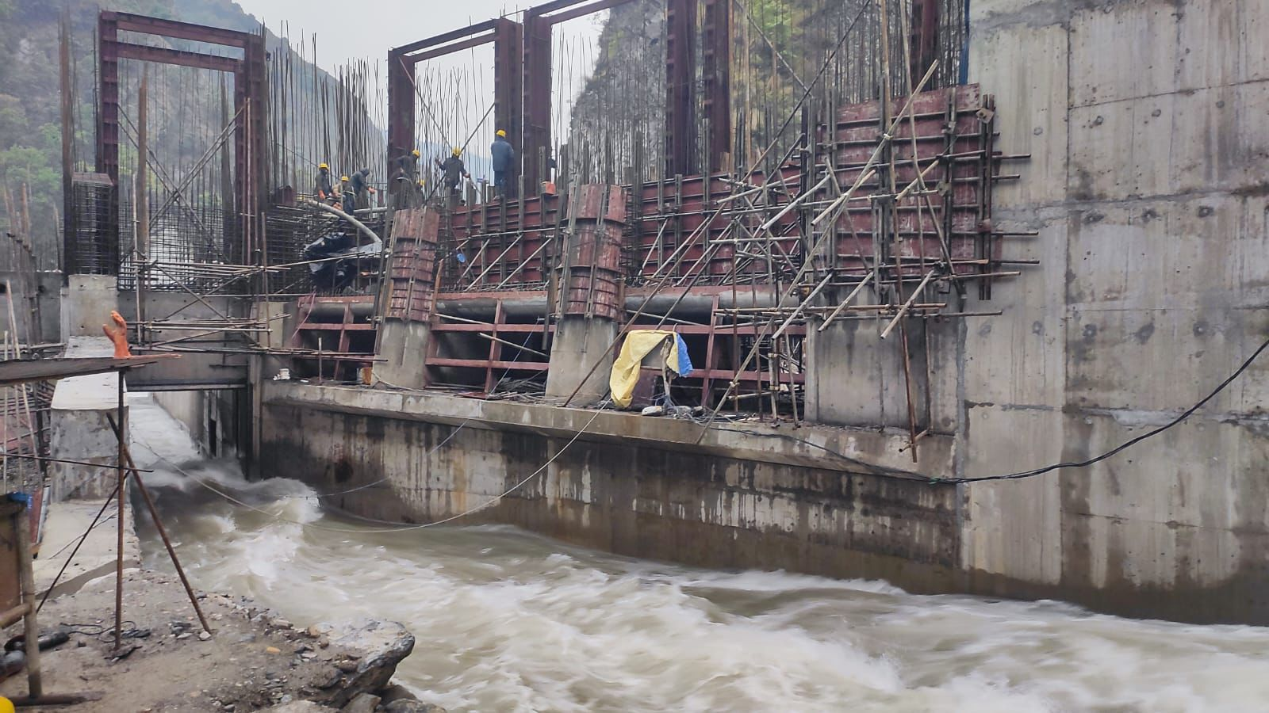
Under Sluice (River Diversion)

Slide 13
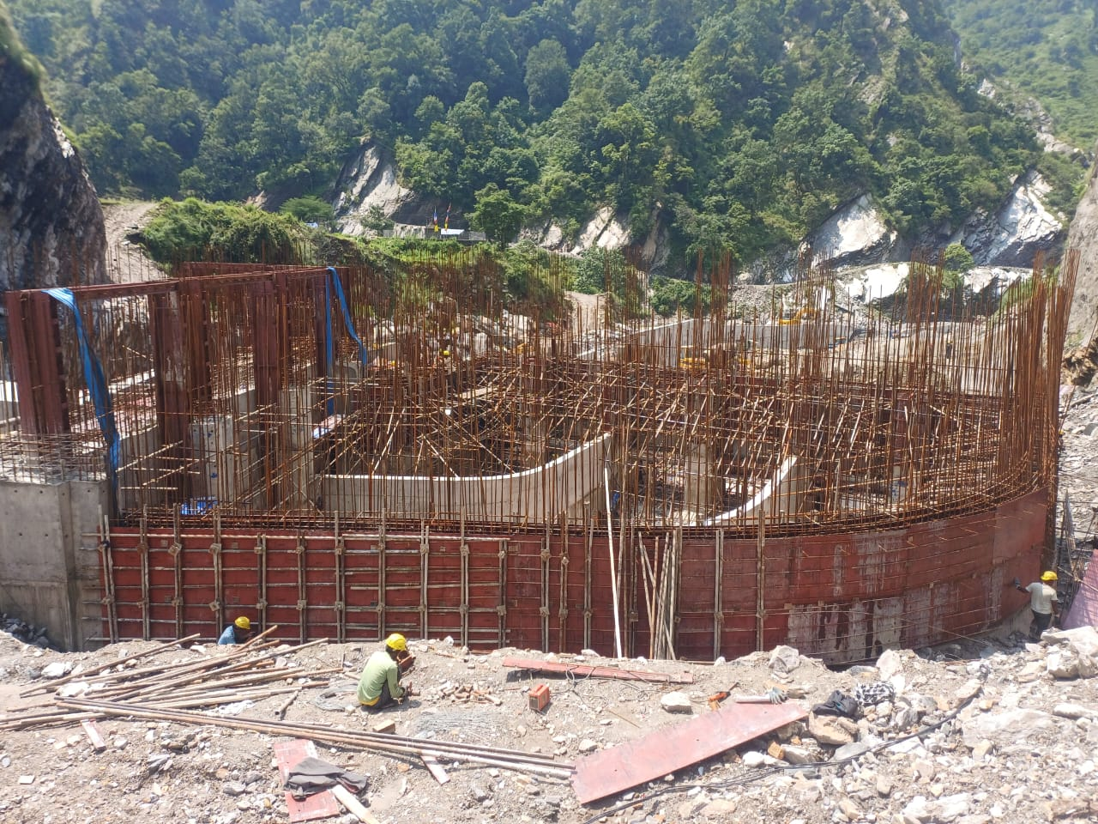
Gravel Trap

Slide 14
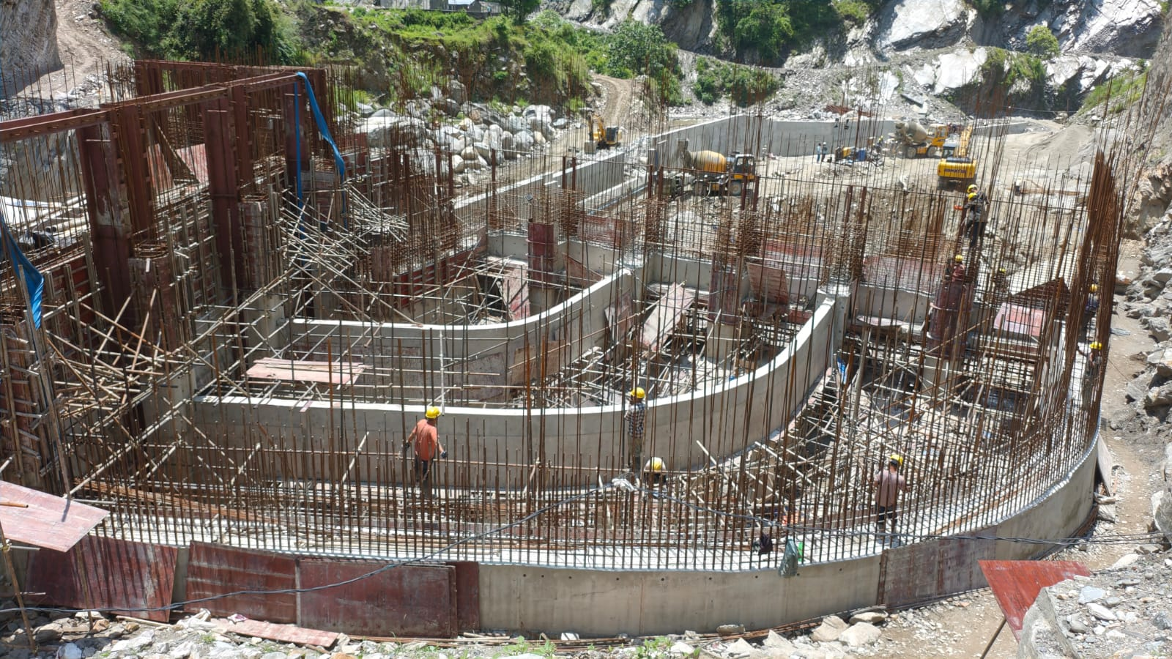
Gravel Trap

Slide 15
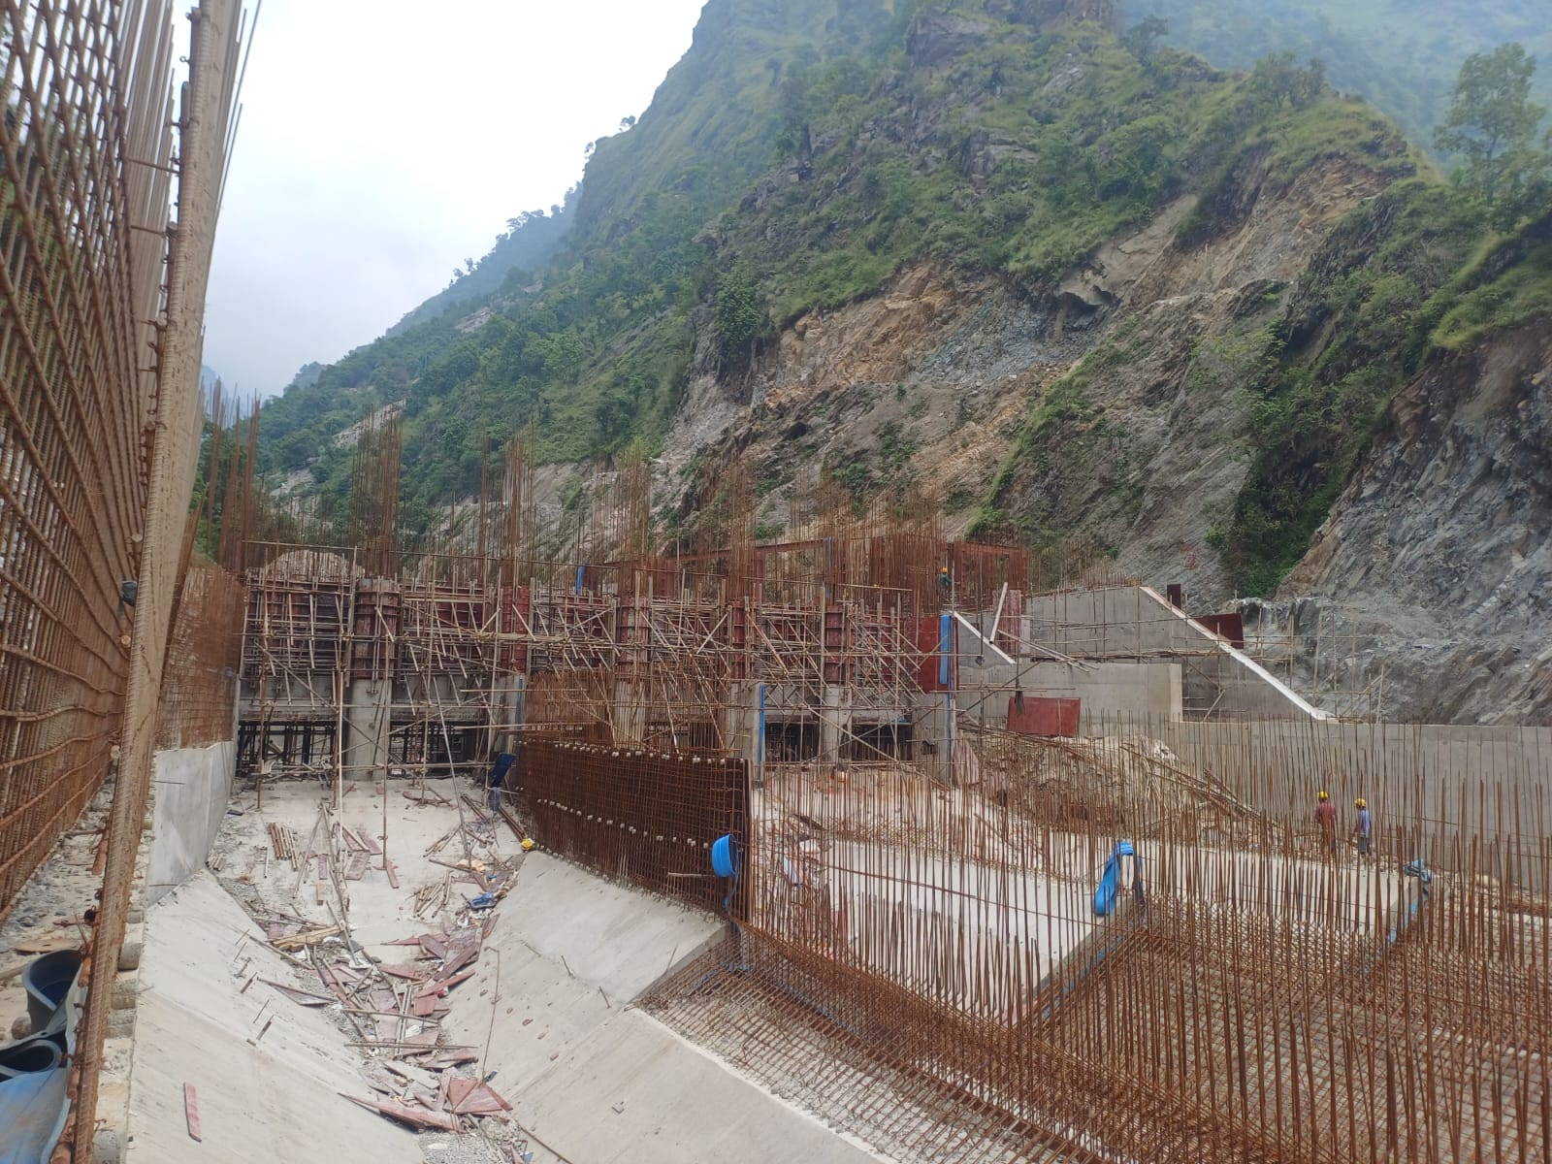
Settling Basin

Slide 16
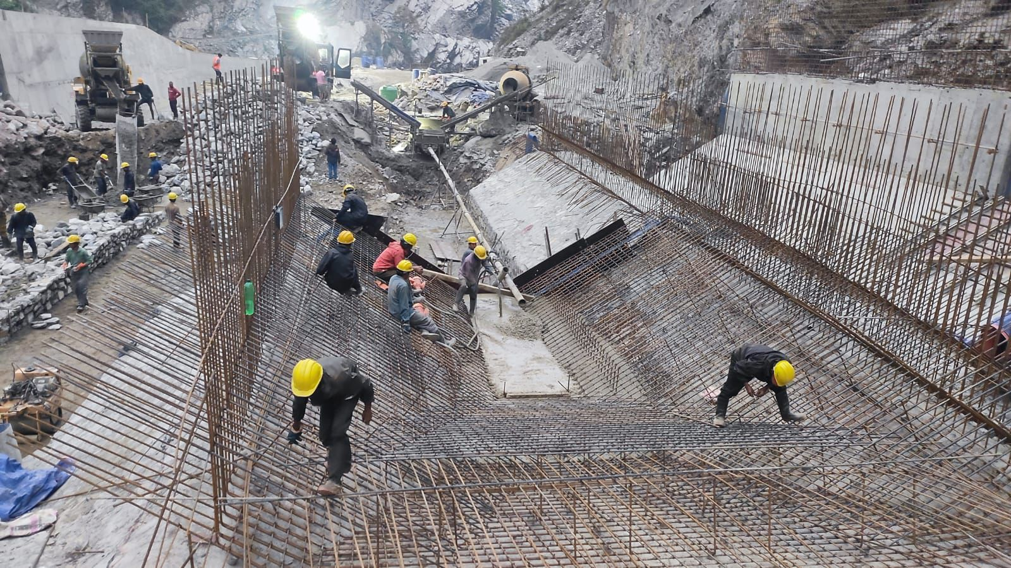
Settling Basin

Slide 17
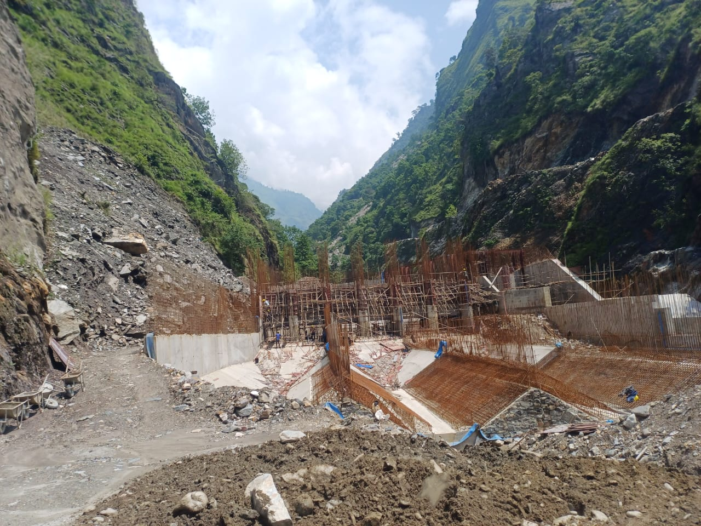
Settling Basin

Slide 18
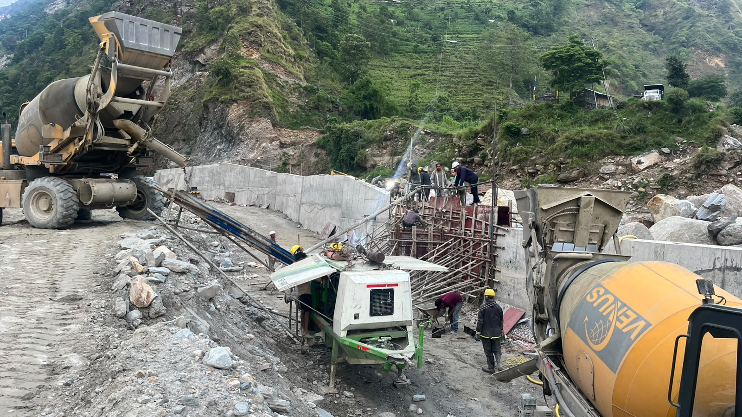
Flood Wall for Head Work

Slide 19
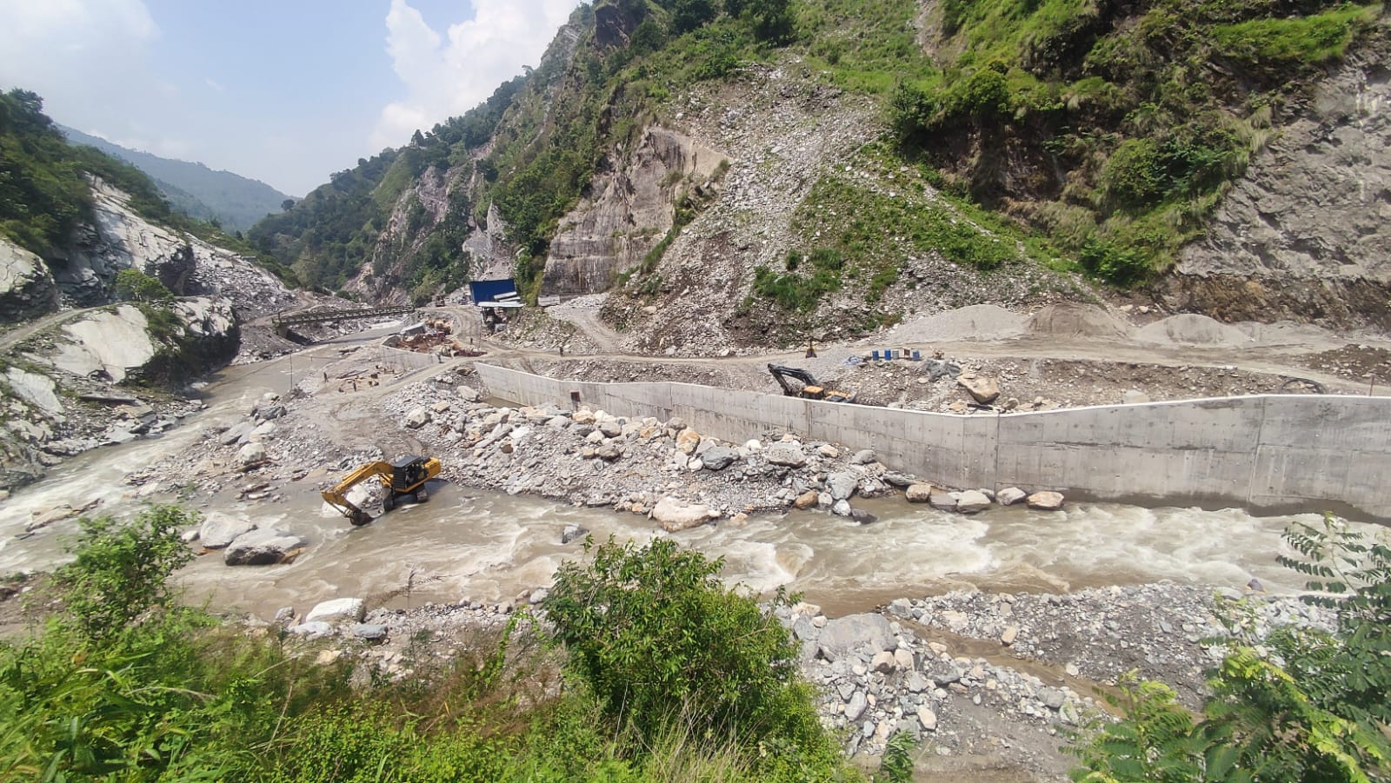
Flood Wall for Head Work

Slide 20
Progress on Tunnel
Tunnel Progress:
Particulars | Progress (in Mtr)
Inlet to Adit | 1,045 mtr.
Adit Upstream towards Inlet | 425 mtr.
Adit Downstream towards Outlet | 385 mtr.
T Junction from Adit (upstream and Down stream) | 188 mtr.
Total | 2,043 mtr.
Total tunnel length | 3,590 mtr.
Progress % | 56.91%

Slide 21
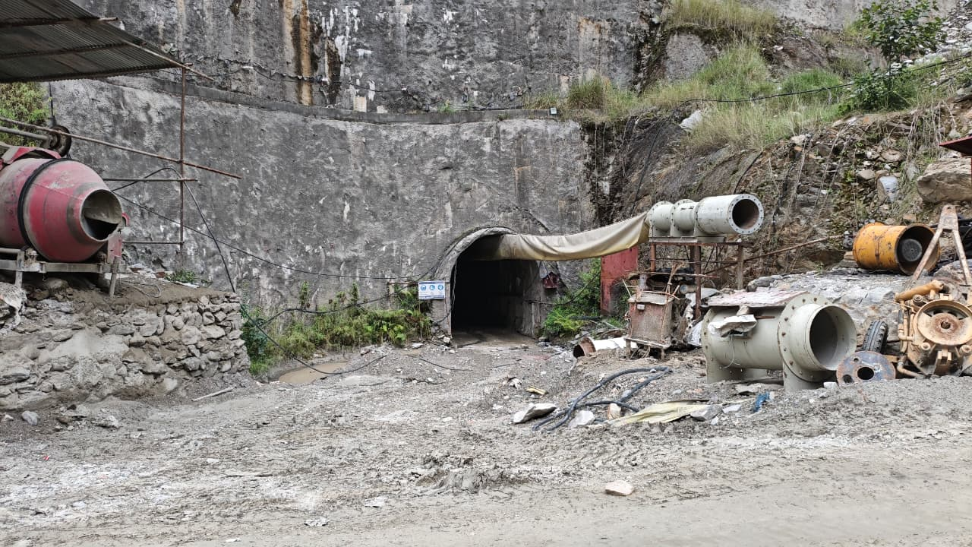
Inlet Portal
Notes:
1000+

Slide 22
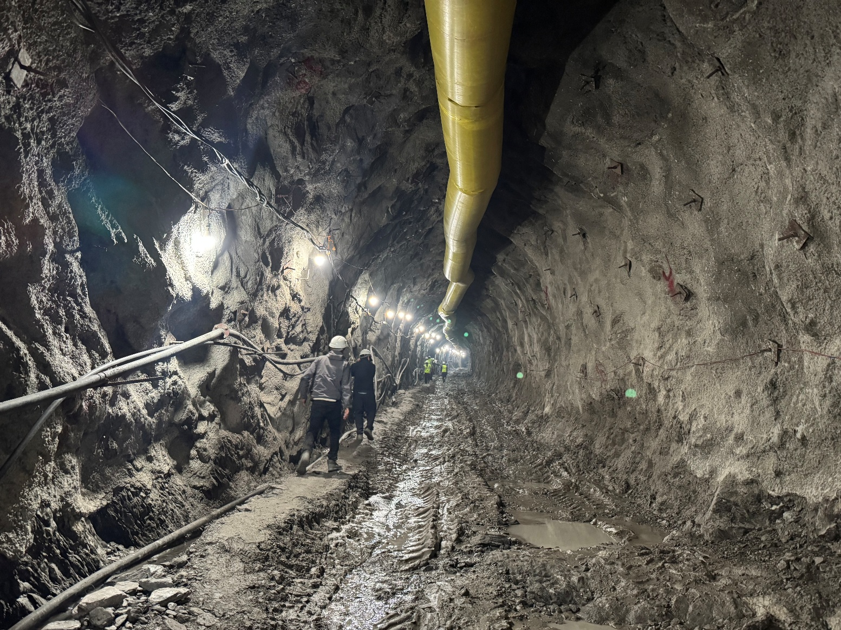
Inlet Tunnel

Slide 23
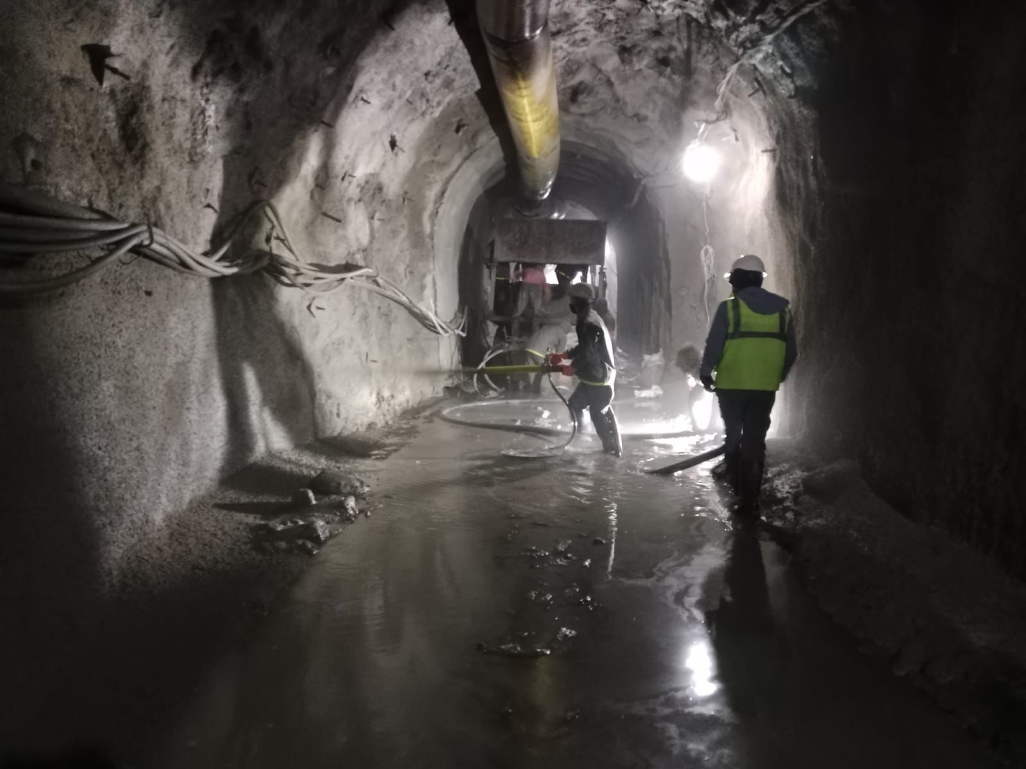
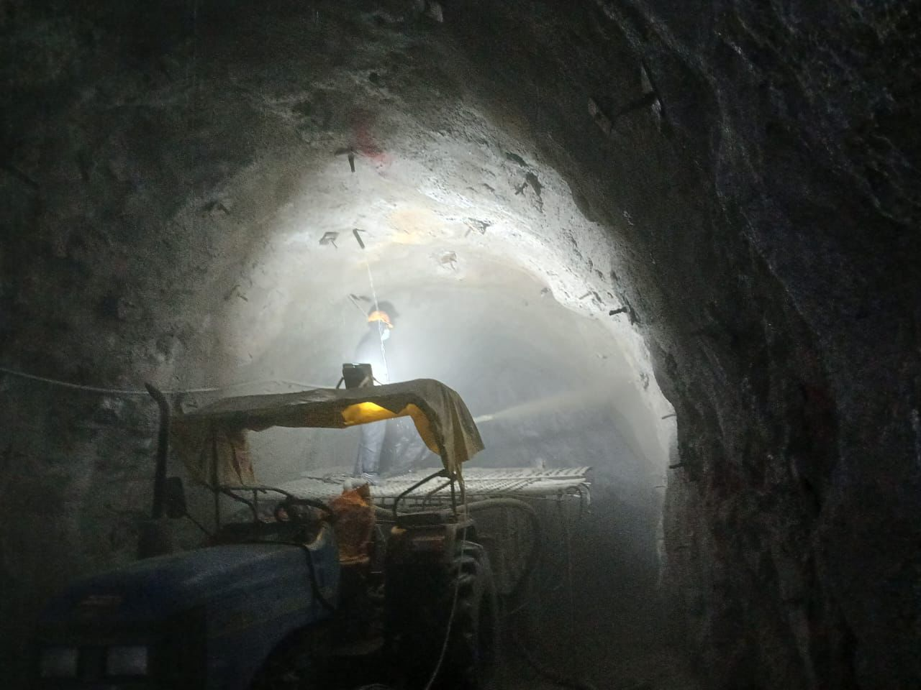
Inlet Tunnel Circuiting

Slide 24
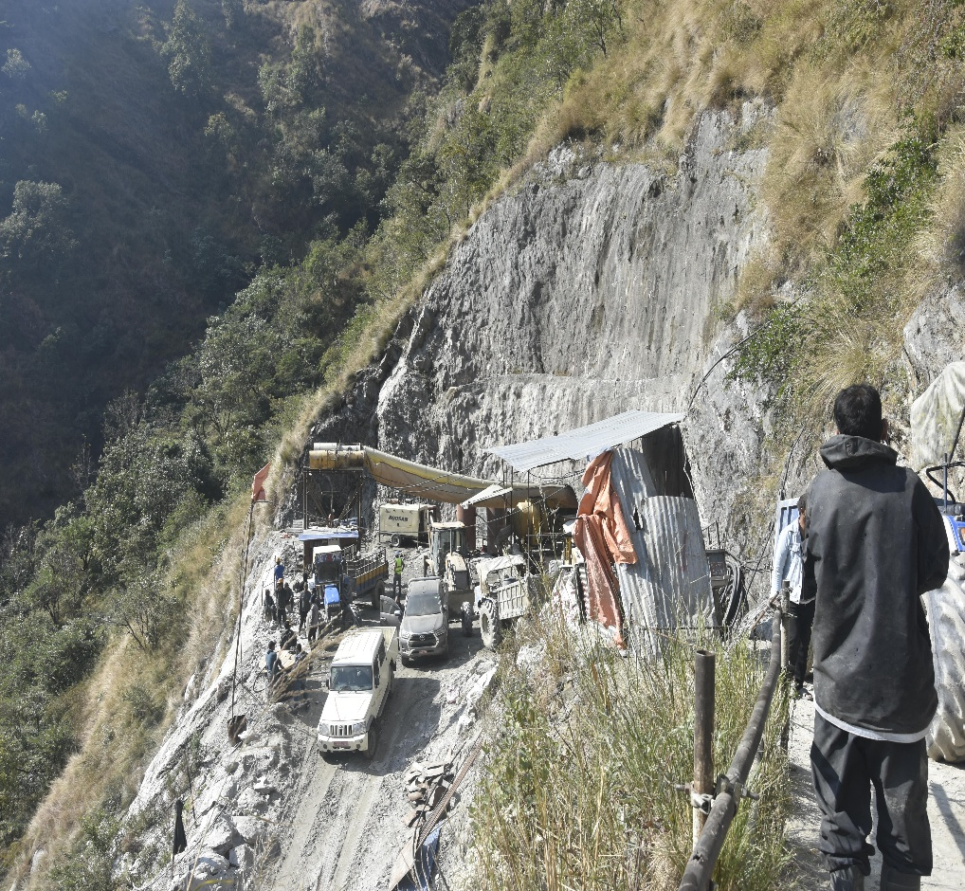
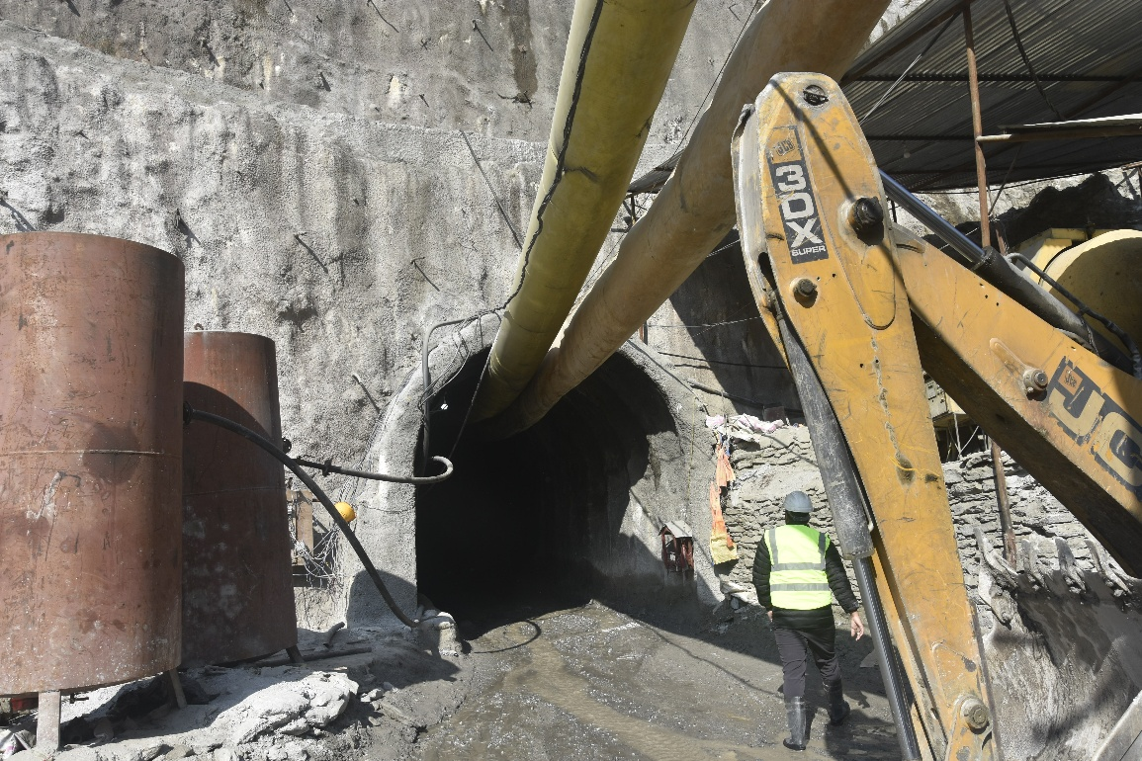
Adit Tunnel

Slide 25
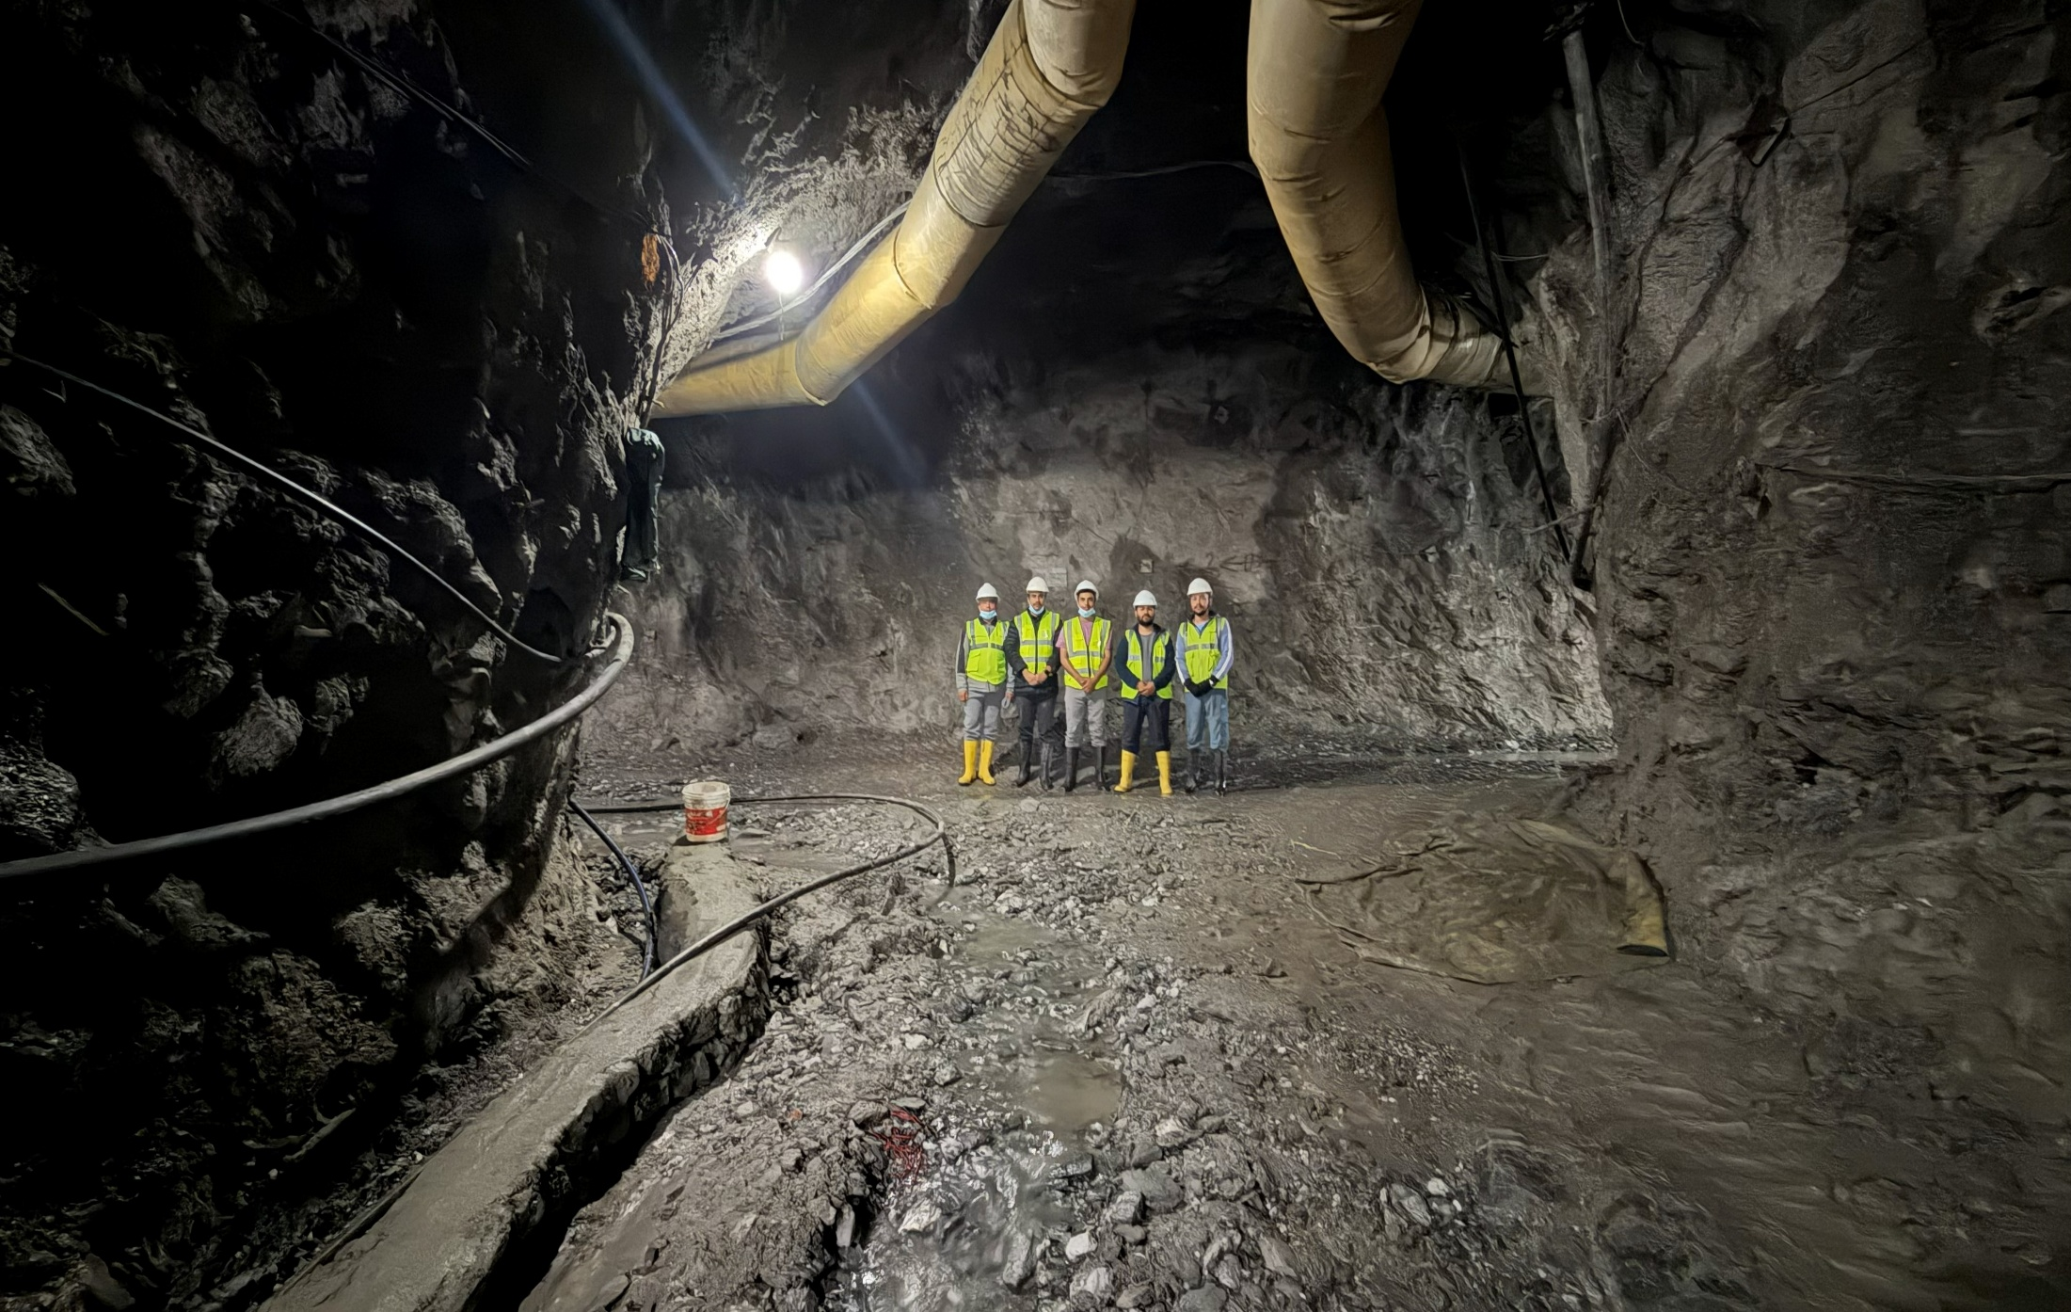
Adit Junction
Notes:
Upstream 300 and down stream 300 + 188 for T structure

Slide 26
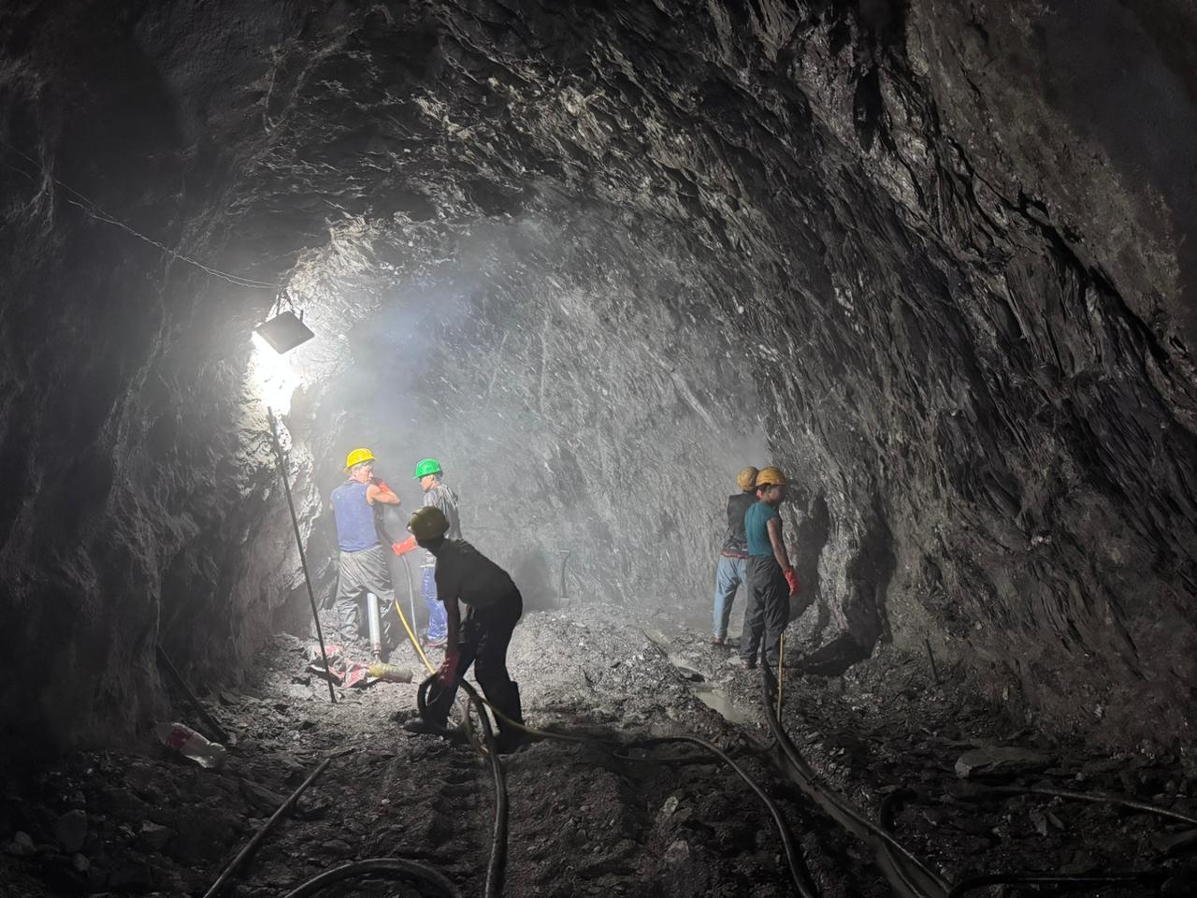
Adit Tunnel
Notes:
Upstream 300 and down stream 300 + 188 for T structure

Slide 27
Progress on Powerhouse
Powerhouse Progress:
Particulars | Progress (in %)
Powerhouse portal excavation | 100%
Main Access Tunnel excavation | 10%
Tailrace Tunnel excavation | 45%
Tailrace Excavation | 100%
Tailrace Gate Frame | 100%
Tailrace culvert | 75%
Power House Flood Wall | 100%

Slide 28
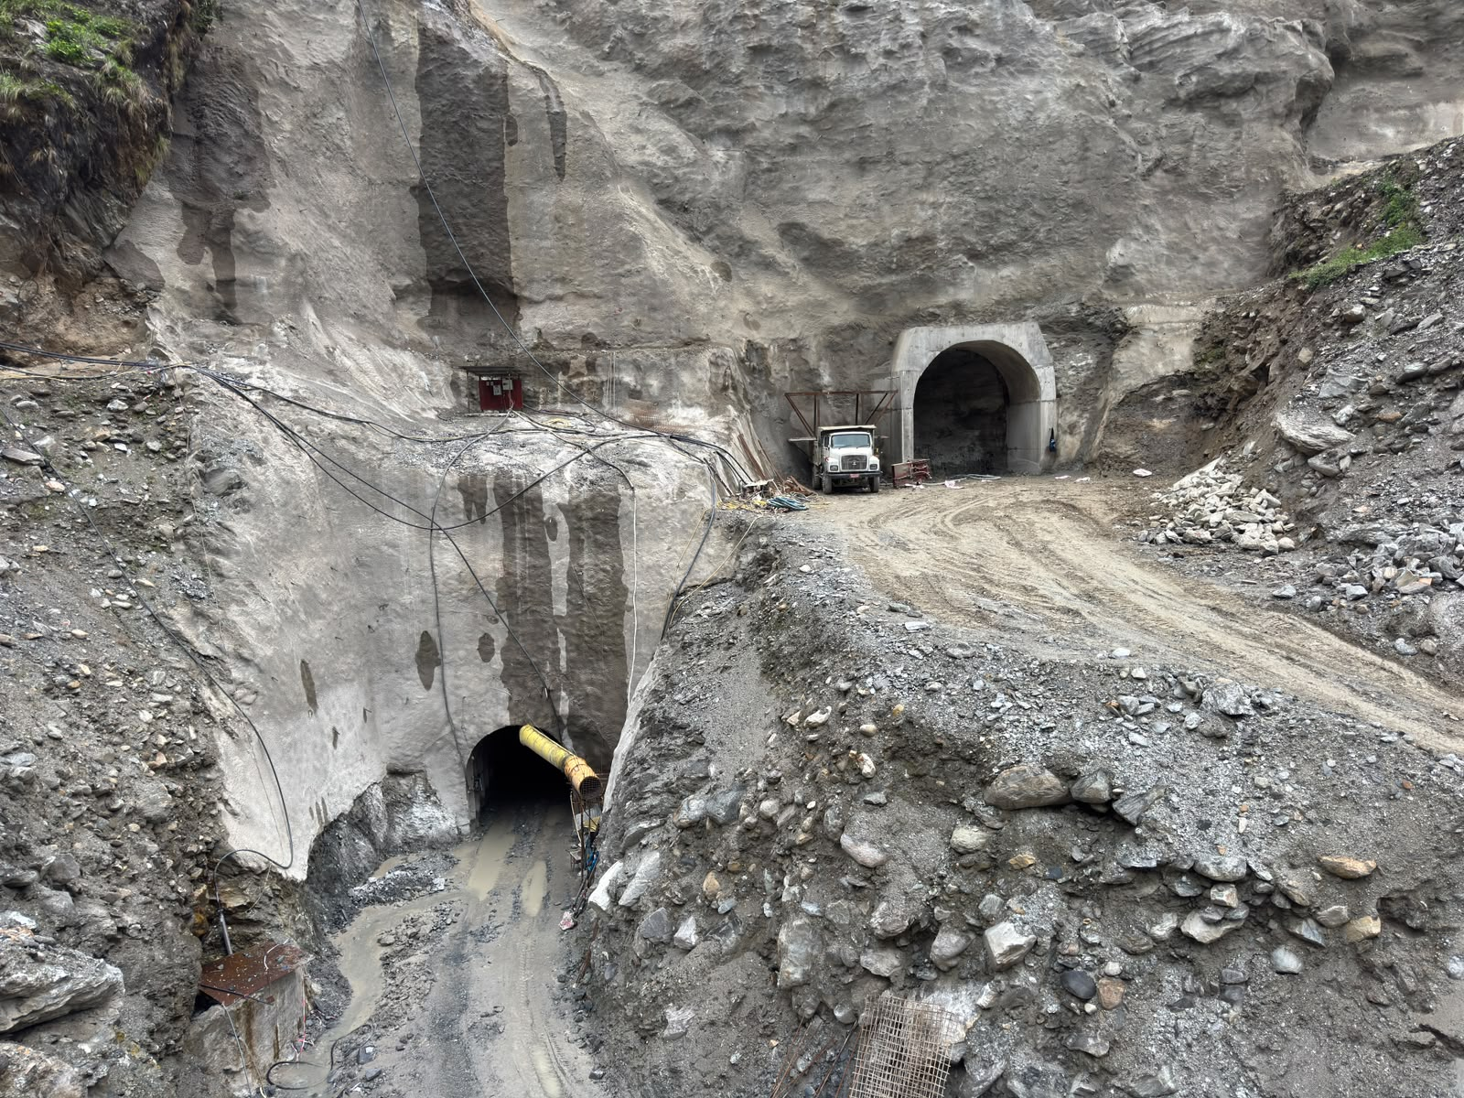
MAT and Tailrace Tunnel

Slide 29
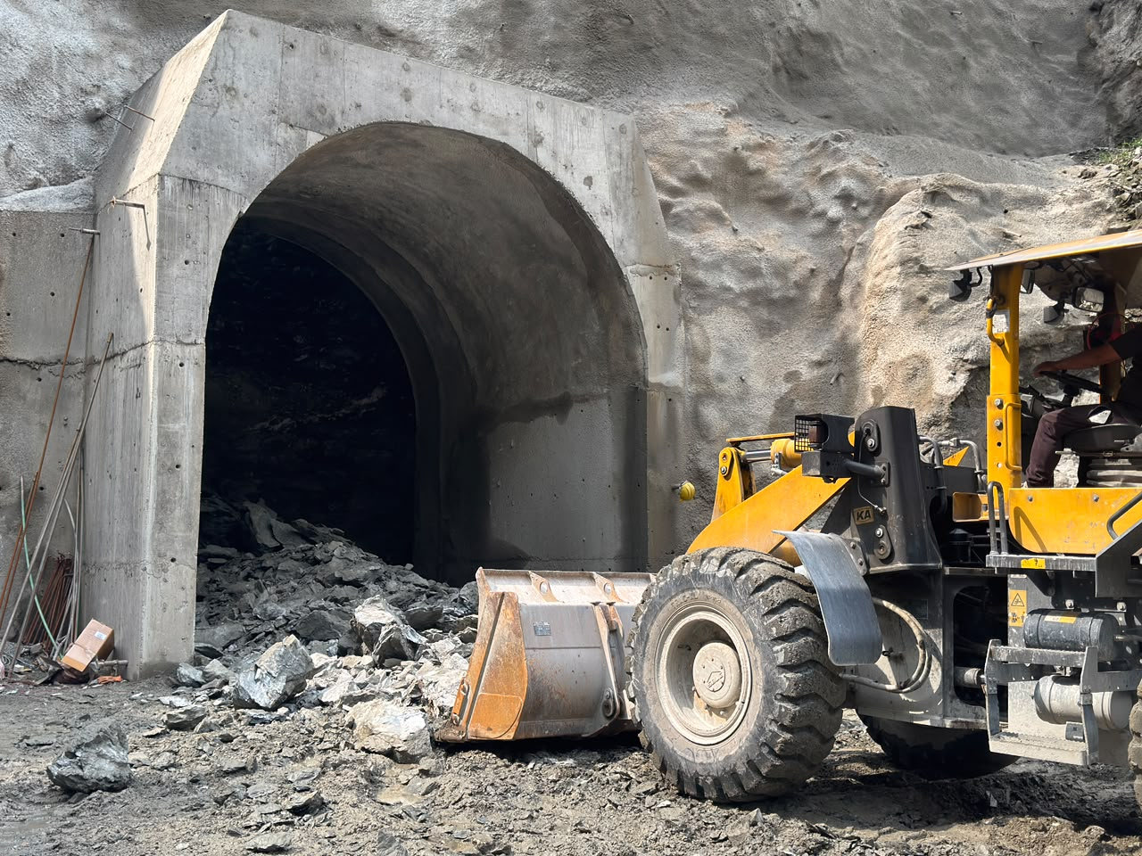
Powerhouse Main Access Tunnel

Slide 30
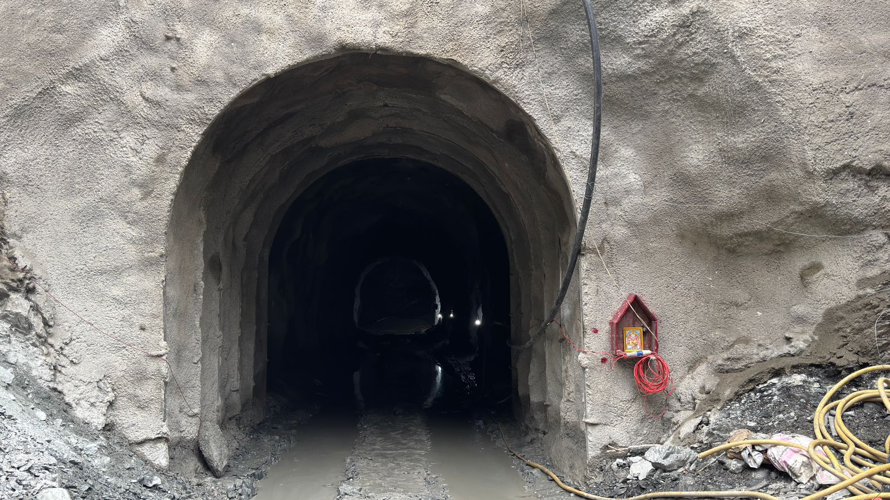
Tailrace Tunnel

Slide 31
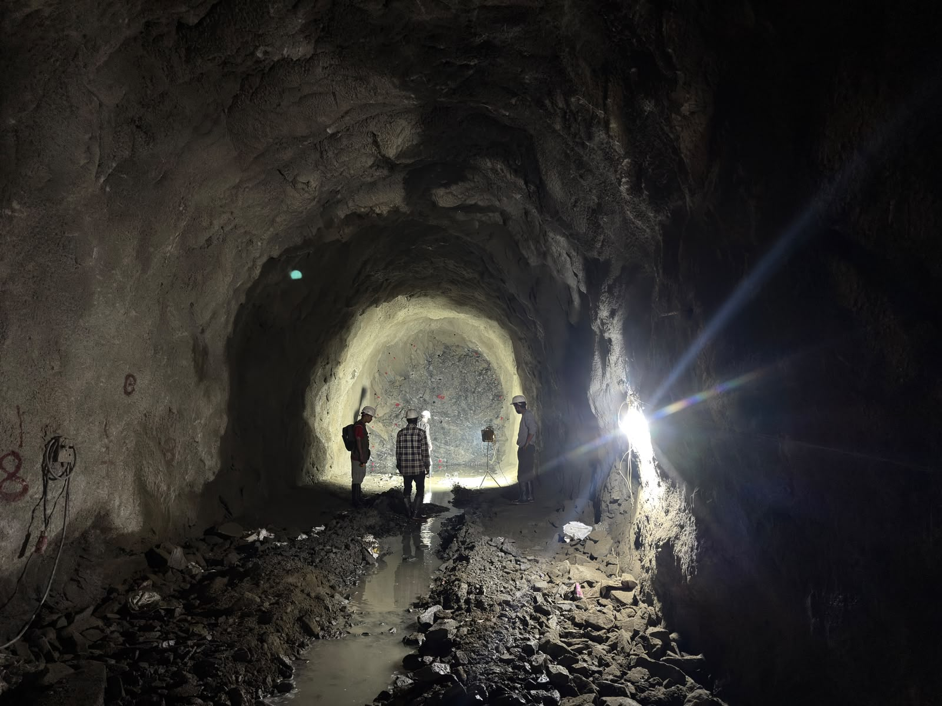
Tailrace Tunnel

Slide 32
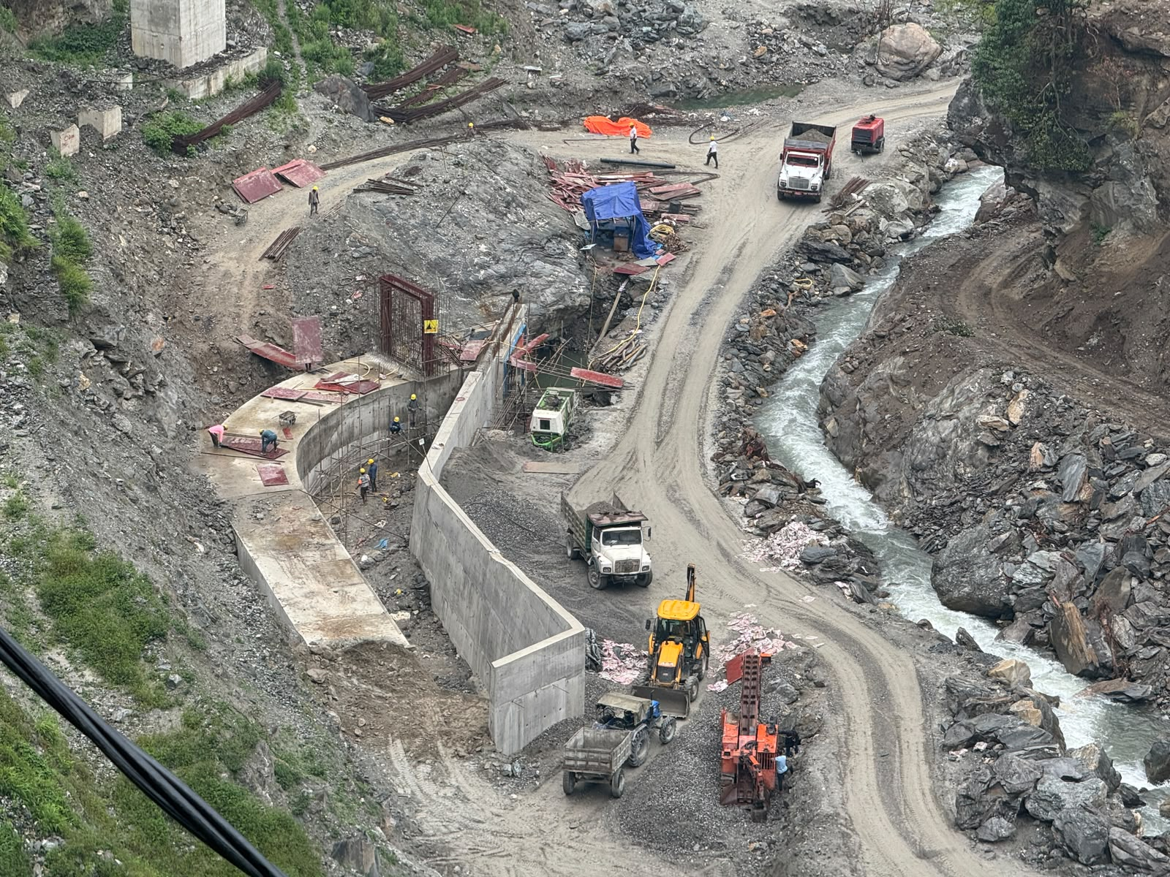
Tailrace Excavation

Slide 33
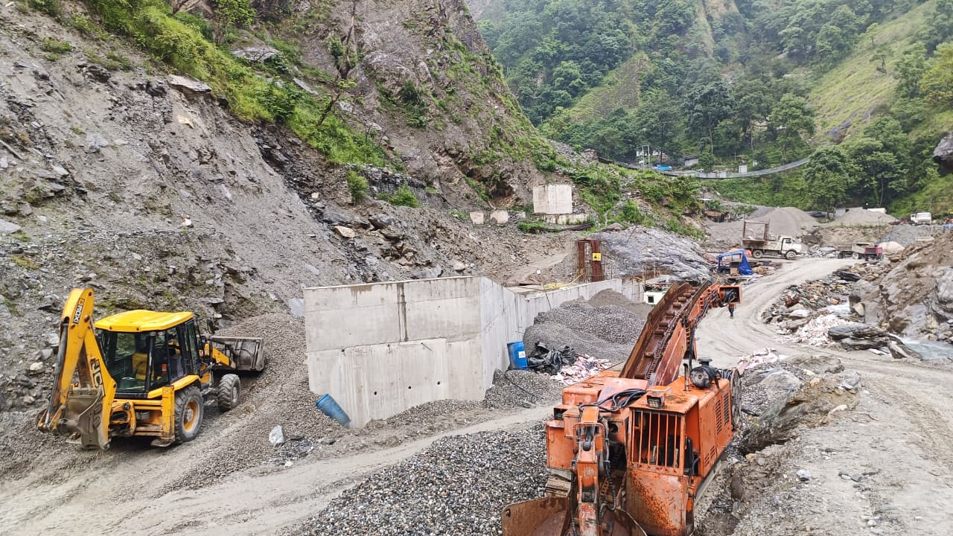
Tailrace Excavation

Slide 34
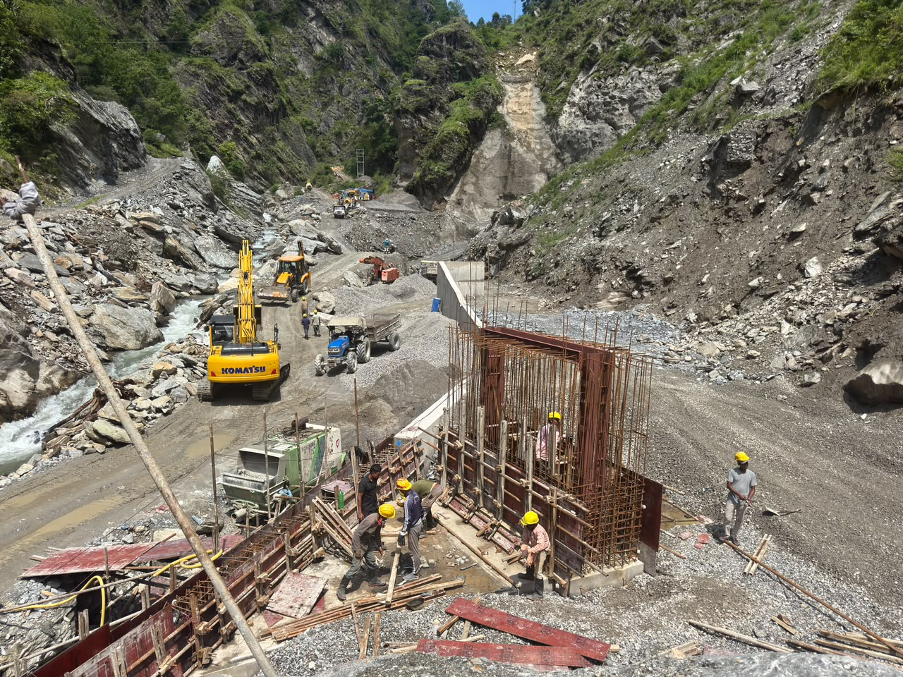
Tail Race

Slide 35
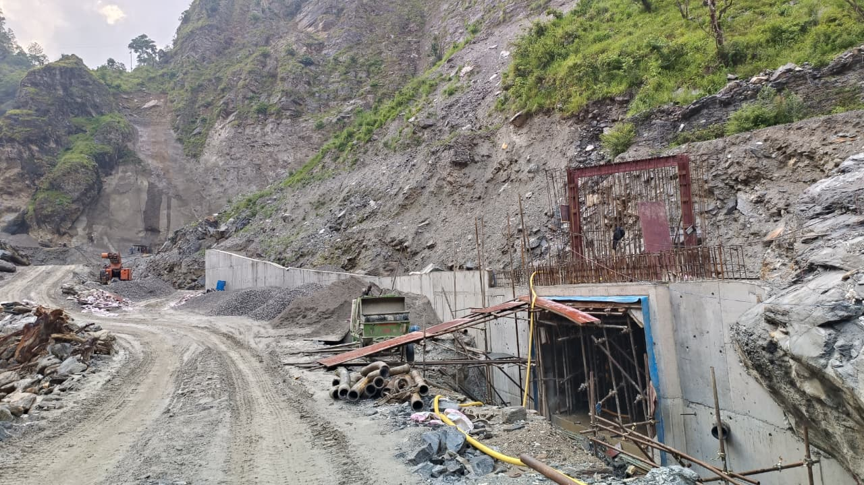
Tail Race End

Slide 36
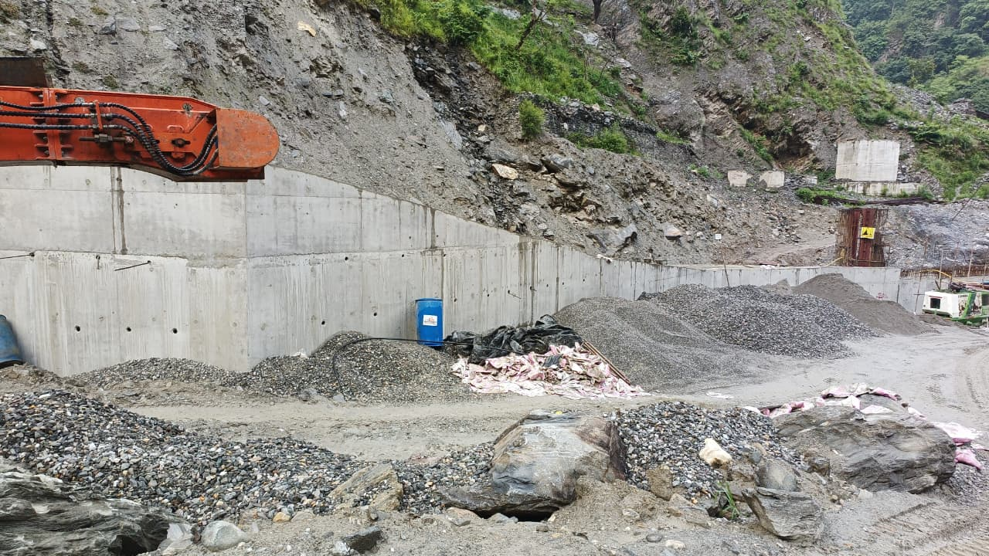
Powerhouse Flood Wall

Slide 37
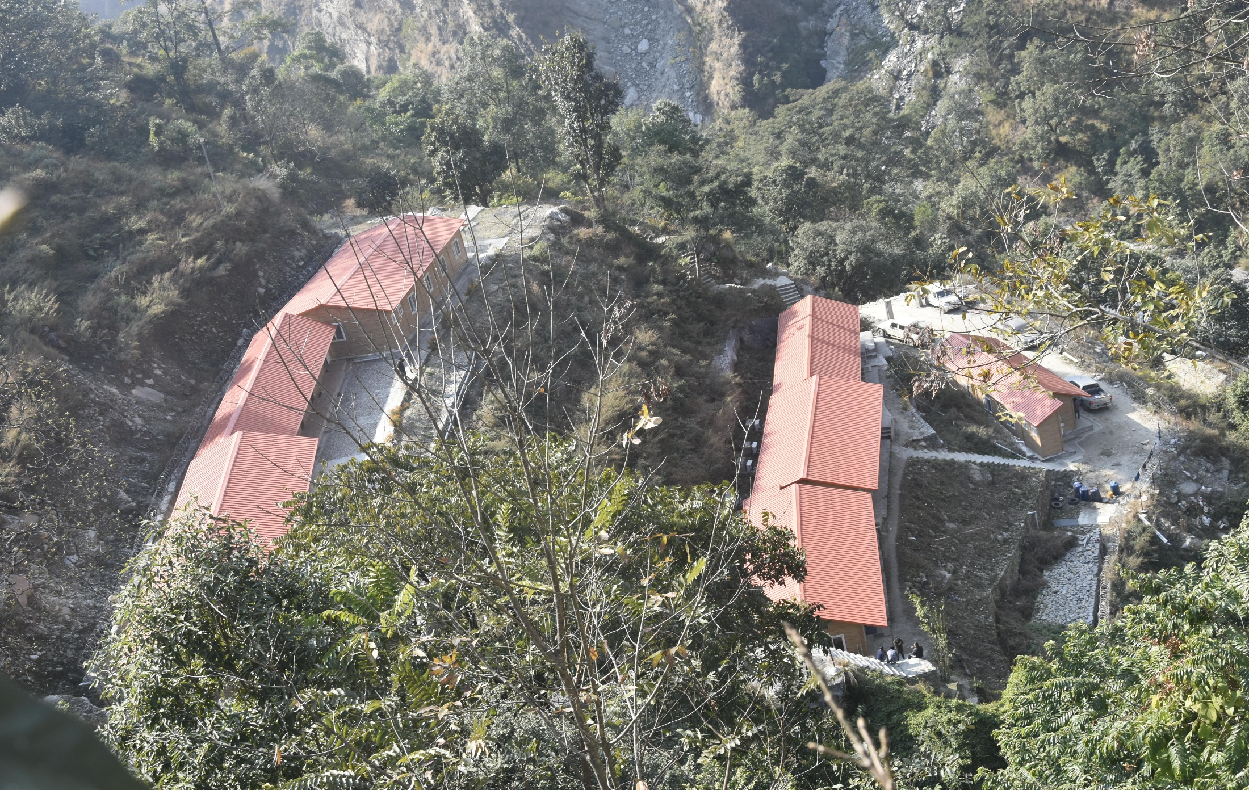
Site Office

Slide 38
Financial Progress

Slide 39
Financial Progress (in Crore)

Slide 40
Financial Vs Physical Progress

Slide 41
Loan Utilization (Amt in Cr.)

Slide 42
Loan Vs Financial Vs Physical Progress

Slide 43


