Slide 1
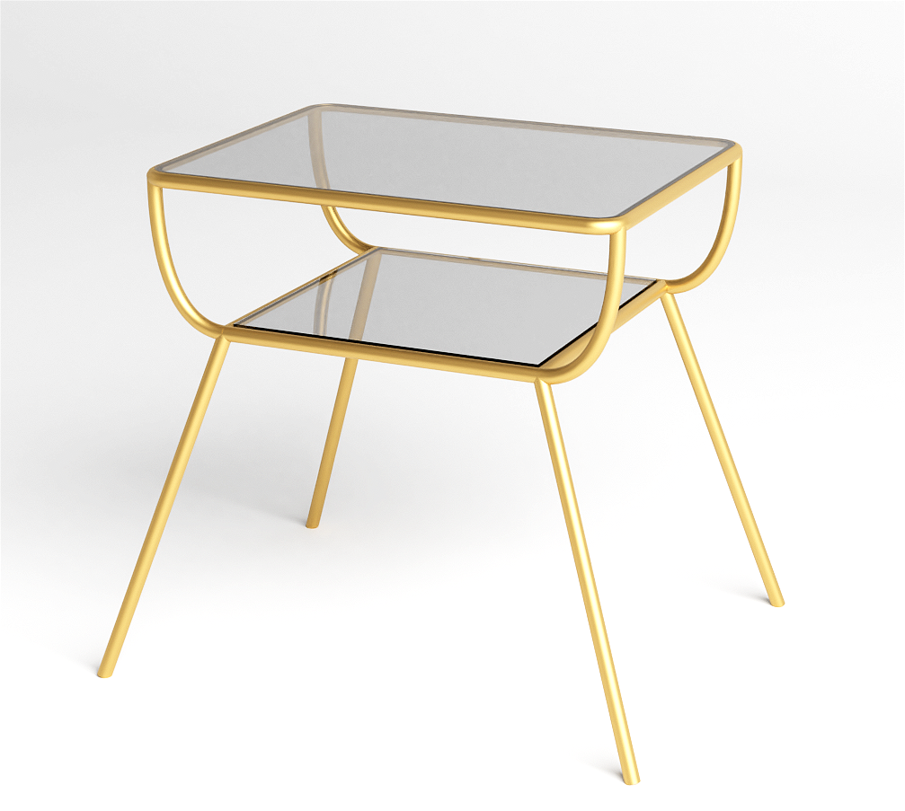
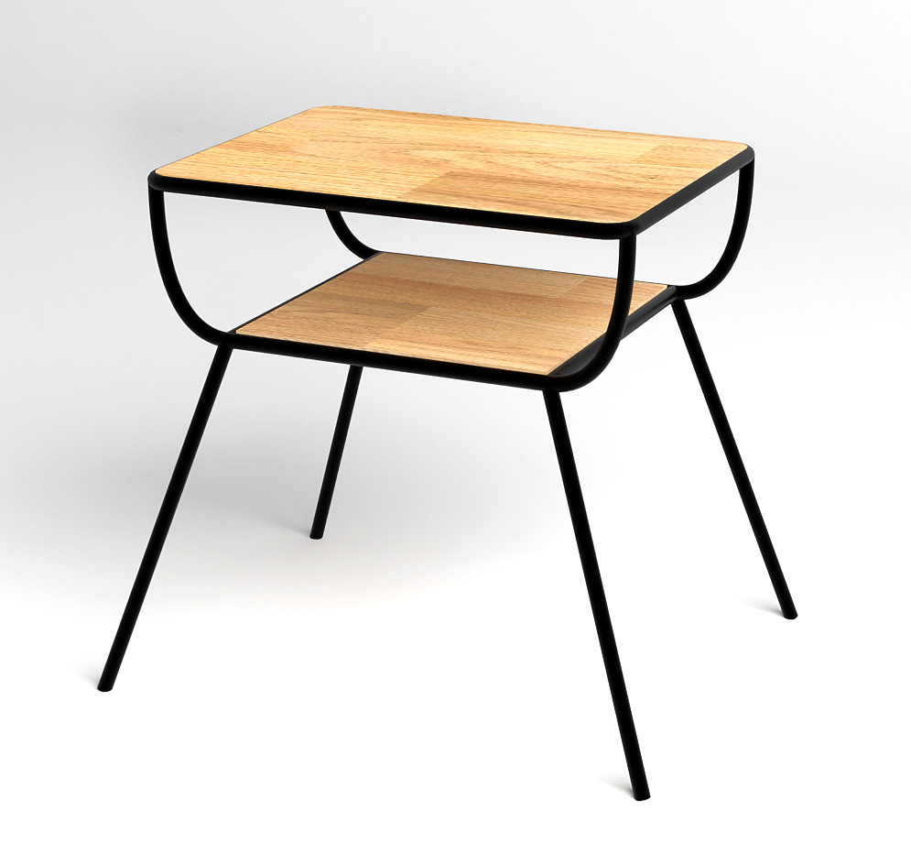
32”x32”x36”
32”x32”x36”

Slide 2
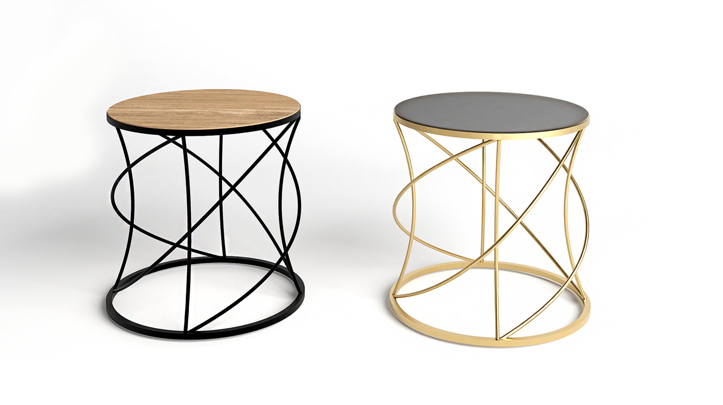
32”x32”x32”
32”x32”x32”

Slide 3
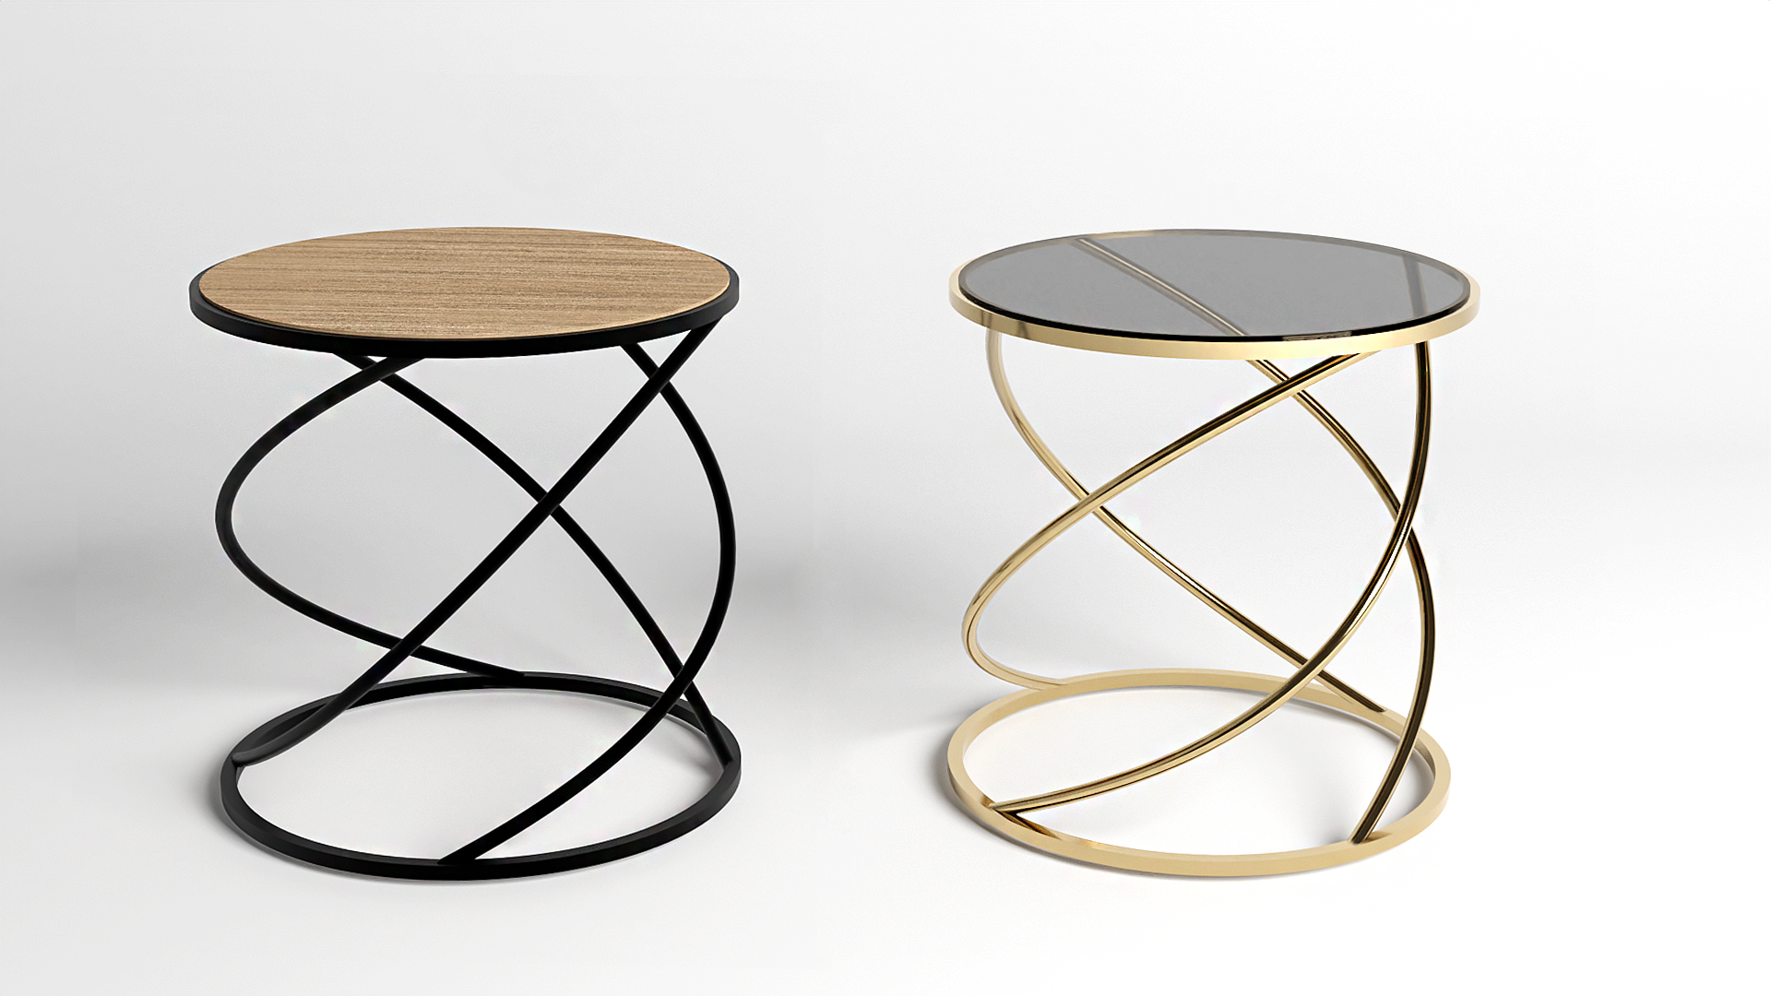
32”x32”x32”
32”x32”x32”

Slide 4
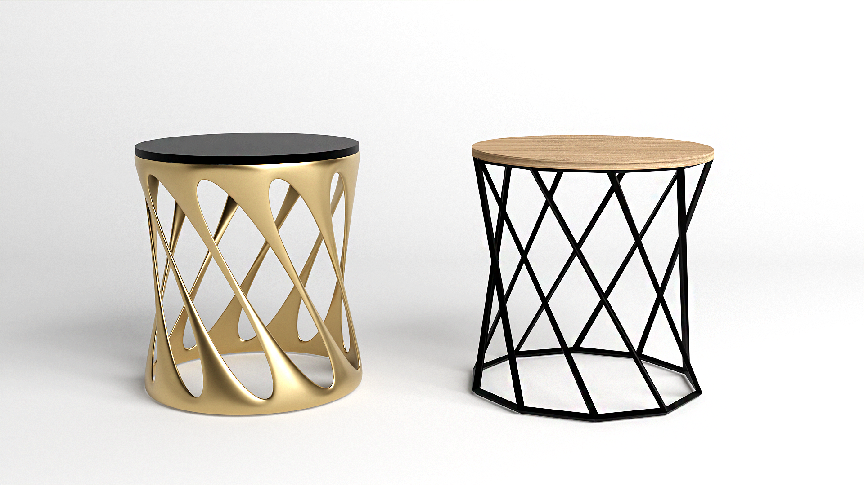
32”x32”x32”
32”x32”x32”

Slide 5
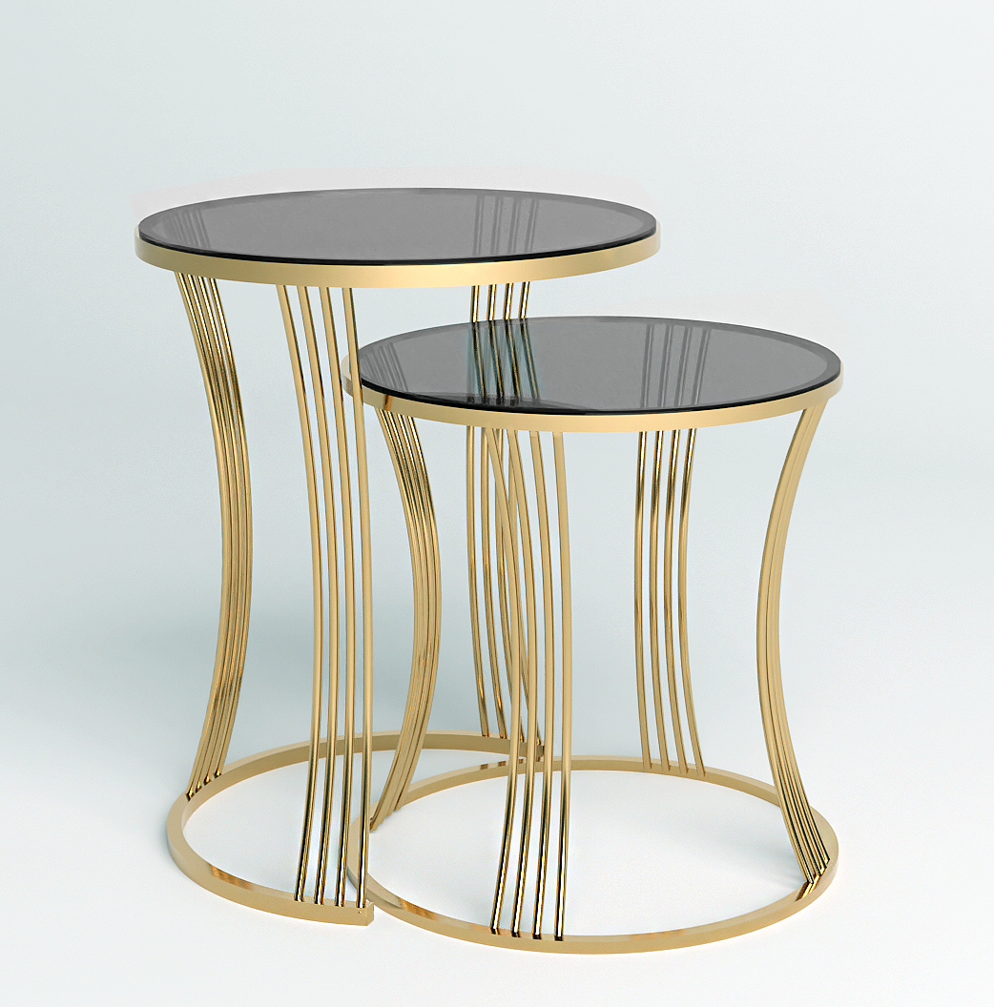
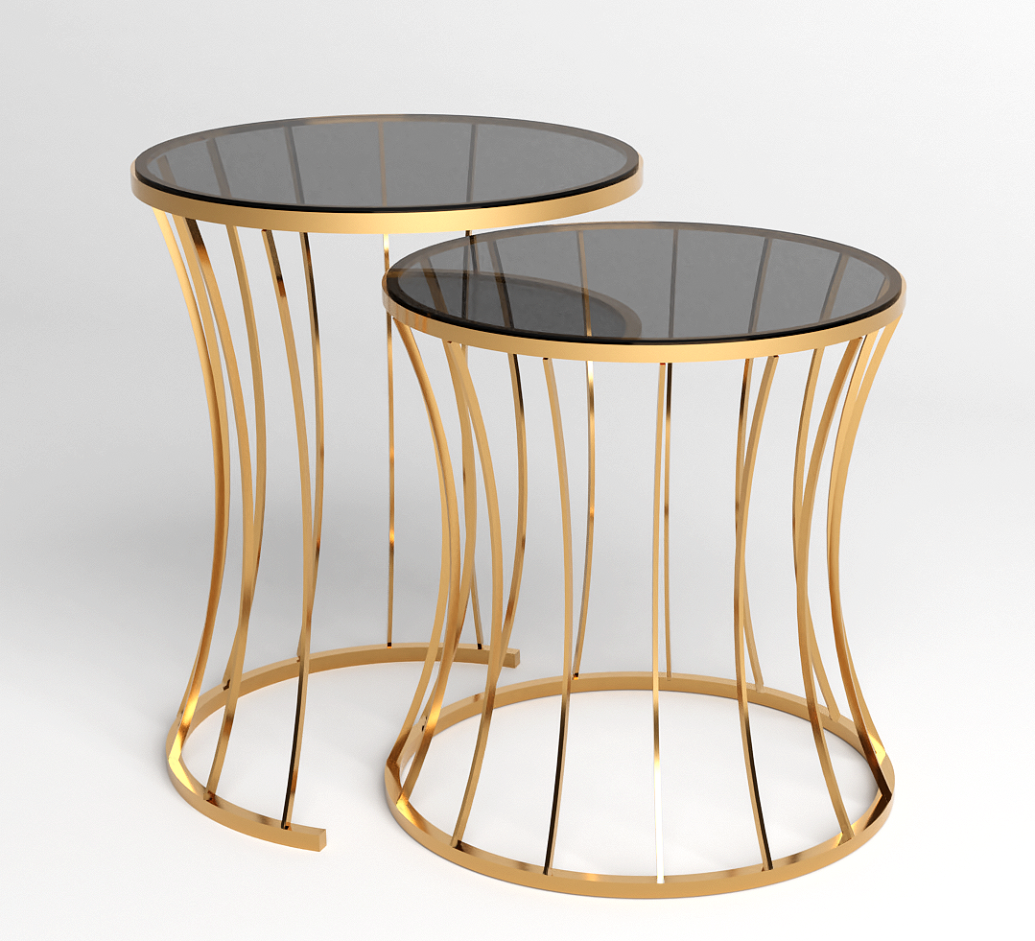
32”x32”x32”
32”x32”x32”

Slide 6
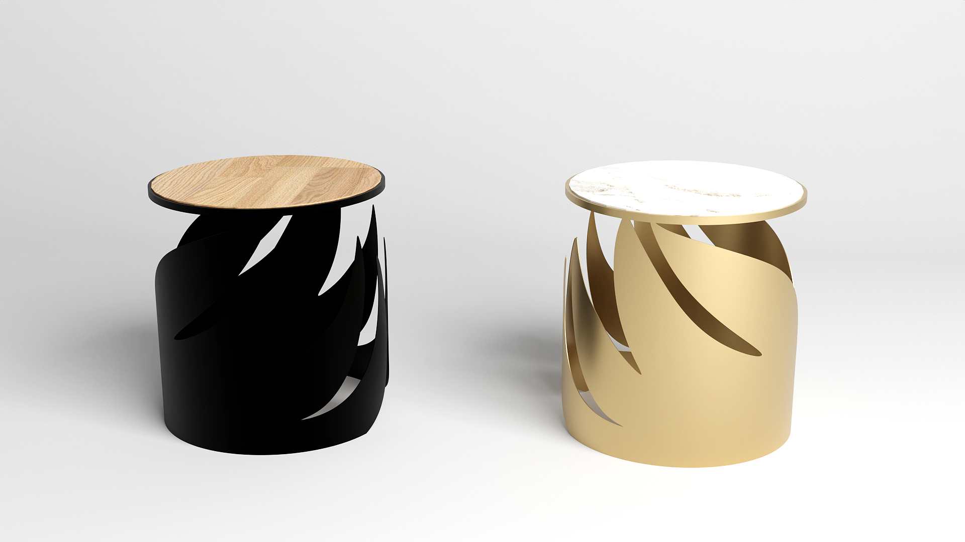
32”x32”x32”
32”x32”x32”

