Slide 1
I M HANDICRAFT
Manufacturer , Supplier & Exporter Of All
Kinds Of Handicrafts Items
A Unique Collection
Of
Globe

Slide 2
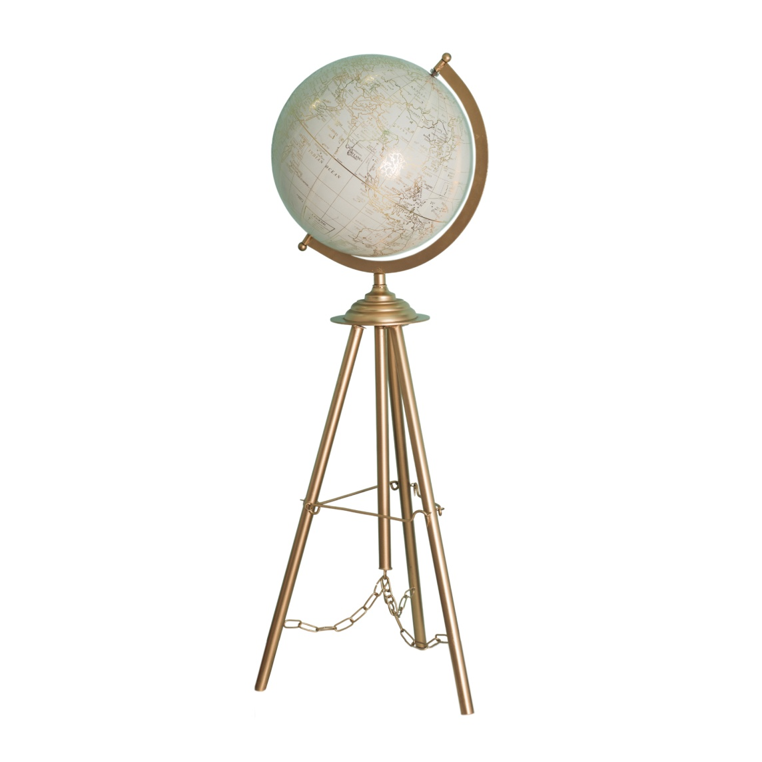
IMH – 25001 (12”)

Slide 3
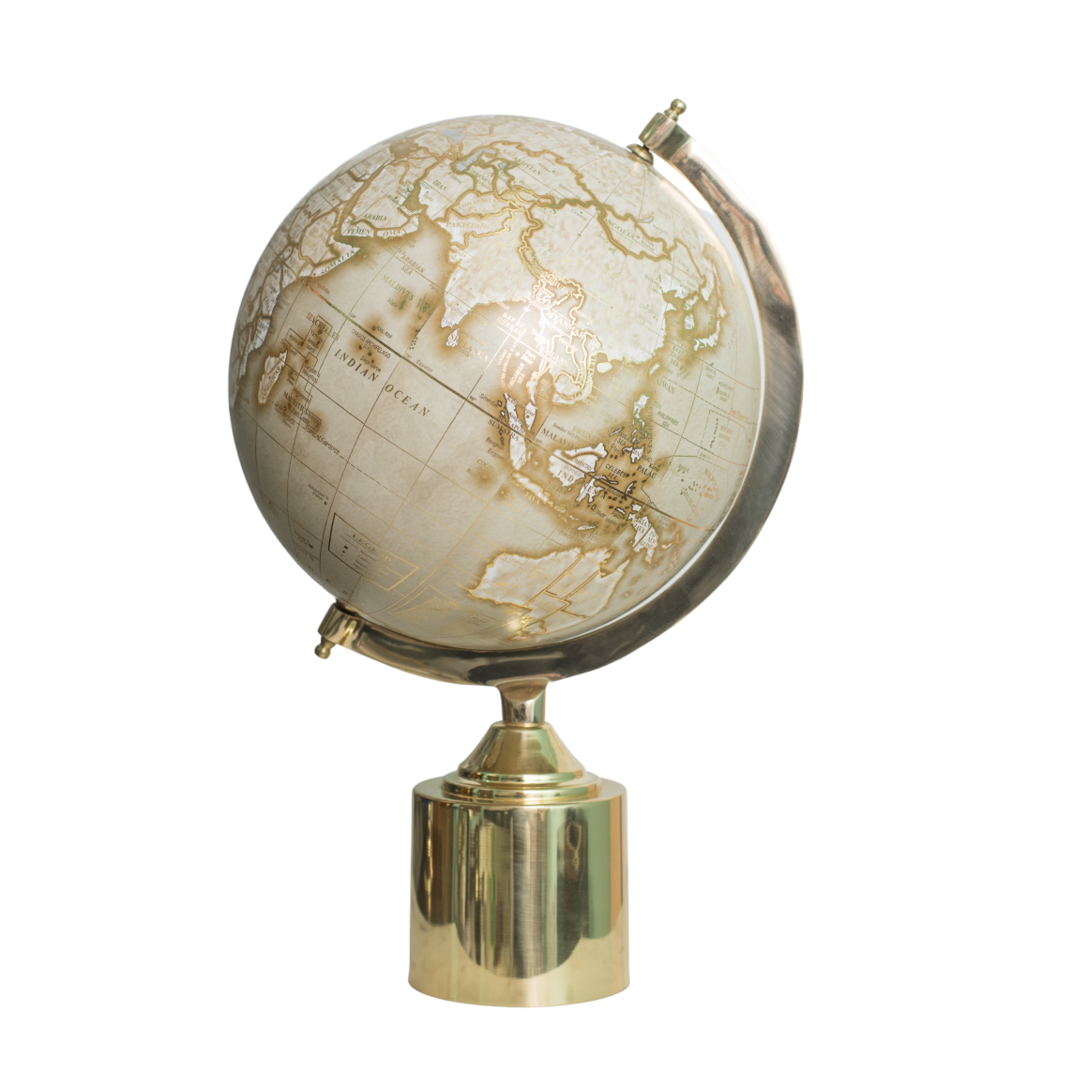
IMH – 25002 (10” BRASS)

Slide 4
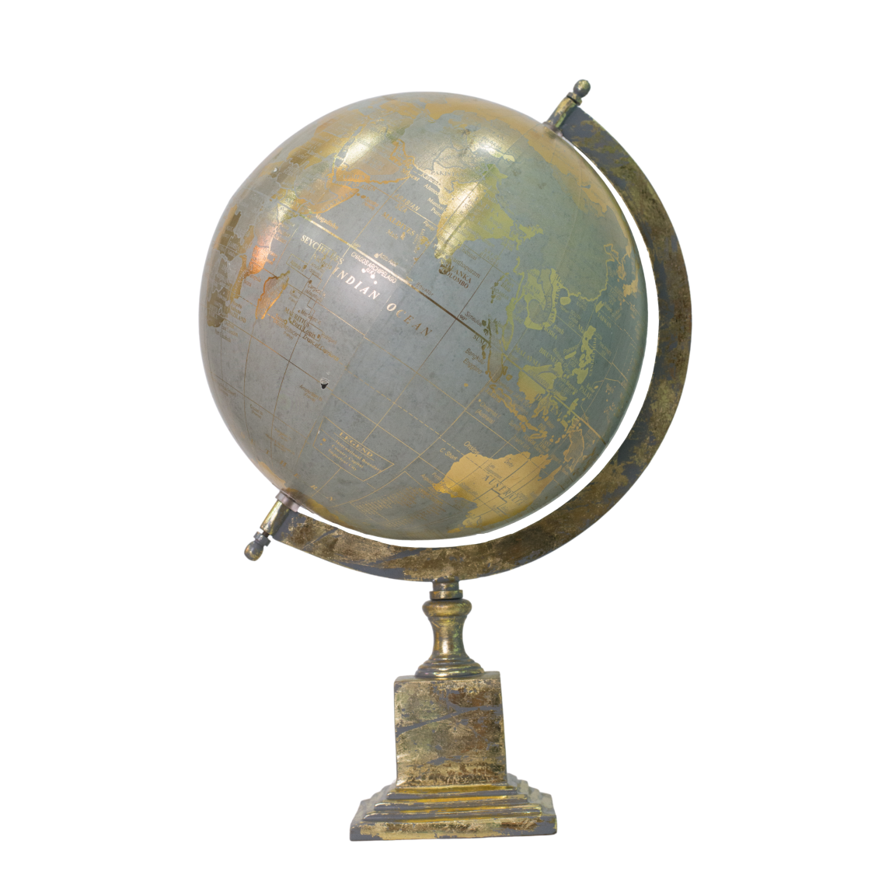
IMH – 25003 (10”)

Slide 5
IMH – 25004 (10”)

Slide 6
IMH – 25005 (8”)

Slide 7
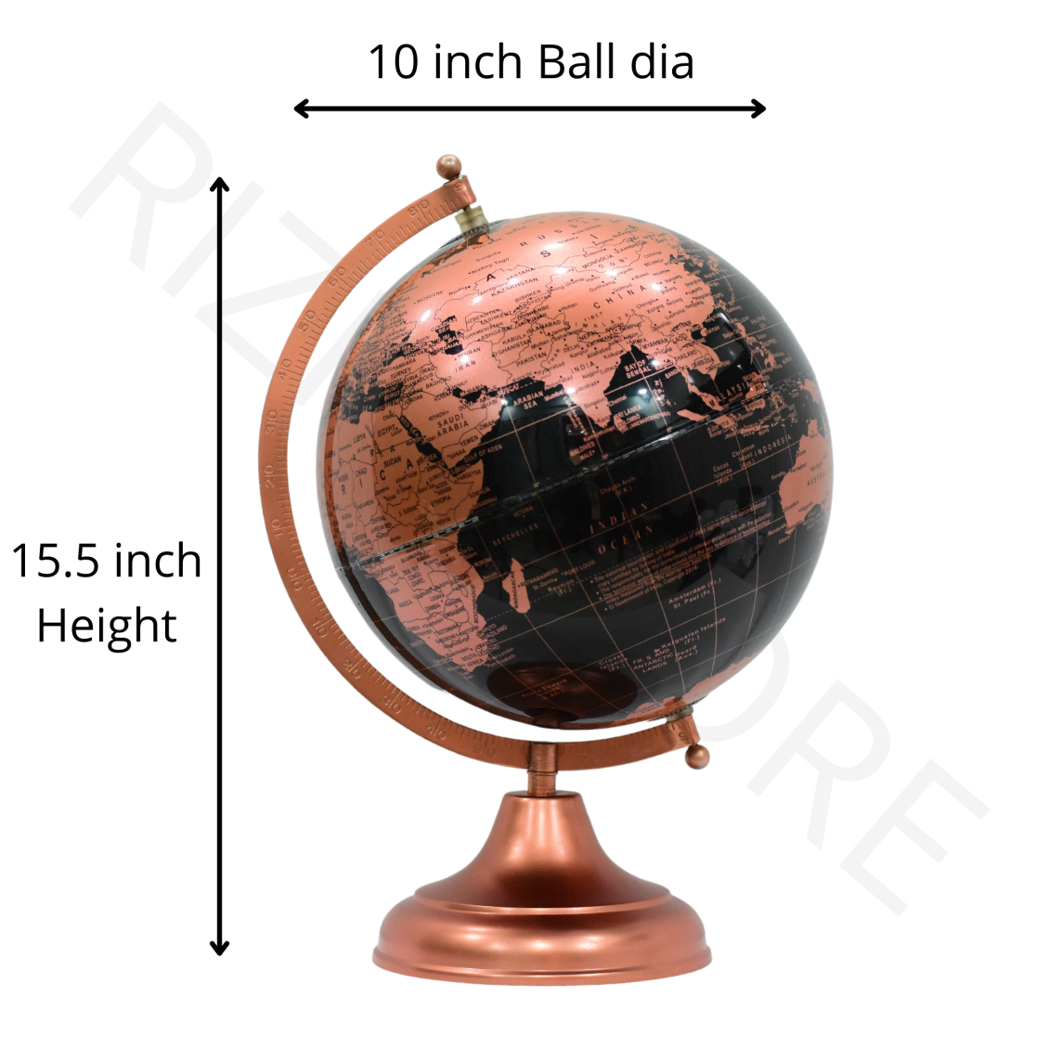
IMH - 25006

Slide 8
IMH- 25007 (8”)

Slide 9
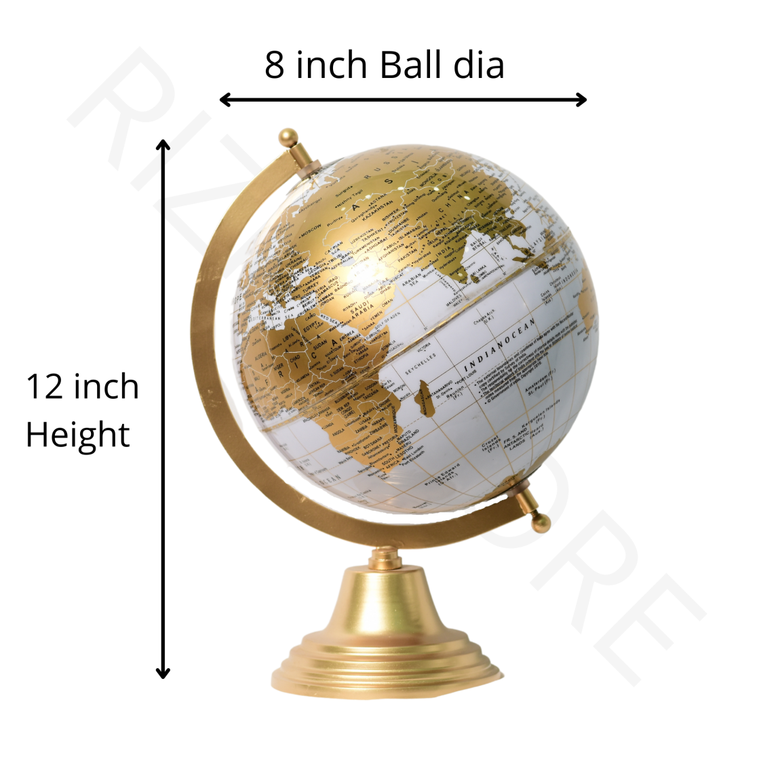
IMH - 25008 (8”)

Slide 10
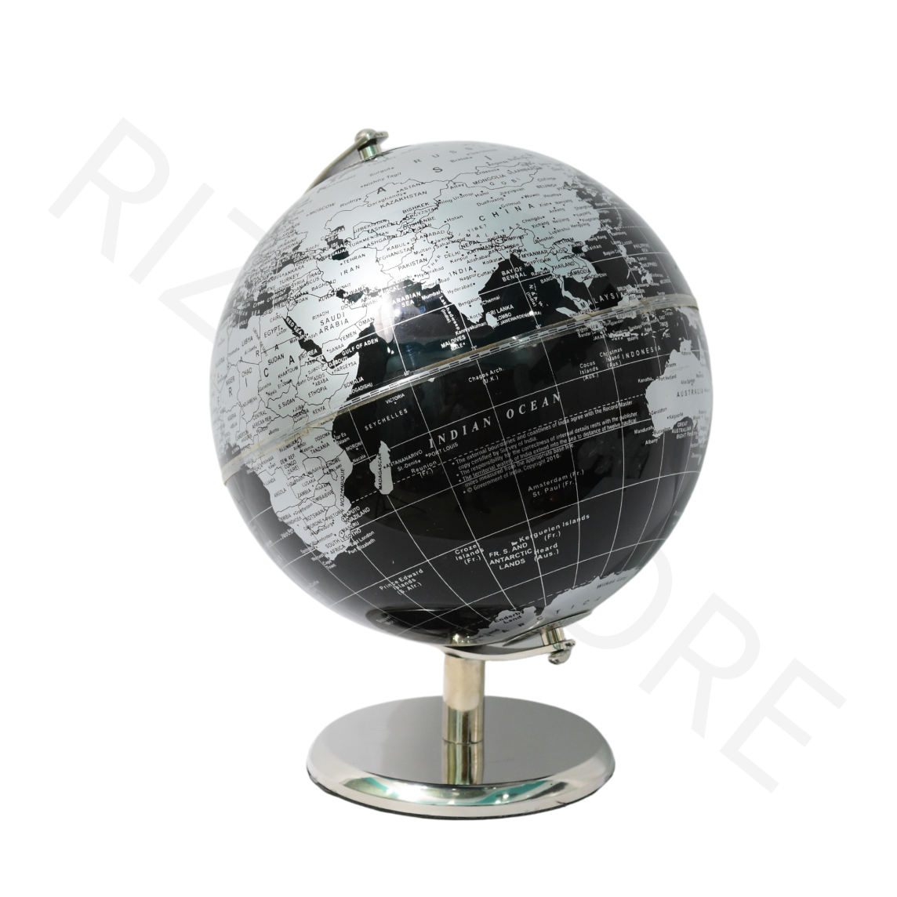
IMH – 25009 (8”)

Slide 11
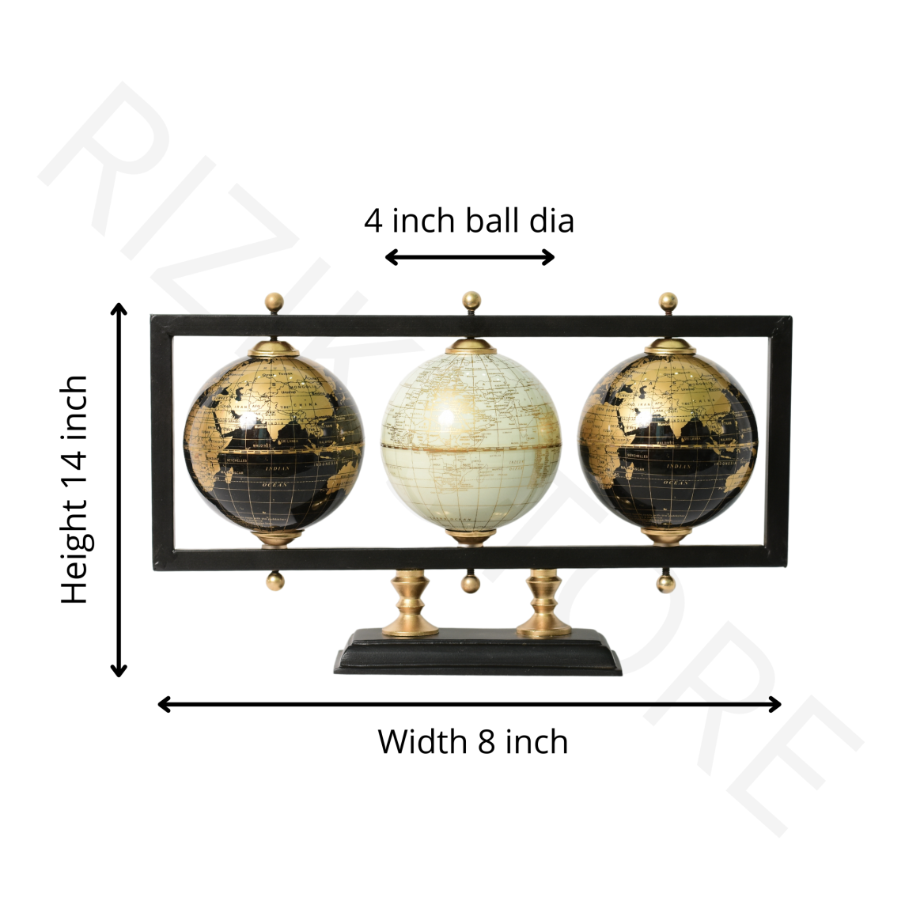
IMH – 25010 (8”)

Slide 12
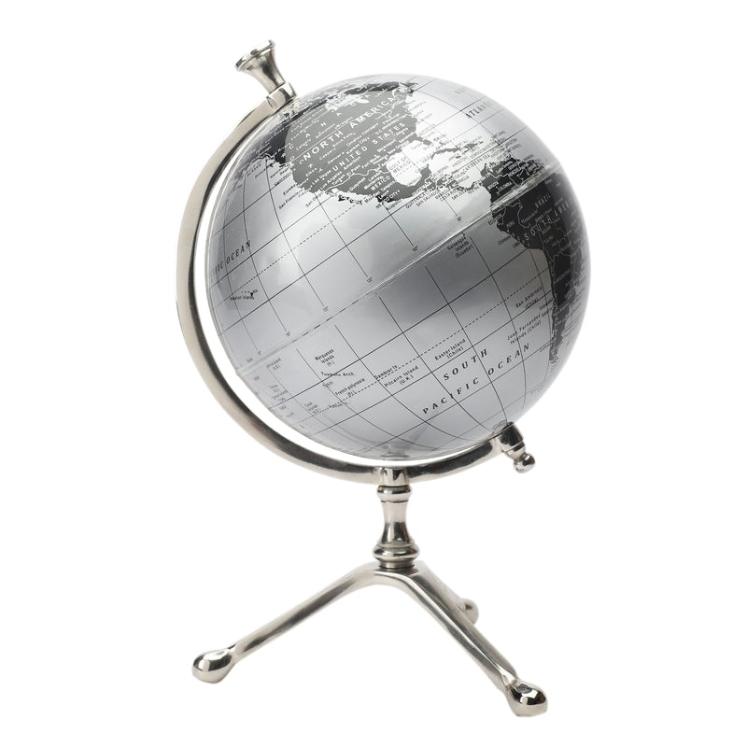
IMH – 25011 (8”)

Slide 13
IMH – 25012 (8”)

Slide 14
IMH – 25013 (8”)

Slide 15
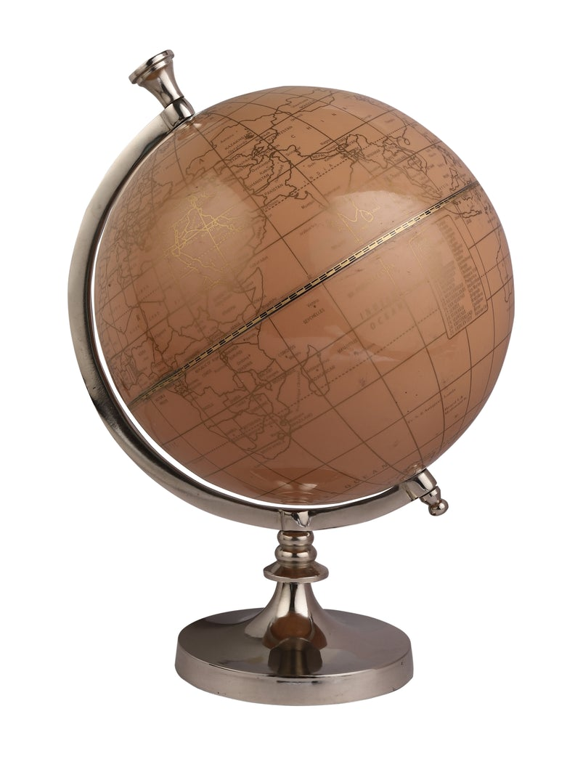
IMH – 25014 (8”)

Slide 16
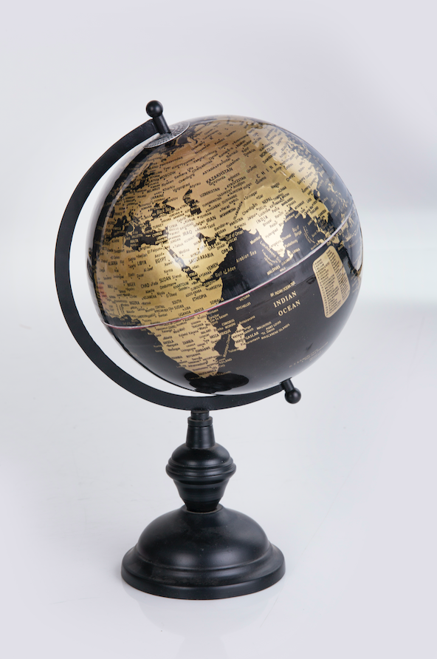
IMH – 25015 (8”)

Slide 17
IMH – 25016 (8”)

Slide 18
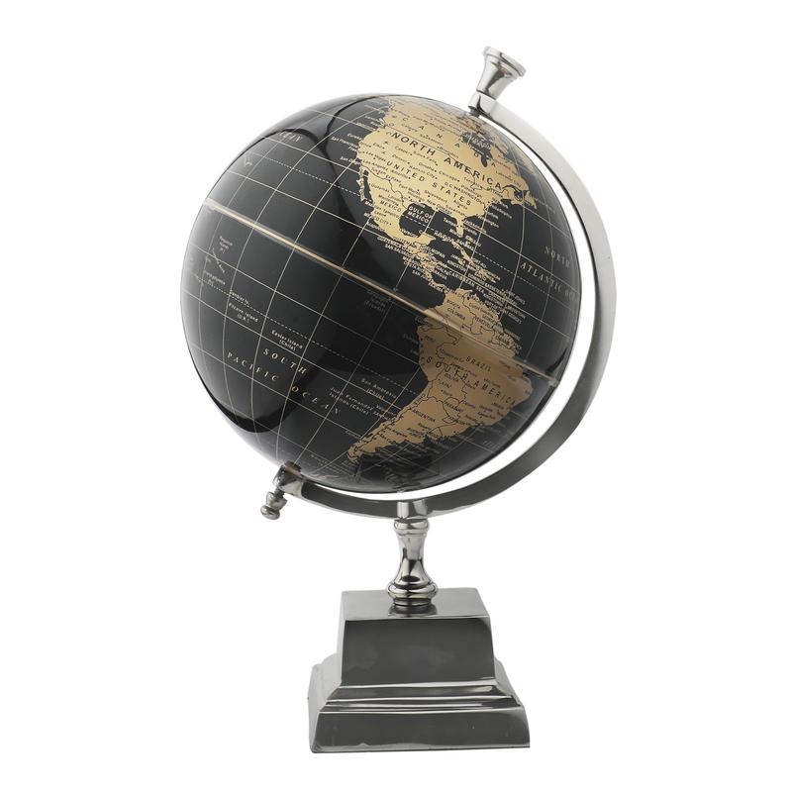
IMH – 25017 (8”)

Slide 19
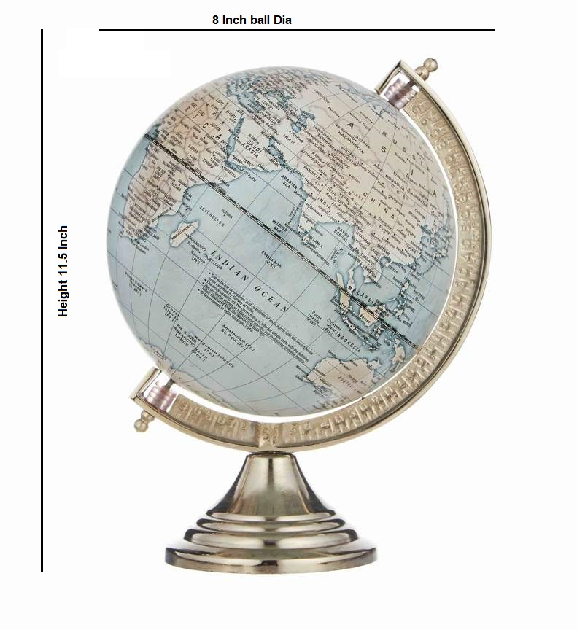
IMH – 25018 (8”)

Slide 20
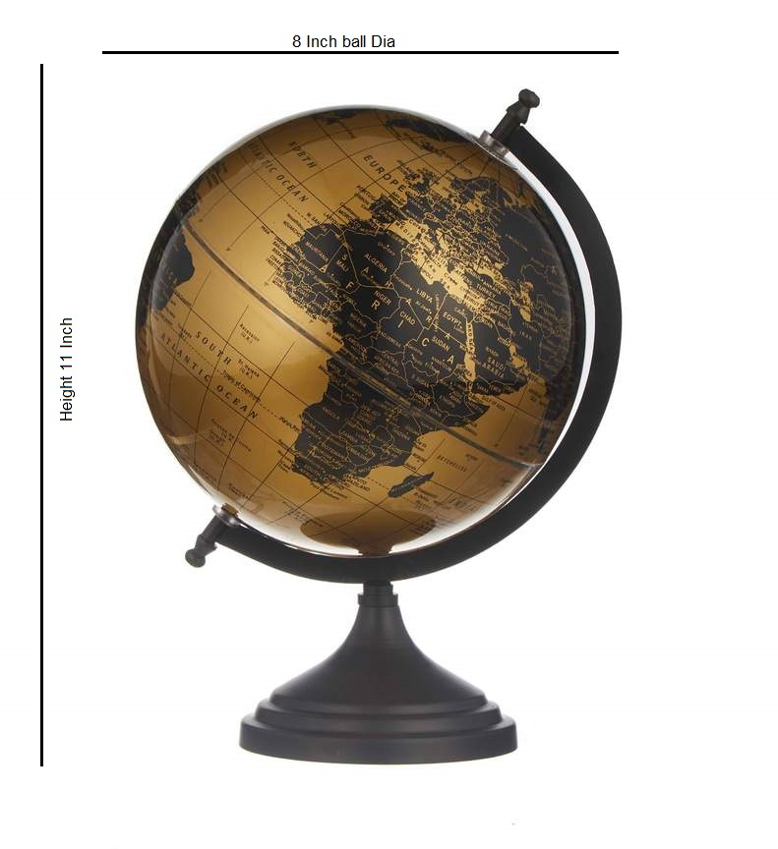
IMH – 25019 (8”)

Slide 21
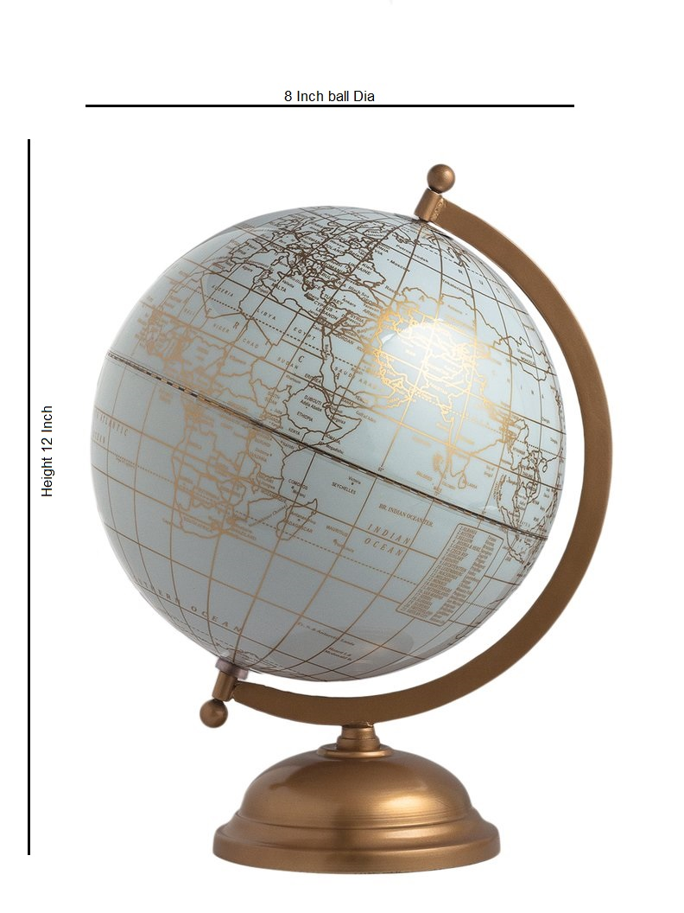
IMH – 25020 (8”)

Slide 22
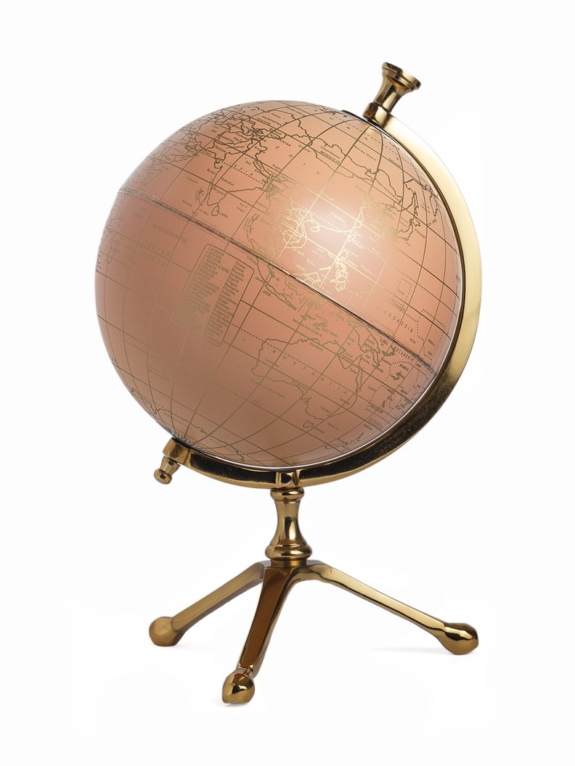
IMH – 25021 (8”)

Slide 23
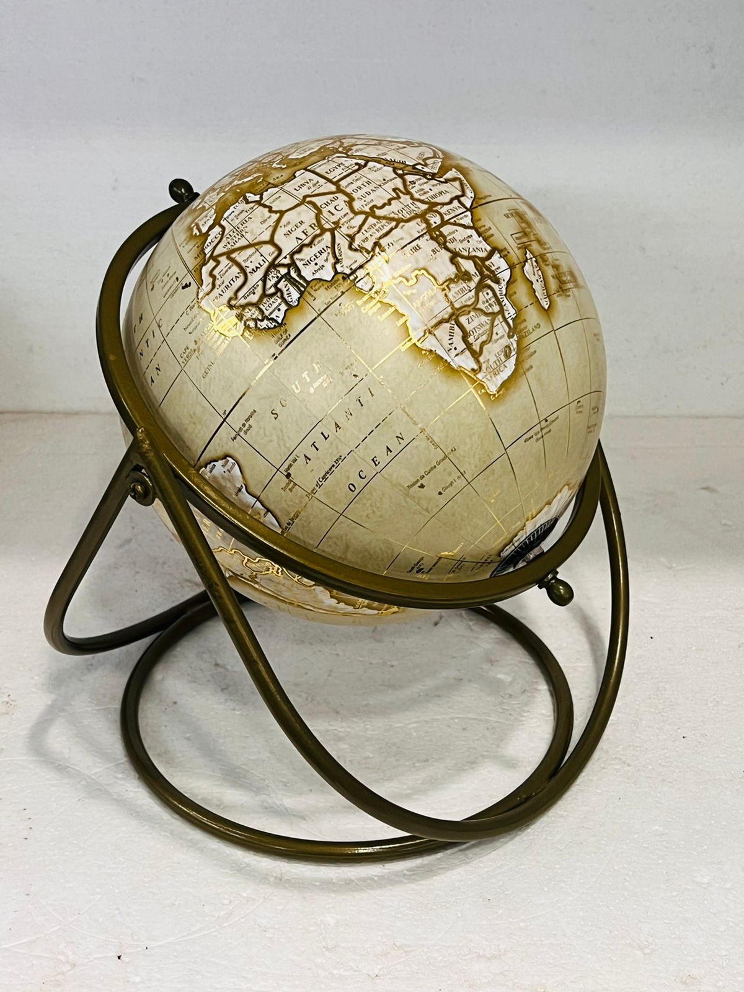
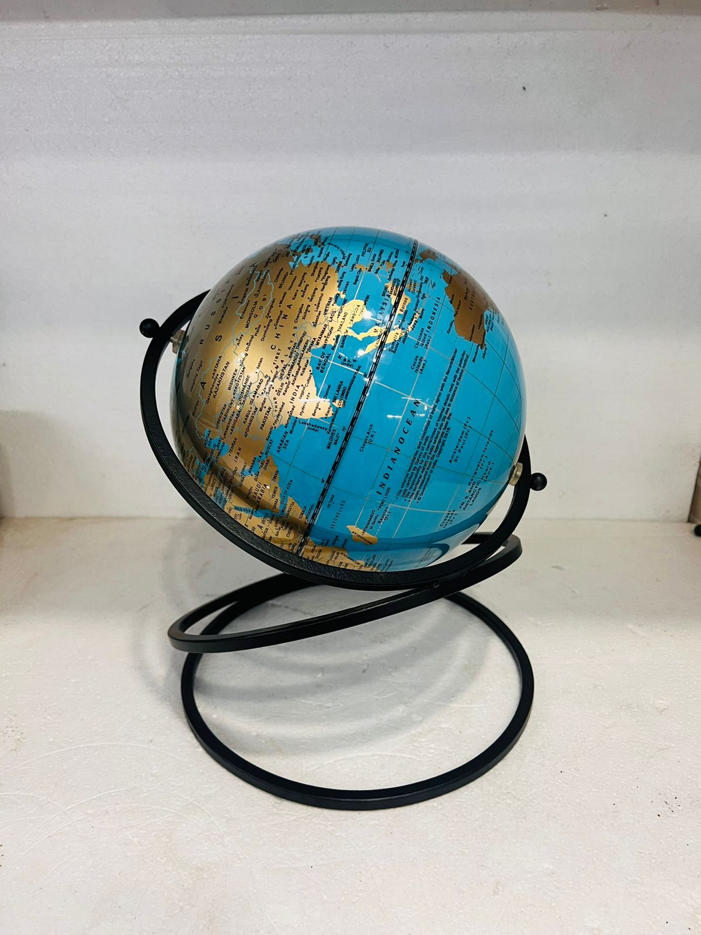
IMH – 25022 (8”)

Slide 24
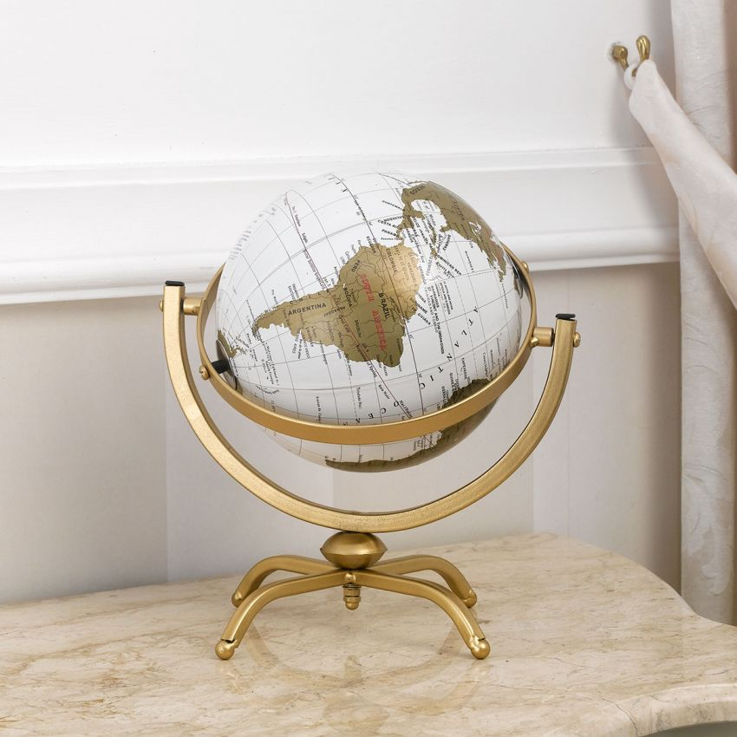
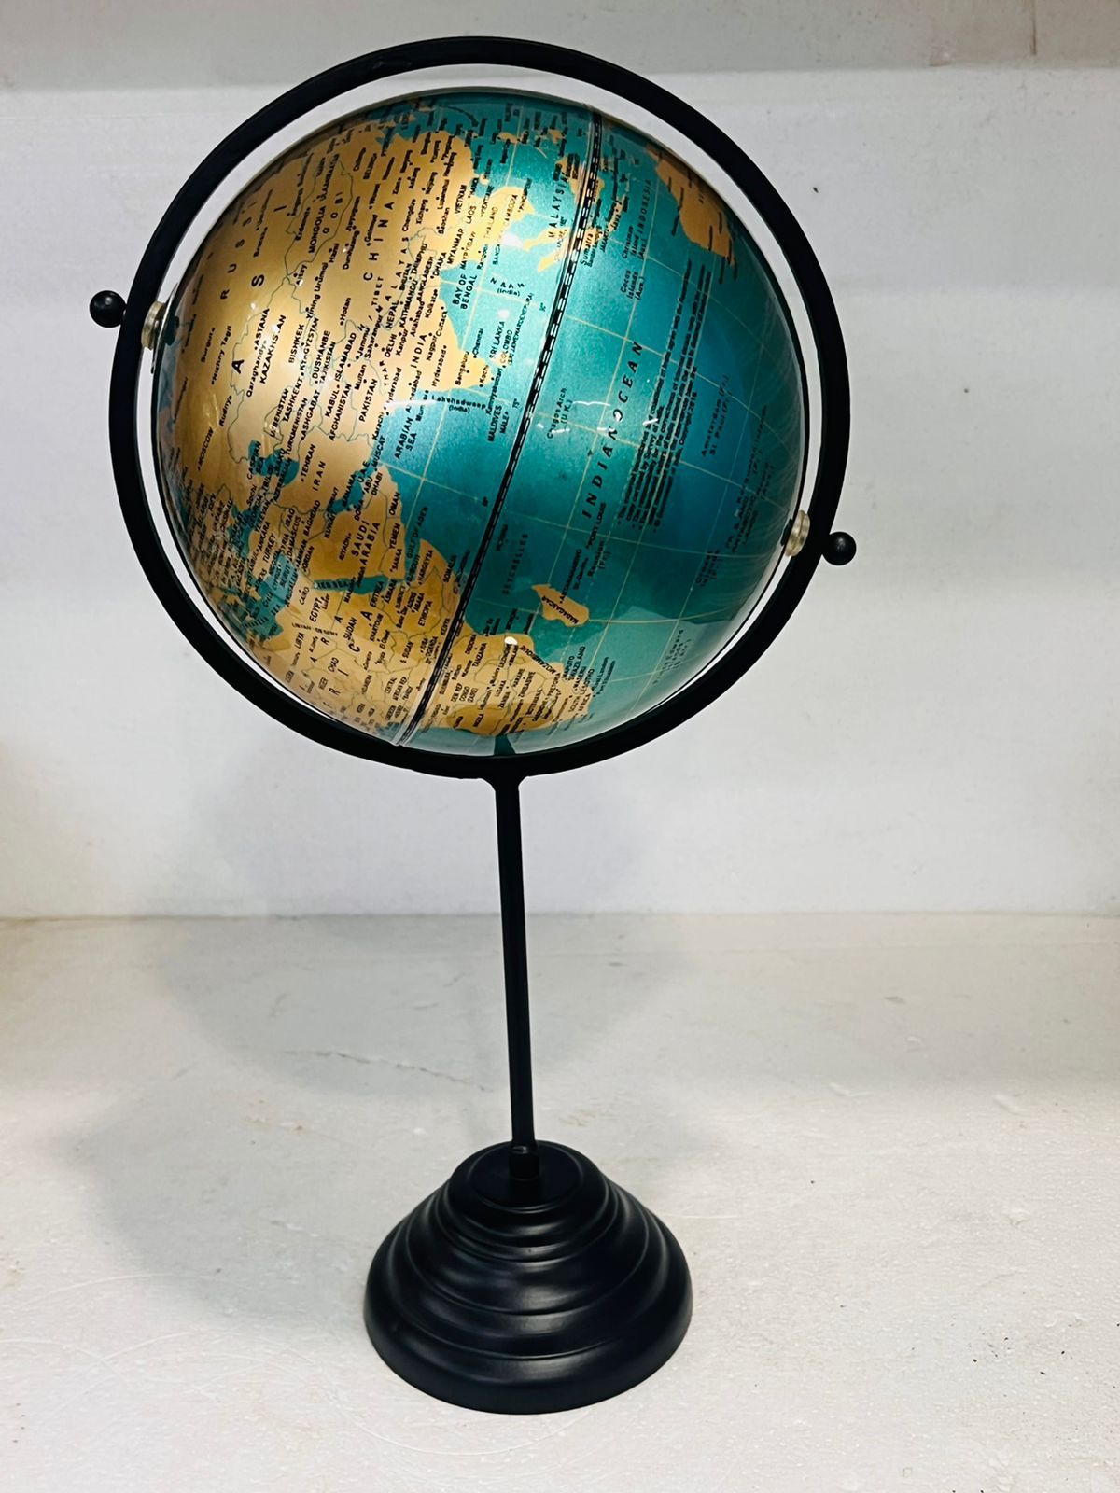
IMH – 25023 (8”)
IMH – 25024 (8”)

Slide 25
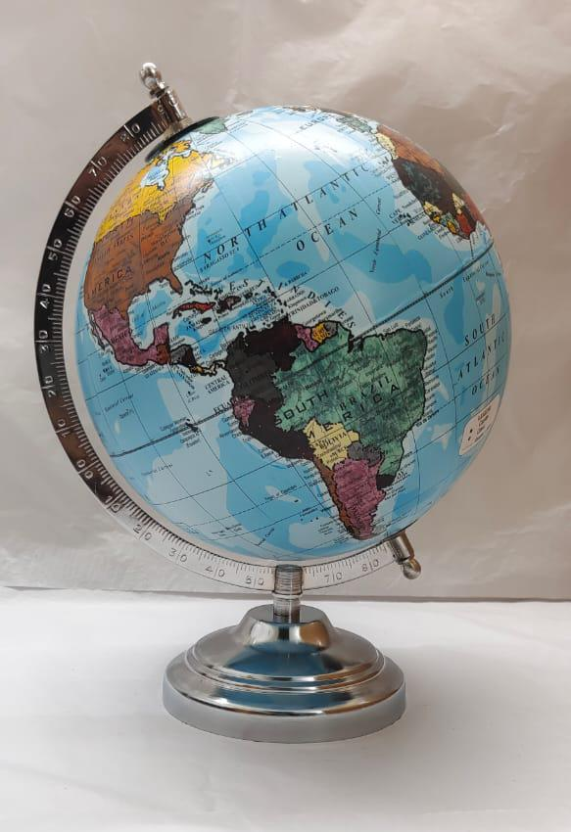
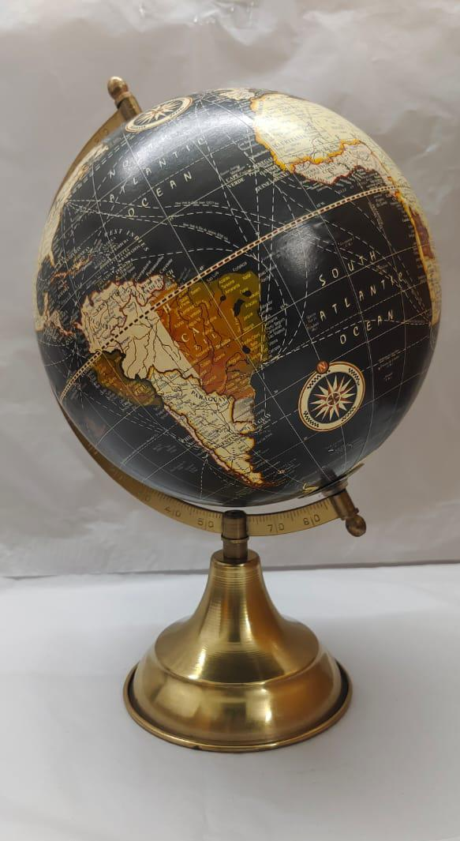
IMH – 25025 (8”)
IMH – 25026 (8”)

Slide 26
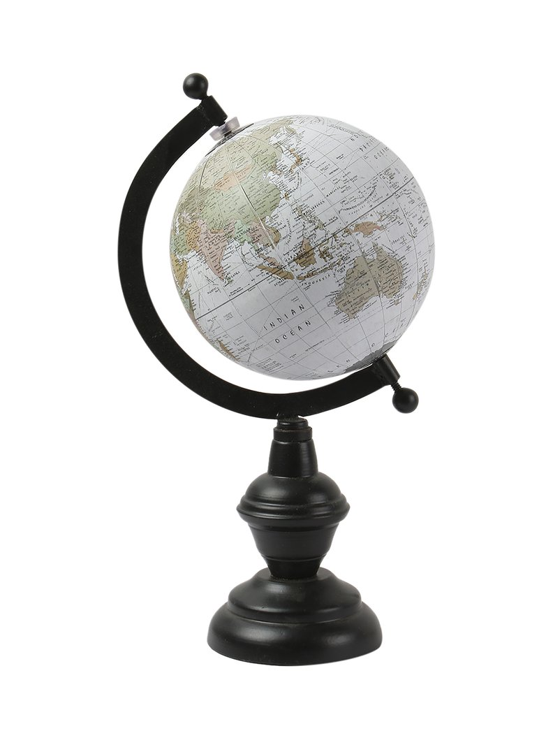
IMH – 25301 (5”)

Slide 27
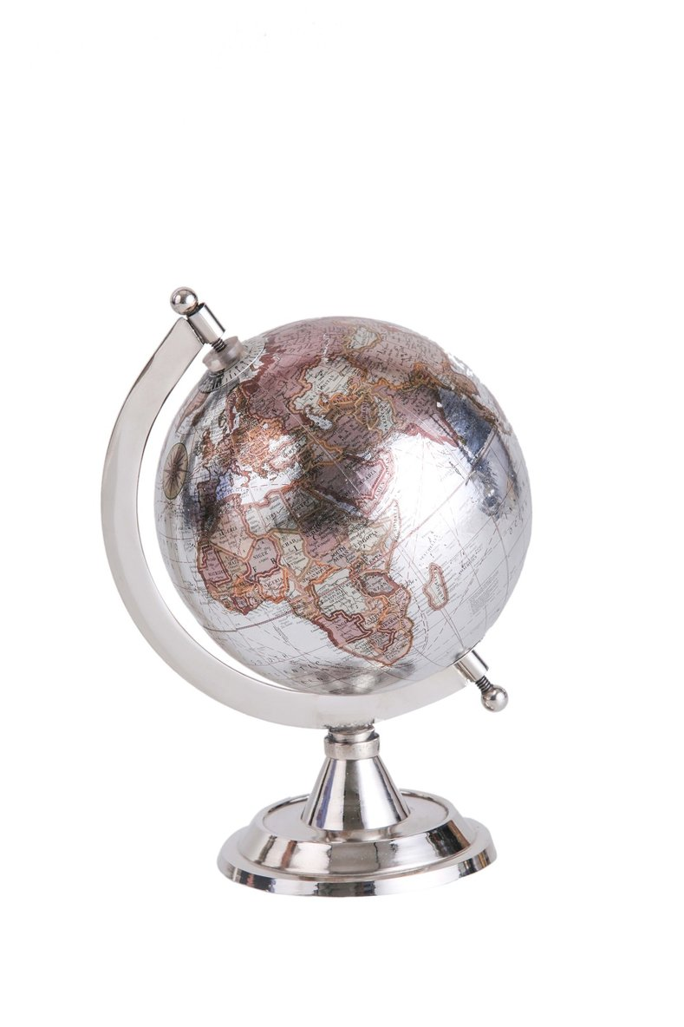
IMH – 25302 (5”)

