Slide 1
Accounting 101
A resource guide for small business owners

Slide 2
Accounting is the language of business. It’s important to understand what your business is saying.
Just like with any relationship, effective communication and honesty is key.

Slide 3
What is Accounting?
"the art of recording, classifying, and summarizing in a significant manner and in terms of money, transactions and events which are, in part at least of financial character, and interpreting the results thereof.“ ~ The American Institute of CPAs

Slide 4
Why is accounting important for my business?
The purpose of accounting is provide useful information to economic entities (profit & non-profit) in order to make informed decisions
Internal Decisions
  Money makers vs money pits
  Outsource vs make in house
External Decisions
  Lines of credit
  Funding/grants

Slide 5
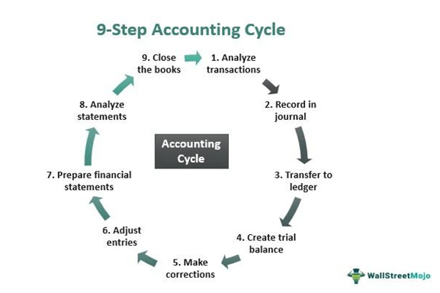
The Accounting Cycle
As a business owner, steps 1-3 is the part of the accounting cycle that you can keep up to date and organized

Slide 6
The Accounting Cycle - Analyze the Transaction
The first step in the accounting cycle is to examine the source document and determine the effects of the business event to the accounts of the company. After that, record the transaction through a journal entry .
  Source document examples
    Receipt
    Invoice
    Purchase order
  Business event examples
    Buy inventory
    Make a sale
    Sell a piece of equipment
*Note: EVERY business event produces a source document

Slide 7
The Accounting Cycle – Record the Transaction
  aka book of original entry
  where business transactions are first recorded
  Recorded in chronological order
  Include brief description of the business event for your own reference
    Ex: Purchased a book of stamps
  Should be done frequently
    Once per week depending on activity level of the business

Slide 8
Account Classifications
The following are the basic foundational accounts every business starts with:
Assets
Liabilities
Owner’s Equity
Revenue (Income)
Cost of Goods Sold
Expenses

Slide 9
Assets
Definition – resources that the company owns
  Cash and equivalents
  Accounts receivable
  Inventory
  Fixed assets – property, plant and equipment
  Pre-paid expenses
  Other assets

Slide 10
Liabilities
Claims against the company’s assets
  Accounts payable
  Payroll liabilities
  Notes payable

Slide 11
Owner’s Equity
Owner’s total investment in the business or net claim to assets
Aka net worth
Assets – Liabilities = Net worth
  Owner’s capital – assets owner puts into the business
  Owner’s draw – assets the owner withdraws and converts for personal use

Slide 12
Revenue (Income)
aka gross sales
aka gross receipts
Includes income received related to the business

Slide 13
Cost of Goods Sold (COGS)
The cost of the product a company sells
**Note: Service businesses do not usually have COGS

Slide 14
Expenses
Selling, general, and administrative
  Expenses that do not directly relate to making or wholesaling a product
  Not COGS
  Examples include:
    Postage
    Utilities

Slide 15
Other Income & Expenses
Other Income - non business related income
  Gain on the sale of an asset
  Interest income
Other expenses
  Loss on the sale of an asset
  Interest expense

Slide 16
Chart of Accounts
A master list of accounts set up to handle company transactions. Usually assigned a three or four digit code and organized as follows
Assets – 1000s
Liabilities – 2000s
Equity – 3000s
Income – 4000s
Expense -- 5000s

Slide 17
Bank Reconciliations
The process of matching the what’s in the cash account per the accounting records to the bank statements
  Bank statement is what actually happened – this is the point of reference
  Accounting records are what you say happened
Should be done at least monthly

Slide 18
Financial Reports
Provide useful information in an organized manner for
  Decision making
  Potential investors
  Financing
Most common
  Balance sheet
  Income Statement

Slide 19
Balance Sheet
aka Statement of Net Position
Shows the health of a business
Accounting equation
Assets = Liabilities + Owners Equity
or
Assets - Liabilities = Owner’s Equity

Slide 20
Income Statement
aka Profit & Loss Statement
Shows financial results for a period of time
  Usually a fiscal year
The are items reported on the income statement are normally entered on the Schedule C of your income tax return as well

Slide 21
Tax Planning 101

Slide 22
Taxes
Set up an account for taxes payable to the federal and state government
  Set money aside from sales and make periodic estimated payments to prevent underpayment penalties
  35 percent is a good provision
  Making quarterly estimated payments is ideal contingent upon level of business activity throughout the year

Slide 23
Most Common Business Tax Deductions
Meals and entertainment
Travel
Charitable contributions
Advertising
Professional & legal
Depreciation
Business use of home

Slide 24
References
Accounting Basics: Accounting 101 (2022). Accountingverse.
https://www.accountingverse.com/accounting-basics/
Loughran, M. (2011). Financial Accounting for dummies. John Wiley & Sons.

